Slide 1
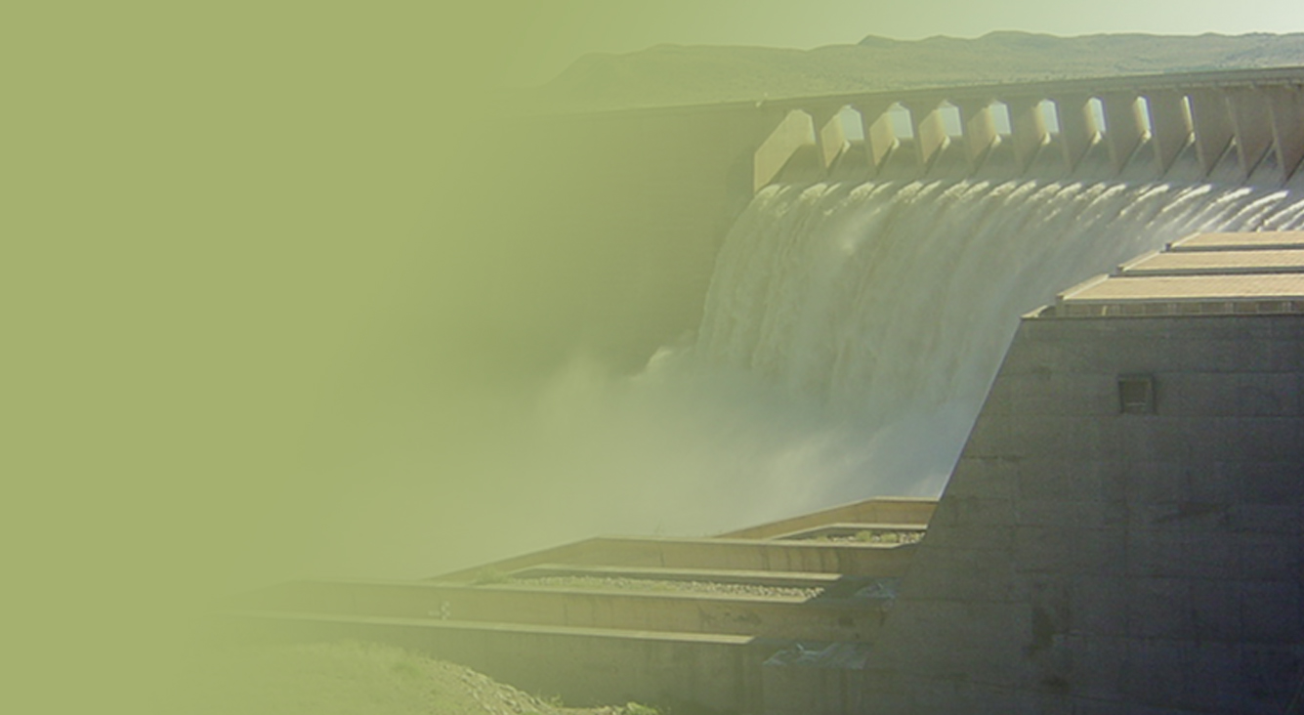
Financial Relief to Water Boards and Management of Municipal Debt
PRESENTATION TITLE
Presented by:
Name Surname
Directorate
Date
Presented by: Ms D Mochotlhi
Acting Director-General
23 February 2021

Slide 2
Contents
Purpose………...…………………..…………………...…………………...….………………………………….3
We are facing critical times ………………….....………..………………………………………………………4
Revenue loss as a result of 0% increase for bulk tariff for 2020/21 FY………………………………………5
Temporal Relief Facility…………………………………………………………………………………………....6
Water Boards debtors age analysis for Dec 2020…………………………..……………………….…………7
Top 11 municipalities with largest arrear amount ……………………………………………..…….………….8
Key arrangements and actions July-Dec 2020………………………………………………………………....9
Water Trading Entity debtors age analysis……………………………………………………………………...10
List of meetings held on Debt Issue ……………………………………………………………………………..11
Proposed Recommendations …………………………………………………………………………………… 12

Slide 3
Purpose
To brief Portfolio Committee on the state of water boards that are in dire financial situation as result of non-payment by the municipalities for bulk potable water supply which require intervention.

Slide 4
We are facing critical times
COVID-19 Impact on the water and sanitation sector has raised alarm on our capacity to deliver services during critical times.
The operating deficit in the sector as a whole requires attention. We are facing a financial crunch
Revenue and tariffs cannot sustain business .
Water Trading Entity owed R13,3 bn by Municipalities as at 31 Dec 2020
Water Boards owed almost R13 bn as at 31 Dec 2020
Declining credit ratings and borrowing capacity
Stringent rules on state guarantees
Inadequate investments in infrastructure
Financial sustainability of Water boards under severe stress.
Revenue loss of about 7% (R1,9 billion) due to 0% tariff increase during 2020/21 financial year
Looming labor unrest over moratorium on conditions of service

Slide 5
Detailed breakdown of Water Boards revenue loss as a result of 0% tariff increase during 2020/21
Water Boards | Audited 18/19 (R'm) | WB Revenue Projection (R'm) |  |  |  | % 2019/20 vs 2020/21 | % 2020/21 vs 2021/22 | % 2021/22 vs 2022/23
 |  |  |  |  |  |  |  |  | Revenue loss due to tariff reduction 20/21 R'm
 |  | 2019/20 Draft AFS | 2020/21 | 2021/22 | 2022/23
Amatola Water | 423 | 419 | 419 | 474 | 528 | 0% | 13% | 11% | 39
Bloem Water | 752 | 818 | 812 | 968 | 1 066 | -1% | 19% | 10% | 74
Lepelle Northern Water | 591 | 602 | 602 | 701 | 769 | 0% | 16% | 10% | 31
Magalies Water | 979 | 789 | 693 | 896 | 1 000 | -12% | 29% | 12% | 78
Mhlatuze Water | 402 | 664 | 435 | 789 | 861 | -34% | 81% | 9% | 126
Overberg Water | 56 | 63 | 63 | 81 | 80 | 0% | 29% | -1% | 14
Rand Water | 15 539 | 16 423 | 16 678 | 19 507 | 21 082 | 2% | 17% | 8% | 1 084
Sedibeng Water | 1 648 | 1 680 | 1 423 | 2 135 | 2 551 | -15% | 50% | 19% | 100
Umgeni Water | 3 538 | 4 118 | 4 222 | 4 512 | 5 123 | 3% | 7% | 14% | 376
Total | 23 928 | 25 576 | 25 347 | 30 063 | 33 060 | -1% | 19% | 10% | 1 922
Projected revenue loss of about 7% (R1,9 billion) due to 0% tariff increase during 2020/21 financial year. The revenue loss analysis above only considers the bulk water potable tariff not secondary activity revenue and other income. There has been no funding injected to assist water boards to cope with a stress of no tariff increase for the 2020/21 financial year except the 5 water boards who are in deficit already

Slide 6
TEMPORARY RELIEF FACILITY SET UP TO ASSIST WATER BOARDS HAS BEEN CONSIDERED TO SOFTEN THE IMPACT OF COVID AND NON PAYMENT BY MUNICIPALITIES
Water Board | Requested funding | Recommend funding | Variance
 | R’000 | R’000 | R’000
Amatola Water | 61 000 | 61 000 | 0
Bloem Water | 162 000 | 162 000 | 0
Magalies Water | 92 000 | 72 000 | 20 000
Lepelle Northern Water | 94 000 | 94 000 | 0
Sedibeng Water Board | 600 000 | 267 000 | 333 000
Total | 989 000 | 656 000 | 353 000
5 water boards need financial support in order to keep afloat with operations, maintenance and payment of salaries.
NT response on 26 Jan 21- argue that the recommended utilisation of unspent fund capital budget under RBIG is no longer feasible due to legal advise which concluded that the purpose of RBIG allocation cannot be changed. DWS does not have residual budget under goods and services to fund Water Boards

Slide 7
TOP 11 MUNICIPALITIES WITH LARGEST ARREAR AMOUNTS

Slide 8
KEY PAYMENT AGREEMENTS BETWEEN MUNICIPALITIES AND WATER BOARDS
Mangaung Metro
Agreed to pay current accounts on monthly basis & R20m on arrear accounts
Paid R128 million to Bloem Water between 30 November 2020 and 24 December 2020.
Kopanong Local Municipality
Bloem Water has started water restrictions as a result of defaulting on the payment arrangement, the municipality paid R1,2 million between 3 November and 23 December 2020. New bulk supply contract arrangement expected to be signed on 10 Feb 2021
Mopani DM and Sekhukhune DM
Repayment agreement to settle debt amounting R509m was entered between Mopani DM and LNW in Sept 2020
Repayment agreement to settle the outstanding debt amounting R170m was entered into between Sekhukhune and LNW in December 2019
Amatola DM
Amatola Water and Amatola DM are busy renegotiating on the payment arrangements which could not sustain the water board on the initial arrangement
Matjhabeng LM
Sedibeng Water has started water restrictions as a result of defaulting on the payment arrangement by the municipality and negotiations are on-going

Slide 9
WTE DEBTORS AGE ANALYSIS AS AT 31 DECEMBER 2020
Municipal Type | Sum of Current | Sum of 30+ Days | Sum of 60+ Days | Sum of 90+ Days | Sum of 120+ Days | Sum of 150+ Days | Sum of 180+ Days | Sum of Total | Total Balance Less Current
Dist Municipalities (DM) | 22 846 | 32 798 | 75 162 | 41 481 | 23 107 | - 13 721 | 1 748 938 | 1 930 612 | 1 907 766
Local Municipalities (LM) | 47 997 | 102 871 | 181 498 | 153 320 | 74 628 | 43 024 | 4 567 741 | 5 171 079 | 5 123 083
Metro Municipalities (MM) | 26 021 | 31 348 | 24 639 | 21 026 | 26 465 | 22 436 | 160 536 | 312 471 | 286 450
Water Board (WB) | 765 760 | 716 567 | 372 676 | 157 437 | 89 131 | 71 419 | 4 610 037 | 6 783 028 | 6 017 268
 | - | - | - | - | - | - | - | - | -
Grand Total | 862 624 | 883 585 | 653 975 | 373 265 | 213 331 | 123 159 | 11 087 252 | 14 197 190 | 13 334 566

Slide 10
Inter Ministerial Task Team (IMTT)
The 5th Administration established the Inter Ministerial Task Team (IMTT) on Electricity Reticulation & Distribution to find solutions to the Constitutional, Systemic and Structural Challenges in electricity reticulation. It comprised of the following members: The Minister for Cooperative Governance (as Chairperson); The Minister of Finance; The Minister of Energy; The Minister of Public Enterprises; The President of SALGA; and the Chairperson of the Eskom Board.
Following the Portfolio Committee meeting held on the 29 November 2017, the IMTT on Electricity Reticulation & Sanitation resolved to amend the mandate to include Water Debt Issues. This was done in order to devise a plan to resolve the outstanding debt in more structured way. The Minister of Water and Sanitation was then included in the membership of the IMTT. The IMTT ended with the establishment of the current Administration and was not re-activated.
During the current Administration a
During the current Administration a Multi-disciplinary Revenue Task Team chaired by the Deputy President has been established with water participating at a Technical Level.

Slide 11
INTERGOVERNMENTAL AND CONSULTATIOn meetings HELD ON DEBT AND FINANCIAL LIQUIDITY OF WATER BOARDS

Slide 12
Response from National Treasury
DWS need to reprioritize within its budget allocation.
The available grant funding cannot be utilised for as Temporal Relief Facility to water boards operations .

Slide 13
RECOMMENDATIONS
Temporal Relief Facility is being set up to assist financially distressed water boards until end of June 2021- thereafter a financial sustainable base is required.
MEC’s to assist on political intervention at municipal level and to unblock challenges and disputes between water boards and municipalities.
CoGTA to ensure that municipalities are professionalized in water services delivery to ensure better management of retail business as this affect entire water value chain.
District Hub consisting of multi-disciplinary team to intervene in an integrated approach to manage the entire water value chain .
Water boards to implement credit control measures including water limitations or restrictions (SALGA does not support this view) further discussion meeting is being arranged between SALGA, DWS, COGTA and NT on this matter.
13
13

Slide 14
RECOMMENDATIONS
Water Boards Leg is being formed as part of Multidisciplinary Revenue Task Team (MRTT) –on non-payment of bulk water – similar to Eskom. SALGA, NT, COGTA and DWS agreed to develop TOR which is being drafted for water boards and Water Trading Entity.

Slide 15
Thank You

