Slide 1
VIRTUAL PRESENTATION FOR THE UPDATE OF REQUEST FOR INFORMATION (RFI) FOR 2500MW NUCLEAR NEW BUILD PROGRAMME
TO THE PORTFOLIO COMMITTEE ON MINERAL RESOURCES AND ENERGY ON TUESDAY, 23 FEBRUARY 2021
Deputy Director General: Nuclear Energy
Mr Zizamele Mbambo

Slide 2
Outline of Presentation
Purpose
Background
RFI Responses and offerings
Structure of RFI
NPP and SMR
SMR Technology in Hybrid System
Cost of nuclear and financing models
Financing models and ownership structure options
Observations
Outcome of state of readiness of vendor companies designs
Technology development status of SMRs
Programme Timelines
Overall conclusion

Slide 3
RFI PURPOSE
To test and establish market interest towards nuclear expansion programme in South Africa;
To investigate market appetite for viable financial and funding models that could be considered for the procurement of nuclear technology in South Africa, taking into account the pace, scale, value for money, affordability, ease of deliverability and other benefits for the country; and
To enable the Government to plan for the strategic decisions for the programme going forward.

Slide 4
BACKGROUND
IRP2019 – decision 8:
“Commence preparations for a nuclear build programme to the extent of 2500 MW at a pace and scale that the country can afford because it is a no-regret option in the long term”.
On 15 June 2020, the Department of Mineral Resources and Energy (DMRE) issued a Request for Information (RFI) to test the market for the successful implementation of the Nuclear New Build Programme (NNBP). The RFI responses closed on the 15 October 2020.
Established Project Technical Task Team (PTTT) to evaluate all submissions, to extract as much information as possible to profile state of readiness of vendor companies to implement the NNBP.
Stakeholders invited: DMRE, Eskom, Necsa, NRWDI, NNR, DTIC, DSI, DEA,NT, DPE (Total about 50 nuclear professionals)

Slide 5
RFI RESPOSES AND OFFERING
25 responses
5 – Conventional PWR
16 - SMR
14- SUPPORT SERVICES

Slide 6
STRUCTURE OF THE RFI
EXPERIENCE IN NUCLEAR INDUSTRY
Construction
Operation
PWR & SMR
Type of Reactor & Desalination
Readiness of deployment
FUNDING, FINANCING AND CONTRACTING TYPE
Ownership
Pace, scale & value for money
LOCALISATION & COLLABORATION WITH LOCAL COMPANIES
SITING, PERMITTING AND SAFETY AND PROJECT MANAGEMENT

Slide 7
NPP&SMR
The bidders who responded have collectively supplied over 240 of the 454 reactors in operation globally.
In terms of experience in recent Generation III/III+ reactors, from the submissions there are seven plants in operation, comprising of three designs, with several others under construction.
The majority of SMRs are in the design stage with plans to be operational by 2030.
Two SMRs are currently constructed, one is operational as a prototype and the other one will enter operation as a demonstration plant in 2021.

Slide 8
SMR Technology in a Hybrid Systems
Some Vendor Companies demonstrated how these Technologies could be used for
water desalination
synthetic fuels
district heating
It is important to also note that the SMRs Technologies have load following and peaking capability and thus could be used to complement intermittent renewables with zero carbon emissions.

Slide 9
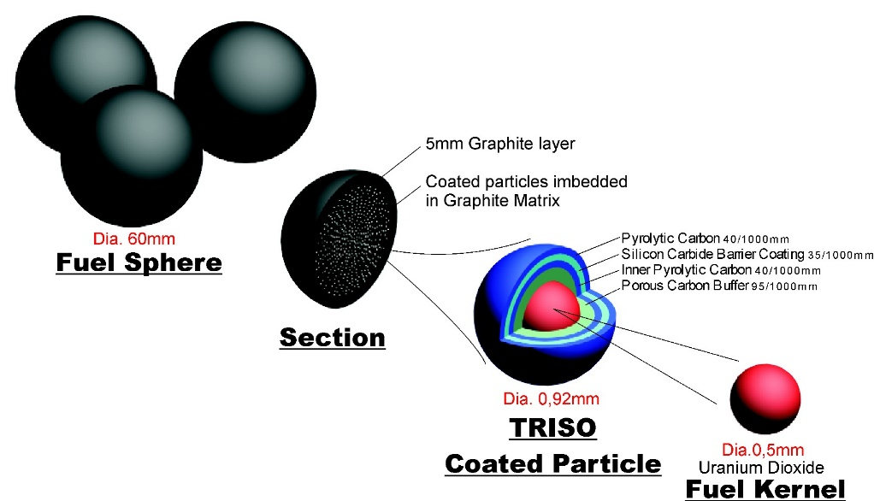
SMR Technology in a Hybrid Systems
SMR Technology in SA is not new.
SA has a PBMR Technology that is Under care and Maintenance at Eskom
A number of Vendor Companies are looking to explore this kind of Technology
SA could seize this moment to further explore to cooperate with willing partners during the negotiations in further developing its PBMR Technology which is under Care and Maintenance.
Currently, tests results indicated that SA fuel, as depicted above is one of the best in the world.

Slide 10
Costs of Nuclear and Financing Models
The overnight cost is the cost of a construction project if no interest was incurred during construction, as if the project was completed “overnight”.
Of the 25 responses received, only 11 of these provided Overnight costs for the programme. In addition, some vendor companies provided the Levelised Costs of Energy (LCOE) which are costs incurred during the life cycle of the plant and may include cost of capital, decommissioning, fuel costs, fixed and variable operations and maintenance costs, financing costs, and an assumed utilization rate.

Slide 11
Financing Options (Summary)
Range 1470-9530 USD/Kwe
IRP uses USD5000/KWe

Slide 12
Financing Model and Ownership Structure Options
Level of Government
Control
Contracting
Ownership
Financing
Funding
Revenue
SOE/Utility
RAB
Corporate Finance
Equity
EPCM
JV
MDIs
PPP
CFD
Split Package
SPV
Project Finance
Bonds
ECA Loans
PPA
EPC
BOOT
IPP
Vendor Finance
Loans
Offtake
BOO
DMRE Proprietary ©, Preliminary work

Slide 13
Financing Model and Ownership Structure, Continued
Proposals from a number of Vendor Companies included a Nuclear SPV funded with Debt and Equity with “sovereign support” from SA to make the project bankable.
In this model, the nuclear plant will be housed in this SPV. The project will be structured in typical project finance model with project risk allocated to the party who is best able to take the risk.
Risk is allocated between the following main contractors: EPC contractor; O&M contractor (vendor country);

Slide 14
Observations
The range of the overnight costs indicated that the overnight capital costs for SMRs and some conventional PWR are between US$ 1 470 to US$ 9 530 /kWe. The value used in IRP is ~US$ 5000 kWe.
Some companies offered a vendor funded financing model, where the private consortium would have responsibility for raising some or all of the necessary financing required for the project.
Several vendors offered independent ownership models such as a Build, Own, Operate or a Build, Own, Operate and Transfer.

Slide 15
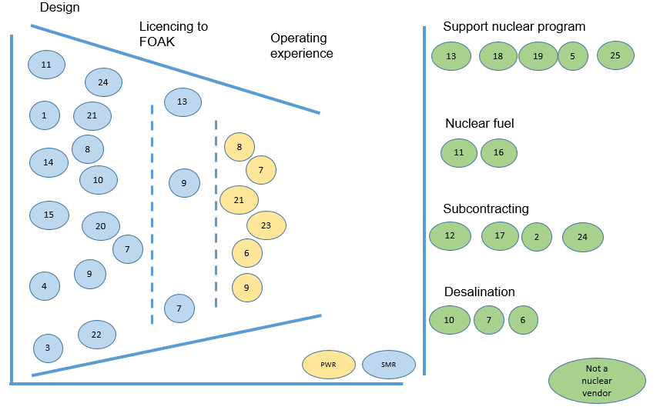
Outcome of state of readiness of vendor companies

Slide 16
Technology Development Status of SMRs
Concept | Basic Design | Detail Design | Experimental Reactor | Prototype Reactor | Demo Plant | Commercial Plant
A
J
L
D
E
F
B
K
O
I
C
H
N
G
M
p
Advancement of Development from Concept to Commercial is
~15-20 years

Slide 17
PROGRAMME TIMELINES
Summary
Must provide option that can guarantee 2500MW in the early 2030’s.
Funding model to make option accessible
Development status of SMR and possible fleet benefits i.e. local IP ownership and supply options
Contract placed
RFP
1st unit
2nd unit
PWR
2 years
6-10 years
2 years
RFP
1st unit
2nd
3rd
SMR
Licensing
FOAK
Vendor country/company
Vendor to take risk for development and licensing
2-5 years
2 years
4-6 years
2 years
1 year

Slide 18
SUMMARY
Few vendor companies have proposed project schedule with timeliness but limited information has been provided;
It would take up to 10 years to construct and operate PWR nuclear installations. Much shorter time for SMRs to construct, but licensing is protracted;
Most of the companies, especially local companies, are interested in offering support services to the Nuclear New Build Programme (NNBP);
Commitment to localisation will be even more clearer during procurement negotiations. Most of vendor companies are willing to collaborate with local companies on conventional island and the balance of plant;
EPCM seems to be the preferred mode of contracting as proposed by some vendor companies;

Slide 19
OVERALL CONCLUSION
An option to build a larger PWR (commercial off-shelf reactors) with a package for SMRs that can be deployed inland can be considered. This will provide South Africa with an opportunity to close the Gap on the electricity demand per IRP2019 post 2030 whilst the majority of the SMRs are developed and will be commercialized around 2030.
The development of the SMRs by most vendors is still at a design and demonstration phase and the NNR will need to be engaged early in the development stages.
Innovative financing options were proposed by market for 2500MW NNBP that may not require upfront investment by state, especially noting that most of the project development is at an advanced stage.

Slide 20
OVERALL CONCLUSION,CONTINUED
Following the RFI, the Department will develop an optimal implementation strategy and make recommendations for Government to take key strategic decisions .
There is sufficient market appetite to develop Nuclear New Build Programme in South Africa.
All bidders demonstrated their confidence in South Africa as an investment for Nuclear New Build Programme.
Nuclear New Build Programme provides huge opportunity for investment into South African Economic Reconstruction and Recovery Plan (Localization, Industrialization& Job creation potential)

Slide 21
THANK YOU

