Slide 1

Department of
Higher Education and Training
2021 Higher Education Institution Admissions and NSFAS Funding
Joint Meeting of the
Portfolio Committee on Basic Education
Select Committee on Education and Technology, Sports, Arts and Culture
Portfolio Committee on Higher Education, Science and Technology
23 February 2021

Slide 2

Presentation Overview
University Preparation for the 2021 Academic Year
2021 University Academic Year Plans
2021 Registration Period at Universities
University Enrolment Planning
Central Application Clearing House
Initiatives to Support Quality Teacher Education
TVET Enrolments for 2021

Slide 3
University Preparation for 2021 Academic Year
2020 was a year of multiple challenges due to the emergency changes to higher education teaching and learning required in response to the COVID-19 pandemic
All universities implemented emergency remote teaching and learning following the initial shutdown of universities in March 2020. The plans of universities took different forms, taking into account the different circumstances of institutions. All institutions established COVID-19 Task Teams
The Department provided regular support and advice to institutions, including on teaching and learning; health and safety; campus return plans and other areas of support. The Department also regularly monitors universities on the basis of agreed indicators. The next monitoring report for the 2020 academic year will be finalised by the end of the month
The Minister approved a COVID Responsiveness Grant (CRG) to assist universities with costs and resources required to support the move to emergency teaching and learning, and the health and safety aspects of the response to the pandemic. The grant was created from re-prioritised funds

Slide 4
University Preparation for 2021 Academic Year
NSFAS students continued to receive their allowances for the academic year, including for periods of time that they were not on campus. Living allowances were provided for the extended academic year for qualifying students
The Department negotiated a framework for tuition and accommodation fees which was implemented across the system to mitigate against additional costs for tuition and accommodation, and to support institutions to engage with private accommodation providers for the extended academic year period
Students returned to campuses at different times, according to guidance provided in Government Gazette (43414) issued on 8 June 2020. Universities provided different forms of support to students including in some instances access to devices, in all institutions access to data to support remote teaching and learning, and in some cases also the delivery of hard copy materials. In addition, in line with the commitment to ensure that every student was given an opportunity to complete the academic year, once students were able to return to campuses, further teaching and learning programmes, catch up programmes, adjusted timetables and additional support were provided during the extended academic year
This is line with the intention to save lives and save the academic year

Slide 5
2021 University Academic Year Plans
02
01
03
5

Slide 6
2021 University Academic Year Plans
02
01
03
6

Slide 7
2021 University Academic Year Plans
02
01
03
7

Slide 8
2021 University Academic Year Plans
02
01
03
8

Slide 9
2021 University Academic Year Plans
02
01
03
9

Slide 10
2021 Registration Period at Universities
Admissions decisions are made by individual universities. As the overview of institutional plans shows, institutions have staggered registrations for continuing and new students. Admissions decisions will be underway this week following the release of the 2020 NSC results
Some continuing students have already commenced with the 2021 academic year, particularly in medicine. Others will be commencing between March and April 2021. The intention is for institutions to complete the 2021 academic year within the calendar year. However, this requires timetable adjustments and will depend on the trajectory of the virus
The Department will continue to monitor institutions on the basis of an adjusted monitoring report – focusing on teaching and learning matters and on health and safety
It is likely that adjusted directions will be issued to provide guidance to institutions on the effective management of the 2021 academic year in line with national regulations
10

Slide 11
Enrolment Planning Process
The Department negotiates enrolment targets with universities in cycles. The Ministerial Statement on Student Enrolment Planning 2020 to 2025 for Universities indicates targets for the system and individual institutions
This is a 6 year enrolment planning view, with a mid-term review, to encourage better integrated planning at universities
The mid-term review will take place from March 2022 to May 2022. Some of the targets may be adjusted in line with the current conditions (financial and infrastructure realities) as well as skills priorities
The following slide shows enrolment figures for the number of First Time Entering (FTEN) students and spaces available in scarce skills areas
Enrolment planning is a critical process to ensure that the appropriate resources are allocated to the system to support quality teaching and learning
11

Slide 12
Enrolment Spaces for FTENs in Public Universities
Public University | Max Number of new spaces
All funded Under graduate programmes | 184 315 (204 315 less UNISA reduction of 20 000)
Scarce skills programmes | 67 863
Engineering | 16 647
Life and Physical Sciences | 17 161
Human Health | 10 155
Animal Sciences | 943
Veterinary Sciences | 211
Teacher Education | 22 746
12

Slide 13
Central Applications Clearing House (CACH)
High competition for spaces in universities – meeting the minimum requirements does not mean a space for everyone that applies
CACH is for students who have applied for a space at a university and been declined
In 2021, CACH is a referral system –Sign up for CACH (Central Applications Clearing House):
  send an sms with name and ID number to 31629
  register or sign-up online at cach.dhet.gov.za
  send an email to CACH@dhet.gov.za
  CACH 2021 is designed to assist students to find suitable spaces still in the system (at other universities or TVET colleges) or to provide advice through referral to career development services
  CACH cannot guarantee any applicant a space to study
  CACH cannot determine when the institutions will contact the applicant for possible placement
  CACH handles applications it does not handle admissions
13

Slide 14
Central Applications Clearing House (CACH)
Career Development Services:
Get advice on career paths and study opportunities in the Post-School Education and Training system
Call: 086 999 0123
SMS/Text Message (please call me): 072 204 5056
  Email: careerhelp@dhet.gov.za
  Website: https://www.careerhelp.org.za/
14

Slide 15
Central Applications Clearing House (CACH)
CACH process:
When CACH receives an SMS, an agent will call an applicant back, to register all requested details (field of study and preferred province)
The applicant’s personal details and matric results will be confirmed and made available to institutions of higher learning
Institutions logon to CACH to retrieve list of students who meet criteria of available spaces
Institutions will contact applicants directly to offer them available places
15

Slide 16
Central Applications Clearing House (CACH)
CACH service operation:
CACH 2021 to continue as outbound service
CACH sign-up service will run from:
- Duration: 22 February 2021 to 30 April 2021
Operation Times: Mondays to Friday between 8am to 6pm and Saturday from 8am to 2pm
CACH communication channels:
Newspaper publications
Social media:
  Facebook : CACH_SA
  Twitter : CACHSA
SMS : 31629
16

Slide 17
Initiatives to Support Quality Teacher Education
The focus of initial teacher education at the Department of Higher Education and Training is to support universities to provide quality teacher education across pre-schooling and schooling, and the post-schooling sectors. This includes teachers for schools, early childhood development, and lecturers for TVET and CET colleges
24 Public universities provide initial and continuing teacher education in the country. Shift towards supply of teachers in specialisation areas required and responsiveness to new requirements. Paying attention to supply and demand issues
Focus on quality of teacher education programmes. Professionalisation of teachers and lecturers in teacher education
Policies for offering professional education, e.g. ECD educators, MRTEQ, TVET and CET lecturers
Strategic interventions (supported by EU sector support grant, targeting strategic national imperatives and partnerships with universities). All products on National Open Learning System (NOLS). Includes strengthening teaching of African languages, special needs education and others
17

Slide 18
TVET Enrolments for 2021
There is no carry-over from the 2020 academic year into 2021. All enrolled and qualifying students wrote their national examinations in various examination sessions in 2020. The last batch of results were released on 05 February 2021
Online applications opened for TVET colleges enrolment in October 2020. Over 300 000 applications were received. The translation into actual registrations is however very low and will be covered in the section on ‘Challenges’
Colleges enrol students according to an approved enrolment plan, and is based on the subsidies provided by the fiscus to cover enrolments primarily in the National Certificates (Vocational) and the Report 191 programmes. The ‘ Total Planned Targets’ in the slides include planned enrolments funded from alternate sources, such as the National Skills Fund and Sector Education and Training Authorities. These figures are finalised in the course of the year
The 2020 Grade 12 learners who wish to enrol in TVET colleges will be able to do so for Trimester 2 and Semester 2 in 2021
18

Slide 19
TVET Enrolments for 2021
The next several slides provide preliminary data on enrolments in the 50 TVET colleges across 6 regions. It must be noted though that the data is quite unstable at this stage and is subject to extensive verification and finalisation. It does however provide a snapshot of enrolments nationally, and the processes that still need to be undertaken to deal with the high volume of walk-ins
College enrolment plans cover headcount enrolments for two semesters, three trimesters and annual enrolment. Enrolment figures for the later semester and 2 trimesters will only become available at those appropriate times
By the time enrolment numbers are reconciled, total enrolments are generally much higher than suggested by the indicative figures during enrolments. In 2020, there were notable over-enrolments in several colleges. This is being managed for 2021
19

Slide 20
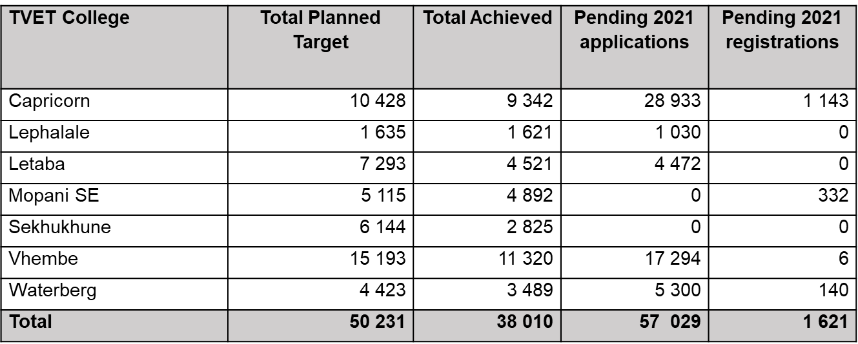
Limpopo: Planned and Achieved Enrolment
20

Slide 21
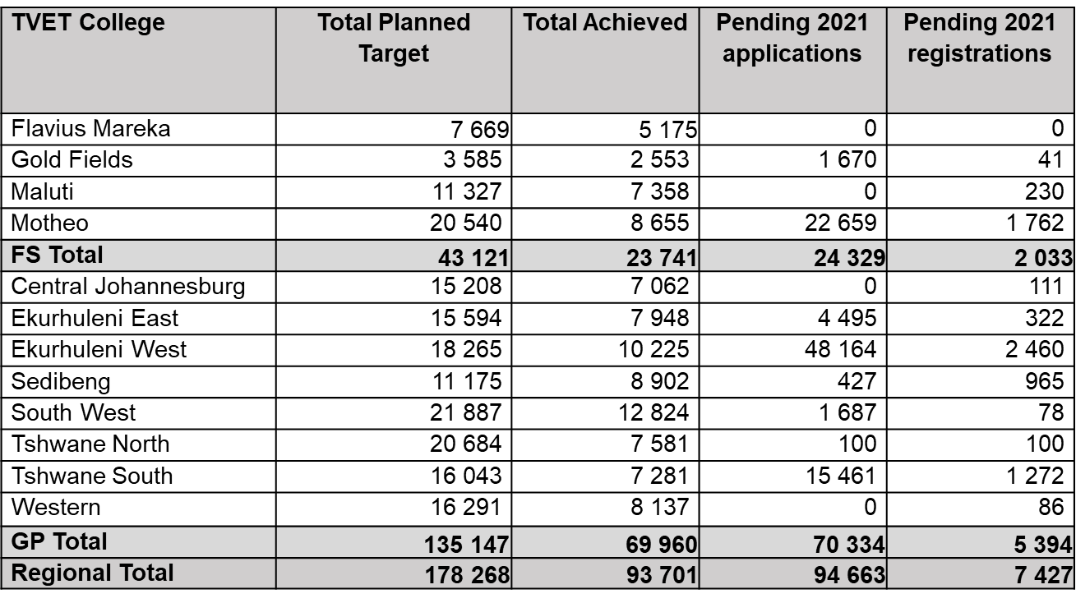
Free State and Gauteng: Planned and Achieved Enrolment
21

Slide 22
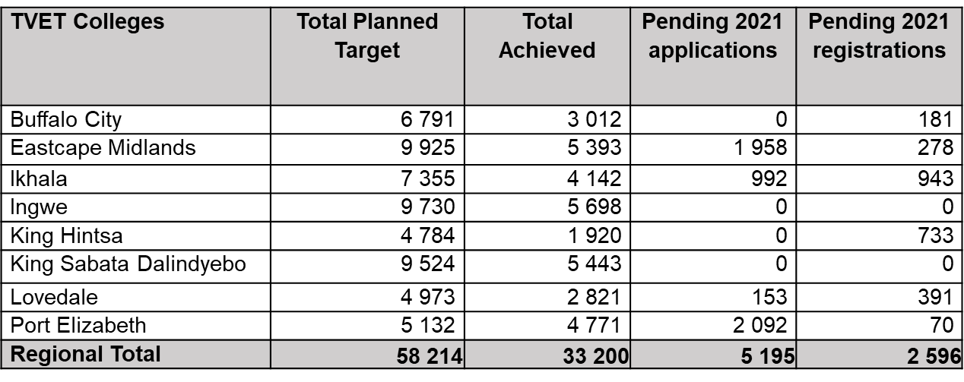
Eastern Cape: Planned and Achieved Enrolment
22

Slide 23
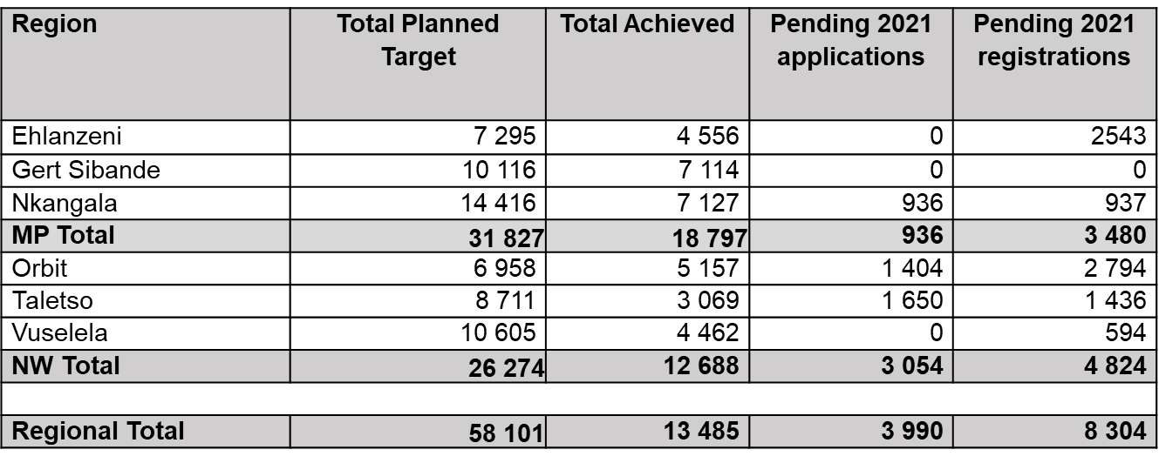
Mpumalanga and North West: Planned and Achieved Enrolment
23

Slide 24
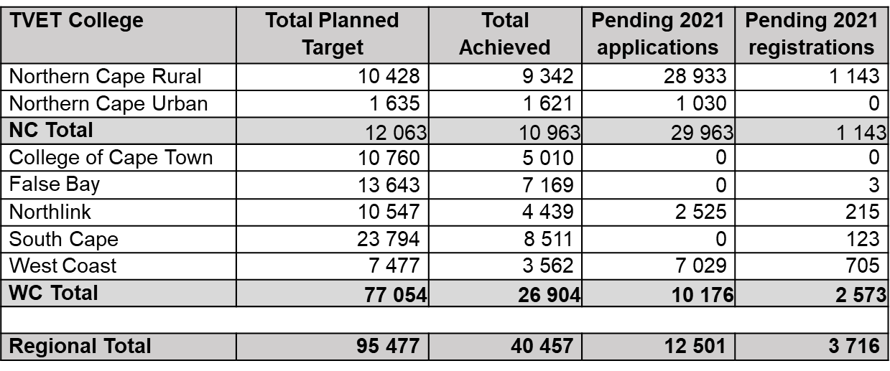
Northern Cape and Western Cape: Planned and Achieved Enrolment
24

Slide 25
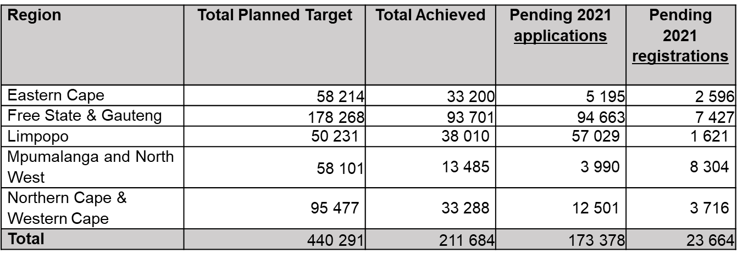

National: Planned and Achieved Enrolment
25

Slide 26
Challenges Experienced in 2021 Enrolment Process
Online applications
Prospective students struggle with online applications and communication due to lack of devices and/or data in rural locations
Prospective students do not submit all required documents when requested to do so (for verification and scoring). This results in not being able to complete the admission process within pre-determined timeframes
Prospective students did not accept and confirm their provisional registration
Provisionally registered students failed to finalise registration, as required in the sequential steps of the registration process
Despite the call for online applications, colleges experienced high volumes of walk-ins by prospective students
26

Slide 27
Challenges Experienced in 2021 Enrolment Process
Registration
Late release of results delayed finalisation of registration. This was the knock-on effect of the pandemic and its impact on the 2020 academic year
Low enrolment numbers for National Certificate (Vocational) and Prevocational Learning Programmes
Delayed registration by returning students. Students' withdrawal due to COVID-19 phobia
Some students were admitted at universities
NSFAS
NSFAS outstanding 2020 application funding status. Delayed funding outcomes for a portion of the 2020 bursary applicants, which negatively impacted on the 2021 registrations, e.g. Trimester 2 – 2020 students
NSFAS online portal access: Challenges experienced with access to NSFAS online portal to capture walk-in applications – was addressed with NSFAS
27

Slide 28

Thank You

