Slide 1
2019/20 ANNUAL REPORT

Slide 2
TABLE OF CONTENTS
LEGISLATIVE MANDATE
MISSION STATEMENT
2019/20 PERFORMANCE HIGHLIGHTS
HR OVERVIEW
FINANCIAL OVERVIEW
RISK MANAGEMENT

Slide 3
LEGISLATIVE MANDATE
The Railway Safety Regulator (RSR) was established in terms of the National Railway Safety Regulator Act 16 of 2002 (“The Act”) as amended.
The primary legislative mandate of the RSR is to oversee and enforce safety performance by all railway operators in South Africa including those of neighbouring states whose rail operations enter South Africa
In terms of The Act, Operators are primarily responsible and accountable for ensuring the safety of their railway operations.

Slide 4
DUTIES AND RESPONSIBILITIES
Issue and manage Safety Permits in accordance with the Safety Management System Determination;
Continuously monitor improvements in safety targets by assessing operators Safety Improvement plans (ASIP);
Conduct safety inspections and audits;
Monitor, investigate and report railway occurrences;
Develop Regulations, Safety Standards and guidelines;

Slide 5
DUTIES AND RESPONSIBILITIES
Enforce Compliance by:
Issuing notices of non-conformance and non-compliance;
Imposing penalties for non-compliance with the Act and/or the Safety Standards adopted by the RSR’s Board of Directors
Revocation or Suspension of the Safety Permit (Section 26 of the Act)

Slide 6
MISSION STATEMENT
VISION
Safe, reliable and sustainable railway operations recognised globally.
MISSION
VALUES
- Integrity
- Transparency
- Fairness
- Innovation
- Timely and accountable delivery
- Mutual Respect
- Excellence
To oversee and promote safe railway operations through appropriate support, monitoring and enforcement, guided by an enabling regulatory framework.

Slide 7
2019/20 PERFORMANCE HIGHLIGHTS

Slide 8
PERFORMANCE TREND

Slide 9
ACHIEVEMENTS
OUTCOME 1: RAILWAYS ARE SAFER
APEX PRIORITY | CONTRIBUTION
1: Transforming the economy to serve all South Africans and create jobs | Occurrence Reporting Categories published; Railway Management Maturity assessment conducted on Transnet; Human Factors management study – Status quo assessment for safety-critical grade positions in train operations to determine the requirements for effective oversight on vacancies; Determination on Verbal Safety Critical Communication published; Interface agreement audit report between Transnet and its counterparts; Rail Communicators Forum established.

Slide 10
ACHIEVEMENTS
OUTCOME 2: SUSTAINABLE INSTITUTIONAL GROWTH AND DEVELOPMENT
APEX PRIORITY | CONTRIBUTION
1: Transforming the economy to serve all South Africans and create jobs | External bursaries awarded to 29 students to the value of R2, 762, 474.00 Internal bursaries to 9 staff members to the value of R282 485.00.

Slide 11
ACHIEVEMENTS
OUTCOME 3: IMPROVED STAKEHOLDER SERVICE
APEX PRIORITY | CONTRIBUTION
4: Tackling the persistence of apartheid spatial development to build sustainable and safe human settlements, towns and rural areas, and effective local government | Constant engagement with SALGA as a nodal point to municipalities; Member of the Tshwane Rail Steering Committee and can influence the rail-safety agenda;
6: Build a better Africa and world | Member of the Southern African Railways Association (SARA)

Slide 12
HUMAN RESOURCES

Slide 13
HR OVERVIEW
125
149
13
13
9
13
No. of employees: 147
No. of positions: 175

Slide 14
VACANCY RATE

Slide 15
EMPLOYMENT EQUITY

Slide 16
EMPLOYMENT EQUITY
LEVELS | AFRICAN | COLOURED | INDIAN | WHITE
Top Management | - | - | - | -
Senior Management | 7 | 1 | - | 1
Professionally qualified | 57 | 5 | - | 4
Total Staff | 133 | 7 | - | 7

Slide 17
FINANCE

Slide 18
AUDITOR GENERAL OPINION
Unqualified
Non-compliance on:
Procurement and Contract Management
Expenditure Management

Slide 19
AUDIT OUTCOMES
FINANCIAL STATEMENTS
FINANCIAL YEAR | OUTCOME | NUMBER OF FINDINGS | NUMBER OF RECURRING FINDINGS
2017/18 | Unqualified | 16 | 4
2018/19 | Unqualified | 15 | 1
2019/20 | Unqualified | 13 | 3
Nature of findings Procurement and Contract Management Intangible Assets Human Resources

Slide 20
YEAR-ON-YEAR REVENUE

Slide 21
BBBEE SPEND

Slide 22
FINANCIAL HEALTH
2019/20 Accounting surplus of R41 453 052
2019/20 Cash surplus of R21 025 471
Effects of non- cash items such as depreciation and impairment.
Request for retention of surplus has been submitted to National Treasury to fund open commitments as at 31 March 2020.

Slide 23
RISK MANAGEMENT

Slide 24
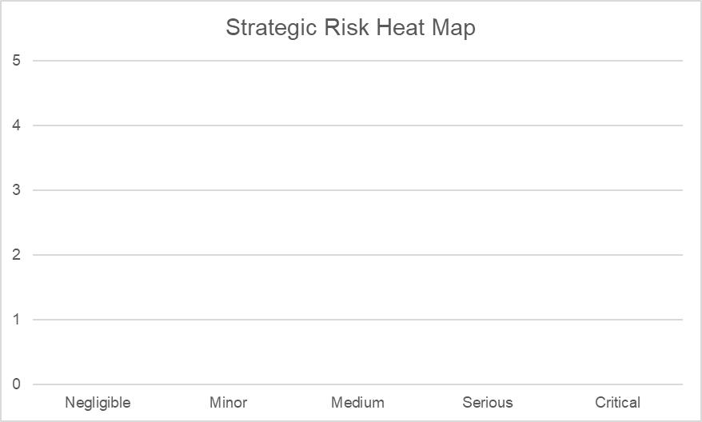
STRATEGIC RISK PROFILE
Almost certain
Highly likely
Almost certain
1
Possible
Highly likely
3
2
Remote
Possible
5
4
Unlikely
6
Remote
7
8
Unlikely
Impact
Likelihood
Impact
No | Outcome | Risk
1 | Railways are safer | Lack of independence
2 | Sustainable institutional growth and development | Loss of key personnel
3 | Sustainable institutional growth and development | Financial sustainability
4 | Railways are safer | Inaccurate and incomplete safety information
5 | Railways are safer | Loss of critical data
6 | Improved stakeholder service | Inadequate stakeholder buy-in and support
7 | Railways are safer | Rapid technological advancements
8 | Railways are safer | Excessive cost of regulation

Slide 25
THANK YOU
THANK YOU
THANK YOU

