Slide 1

Progress Update to the Portfolio Committee on Communications
Towards Successful Digital Migration
16 February 2021

Slide 2
Outline
Overall Migration Framework
Overview of Activities
Progress Since Last Committee Meeting
Progress To Date
Awareness Campaigns
Roadmap to Analogue Switch Off (ASO)
Accelerated Delivery Plan
Timeframes to ASO
Funding for Voucher Subsidy
Implementation Challenges and Mitigations

Slide 3
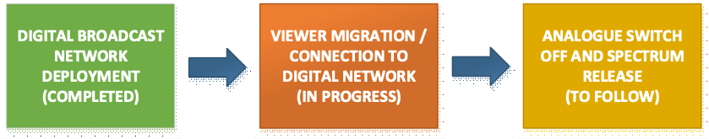
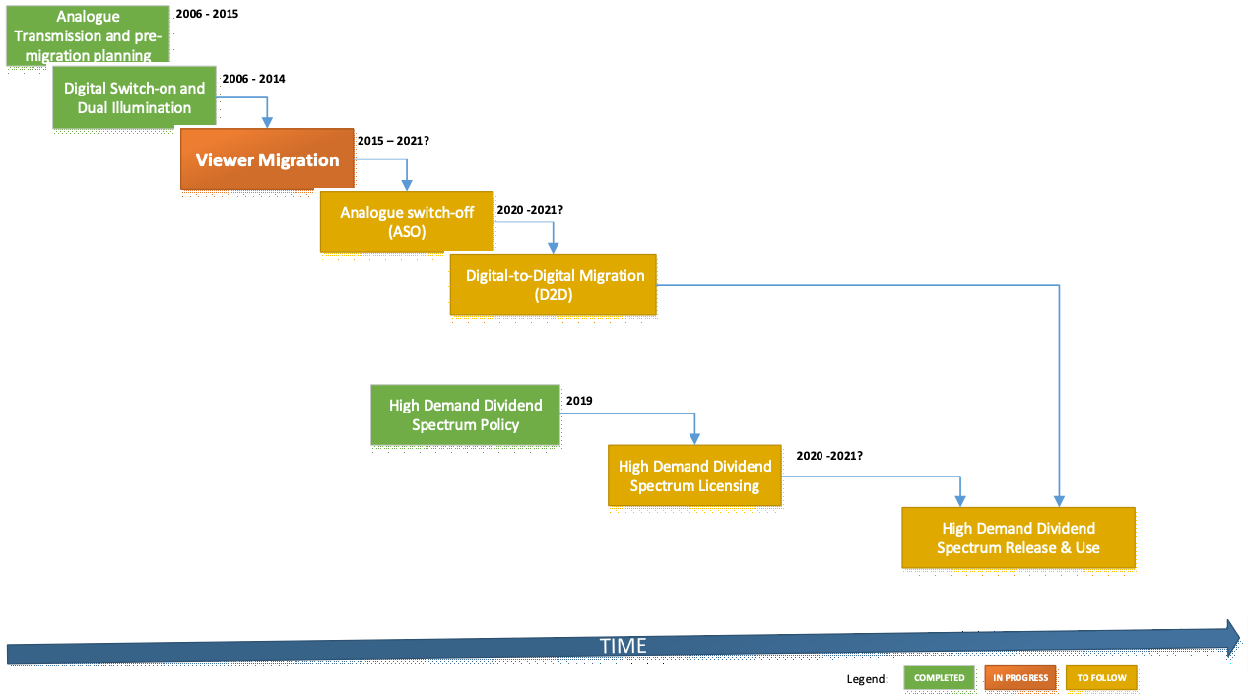
Overall Migration Framework and Current Status
  Analogue broadcasts have been switched off in the SKA as a result (18 transmitters)
  One Transmitter in FS Senekal Switched Off

Slide 4
Overview of Activities
Transmission Network & Digital Content
DTT network fully deployed and optimised across the country
  Digital Terrestrial Television (DTT) - 88% Population coverage
Direct-to-home (DTH) satellite - 12% Population Gap Cover
Digital Content available on the DTT and Satellite platforms (7 SABC, 4 e.tv, 19 Radio)
Spectrum Interference Harmonisation
Bilateral engagements conducted with neighbouring countries
Mitigate against mutual cross-border interference during the migration process
SABS published revised decoder standard in October 2020
Enabling cheaper decoders and mass availability
Integrated Digital TV (IDTVs) available to extend DTT uptake
Device Standards
STB Distribution
Manufacturers to produce cheaper decoders using revised SABS standard for retail and voucher scheme
Distribution of subsidized decoders underway using existing decoder stock at SAPO
Awareness and Communication
Awareness and communication strategy and plan in conjunction with GCIS and SABC
Roll-out underway to educate and inform the public about the programme
Analogue Switch Off for Spectrum Release
Current Activity – Phased Provincial controlled hard switch off being implemented

Slide 5
Progress Since Last Committee Meeting
Depletion of Decoder Stock
Distribution Vouchers
Appointment of Installers
  Sentech-led installation management
  Installation companies appointed in FS , NC and NW
  Installation companies to be appointed in Limpopo in March 2021.
Installation of STBs
  Commenced in FS - 6300 installations done.
  Will Commence in NC and NW in February 2021,
  Aggressive delivery plan and timelines being continually revised to realize early Analogue Switch Off and Spectrum release.
  Have full cooperation of implementing SOEs
Consultations with Provinces
  NC, NW, LP and FS consulted in January 2021.
  Ongoing consultations in the district and local municipalities while decoder roll out is underway.
  High priority to local installers at municipal level.
Voucher Subsidy framework
  Framework developed by SAPO.
Voucher Subsidy System
  SITA engaged regarding the development of the voucher distribution system to ensure citizen data protection.
Mass Decoder and Digital TV Availability
  Revised decoder standard for decoders published, to enable cheap decoder manufacturing.
  Digital TVs (IDTVs) for digital terrestrial reception already available in major retailers.
  Incentive and mass communication to drive user adoption being implemented

Slide 6
Progress To Date
Appointment of Installers
  Sentech-led installation management
  Installation companies being appointed by Sentech in FS , NC and NW
  Installation companies to be appointed in Limpopo in March 2021.
Installation of Decoders
  Commenced in FS - 6300 installations done.
  Proceeding with installations in NC and NW in February 2021,
  Aggressive delivery plan and timelines being continually revised to realize early Analogue Switch Off and Spectrum release.
  Have full cooperation of implementing SOEs
Consultations with Provinces
  NC, NW, LP and FS consulted in January 2021.
  Ongoing consultations in the district and local municipalities while decoder roll out is underway.
  High priority to local installers at municipal level as part of local empowerment.

Slide 7
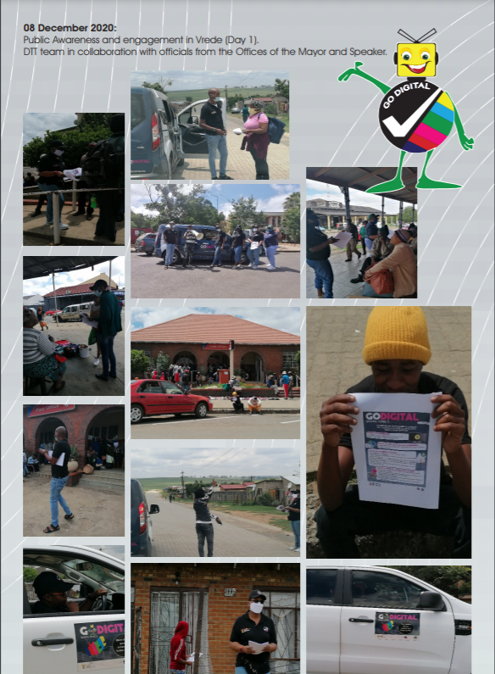
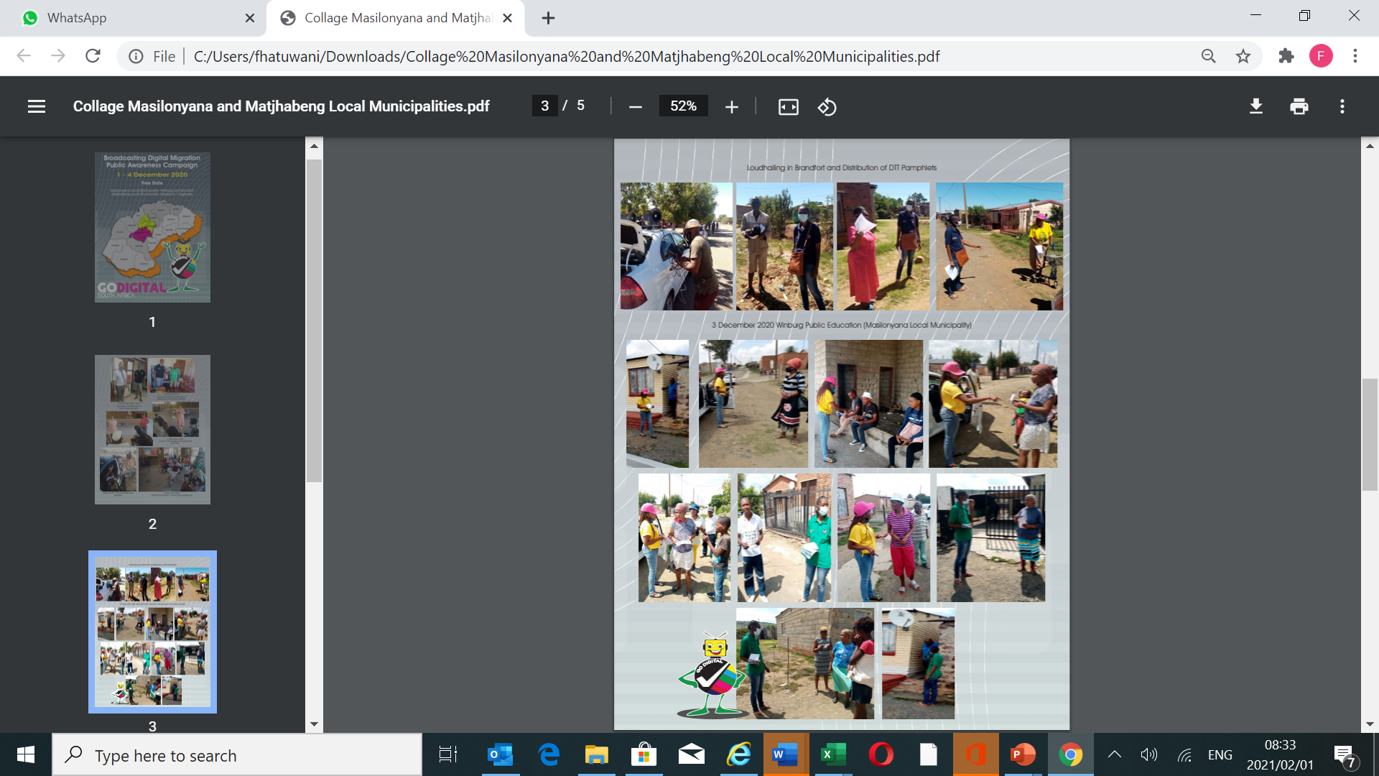
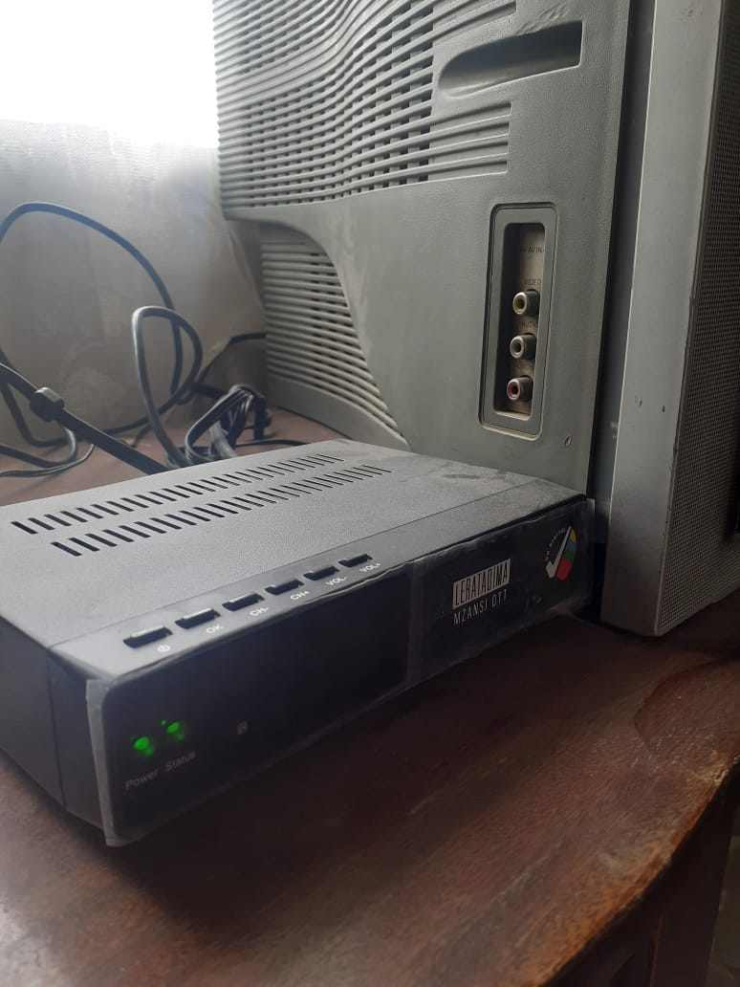
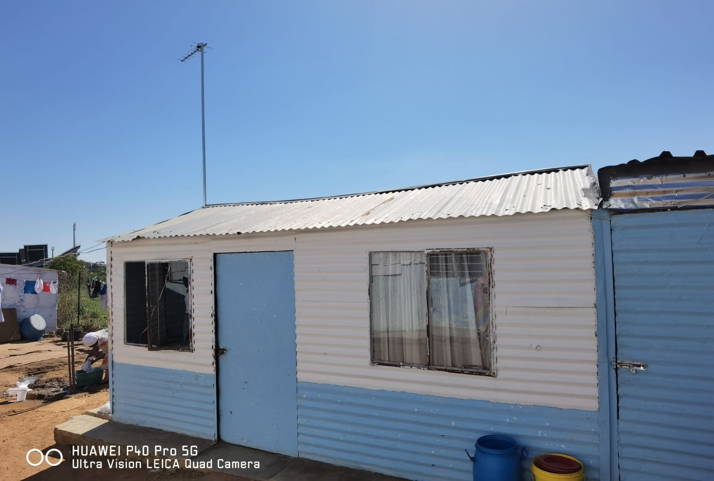
Awareness Campaigns and Installations
Demonstration of on-ground public education and awareness campaigns in the Free State encouraging indigent households to register for government subsidy and those who do not qualify for subsidy to acquire digital decoders or IDTVs on retail market.
  Loud hailing;
  Distribution of Pamphlets; and
  One-on-one engagements.
  Further campaigns conducted as part of the Minister and Deputy Minister community outreach programme in other provinces
Installed indigent household in Free State

Slide 8
Roadmap to ASO (current activities)
  Brought forward ASO timelines in conjunction with Broadcasters and Sentech to conclude ASO within 1 calendar year – ASO to commence on 8 March 2021
  Aggressive but controlled hard switchover process being implemented in provincial phases
  Private Public Partnership (PPP) interventions to augment SOE capacity for installations and voucher management being introduced
    Hybrid distribution approach with stakeholders
  Distribution and management of voucher system
  Continuous engagement with local electronics manufacturing sector to trigger market availability of affordable decoders
Demand being created through the hard switch off approach and concerted marketing/awareness

Slide 9
Accelerated Delivery Plan – Phase I (860 000 Decoder Stock in FS, NC, NW & LP)
Deliverables | Activities | Role Player
Provincial Delivery | Provincial, District, and local municipalities stakeholder engagements done (Free State, Northern Cape, North West, Limpopo) | DCDT, USAASA
Free State to Install - 129 117 | STBs distributed and installed across all district municipalities Conduct installation Quality Assurance | SENTECH /SAPO
Northern Cape to Install – 70 409 | STBs distributed and installed across all district municipalities Conduct installation Quality Assurance | SENTECH /SAPO
North West to Install – 294 031 | STBs distributed and installed across all district municipalities Conduct installation Quality Assurance | SENTECH /SAPO
Limpopo to Install – 360 143 | STBs distributed and installed across all district municipalities Conduct installation Quality Assurance | SENTECH /SAPO
Continuous deliberations for revised delivery timelines underway with broadcasters to accelerate decoder rollout and switch-off

Slide 10
TIMEFRAMES TO FINAL ASO
  A phased provincial hard switch off plan has been agreed to with broadcasters and Sentech, to get close to the December 2021 target and to further mitigate against the timeline slippage
  To ensure minimum disruption to citizens, strict consideration is being made on the effect of hard switch off in various regions, noting the differing population numbers affected by the transmitters in the respective regions (rural vs metros)
  The revised delivery plan is envisaged to be carried through a period of just over one calendar year, between March 2021 – March 2022
  ASO will be achieved incrementally in provincial phases as milestones, starting with FS in March 2021 and concluding with Gauteng in March 2022
  The revised delivery plan will be continuously optimized in consideration of potential risks and other external variables
  Mitigation measures and additional interventions are further explored in slides to follow

Slide 11
ired.

Slide 12
Phase I Implementation Challenges
Challenges
Mitigations
  Inadequate budget provided for installations
  Inadequate installer capacity at district and local municipalities.
      Led to appointment of installers across the province.
      Leading to sub-contracting of local installers at low installation fee per device.
      Local installers reluctant to participate on the programme due to the insufficient allocated installation fees.
    Socio-economic challenges inhibiting participation by the communities.
      Unregistered installers pushing for inclusion
      Deficiency in the community awareness about the programme
    USAASA and SENTECH have agreed on an approach to mitigate against the installation fee challenge
    Another tender was published by Sentech in January 2021 for direct appointment of local installers.
      Awareness campaign to local installers to respond to the tender.
      Provincial governments requested to assist with the generation of database of local installers.
      Private sector participation to augment installer capacity
    Project Steering Committees at provincial level monitoring and resolving challenges as they arise.
    Increase awareness drive

Slide 13
THANK YOU

