Slide 1
Civil Aviation Amendment Bill [B 44 – 2018]
Comments : MEMORANDUM ON THE OBJECTS
Presentation to the Portfolio Committee on Transport
16 February 2021
Rennie Van Zyl
Independent aviation consultant & concerned citizen
ICAO retiree

Slide 2
Main Comments
CLAUSE 1. The change of Director to that of Commissioner
CLAUSE 1. Definitions-
CLAUSE 1. Executive Responsible For Aircraft Accident And Incident Investigation
CLAUSE 2. Section 2: aircraft belonging to the South African National Defence Force
CLAUSE 8. General comments following Sections:
Section 11; 14; 15; 16; 18; 30; 34; 36; 41; 63;
CLAUSE 13 Section 74 – Charges, Fees & levies
CLAUSE 14 Section 76 – influencing
CLAUSE 24 Section 99- liability
CLAUSE 32 Section 113 (1) – Regulatory compliance
CLAUSE 48 Section 130 – Exemptions
CLAUSE 53 Section 142(3) – Tokyo Convention
CLAUSE 61 Deletion Of Section 163(3) - International Standards
CLAUSE 69 Section 155(1) Fees Committee

Slide 3
CLAUSE 1. The change of Director to that of Commissioner
Prior to 1970
DOT had a National Transport Commission Persons represented industry
Commissioner for Civil Aviation – Col Bob Preller
DOT Director of Civil –Public Servant – Mr Sally Du Toit (DCA)
After 1970
Positions combined - CCA
Many Parts of the world CAA’s headed by a Director or even Director General
ICAO Doc 9734 uses
With amendment of the Aviation Act 1960 - CCA changed to Director
No need to change other than for ego reasons
It will introduce significant rewriting of software; Manuals and other printed documents used
There is a cost implication.

Slide 4
CLAUSE 1. Definitions
The definitions of
Aerodrome Manager; Designated Airport; Airport; Heliport.
It should be noted that Helistop is not used by ICAO
These require attention by the DOT to resolve.
Main issue is re the:
New definition of EXECUTIVE RESPONSIBLE FOR AIRCRAFT ACCIDENT AND INCIDENT INVESTIGATION
If appointed by SACAA, a conflict of interest exists.

Slide 5
CLAUSE 2. Section 2: an aircraft belonging to the South African National Defence Force
What about Section 142 (2)
(2) Except with the written permission of the Minister or a person in the service of the State authorised by the Minister and subject to such conditions as the Minister or such a person may determine, no person shall convey any conventional arms, drugs or animal product in an aircraft.
Will the Minister have to give a permission for any armed SAAF or SAPS aircraft when a flight is planned for example from FABL?
CLAUSE 8 Section 11
Section 11 – what has changed – it is the same as the current CA 2009 Act?

Slide 6
Main Concern – Section 14
Section 14 (1) (a) Reads:
“to ensure that the investigation procedures and practices are compatible with—
(a) any international agreements or Conventions to which the Republic is
a party;”
With respect to the above requirements, it is necessary to review the independence of the investigation processes following the aircraft accident involving a Cessna Citation aircraft as operated by the South African civil Aviation Authority (SACAA) that occurred on 23 January 2020.
In this regard the ICAO recommendations clearly state that:
The investigation authority should not report to the same Minister responsible for the regulation and/or safety oversight of civil aviation in the State or to a judicial authority.
(refer to an extract from ICAO Doc 9756, Part 1, 2nd Edition)

Slide 7
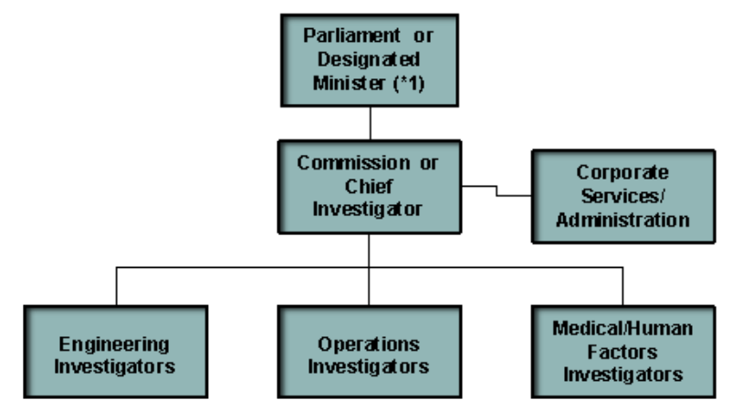
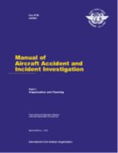
Check and balances
2.3 LEGISLATION REGARDING THE CONDUCT OF INVESTIGATIONS
. The accident investigation authority should, through legislation, have immediate and unrestricted access to all relevant evidence without requiring prior consent from judicial bodies or other authorities.
Accident investigators should be aware that aircraft accidents may be subject not only to a technical investigation but also to some form of judicial, regulatory, labour, occupational health and safety, environmental protection, administrative and/or disciplinary inquiries.
However, accident investigation procedures should not be constrained by these types of processes, and national legislation, regulations, and perhaps MOUs, should specify the procedures to be followed in order to keep the technical investigation separate from these other proceedings.
The legislation shall make it clear that accident prevention is the sole objective of the investigation and shall emphasize that it is not the role of the accident investigation authority to apportion blame or liability.
Figure I-2-2. Example of a streamlined organizational structure
Note
*1 The investigation authority should not report to the same Minister responsible for the regulation and/or safety oversight of civil aviation in the State or to a judicial authority.
The above is also applicable to Section 41.

Slide 8
Section 15. Appointment of Members of ASIB
The need for a Deputy Chairman was introduced by the portfolio committee when reviewed in 2009/2010.
Deletion of the requirement for publication in the Gazette is in conflict with transparency.
Section 16: “other relevant expertise or qualifications”
How is this to be assessed and by whom?
Section 18 Disqualification and removal of members
This appeared in Section 18 of previous Act?
What has happened to Sections 16 & 17?
The reference to the 1993 Constitution has to be changed to
“the Constitution of the Republic of South Africa Ac,1996(Act No.108 of 1996)”.
Section 30 Powers of Aviation Safety Investigation Board
Section 30 (1) (d) & (i)
How are financial implications to be handled?

Slide 9
Section 34 Search and seizure by appointed investigators
Section 34. (1) Does this meet constitutional provisions?
Section 34. (5) Is the content of certificate of appointment prescribed?
Section 36 Return of seized property
If a part was damaged after seizure, is owner entitled to damages?
Section 41 Aircraft accident or incident investigation report
Refer also comments Section 14 (1) (a)
Section 41. (1) Please Note ICAO comments as quoted in Section 14 above.
Section 41 (5) Interim statement
An Interim Statement has to be issued every 12 months if investigation has not yet been completed. - This should be included
Section 63 Rules
Section 63 (1) (f) Should the Dept of Finance not be involved- check and balances, otherwise open to abuse. ASIB is a monopoly with no free market forces for check and balances?

Slide 10
CLAUSE 13 - SECTION 74 Fees and charges
Note has to be taken by comments of a previous legal advisor, which I share:
Period of four months’ notice of an increase in fees, charges and levies is too long
It is not clear why a distinction in the consultative process between charges and fees is being made.
In practical terms this means that in the case of an amendment of fees and levies , the period from initiating the process up to the publication in the Government Gazette, can take up to 8 months
From start to finish the process to publish an increase in fees, charges and levies may take a minimum period of 10 months.

Slide 11
CLAUSE 14 - Section 76 - Influencing
The amended clause intends to prevent the CAA Board to compromise or to obstruct the Commissioner in the execution of his or her duties. It is proposed that the words “or attempting to influence the Commissioner” be added to the text.”
CLAUSE 24 Section 99 Liability
The expansion of the limitation of liability is to wide.
This should remain restricted to that of the employees of the SACAA.
CLAUSE 32 Section 113 Monitoring regulatory compliance
Section 113 (1) to delete an unnecessary word ‘‘reasonable’’.
What about conditions of Section 113 (4) & (5)? – actions only in terms of a warrant
(4) For purposes of monitoring regulatory compliance with any legislation
administered ……….
(5) (b) (b) The proviso to paragraph (a) does not apply where the person concerned believe on reasonable grounds that any object, book or document which is the subject of the search may be destroyed, tampered with or disposed of if the provisions of the said proviso are first complied with.

Slide 12
CLAUSE 48- AMENDMENT OF SECTION 130 – Exemptions
This is not a practical proposal.
The Minister’s office will be swamped by exemption requests and cause delays and major problems for the industry.
This must remain with Director unless provision is made for Director to grant exemptions in respect of the CARs.
CLAUSES 52,56,57.58 AND 59 SECTIONS 140,145,146,147 AND 148
Functions of authorized officers and persons have distinct differences in functions. Authorizations need to be different. there should be a clear separation in authorizations for safety and security purposes.
There should be a clear separation in authorizations for safety and security purposes.
Functions of authorized officers and persons have distinct differences in functions, hence Authorizations need to be different.
However, note has to be taken by comments of a previous legal advisor, which I share.

Slide 13
CLAUSE 53-amendment Of Section 142(3) – Tokyo Convention
“4.1 The words “of the Convention relating to Offences and other Acts committed on board an aircraft, 1963 signed at Tokyo” are unnecessary and confusing. The reference to Marshalling Signals, Interception Manoeuvres and orders ‘relate to Annex 2 of the Convention and does not have a bearing on the Tokyo Convention,1963, which relates to Offences and other Acts committed om board an Aircraft
4.2 The said words can be deleted without affecting the contents and meaning of the particular proviso.”
Clause 69 SECTION 155(1)
In this regard it has to be pointed out that with reference to the proposed establishment of a Fees Committee as per section 155(1) in the draft Bill, such a committee, which consists of members of the aviation industry already exists as one of six a sub-committees of the CARCOM (Section 159 of the principal Act and Subpart 2 of Part 11 of the Civil aviation Regulations, 2011).It is therefore submitted that It would appear that the proposed Fees Committee is a duplicate of the existing Fees Sub-committee of CARCOM and is therefore not necessary.

Slide 14
CLAUSE 61 -DELETION OF SECTION 163(3) – International Standards.
It is submitted that the deletion of this particular sub-section is not justified for the following reasons:
The introduction of an international standard does not require a physical insertion in the appropriate CATS document
This means the content of the inserted international aviation standard cannot be contained in the applicable CATS document. As the text of the various Annexes are not contained in legal textbooks or the SACAA website.it can be difficult to obtain such texts.
The existing sub-section (2) has to remain as it indicates the process for the issuing of an international aviation standard.
The proposed amendment in the draft Bill does not address the matter of how international aviation standards can be made part of the CATS documents. The proposed sub-section does not cover the aspects mentioned in the existing sub-section (2).

Slide 15
Conclusion
Thank you for the opportunity to be able to submit comments for consideration by the Portfolio Committee.

