Slide 1

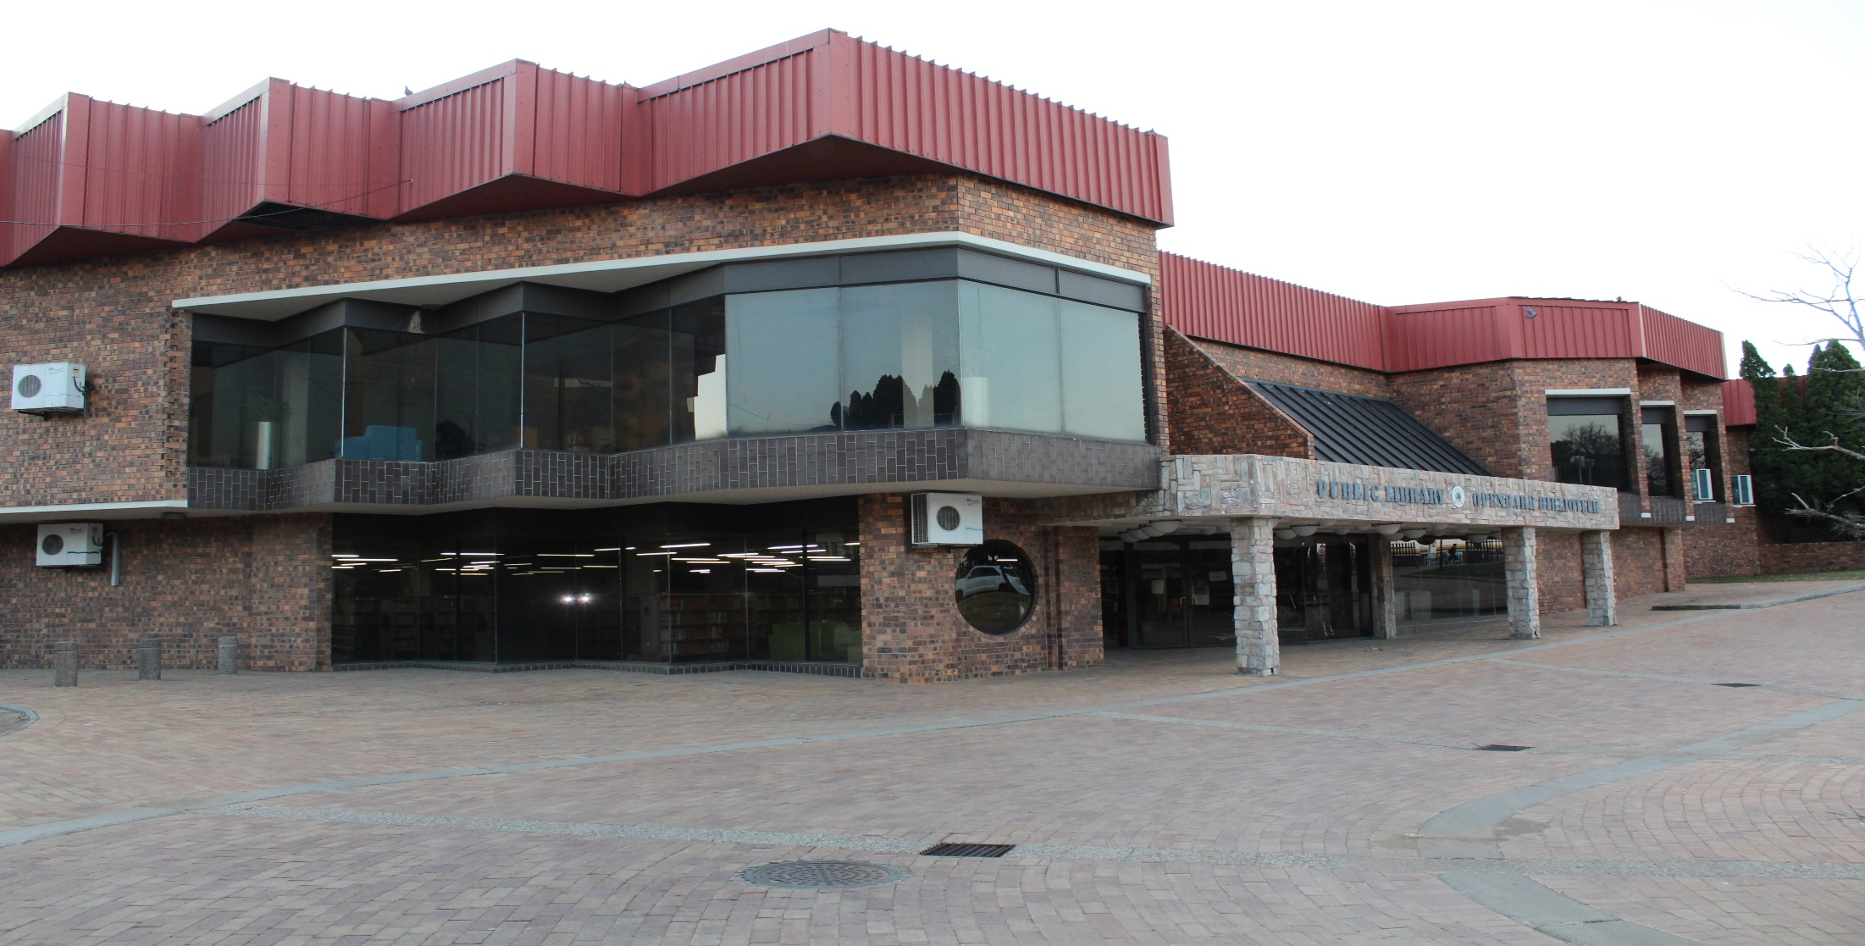
PRESENTATION ON THE STATE OF THE MUNICIPALITY
PRESENTED BY
Cllr. NG Zuma
Executive Mayor 16 FEBRUARY 2021

Slide 2
PRESENTATION OUTLINE
INTRODUCTION
FINANCIAL VIABILITY: REVENUE
VISION
To be a Model City and a Centre of Excellence
FINANCIAL VIABILITY: EXPENDITURE
POST AUDIT ACTION PLAN
IRREGULAR, FRUITLESS AND WASTEFUL EXPENDITURE
MUNICIPAL PUBLIC ACCOUNTS COMMITTEE (MPAC)
CONSEQUENCE MANAGEMENT
INSTITUTIONAL CAPACITY
INTERNAL AUDIT COMMITEE
TURN AROUND STRATEGY
RECOMMENDATIONS
CONCLUSION

Slide 3
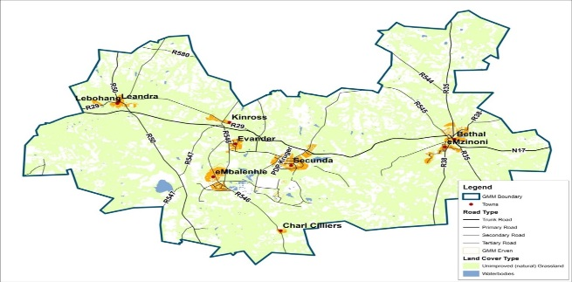
INTRODUCTION
Govan Mbeki Local Municipality is situated in the south-eastern part of Mpumalanga Province, abutting Gauteng Province in the south-west; approximately 150km east of Johannesburg and 300km south-west of Nelspruit (capital city of Mpumalanga).
Govan Mbeki Municipality is one of the 7 local municipalities under the jurisdiction of Gert Sibande District (the other districts being Ehlanzeni and Nkangala) and one of the 18 local municipalities within Mpumalanga. The Govan Mbeki area is mainly agricultural / rural with 3 urban conglomerates, namely; Leandra (Leslie, Lebohang and Eendracht) in the western edge, The Greater Secunda (Trichardt, Evander, Kinross and Secunda / Embalenhle) conurbation in the central part and Bethal / Emzinoni in the east.
Govan Mbeki Municipality is the 4th largest economy in Mpumalanga province and contribution to the provincial economy in 2019 was 12.7% and 47.2% to district economy. The comparative advantage of the municipality is in mining and manufacturing
Govan Mbeki has been identified amongst the struggling municipalities in the province in so far as meeting its service delivery obligations to the satisfaction of the consumers.
Consequently, the municipality has been receiving support from Treasury, Cogta and GSDM.
The municipality continues to operate under difficult conditions as evident in the escalation of the debtors book.

Slide 4
FINANCIAL VIABILITY: REVENUE

Slide 5
2020-2021 Budget
GMM approved its Budget in May 2020 within the legislated timeframes.
Overall budget summary:
ITEMS | FIGURES
Expenditure | 2 411 111 444,00
Impairment | 194 222 640,00
Revenue | (2 605 334 084,00)
Deficit | -
Transfer and Receipts Capital; | 172 422 004,00
Equitable share ring fenced | 43 000 000,00
Total operational deficit | 351 732 004.00

Slide 6
Budget for the 2020/2021 Financial Period

Slide 7
Revenue collection history
Month | Billed Amount | Collected Revenue | %
Mar-20 | 155 277 097 | 99 509 777 | 64%
Apr-20 | 142 139 822 | 75 575 666 | 53%
May-20 | 151 525 820 | 91 761 625 | 61%
Jun-20 | 137 924 620 | 87 429 925 | 63%
Jul-20 | 121 807 410 | 82 365 186 | 68%
Aug-20 | 150 116 373 | 75 357 301 | 50%
Sep-20 | 166 369 585 | 114 468 691 | 69%
Oct-20 | 170 536 232 | 106 370 315 | 62%
Nov-20 | 484 149 159 | 99 939 493 | 21%
Dec -20 | 151 041 291 | 91 872 747 | 61%

Slide 8
COMPARATIVE YEARS PAYMENT RATE
Month | 2018/19 | 2019/20 | 2020/21
July | 72% | 62% | 68%
August | 60% | 61% | 50%
September | 54% | 68% | 69%
October | 66% | 70% | 62%
November | 74% | 68% | 60%
December | 65% | 61% | 61%

Slide 9
GOVERNMNET DEBT
INSITITUTIONS | AMOUNT OWED
SCHOOLS | 5 592 552,00
HOSPITALS | 4 382 603,84
CLINICS | 369 428,39
PUBLIC WORKS | 1 104 915,87
RURAL DEVELOPMENT & LAND REFORM | 74 407,74
ROADS | 199 634,05
TOTAL | 11 723 541,89

Slide 10
FINANCIAL VIABILITY: EXPENDITURE

Slide 11
EXPENDITURE 2020/2021 FINANCIAL PERIOD

Slide 12
COVID RELATED EXPENDITURE R3 285 255.19

Slide 13
COVID RELATED EXPENDITURE

Slide 14
COVID RELATED EXPENDITURE

Slide 15
ESKOM BILL PER TOWN & COLLECTION PER TOWN ( NOVEMBER 2020)
AREA | Bill | ACTUAL COLLECTIOPN
Secunda /Embalenhle/Bethal - 0852 | R41 570 338.75 | -21 629 599.95
Kinross - 4499 | R3 820 554.05 | -1 840 627.02
Evander - 2361 | R5 616 236.29 | -768 238.54
Graceland - 6339 | R403 705.76 | -337 669.51
Total bill for November | R 51 410 834.85 | -24 576 135.01

Slide 16
ESKOM BILL PER TOWN & COLLECTION PER TOWN ( DECEMBER 2020)
AREA | Bill | ACTUAL COLLECTIOPN
Secunda/Embalenhle/Bethal - 0852 | R38 673 565.75 | -21 685 733.73
Kinross - 4499 | R3 413 734.39 | -1 845 403.87
Evander - 2361 | R5 241 899.00 | -770 232.29
Graceland - 6339 | R426 485.88 | -360 225.95
Total Bill for December | R47 755 685.02 | -24 661 595.84

Slide 17
CREDITORS INTEREST
For the month of December 2020, R 2.72 billion outstanding for more than 30 days. The main creditors being:
Supplier Name | Department/Section | Type of Expenditure | Amount | Estimated Interest
Eskom Holdings Soc Ltd - | Energy | Electricity | R2,3 Billion | R700 m
Rand Water | Water and Sewer | Bulk Purchases | R355 Million | R90 m
GMM entered into a repayment plan with Rand Water that offers relief to pay the current account in 45 days. Effective from October, the municipality has been honoring this arrangement. Eskom repayment plan been approved by council and sent to the power utility. The plan was signed on the part of GMM awaiting finalization by Eskom.

Slide 18
MONTHLY COMMITMENT
Description | Amount
Salaries | R50 100 000,00
Rand Water | R35 000 000,00
Eskom | R52 000 000,00
Land fill sites | R950 000,00
Meter readings | R1 600 000,00
Systems ( Munsoft, Muncom, DATA master | R700 000,00
Security | R2 500 000,00
Cleaning of septic tanks | R1 600 000,00
Sasol sewer | R1 000 000,00
Operational costs (telephone, diesel, workshop etc) | R2 800 000,00
TOTAL | R148 250 000,00

Slide 19
ANALYSIS OF REVENUE VS COMMITMENT
 | Amount
Average monthly Collection | 91 872 747,85
Less monthly commitment | (R148 250 000,00)
Surplus / (Deficit) | (R56 377 252.15)
Total Creditors Age analysis as of December 2020 this exclude direct purchase | R2 725 777 065.41
Comments: The current status quo is that the municipality is unable to fulfil its obligations as they fall due.

Slide 20
POST AUDIT ACTION PLAN

Slide 21

AUDIT OUTCOMES
GMM historical performance on its Audit is depicted as below:
2014/15 | 2015/16 | 2016/17 | 2017/18 | 2018/19
Unqualified with Findings | Unqualified with Findings | Unqualified with Findings | Disclaimer | Disclaimer
The reason for the regress in audit outcome is due to the change in financial systems which proved difficult in an attempt to comply with MSCOA. During this period, GMM migrated between 3 service providers rendering AFS submission outside the legislated timeframes. The 2018-19 audit outcome was communicated on the 08 December 2020 during which period, GMM was already undergoing the 2019-2020 audit. This was following the submission of the AFS on the 31 October 2020 as per the extension by the Minister.

Slide 22
2017/2018 Audit outcome Disclaimer paragraphs
The municipality received a Disclaimer opinion in the year 2017/2018 financial year with 15 Paragraphs which are summarized below:
No | 2017/2018 Audit outcome ( Disclaimer paragraphs )
1 | Service charges
2 | Payables from exchange transaction
3 | Property rates
4 | Employee related cost and councillors remunerations
5 | Consumer deposit
6 | Value added Tax- Receivables
7 | Bank overdraft
8 | Debt impairment
No | 2017/2018 Audit outcome ( Disclaimer paragraphs )
9 | Contracted services
10 | General expenditure
11 | Irregular expenditure
12 | Interest received on outstanding debtors
13 | Long term receivables
14 | Property plant end equipment
15 | Total revenue and expenditure

Slide 23
2018/2019 Audit outcome Disclaimer paragraphs
The municipality managed to reduce the Disclaimer opinion paragraph from 15 to 7 based on the Audit report for 2018/2019
No | 2018/2019 Audit outcome ( Disclaimer paragraphs )
1 | Service charges
2 | Cash and cash equivalents
3 | Consumer deposit
4 | Receivables from non- exchange transactions
5 | Debt impairment expense
6 | Irregular expenditure
7 | Corresponding figures
The late release of the 2018/2019 audit report has a huge impact on the 2019/2020 audit.

Slide 24
Audit Action Plan
The disclaimer is as a result of the conversion mis-alignment that occurred during migration process between three systems in 2017.
To address this, GMM sourced the services of an external service provider to assist with the alignment issues that are inherent in the systems challenges.
This service should address Service charges, Consumer deposit, Receivables from non- exchange transactions, Debt impairment expense.
The closing balances for the period ending 30 June 2019 have since been corrected thereby addressing the corresponding figures finding.

Slide 25
IRREGULAR, FRUITLESS AND WASTFUL EXPENDITURE

Slide 26
UNAUTHORIZED EXPENDITURE
Unauthorised expenditure | Movements from Audited AFS
Opening balance as previously reported | R 459 430 391
Current movements | R 897 063 000
Closing balance 30 June 2020 | R 1 356 493 391
COMMENTS The above unauthorised expenditure is indicative of cash flow challenges meaning that the municipality operates with an unfunded budget which is made up of R2,7 billion that is made up of historical debt to creditors such as Eskom, Rand Water and Suppliers that needs to be serviced. The municipality is paying historical creditors from the current budget resulting in authorised expenditure. The report will be tabled to Council to authorise these expenditure. The unauthorised will be incurred until an improvement is made in the revenue exceeds expenditure.

Slide 27
FRUITLESS AND WASTEFUL EXPENDITURE
Fruitless and wasteful expenditure | Movements from Audited AFS
Opening balance as previously reported | R 168 145 510
Add: Expenditure identified - current | R 177 693 915
Closing balance | R 345 839 425
COMMENTS Fruitless and wasteful expenditure is due to interest charged on overdue accounts arising from Eskom, Rand Water and other creditors. GMM is unable to service major creditors within 30 days due to its financial position.

Slide 28
IRREGULAR EXPENDITURE
Irregular expenditure | Movements from Audited AFS
Opening balance as previously reported | R 406 851 296
Add: Irregular expenditure - current | R 251 151 355
Closing balance | R 658 002 651
COMMENTS GMM is in the process of reducing Irregular expenditure. Comparative to the prior year, Irregular expenditure was reduced by 61%. Irregular expenditure was a result of non-compliance to the SCM policy and applicable regulations. The municipality is ensuring that procurement is made from contracted panels of service providers. Insourcing of services has also reduced irregular expenditure.

Slide 29
CONSEQUENCE MANAGEMENT

Slide 30
CONSEQUENCE MANAGEMENT
Municipal Public Accounts Committee (MPAC) concluded its investigation on the financial performance report for the first and second quarter of the financial period 2019/2020 as well as the mid term financial performance for the same financial period.
Council suspended 2 Senior Managers in September and October 2020 and disciplinary processes are underway.
The Disciplinary Board is investigating three cases of financial misconduct. Council resolved to strengthen the Disciplinary Board through appointment of an Independent member as per the Terms of Reference while Treasury delegated an official to serve on the committee.
The MEC tabled the section 106 report to Council on 06th of October 2020 and Council at its extra ordinary meeting held on the 20th of October 2020 adopted the report.
An action plan to address the recommendations of the 106 report was subsequently adopted by Council.
3 Senior Managers and 2 then Acting Directors are undergoing disciplinary processes.

Slide 31
MUNICIPAL PUBLIC ACCOUNTS COMMITTEE
Council have an MPAC committee established in terms of Section 79 of the Structures Act.
12 members of Council serves on MPAC and is represented by Councillors from 4 diverse political parties serving in Council.
Terms of Reference for the Committee are in place.
MPAC sits in line with the Council schedule.
MPAC reposts to Council on all matters delegated.
MPAC has a full time secretary and have access to the services of the researcher as and when required.
In order to strengthen administrative capacity in MPAC, a Municipal Advisor from National Treasury has been seconded to MPAC.

Slide 32
INSTITUTIONAL CAPACITY
APPOINTMENT OF SENIOR MANAGERS SEC 54A & 56
POSITION | STATUS | DATE | Latest Development
Municipal Manager | Filled | October 2018 | Placed on suspension since the 3rd of September 2020. AMM appointed.
Chief Financial Officer | Filled | October 2017 | Placed on suspension since the 9th of October 2020. ACFO has been seconded by GSDM effective from the 19th of October 2020.
Director Corporate Services | Filled | October 2018
Director Technical Services | Filled | December 2019
Director Community Services | Filled | February 2020
Director Planning & Development | Vacant | 1 January 2021 | The post has since been advertised

Slide 33
Internal Audit
GMM established an in-house Audit Committee that is staffed and reports administratively to the Municipal Manager and functionally reports to the Audit Committee.
There are 6 positions on the organisational structure with 1 vacancy.
Name | Position + Experience | Qualifications
I Makola | CAE (12 years of external & internal audit) | B com (Articles), MFMP ACCA – In progress Post Grad Int Auditing in progress
T Khumalo | Supervisor (7 years) | B com (Accounting) Municipal financial management
C Masango | Performance Auditor (7 years) | National Diploma cost and management accounting
D Reddi | Internal Auditor (6 yrs) | B com (accounting)
T Lekhoba | Internal Auditor (6 yrs) | National Diploma: Internal Auditing Advance diploma in Accounting Sciences: IA

Slide 34
Internal Audit
Capacity
Five independent members appointed
Three are qualified CA(SA)
2. Functionality
Committee meets quarterly and reports to Council
In this current FY, 3 AC meetings were held. Another meeting is scheduled for 17 February 2021.
3. Effectiveness
AC reports to Council with clear recommendations.
Council adopts recommendations of AC.

Slide 35
TURN AROUND STRATEGY

Slide 36
INTERVENTIONS UNDERWAY
The turn around strategy of the municipality is targeting reducing of contracted services and reduction in redundant infrastructure through the following measures:
REVENUE
Insourcing of meter reading services Started the process of disposal of obsolete assets. Implementation of business cut-offs Internal data cleansing through write off of uncollectable debt and credit control measure
INSOURCING THROUGH ACQUISITION OF FLEET
Purchase orders for the following fleet has been issued: Honey suckers x3 Water carts x2 High pressure jet x1 Tipper trucks x4 Front end loader x2 Bulldozer TLB’s x 6 – Delivered and handed over to GMM
INFRASRTUCTURE
Reduce overloaded transformers in Embalenhle and Bethal Ensure all damaged water and electricity meters are replaced

Slide 37
ELECTRICTY AND WATER INFRASTRUCTURE
Ghost vending (change supplier group codes).
REVENUE AND EXPENDITURE MANAGEMENT
Comprehensive data cleansing
LEGAL
Conclusion of debt litigation cases
PLANNING AND DEVELOPMENT
Conduct Land Audit
Timeous servicing of municipal debt
Remove illegal connection.
Meter audits.
Install meters on un-metered consumers
Monitoring of zero purchase meter/households
System integration
Data integration between GV and FMS
Procurement of smart Vending and meter management system
Improved accuracy in billing
Consistent application of credit control and debt management policy.
Recover properties sold and never paid for
Bulk metering and sectorization
Water demand management
Upgrading of water and electricity infrastructure
Regular maintenance of infrastructure
Hand over non-paying customers
Write off uncollectable debt
Retrieval of land not paid
Contract Management
Overtime reduction
Insourcing of services
Implementation of Cost Containment
Implementation of GVR
TURN AROUNT STRATEGY

Slide 38
RECOMMENDATIONS
That, the presentation on the Financial Position of Govan Mbeki Municipality be noted.
That, the need for government, private sector and community partnerships to support the revenue enhancement of the municipality is required in the following:
National intervention on the charging of interest by Eskom and Rand Water
Settling of government debt owed to GMM
Local businesses who are Large Power Users to service accounts timeously
Community partnership in creating a culture of payment of services

Slide 39

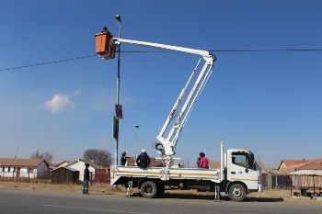
Thank you

