Slide 2
TABLE OF CONTENTS
Strategic Overview
Overview of the NHC Performance in 2019/20
Governance
Audit and Finance
End

Slide 3

STRATEGIC OVERVIEW

Slide 4
The Mandate of the NHC
The mandate of the NHC is contained in Section 4 of the National Heritage Council Act, 1999 (No. 11 of 1999) (Objects of the act). It is:
To develop, promote and protect the national heritage for present and future generations;
To coordinate heritage management;
To protect, preserve and promote the content and heritage that resides in orature, in order to make it accessible and dynamic;
To integrate living heritage with functions and activities of the Council and all other heritage authorities and institutions, at national, provincial and local levels;
To promote and protect indigenous knowledge systems, including, but not limited to, enterprise and industry, social upliftment, institutional framework and liberatory processes;
To intensify support for the promotion of the history and culture of all our peoples, and particularly to support research and publications on enslavement in South Africa.

Slide 5
Vision
A nation proud of its African heritage.

Slide 6
Mission
Through development, promotion and preservation of heritage for sustainable development and transformation, we will know that we are achieving this when South Africans experience the following:
They are knowledgeable about heritage;
Have access to their heritage;
Benefit from heritage;
Utilise heritage in their lives; and
Behave in a way that demonstrates their pride in heritage

Slide 7
Values
Within Ubuntu philosophy, the following values will guide the programmes, actions and behaviours of Council Members and employees of the NHC and all those who are acting in its name:
Batho Pele;
Integrity;
Professionalism;
Equity; and
Creativity

Slide 8
Foreword by the Administrator
This Annual Report is presented during a transitional phase in the NHC following governance challenges which led to the dissolution of the Council and the resignation of the former CEO.
The Minister appointed the Administrator, together with two Assistant Administrators, with effect from 27 August 2020.
The Team engaged robustly with the management of the NHC in order to understand the governance challenges facing the entity.
The audit process that had commenced in June 2020 was seriously lagging behind and this required the Team to intervene in ensuring that the audit gets finalised.
The challenges in the organisation were further highlighted in the outcomes of the Audit Report which is a Qualified Audit Opinion for the financial year 2019/2020.

Slide 9
Foreword by the Administrator Cont…
During the year under review, the NHC supported work done by heritage practitioners and other stakeholders on the ff:
Commemorative events,
Knowledge production
Cultural expressions.
The flagship Heritage Education Schools Outreach Programme (HESOP)
Golden Shield Heritage Awards (GOSHA).

Slide 10
Foreword by the Administrator Cont…
I wish to express my appreciation to the former CEO who served the NHC as the CEO for fifteen years
Furthermore, I wish to extend a word of gratitude to the previous Council Members for the time that they served the NHC
I would also like to pay respects to Adv. Moopeli, the Free State Representative in Council who passed away on 02 November 2019, the former Chairperson, Dr. Thulani Mbuli who passed away on 11 July 2020 and the former Chairperson and Panel Member Prof M. M. Balintulo who passed away on 20 December 2020.
I would also like to appreciate the appointment of the new Council in December 2020, led by Mr Edgar Neluvhalani as Chairperson.
I am confident that the administrative team will direct the stabilisation of the NHC through the implementation of good governance and sound administration.

Slide 11
OVERVIEW OF THE NHC PERFORMANCE IN 2019/20

Slide 12
2019/20 Performance Highlights
Supported the 2019 National Freedom Day Celebrations in collaboration with the DSAC through a Memorial Lecture on the 200th Anniversary of the Battle of Egazini in Makana.
Collaborated with the South African Interfaith Council to host an Interfaith Dialogue on social cohesion and nation building.
Participated in the Department of Women & Children’s Public hearings on Gender Based Violence

Slide 13
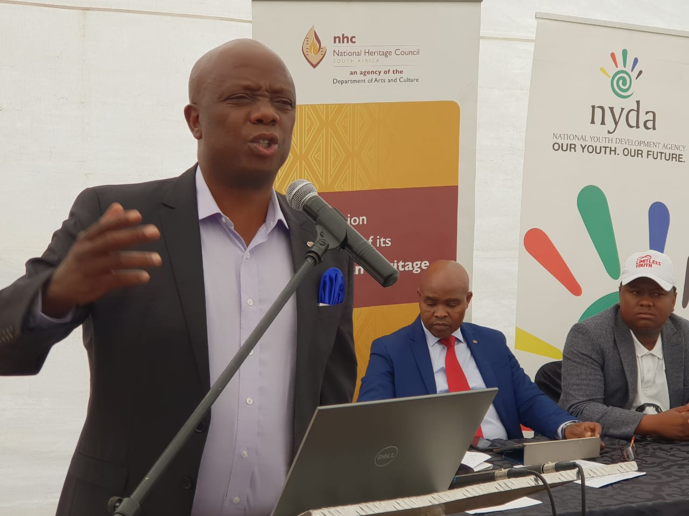
2019/20 Performance Highlights
On the RLHR:
  The NHC partnered with NYDA and SAHRA on the Commemoration of the 40th Anniversary of the hanging of Solomon “Kalushi” Mahlangu and the beginning of public consultations for the declaration of the home as a national heritage site.

Slide 14
2019/20 Performance Highlights
The NHC also supported the inauguration of the Cradock Four Garden of Remembrance in Cradock where the National Department of Tourism (NDT) handed over infrastructure underscoring the nexus between heritage and tourism in order for the Cradock community to leverage economic development on their liberation heritage.

Slide 15
2019/20 Performance Highlights
In pursuit of the Policy Advice mandate of the NHC, two Policy Position Papers were produced and workshopped in the financial year under review. These are on:
  (i) Liberation Icons: Toward a Policy Framework which looks at the role of the state and the families in the burial and memorialization of icons; and
  (ii) Private versus Public Management of Heritage which looks at the common practices and different applications by the two sub-sectors.
On knowledge production, two journal articles on the State of archives in general and another one on Liberation Struggle Archives were produced by the Panel of Experts appointed to augment the internal capacity of the NHC on research and policy development.

Slide 16
2019/20 Performance Highlights
International cooperation
  The NHC was admitted as a member of the Global Public Diplomacy Network (GPDNet) in January 2020 at their 6th General Assembly held in Qatar. The GPDNet was founded in 2014 in Seoul as a platform that contributes to international community through cultural and civil society initiatives by sharing knowledge and encouraging cooperation. The GPDNet is comprised of non-profit national level institutions promoting cultural and public diplomacy.
  Other international engagements included working visits to Vietnam and Syria to explore bilateral cooperation in heritage conservation.
  The DSAC invited the NHC to participate in the Reference Group on the Resistance and Liberation Heritage Museum, and as part of this work joined the multidisciplinary team led by the DSAC to do benchmarking in countries like Senegal, Russia, Germany, Brazil, and Argentina on memorialisation.

Slide 18
STRATEGIC OUTCOME ORIENTED GOALS
Strategic Outcome Oriented Goal 1 | An internationally recognized heritage organisation on the African continent
Strategic Outcome Oriented Goal 2 | Mainstreaming of resistance and liberation heritage.
Strategic Outcome Oriented Goal 3 | Increased knowledge and awareness about South Africa’s heritage by South Africa’s citizens.
Strategic Outcome Oriented Goal 4 | The leading institution on intangible heritage in South Africa.
Strategic Outcome Oriented Goal 5 | Social Cohesion and nation building.
Strategic Outcome Oriented Goal 6 | An effective, efficient and sustainable institution.

Slide 19
PERFORMANCE PER PROGRAMME
Programme 1: Administration
The aim of this programme is to provide strategic leadership and enable NHC performance through the delivery of support services.
The programme is made up of the following sub-programmes:
  Office of the CEO, Communications, Company Secretariat, and Corporate Services.
Strategic objectives: 1.1 Provide strategic management services 1.2 Provide legal services to the NHC 1.3 Promote the NHC and its programmes 1.4 Development of highly capable organisational personnel 1.5 Financial and procurement support provided 1.6 Provide IT support
• 11 targets had been planned for Programme 1 in 2019/20: • All 11 targets (100%) were achieved.

Slide 20
Programme 2: Heritage Promotion
The purpose of the programme is to meet NHC customer expectations through the delivery of NHC products and services.
Programme 2 consists of the following sub programmes:
  Heritage Management, Funding and the Resistance and Liberation Heritage Route
Strategic objectives: 2.1. To intensify the promotion of living heritage through collaborations and stakeholder engagements nationally and internationally 2.2. To develop a national planning, policy development and research capability that will create an enabling environment for the advancement and promotion of National Heritage content 2.3. To build a network of strategic partnerships to strengthen and integrate heritage development by extending the influence of the NHC and leveraging the resources through partnerships 2.4. To coordinate the management of the Liberation Heritage Route, the African Liberation Heritage Programme and national input in the world heritage agenda by promoting the influence of the South African heritage globally.

Slide 21
Programme 2: Heritage Promotion Cont…
A total of 15 targets had been planned for Programme 2 in 2019/20. • 14 targets (93.3%) were achieved. • 1 target was not achieved. The target is on Number of Exchange Programs implemented whereby the NHC participated in the SOMAFCO Youth Exchange Programme to Tanzania instead of implementing

Slide 22
GOVERNANCE

Slide 23
Governance
The NHC is committed to the principles of accountability, openness and integrity as prescribed by legislation and good practices like the King I- King IV Reports on Corporate Governance
  NHC policies and Charters complement this commitment.
The Minister of Sport, Arts and Culture and the NHC Chairperson signed a Shareholder’s Compact in December 2019.
During the year under review, the following reports were submitted:
  1st Quarterly Report submitted on 31 July 2019;
  2nd Quarterly Report submitted on 31 October 2019;
  3rd Quarterly Report submitted on 31 January 2020; and
  4th Quarterly Report submitted on 30 April 2020.

Slide 24
Governance
The NHC Council is constituted in terms of Section 5. (1) of the National Heritage Council Act, No. 11 of 1999.
Its members are appointed as follows:
  5 appointed by Minister of Arts and Culture;
  9 Provincial Reps nominated by MECs but appointed by Minister;
  Chairpersons of SAHRA, Ditsong and Iziko Museums and
  Chairpersons of Archives Commission, Heraldry and National Library of South Africa

Slide 25
Council Committees:
In the year under review Council had constituted the following Committees to assist it in executing its mandate:
  Audit and Risk Committee
  Heritage Programmes, Projects and Research Committee
  Corporate Services and Finance Committee
  Social and Ethics Committee
  Repositioning and International Relations Committee
Meetings of Council
  During the year ended 31 March 2020 six (6) Ordinary Meetings and two (2) Strategy Review Workshops were convened.

Slide 26
Governance cont…
Council Secretary
The Council Secretary (previously Company Secretariat) function is in-house reporting functionally to the Council and administratively to the CEO. The Company Secretariat function was split into Council Secretary and Legal Officer.
In the period under review the Council Secretary resigned in June 2019 and Mr. Tembile Yako was appointed as Acting Council Secretary while a new Council Secretary was being appointed. Two service providers were appointed in the period under review to assist in taking minutes in Council and Committee meetings.
The appointment of Council Secretariat was commenced by Council towards the end of its term before dissolution by the Minister. It is expected to be finalized in the 2020/21 Financial Year.

Slide 27
Governance cont...
Risk management & Internal controls
Risk is managed through a Risk Management Strategy approved by Council & overseen by Audit & Risk Committee, Risk Management Committee & MEXCO
Internal Audit was outsourced and AG noted a regression on Internal controls hence the Qualified Audit Outcome.
Management to attend to the identified weaknesses and report to the Audit and Risk Committee and the Council

Slide 28
Governance cont…
Compliance with laws and Regulations
The NHC complies with legislation and regulatory imperatives applicable to it including but not limited to The National Heritage Council Act of 1999, PFMA, Treasury Regulations, Practice Notes, King I – IV Reports, Labour laws, Health and Safety Laws, Procurement Prescripts, BBBEE etc.
Minimising conflict of interest
All Council members and employees of the NHC sign Declaration of Interest Forms annually in accordance with the National Heritage Council Act of 1999.
Health, safety and environmental issues
The NHC has designated a member of staff to be responsible for facilities management to ensure that health, safety and environmental issues are addressed.

Slide 29
Governance cont…
Fraud and corruption
To mitigate the risk of fraud and corruption the following instruments are in place:
  i) Fraud Prevention Plan that is aimed at mitigating the risk of fraud and corruption in the Council;
  ii) Anti-Fraud and Corruption Policy;
  iii) Code of Ethics and Business Conduct; and
  iv) Risk and Fraud Implementation Plans
  v) Use of the DSAC Hotline – No cases were reported in 2019/20
Code of Conduct
The Council has an approved Code of Conduct and Ethics Policy in place.
However, these policies need to be reviewed.

Slide 30
AUDIT AND FINANCE

Slide 31
AUDIT AND FINANCE
The NHC has received a Qualified Audit Opinion from the Auditor General of South Africa(AGSA) for 2019/20.
Basis for Qualification:
Valuation of property, plant and equipment,
Misstatements of the Annual Performance Information,
Internal Control Deficiencies,
Inadequacy of Contract Management and Consequence Management.
The unsatisfactory compliance with legislation in relation to financial management was also raised as a matter of emphasis.

Slide 32
AUDIT AND FINANCE cont…
Details of irregular expenditure (2019/20):
Expenditure incurred on expired contract ( R86,000.00);
Expenditure incurred without following a procurement process (R 2,033,000.00); and
Non-compliance with the PFMA and the Preference Procurement Regulations (R 1,698,000.00).
Non-compliance with the PFMA and Preference Procurement Regulations – Management is still awaiting National Treasury's confirmation which could not be obtained when the audit was concluded.

Slide 33
AUDIT AND FINANCE cont…
Audit Challenges 2019/20 :
Accounting Authority was dissolved including Audit and Risk Committee (ARC). Thus the absence of ARC was conspicuous;
The audit outcome was not considered and accepted by the ARC due to dissolution;
Valuators Report (Reassessment of useful lives – Property, Plant and Equipment) could not be concluded due to COVID-19 National Lockdown Regulations; and
Judgements made by Management on reassessment of useful lives – PPE (as previously assessed and accepted) was not accepted by the A-G for the 2019/20 audit.

Slide 34
AUDIT AND FINANCE cont…
  General financial review of the NHC
The NHC is fully funded by the Department of Sport, Arts and Culture.
The Interim Accounting Authority (Administration Team) evaluated the appropriateness of the going concern assumptions used in the preparation of the annual financial statements.
After their appointment, the Team had to prioritize, facilitate, oversee and ensure that the audit gets concluded.
There have been significant improvements in lowering the NHC`s accumulated deficit over the years.
NHC budget and staff complement are more tilted towards support rather than core business of the entity.

Slide 35
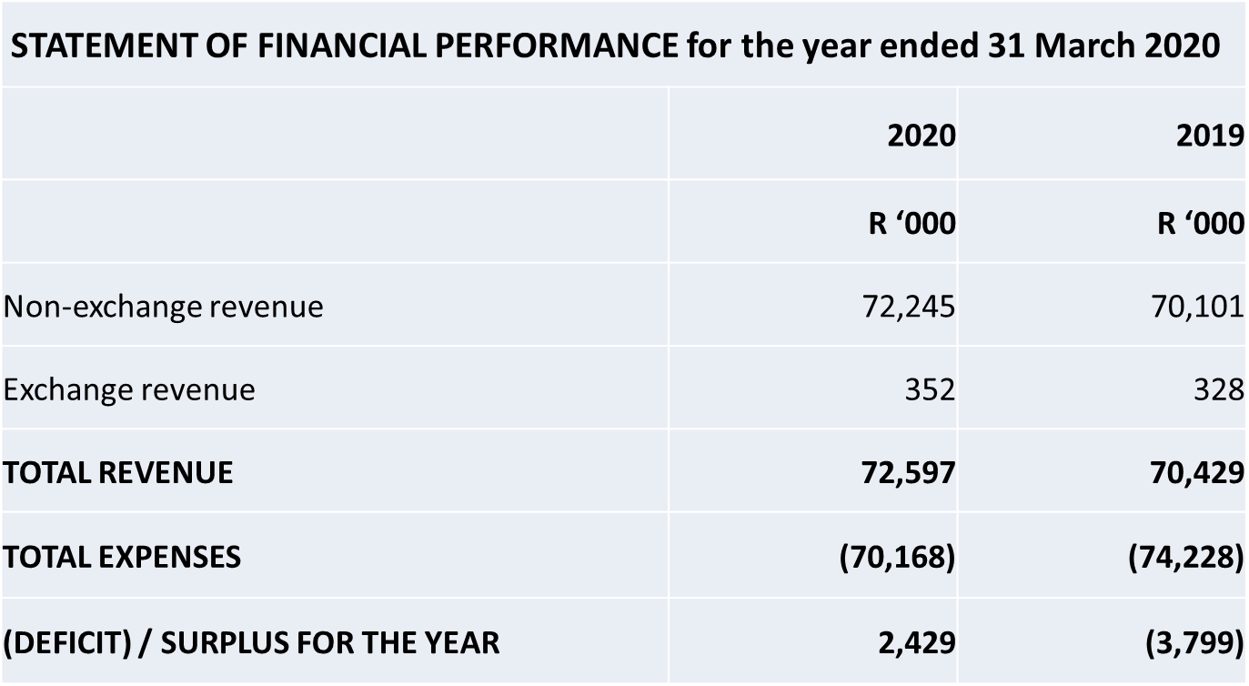
AUDIT AND FINANCE cont…

Slide 36
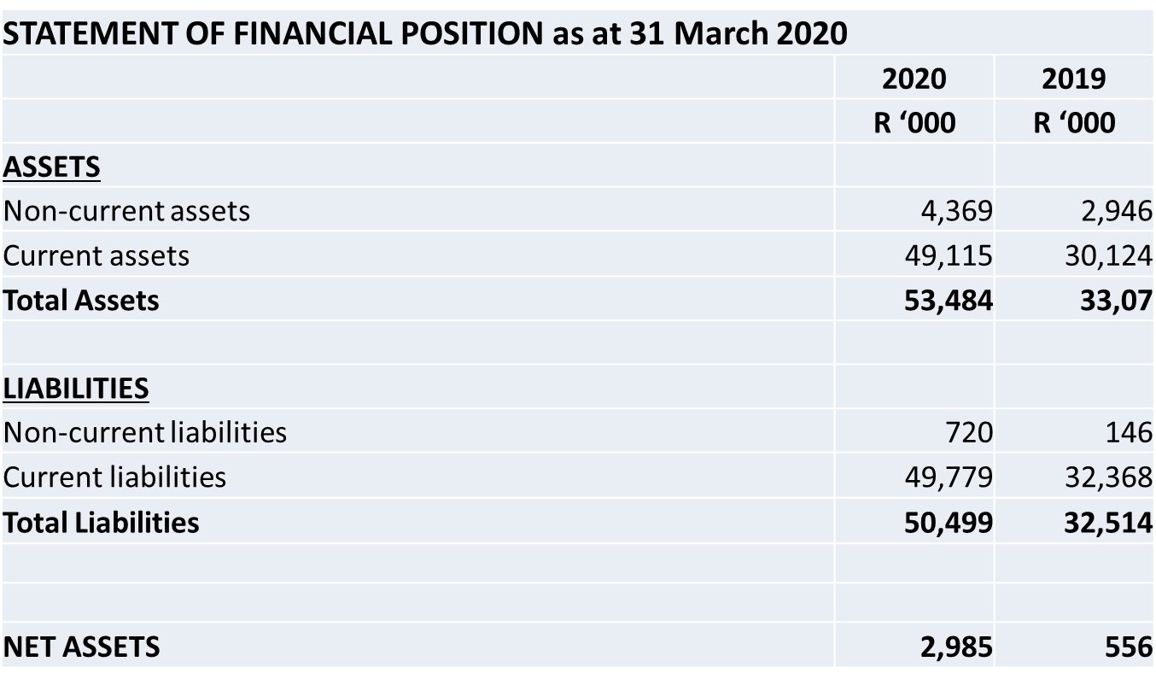
AUDIT AND FINANCE cont…

Slide 37
CONCLUSION
In conclusion, a new Council has been appointed in December 2020 and the Administration Team will hand over to it during the transitional period
Team will also round up its mandate and hand over its report to the Minister

Slide 38

Thank You

