Slide 1

^{when the sun rises}
^{we work hard to deliver}
PRESENTATION TO PORTFOLIO COMMITTEE ON CO-OPERATIVE GOVERNANCE AND TRADITIONAL AFFAIRS ON STATE OF DR JS MOROKA AND PROGRESS ON THE Intervention in terms of section 139 (1)(b) of the constitution in dr js moroka local municipality

Slide 2
PURPOSE
To present the state of Dr JS Moroka Local Municipality to the Portfolio Committee on Co-operative Governance and Traditional Affairs and progress on the intervention in terms Section 139 (1)(b) of the Constitution of the Republic of South Africa, 1996.

Slide 3
EXECUTIVE SUMMARY
Dr. JS Moroka Local Municipality, was placed under Administration the on 17 January 2020, after the Executive Council resolved to intervene in the municipality in terms of Section139 (1)(b) of the Constitution of the Republic of South Africa. The intervention was be for a period of six (6) months from the date of the Executive Council approval. The intervention period came to an end on 17 July 2020. (At its special sitting on 30 September 2020, The Executive Council resolved to extend the intervention by an additional 6 (six) months.)
A Team comprising of the following were appointed:
Mr BM Mhlanga: The Administrator (Human Settlement)
Mr JS Mzobe (COGTA: withdrawn)
Adv P Mabaso , Legal Assistant (Human Settlements)
Engineers
Mr PG Mpofu (Human Settlements: withdrawn)
Mr R. Ntshanana (Human Settlements)
Mr M. Bodika (MISA)
Mr R Gillmer( MISA)

Slide 4
EXECUTIVE SUMMARY…cont
The department developed a Turnaround Strategy for the Administration team and this was approved by the MEC on 28 February 2020
The initial intervention lapsed on 17 July 2020, at its sitting of 30 September 2020, The Executive Council resolved to extend the intervention by an additional 6 months.

Slide 5
SUCCESS AREAS: 1 BUILDING CAPABLE INSTITUTIONS
The general state of the institutional stability has improved remarkably with the advent of the interim order that was issued against the former Municipal Manager, Mr Kubheka on 31 March 2020.
Some confusion and misunderstanding emerged at some point between Administrator, Executive Mayor and Speaker over the approval of draft IDPs and Budget for 2020/21 and roles and responsibilities between Administrator and Executive Mayor.
The MEC immediately convened a meeting with Executive Mayor, Speaker, Chief Whip and Administrator on 17 April 2020 and the confusion and/or misunderstanding was clarified and put to rest amicably.
Executive Managers case at the CCMA finalized and two returned to work, one took a settlement. Another one has since left the institution.
The CFO disciplinary cases was finalised and a dismissal sanction was issued.
The Municipality has advertised the posts of the Municipal Manager, Chief Financial Officer, Director Corporate Services and Director Technical Services.

Slide 6
SUCCESS AREAS: 1 BUILDING CAPABLE INSTITUTIONS..cont..
Local Labour Forum established to deal with employee related matters and streamlining of the organogram/ organizational structure and meets regularly
Appointment of the acting senior managers in vacant posts
Outstanding Issues
Filling up of critical positions eg MM, Director Corporate Services, Chief Financial Officer, and Director Technical Services
Streamlining of the organizational structure
Improve Council operational systems
Conduct skills audit
More capacity building program are required

Slide 7
SUCCESS AREAS: 2 FINANCIAL MANAGEMENT
    Whilst a number of challenges were reported in the beginning of the intervention in Dr JS Moroka some attempts were made to resolve them.
    The municipality has paid a number of its long outstanding invoices, some of them which were older than 8 months, and is now trying to pay service providers on time.
    The municipality has reviewed its internal control environment and adopted its procurement financial delegations.
The monthly section 71 reports have being produced
Establishment of BTO Committees or / and operational structures
Prepared Councillors Upper limits documentation during May 2020 with the use of clear templates, Gazette, Audited AFS, 2016 Survey data of Statistics SA and other relevant information.
Reviewed certain BTO policies in the absence of Policy Development Committee.
Firmed-up Procedure Manual to be utilised at Expenditure in execution of Payments that resembled the context of being Process flow.
Introduced culture of subjecting any contract extension, variation order and the likes to the very Bid Adjudication Committee other than being one man’s show.
Introduced and centralised Invoice Register and Tracking system and housed it at Expenditure division.
Stopped the culture of generation of Official Purchase Order by the end of a transaction instead of preceding the other stages or vice-versa.

Slide 8
SUCCESS AREAS: 2 FINANCIAL MANAGEMENT ..cont..
PT assisted with the development of the budget in ensuring that it is not unfunded.
Supported municipality with adjustment budget
Development of a revenue enhancement strategy and action plan
Support was provided in assisting the municipality in improvement in the areas of asset management and supply chain management, that included the review of policies and training of Bid Committees.
Review of the control environment by providing standard operating procedures in the areas of expenditure management, revenue management, supply chain, asset management and contract management.
On the 26th October 2020 the municipality met with Auditor General Provincial Treasury regarding the incomplete 2018/19 financial statements.
It was agreed that the municipality would be audited simultaneously for 2019/20 and 2018/19 by AGSA.
Provincial Treasury requested the draft financial statements prior submission to AG for review and quality assurance
Training was further provided to MPAC and Disciplinary Board to improve capacity in dealing with UIF&W expenditure
Policy review of Asset management concluded.

Slide 9
SUCCESS AREAS: 2 FINANCIAL MANAGEMENT..cont..
Outstanding Issues
None verification of section 71 publications remains a challenge
Quality production of AFS
Filling of critical posts in BTO
Implementation of the procurement plan
Establishment of the policy review committee
Asset register and verification meeting arranged, but was cancelled at last minute by municipality and needs to be rescheduled
Timeous reporting to Treasuries
Vetting of BTO officials
The Audit steering committee meeting was scheduled but did not take place due to non attendance by committee members and commitment by the administrator
Meeting was requested with regard to document management on 29 January with no response from Municipality.

Slide 10
SUCCESS AREAS: 3 BASIC SERVICES
Monitoring and capacity development provided to the PMU including hands-on support for the acceleration of implementation.
Outstanding Issues
Projects identification especially water related projects
Development of the Capital Investment Programe
Development of sector plans (eg water and sanitation)
100% expenditure on MIG
Ensure quality on all infrastructure projects
Identification of water source due to draught
Water demand and conservation management
Water, Sanitation and Roads projects are being implemented
There are clear projects for bulk infrastructure interventions with recommendations from DWs and approval by COGTA.
COGTA also assisted through liaison with Department of Water and Sanitation to accelerate technical reports and appraisal of water and sanitation projects for all MIG projects to be approved and registered for both 2019/20 and 2020/21 financial years.

Slide 11
SUCCESS AREAS: 4 GOOD GOVERNANCE
    The Executive Mayor Cllr T Madileng resigned as an Executive Mayor and Councillor in October 2020 and was replaced by Cllr R Mathabe as the new Executive Mayor. Cllr D Mahlangu was elected as the new speaker.
    Governance Committees such as Section 79 and 80 Committees, Risk Committee, Internal Audit Committees have been resuscitated.
    Council meetings are seating regularly through teleconferencing due to COVID 19/ lockdown regulations
    There is also a need to resuscitate MPAC to strengthen the accountability of the Municipality including the Audit Committees.
    Risk register developed and submitted to Council for approval
    Appointment of the risk champions
    Centralization of contract management under BTO
    Internal Audit plays a meaningful role
    Section 106 investigation report has been handed over to the Municipal Council on 06 October 2020, with directives that the municipality must develop an action plan to implement the findings of the report. The municipality has still not submitted the action plan.

Slide 12
SUCCESS AREAS: 4 GOOD GOVERNANCE..cont
    Outstanding Issues
Action plan to respond to S106 Investigation report.
Section 79 and 80 committees to develop schedule of meetings and adhere to it.
Monitoring of the implementation of the SDBIP
Address the backlog on compliance matters to Council
Development of a comprehensive Performance Management System including the software
Embrace the culture of Batho-Pele
Improve audit outcomes

Slide 13
SUCCESS AREAS 5. PUTTING PEOPLE FIRST
  Processes have started with community engagement through radio programmes. The Department has sponsored radio slots in Ikwekwezi Radio Station to host the Administrator , Executive Mayor and councillors in engaging communities.
  Community radio stations have also been used to engage and inform the communities.
  Public Participation/ Ward Committees schedule of meetings per ward have been approved by Council on 30 June 2020 for the 2020/21 financial year.
  Outstanding Issues
  A comprehensive Public participation strategy must be developed taking into cognisant the challenges created by COVID 19.

Slide 14
STATUS QOU ON BASIC SERVICE DELIVERY
  Water Supply
  Due to persistent drought conditions and a growing water demand the provision of bulk water supply is constrained in Dr JS Moroka Local Municipality. This calls for augmentation of supply through re-commissioning of an existing Mthombo Emergency Pipeline, development of groundwater (boreholes) and integration of the planned Rust de Bulk Water Scheme to address the growing bulk water demand.
  Dr JS Moroka municipality depends on raw water supply from Mkhombo dam. The dam level remain low despite heavy rains due to the severe drought. The existing WTW which has a design capacity of 68 Ml/ day and is currently operating at less than 50% of its treatment capacity.
  The refurbishment and upgrading of Mthombo Bulk line to supplement water supply to Weltevreden Treatment Plant to the value of R45 million has been registered and approved as an intervention for the water crisis. The project is under implementation. However, the municipality has delayed on the appointment of service providers.
  The drilling of additional boreholes as proposed through 16 technical reports recommended is also expected to bring further relief. This will give an additional 4 megalitres per day. This intervention is being pursued by the municipality. However, the municipality has delayed with the implementation of these projects.

Slide 15
STATUS QOU BASIC SERVICE DELIVERY Continues
  The proposed Rust de Winter Bulk Water scheme constitutes a 10 megalitre treatment plant, 50 km bulk pipeline and storage reservoir. The preliminary cost of the scheme established in the feasibility report are in the order of R611 million. This is a long-term project that DWS has already done the feasibility phase thereof. DWS has initiated process for the implementation of the scheme.
  Electricity Supply
  The municipality has no serious challenges with electricity supply because Eskom supplies the municipal area and always timely responds to outages.
  Refuse removal
  The municipality remains with below 25% of households with access to refuse removal.
  The municipality in this financial year has planned to purchase a waste removal truck through MIG at the value of R3,5million. It is expected that this vehicle would assist in increasing access.

Slide 16
MUNICIPAL INFRASTRUCTURE GRANT
  The municipality in the current financial year has an allocation of R154 million of which R125 million is the allocation for 2020/21 FY and R29million is a roll-over from the 2019/20 FY.
  As at end of January 2021, the municipality reported an expenditure of R40 607 000 (26.4%) of its R154 million allocation when it should have been at above 50%.
  It should be noted that in November 2020 the Department had a one on one with the municipality to address under-expenditure of which this meeting precedes other intervention meetings.
  Unfortunately, the municipality often fails to implement recommendations and intervention actions to accelerate project implementation and expenditure.
  During the recent meetings regarding stoppages of funds i.t.o DORA it was also discovered that the municipality has not appointed service providers on three projects to the value of R35million resulting in the Department formally making a submission to DCOG for the stoppage of R23million which shall be reallocated to high spending and needy municipalities.

Slide 17
MUNICIPAL INFRASTRUCTURE GRANT Continues..
  Implementation challenges
  Poor planning resulted in a total of 12 water projects requiring budget maintenance which is above 20% of the approved budget. The approved amount for these projects was R69 million and contractors were appointed at the value of R96 million which was above the approved amount.
  Delays in the appointment of service providers is the major contributor to the under-expenditure by the municipality.
  Despite the support of MISA, the municipality lacks capacity to implement its grant funded projects.
  The municipality has the biggest project management unit in the province but skills and competencies seem to be a major problem.
  Recently, the Department also deployed one of its Civil Engineer from the Provincial Project Management Unit to assist the municipality and observed that rapid preparation of technical reports by the municipality resulted in under-costing of projects.

Slide 18
COVID-19 INTERVENTIONS
A number of water projects have been reprioritised through MIG to improve water supply in various wards within the municipalities. These projects include drilling and equipping of boreholes, replacement, refurbishment and upgrading of bulk lines including booster pumps.
In addition, a total of 82 water tanks have been installed in all the 31 wards of the municipality, 64 of these tanks were supplied by DWS and 18 of these tanks were provided by the Nkangala District Municipality through the District Coronavirus Command Centre. DWS also made available a total of 8 water trucks for the delivery of water.
The Premier through the COVID-19 awareness programme distributed a total of 15000 sanitizers of 25 litres to various households across the 31 wards of the municipality. In addition, DWS and other sectors provided items such as hand sanitizers and bar soaps to the municipality. The Nkangala District supported by the province decontaminated a number of public paces within the municipal area of jurisdiction. Day to day inspection of public places, transportation facilities, schools and business or work facilities have been undertaken by a joint operation that include various sectors such as SAPS, SANDF, Department of Employment and Labour including Municipal Environmental Health Practitioners among others
The municipality received the Disaster Relief Grant of R 417 000.00 which has been used for fumigation, procurement of hand sanitizers, thermometers, duct tapes, and disinfection sprays.
A total of 2900 food parcels were distributed across the 31 wards of the municipality through combined efforts of the Mpumalanga Department of Social Development, Department of Agriculture, Rural Development, Land and Environmental Affairs including donations.

Slide 19

TROPICAL STORM DAMAGES
MUNICIPALITIES | TYPES OF INCIDENTS | INFRASTRUCTURE AFFECTED | SUPPORT ROVIDED | SUPPORT REQUIRED
Dr JS Moroka | Heavy rainfall at loading Heavy rain and flooding | Ward 21 Kabete settlements flooded Ward 30 flooded Collapsing of mud houses | The local municipality organized a TLB requested to redirect water flow Assessment in progress | Water redirected through the creation of temporary channels DHS to assist

Slide 20
  CHALLENGES ENCOUNTERED (LESS SUCCESSFULL AREAS)
    Correct interpretation of the duration of the extension of the intervention. The departments view is that the administration was extended from the lapse of the initial intervention which was 17 July 2020 and therefore should have lapsed in January 2021. However the Administrator is still in the municipality.
    There is poor co-operation from the Administrator. He is not submitting progress reports to the department, despite numerous request in this regard.
    Procurement processes not followed at all times.
    Vacancies in critical key positions in the municipality ( MM, CFO, Director Technical Services and Director Corporate Services). This threatens the stability of the municipality.
    AGSA could not finalize 2018/2019 audit exercise due to hostile environment

Slide 21
WAYFORWARD
  There is a need for the Department to provide support in terms of Section 154(1) and 155(6) of the Constitution of the Republic of South Africa, 1996 read with section 105 of the Local Government Municipal Systems Act, 2000, by seconding an acting Municipal Manager and Chief Financial Officer.
  There is a need for correct interpretation of the duration of the intervention to avoid any legal quagmires that may come.
  There will be a transitional period where the Administration will hand over back the functions to the municipality once the Acting Municipal Manager is in place.
  The department will continue to provide hands on support to the municipality even after the Administration has ended.

Slide 22
CONCLUSION
The Portfolio Committee on Co-operative Governance and Traditional Affairs takes note of the presentation on the state of Dr JS Moroka Local Municipality.

Slide 23
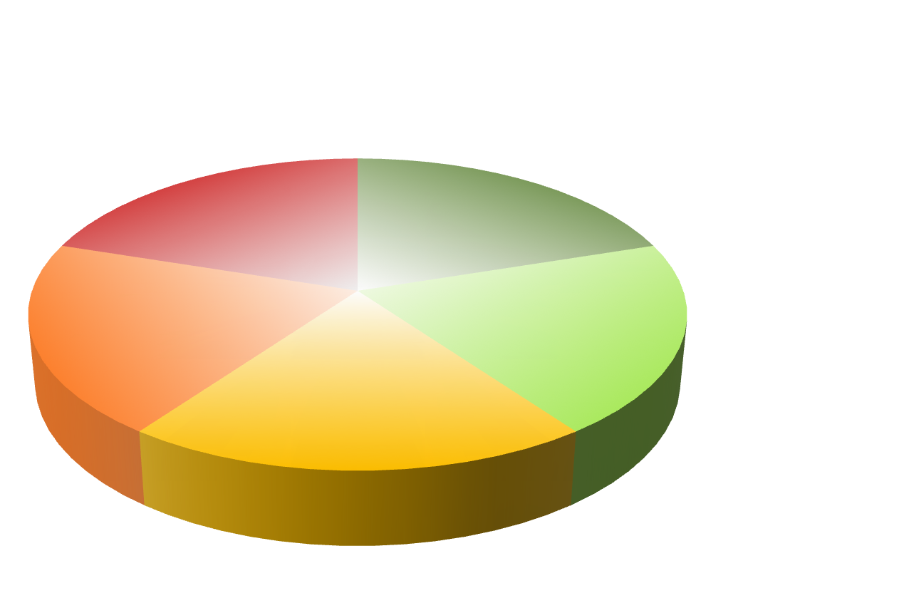
Questions
Comments
Inputs
Suggestions
Nothing
Thank You

