Slide 1
COVID-19 update
10 February 2021

Slide 2
Status update
Testing rates by population
Global test rate
19.22%
As at 9 February 2021
Total number of employees | 472,082
Number of employees back at work | 382,905
Total number of tests | 107,828
Total positive cases | 28,588
Active cases | 1,073
Recovered | 27,196
Deaths | 319
RSA test rate
14.24%
Mining test rate
22.84%
Status of cases
Active cases
4%
Recovered cases
96%

Slide 3
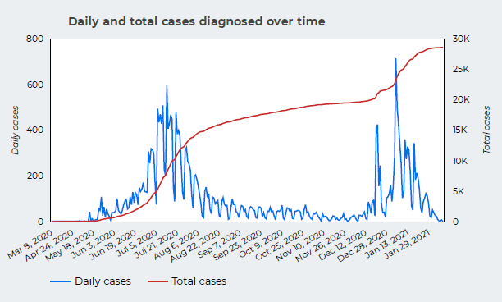
Status update

Slide 4
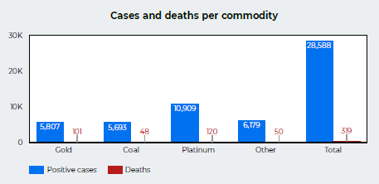
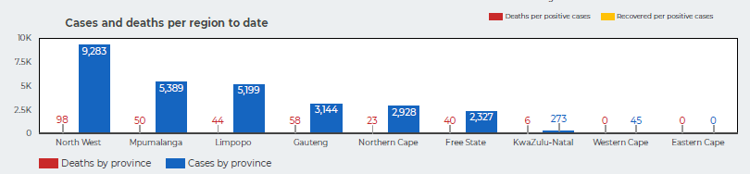
Status update

Slide 5
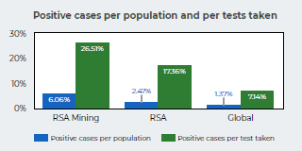
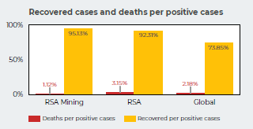
Status update

Slide 7
Analysis of deaths
N = 275
as at 29 January 2021

Slide 8
Response of industry to second wave
Pre- and post-December break readiness plans
  Additional education of employees on COVID-19 prevention measures
  Staggering the release and return of employees
  Encouraging workers not to travel home to hotspots where possible
  Arranging PCR tests for foreign employees and facilitating border crossing
  More testing on return, especially for employees from hotspots
  Wider adoption of COVID antigen testing

Slide 9
Vaccine preparedness
Minerals sector supportive of government-led vaccination strategy
Sector has offered its significant infrastructure and resources to support roll-out:
  60,000 to 80,000 vaccinations per day
  To vaccinate 2.5 million to 3 million people – employees, families and mining communities
Mine facilities registering as vaccination sites
Registration of 1.5 million health workers (Phase 1) underway
Mineworkers part of Phase 2, together with vulnerable groups and populations in congregate settings
Collaborative approach with unions
  – education is key

Slide 10
Conclusion
South Africa getting past the second wave
Vaccination an important component of integrated approach to saving lives and livelihoods
Third wave possible in winter 2021 - Severity of third wave will depend on immunity achieved from previous epidemics and the vaccine programme
Heightened vigilance continues with preventive measures
Work continues as ‘business unusual’

Slide 11
Questions?

