Slide 1
An Update on WCHFB IMPLEMENTATION
February 2021

Slide 2
Overview
Introductory Remarks
Legislative Framework
Overview of status of Hospital Boards and Clinic Committees
Status update on the appointment of Clinic Committee in the Province
Training Update
Implementation Challenges
Concluding Remarks

Slide 3
Introductory Remarks
Community Involvement in Health (CIH) is recognised globally and locally as a key ingredient to well performing health systems
CIH is part of the vision of Healthcare 2030 – and that functional statutory structures are a key enabling mechanism.
The legislative framework (Western Cape Health Facility Boards and Committees Act, 2016 (Act 4 of 2016) and associated Regulations) has been put in place.

Slide 4
Legislative Framework

Slide 5
Legislative Framework
The legislative framework (Western Cape Health Facility Boards and Committees Act, 2016 (Act 4 of 2016) and associated Regulations) has been put in place.
The legislation makes provision for clustering of clinic committees :
Provincial Minister must determine the group by having regard to—
the geographic distance between the primary health care
facilities
the size and distribution of the population served by the
primary health care facility
(c) the service volume of the primary health care facility.
Notes:
- Group/ cluster of clinic committees reporting to the Board

Slide 6
Structure of New facility Boards and Clinic Committees
Committees: NOT more than 12 members in total
1 or more municipal councillors for the area in which the clinics are located
Community members (50% of total number of members in the Committee)
Head of the facility/clinic or a manager designated by the District Health manager
South African of 18 years and above
(Section 6 and 7)
Boards: 14 members in total
1 or more municipal councillors for the area.
Community members (50% of total number of members in the Committee)
At least 1 person with technical expertise in business, law, finance or accounting or an area relevant to the Board
Head of the Hospital or a person representing clinical staff of every hospital concerned
At least 1 person representing clinical staff
At least 1 person representing non-clinical staff
Member of Provincial parliament and a Municipal Councillor may be appointed
South African of 18 years and above
( Section 5 and 7 )
Notes:
Everyone should be SA citizen and over the age of 18 years

Slide 7
Section 5(2) of the Act, which refers to the appointment of Members of the Provincial Parliament to the Hospital Boards.
Subsection 5(2): In addition to the members appointed in terms of subsection (1) the Provincial Minister may appoint to a Board –
A member of the Provincial Parliament, nominated by the parliamentary committee concerned with health matters; and
One or more councillors of the municipal council for the municipal area in which the hospital is situated, nominated by the municipal council or a health-related committee of the municipal council
The nomination of MPLs for Health Facility Boards needs to be submitted in writing from the Standing Committee on Health.
The Standing Committee needs to decide on which MPLs are to serve on which boards and submit the minutes of the meeting thereof to the Minister’s office. Thereafter, the Minister can appoint the MPLs to the respective boards.
However, it needs to be noted that MPLs can only be added to a board if there are more than 50% of the board members who are community members. This is because sub-section 5(3)(a) of the Act states that: “The members appointed in terms of subsection (1)(a) must constitute at least fifty per cent of the total number of members of the Board.” Thus, if the board currently only has 50% of members who are community members in terms of clause 5(1)(a) of the act, then adding an MPL would result in the board being invalid.

Slide 8
Overview of status of Hospital Boards and Clinic Committees

Slide 9
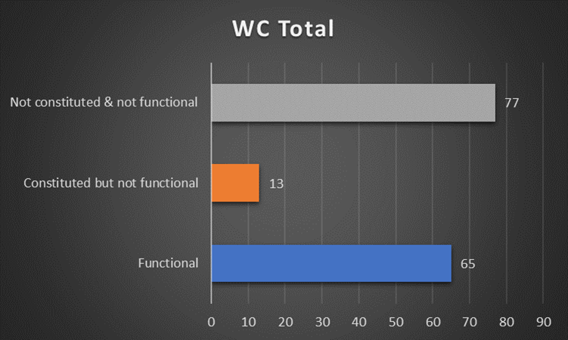
Provincial Overview of Clinic Committees
Functionality:
There should be a total of 155 functional Clinic Committees in WC
There are currently:
Functional (properly constituted and actively functional: 65 (Metro: 26; Rural: 39)
Constituted but not functional: 13 (Metro:4; Rural: 9)
Not constituted and not functional: 77 (Metro:15; Rural: 62)
Notes:
Functional meaning properly constituted and actively functional
Constituted but not functional meaning all the members are appointed BUT not functional because they may have not met

Slide 10
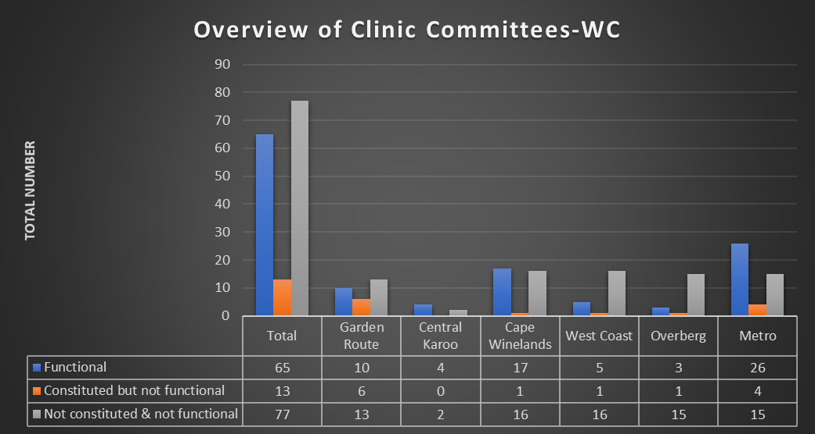
Overview of Clinic Committees by District

Slide 11
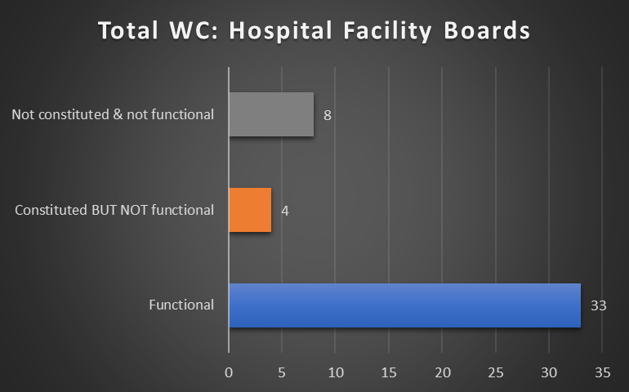
Provincial Overview - Hospital Facility Boards
The overall purpose of the Board is to ensure accountability of the health facility management to the community and responsiveness to the needs of patients and their families.
Functionality:
There should be a total of 45 functional Hospital Facility Boards in WC
There are currently:
Functional: 33 (Metro:14; Rural: 19)
Constituted but not functional: 4 (Metro: 3, Rural: 1)
Not constituted and not functional: 8 (Metro: 2; Rural: 6)

Slide 12
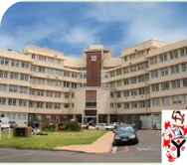
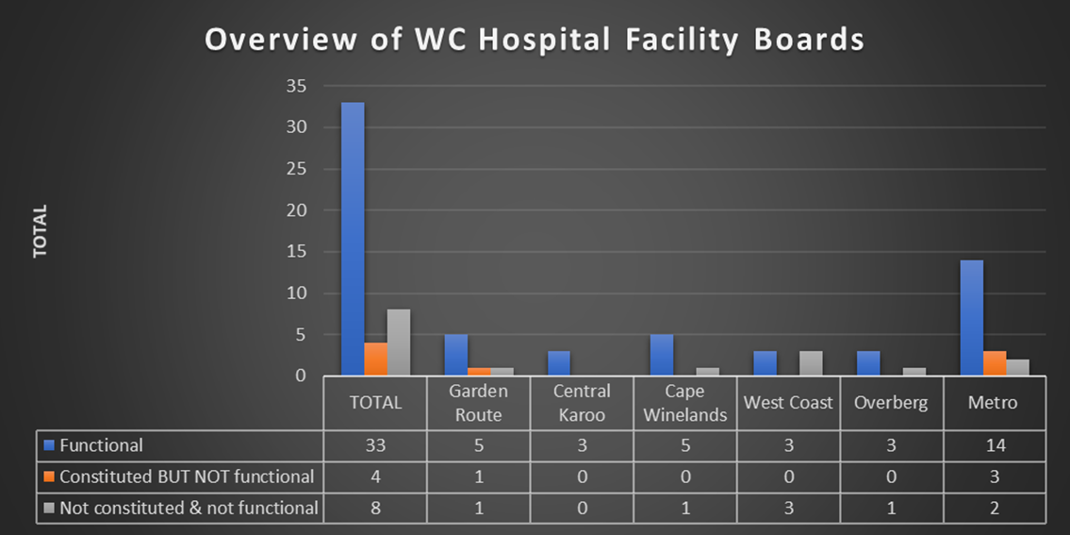
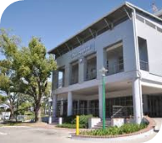
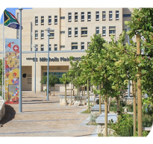
Overview of Hospital Facility Boards by District

Slide 13
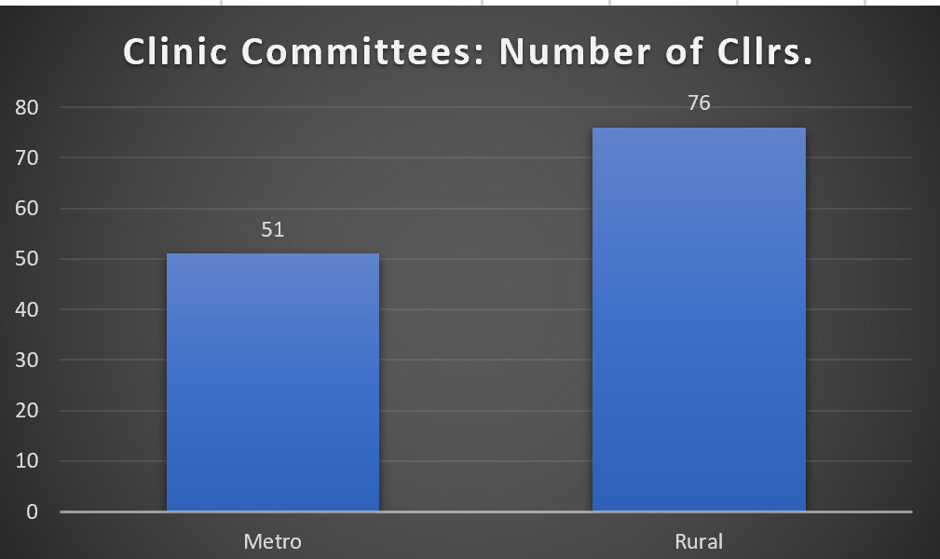
Councillors on Clinic Committees

Slide 14
Status update on the appointment of Clinic Committee in the Province

Slide 15
Status update on the appointment of Clinic Committee in the Province
The majority of the terms newly formed clinic committees of the new act are due to expire at the end of June, July or August 2021.
There are 2 groupings regarding the advertising processes for statutory bodies.
Advertisement for Committee and Board members where the structures were previously NOT correctly constituted.
Advertisements for replacement of Committee and Board members whose terms are expiring - will also consider re-appointment of CC members for second term where appropriate.
Preparation for advertisement has begun
The advertisement will soon be placed in print media.
The closing date for nominations will be 6 weeks from the date of placement of advertisement.
In addition to being placed in the local papers, the advertisements will be put on the department website, Facebook pages and put on the notice boards of clinics and hospitals.

Slide 16
Overview of Clinic Committees & Hospital Boards for Advertising
20/ 45 Health Facility Boards
146/ 155 Clinic Committees
Notes:
Inclusive

Slide 17
Training Update

Slide 18
Training
National material has been adapted to include the Western Cape legislation and Regs.
The National Health System
Health in context
Health governance paradigms
Information, skills and values relevant to the roles of Health Governance Structures
2. Reflection and Review pertaining to the training
Feedback positive. Well presented.
Content and reading material well received
Use of chatbox and responses to questions effective
Co-Facilitator support has worked well
An HFB and Clinic Committee member training survey was conducted in October 2020
3. Training of Trainers
A developer of the Training Programme, ‘Capacity strengthening of Health Governance Structures’, will be appointed on a sessional basis. NB: Internal capacity being built to roll out training
Training of master trainers, (2 x CLOs Metro; 5 x CLOs Rural) to be concluded by end of February 2021
Support and mentor all master trainers
Address additional training needs and review impact of training

Slide 19
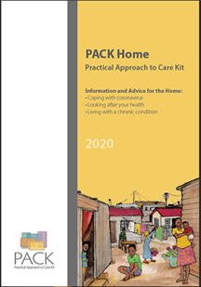
Progress on Training
Nov-Dec 2020
Clinic Committee members trained:
Metro: 71
Rural PHC Managers & CLOs: 40
All training has moved online
PACK COVID-19 was offered to clinic committees in 2020
The focus of the training now includes COVID-19 vaccination

Slide 20
Implementation Challenges

Slide 21
Some Implementation Challenges
The interest amongst communities to volunteer has varied.
The teething problems to get full functionality of committees (inadequate no. of members, lack of quorum for meetings etc)
Challenges related to appointment of councillors to Clinic Committees
In some instances, Lack of remuneration seen as disincentive
Training postponed in January due to the loss of our master trainer
Also, Rural Health Services had requested the postponement of training due to the second COVID-19 wave
Currently, CLOs are busy with community engagement around vaccination awareness

Slide 22
Concluding Remarks

Slide 23
Concluding Remarks (1)
In 2020, we have had to de-escalate on multiple fronts to focus on Covid.
In Aug / Sept, 2020, post first wave, we were starting to prepare to catch up on backlogged situations - we then experienced a massive second wave with much greater intensity than the first wave and we had to reprioritise.
We are going thro a process of intentional grieving, healing and recovery
Context for 2021/22 - We have colliding imperatives in the forthcoming financial year :
Possible third wave and the need for contingency planning mitigate this risk.
Non - Covid backlogs – from PHC services to elective surgery in hospitals
Trauma will escalate with the lifting of alcohol restrictions.
Massive vaccination programme to be roiled out
Severe budget shortfalls
4. We have made good progress in establishing capacity :
ASD post within the minister’s office
Agreed to create a focal point for statutory structures within the Quality assurance Directorate
Recruited CLOs within districts - support sub districts for local engagement
Building internal training capacity thro the master training programme.

Slide 24
Concluding Remarks (2)
5. Community involvement remains an important pillar of PHC and Health systems :
The Minister has led from the front in engaging communities
Statutory structures are always informed of her visits
Vulimpilo road show to engage statutory structures :
Return to comprehensive services
Fear and safety
Bridging the gap between the department and the community
6. Approach 2021/22 with renewed vigor and efforts to establish functional structures within the context that embraces the new financial year.

