Slide 1
Adhoc Committee on Covid-19
Health Update
Dr K Cloete

Slide 2
Overview
Surveillance & Response Update
Health platform COVID response
Safe-guarding well-being of health care workers
Vaccine strategy
Conclusions

Slide 3
Surveillance & Response Update

Slide 4
Integrated testing, case, hospitalisation and mortality trends

Slide 5
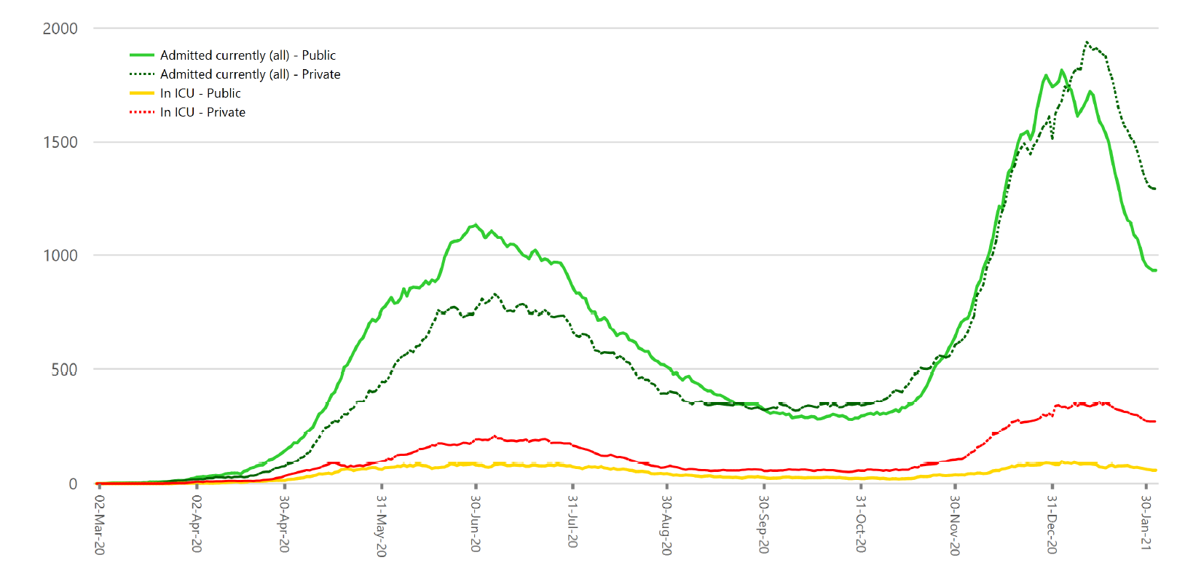
Hospitalisation trends of patients with confirmed SARS-CoV-2
(including specialised hospitals, excluding PUIs)

Slide 6
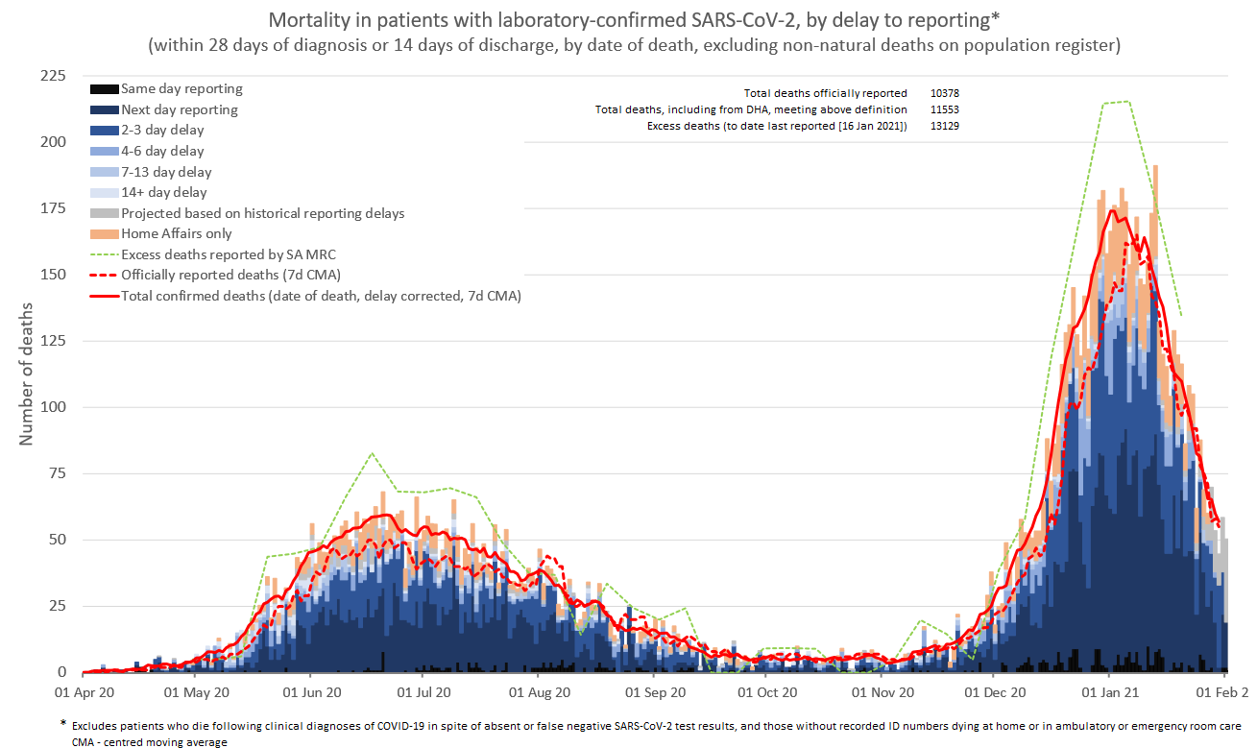
Mortality by date of death
CMA – centred moving average

Slide 7
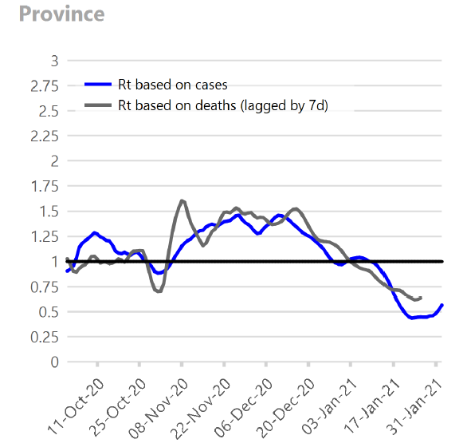
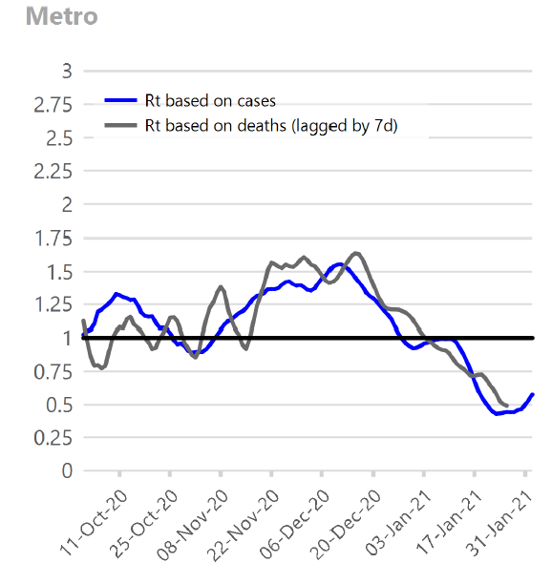
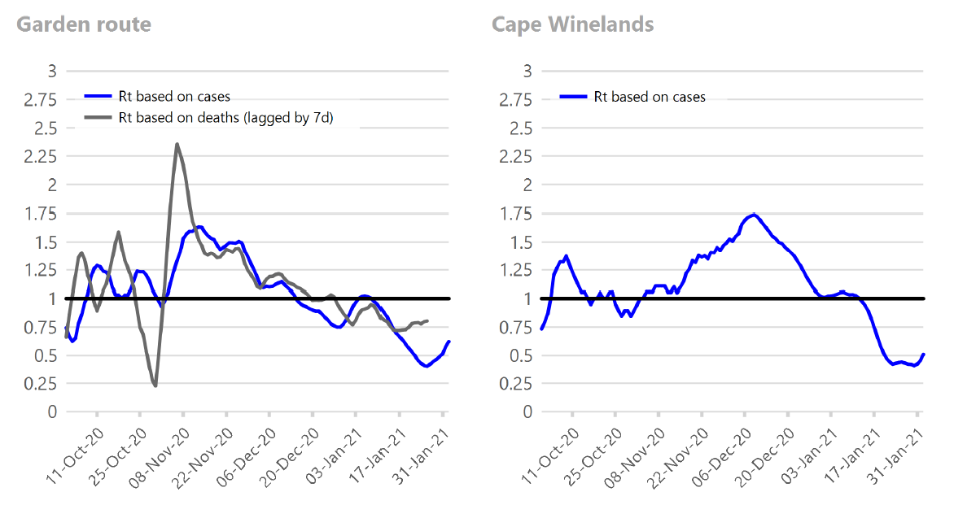
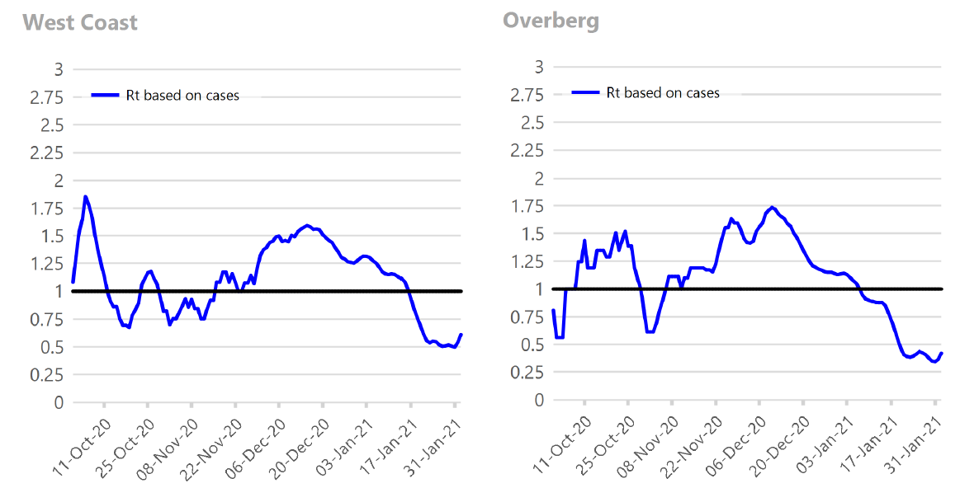
Current reproduction number
Approximated based on smoothed doubling times

Slide 8
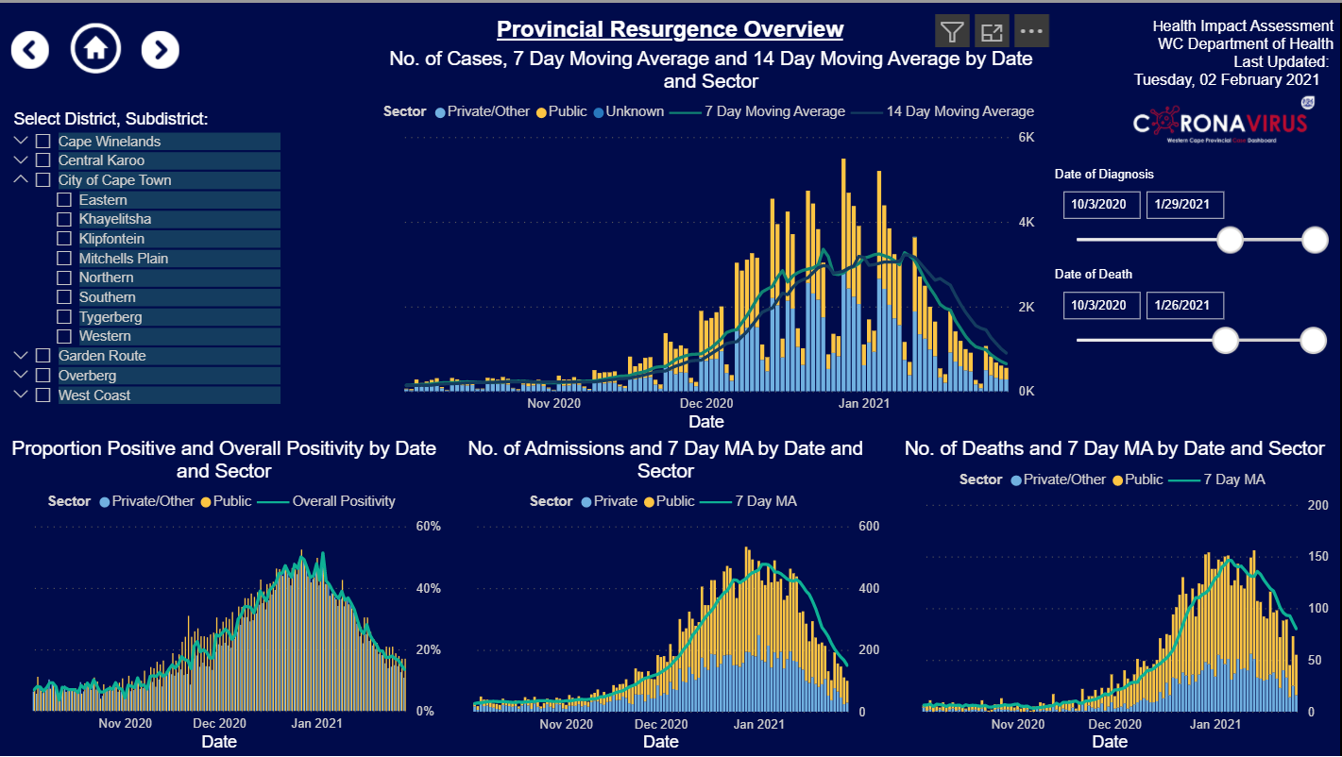
Provincial Overview
- 44% in last wk
(22-29 Jan)
-42% in last wk
(22-29 Jan)
-31% (19-26 Jan)
The Western Cape continues its downward trajectory following the peak of the second wave in early January 2021.
Using 7 day moving averages, confirmed cases have declined a further 44%, while admissions and deaths have dropped by 42% and 31% respectively.
The proportion positive has dropped further to 13.47% on 29 January 2021.
The province is heading towards levels seen prior to the second wave (late October) and may reach this at some point next week.
While all data are pointing downwards, and we are relieved, we must take note that admissions and deaths are still high. The health system is still under pressure and everyone in the Western Cape is still at risk.

Slide 9
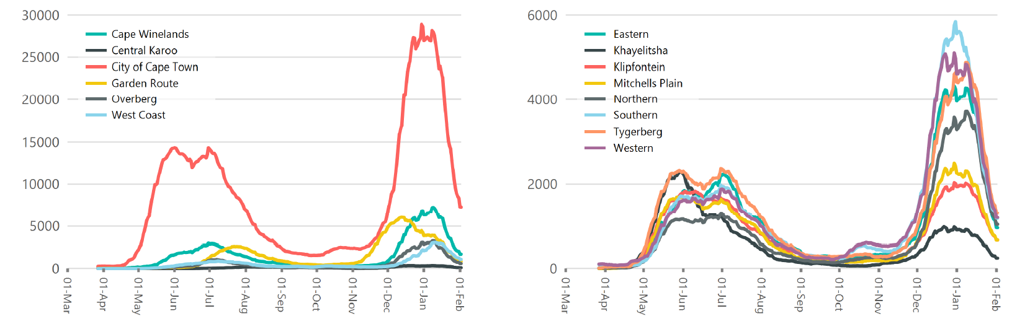
Active cases
Districts
Cape Town subdistricts

Slide 10
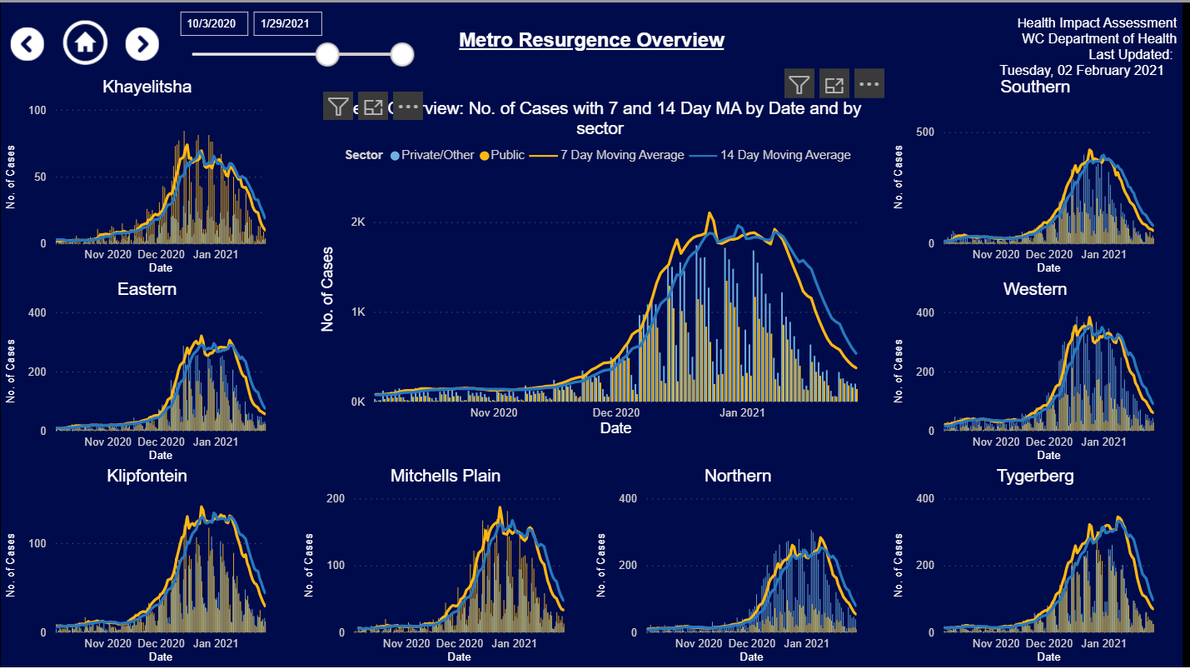
Metro Overview
-63%
-43%
- 46% in last wk
(22-29 Jan)
-49%
-40%
-49%
-46%
-42%
-48%
Cases in the Metro decreased by 46% from 22-29 January 2021.
All sub-districts show a marked decrease in cases as the Metro approaches levels seen before the second wave.

Slide 11
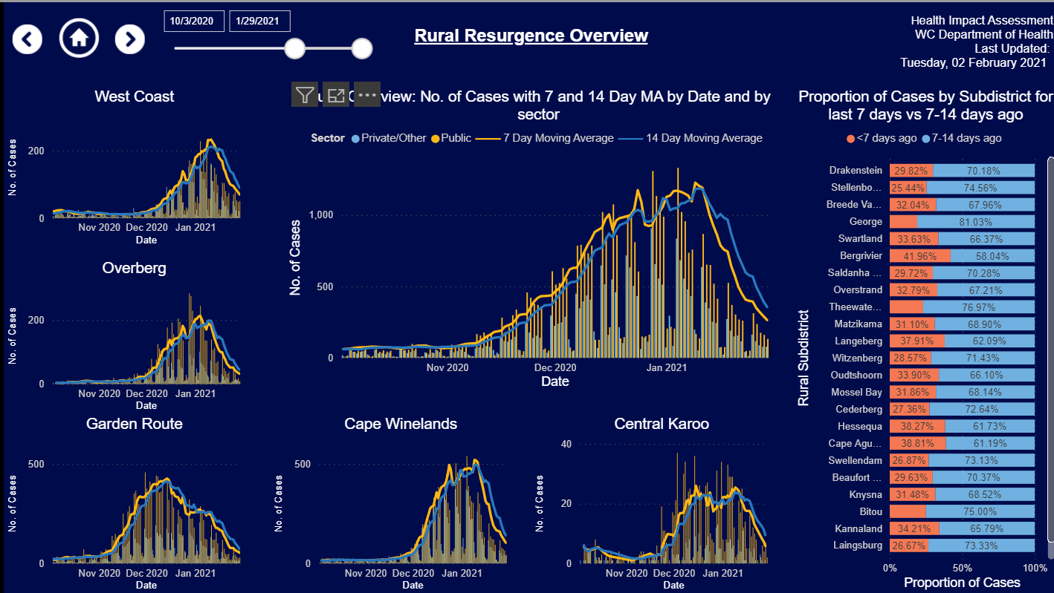
Rural Overview
-45%
-41% in last wk
(15 -22 Jan)
-45%
-45%
-45%
-45%
Cases in Rural have declined by 41%, and the pattern is repeated across all districts.
As with the Metro, cases in Rural are also heading towards pre-second wave levels.

Slide 12


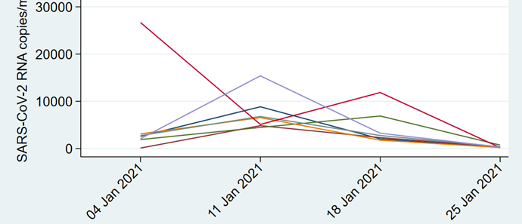
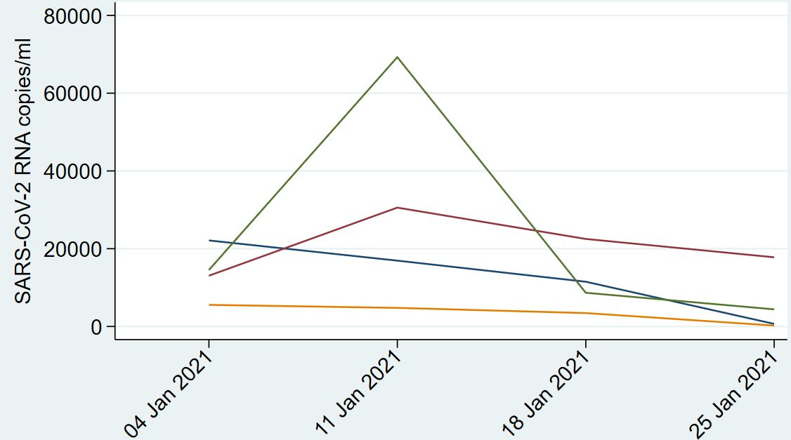
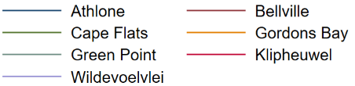
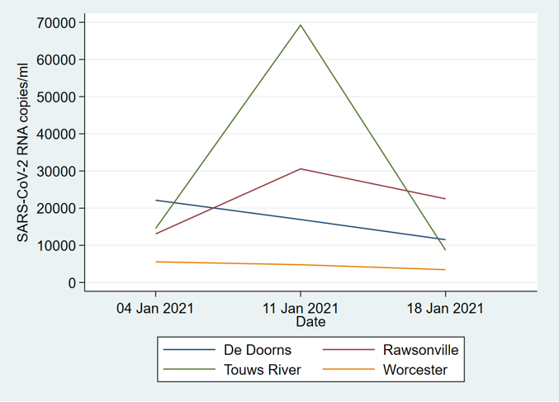
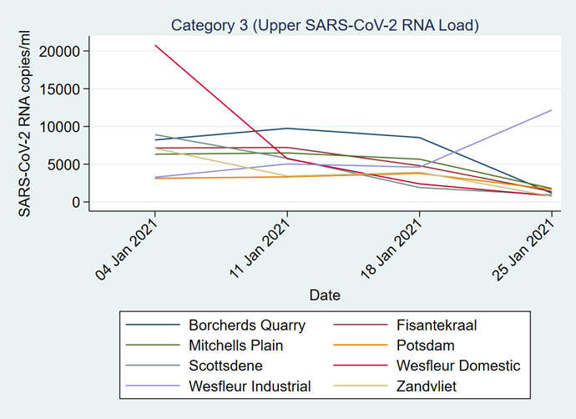
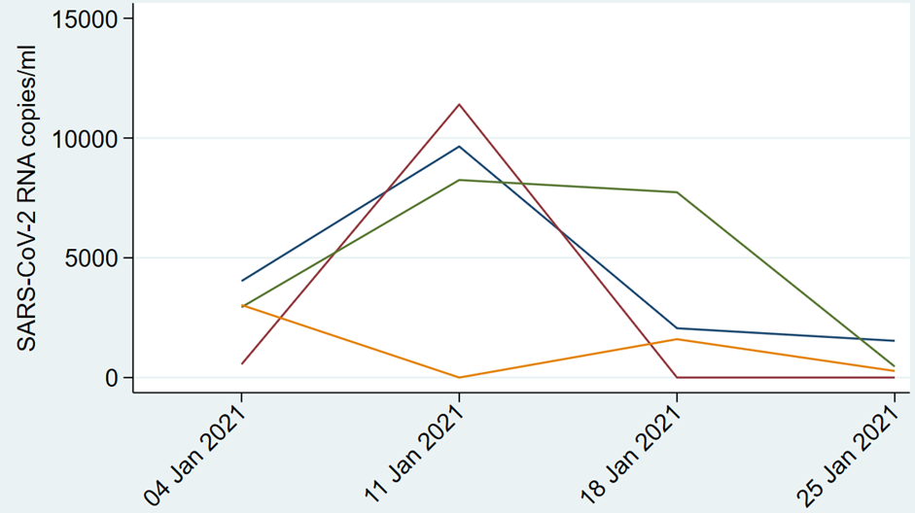
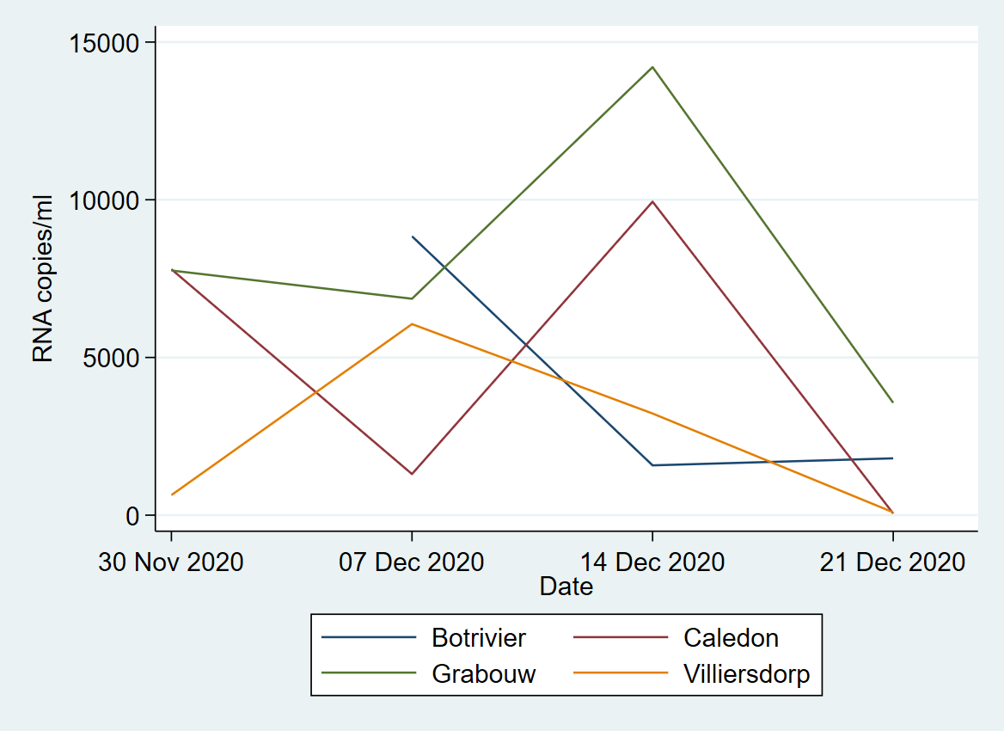
Triangulating with wastewater
WEEK 4 2021
update
SAMRC COVID- 19 AND WASTEWATER EARLY WARNING SYSTEM
City of Cape Town, Breede Valley AND Overberg
  Metro:
  Decrease in SARS CoV-2 RNA across all treatment plants except Wesfleur Industrial
  Breede Valley:
  Decrease across all areas but levels in Rawsonville relatively high
  (>17,796 copies/ml)
  Theewaterskloof:
  Decrease in all areas; no SARS-CoV-2 detected in Caledon

Slide 13
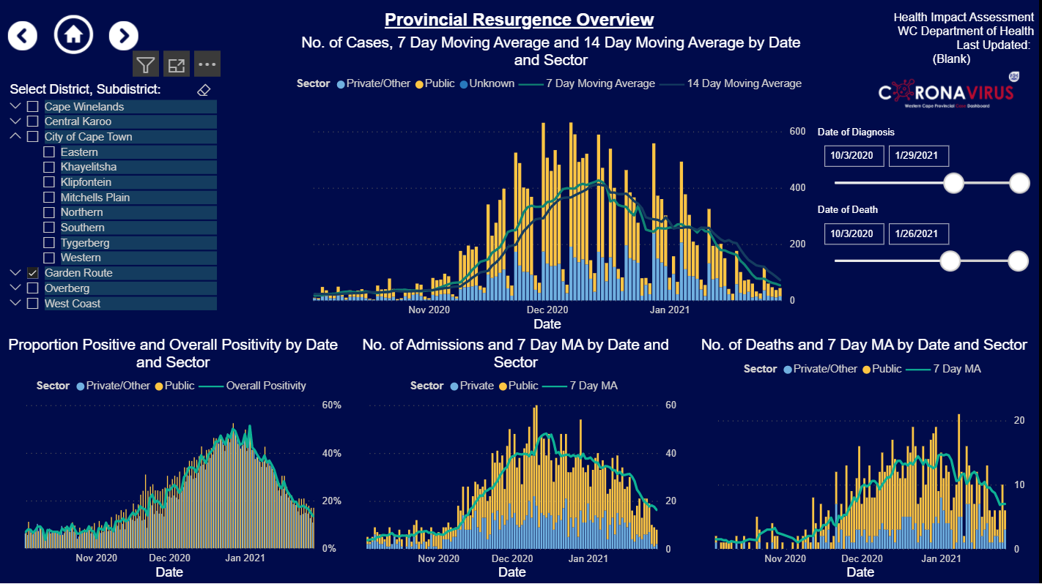
The seven day moving average of case numbers in the Garden Route continue to decline, and case numbers across all sub-districts are on a downward trajectory.
Hospitalisations and deaths are on a steady downward trajectory.
These data are re-assuring, but citizens must continue to protect themselves.
.
Garden Route

Slide 14
The health platform COVID response

Slide 15
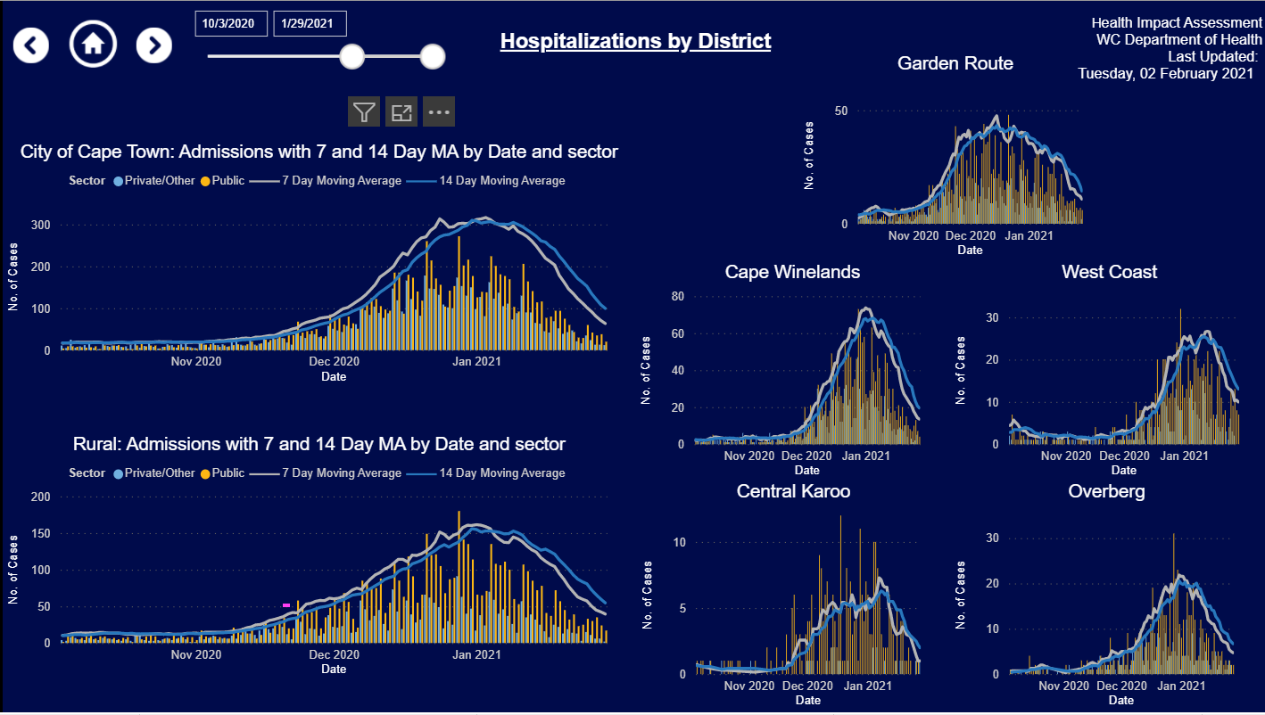
Hospital Admissions By Health District (public and private)
Cape Winelands
Central Karoo
Metro
Garden Route
West Coast
Overberg
Hospital admissions have passed the peak and are declining in all districts.

Slide 16
Acute service platform – general comments
Currently 2330 COVID patients in our acute hospitals (1398 in public hospitals & 932 in private hospitals). This excludes PUIs and cases in specialised hospital settings.
COVID hospitalisations have continued to decline whilst the trauma cases has remained significantly lower than usual.
The Metro hospitals have an average occupancy rate of 79%; George drainage area hospitals at 59%; Paarl drainage area hospitals at 71% & Worcester drainage area hospitals at 63%.
Occupancies in COVID beds show Metro hospitals at 38%; George drainage area hospitals at 34%; Paarl drainage area hospitals at 55%; Worcester drainage area hospitals at 33%.
COVID & PUI cases currently make up 18% of all available acute general hospital capacity in both Metro and Rural Regional Hospital drainage areas.
COVID inter-mediate care - the Hospital of Hope (Brackengate) currently has 82 patients (3 131 cumulative patients), Freesia & Ward 99 has 34 patients, Mitchell Plain hospital of hope has 61 patients and Sonstraal currently has 48 patients.
The Metro mass fatality centre has capacity for 240 bodies; currently 24 decedents (cumulative total of 1257 bodies) admitted. The overall capacity has been successfully managed across the province.
Notes:
The 795 beds are included in the IC and Acute care bed numbers

Slide 17
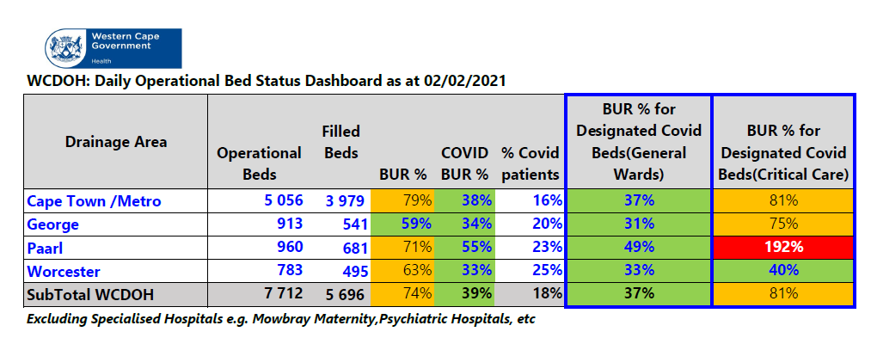
Acute Care Availability & Utilisation per Drainage Area
Operational Bed = an inpatient bed available for inpatient use that is staffed and equipped.

Slide 18
Daily oxygen consumption over past month – tons/day

Slide 19
Public Sector oxygen consumption trend - tons/day

Slide 20
Oxygen utilisation – general comments
The combined oxygen utilisation in the Western Cape Public and private hospital sectors is 67.46 tons/day (after a peak of >80 tons/day).
The combined public- private utilisation is now below the maximal production capacity of 70 tons/day at the Afrox Western Cape plant.
The public sector daily bulk oxygen consumption is 47.89% of the Kuilsriver plant for the 7 day period ending 1st February (compared to 70.56% for the period ending 15th January at our peak oxygen consumption).
The department’s total bulk oxygen consumption has reduced to around 31.41 tons daily when compared to 51 tons daily in the first week of January.
The Western Cape now have 4 bulk oxygen tankers allocated for the daily delivery of oxygen supplies during this week.
We will continue to monitor the utilisation of oxygen over the coming weeks, but the situation has completely stabilised.
Notes:
The 795 beds are included in the IC and Acute care bed numbers

Slide 21
Safe-guarding well-being of health care workers

Slide 22
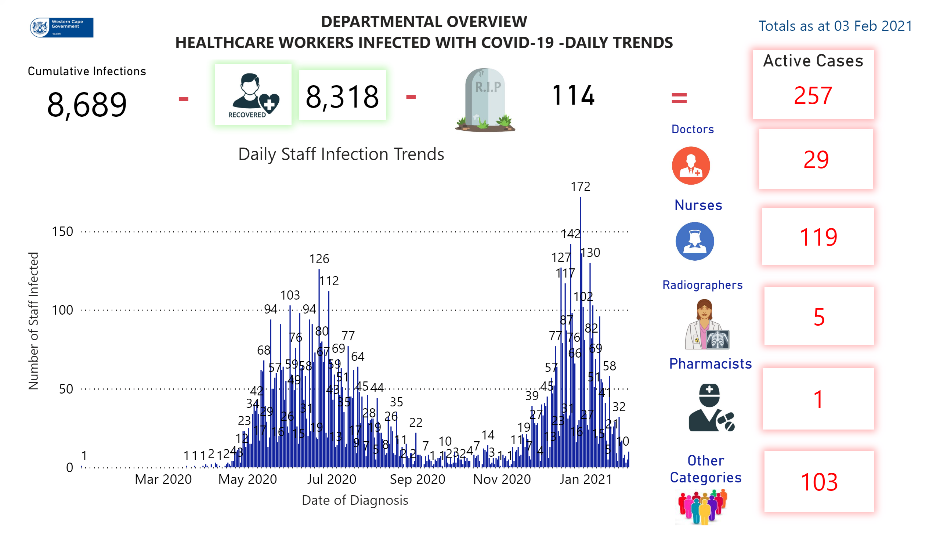
DailyTrends
Notes:
textbox
No alt text provided.
textbox
No alt text provided.
textbox
No alt text provided.
image
No alt text provided.
Daily Staff Infection Trends
No alt text provided.
Doctors
No alt text provided.
Nurses
No alt text provided.
card
No alt text provided.
card
No alt text provided.
card
No alt text provided.
Cumulative Infections
No alt text provided.
Pharmacists
No alt text provided.
card
No alt text provided.
Other Categories
No alt text provided.
card
No alt text provided.
image
No alt text provided.
card
No alt text provided.
image
No alt text provided.
card
No alt text provided.
card
No alt text provided.
Radiographers
No alt text provided.
textbox
No alt text provided.
Active Cases
No alt text provided.

Slide 23
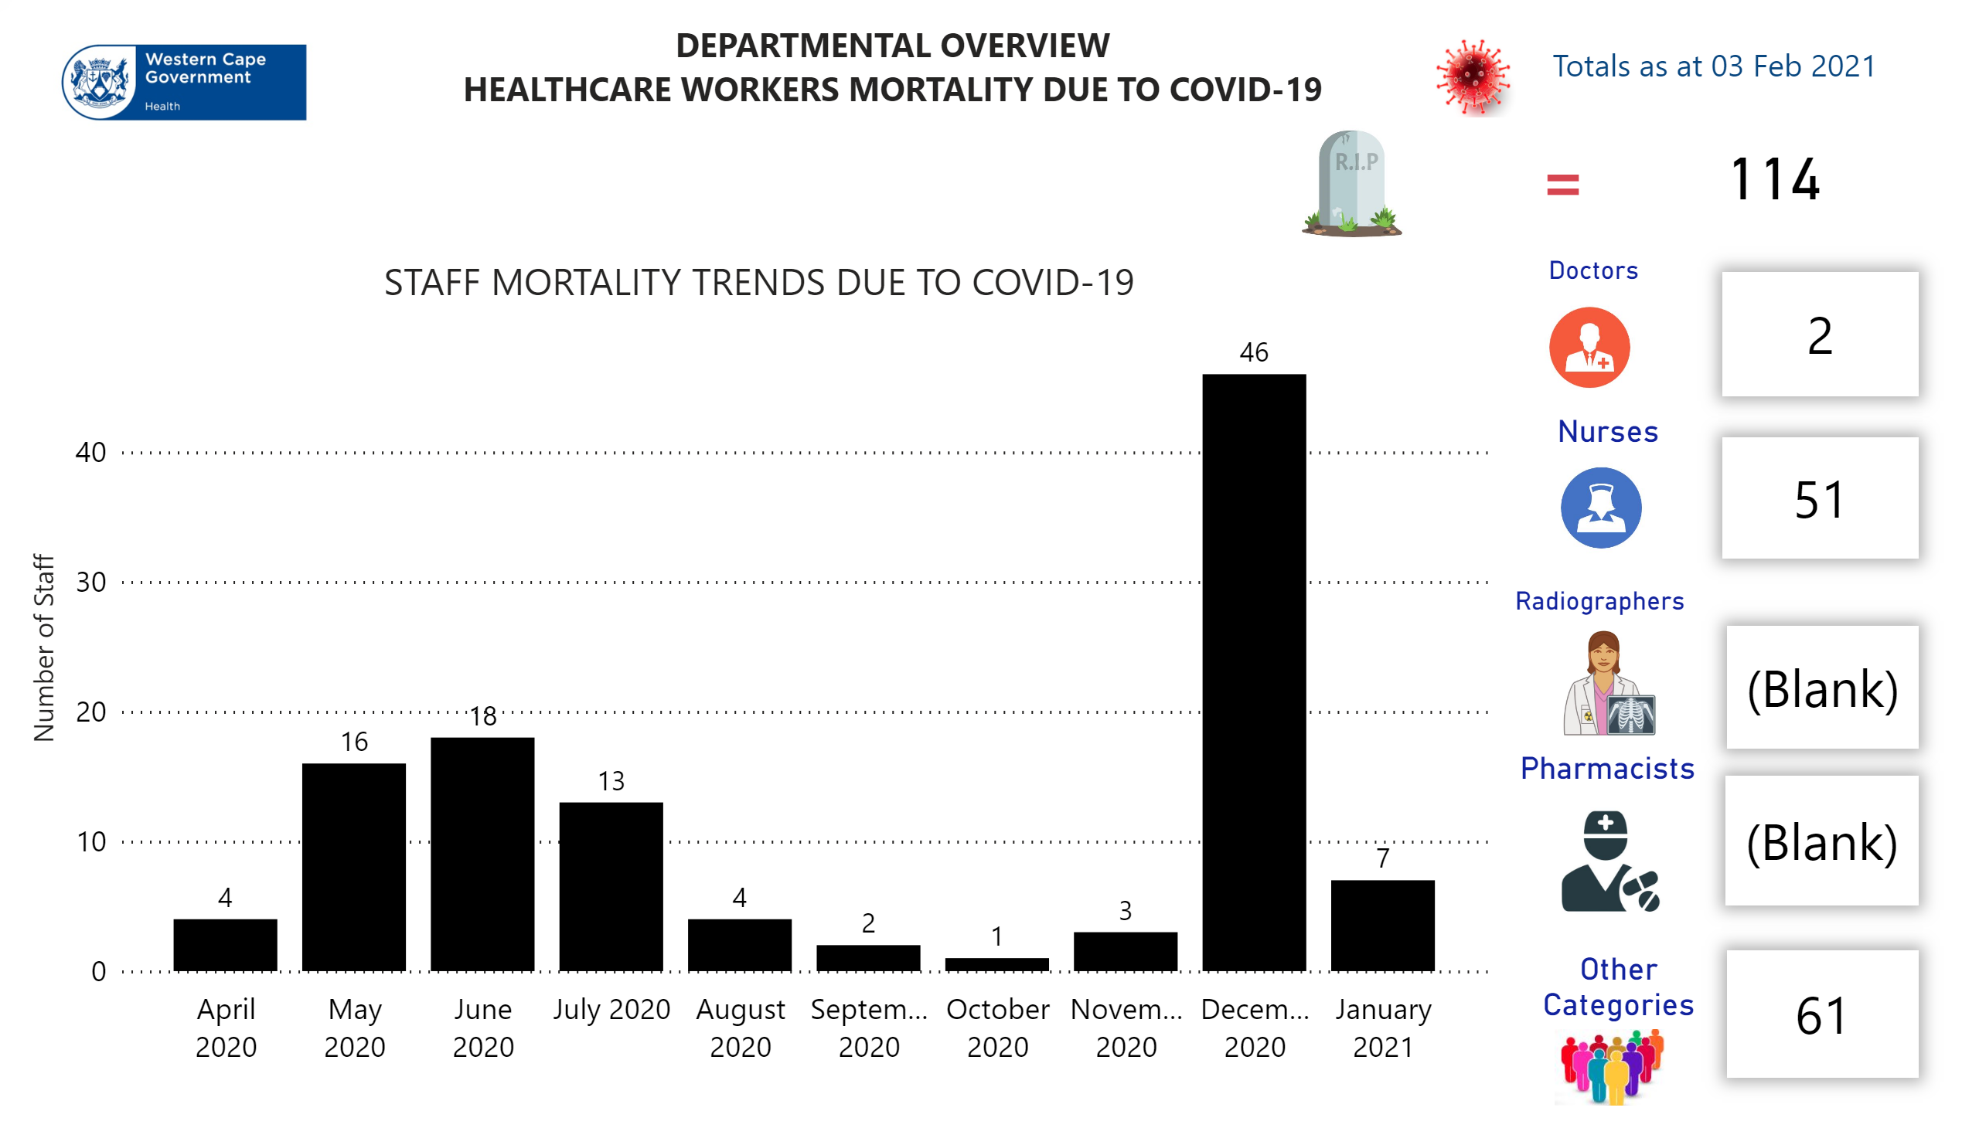
RIP
Notes:
image
No alt text provided.
textbox
No alt text provided.
image
No alt text provided.
STAFF MORTALITY TRENDS DUE TO COVID-19
No alt text provided.
Doctors
No alt text provided.
Nurses
No alt text provided.
card
No alt text provided.
card
No alt text provided.
card
No alt text provided.
Pharmacists
No alt text provided.
card
No alt text provided.
Other Categories
No alt text provided.
card
No alt text provided.
image
No alt text provided.
card
No alt text provided.
card
No alt text provided.
Radiographers
No alt text provided.
textbox
No alt text provided.

Slide 24
High Level Summary on Recruitment Drive
Category of HCW | Possibly Available | Appointed on PERSAL
MO | 142 | 22
Enrolled Nurse(EN) | 102 | 12
Enrolled Nursing Auxiliary (ENA) | 119 | 14
Not Indicated | 29 | 5
Professional Nurse | 126 | 50
Professional Nurse with Specialty | 36 | 8
 | 554 | 111
Institutions have made 297 Offers to the following categories of staff:
OSD-Category Rank | Filled | Reserved Posts | Grand Total
Allied Health | 19 | 7 | 26
Doctors | 66 | 23 | 89
Nursing | 652 | 253 | 905
Pharmacists | 5 | 1 | 6
Pharmacists-Assistant | 10 | 1 | 11
Social Workers | 7 | 1 | 8
Admin and Related | 144 | 11 | 155
Grand Total | 903 | 297 | 1200
There are currently 903 filled posts across the platform for additional COVID posts, 297 offers are pending finalization which will bring the total to 1200. Of the 665 Recruitment Drive applicants, 111 has thus far been appointed on PERSAL. The balance of which 554 are possibly available for appointment.
Notes:
The number of reserved posts on PERSAL indicates 516 which included funded posts in the Rural that was not reserved with a warm body. A meeting has been convened with Izak Wessels from CD: Rural to clarify the post situation. Therefore, a total 195 posts were removed from reserved posts numbers until clarity is obtained.

Slide 25
Vaccine Implementation update

Slide 26
Aims of COVID-19 vaccine in South Africa
Prevent severe illness and death
Reduce transmission
Protect our health system
As at 1 February 2021, 98.3 million shots of COVID-19 vaccine had been given, 31.8 million in the USA.
(www.bloomberg.com) https://www.bloomberg.com/graphics/covid-vaccine-tracker-global -distribution/

Slide 27
Vaccines with available efficacy results
Vaccine | Efficacy | Efficacy against severe disease | Efficacy in high- risk groups | Dose regimen | Comments
Biontech/ Pfizer/ Cominarty | 95% | 90% | Yes, older age groups | 2 doses | NEJM published
Moderna | 94% | 100% | Yes, older age groups | 2 doses | NEJM published
Oxford/ Astrazeneca/ Covishield | 62.1-90% | 100% | Older age groups >55, HIV not known | 2 standard doses or Low/high dose | Lancet published
Sinopharm (Beijing Strain) | 86% | 100% |  | 2 doses | News reports
Sinovac (coronavac) | 50.4 - 91.2% | 100% |  | 2 doses | News reports
Sputnik V | 91.40% | 100% |  | 2 doses | Sputnik V website
Novavax | 49-89% | (yes but small numbers) | ? HIV persons | 2 doses | News reports/ 66% in HIV negative persons
Johnson and Johnson | 66% (57 - 72%) | 85% |  | 1 dose | News reports

Slide 28
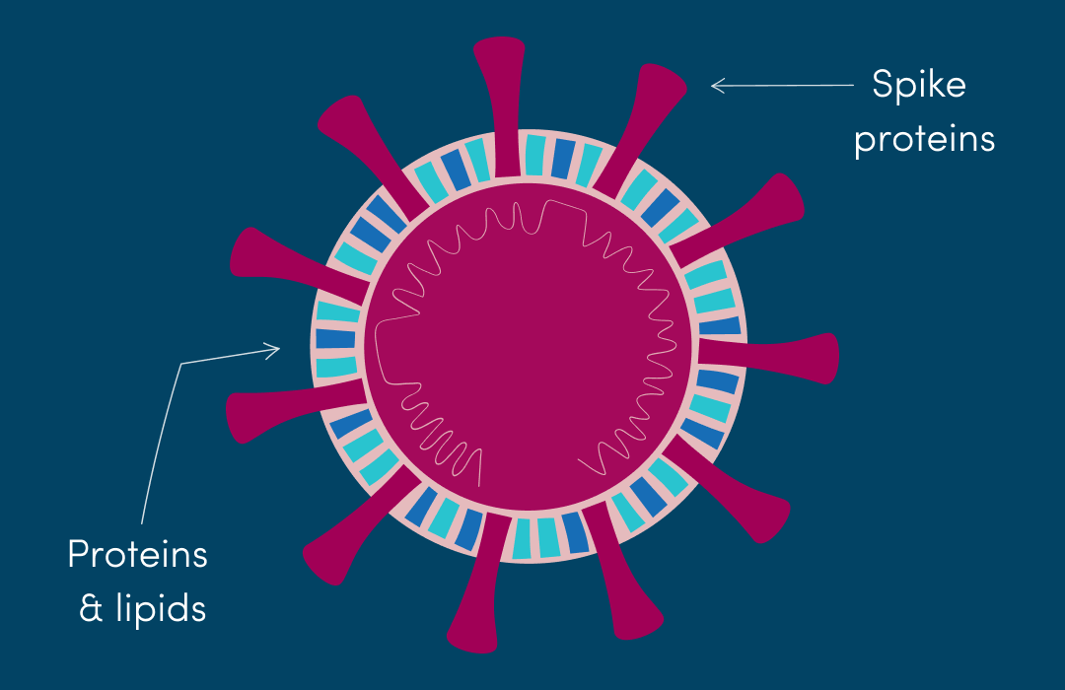


How does a viral vector vaccine (Oxford/ AstraZeneca, J&J, Sputnik 5) work?
SARS-CoV-2
Adenovirus
Spike protein gene
Spike protein gene
Human cell
Y
Y

Slide 29
How does mRNA vaccines (Pfizer, Moderna) work?
SARS-CoV-2
Packaged in
Lipid nano particles (LNP)
Synthetic RNA code
Spike protein gene
Human cell
Y
Y
Spike protein gene

Slide 30
Was the vaccine development rushed?
What were the reasons that the vaccine was developed so quickly?
The Chinese scientists made the genome (genetic material) of the virus available globally in January so multiple organisations could start working on developing vaccines at the same time.
The phases of clinical trials were combined so that the vaccines could progress more quickly through the clinical development process.
Huge amount of resources/ funding was made available to develop the vaccines so that many scientists could work on this and many scientific tasks could take place more quickly than would normally be the case.
There were many cases of disease occurring over a short period which made testing the vaccine easier.
Scientists built on previous efforts to develop vaccines for SARS and MERS-CoV which are both caused by coronaviruses.

Slide 31
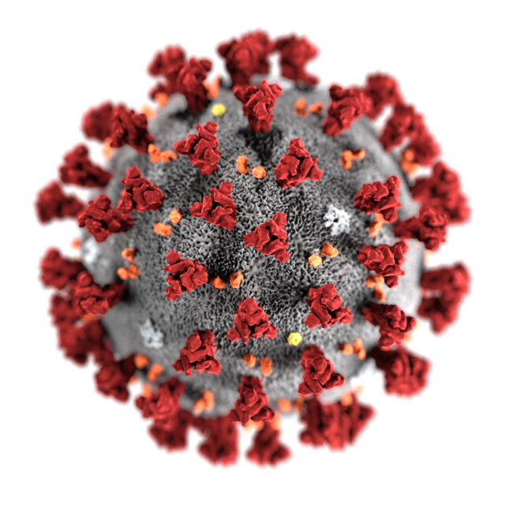
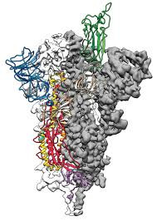
Will the vaccine work against the new variant 501.V2?
Scientists are hopeful because the vaccine targets the entire spike protein.
A definitive answer will be available in mid-late February from the South African trial.
Laboratory studies are also underway.
Worst case scenario is the vaccine would need to be modified (like the flu vaccine).
The new variant has small changes in the make-up and shape of the spike protein on the virus.
Other vaccines are reported to have some efficacy against the new variant

Slide 32
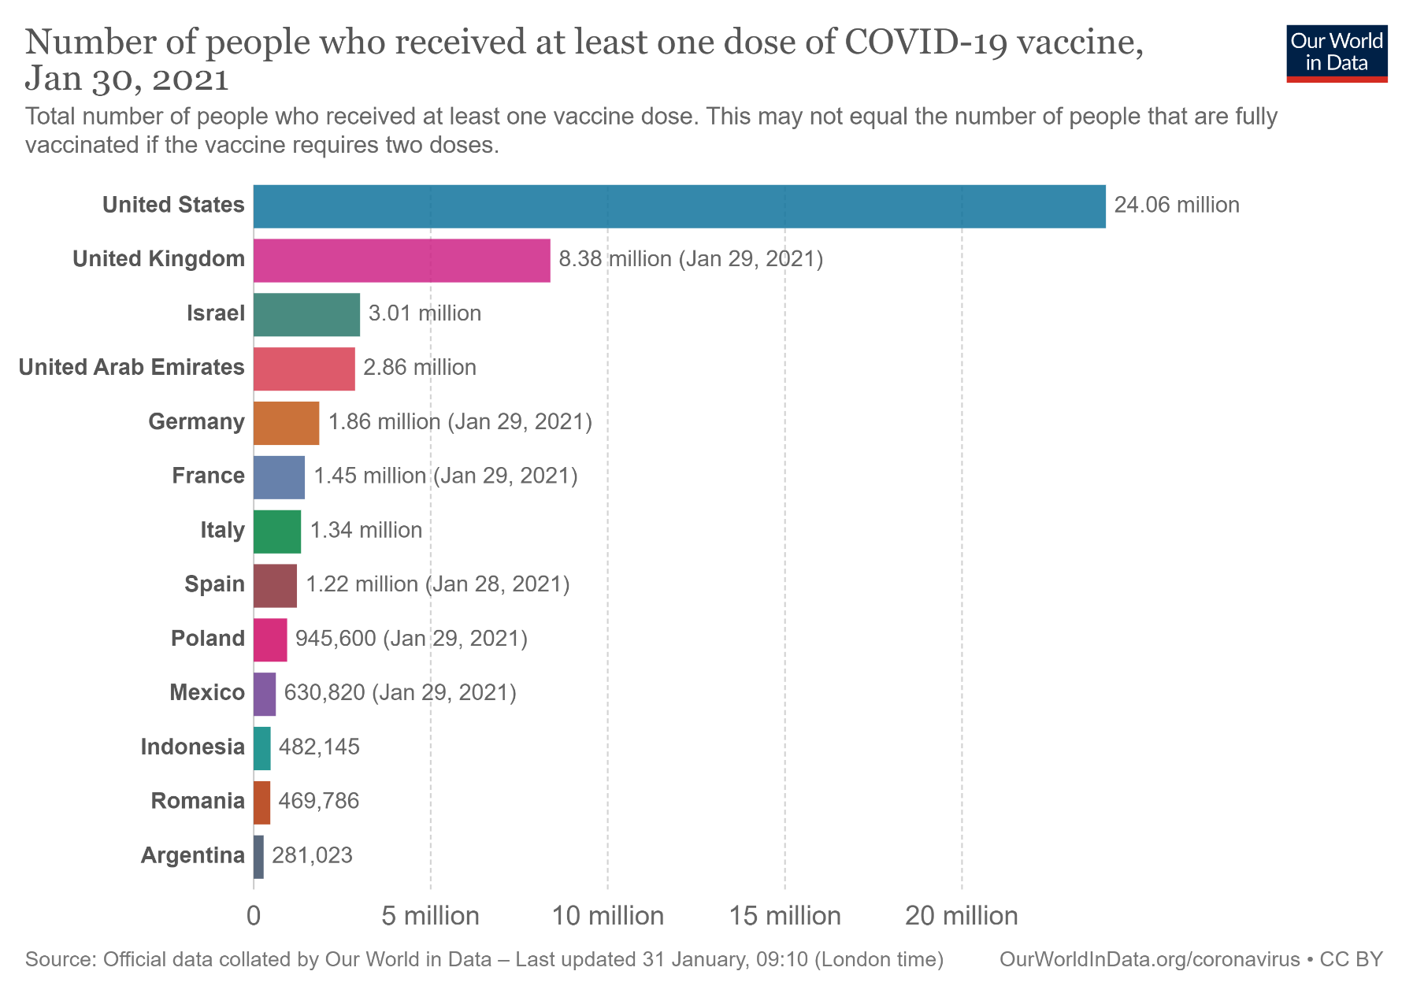
Current vaccine distribution
(as at 1 Feb - 98 million doses given - Bloomberg.com)

Slide 33
Vaccines on order – NDoH update
Covishield – 1.5 million doses – Feb 2021
Pfizer – 20 million doses – arrival date unknown
Covax – 10% of SA population = 12 million doses – Covax released information on the global volume allocation by country:
  Pfizer/BioNTech - 117,000 doses with delivery beginning as of mid-February with total doses that are for the Q1 supply- based on conditions: indemnity, regulatory
  AstraZeneca / SKBio (2,976,000 - 5,028,000) doses. Delivery as of mid/late February, subject to WHO EUL Indicates H1 supply, with 25-35% available in Q1 and 65-75% available in Q2 - based on conditions: indemnity, regulatory
Johnson and Johnson – 9 million doses – arrival date unknown. Opportunity to access an additional 20m doses being negotiated awaiting JnJ feedback.
The goal is to vaccinate 40 million South Africans – currently +/- 25.75 million provided for.

Slide 34
NDoH update on expected delivery of vaccine doses

Slide 35
NDoH confirmation of allocated 1st doses – Public Sector employees on PERSAL
 | Employees (PERSAL) | Doses | Proportion
Eastern Cape | 60 231 | 60 500 | 15.3%
Free State | 19 788 | 20 000 | 5.0%
Gauteng | 85 605 | 85 500 | 21.6%
KwaZulu-Natal | 81 519 | 81 500 | 20.6%
Limpopo | 44 526 | 44 500 | 11.2%
Mpumalanga | 30 341 | 30 500 | 7.7%
Northern Cape | 9 993 | 10 000 | 2.5%
North West | 29 081 | 29 000 | 7.3%
Western Cape | 35 090 | 35 000 | 8.8%
Total | 396 174 | 396 500 | 100.0%

Slide 36
NDoH confirmation of allocated 1st doses – Private Sector employees
Province | Hospital | Spec | GPs | Path | Rad | Pharm | Allied | Dentist | Opt | Other | Total
Eastern Cape | 8,654 | 1,023 | 2,543 | 700 | 341 | 1,957 | 1,033 | 784 | 204 | 595 | 17,834
Free State | 8,511 | 894 | 1,520 | 655 | 277 | 1,007 | 891 | 587 | 125 | 500 | 14,966
Gauteng | 61,638 | 9,003 | 10,818 | 8,391 | 3,062 | 16,482 | 8,789 | 5,941 | 1,156 | 4,217 | 129,496
Kwa-Zulu Natal | 26,625 | 3,197 | 4,595 | 2,551 | 933 | 4,330 | 3,094 | 2,375 | 516 | 1,574 | 49,789
Limpopo | 3,183 | 372 | 1,635 | 347 | 61 | 952 | 849 | 832 | 224 | 352 | 8,806
Mpumalanga | 5,097 | 507 | 1,810 | 474 | 214 | 1,192 | 823 | 752 | 173 | 394 | 11,435
North West | 5,786 | 552 | 1,410 | 407 | 283 | 1,119 | 623 | 699 | 139 | 386 | 11,403
Northern Cape | 2,116 | 175 | 568 | 158 |  | 451 | 212 | 221 | 44 | 144 | 4,088
Western Cape | 27,868 | 4,899 | 5,468 | 2,529 | 1,393 | 6,383 | 4,511 | 2,928 | 464 | 2,143 | 58,584
Total | 149,478 | 20,619 | 30,365 | 16,212 | 6,564 | 33,873 | 20,822 | 15,118 | 3,045 | 10,304 | 306,398

Slide 37
Primary Distribution Plan Status
Free State
Gauteng
Phase I: Depot
Phases II and III:
Direct delivery to
  30 Hospitals
  1 CHC
Depot for buffer
Direct delivery to
  5 District Pharmacies
  29 Hospitals
Limpopo
Depot
Direct delivery to 38 hospitals
North West
Direct delivery to 17 hospitals
Mpumalanga
Depot
Northern Cape
Direct delivery to 15 Hospitals
KwaZulu-Natal
Depot
Direct delivery to
  68 Hospitals
  22 CHC
Phase I direct delivery sites TBC
Western Cape
Eastern Cape
Cape Medical Depot (CMD)
Depots – PE and Mthatha
Direct delivery to 8 hospitals
30 January 2021

Slide 38









COVID-19 Vaccine Supply Chain Timelines
1 Feb
2 Feb
3 Feb
4-5 Feb
6 Feb
7-8 Feb
9 Feb
10 Feb
Terminal | Customs | On carriage to warehouse | Warehouse Receive Check Sample Store in quarantine | Samples to NCL | NCL Testing | Test Report | Warehouse Release from quarantine Pick Pack Dispatch | Carriage to administration site | Vaccination site Receive Check Store | Vaccinate recipients
WHAT
Bloemfontein
Vaccination sites
WHERE
OR Tambo
Midrand, Johannesburg
WHO
Provinces

Slide 39



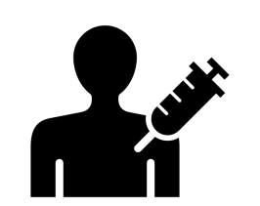
Functional processes
Pre- registration & Accreditation
Registration
Appointment Process
Vaccine Administration
Vaccine Administration
Facilities
Vaccinators
(“ voters roll ”)
Clients
2nd dose
Consent
Vaccination – First dose
Appointment for 2nd dose
Issue proof of vaccination
Above processes supported by adequate supplies, infrastructure, skilled people and data systems

Slide 40
Vaccine implementation update (1)
We have developed an Implementation Framework for the roll-out programme – which will be posted on the WCG: Health website.
1 million doses arrived in the country on 01 February 2021.
Upon arrival, the quality control process (NCL testing) as required by SAPHRA will be accelerated.
The Biovac Institute will be responsible for distribution of the vaccines to provinces.
The vaccines are anticipated to arrive within the next 10 days within provinces.
In the Western Cape, the Central Medical Depot (CMD) will distribute vaccines to WCG: Health facilities, private sector facilities and COCT facilities.
The plan is to officially start on 15 Feb 2021

Slide 41

Vaccine implementation update(2): Phases and
Prioritisation Groups
Phase I
Health Care Workers :
Phase II
Essential Workers
Phase III
Older than 18 years
Care Workers
CHWs
Health Science students
Estimated target:
Public & Private Health Sectors
133 000
Clients in congregate settings
Older than 60 Years
Older than 18 yrs with Co-morbidities
Estimated target :
2m
Estimated target :
2,9m
Traditional Healers

Slide 42
Vaccine implementation update (3): Phases and
Prioritisation Groups
The allocation of doses to provinces is being finalised nationally.
  The Covishield vaccine will be used for both doses to each health care worker.
  There will be some prioritisation required within phase I to accommodate the sequencing in line with the available doses. Some of the considerations include:
Phase 1
Public vs Private Sector
(proportion of personnel; population served)
Pro rata allocation to demander sites (facilities)
Within facilities: patient facing vs non-patient facing

Slide 43
Vaccine implementation update (4): Master Facility List
Master Facility List (Vaccination Sites):
  378 public facilities and 41 private vaccination sites have been identified – which must be accredited as per a national checklist.
  Curators and facility representatives are receiving training on the Master Facilities List and will ensure that all vaccination sites are verified and curated.
The HCW registers are being finalised (beneficiary register) for PERSAL and non-PERSAL staff.

Slide 44
Vaccine implementation update (5): Administration Sites
Vaccine Administration Sites ( Public sector)
District | No. of sites
Metro ( WCGH + COCT) | 154
Cape Winelands | 56
Central Karoo | 17
Garden Route | 85
Overberg | 25
West Coast | 36
Central Hospitals | 3
Other ( CDU, WCBTS) | 2
Total | 378

Slide 45
Vaccine implementation update (6): Distribution Plan
Central Medical Depot
  Deliver to 41 private vaccination sites
  Deliver to 378 public facilities (including City Health facilities)
  Courier in place and dedicated to this, to ensure alignment to vaccine programme start date
  Distribution will take place within 5 – 10 working days from being received.
SAPS and Law enforcement are being briefed as things move to ensure safe-guarding of vaccines on route

Slide 46
Vaccine implementation update (7): SCM
93 Vaccine Friendly fridges due for delivery this week
Generators assessment has been conducted and portable generators are on standby
Consumable orders placed and received (needles, syringes, cooler boxes)
PPE adequate
Vaccine cards designed and procurement commenced against an existing contract
Vaccines will be dispatched with the following:
  All related consumables
  Vaccine cards
  Information sheets

Slide 47
Vaccine implementation update (8): Training for
Vaccinators
  Training of vaccinators will commence on 02 February 2021 by Provincial PDC. Over 1995 vaccinators ready for training and 500 applicants to be loaded.
  This will be the biggest training intervention launched by the People Development Centre to date and will include staff from WCGH, CoCT, NGOs and private sector.
  Training will focus on handling, storage, research, special considerations, product information and data management aspects, aligned to NDoH and WHO criteria for inclusion.
  The training programme includes a virtual online training package in both SD and HD format to allow access on mobile devices and computers.

Slide 48
Vaccine implementation update (9): Training for
Vaccinators
TRAINING PROGRAMME
TRAINING INTERVENTION | MODE OF DELIVERY | TARGET GROUP
COVID-19 VACCINE TRAINING | 3,5-hour podcast, available via online link or flash drive (Stellmed and PDC) | vaccinators team managers support staff (e.g., pharmacy)
WEEKLY SHORT UPDATE TRAINING CHECK-INS | MS Teams (PDC and content experts) | Vaccinators team managers support staff (e.g., pharmacy) NOTE: Alternatively, one member of the COVID-19 vaccine team will update the rest of the team members.
COVID-19 INFORMATION SESSIONS | Online / Presentation by the Knowledge Translation Unit with the support of the Communications Directorate | All Health Care Workers

Slide 49
Vaccine implementation Update (10)
Early discussions have started about planning for Phase II and III
  Massive scale-up
  High volume centres will need to be explored
  Will engage with the private sector
  Parallel planning logistics, social mobilisation is critical.

Slide 50
Vaccine implementation Update (11) - Next steps
Finalise non-PERSAL beneficiary list:
  33 000 names uploaded on Sharepoint
  Confirmation required from all sources
Engage Private Sector:
  Met with National B4SA team
  Western Cape team to be formalised by Friday
Set-up Phase 2 & 3 planning co-ordination:
  Exploratory meetings held with City and IEC already
  Formal committee to be commenced next week

Slide 51
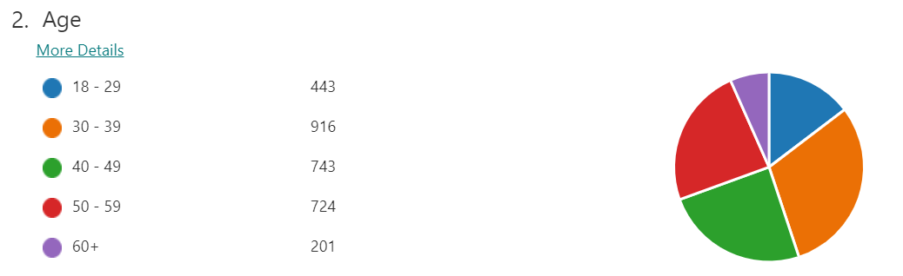
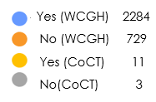
Staff Readiness: Rapid Poll Results
Number of respondents at the time of Report: 3027
3. Are you a Frontline Worker (direct contact with clients / public / patients)?

Slide 52
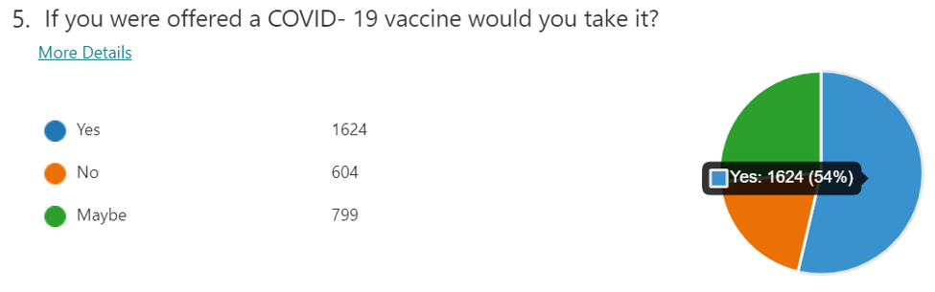



Staff Opinion Poll
Getting to “Yes” – Build the Credibility and Trust
Continue supplying credible information about the vaccines (science and safety)
Clarifying processes and localising the information to address the hesitancy
Engaging with trusted influencers within communities

Slide 53




Communication
Give reassurance – evidence-led quality information: good set of tools to be used internally and externally (to form the foundation of discourse) e.G. FAQ/info sheet and voice-over slide presentation
Inspire trust through advocacy and info sharing: through a range of expert voices and “local” trusted people throughout the health system. Not a punitive approach, but respectful and reasonable, yet hopeful
Hear voices, give honest feedback and be open and responsive: always give adequate time in sessions for listening and capturing feedback to ensure we maintain a dialogue. Counter polarization, while accepting we will not win all

Slide 54



Tools that can help
Coronavirus web page with resources
Covid-19 Vaccination Fact Sheet
https://coronavirus.westerncape.gov.za/covid-19-vaccination

Slide 55


Tools that can help
Video with encouragement
Slideshow with basic science info and voice

Slide 56
Conclusions

Slide 57
Concluding remarks
We have passed the peak of the 2nd wave in the Western Cape, with clear and consistent signs of decline in cases, hospitalisation and deaths.
Our local teams remain on high alert for surveillance & response to localised clusters, especially for the vulnerable.
We should remain vigilant and continue to adhere to protective behaviours to reduce new cases – while restrictions are lifted in a phased manner.
Our health care workers have faced significant mental and emotional strain. We have started an intentional process of grieving and healing.
It is essential to maintain a strong focus on behaviour change to ensure containment for the coming months, as we gear up access to vaccines.
We should gear up the implementation of vaccines as the key drive against COVID over the coming months.

Slide 58
Thank you

