Slide 1
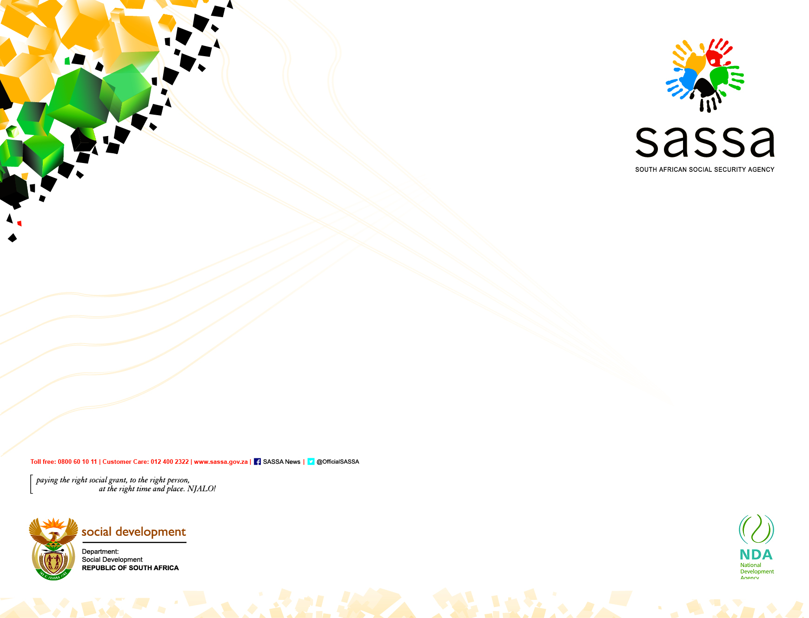
Presentation to the Standing Committee on Social Development on lapsing of temporary disability grants, re-applications, overcrowding at SASSA offices and interventions taken to address these
21 January 2021

Slide 2
Presentation Outline
Context and overview
Summary Financial position of SASSA
Temporary disability grants clarification
Current pressures
Summary of grant extensions
Management plans : TDG re-applications
Management plans : CDG re-applications
Customer experience
Progress to date (SASSA National and Western Cape)
Actions implemented within budget
Social relief of distress as interim support measure
Challenges
Interventions – short and longer term
Recommendation

Slide 3
1.CONTEXT AND OVERVIEW
As the March 2020 started; much as we were aware that the pandemic had hit some parts of the world and busy with finalizing our year plans for 2019; little did we know that the President will announce Level 5 lock down and all our plans will be thrown in disarray
We had completed and set audacious goals to change the land scape of our institution with a drive to impact the lives of our people both internally and those that we serve
The major goals presented to the portfolio committee were streamlined to include:
  Focus on reducing poverty levels of the clients we served
  Contributing to Economic transformation
  Most of all Improving customer experience; and
  Improved Organisational efficiency which was to drive costs down and ensure effective and efficient service delivery
    Technology and digitizing our platforms was at the centre of our strategy for the MTEF
Had developed guiding principles on how we do our work the most important of which was putting our customer needs at the forefront;
  It was therefore devastating that we instead experienced the lives of our clients especially in the last 2 weeks impacted extremely negatively
Our world like many in our country and in the world was on March 25th thrown in disarray
  Level 5 Lockdown announced
fires and floods.

Slide 4
1.CONTEXT AND OVERVIEW
Let me then as we start the presentation requested by the Standing Committee on Social Development for an update first acknowledge the challenge of overcrowding that has been seen in some of our offices particularly over the past two weeks.
  We are faced with a situation where a high number of temporary disability grants were lapsed at the same time and as such beneficiaries come in numbers and demanded immediate service This is understood given the challenge of deepening poverty and the complications that came with the revised lockdown restrictions.
  I would like to take this opportunity to apologise to the applicants who were inconvenienced due to the lapsing of the grants despite it having been communicated individually and on a range of platform
    As SASSA, we are doing everything possible to address this challenge. When we planned for the year 2020,
We committed ourselves as a collective that we will over the 5 year period ensure that we fulfill our constitutional mandate of ensuring that we provide social assistance (income support) to qualifying South Africans who are unable to support themselves and or their dependents
We also committed to invest our resources towards improving service delivery, digital transformation and business process engineering. All these are to be done to improve the customer experience of our people and address their felt needs

Slide 5
1.CONTEXT AND OVERVIEW
The lockdown has had a significant impact in the implementation of the priorities that we initially planned.
SASSA like many organisations, has had to embark on Reprioratisation to accommodate the Covid-19 measures with our plans thrown in complete disarray whilst presenting new opportunities and lessons
We had to review some of the interventions/targets in July where we lost time due to lockdown. Extension of the validity of temporary disability and care dependency grants that lapsed from February 2020 and during the State of Disaster. The cost of these extensions is approx. R1,8 bn. We remain to assist the TDG applicants, however, the resources at our disposal are not sufficient to continue to cover everyone. We are therefore required in terms of the law to conduct new assessments in order to ensure that only qualifying beneficiaries are considered and paid
We activated, specific programmes that contribute to government’s comprehensive measures that are targeted at securing the wellbeing of South Africans for the duration of the national lockdown period and beyond. Some of the interventions included;
  Provision of food parcels through the social relief programme
  Provision of not only a system but also on boarding and processing of a new client base never served by SASSA before utilizing new platforms that we intended to implement in later years for a clients we serve – the SRDCOVID grant beneficiaries;
  Came with extreme pain yet exciting learning for the future some of which we are already chattering

Slide 6
1.CONTEXT AND OVERVIEW
The past year has been the most challenging period since the advent of democracy, with the country involved in a fight against two major pandemics: the economic crisis impacting peoples livelihoods and the COVID -19 pandemic.
The challenges were exacerbated by the economic disruption which quickly translated into a poverty crisis, as more households run out of resources to meet their basic needs.
SASSA was one of the key stakeholders to implement some of the critical socio-economic relief measures that were announced by the President. In addition to the payment of the normal social grants SASSA implemented the following interventions
Top Up of existing grants
  Top-Ups for existing social grants which were implemented for a period of six months (from May-October 2020). Approximately R30 billion was spent on the top-ups
Special COVID-19 Social Relief of Distress (SRD) Grant implemented from May 2020 and will end in January 2021.
  Approximately 15 billion has been on the special Covid-19 SRD grant to the benefit of over 6 million beneficiaries monthly
Extension of the validity of temporary disability and care dependency grants that lapsed from January 2020 and during the State of Disaster to be paid until 31 December 2020. (this is the focus of the presentation today)
In addition, the Agency continue to assist in areas affected by disasters such as wild fires and floods.

Slide 7
2. Financial Implications
Description | Allocated amount (millions) | Notes
Budget allocation – social grants for 2020/21 | 172 363 | For all existing social grants – older persons, disability, foster child, care dependency, child support, grant in aid and social relief
Additional amount allocated for COVID 19 relief package | 48 244 | Includes amount for grant top up, care giver allowance and R350 grants plus additional amounts for R350 grant for the extended period from November to January 2020 (R15 473; R15 201; R10 273; R6 797 and R500 million)
Total amount for financial year | 220 607
Projected expenditure | 220 196 | For all social grants and COVID R350 grant
Available funding | 411

Slide 8
3. Temporary Disability Grants Clarification
A Disability grant (DG) is awarded in terms of the Social Assistance Act, 2004
Medical assessment is a prerequisite for an application for a disability grant
Assessment model is medical not social
Grants provided to those who are unable to work as a result of the functional limitation caused by the disability or medical condition: not provided for chronic conditions, or conditions which are manageable with treatment
Temporary disability grants provided for a period of 6 to 12 months, after which the grant lapses in terms of Social Assistance Act.

Slide 9
4. Current pressures
The extension of the TDG will cost approximately R1,2 billion for the remainder of the financial year
The only possible available budget is R411 million, which is being considered for utilisation to support where necessary. This is based on an assumption of 80% return of lapsed TDGs following an assessment process.
Should the rate of return for lapsed TDGs be 50%, the possible funds available for utilisation will increase to R817 million.
Remaining funding for SRD is only R190 million – needed to cover costs of disasters which have already occurred in Western Cape and Eastern Cape, as well as any others which may occur before 31 March 2021, and possible financial support for those whose TDGs have lapsed and who meet the criteria for SRD as legislated.

Slide 10
5. Summary of extensions
The table below indicates the numbers of TDG’s which were extended beyond the period for which they were approved for the period from February to December 2020, under the Disaster Management Act. The cost of these extensions is approx. R1,8 bn which came from the existing allocation:
Province | Feb | Mar | April | May | June | July | Aug | Sep | Oct | Nov | Dec | Total
Eastern Cape | 1 111 | 1 258 | 1 235 | 785 | 873 | 1 493 | 1 407 | 1 378 | 992 | 424 | 190 | 11 146
Free State | 1 159 | 1 464 | 1 694 | 1 398 | 1 458 | 1 798 | 1 567 | 1 236 | 1 177 | 688 | 723 | 14 362
Gauteng | 1 565 | 3 682 | 4 199 | 3 403 | 4 137 | 3 971 | 3 439 | 2 743 | 3 066 | 1 430 | 1 759 | 33 394
KwaZulu-Natal | 2 586 | 4 130 | 4 498 | 4 001 | 5 060 | 4 976 | 4 464 | 3 691 | 3 115 | 1 922 | 2 441 | 40 884
Limpopo | 1 378 | 2 151 | 2 430 | 2 082 | 2 539 | 2 314 | 2 062 | 2 161 | 1 792 | 872 | 1 552 | 21 333
Mpumalanga | 1 152 | 1 693 | 1 831 | 1 396 | 1 520 | 1 533 | 1 386 | 1 271 | 1 213 | 659 | 735 | 14 389
North West | 826 | 1 587 | 1 591 | 1 218 | 1 175 | 1 436 | 1 547 | 1 016 | 902 | 588 | 595 | 12 481
Northern Cape | 1 888 | 1 435 | 1 841 | 1 363 | 1 586 | 1 151 | 1 515 | 924 | 918 | 803 | 737 | 14 161
Western Cape | 3 573 | 6 476 | 6 847 | 5 791 | 5 390 | 6 262 | 5 082 | 3 869 | 4 125 | 3 143 | 1 765 | 52 323
Total | 15 238 | 23 876 | 26 166 | 21 437 | 23 738 | 24 934 | 22 469 | 18 289 | 17 300 | 10 529 | 10 497 | 214 473

Slide 11
6. Management Plan TDG re-applications
Communication and Messaging Programme
    Affected clients were informed via individual letters
    During monitoring and queue management when payment of grants occurred, staff informed clients
    Public Mass Media- and Social platforms used
Stakeholder Co-operation and Support
  Community leadership
  Department of Health:
  - availability of medical practitioners for assessment and
  - access to medical records of clients
  Local Government for access and use of community halls

Slide 12
7. Management Plan TDG re-applications
(iii) SASSA Employee Intervention Programme
  Project planned to be completed by 31 March 2021
  Approach: Segregation of lapsed TDG and Care Dependency Grants (CDG)
  Additional budget secured for doctors conducting assessments use of community halls and overtime for staff
  Client appointment system implemented for medical assessment and completion of the social grant application
  Referral form for completion of medical history available on SASSA website for downloading by either client and/or stakeholder assisting the client
  Limit on numbers of clients allowed into SASSA offices at any one time depending on available space, in compliance with COVID Regulations.
  Deployment of volunteers in partnership with NDA to assist with queue management and promote compliance with the COVID-19 precautionary protocols
  -

Slide 13
8. Management Plan CDG re-applications
CDG where child turned 18 years in the course of 2020 were extended under the Disaster Management rules – total of 11 243
Grants lapsed end December – new application for disability grant required in name of individual (not care giver, as with CDG)
Arrangements made for previous medical to be used for SASSA doctors to complete paper based assessments (CDG child not required to undergo new assessment, except in cases where there is no medical, or the medical is inconclusive)
Once medical assessment completed, care giver called to apply for the disability grant for the young person, as his/her procurator
Above process implemented to prevent severely disabled clients having to be brought to SASSA offices

Slide 14
9. Customer experience
SASSA is addressing the following to improve the customer experience:
  Increased days for services to clients for disability grants
  Limit numbers of clients in office at any one time to ensure compliance to COVID protocols
  Increase numbers of clients who can be seen by doctors per day, to increase assessments done
  Bookings for clients rather than have everyone queuing for extended periods
  On-line applications available for grants for older persons, child support grants and foster child grants so that clients do not have to report to offices to do this.
  National call centre strengthened with contracted service provider and regional call centres

Slide 15
10.1 Progress to date : TDG
Province | Target | Number booked | Number assessed
Eastern Cape | 10 975 | 5 314 | 1 735
Free State | 12 951 | 3 443 | 2 300
Gauteng | 33 394 | 5 693 | 1 091
KwaZulu-Natal | 40 884 | 8 903 | 4 779
Limpopo | 21 615 | 4 713 | 2 453
Mpumalanga | 15 019 | 3 081 | 647
Northern Cape | 14 006 | 5 005 | 1 215
North West | 12 481 | 3 136 | 1 853
Western Cape | 52 323 | 11 744 | 905

Slide 16
10.2 WC Progress to date : TDG
Western Cape Local Offices | Target | Number booked 15/01/21 | Number assessed 15/01/21
Athlone | 2 485 | 667 | 0
Bellville | 7 299 | 997 | 0
Khayelitsha | 6 115 | 618 | 0
Wynberg | 2 470 | 939 | 0
Cape Town | 1 668 | 494 | 17
Eerste River | 6 650 | 1 831 | 32
Gugulethu | 3 813 | 608 | 0
Mitchells Plain | 2 829 | 1 000 | 0
Caledon | 1 750 | 573 | 49
Paarl | 3 006 | 1 206 | 155
Worcester | 1 684 | 648 | 127
Beaufort West | 677 | 57 | 0
George | 4 046 | 574 | 86
Oudtshoorn | 1 012 | 268 | 96
Vredenburg | 4 826 | 194 | 109
Vredendal | 1 993 | 1 070 | 234
Western Cape | 52 323 | 11 744 | 905

Slide 17
11. Actions implemented within budget
Reinstatement of most vulnerable categories of TDG clients:
  Those who are 59 years old: 9 295
  Those receiving TDG and grant in aid: 6 079
  Those receiving TDG through procurator: 577
  Those receiving TDG through administrator: 73
Total for reinstatement : 16 024
Total cost for this for the 2020/21 financial year is R98 million; while cost for a period of 12 months is R391 million
Limited SRD to be provided within budget to TDG clients who apply while they are waiting for an assessment at value of R500 per month per person SRD to be provided for maximum of 2 months on approved applications for an estimated 150 000 clients : total R150 million. Budget availability is R190 million. Balance to be reserved for responses to disasters. SRD to be reserved for those affected by lapsed TDGs only

Slide 18
12. SRD as interim support
In order to try and reduce the hardship caused by the process, which is needed to ensure compliance to legislation, SRD in the form of cash will be considered for those who have no other form of income for a limited period only while they are waiting to be re-assessed – on condition that they apply for the SRD
SRD requires an application per individual to ensure compliance with legislation and prevent audit findings. By 18 January 2021, 238 people had already applied for support through SRD and payment will be effected this week.
System enabled to pay the approved SRD at a rate of R500 per person into the bank account previously used to receive the grant (every applicant does have a valid account which has been verified)
Reduced amount of R500 per person will be provided to approved applicants only, as the amount of money for SRD is limited. The support will only be provided while the clients are waiting to be assessed and subject to them completing an application which must comply with legislative prescripts.

Slide 19
13. Challenges
The country was under level 1 lockdown restrictions when the project was developed and approved. The return to lockdown level 3 at the end of December has created challenges, particularly with access to health facilities for records and assessments
Health facilities which had initially agreed to assist are now limiting access, as a result of the increase in COVID cases – especially in the Western Cape, which has the highest numbers
Organised labour likely to raise objections about increased numbers being served at local offices under level 3 due to increased perceived risk to staff
Lack of access to Community halls used as service points – particularly in Western Cape which has resulted in overcrowding at SASSA local offices.
Funding to reinstate all lapsed TDGs and keep in payment to March will be approximately R1,2 billion in the 2020/21 financial year. Based on updated projections, funds are not available to support this. Carry through costs of approximately R400 million per month for 2021/22 cannot be absorbed within budget.

Slide 20
14. Interventions
Short term
Strengthened communication as support to this project – use of community radio stations; use of SASSA mobile units to take services closer to communities; additional support for the call centre to ensure that all calls are responded to -
Project to continue as planned, but with additional doctors to be contracted (process already underway in Western Cape, which is area most affected).
Approach made to COGTA and the city to for community halls to be made available in order to bring the service closer to people and reduce pressure on SASSA offices. 133 Sites out of 180 sites availed in the Western Cape (11 out of 41 sites in the Cape Metropole availed during this week only)
Fast track the appointment and training of additional contract doctors in Western Cape (33 additional doctors will sign SLA with SASSA; Training to be scheduled in week of 18 January)
Referral forms available on SASSA website, and also mailed to clients who enquire, to take some initial pressure off local offices. The contact details of the people who have been given the forms, without going to SASSA offices are then provided weekly to local offices, to schedule the assessments required
Allocate the mobile offices to ensure that services are taken closer to communities
Strengthen engagements with NGOs working with people with disabilities to assist with communication to affected clients
Progress to be reported weekly to immediately implement remedial actions where necessary
Appeals Tribunal put on standby to cope with increased numbers of rejected applications, as not all re-applications are likely to be approved

Slide 21
15. Interventions
Medium to Long term
Investigation into the high number of TDGs provided in Western Cape in particular
Strengthening of assessments for disability grants, to ensure that these are provided for the correct reasons – inability to be employed and not on social grounds
Continued education and communication to clarify the types of grants
Automation of grant application processes to reduce need for in person contact for many processes – while maintaining the personal channel for those with limited access to internet and data
Review the legislative environment governing the disability related grants – introduce assessments by other health professionals and not only doctors; reconsider the process change of care dependency grants to disability grants
Linking to employment and development opportunities to reduce dependency on social assistance (whole of government responsibility)

Slide 22
16. Recommendation
It is recommended that the Standing Committee take note of progress to address the challenges pertaining to the lapsing of the temporary disability grants, as well as to note the planned short and longer term interventions:

Slide 23
Thank You
Enkosi
Dankie

