Slide 1
PORTFOLIO COMMITTEE ANNUAL REPORT
2019 / 2020

Slide 2
AGENDA
Situational analysis
Annual Performance Information
Annual Financial Statements
Audit report overview
Questions

Slide 3
SITUATIONAL ANALYSIS

Slide 4
SITUATIONAL ANALYSIS
The NYDA achieved a sixth clean audit from the Auditor General of South Africa.
The NYDA achieved 22 out of 23 Key Performance Indicators translating into a 96% performance achievement.
The NYDA spent 100% of its financial allocation.
For the majority of the financial year under consideration the Board of Directors could not quorate.
The NYDA remains in a strong financial position given the impact of Covid-19 and can weather the storm.
The focus looking forward must be on youth unemployment.

Slide 5
ANNUAL PERFORMANCE INFORMATION

Slide 6
PROGRAM 1: ADMINISTRATION
Strategic Objective | Key performance Indicator | 2019/20 Target | 2019/20 Actual | Reason for Variance
To establish a credible, efficient and effective organisation | Value of funds sourced from the public and private sectors to support the youth development programmes | R100 million | R115 549 000.00 | Annual target met and exceeded due to stakeholders’ willingness to partner with the NYDA and increased fundraising drive of the Agency.
 | Number of jobs partnerships established with public and private sector | 10 jobs partnerships established with public and private sector | 10 jobs partnerships established with public and private sector | Annual target met
 | Number of market linkage partnerships established with public and private sector | 10 Market linkage partnerships established with public and private sector | 10 Market linkage partnerships established with public and private sector | Annual target met

Slide 7
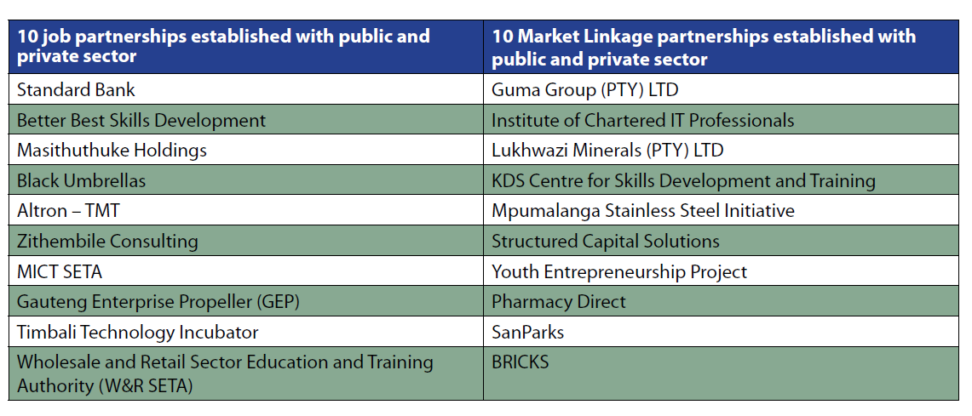
PARTNERSHIPS ESTABLISHED

Slide 8
PROGRAM 1: ADMINISTRATION
Strategic Objective | Key performance Indicator | 2019/20 Target | 2019/20 Actual | Reason for Variance
To establish a credible, efficient and effective organisation | Develop compliant SCM and standard operating procedures | Develop compliant SCM policy and standard operating procedures | Developed compliant SCM policy and standard operating procedures | Annual target met
 | Number of Quarterly Financial Management Reports produced | 4 Quarterly Financial Management Reports produced | 4 Quarterly Financial Management Reports produced | Annual target met
 | Develop and implement Annual Workplace Skills Plan | Develop and Implement Annual Workplace Skills Plan | Developed and implemented Annual Workplace Skills Plan | Annual target met

Slide 9
PROGRAM 2: PROGRAM DESIGN, DEVELOPMENT AND DELIVERY
Strategic Objective | Key performance Indicator | 2019/20 Target | 2019/20 Actual | Reason for Variance
To provide socio-economic empowerment interventions and support for young people in South Africa | Number of youth owned enterprises supported through Grant Programme | 1000 | 1136 | Annual target met and exceeded due to the 1000 businesses in 100 days’ campaign which provided additional funding to the program.
 | Number of beneficiaries supported with business development support services offered by the NYDA | 20 000 | 20 730 | Annual target met and exceeded due to additional partnerships which contributed to the higher achievement.
 | Number of jobs created and sustained through supporting entrepreneurs and enterprises | 3500 | 5013 | Annual target met and exceeded due to additional jobs created through 1000 businesses in 100 days campaign.
 | Number of jobs facilitated through placements in job opportunities | 10 000 | 14 021 | Annual target met and exceeded due to additional job partners sourced during Quarter 4 when placement opportunities were higher.

Slide 10
PROGRAM 2: PROGRAM DESIGN, DEVELOPMENT AND DELIVERY
Strategic Objective | Key performance Indicator | 2019/20 Target | 2019/20 Actual | Reason for Variance
To provide increased information and universal access to young people | Number of business centres established | 4 | 4 | Annual target met
 | Number of new service delivery channels established for young people to access NYDA information | 17 | 15 | Annual target not met. Part of the planned achievement of the target was the procurement of six mobile outreach vehicles. The order for the vehicles was placed and the delivery was planned prior to 31 March 2020, but due to the country being in lockdown from 26 March 2020 the delivery could not be completed. The delivery was completed on Level 3 of the Risk Adjusted Strategy in June 2020.
 | Number of events for providing youth development information | 200 | 388 | Annual target met and exceeded due to demand for NYDA to exhibit at various events and municipalities where we established new district offices.
 | Number of young people trained to enter the job market | 70, 950 | 74, 383 | Annual target met and exceeded due to partnerships with municipalities where we opened new district offices.

Slide 11
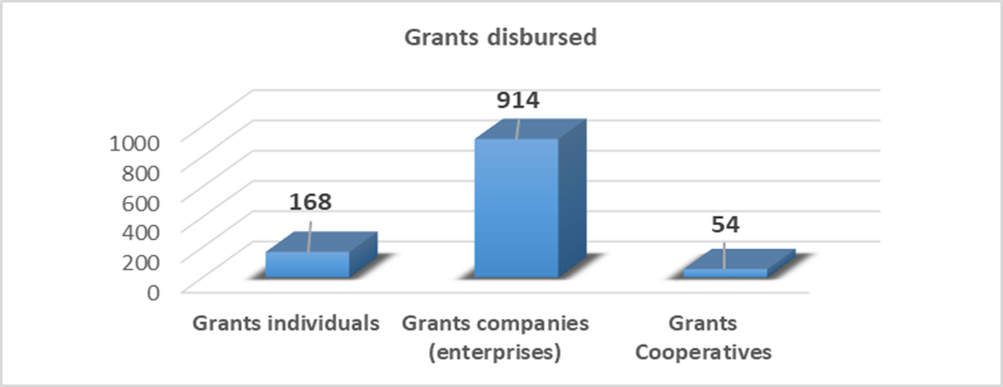
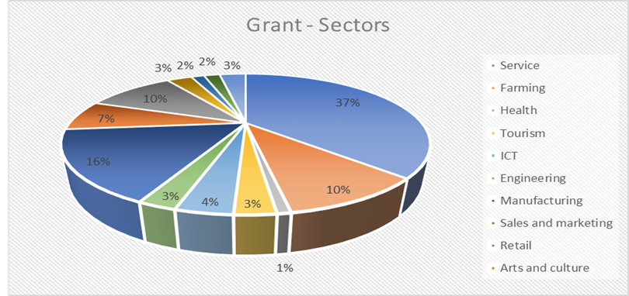
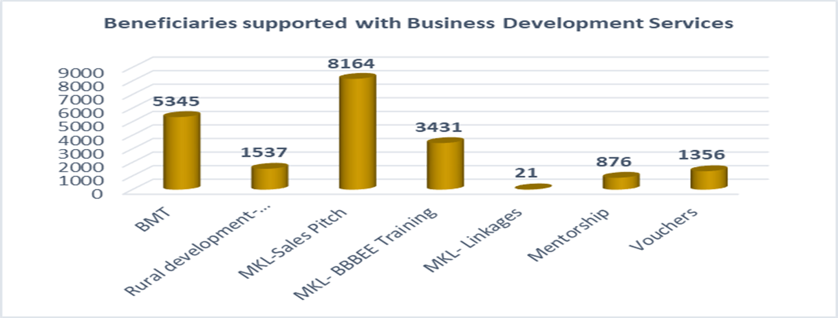
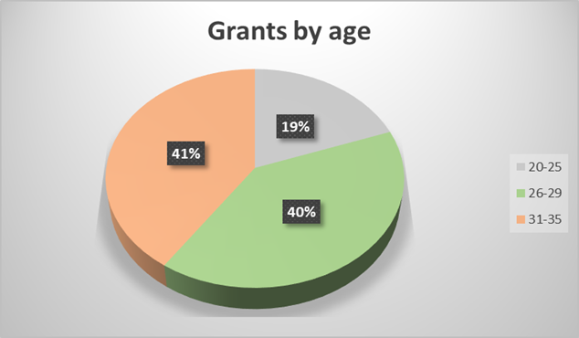
PROGRAM 2: PROGRAM DESIGN, DEVELOPMENT AND DELIVERY

Slide 12
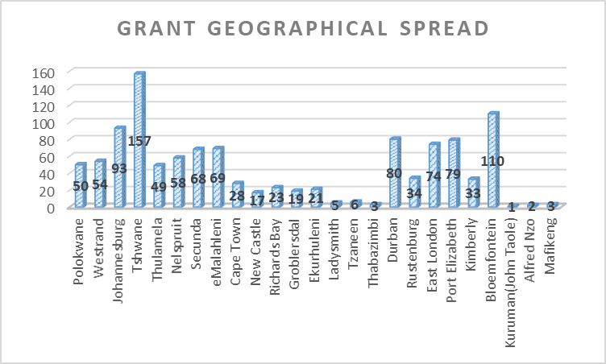
PROGRAM 2: PROGRAM DESIGN, DEVELOPMENT AND DELIVERY

Slide 13
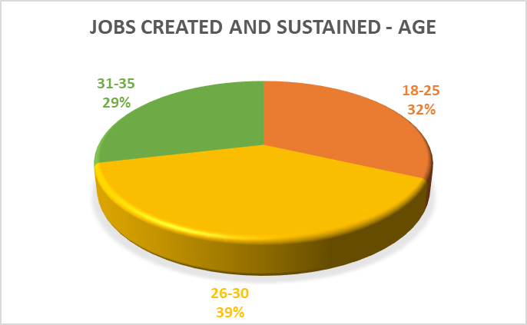
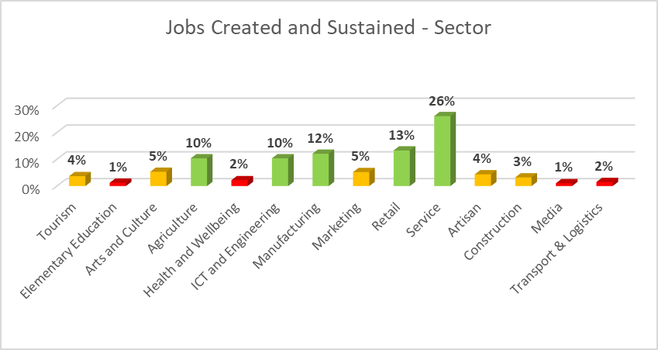
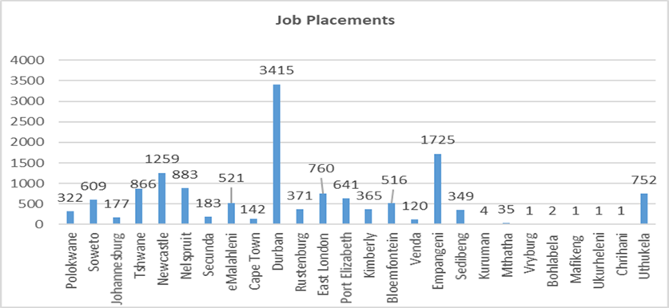
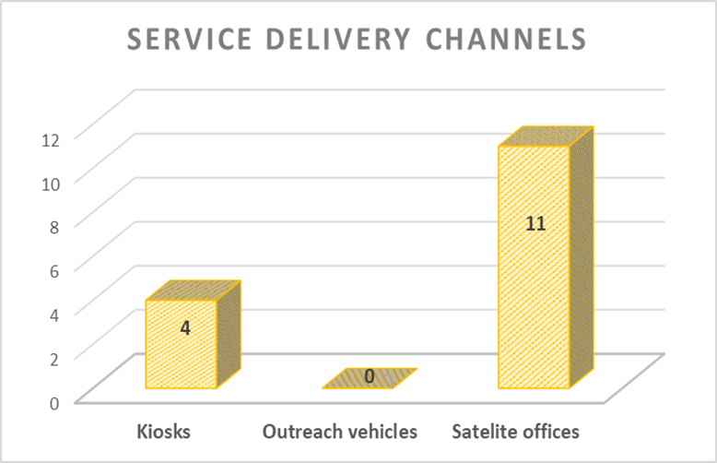
PROGRAM 2: PROGRAM DESIGN, DEVELOPMENT AND DELIVERY

Slide 14
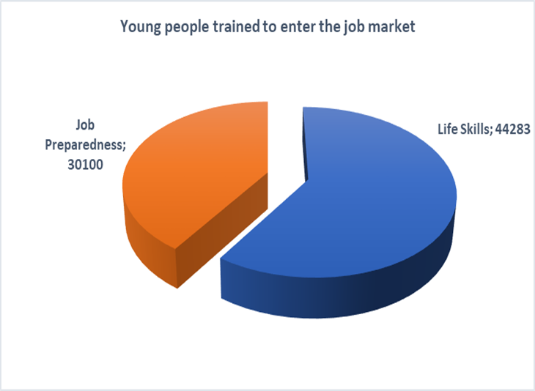
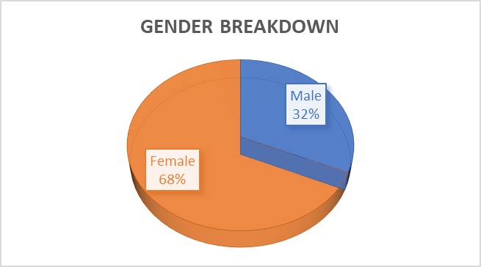
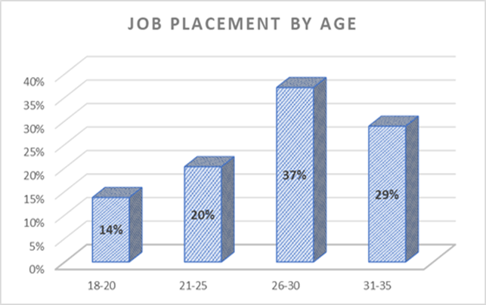
PROGRAM 2: PROGRAM DESIGN, DEVELOPMENT AND DELIVERY
Name of Business Centre | Province
Emalahleni Business Centre | Mpumalanga
Polokwane Business Centre | Limpopo
West Rand Incubation | Gauteng
Secunda Incubation | Mpumalanga

Slide 15
BENEFICIARY STORY: YOUTH ENTRPRENEUR

Slide 16
BENEFICIARY STORY: JOBS PROGRAM

Slide 17
PROGRAM 3: NATIONAL YOUTH SERVICE
Strategic Objective | Key performance Indicator | 2019/20 Target | 2019/20 Actual | Reason for Variance
To coordinate the implementation of NYS across all sectors of society | Number of Government Departments partnerships established to implement NYS at national level | 18 Government Departments partnerships established to implement NYS at national level | 19 | Annual target met and exceeded due to road shows implemented by National Youth Service Unit and interest generated by support from the Presidential Youth Service (PYS)
 | Number of Government Departments partnerships established to implement NYS at provincial level | 18 Government Departments partnerships established to implement NYS at provincial level | 30 | Annual target met and exceeded due to National Youth Service Unit efforts to engage with provinces to implement the Presidential Youth Service (PYS)
 | Number of Government Departments partnerships established to implement NYS at local level | 60 Government Departments partnerships established to implement NYS at local level | 66 | Annual target met and exceeded due to willingness of Local Government to implement service projects.
 | Review and implement NYS Marketing and Communications Strategy | Review and implement NYS Marketing and Communication Strategy | Reviewed and implemented NYS Marketing and Communication Strategy | Annual target met
 | Number of partnerships established to implement NYS with civil society and the private sector | 100 partnerships established to implement NYS with civil society and the private sector | 106 | Annual target met and exceeded due to willingness of civil society to partner and implement service projects.

Slide 18
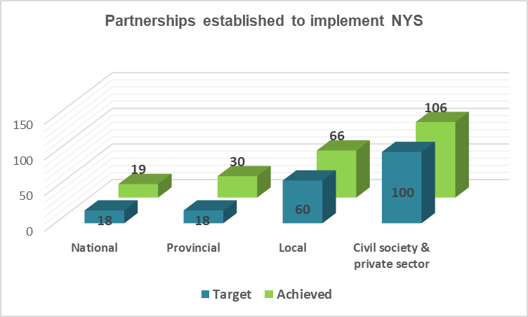
PROGRAM 3: NATIONAL YOUTH SERVICE

Slide 19
BENEFICIARY STORY: NYS

Slide 20
PROGRAM 4: RESEARCH AND POLICY
Strategic Objective | Key performance Indicator | 2019/20 Target | 2019/20 Actual | Reason for Variance
To produce research and policy which influences change on youth sector and build sustainable relationships | Number of Satisfaction surveys conducted | 4 Satisfaction surveys conducted | 4 Satisfaction surveys conducted | Annual target met
 | Number of Impact evaluations conducted | 3 Impact evaluations conducted | 3 Impact evaluations conducted | Annual target met
 | Produce Annual Report on government wide priorities | Produce Annual Report on government wide priorities | Produced Annual Report of government wide priorities | Annual target met
 | Number of Youth status outlook reports produced | 4 Youth status outlook reports produced | 4 Youth status outlook reports produced | Annual target met

Slide 21
ANNUAL FINANCIAL STATEMENTS

Slide 22
FINANCIAL OVERVIEW
The NYDA prepared the Annual Financial Statements (AFS) for the year ended 31 March 2020 and submitted for audit on 31 July 2020.
The AFS were audited by the Auditor General South Africa, who subsequently issued an audit on the 27th of October 2020. The Agency has maintained its sixth consecutive clean audit report.
The NYDA reported surplus for the year of R8.5 million in 2019/20 and has a cash balance of R65 million against payables of R48 million.
The Agency continue to operate as a going concern, i.e. it is able to fund it operations and projects for the next foreseeable future.
There was no unauthorized expenditure for the year.

Slide 23
FINANCIAL OVERVIEW
The NYDA incurred irregular expenditure of R171 000 (0.03% of the total expenditure). An investigation indicated that an employee who was involved in the procurement process failed to declare a conflict of interest. The employee has been subjected to a disciplinary process and pleaded guilty to the charges. The employee has been suspended for three months without pay, docked salary of R150 000 and has been placed on a final written warning. No fruitless and wasteful expenditure was incurred during the 2019 / 2020 financial year.
At year end, the Agency reported capital commitments amounting to R6 million, contingent assets of R5 million and contingent liabilities of R3.1 million.
Related party transactions with the Department of Woman Youth and Persons with Disabilities (DWYPD) were disclosed as grant income in the Statement of Financial Performance; other related party transactions with the board and key management were disclosed in Note 26 of the AFS.

Slide 24
STATEMENT OF FINANCIAL POSITION
Description | 2019 / 2020 | 2018 / 2019
Assets
Current assets
Receivables from exchange transactions | 3 940 | 4 974
Receivables from non-exchange transactions | 13 619 | 10 187
Cash and cash equivalents | 63 712 | 99 128
Non-current assets | 81 270 | 114 289
Property, Plant and Equipment | 47 002 | 27 862
Intangible assets | 19 472 | 12 118
Loan receivables from exchange transactions | - | -
Rental deposit | 5 009 | 5 356
Total assets | 152 753 | 159 625
Liabilities
Current liabilities
Finance lease obligation | 248 | 805
Payables from exchange transactions | 48 701 | 73 169
Employee cost provisions | 15 993 | 10 851
Deferred income | 13 729 | 11 508
Deferred expenses | 2 457 | 435
Non-current liabilities
Finance lease obligation | 340 | 223
Deferred expenses | 6 196 | 6 010
Total Liabilities | 87 664 | 103 001
Net Assets | 65 089 | 56 624
Accumulated surplus | 65 089 | 56 624

Slide 25
STATEMENT OF FINANCIAL PERFORMANCE
Description | 2019 / 2020 | 2018 / 2019
Revenue
Revenue from exchange transactions
Interest income | 4 864 | 5 750
Other income | 2 004 | 410
Gain on disposal of assets and liabilities | 4 | 55
 | 6 872 | 6 215
Revenue from non-exchange transactions
Transfer revenue
Grant income – Department of Women, Youth and Persons with Disabilities | 459 577 | 477 145
Donor funding income | 47 839 | 31 047
 | 507 416 | 508 192
Total revenue | 514 288 | 514 407
Expenditure
Operating expenses | (164 867) | (150 517)
Donor funding disbursements | (47 839) | (31 047)
Finance costs | (73) | (114)
Project disbursements | (293 045) | (311 978
Total expenditure | (505 823) | (493 655)
Surplus / (Deficit) for the year | 8 465 | 20 751

Slide 26
ANNUAL EXPENDITURE BY PROGRAM
Program | Budget | Actual | % dev | Link to the MTSF
Economic participation | R 92,784,657 | R 92,827,566 | 0% | Economic transformation and job creation
JOBS | R 43,736,499 | R 43,657,434 | 0% | Education, skills and health
National Youth Service | R 23,004,459 | R 23,798,000 | -3% | Social cohesion and safe communities
Universal access | R 44,503,439 | R 44,038,000 | 1% | Consolidating the social wage through reliable and quality basic services
Research and policy | R 1,728,000 | R 1,741,000 | -1% | A capable, ethical and developmental state
Administration | R 87,662,000 | R 86,984,000 | 1% | A capable, ethical and developmental state
Employee costs | R 199,380,946 | R 199,654,000 | 0% | A capable, ethical and developmental state
Depreciation, amortization and impairment (non-cash) | R - | R 13,123,000 |  | Consolidating the social wage through reliable and quality basic services
Total | R 492,800,000 | R 505,823,000 | -3%

Slide 27
DONOR FUNDING
Partner | Funds raised | Project description
Services SETA | R19 709 000 | Artisan training
Department of Arts and Culture | R8 731 000 | The Young Patriots Program
Industrial Development Corporation | R733 000 | NYS Volunteer Program
Provincial and local government | R2 607 000 | Grant program
Department of Small Business Development | R345 000 | Braai Café
Department of Small Business Development | R14 997 000 | 1000 businesses in 100 days
CHIETA | R720 000 | Artisan training
Total | R47 839 000

Slide 28
ANNUAL EXPENDITURE BY NATURE
Nature | Budget | Actual | % dev
Administration and overheads | R45,162,000 | R 46,767,000 | -4%
Communications and PR | R30,287,000 | R26,331,000 | 13%
Information Communication and Technology | R27,749,000 | R28,556,000 | -3%
Audits | R5,650,000 | R4,441,000 | 21%
Risk and legal | R3,206,000 | R3,158,000 | 1%
Human Resources | R8,410,000 | R6,506,000 | 23%
Youth training programs | R12,819,000 | R12,856,000 | 0%
Travel and accommodation | R31,808,000 | R30,869,000 | 3%
Project disbursements | R56,638,000 | R59,630,000 | -5%
Donor funded expenditure | R45,300,000 | R47,839,000 | -6%
Grant disbursements | R26,390,054 | R26,093,000 | 1%
Goods and services | R293,419,054 | R293,046,000 | 0%
Employee costs | R199,380,946 | R199,654,000 | 0%
Depreciation, amortization and impairment (non-cash) | R - | R13,123,000
Total | R492,800,000 | R505,823,000

Slide 29
AUDIT REPORT OVERVIEW

Slide 30
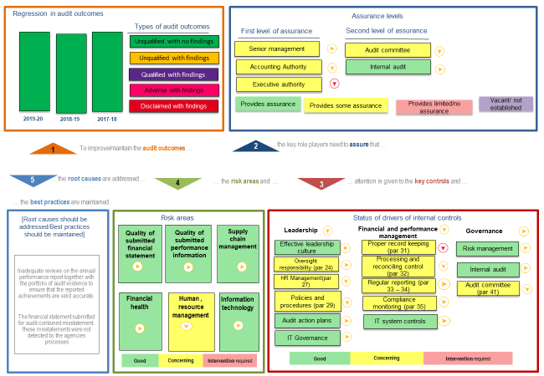
AUDIT REPORT OVERVIEW

Slide 31
AUDIT REPORT OVERVIEW
The audit outcome for the entity was classified as clean with no material findings.
13 audit findings were reported by the Auditor General.
5 of the 13 findings related to misstatements in financial statements which were not material and were adjusted.
1 finding related to performance related misstatements which were also adjusted.
7 findings related to internal control deficiencies.
The financial health and viability of the entity was assessed as good by the AGSA.

Slide 32
LOOKING FORWARD

Slide 33
YOUTH EMPLOYMENT INTERVENTION

Slide 34
YOUTH EMPLOYMENT INTERVENTION

Slide 35
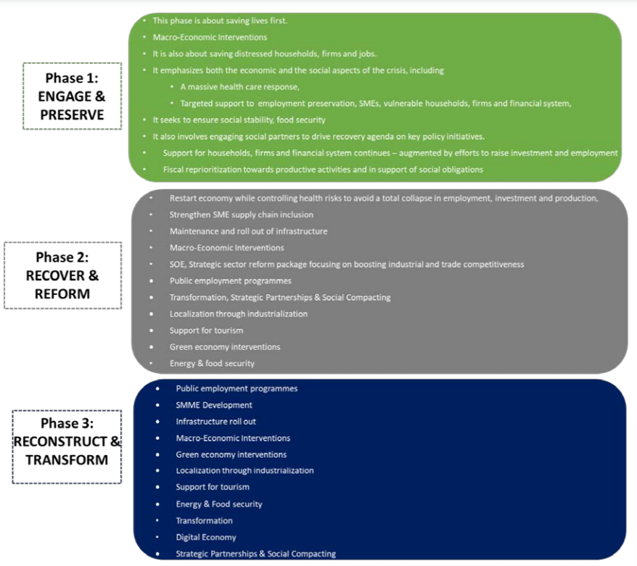
ECONOMIC RECOVERY PLAN

Slide 36
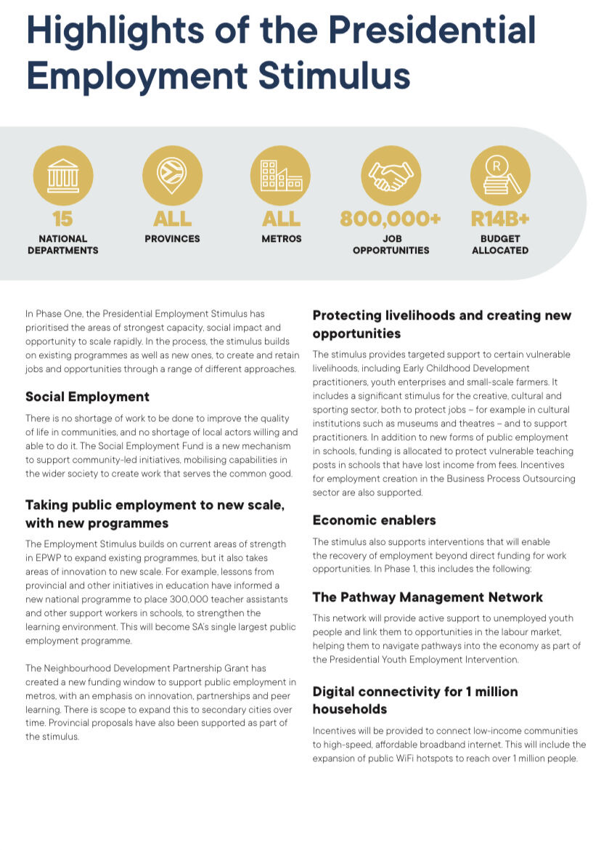
ECONOMIC RECOVERY PLAN

Slide 37
YOUTH EMPLOYMENT

Slide 38
YOUTH EMPLOYMENT

