Slide 1
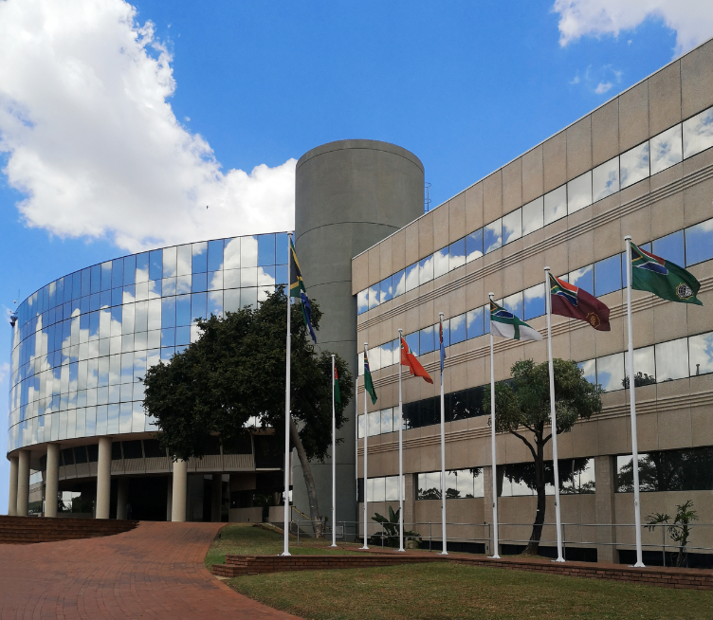

2019/20
DEPARTMENT OF DEFENCE
Annual Report
Presentation to the Portfolio Committee on Defence and Military Veterans on 01 Dec 2020

Slide 2

Aim
Information brief
to the
Portfolio Committee
on Defence and Military Veterans
on the
DOD Annual Report for FY2019/20

Slide 3
Presentation Structure
Background
  Regulatory Framework, subsequent to COVID-19 Lockdown
  Amended Legislative Target Dates

Slide 4
Presentation Structure
DOD Annual Report Structure and Content
  Part A: General Information
  Part B: Performance Information
  Part C: Governance
  Part D: Human Resource Management
  Part E: Financial Information

Slide 5
Presentation Structure
AGSA Audit Outcomes for the year ended
31 March 2020
  Report on the Audit of the Annual Performance Report
  Report on the Audit of the Financial Statements
    Basis for Qualified Opinion
    Material Irregularities

Slide 6
Background

Slide 7
Background
This Annual Report seeks to provide the civil oversight committees of Parliament and the people of SA an overview of the performance of the Department during the financial year under review.
The DOD Annual Report Instruction 0001/2020 dated
30 Jan 2020 gave effect to the legislative framework applicable on Annual Reports, and provided DOD unique guidelines for the compilation of respective Annual Report Inputs.
Subsequent to the National COVID-19 Lockdown effective from
27 Mar 2020, the following supplementary guidelines and instructions relating to Annual Reports, came into effect:
NT updated Annual Report Guide dated Mar 2020, providing amended guidelines regarding the content and format of Annual Reports.

Slide 8
Background
Government Gazette No. 43188 dated 31 Mar 2020, providing exemption from complying with deadlines in ito PFMA
Sec 40(1)(c), 40(1)(d), 55(1)(c) & 55(1)(d).
NT Circular 2019/20 dated 10 Jun 2020 to Accounting Officers “Financial Year End Procedures, Closure and Submission Dates for all PFMA Compliant Institutions as amended”, confirming extension of submission deadlines ito PFMA:
- Sec 41, 51(1)(f) and 76 [submission of Annual Reports to AGSA]
- Sec 40(1)(d) and 55(1)(d) [submission of Audit Report by AGSA]
- Sec 65(1)(a) and 65(2) [tabling of Annual Reports]
(30 Nov 2020)

Slide 9
Background
AGSA letter 06611REG19/20 dated 08 Sep 2020, pertaining to “Possible delays in the audit” and explaining the obstacles experienced during the audit process that impacts the completion of the audit and the submission of the audit report in line with legislation. AGSA will endeavour to conclude the audit on/or before 31 Oct 2020.
Notification from the Deputy President dated 03 Sep 2020 to all members of the Executive requesting the tabling of Annual Reports and Financial Statements before 16 Nov 2020.

Slide 10
Background
Letter from Parliament to the MOD&MV dated 23 Sep 2020 requesting the submission of the draft DOD Annual Report to the PCD&MV before 01 Oct 2020 in preparation of the BRRR process for the Annual Report briefings from 06 – 15 Oct 2020.
- The Pre-Audited DOD Annual Report was provided to the
PCD&MV (for BRRR purposes) on 01 Oct 2020.
- Received the preliminary BRRR on 17 Oct 2020.
Notification from the Deputy President dated 29 Sep 2020 to all members of the Executive requesting the tabling of Annual Reports and Financial Statements by the end of Oct 2020 but latest 16 Nov 2020.

Slide 11
Background
AGSA letter 06611REG19/20 dated 06 Nov 2020, regarding the “Delay in the issue of the audit report for the 19/20 financial year”, explained the challenges encountered with the completion of computer assisted audit techniques. AGSA committed to finalise the audit by 13 Nov 2020.
  (Signed Audit Report received on 12 Nov 2020)

Slide 12
Amended Legislative Target Dates
31 May 2020 31 July 2020
In accordance with Section 40(1)(c) of the PFMA, the AO for the Department “must submit the financial statements within two months after the end of the financial year to the Auditor-General for auditing” (inclusive of the Department’s non-financial performance information).
This implies that the draft Annual Report must be submitted to the AGSA by end May July each year. The AGSA will review the contents of the Annual Report to ensure that it is consistent with the information provided in the AFS, planning documents and any other relevant material. The AGSA will then complete the audit and provide their Audit Report to Parliament for the relevant financial year, usually by end July September October November. (12 November 2020)

Slide 13
Amended Legislative Target Dates
31 August 2020 30 November 2020
Section 40(1)(d) of the PMFA stipulates that the AO for the Department “must submit within five months of the end of a financial year to treasury:
an annual report on the activities of the department;
the financial statements for the financial year after those statements have been audited; and
the Auditor-General’s report on those statements”.
This implies that the final, audited DOD Annual Report must be presented by the AO to the EA and NT by end August October
November. (20 November 2020)

Slide 14
Amended Legislative Target Dates
30 September 2020 30 November 2020
In terms of Section 65(1)(a) of the PFMA, “the executive authority responsible for a department must table in the National Assembly or provincial legislature, the annual report and financial statements referred to in Section 40(1)(d) and the audit report on those statements, within one month after the accounting officer for the department received the audit report”.
Tabling of the Annual Report to the Speaker of the National Assembly and the Chairperson of the National Council of Provinces usually takes place by the end of September November.
(20 November 2020)

Slide 15
2. DOD Annual Report Structure and Content

Slide 16
Part A:
General Information

Slide 17
DOD Annual Report Structure
Part A: General Information
Foreword by the Executive Authority [DOD AR p7]
Strategic Statement by the Head of the Department [DOD AR p9]
Introduction by the C SANDF [DOD AR p11]
Strategic Overview [DOD AR p13]
Organisational and Legislative Mandates [DOD AR p14]
Organisational Structure [DOD AR p16]
Information on the Ministry [DOD AR p17]
Defence Diplomacy [DOD AR p19]

Slide 18
Strategic Overview
The DOD Annual Report for FY2019/20 reflects on the contribution Defence made over the 2014 to 2019 MTSF to the sovereignty of South Africa and the authority of the State.
During the year under review, and more towards the end of the financial year, the armed forces have been in the eye of the storm of the COVID-19 Coronavirus pandemic, assuming roles that have been arrogated to them by the Commander-in-Chief, acting in accordance with the provisions of the Constitution and the Defence Act.
Despite severe budget cuts during the 2014 to 2019 MTSF period, Defence has done well and fulfilled its Constitutional mandate.
[DOD AR p7]

Slide 19
Strategic Overview
The Defence budget has been cut beyond the bone and the Special Defence Account, a key instrument to enable Defence to execute its approved defence acquisition projects, is nearing its demise.
Major acquisition projects for the landward forces and maritime forces are under serious threat from non-completion.
Budget reductions continue to have an adverse effect on the SANDF capability, sustainability and modernisation of defence prime mission equipment and the defence industry as a whole.
ARMSCOR will also have to reduce projects during FY2020/21 to zero in FY2021/22.
[DOD AR p7]

Slide 20
Strategic Overview
Reductions will negatively affect the SA Defence Review 2015 milestone of arresting the capability decline.
There will be the general loss of capacity within the defence industry as a result of the reduced Departmental spend. Between FY2017/18 and FY2020/21, there have been losses of up to
R7 billion in revenue, a significant dent on the GDP. The defence industry work force has declined from 15 000 to 12 000 in the same period.
These developments will result in the inability to meet future SANDF requirements for critical capabilities. It will hamper support to national government imperatives and implementation of the SA Defence Review 2015, as adopted by Parliament and meant to be a blueprint for the future of the SANDF. [DOD AR p7-8]

Slide 21
Strategic Overview
Apart from his role as Head of the Department and Accounting Officer of the Department, the Secretary for Defence also
co-chaired the JCPS Cluster of Government at DG level. It was therefore incumbent on him to lead and coordinate activities in the following key areas: [DOD AR p10]
  Establishment of COVID-19 pandemic work teams.
  Provision of strategic direction and guidance to the appointed work streams.
  Repatriation of 114 South Africans from the City of Wuhan in the People’s Republic of China.
  Formulation of a Socio-Economic Recovery Plan for the country, post COVID-19 national lockdown.
  Developing and consolidating a Draft Framework on the Risk Adjusted Strategy.
  Ensuring the alignment of government-wide security priorities and programmes that were submitted to Cabinet.

Slide 22
Key Policy Developments
The following progress regarding the Constitutional and legislative mandates are reported:
Draft Military Discipline Bill, 2019 [DOD AR p15]
  The draft Bill was published by the PCD&MV for public comments during the fourth quarter of FY2019/20. It is envisaged that the draft Bill will be introduced by the MOD&MV in Parliament during FY2020/21, which will subsequently see the implementation of the Act in the DOD during FY2020/21.

Slide 23
Key Policy Developments
Hydrographic Bill (B17 of 2018) [DOD AR p15]
  The draft Bill was approved by the Selected Committee on Security and Justice on 03 Dec 2019, and by the NCOP and the NA on 06 Dec 2019, after which the Bill was submitted to the President for assent. The Bill continued through the Parliamentary approval process during FY2020/21 and was signed into law by the President on 26 May 2020, which will see subsequent implementation of the Act (Act No. 35 of 2019) in the DOD during FY2020/21.

Slide 24
Key Policy Developments
Defence Amendment Bill (B18 of 2017) [DOD AR p15]
  Efforts to amend the Defence Act, 2002 (Act No. 42 of 2002) was initiated during FY2015/16, with the objective to align the Act with current Departmental requirements to enhance the efficiency of the DOD.
  The draft Bill was published on 11 December 2019 for comments before a Public Hearing scheduled for the fourth quarter of FY2019/20. It was envisaged that the draft Bill will be tabled in Parliament during FY2020/21. The Bill continued through the Parliamentary approval processes during FY2020/21, was signed into law by the President and gazetted on 07 August 2020, which will see the subsequent implementation of the Act (Act No. 06 of 2020) in the DOD, during FY2021/22.

Slide 25
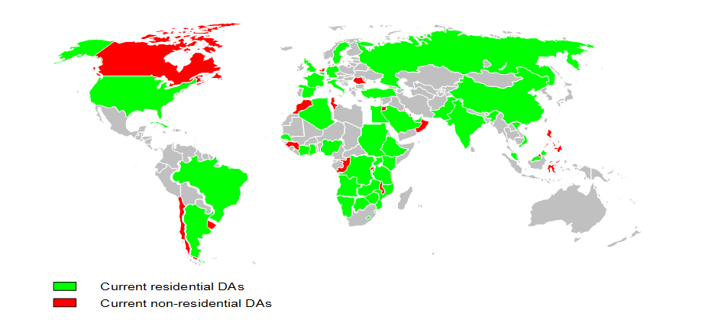
Defence Diplomacy
SANDF Defence Attaché Representation
During FY2019/20, the DOD were represented by residential Defence Attachés in 42 countries, the AU and the UN.
[DOD AR p19]

Slide 26
Defence Diplomacy
Military Attaché and Advisor Corps Representation
During FY2019/20, resident Military Attaché and Advisor Corps representation in SA were from 59 countries.
[DOD AR p20]

Slide 27
Part B:
Performance Information

Slide 28
DOD Annual Report Structure
Part B: Performance Information
South African Defence Review 2015 [DOD AR p23]
Financial Performance Information [DOD AR p27]
(including Capital Investment, Maintenance and Asset Management Plan)
Non-Financial Performance Information [DOD AR p33]
  Strategic Outcome-orientated Outputs [DOD AR p33]
  Overview of Departmental Performance [DOD AR p39]
  Performance Information by Programme [DOD AR p45]

Slide 29
DOD Annual Report Structure
Part B: Performance Information (2)
Appendices on DOD Performance, Targets and Actual Achievements over the 2015 – 2020 Strategic Period:
  Capital Investments, Maintenance and Asset Management Plan [DOD AR p91]
  DOD Selected Performance Indicators, Targets and Actual Achievements [DOD AR p101]
  DOD End-Term Performance against Strategic Indicators and Targets [DOD AR p105]
  Performance against DOD Performance Indicators over Multiple Years (FY2016/17 to FY2019/20) [DOD AR p131]

Slide 30
SA Defence Review 2015 Implementation Status
  During the year under review, the DOD responded to guidelines given by the President with a re-prioritisation and refinement of its planning, the focus being on resolving the issues that prevent the
  execution of current ordered operational commitments in the short-term.
  This ‘Intervention Plan’ not only addresses operational performance but also includes focussed spending on critical multi-mission cross-cutting capabilities that will ensure funding flows to the Defence Industry and Defence Related Industries, both of which remain crucial to the enablement of the defence function in the future, as well as the economy of South Africa.
[DOD AR p23-26]

Slide 31
SA Defence Review 2015 Implementation Status
  The MOD&MV, together with the top-level leadership of the DOD, continued to engage Parliament on the urgent and critical issues facing the Department. Discussions continued with the President, the Minister of Finance and NT, on securing a stable funding trajectory for the Department for the medium to long-term.
  Apart from a limited number of interventions, little can be done to improve the combat power of the Defence Force. The implementation of the SA Defence Review 2015 has been reduced to an effort to reorganise departmental administration towards improving efficiency.
  To this end work continues on the repositioning of the Defence Secretariat through a new Defence Secretariat Strategy, and the development of a new Military Strategy with its concomitant Force Design and Force Structure.

Slide 32
SA Defence Review 2015 Implementation Status
  South Africa is at that critical point where a common and collective understanding is required of how to plan and budget for the Defence Function of the RSA during this period of fiscal constraint and agree collectively on the prioritised interventions to be pursued.
  If the Department does not receive sustainable funding, a
  re-evaluation of SA’s defence capability and the capacity of the DOD to sustain its ordered commitments is inevitable.
  This implies that the Defence Force will have to be redesigned to fit its funding allocation and not its Constitutional obligations.

Slide 33
Financial Performance Information

Slide 34
Defence Vote 19
During FY2019/20, the DOD received an appropriation of Rb50,888, an 4.93% increase on the FY2018/19 appropriation. The DOD was able to spend 99.99% of its appropriated funds and surrendered Rm5,875 to the National Revenue Fund.
Summary of Actual Expenditure versus Adjusted Appropriation for Current and Prior Years
 | FY2017/18 | FY2018/19 | FY2019/20
 | R’000 | R’000 | R’000
Adjusted Appropriation | 48 999 560 | 48 496 235 | 50 888 132
Expenditure | 48 977 232 | 48 492 073 | 50 882 257
Over expenditure | 0 | 0 | 0
Amount overspent as percentage of Adjusted Appropriation | 0 | 0 | 0
Amount surrendered | 22 328 | 4 162 | 5 875
Amount surrendered as percentage of Adjusted Appropriation | 0.046% | 0.009% | 0.012%
[DOD AR p27]

Slide 35
Non-Financial Performance Information

Slide 36
Strategic Outcome-Orientated Outputs
  During the year under review, DOD support to Government outcomes and priorities encompassed two MTSF periods; the MTSF 2014 – 2019 (arranged in 14 outcomes) and the MTSF 2019 – 2024 (arranged in 7 priorities).
  Medium-Term Strategic Framework 2014 – 2019
    Outcome 3: “All people in South Africa are and feel safe”
    Outcome 11: “Creating a better South Africa and contributing to a better and safer Africa in a better World”
  Medium-Term Strategic Framework 2019 – 2024
    Priority 6: “Social Cohesion and Safer Communities”
    Priority 7: “A Better Africa and a Better World”
[DOD AR p35]

Slide 37
MTSF Outcomes and Priorities
In pursuance of its legislative mandate and utilising its inherent defence capabilities, the DOD continued to provide support to the NDP 2030 priorities, relevant to the Defence mandate.
In this regard, the MOD&MV is the Chairperson, and jointly responsible for the coordination of the JCPS Cluster and member of the Joint ICTS Cluster for:
  Medium-Term Strategic Framework 2014 – 2019
    Outcome 3 and Outcome 11
  Medium-Term Strategic Framework 2019 – 2024
    Priority 6 and Priority 7
[DOD AR p36]

Slide 38
Outcome 3 / Priority 6
The SANDF deployed 15 sub-units to execute resourced border safeguarding (Op CORONA) in Limpopo, Mpumalanga, KwaZulu-Natal, Free State, Eastern Cape, Northern Cape and North West Provinces in an endeavour to safeguard and maintain the integrity of the country’s borderline.
Four maritime patrols, in support of Op CORONA were conducted along the east and west coast of Africa.
The SANDF continued its efforts to contribute towards
Op PHAKISA objectives, with specific reference to Initiative 5: “Enhanced and Coordinated Enforcement Programme”, through the conduct of Op CORONA maritime coastal patrols.
[DOD AR p36]

Slide 39
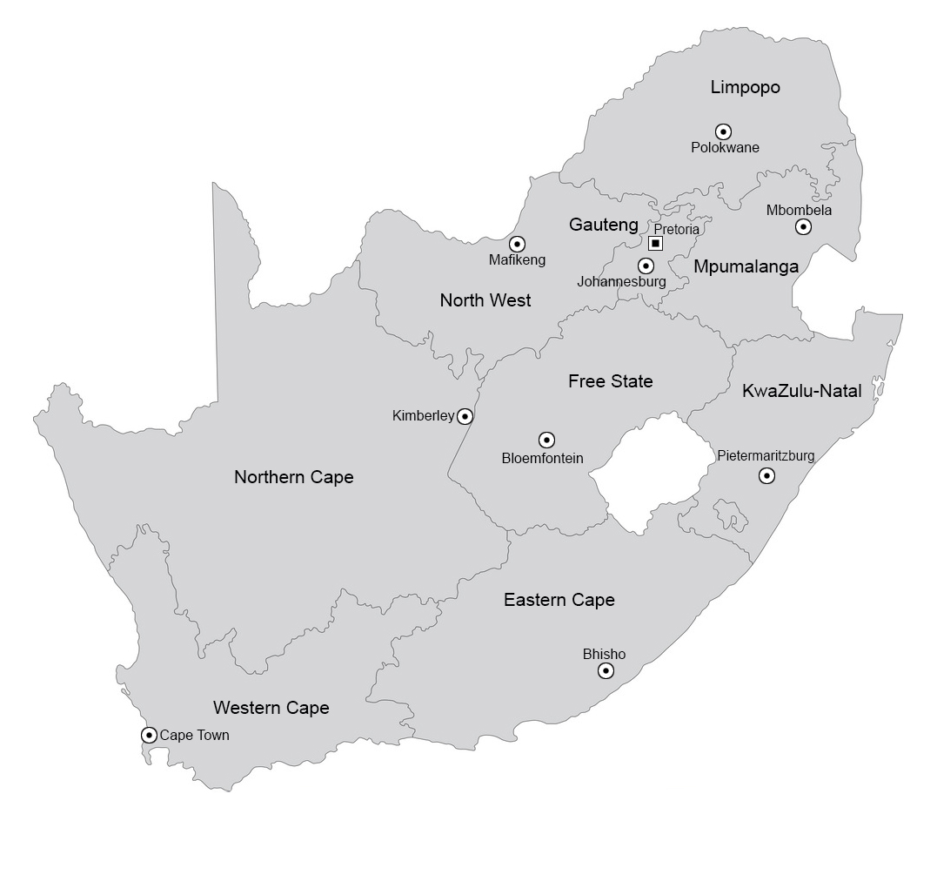
Outcome 3 / Priority 6
Rooibokkraal
Pontdrift
Musina
Madimbo
Sandriver
Macadamia
Gopane
Zonstraal
Pongola
Vioolsdrif
Merrivale
Ndumo
Fouriesburg
Wepener
Maluti
Maritime patrols
Maritime patrols

Slide 40
Operational Successes
Operational successes recorded during internal deployments, included:
43 weapons recovered
13 277 illegal foreigners apprehended
597 criminals arrested
180 stolen vehicles recovered
10 510kg dagga confiscated
929kg of precious metals (mostly copper) confiscated
5 676 live-stock recovered
Contraband goods to the value of Rm41,5 confiscated
[DOD AR p36 & 60]

Slide 41
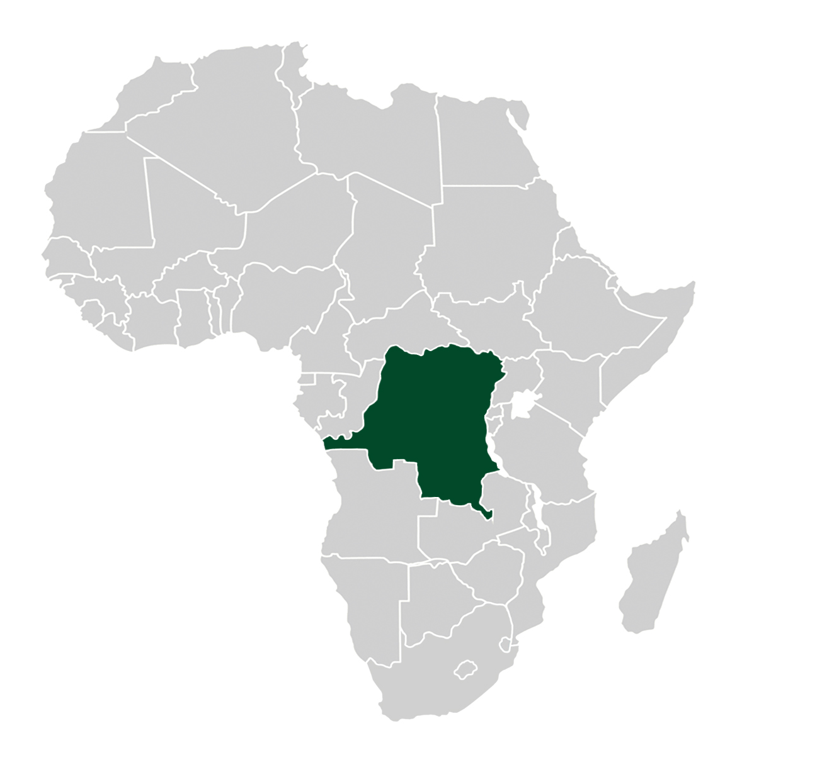

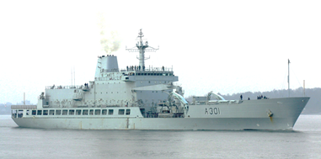

Outcome 11 / Priority 7
DRC
Op MISTRAL
Op
COPPER

Slide 42
Outcome 11 / Priority 7
The SANDF continued to participate with the planning and execution of external peace support operations, rescue operations and humanitarian assistance operations, which included:
Peace Support Operations. The SANDF continued to participate in the UN Peace Support Operation in the DRC (Op MISTRAL).
Anti-piracy Operations. The SANDF continued to support to Mozambican Defence Force with anti-piracy operations in the Mozambique Channel (Op COPPER).
Disaster Aid and Disaster Relief. The SANDF provided humanitarian assistance operations in support of the Government of Mozambique (Op INDIZA), the Government of Malawi (Op UKUNONPHELA), and the Government of Zimbabwe (Op UKUWELA) due to flooding after
cyclone EDAI.
[DOD AR p37]

Slide 43
Outcome 11 / Priority 7
In support of SA’s foreign policy, the DOD:
Took part in a number of peace missions and SANDF troops have served in UN and AU missions on the continent.
Contributed to the FIB under UN Resolution 2098 to neutralise, disarm and prevent the expansion of all armed groups in the eastern parts of the DRC.
Participated in a JIIM military exercise (Ex MOSI), a multinational exercise to promote navigation and sea economic activities between SA, the PRC and Russia, executed on the west coast of SA between Cape Columbine and the Cape of Good Hope from 21 to 30 Nov 2019.
[DOD AR p38]

Slide 44
Outcome 11 / Priority 7
As part of the DOD’s defence diplomacy efforts with key African states and strategic partners, the DOD remains committed to have its Defence Attachés deployed to support Government objectives.
To this extend, the DOD deployed 10 Defence Attachés in the SADC region; Angola, Botswana, the DRC, Lesotho, Mozambique, Namibia, Eswatini, Tanzania, Zambia and Zimbabwe.
[DOD AR p38]

Slide 45
Departmental Performance

Slide 46
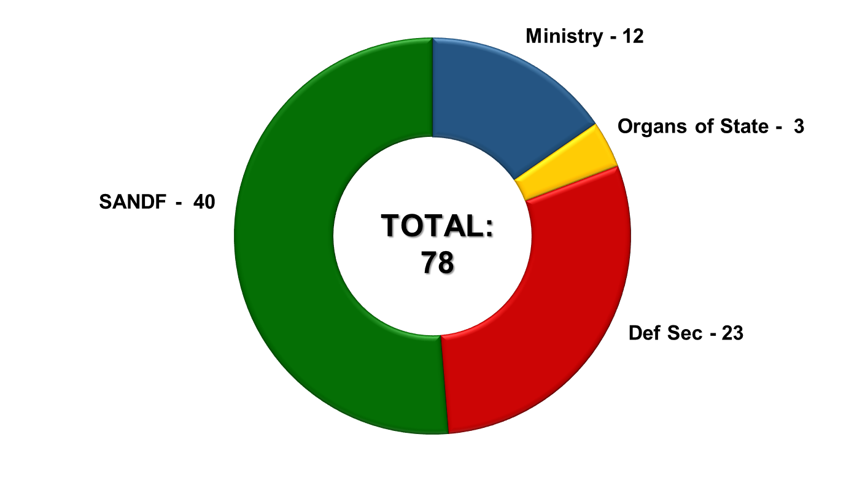
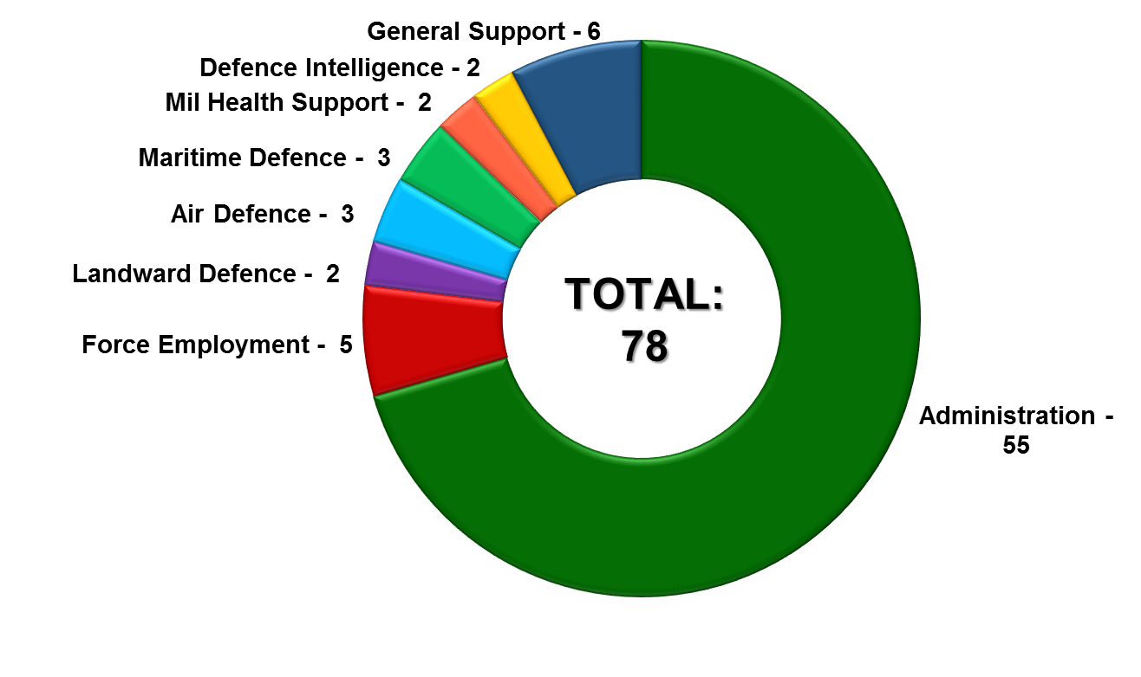
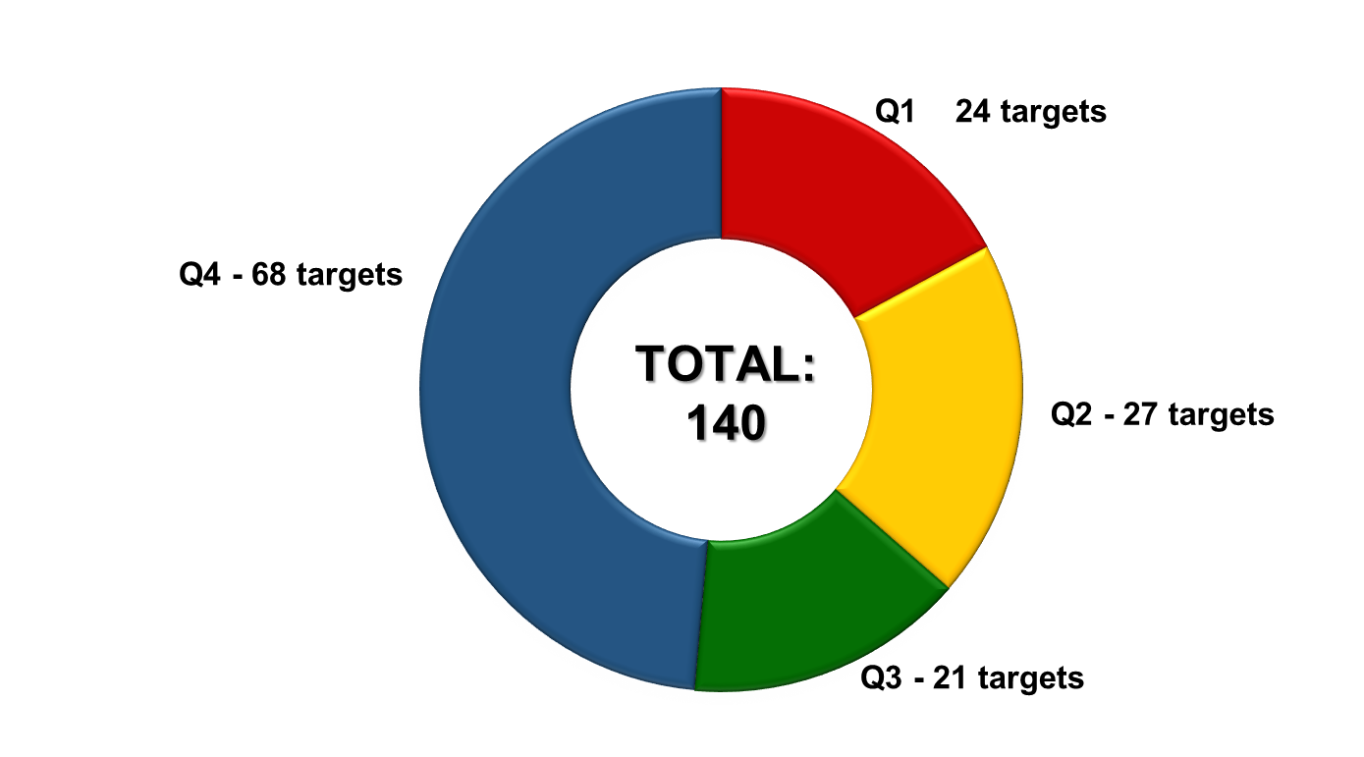
Analysis of DOD Performance Indicators
The DOD reported against 78 Performance Indicators, consisting of 140 targets, in the FY2019/20.

Slide 47
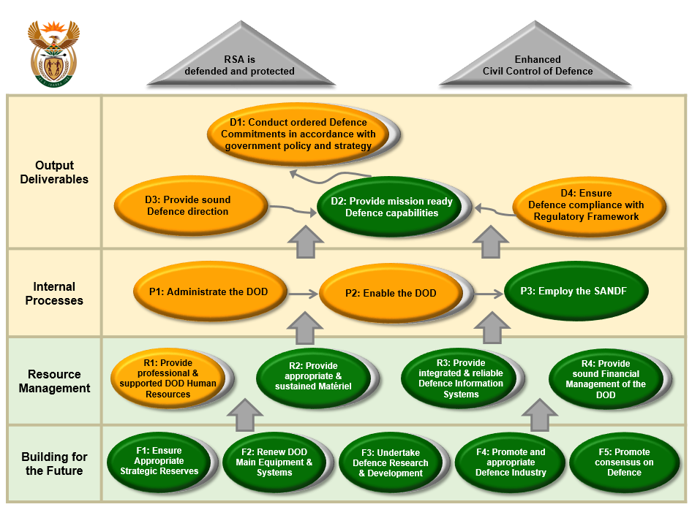
DOD Mandate Achievement
[DOD AR p84]

Slide 48
Year-on-Year Performance Comparison
 | FY2015/16 | FY2016/17 | FY2017/18 | FY2018/19 | FY2019/20
Achieved | 69 (66%) | 62 (65%) | 64 (64%) | 67 (69%) | 57 (73%)
Not Achieved | 35 (34%) | 33 (35%) | 36 (36%) | 30 (31%) | 21 (27%)
Total | 104 | 95 | 100 | 97 | 78
[DOD AR p122]

Slide 49
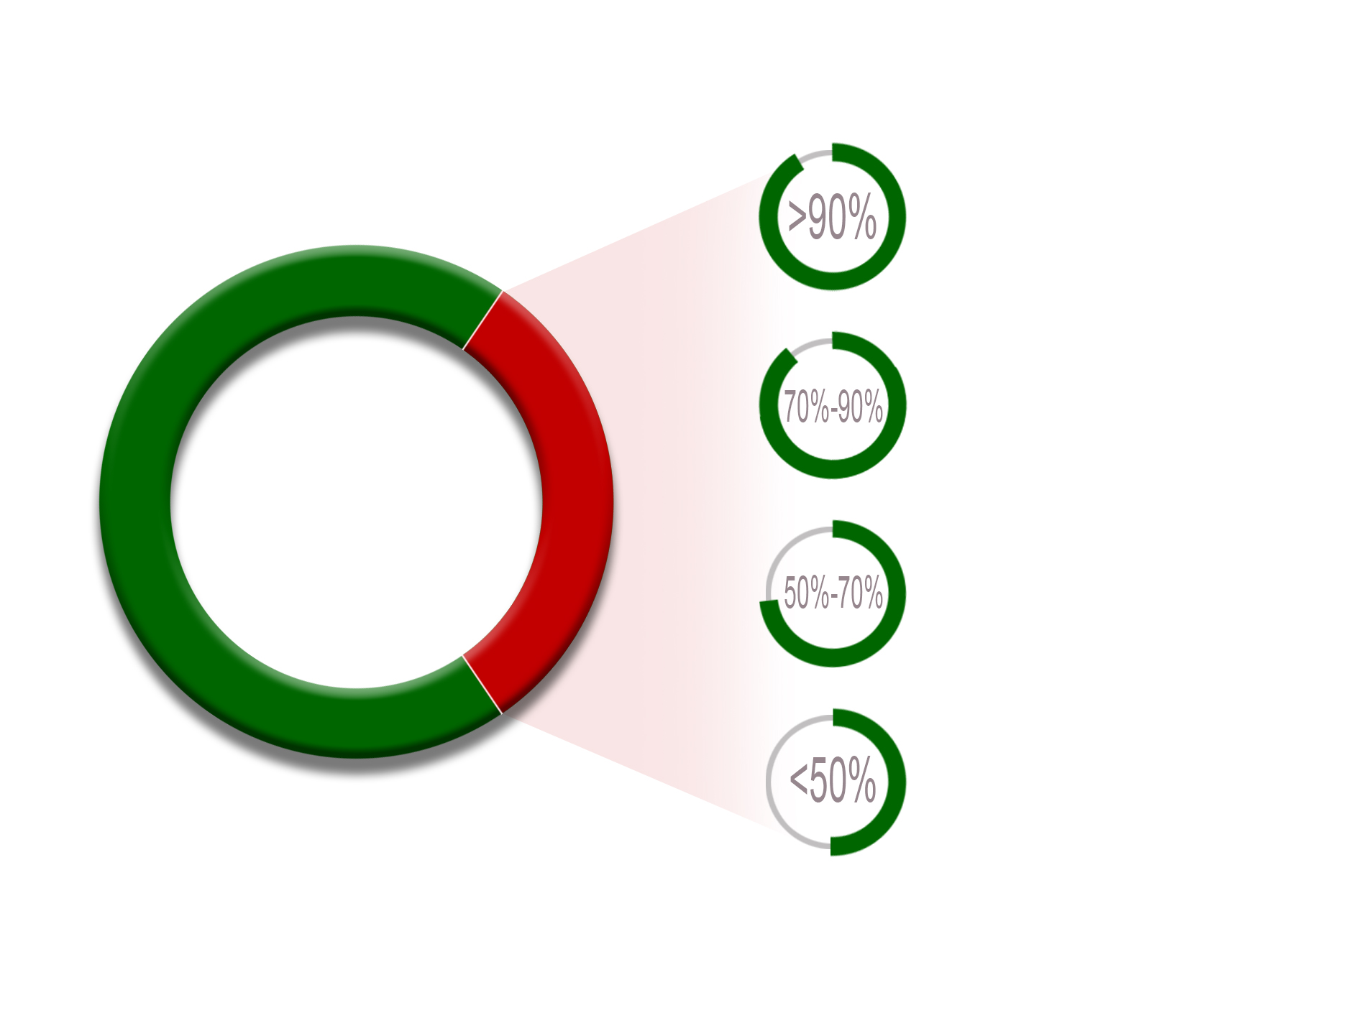
DOD Annual Performance Status
Fully/Overachieved
57 (73%)
Achieved greater than 90% = 5
TOTAL:
78
Achieved between 70%-90% = 5
Achieved between 50%-70% = 7
Achieved less than 50% = 4
Partially/Not Achieved
21 (27%)
[DOD AR p85]

Slide 50
DOD Annual Performance Targets NOT Achieved
Degree of Achievement – GREATER than 90%
Programme | Performance Indicator | Annual Target | Percentage Achievement
Administration | Percentage compliance with submission dates of DOD accountability documents (SMS financial disclosures submitted) [DOD AR p52] | 100% | 99%
Military Health Support | Number of health care activities per year [DOD AR p77] | 2 140 550 | 98%
Defence Intelligence | Number of vetting decisions taken in accordance with requirements [DOD AR p80] | 7 500 | 96%
Administration | Percentage compliance with submission dates of DOD accountability documents (SMS performance agreements submitted) [DOD AR p52] | 100% | 95%
Air Defence | Number of hours flown per year [DOD AR p70] | 17 200 | 94%

Slide 51
DOD Annual Performance Targets NOT Achieved
Degree of Achievement – BETWEEN 70% and 90%
Programme | Performance Indicator | Annual Target | Percentage Achievement
Administration | Number of awareness activities on corruption and fraud conducted [DOD AR p55] | 48 | 90%
Administration | Number of marketing events to promote the Reserves [DOD AR p56] | 30 | 83%
Military Health Support | Percentage compliance with DOD training targets [DOD AR p77] | 80% (648) | 79%
Administration | Percentage of disciplinary cases in the DOD finalised within 90 Days (Military Disciplinary Cases) [DOD AR p54] | 100% | 76%
Maritime Defence | Percentage compliance with DOD training targets [DOD AR p74] | 80% (438) | 71%

Slide 52
DOD Annual Performance Targets NOT Achieved
Degree of Achievement – BETWEEN 50% and 70%
Programme | Performance Indicator | Annual Target | Percentage Achievement
Administration | DOD Enterprise Risk Management maturity level achieved [DOD AR p50] | Level 5 | 67%
Maritime Defence | Number of hours at sea per year [DOD AR p74] | 10 000 | 66%
Administration | Percentage collective grievances and disputes resolved [DOD AR p52] | 85% | 59%
Administration | Percentage of audits completed in terms of the approved Internal Audit Plan [DOD AR p55] | 100% | 59%
Administration | Percentage compliance with submission dates of DOD accountability documents (Reports on RFC activities submitted to the Executive Authority) [DOD AR p48] | 100% (2) (Reports on RFC Activities submitted to the Executive Authority) | 50%
Administration | Percentage adherence to DOD governance schedule (Defence Enterprise Architecture Capability Established and integrated) [DOD AR p50] | 20% (Development and submission for approval of the Enterprise Architecture Capability framework) | 50%
Administration | Measure the level of DOD Morale [DOD AR p55] | Positive | 50%

Slide 53
DOD Annual Performance Targets NOT Achieved
Degree of Achievement – LESS than 50%
Programme | Performance Indicator | Annual Target | Percentage Achievement
Administration | Number of Strategic Activities per annum [DOD AR p56] | 14 | 43%
Administration | Percentage of disciplinary cases in the DOD finalised within 90 Days (PSAP Disciplinary Cases) [DOD AR p52] | 100% | 10%
Administration | Number of Audit Qualifications [DOD AR p49] | 100% (0) | 0%
Administration | Percentage adherence to DOD governance schedule (Strategy) [DOD AR p50] | 50% | 0%

Slide 54
DOD Selected
Performance Indicators

Slide 55
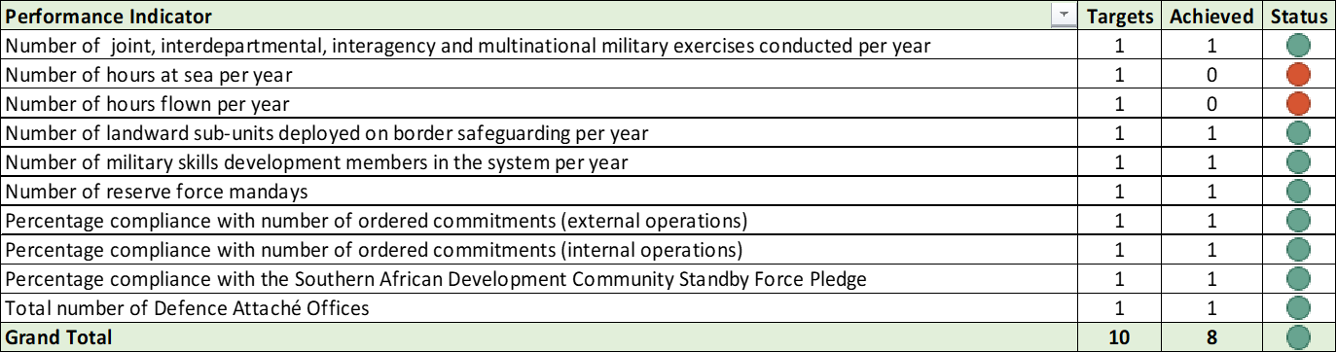
Selected Performance Indicator Summary
The DOD Selected Performance Indicators are derived from the Defence mandate and form the basis of the Department’s budget allocation from NT. These indicators represent the largest cost drivers in the DOD and are included in the ENE.
[DOD AR p40-42 & 101]

Slide 56
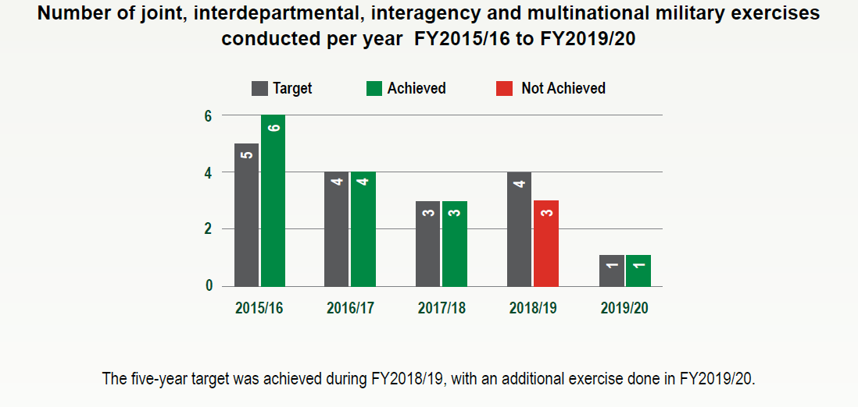
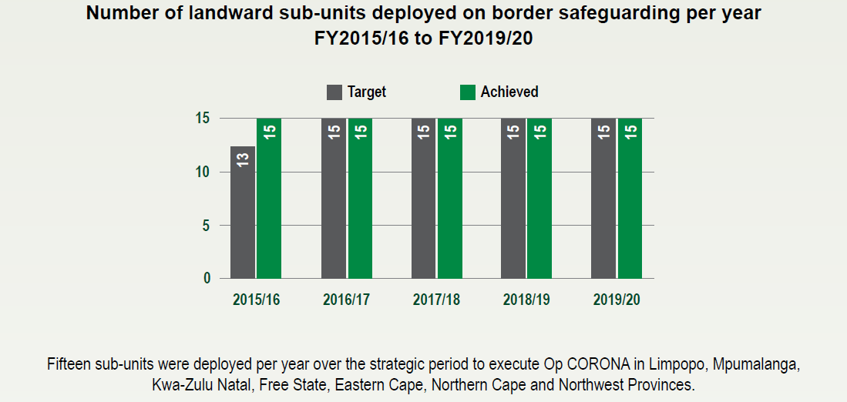
Selected Performance Indicator Summary
[DOD AR p125 & 128]

Slide 57
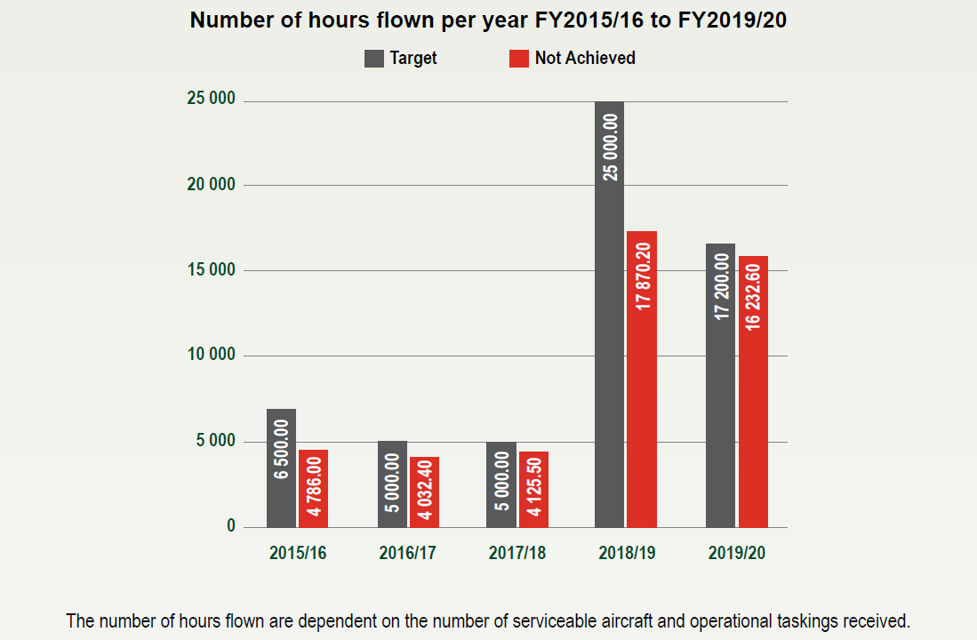
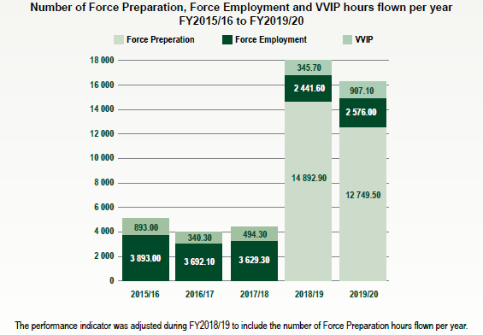
Selected Performance Indicator Summary
[DOD AR p126]

Slide 58
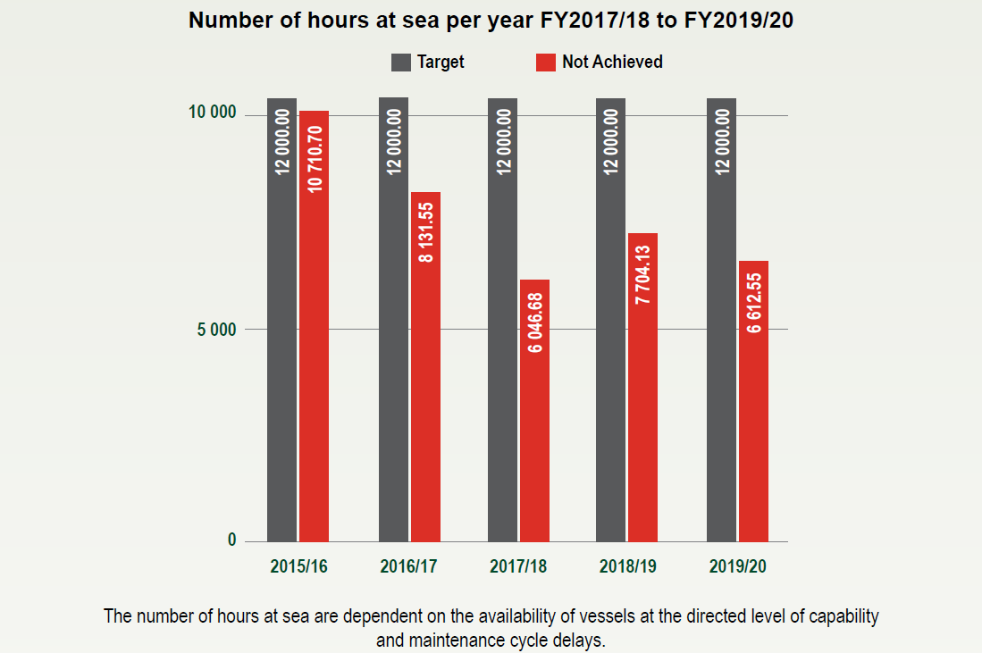
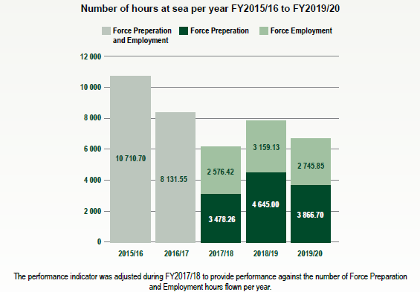
Selected Performance Indicator Summary
Number of hours at sea per year FY2015/16 to FY2019/20
[DOD AR p127]

Slide 59
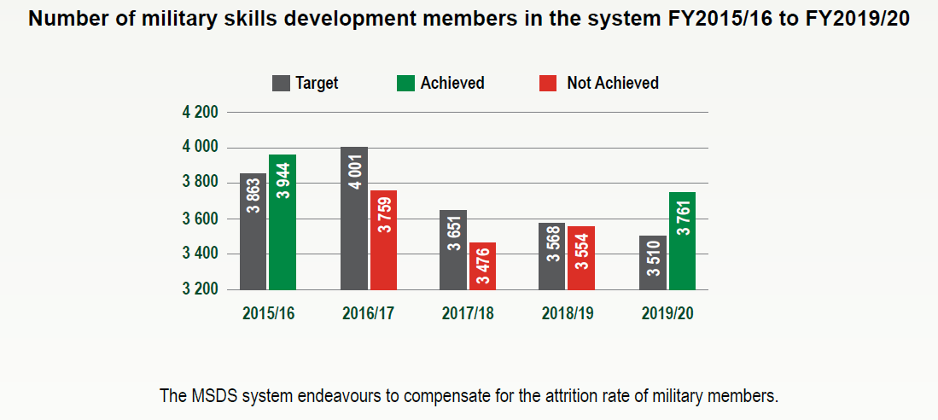
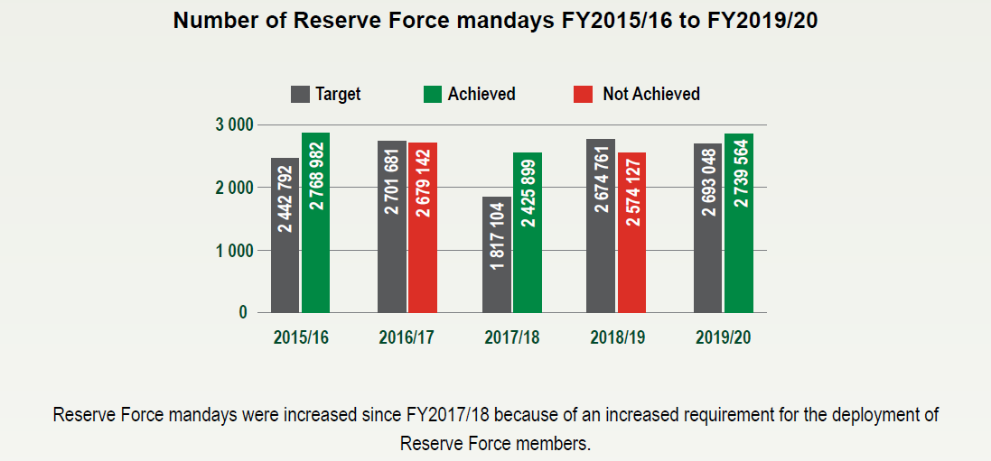
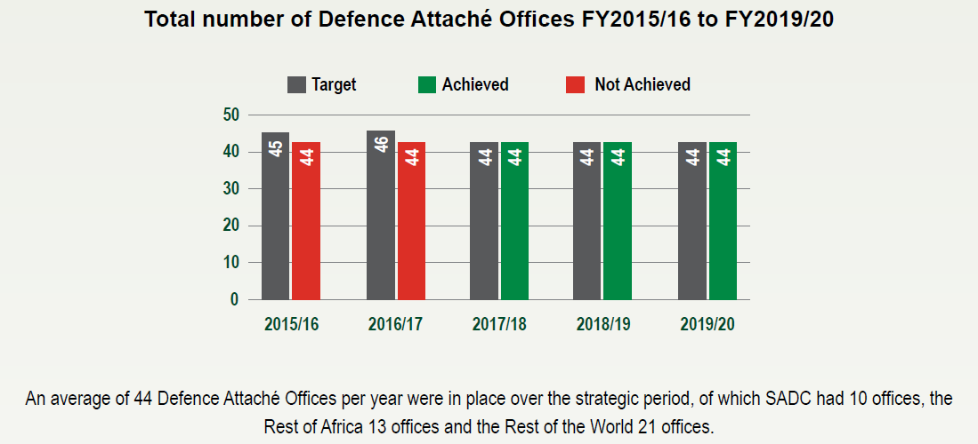
Selected Performance Indicator Summary
[DOD AR p123 & 124]

Slide 60
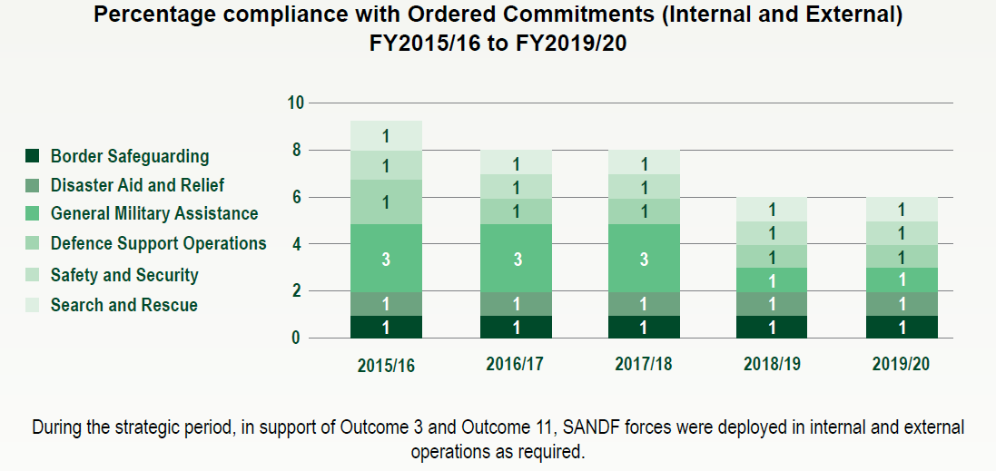
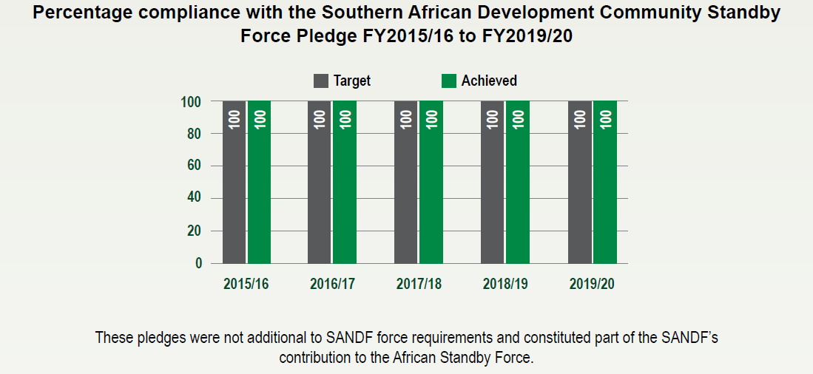
Selected Performance Indicator Summary
[DOD AR p124 & 125]

Slide 61
Part C:
Governance

Slide 62
DOD Annual Report Structure
Part C: Governance
Governance and Accountability [DOD AR p155]
Risk Management [DOD AR p155]
Fraud and Corruption [DOD AR p158]
Minimising Conflict of Interest [DOD AR p159]
Code of Conduct [DOD AR p159]
Health Safety and Environmental Issues [DOD AR p160]
Parliamentary Oversight Committees [DOD AR p160]
SCOPA Resolutions [DOD AR p160]
Prior Modifications to Audit Reports [DOD AR p161]
Internal Audit and Audit Committees [DOD AR p162]

Slide 63
DOD Governance
The DOD, through the leadership of the AO as the Head of Department, is committed to good governance over the establishment of systems and processes that ensure achievement of organisational strategic objectives. The management of the DOD have established and endorsed the Accountability Management Committee, Audit Management Forum and Audit Management Team as some of the forums responsible to manage internal control deficiencies of the Department.
Various Governance, Risk and Compliance structures are implemented within respective Services and Divisions for control, monitoring and accountability purposes.
[DOD AR p155]

Slide 64
DOD Enterprise Risks
Deteriorating DOD Facilities and Infrastructure
Outdated and Non-integration of DOD Information Communication Technology Systems
Prevalence in Fraud and Corruption
High Prevalence of Litigation
Forfeited rights on DOD Property
Compromised Defence Direction
The DOD has not been able to mitigate these Risks satisfactorily during the period under review.
[DOD AR p156-158]

Slide 65
Part D:
Human Resource Management

Slide 66
DOD Annual Report Structure
Part D: Human Resource Management
Human Resource Overview [DOD AR p173]
Human Resource Oversight Statistics [DOD AR p174-204]
(+/- 59 DPSA prescribed and DOD specific tables)
Utilisation of Consultants [DOD AR p202-203]

Slide 67
DOD HR Overview
During the period under review, the DOD continued to deliver on its legislative mandate in support of Government Imperatives.
The Department is challenged in as far as the annual CoE allocation. The most prominent challenge is that the CoE allocation received, presuppose a reduction of the personnel capacity to fit within the appropriated allocation.
Numerous engagements between the DOD and the NT, amongst others, to resolve the impasse, have delivered no solution.
The Department’s position is to maintain an average HR capacity of 75 500; recruit according to attrition and utilise 2 695 963 reserve force mandays.
[DOD AR p173

Slide 68
DOD HR Overview
For the reporting period, the Department planned an average HR capacity of 74 901. As at 31 March 2020, the average HR capacity was 74 096. The CoE allocation for the FY2019/20 was Rb29,193. The required HR budget was Rb32,094, which was in line with planned HR capacity for the financial year.
For the year ending 31 March 2020, the final HR expenditure was Rb31,803 which constitutes 0.91% deviation between the projected HR costs and final HR expenditure. Therefore, a Rb2,6 budget shortfall occurred. [DOD AR p173]
A decrease in expenditure relating to the Utilisation Of Consultants were recorded year-on-year, from Rm76,806 in FY2018/19 to Rm4,451 in FY2019/20. [DOD AR p202-203]

Slide 69
Part E:
Financial Information

Slide 70
DOD Annual Report Structure
Part E: Financial Information
Accounting Officer Report [DOD AR p207]
  (dated 29 Jul 2020)
Report of the Auditor-General to Parliament [DOD AR p219]
  (dated 12 Nov 2020)
Audited Consolidated Annual Financial Statements [DOD AR p230]

Slide 71
3. AGSA Audit Outcomes
for the year ended
31 Mar 2020

Slide 72

Audit Outcomes for the year ended 31 March 2020
Auditing to build public confidence

Slide 73

Report on the Audit of the
Annual Performance Report
The usefulness and reliability of the reported performance information was evaluated in accordance with the criteria developed from the performance management and reporting framework.
No material findings was raised on the usefulness and reliability of the reported performance information for the following programme:
Programme 2 – Force Employment
[DOD AR p221-222]

Slide 74
Report on the Audit of the Financial Statements
Basis for Qualified Opinion
1. Goods and services and Investments [DOD AR p219]
The department accounts for non-sensitive and sensitive projects expenditure in connection with special defence activities as per section 2(2)(a) of the Defence Special Account Act of South Africa, 1974 (Act No. 6 of 1974), as amended. Due to the sensitivity of the environment and the circumstances under which the related transactions were incurred and recorded, sensitive projects expenditure and related investments are qualified due to the limitations imposed on the auditors.

Slide 75
Report on the Audit of the Financial Statements
Basis for Qualified Opinion (2)
2. Irregular Expenditure [DOD AR p219]
Irregular expenditure amounting to Rb2.836 was recorded during the current audit due to non-compliance with supply chain management processes and underfunding of COE. The nature, cause and circumstances of non-compliance with supply chain management processes are not isolated but indicative of similar non-compliance in the population. The irregular expenditure disclosed is therefore not complete.
Of the Rb2,836 irregular expenditure incurred for FY2019/20, Rb2,609 was for expenditure above the CoE allocation; this was due to a reduction imposed by NT through budget reduction on actual employees in the services of the DOD.
The difference of Rm230 was incurred due to contracts awarded through unfair bidding processes from previous years which are still running and paid in the FY2019/20.

Slide 76
Report on the Audit of the Financial Statements
Material Irregularities
1. Inventory and asset management contract was not awarded to only the bidder that scored highest points in the evaluation process [DOD AR p226]
Contract not awarded to company who scored the highest points
Awarded to two companies on a 50/50 basis
Total value of contract = Rm922
Rm451,9 paid as at end of financial year
2. Lease payments made for unoccupied office buildings [DOD AR p226]
Initial lease started in 2015
Full occupation only in January 2020 for five buildings
R108m was paid, when buildings were not fully utilised

Slide 77
Report on the Audit of the Financial Statements
Material Irregularities (2)
3. Unfair award for the supply of fuel [DOD AR p227]
Contract for supply of jet fuel
Pricing was set between R11,32 and R13,84
Award finally made to supplier who charged 33 cents per litre more, for 1 million litres of fuel due to change in mode of transport from rail to road
Possible loss of Rm2,57

Slide 78

Thank you…

