Slide 1
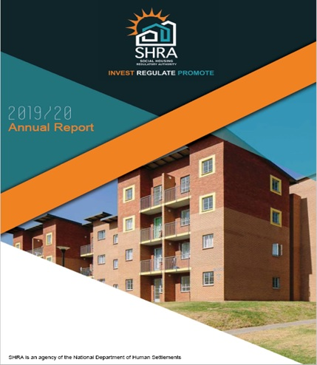
Presentation to the:
PORTFOLIO COMMITTEE ON HUMAN SETTLEMENTS, WATER AND SANITATION
26 NOVEMBER 2020
1

Slide 2
AGENDA
1
Executive Overview
2
Highlights of the period
3
Non-financial performance
4
Financial performance
5
Audit Outcome
2

Slide 3
The SHRA Vision and Mission
VISION: A thought-leader, stimulator and regulator of world-class self-sufficient social housing solutions.
MISSION
Facilitate delivery of quality, sustainable social housing at scale to advance the needs of low- and middle-income groups in support of spatial, economic and social restructuring.
3

Slide 4
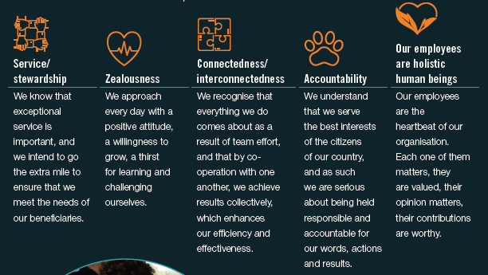
SHRA Values
4

Slide 5
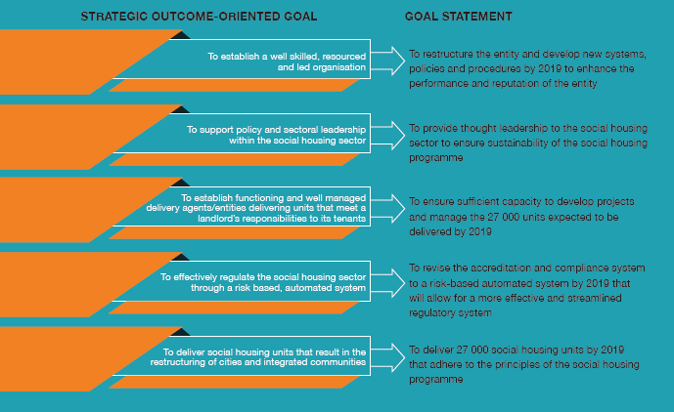
The SHRA Strategic Goals
5

Slide 6
Executive Overview
Approximately 17,000 units have been completed from the start of the 2014/15 year to the end of 2019/20.
Growth in the number of units under regulation over the from 20 477 units in 2014/15 to 39 407 in 2020 (92% increase). There were 103 fully and conditionally accredited institutions on the SHRA Accreditation Register, of which twelve (12) institutions are fully accredited and 91 are conditionally accredited.
Increased expenditure of the CCG to R 1 202 831 411 in 2020 representing 166% performance against budget. This is against an initial expenditure of R35 964 329 in 2014/15 and R776 202 726 in the prior 2018/19 year.
The total deficit of R413 388 836 (for 2020) has reduced the retained surplus from 989 631 709 in 2019 to R576 242 873 as at end 2020. Operating expenses (R83.48m) was 6.4% of Total Programme and Operating Costs of R1 299 954 838.
SHRA’s performance achieved was 67% for the 2019/20 year.
Out of the 30 performance indicators, 8 indicators (27%) related to transformation.
Staff vacancy rate at the end of the period was 15% and the headcount of 47 full time staff.
The interim Council was appointed by the Minister with effect from 28 October 2019.
During the year the SHRA had invested effort and time in the development of the MySHRA portal to provide systems and processes that are more efficient and stakeholder friendly.
6

Slide 7
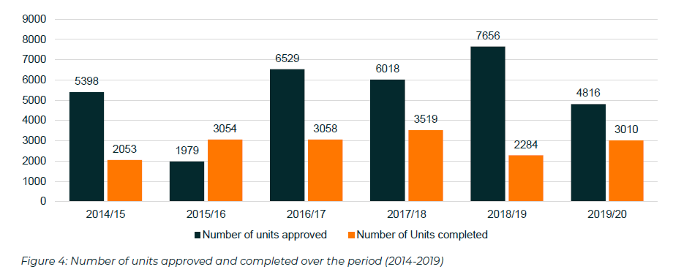
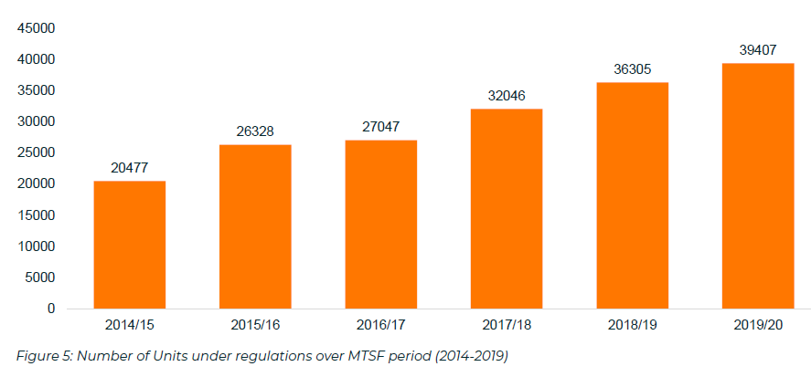
U
HIGHLIGHTS: UNITS APPROVED, ACCREDITED & REGULATED
Total Units Completed over the period: 16 978
Total Units Approved: 32 396
Total Units under regulation (2019/20) = 39 407 units
This represents a 92% increase from 2014/15 = 20 477 units;
And a 8.5% increase (3 105) year on year from 20181/9 = 36 305 units
7

Slide 8
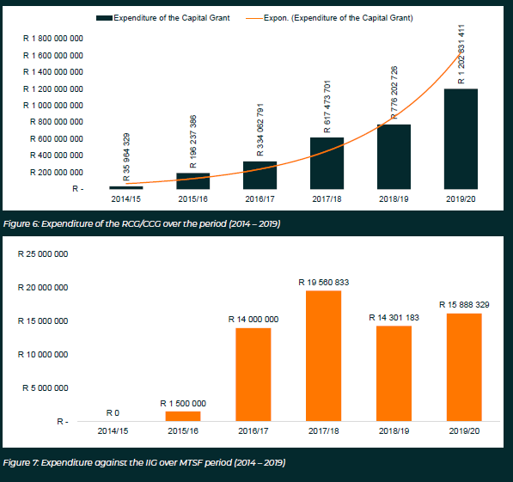
GRANT EXPENDITURE (CCG & IIG)
CCG Expenditure 2019/20 = R1 202 831 411, an increase of 55% (R426.6m) from the R776 202 726 expended in the prior year.
When compared to 2014/15 expenditure of R35 964 329 the 2019/20 expenditures translates to an annual 102% increase over the period 2014/15 – 2019/20
IIG Expenditure for 2019/20: R 15 888 329, an increase of 11% (R1.6m) from the R14 301 183 32 396 spent in the prior year.
8

Slide 9
SURPLUS RETENTION
The total retained surplus as at the end of 2020 was R576.24m.
Operating deficit for the year was R413.39m
SHRA has for the second time in the past five year’s experienced an operating deficit, the last being in the 2015/16 year with an amount of – R45.69m
9

Slide 10
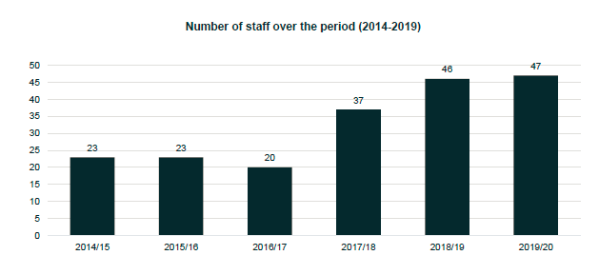
STAFFING TRENDS
Staff count has doubled since 2014/15, with 47 employees dedicated to a programme that manages R1.3bn in programme and operational expenditure.
10

Slide 12
SHRA Annual Report 2019/20
NON-FINANCIAL PERFORMANCE
12

Slide 13
PROGRAMME 1: ADMINISTRATION (1)
Strategic Objective | To establish a well-skilled, resourced and led organisation
Performance indicator | 2019/20 Annual Target | Actual Performance | Comments on non-achievement
Audit outcome on previous year’s financial and non-financial performance information. | Clean audit outcome | SHRA received an unqualified audit opinion for 2018/19 | SHRA received an unqualified audit opinion with emphasis of matter, non-compliance with legislation, material findings on the usefulness and reliability of reported performance information as well as irregular expenditure. Going forward management will attend to the Audit Corrective Action in order to reduce the number of matters raised by the external auditors in the Annual Audit report for 2020. Management has reported against this corrective action document and one matter is still outstanding.
Percentage variance on total approved budget vs. actual expenditure (operational and capital) per annum | 15% variance on total approved budget vs. actual expenditure | A positive 4.53% on total approved budget vs. actual expenditure | The total variance on total approved budget including reallocated interest and accumulated surplus vs actual expenditure is 10.47% against a target of 15%, this is largely attributable to year-end provision of debtors arising from cancelled CCG contracts amounting to approximately R35m.
13

Slide 14
PROGRAMME 1: ADMINISTRATION (2)
Strategic Objective | To establish a well-skilled, resourced and led organisation
Performance indicator | 2019/20 Annual Target | Actual Performance | Comments on non-achievement
Percentage procurement spend to majority black owned or controlled service providers (>50% black) | 65% procurement spend to majority black owned or controlled service providers | 92.83% procurement spend to majority black owned or controlled service providers (>50% black) | There is a positive variance of 27.83%. Management had consciously sought to appoint service providers that were level 1 and 2 B-BBEE compliant.
Percentage procurement spend to the collective of service providers that are majority owned by women, youth, persons with disabilities and military veterans | 30% procurement spend to the collective of service providers that are majority owned by women, youth, persons with disabilities and military veterans | 44.45% procurement spend to the collective of service providers that are majority owned by women, youth, persons with disabilities and military veterans | There is a positive variance of 14.45% due to this being raised as a strategic imperative by the SHRA Council. Management had actively sought to appoint service providers that were level 1 and 2 B-BBEE compliant with emphasis on those service providers that are owned by women, youth, persons with disabilities and military veterans
14

Slide 15
PROGRAMME 1: ADMINISTRATION (3)
Strategic Objective | To establish a well-skilled, resourced and led organisation
Performance indicator | 2019/20 Annual Target | Actual Performance | Comments on non-achievement
Percentage overall organisational performance rating (AG standard ³ 80%) | ≥ 80% overall organisational performance rating | 67% overall organisational performance rating | There is a negative variance of 13%. This is due to non-achievement of four (4) indicators relating to, Publishing of the State of the Sector Report, Conducting of Building Condition Audits and, the completion of Social Housing Units and the Awarding of CCG in the year to ODAs not being achieved. While this is an improvement on the prior year’s achievement of 62%, going forward, management will strive to manage the dependencies that exist on indicators such as these and ensure that targets are appropriately planned and implemented in order to achieve the 80% overall organisational rating as per AG standards in the new financial year 2020/21.
15

Slide 16
PROGRAMME 1: ADMINISTRATION (4)
Strategic Objective | To support policy and sectoral leadership within the social housing sector
Performance indicator | 2019/20 Annual Target | Actual Performance | Comments on non-achievement
End of term submission of Social Housing Sector inputs for consideration in the development of the forthcoming MTSF | Submission of social housing sector inputs to the Department of Human Settlements for consideration of the 2019/20 MTSF, by Q2 2019/20 | End-of-term MTSF submission made in Q2 and regular sector feedback provided throughout the year | No variance
Timeline for publishing the Annual State of the Social Housing Sector Report of the previous financial year | 2018/19 State of the Social Housing Sector Report published in Q2 | 2018/19 State of the Social Housing Sector Report was not published in Q2 | The 2018/19 State of the Sector Report was not published in Q2 which has led to the annual target not being achieved. This was due to limited internal capacity and availability of information needed to finalise the report. Going forward management will ensure that there is sufficient capacity to meet the target.
16

Slide 17
PROGRAMME 1: ADMINISTRATION (5)
Strategic Objective | To support policy and sectoral leadership within the social housing sector
Performance indicator | 2019/20 Annual Target | Actual Performance | Comments on non-achievement
Timeline for the serving of a Student Housing Programme proposal at MinMec | Student Housing Programme proposal to serve at MinMec by the end of Q2 | Council Approved Proposal routed for Minister’s consideration. | Not Achieved. As a result of a decision made by the National Department of Human Settlements’ Executive Management Team (EMT), it was decided that the SHRA Student Housing proposal be considered by the Minister who has administrative authority to deal with the matter, and not MinMEC. Going forward, the SHRA will aim to manage indicator dependencies on the National Department of Human Settlements through deepening the consultative process.
Percentage improvement in Biennial Stakeholder Perception Rating | Biennial stakeholder perception survey conducted in 2019/20, reported in Q4 | Stakeholder perception survey conducted and tabled at Exco during the period under review | No variance
17

Slide 18
PROGRAMME 1: ADMINISTRATION (6)
Strategic Objective | To support policy and sectoral leadership within the social housing sector
Performance indicator | 2019/20 Annual Target | Actual Performance | Comments on non-achievement
Percentage achievement of the milestones of the annually approved stakeholder relations management plan | 80% achievement of the milestones of the approved stakeholder relations management plan | 80% of planned activities were achieved against the quarterly target. | No variance
18

Slide 19
PROGRAMME 2: CAR (1)
Strategic Objective | To effectively regulate the social housing sector through a risk-based, automated system
Performance indicator | 2019/20 Annual Target | Actual Performance | Comments on non-achievement
Percentage of reporting SHI’s and ODA’s with units under regulation that meet 5 out of 5 of the primary benchmarks* per annum | 61.5% (16/26) of reporting SHI’s and ODA’s with units under regulation that meet 3 out of 5 of the primary benchmarks | 61.5% of reporting SHIs and ODAs with units under regulation that meet 3 out of 5 of the primary benchmarks | No Variance. 12 out of the 26 reporting SHIs and ODAs with units under regulation met 3 out of the 5 benchmarks, and 4 out of the 26 reporting SHIs and ODAs with units under regulation met 4 out of 5 of the primary benchmarks, totalling 16 out of the 26 SHIs and ODAs that met at least three out of five of the benchmarks.
Number of fully accredited Social Housing Institutions (cumulative) | 13 fully accredited SHI’s | 12 fully accredited SHIs | A negative variance of one. This is due to the accreditation process that might not have been understood by applicants. The CAR Programme will invest resources to educate the sector on the accreditation process.
19

Slide 20
PROGRAMME 2: CAR (2)
Strategic Objective | To effectively regulate the social housing sector through a risk-based, automated system
Performance indicator | 2019/20 Annual Target | Actual Performance | Comments on non-achievement
Number of subsidised social housing units' tenancy audits (including tenancy surveys) conducted per annum | 3 300 subsidised social housing units' tenancy audits conducted | 3 406 subsidised social housing units were audited. | A positive variance of 106 tenancy audits conducted. As at end March 2020 audits have been conducted on 12 projects totalling 3728 units, consisting of 3557 tenants (i.e. excluding vacancies). A consolidated dataset that includes income information of 3406 social housing units have been validated and captured.
Number of subsidised social housing units' building condition audits conducted per annum | 3 300 subsidised social housing units' building condition audits conducted | 3 083 subsidised social housing units' building condition audits conducted | A negative variance of 217 units not completed by end of March 2020. This was due to the fact that SHRA appointed service providers were prevented from entering projects during March 2020. The effected audits were Steve Tshwete Housing Association where the landlord delayed in providing the necessary information; Yeast City Housing where the landlord indicated that they were delayed by other audits; and the Ekurhuleni Housing Company where the landlord was managing a conflict with their tenants and could not secure access. Going forward the balance of the audits will be completed during the 2020/2021 financial year.
20

Slide 21
PROGRAMME 2: CAR (3)
Strategic Objective | To effectively regulate the social housing sector through a risk-based, automated system
Performance indicator | 2019/20 Annual Target | Actual Performance | Comments on non-achievement
Cumulative number of social housing units accredited (approved for capital grant funding) over the 2015-2020 period | 28 026 social housing units accredited (Annual Est.: 7,000) | 27 042 cumulative number of social housing units accredited over the 2015-2020 period (Annual 4 860) | A negative variance of 984 units having been accredited (96% of the target). This is due to the fact that the majority of projects that applied for accreditation did not achieve project readiness status and this resulted these projects not going forward through to approval stage. Going forward, further project facilitation and support work will be undertaken to ensure that these projects can be accredited by the fourth quarter of 2020/2021
Number of project applications received into the project pipeline by conditionally accredited first-time applicants | 8 project applications received into the project pipeline by conditionally accredited first-time applicants | 6 project applications received into the project pipeline by conditionally accredited first-time applicants | A negative variance of 2 projects. Most conditionally accredited SHIs do not necessarily have access to land, which would lead them to submitting projects for accreditation. Communication and information dissemination work will be conducted in the 2020/2021 financial year, to educate potential applicants on the accreditation process and requirements. The accreditation policy has also been revised, to include access to land as criteria for obtaining accreditation.
21

Slide 22
PROGRAMME 2: CAR (4)
Strategic Objective | To effectively regulate the social housing sector through a risk-based, automated system
Performance indicator | 2019/20 Annual Target | Actual Performance | Comments on non-achievement
Percentage of projects in the pipeline that are from capital grant applicants that are black majority owned or controlled (>50% black) | 65% of projects in the pipeline are from capital grant applicants that are black majority owned or controlled | 68% of projects in the pipeline are from capital grant applicants that are black majority owned or controlled | A positive variance of 3%. 26 of the 38 projects in the pipeline are form capital grant applicants that are black majority owned or controlled.
Cumulative number of units under regulation | 38 288 social housing units under regulation (Annual 4 000) | 39 407 Cumulative number of units under regulation | A positive variance of 1 119 units. The number of units under regulations grew to 39 407 as at the end of the fourth quarter. The increase in units under regulation are due to an increased number of projects being accredited as well as improved reporting by delivery agents as a result of training on reporting requirement by the Compliance unit.
22

Slide 23
PROGRAMME 2: CAR (5)
Strategic Objective | To effectively regulate the social housing sector through a risk-based, automated system
Performance indicator | 2019/20 Annual Target | Actual Performance | Comments on non-achievement
Number of Institutional Housing Subsidy projects brought under regulation | 4 x Institutional Housing Subsidy projects brought under regulation | 5 x Institutional Housing Subsidy projects brought under regulation | Positive variance of 1 due to the Constitutional Court ruling against Cape Town Community Housing Company where projects are now brought back under regulation and reported on.
23

Slide 24
PROGRAMME 3: SD&T (1)
Strategic Objective | To establish functioning and well managed delivery agents/entities delivering units that meet a landlord’s responsibilities to its tenants
Performance indicator | 2019/20 Annual Target | Actual Performance | Comments on non-achievement
Percentage of pre-selected SHI’s and/or ODA’s without accredited projects supported annually through a customised incubation programme to have projects in the pipeline by the end of the financial year | Social Housing Sector Development Plan for 2019/20 developed and submitted in accordance with the Social Housing Act by the end of March 2019 | 50% (5/10) of Incubation programme participants with projects in the pipeline by the end of the financial year | 50% (5/10) selected institutions have projects in the pipeline by the end of the financial year
Percentage of identified SHI’s that received an IIG, of which the intervention is completed within the current financial year, either maintained or improved their level of accreditation | 82.5% SHI’s maintained or improved their level of accreditation | 100% (2/2) SHI's maintained their level of accreditation | Positive variance of 17.5%, due to maintained levels of accreditation of both SHI's where support interventions were completed
24

Slide 25
PROGRAMME 3: SD&T (2)
Strategic Objective | To establish functioning and well managed delivery agents/entities delivering units that meet a landlord’s responsibilities to its tenants
Performance indicator | 2019/20 Annual Target | Actual Performance | Comments on non-achievement
Percentage of identified projects that received an IIG, of which the work is completed within the current financial year, are recommended to the TEC for capital grant award | 77.5% projects recommended to the TEC for capital grant award | 100% (4/4) projects recommended to the TEC for capital grant award | Positive variance of 22.5% due to project support work focusing on project technical readiness and financial feasibility to achieve recommendations to the TEC for capital grant award
Percentage of Institutional Investment Grant (IIG) recipients that are majority black owned or controlled | 65% of IIG recipients are majority black owned or controlled | 70% (21/30) of IIG recipients are majority black owned or controlled | Positive variance of 5% due to continuous engagement with IIG recipients to validate B-BBEE status as per evidence requirements
25

Slide 26
PROGRAMME 3: SD&T (3)
Strategic Objective | To establish functioning and well managed delivery agents/entities delivering units that meet a landlord’s responsibilities to its tenants
Performance indicator | 2019/20 Annual Target | Actual Performance | Comments on non-achievement
Percentage of grant recipients that have adopted the Social Housing Sector Transformation Charter by the end of the 5-year planning period | 50% of grant recipients have adopted the Social Housing Sector Transformation Charter by the end of the 2019/20 financial year | 57% (30/53) of grant recipients adopted the Social Housing Sector Transformation Charter | Positive variance of 7% due to continuous engagement with grant recipients to adopt the Social Housing Sector Transformation Charter
Timeline for production of the annual social housing sector transformation dashboard and report | Annual social housing sector transformation dashboard and report produced in Q4 | Annual social housing sector transformation dashboard and report produced in Q4 | No variance
26

Slide 27
PROGRAMME 4: PD&F (1)
Strategic Objective | To deliver social housing units in the restructuring of cities and integrated communities
Performance indicator | 2019/20 Annual Target | Actual Performance | Comments on non-achievement
Cumulative number of social housing units completed between 2014/15 and 2019/20 | 19 584 units completed (Annual Est: 4 871) | 16 978 cumulative number of social housing units completed between 2014/15 and 2019/20 (Annual 3 010) | Negative variance of 2 606 social housing units completed. This is due to: A) blocked projects which have not broken ground 12 months since approval of the project due to the grant recipient not achieving contractual conditions precedent; B) CCG cancellations of contracts due to non-performance which would otherwise have delivered units, C) Projection of unit completion which had either not materialised or fewer than projected units had been completed from the following projects: Qhama; Hlalanathi; Goldenwest; Hillside View; Townlands; Carnival Gardens; Mogale Junction; and D) Grant Recipients’ challenges with their professional team, the impact of the construction mafia, community unrests resulting in the interruption and stoppages on construction sites, the global impact of COVID 19 felt in March 2020. PD&F will review each non-performing project’s recovery plans, planned cashflow and resources on-site. The blocked projects are receiving specific intervention to resolve the challenges including contract administration in line with CCG agreements.
27

Slide 28
PROGRAMME 4: PD&F (2)
Strategic Objective | To deliver social housing units in the restructuring of cities and integrated communities
Performance indicator | 2019/20 Annual Target | Actual Performance | Comments on non-achievement
Number of social housing units delivered (tenanted) | 4 000 social housing units delivered (tenanted) | 4 012 social housing units delivered (tenanted) | Positive variance of 12 social housing units tenanted. Portfolio Managers pursued projects where tenanting was projected and, in many instances, received more units than projected which have been verified by CAR. The outlook is great in that units completed in the current year will be managed to meet tenancy in the 2020/21 FY to meet the delivery target.
Percentage of annual Consolidated Capital Grant allocation awarded to Other Delivery Agents | 25% annual CCG allocation awarded to ODA’s | 9% of the annual CCG allocated to ODAs | Negative 16% variance of the annual CCG awarded to ODAs. Of the total CCG award (R1 194 442 337) to 13 Grant Recipients,3 were ODAs totalling an award of R107.66m for the 2019.20 FY. This target was not achieved as the onward recommendation and approval of 8 projects by ODAs that were pre-assessed by the SHRA totalling 3505 social housing units and a GGC value of R952 893 835. had not materialised by the 4th quarter. Going forward, the SHRA will actively pursue projects from ODAs to meet the 2020/21 target and consider project accreditation enhancements that could assist in achieving this target.
28

Slide 29
PROGRAMME 4: PD&F (3)
Strategic Objective | To deliver social housing units in the restructuring of cities and integrated communities
Performance indicator | 2019/20 Annual Target | Actual Performance | Comments on non-achievement
Percentage of Consolidated Capital Grant (CCG) allocation awarded to black majority owned / controlled enterprises (>50% black) | 65% of CCG allocation awarded to black majority owned / controlled enterprises (>50% black) | 95.45% of the CCG allocation awarded to black majority owned / controlled enterprises (>50% black) | Positive 30.45% variance of the CCG allocation awarded to black majority owned/controlled enterprises (>50% black). Of the total 13 CCG awarded to grant recipients (totalling R1 194 442 337) the majority were black owned and controlled with 12 grant recipients registered as level 1 and 2 B-BBEE contributors having been granted CCG contracts amounting to R1 124 300 651 for the year under review. Going forward the SHRA will continue to encourage project applications by transformed applicants.
Percentage of Consolidated Capital Grant (CCG) allocation awarded to the collective of enterprises designated as majority owned or controlled by women, youth, persons with disabilities and military veterans | 30% of CCG allocation awarded to the collective of enterprises designated as majority owned or controlled by women, youth, persons with disabilities and military veterans | 40.26% of the CCG allocation awarded to the collective of enterprises designated as majority owned or controlled by women, youth, persons with disabilities and military veterans | Positive 10.26% variance of CCG allocation awarded to the collective of enterprises designated as majority owned or controlled by women, youth, persons with disabilities and military veterans. Of the 13 accredited projects, 4 grant recipients were entities that were majority owned/controlled by designated groups with a CCG value of R480.66m out of the total R1 194.4m of CCG awarded for the year. The SHRA will continue to actively promote applications from entities that are owned or controlled by the collective of enterprises designated as majority owned or controlled by women, youth, persons with disabilities and military veterans.
29

Slide 30



FINANCIAL INFORMATION
30

Slide 31
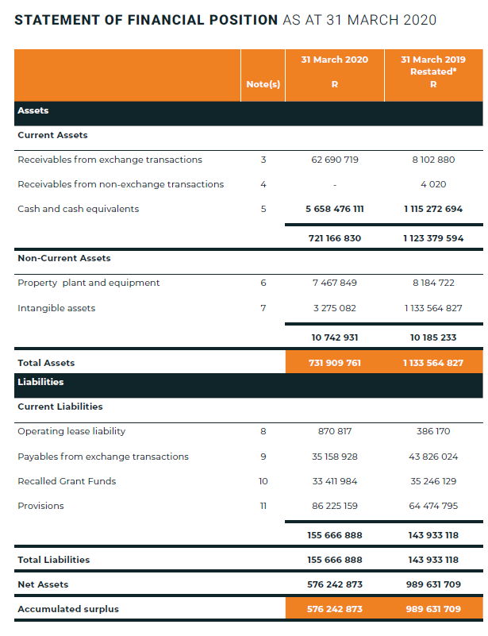
ASSETS & LIABILITIES
Current assets have decreased from R1.12bn to R721m (decrease of R402m or 36% y-o-y)
Cash held as surplus in prior years have decreased from over R1,1bn in 2019 to just over R658m as a result of the use of the prior year’s surplus.
Total Liabilities have increased by 8% (R11.7m) from the prior year (R143.9m ) to R155.7m.
  Payables have reduced from R43.8m to R35.1m (R8.67 m or a 20% decrease)
  Provisions have increased by R21.7m (34%) to R86.2m. This includes interest earned that was capatalized (R35.7m was generated in the year of which R10.95 was utilised. The balance of R3.2m is a provision for bonuses.
31

Slide 32
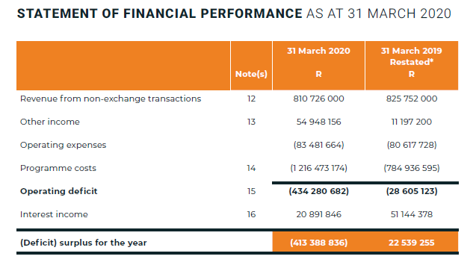
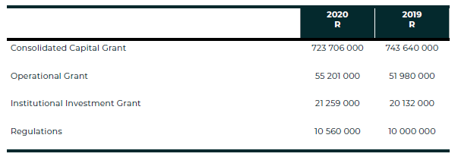
REVENUE
Revenue had decreased by R15m (2%) to R810.7m from R825.7
  CCG received decreased by 2.7% (R19.9m) from R743.6m in 2019 to R723.7 for 2020.
  Operational Grant receipts reflected an increase of R3.2m (6.2%). IIG also increased by R1.1m (5.6%) from R20.13m in 2019 to R21.26m in 2020. Regulatory related revenue increased by R560k (5.6%) from R10m to R10.56m in 2020.
The SHRA reflected an operating deficit of R413m from a surplus of R22.54m in 2019
Of the R1.3bn (Operating expenses and programme costs), R83.4m was for operating expenses (6.4% Operating Efficiency realised for 2019/20),
32

Slide 33
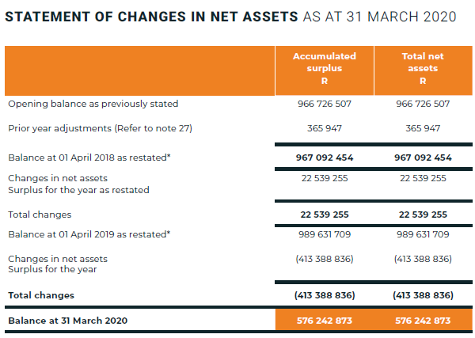
NET ASSETS
The SHRA had recorded a total surplus of R576.24m as at the end of 2020.
Changes in net assets were R413.39m
Restatement of prior year figures are as a result CCG recoveries, treatment of programme costs related to a SHI in the process of liquidation and correction in allocation of legal fees and professional fees previously expensed.
33

Slide 34
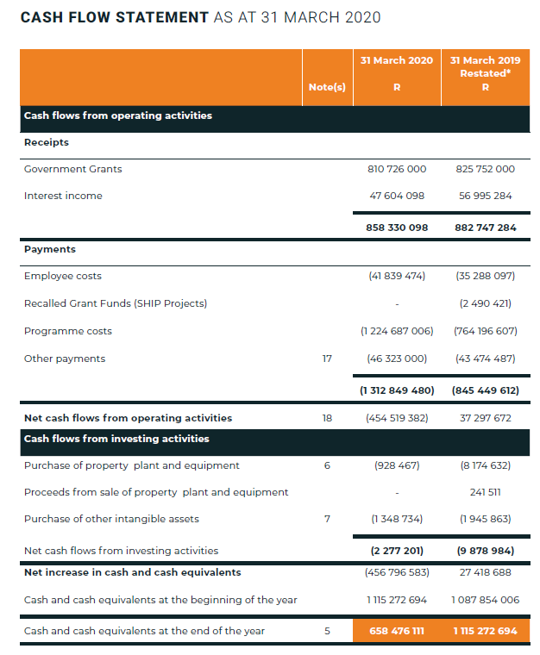
CASH FLOW
The SHRA had recorded a net cash flow deficit from operating activities of –R454.5m for 2020 compared to a positive net cash flow from operating activities of R37.3m in 2019.
Cash and cash equivalents had decreased from R1.1bn at the end of 2019 to R658m as at the end of 2020
34

Slide 35
AUDIT OUTCOME 2019/20
Audit Opinion | Unqualified
Emphasis of matter | Matters of emphasis identified did not modify the audit opinion
Annual Financial Statements | Material findings on annual financial statements (completeness of receivables, other income and provisions, commitments and contingent assets) identified and corrected.
Compliance with Legislation | Instances of non-compliance in relation to a) expenditure management, b) annual financial statements, performance and annual report and c) the appointment of Council.
Predetermined objectives | Material findings on usefulness and reliability of reported performance information in relation to Programme 4 in regards to the completeness and accuracy of the recorded number of units tenanted was raised.
Fruitless and wasteful expenditure | None.
Irregular expenditure | R 225 663 337 (R59.91m in current year, R139.03m to the prior year – as a result of 2 projects not being located within a gazetted RZ plus an opening balance of R26.73m)
35

Slide 36
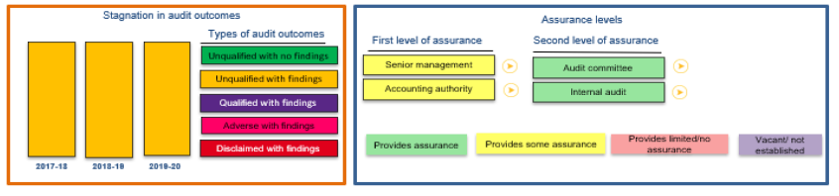
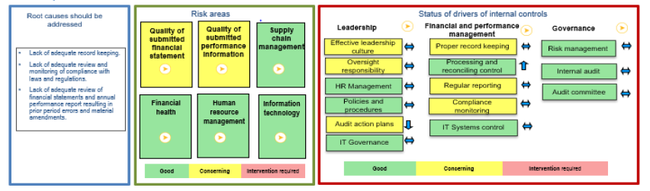
AUDIT OUTCOMES 2017 - 2020
36

Slide 37
THANK YOU
37

