Slide 1
PORTFOLIO COMMITTEE BRIEFING: PROJECT KUYASA 24 NOVEMBER 2020

Slide 2
We now have a name for the Turnaround Programme
“ Kuyasa” is a Zulu phrase for “the sun is rising”.
Interpretation: Rising of the New Restitution programme

Slide 3
Using the following business Architecture model, 9 projects have been identified that interlink with the 5 outcomes defined in the terms of reference of the project
Business Architecture Model
Determination of IT system requirements excluded from project scope
Outcomes and Projects
1
2
3
4
5
Outcome 1: Backlog reduction & process improvement
Outcome 2: Change & People Management
Outcome 3: Organisational Form
Outcome 4: Finance & Settlement Models
Outcome 5:
Project management & Closeout
Project 1.1
Backlog reduction Strategy
Project 2.1 Change Management
Project 3
Organisational Form
Project 4.1
Development of Financial Models
Project 5.1
PMO
Project 1.2
Process Improvement
Project 2.2
People Management
Project 4.2
Development of Settlement Models
Project 5.2
Closeout Report
Notes:
3
3

Slide 4
1. TERMINOLOGY

Slide 5
Settled claim
Refers to a claim that has been approved as valid either through an agreement contemplated in section 42D of the Restitution Act or through an order of court IN terms of section 42d(1)(a).
Finalised claim
Refers to a claim where the intended award approved through settlement by 42D or court order has been fully implemented. Land has been transferred or financial compensation has been paid in full in terms of section 42d(1)(b)-(f). This would have to include the full payment of grants that were allocated for the benefit of the claimants.
Pure outstanding land claim
Refers to a claim that is wholly outstanding. In simple terms, this means that none of the properties subject to the claim have been settled. It is worth noting that claims that have been partially settled, which are commonly referred to as phased settlement, are not counted in this category.
State Land claims
Refers to a claim that affects a property registered in the name of the state.

Slide 6
TERMINOLOGY
Phased outstanding land claim
Refers to a claim where an agreement contemplated in section 42D of the Restitution Act has been entered into in respect of one or multiple portions/ properties under this one claim. This happens mostly in large claims, where the land under claim is owned by multiple owners – involving protracted negotiations – thus resulting in a staggered (phased) approach in the settlement of the entire claim.
Phased claims arise as a result of one (or combination) of the following scenarios:
Complexity of the claim (i.e. overlapping claims, high value properties, large number of claimants.
Disputes in terms of validity on certain properties
Settlement in terms of willing sellers;
Limitation of the budget allocated at a point in time
Court matter
Refers to a claim that has been referred to court in terms of section 14 of the Restitution Act. The court may already have given instruction on how the claim is to be settled or such court order may still be pending.

Slide 7
TERMINOLOGY
Project Kuyasa
Refers to a project that has been initiated by the CRLR and is geared towards a comprehensive overhaul of the processes, systems and models used by CRLR in the processing of land claims to ensure the entity delivers better and faster services to its clients.
Project deliverables (in short and medium) include the following:
Strategy development towards expeditious reduction and complete settlement of all backlog claims
Business process review and refinement to shorten turnaround times
Recommendations on the most viable (fit for purpose) corporate entity and structure
Recommendations on the viable land claims settlement models and cost-effective financial settlement models

Slide 8
TERMINOLOGY
Post settlement
Refers to a range of processes and activities that involve the provision of a variety of technical and financial resources to land restitution beneficiaries who receive land to enable them to secure land development plans (initially) as well as production capital (secondary).
Once a claim has been settled, what follows thereafter is the execution of the approval which happens through effecting transfer of the land or the payment of financial compensation or both. The commitment arising out of every approval is placed in a commitment register for monitoring and tracking to ensure that the award which could be land restoration or financial compensation and development grants is affected to the benefit of intended beneficiaries.
Once the entire award has been implemented, the value of the award that would have been entered into the commitment register is then removed.

Slide 9
2. PERFORMANCE UP TO MARCH 2020

Slide 10
CLAIMS LODGED AS AT 31 DECEMBER 1998
Claims lodged in 1998 were not only done at the Commission, however lodgement also took place at various departments, police stations, post offices and municipal offices. The above process have contributed to the challenge of arriving at a definitive figure for 1998 Lodgements.
Province | Total Lodged
Eastern Cape | 16 716
Free State | 2 682
Gauteng | 13 162
KwaZulu-Natal | 16 394
Limpopo | 3 489
Mpumalanga | 3 400
North West | 3 902
Northern Cape | 3 852
Western Cape | 16 099
TOTAL | 79 696

Slide 11
STATISTICS ON SETTLED RESTITUTION CLAIMS: CUMULATIVE STATISTICS: 1995 - 31 MARCH 2020
PROVINCE | CLAIMS | HHs | BEN | FHHs | PEOPLE WITH DISABILITIES | HECTARES SETTLED
E CAPE | 16954 | 84512 | 382606 | 32141 | 0 | 137810
F STATE | 2669 | 8621 | 52379 | 3175 | 10 | 59759
GAUTENG | 13351 | 20056 | 80493 | 8900 | 13 | 17443
KZN | 15804 | 95904 | 545777 | 31505 | 497 | 841067
LIMPOPO | 4511 | 63759 | 307151 | 25740 | 0 | 734193
MPLANGA | 3223 | 59223 | 303629 | 20147 | 58 | 528551
N CAPE | 4024 | 25670 | 135526 | 10347 | 140 | 837139
N WEST | 3964 | 44477 | 222059 | 19588 | 37 | 548724
W CAPE | 17282 | 33350 | 149488 | 14664 | 378 | 11050
TOTAL | 81782 | 435572 | 2179108 | 166207 | 1133 | 371 5736
1. The above total excludes reporting on urban claims from 2006 up until 2011/12, the verification of the above statistics is work in progress. 2. The statistics have been compiled based on the information reflected in the database of settled restitution claims and Commitment Register. 3. In order to improve the accuracy of our statistics, restitution claims is on an ongoing basis subjected to internal auditing. 4. Please note that the number of hectares restored is currently under review, both with regard to existing data, as well as outstanding data on state land. The total restitution award also include the cost of solatium that was paid out, i.e. KwaZulu-Natal [R6,330,000.00], Western Cape [R41,000.00] and Mpumalanga [R50,500.00] The total for settled claims now also includes the dismissed claims as well as adjustments due to ongoing verification and reconciliation/declaration of funds memoranda. The totals for dismissed claims are based on the official inputs received from the regions at the time of compiling the management statistics.

Slide 12
STATISTICS ON SETTLED RESTITUTION CLAIMS: CUMULATIVE STATISTICS: 1995 - 31 MARCH 2020
PROVINCE | LAND COST | FIN COMP | GRANTS |  |  |  | TOTAL AWARD
 |  |  | Development | RDG | SPG | RSG
E CAPE | 128 859 350.29 | 4 546 472 962.70 | 379 314 190.36 | 81 426 000.00 | 39 003 850.00 | 50 972 735.00 | 5 226 049 088.35
F STATE | 80 146 832.05 | 449 590 938.51 | 40 280 669.71 | 9 174 000.00 | 4 400 640.00 | 1 721 295.00 | 585 314 375.27
GAUTENG | 101 419 933.57 | 1 008 786 303.87 | 72 142 501.38 | 6 255 000.00 | 2 062 080.00 | 4 161 445.00 | 1 194 827 263.82
KZN | 8 140 212 507.58 | 3 778 538 072.39 | 790 345 644.28 | 98 448 000.00 | 42 859 440.00 | 49 356 685.00 | 12 906 090 349.25
LIMPOPO | 4 411 294 360.04 | 2 310 769 749.95 | 874 121 844.86 | 99 422 640.00 | 45 732 600.00 | 26 142 580.00 | 7 767 483 774.85
MPLANGA | 6 072 729 165.93 | 1 134 596 813.80 | 561 880 628.77 | 93 465 000.00 | 44 684 310.00 | 20 708 300.00 | 7 928 114 718.50
N CAPE | 881 532 806.23 | 1 188 055 329.59 | 236 938 450.99 | 11 668 460.88 | 12 829 180.94 | 13 176 810.00 | 2 344 201 038.63
N WEST | 3 400 009 176.34 | 719 873 934.55 | 617 398 442.61 | 81 906 000.00 | 39 238 874.23 | 8 329 485.00 | 4 866 755 912.73
W CAPE | 134 495 046.52 | 1 532 563 282.76 | 682 068 460.02 | 15 282 540.00 | 4 195 452.00 | 758 880.00 | 2 369 404 661.30
TOTAL | 23 350 699 178.55 | 16 669 247 388.12 | 4 254 490 832.98 | 497 047 640.88 | 235 006 427.17 | 175 328 215.00 | 45 188 241 182.70
1. The above total excludes reporting on urban claims from 2006 up until 2011/12, the verification of the above statistics is work in progress. 2. The statistics have been compiled based on the information reflected in the database of settled restitution claims and Commitment Register. 3. In order to improve the accuracy of our statistics, restitution claims is on an ongoing basis subjected to internal auditing. 4. Please note that the number of hectares restored is currently under review, both with regard to existing data, as well as outstanding data on state land. 5. The total restitution award also include the cost of solatium that was paid out, i.e. KwaZulu-Natal [R6,330,000.00], Western Cape [R41,000.00] and Mpumalanga [R50,500.00] 6. The total for settled claims now also includes the dismissed claims as well as adjustments due to ongoing verification and reconciliation/declaration of funds memoranda. The totals for dismissed claims are based on the official inputs received from the regions at the time of compiling the management statistics.

Slide 13
2. STATISTICS AND ANALYSIS (Status Quo)

Slide 14
Current Outstanding Claims count as of Jan 2020 based on the provincially provided information (Yet to be verified by external audit)
National Summary
Provincial Breakdown
740
8
2,693
1,576
2,010
Total Claims
Finalised & Settled (Recently*)
Total Outstanding
Pure Outstanding (No S42D)
Phased
Outstanding Claims
EC
FS
GP
KZN
LP
MP
NC
NW
WC
Total Claims = 9 400 – refers to baseline figure (approximately April 2019) used to track progress (baseline yet to be finalised and verified)
Finalised and Settled = 1 128 – refers to the progress made since the baseline was established
Total Outstanding = 8 272 – refers to number of claims still requiring settlement
Pure Outstanding = 6 903 – refers to number of claims with no form of settlement agreement (e.g. S42D)
Phased = 1 369 – refers to the number of claims with some form of settlement agreement (partial/phased settlement)

Slide 15
Using the provided management reporting tool information, the 3 key bottlenecks have been identified; Research, Valuation & Settlement Negotiation
Breakdown of Claims by “Targeted” Milestone
Research & Gazetting (43%)
Lodgement
0%
Pure Outstanding
Phased
A variety of issues have resulted in the large portion of claims at the research stage; complex processes, not obtaining landowners permission, poor quality of external reports, missing information on claim form, limited database support, etc
Screening & Categorisation
2%
Preliminary Investigation
5%
Gazette
15%
Further Research
28%
Settlement “Negotiations” (15%)
Claimant Verification
7%
Options Workshop
2%
Settlements cannot be finalised due to number of issues: untraceable beneficiaries, Claimant and/or Owner not happy with settlement amount, Claimants trying to changing the settlement model (financial to land), errors or lapses in some of the supporting documentation
Valuation
14%
Mediation
2%
Settlement
15%
Court
2%
Valuation “OVG” (14%)
Missing Files
2%
Validations cannot be finalised due to number of issues: capacity at the OVG (takes on average 18 months), rejection of original offer requiring revaluation by OVG, original offer lapses due to prolonged time
Untraceable Claimant
2%
Other
6%
Breakdown of Claims by Urban vs Rural
TBD
Rural
Urban
Court (2%)
Urban Vs Rural Claims
Although the current claims at court are relatively low, as the downstream bottlenecks are removed the courts could see an increased spike in cases (CRLR is aware and forecasting this spike)
1%
75%
24%
Specific Kuyasa Projects, such as BPR and Settlement Models, are implementing solutions to reduce the specific bottleneck areas

Slide 16
The land use breakdown indicates majority of the claims are mixed use which links back to the complexity of the outstanding claims
Breakdown of hectares by land use
Land use comments
The land use overview gives a complete message to the amount of hectares under claim per each of the various land uses
This information is critical when engaging directly with the sectors so that accurate plans and impact assessments can be produced
Currently the of input data for the hectares is poor quality so the distribution of the bars on the graph is not necessarily accurate
A notable observation is the amount of claims deemed “mixed” use indicating that for 1 claims multiple sector involvement is requires, hence increasing the complexity
Conservation
4%
Ecotourism
1%
Mining
0%
Agriculture
4%
Forestry
13%
Sugarcane
0%
Farming
5%
Residential
13%
Mixed
35%
TBD
25%
Stats are likely to change and will only be confirmed once the verification has been completed

Slide 17
Eastern Cape stats as of Jan 2020 (Yet to be verified by external audit)
Eastern Cape
Provincial Claims Breakdown
Bottleneck Points - “Targeted” Milestone
Lodgement
0%
Screening & Categorisation
4%
Preliminary Investigation
2%
Gazette
7%
Further Research
37%
Claimant Verification
4%
Options Workshop
2%
Valuation
30%
Mediation
1%
Total Claims
Finalised & Settled (Recently*)
Total Outstanding
Pure Outstanding (No S42D)
Phased
Settlement
7%
Court
0%
Missing Files
0%
Untraceable Claimant
2%
District Claims Breakdown
Other
2%
Urban vs Rural
TBD
Rural
Urban
Urban vs Rural Claims
0%
64%
36%
TOTAL
Alfred Nzo
Amathole
Chris Hani
Joe Gqabi
OR Tambo
Sarah Baartman

Slide 18
Free State stats as of Jan 2020 (Yet to be verified by external audit)
Free State
Provincial Claims Breakdown
Bottleneck Points - “Targeted” Milestone
0
Lodgement
0%
Screening & Categorisation
0%
Preliminary Investigation
0%
Gazette
0%
Further Research
0%
Claimant Verification
0%
Options Workshop
0%
Valuation
0%
Mediation
0%
Total Claims
Finalised & Settled (Recently*)
Total Outstanding
Pure Outstanding (No S42D)
Phased
Settlement
0%
Court
100%
Missing Files
0%
Untraceable Claimant
0%
District Claims Breakdown
Other
0%
Urban vs Rural
1
1
TBD
Rural
Urban
TOTAL
Fezile Dabi
Lejwel- eputswa
Thabo Mofutsanyana
Xhariep
Urban vs Rural Claims
0%
100%
0%

Slide 19
Gauteng stats as of Jan 2020 (Yet to be verified by external audit)
Gauteng
Provincial Claims Breakdown
Bottleneck Points - “Targeted” Milestone
13
Lodgement
0%
Screening & Categorisation
8%
Preliminary Investigation
18%
Gazette
4%
Further Research
24%
Claimant Verification
19%
Options Workshop
1%
Valuation
8%
Mediation
1%
Total Claims
Finalised & Settled (Recently*)
Total Outstanding
Pure Outstanding (No S42D)
Phased
Settlement
16%
Court
1%
Missing Files
0%
Untraceable Claimant
0%
District Claims Breakdown
Other
1%
11
17
Urban vs Rural
TBD
Rural
Urban
17
TOTAL
Ekurhuleni
Johannesburg
Tshwane
Sedibeng
West Rand
Urban vs Rural Claims
0%
87%
13%

Slide 20
KwaZulu Natal stats as of Jan 2020 (Yet to be verified by external audit)
KwaZulu Natal
Provincial Claims Breakdown
Bottleneck Points - “Targeted” Milestone
Lodgement
1%
Screening & Categorisation
1%
Preliminary Investigation
10%
Gazette
5%
Further Research
48%
Claimant Verification
1%
Options Workshop
1%
Valuation
9%
Mediation
1%
Total Claims
Finalised & Settled (Recently*)
Total Outstanding
Pure Outstanding (No S42D)
Phased
Settlement
6%
Court
0%
Missing Files
3%
Untraceable Claimant
2%
District Claims Breakdown
Other
11%
903
Urban vs Rural
TBD
Rural
Urban
TOTAL
Amajuba
eThekwini
Harry Gwala
Ilembe
King Cetshwayo
Ugu
Umgungundlovu
Umkhanyakude
Umzinyathi
Uthukela
Zululand
Urban vs Rural Claims
3%
58%
39%

Slide 21
Limpopo stats as of Jan 2020 (Yet to be verified by external audit)
Limpopo
Provincial Claims Breakdown
Bottleneck Points - “Targeted” Milestone
Lodgement
0%
Screening & Categorisation
0%
Preliminary Investigation
0%
Gazette
45%
Further Research
8%
Claimant Verification
19%
Options Workshop
0%
Valuation
5%
Mediation
2%
Total Claims
Finalised & Settled (Recently*)
Total Outstanding
Pure Outstanding (No S42D)
Phased
Settlement
20%
Court
0%
Missing Files
0%
Untraceable Claimant
0%
District Claims Breakdown
Other
0%
Urban vs Rural
TBD
Rural
Urban
TOTAL
Capricorn
Mopani
Sekhukhune
Vhembe
Waterberg
Urban vs Rural Claims
0%
97%
3%

Slide 22
Mpumalanga stats as of Jan 2020 (Yet to be verified by external audit)
Mpumalanga
Provincial Claims Breakdown
Bottleneck Points - “Targeted” Milestone
Lodgement
0%
Screening & Categorisation
1%
Preliminary Investigation
1%
Gazette
16%
Further Research
22%
Claimant Verification
4%
Options Workshop
2%
Valuation
16%
Mediation
2%
Total Claims
Finalised & Settled (Recently*)
Total Outstanding
Pure Outstanding (No S42D)
Phased
Settlement
26%
Court
5%
Missing Files
2%
Untraceable Claimant
2%
District Claims Breakdown
Other
0%
Urban vs Rural
TBD
Rural
Urban
TOTAL
Ehlanzeni 1
Ehlanzeni 2
Gert Sibande
Nkangala 1
Nkangala 2
Urban vs Rural Claims
0%
95%
5%

Slide 23
Northern Cape stats as of Jan 2020 (Yet to be verified by external audit)
Northern Cape
Provincial Claims Breakdown
Bottleneck Points - “Targeted” Milestone
Lodgement
0%
Screening & Categorisation
0%
Preliminary Investigation
0%
Gazette
1%
Further Research
2%
Claimant Verification
0%
Options Workshop
0%
Valuation
11%
Mediation
14%
Total Claims
Finalised & Settled (Recently*)
Total Outstanding
Pure Outstanding (No S42D)
Phased
Settlement
51%
Court
12%
Missing Files
0%
Untraceable Claimant
0%
District Claims Breakdown
Other
8%
Urban vs Rural
9
TBD
Rural
Urban
9
TOTAL
Frances Baard
John Taolo Gaetsewe
Namakwa
Pixley kaSeme
ZF Mgcawu
Urban vs Rural Claims
0%
71%
29%

Slide 24
North West stats as of Jan 2020 (Yet to be verified by external audit)
North West
Provincial Claims Breakdown
Bottleneck Points - “Targeted” Milestone
Lodgement
0%
Screening & Categorisation
0%
Preliminary Investigation
0%
Gazette
0%
Further Research
0%
Claimant Verification
2%
Options Workshop
3%
Valuation
11%
Mediation
2%
Total Claims
Finalised & Settled (Recently*)
Total Outstanding
Pure Outstanding (No S42D)
Phased
Settlement
6%
Court
8%
Missing Files
0%
Untraceable Claimant
0%
District Claims Breakdown
Other
68%
Urban vs Rural
TBD
Rural
Urban
7
4
TOTAL
Bojanala
Dr Kenneth Kaunda
Dr Ruth Segomotsi Mompati
Ngaka Modiri Molema
Urban vs Rural Claims
0%
96%
4%

Slide 25
Western Cape stats as of Jan 2020 (Yet to be verified by external audit)
Wester Cape
Provincial Claims Breakdown
Bottleneck Points - “Targeted” Milestone
Lodgement
2%
Screening & Categorisation
1%
Preliminary Investigation
0%
Gazette
2%
Further Research
14%
Claimant Verification
1%
Options Workshop
6%
Valuation
38%
Mediation
9%
Total Claims
Finalised & Settled (Recently*)
Total Outstanding
Pure Outstanding (No S42D)
Phased
Settlement
16%
Court
2%
Missing Files
0%
Untraceable Claimant
7%
District Claims Breakdown
Other
1%
24
18
33
Urban vs Rural
41
TBD
Rural
Urban
TOTAL
West Coast
Overberg
Eden
Cape Winelands
Cape Town
11%
Urban vs Rural Claims
89%
0%

Slide 26
3. BACKLOG STRATEGY

Slide 27
To date PK has completed 5 deliverables, with PK currently working on the pilot and finalisation of the strategy and reporting tools
Overview & Background
Completed Deliverables
1.1.1
Terms of Reference for CRLR to use in determining an underwritten baseline for all outstanding cases
1.1.2.
Verified list of backlog claims
1.1.4.a
Draft Reporting and tracking tools
1.1.7.
Technical task team Terms of Reference
1.1.3.a
Draft Backlog reduction strategy & plan
DONE – Sign-Off on 6th Aug 2019
DONE – Sign-Off on 21st Aug 2019
DONE – Sign-Off on 16th Sept 2019
DONE – Sign-Off on 22nd Jan 2020
Deliverables in Progress
DONE – Sign-Off on 22nd Jan 2020
1.1.5
1.1.3.b
1.1.4.b
Pilot phase monthly reports (Deliverables 1.1.5.1 to 1.1.5.6)
Finalised Backlog reduction strategy & plan
Finalised Reporting and tracking tools

Slide 28
The 28 prioritised initiatives are distributed across the 6 newly defined objectives; the Vision, Mission & Values must be reviewed against the departments strategy
- Kuyasa Project
- Strategic Session Inputs
Overview & Background
- TTT Development
- Management Project (in session)
Vision⁽¹⁾
(What we want to be)
A Commission of excellence that ensures that effective, efficient and speedy redress is provided to victims of racially based land dispossessions
Mission⁽¹⁾
(Why we
exist/what we do)
To Be Reviewed inline with departmental Strategy
We exist to provide equitable redress to victims of racially motivated land dispossessions, in line with the provisions of the Restitution of Land Rights Act, 1994 (Act No. 22 of 1994), as amended
Values⁽¹⁾
(What we believe in)
Encourage Diversity
Legally Compliant
Transparent, Accountable & Responsive
Maintaining High Service Standards
Professional & People Focused Workforce
New Strategic Components
1. Ensure the CRLR is adequately equipped to restore all land rights
2. Establish the CRLR as an autonomous organisation, improving the governance structures and overall service delivery
3. Define a clear organisational mandate in line with processes and supported by an appropriate structure
4. Improve stakeholder management, communication channels and overall customer satisfaction
5. Implement a secure information system that promotes effective management
6. Prepare the CRLR to adequately process new order claims
Strategic Plan Hierarchy⁽²⁾
Strategic Objectives
(Specific Outcomes)
9A
21A
25A
S40
22A
S33
S39
17A
23A
20A
19A
S32
7A
21B
S30
S29
Prioritised Strategic Initiatives
(How we will achieve our Objectives)
26A
26B
2B
3A
12A
6A
16A
S34
18A
8A
24A
28A
Action plans and Performance Measure (linked to initiative factsheets)
Corporate, Business Unit and Departmental/Divisional Operational Plans & KPIs
Objective 3 is considered the “engine room” objective and as such it has the most linked initiatives; objective 2 has the fewest however these are very focused and considered larger projects
Source:; (1): CRLR Strategic Plan 2015 to 2020; (2) FTC Strategic Development Framework

Slide 29
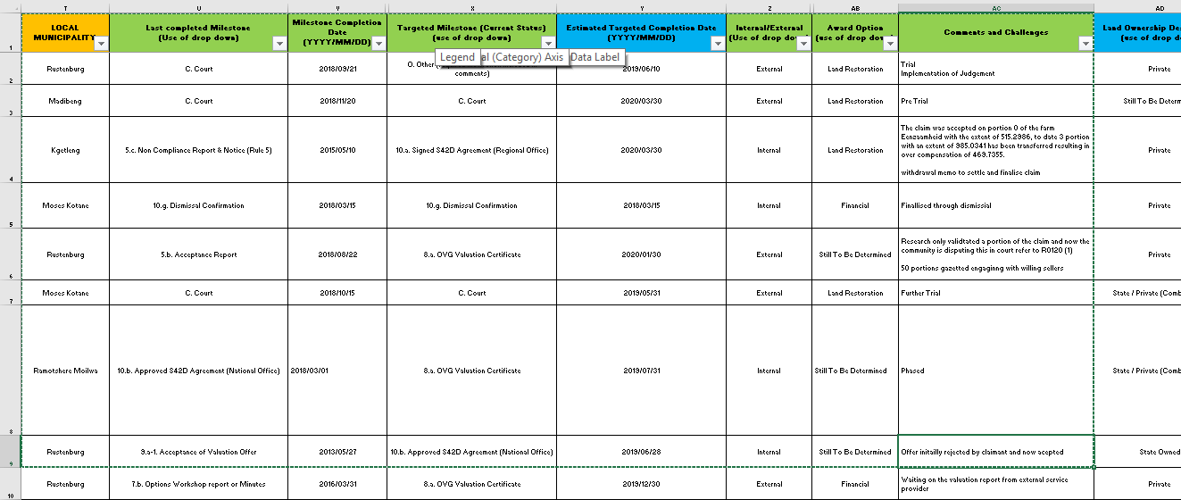
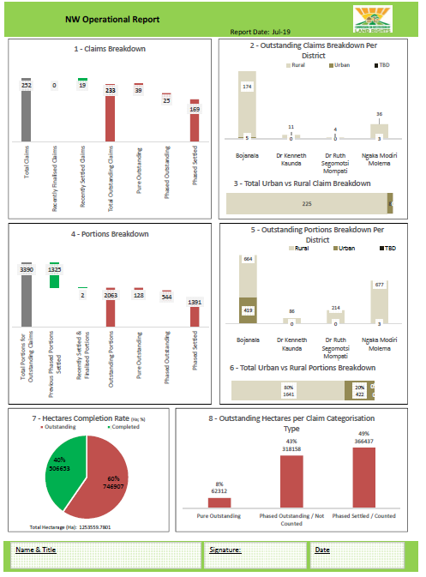
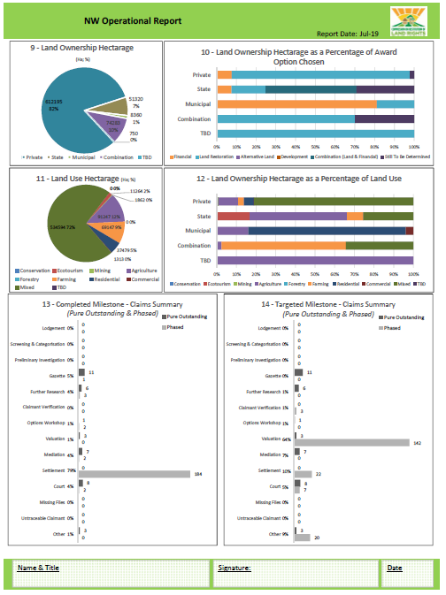
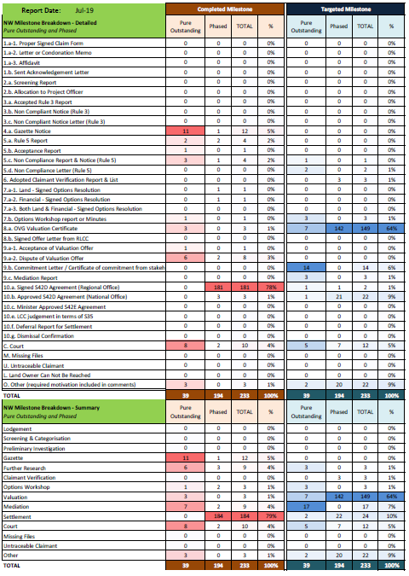
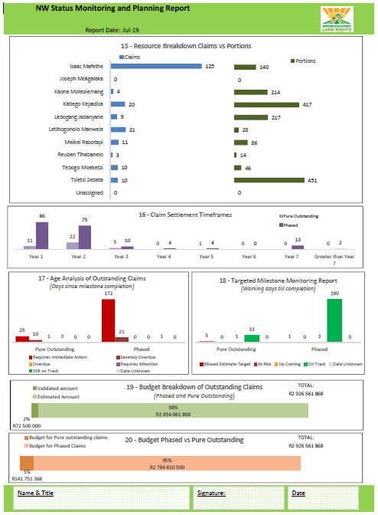
The quality of the outputs in the draft management reporting tool is directly dependant on the quality of the information populated in the excel template by the provinces
Outstanding Claims Data Review
Overview
Population of Excel Template
As the management tools report is extracted from the populated Excel database template neither should be considered in isolation
The 35 fields in the excel template contains information populated as part of Deliverable 1.1.2. This information automatically linked to a combination of the 20 graphs that make up the 4 page draft management reporting tool
Draft Management Reporting Tool Example
Page 1
Page 2
Page 3
Page 4
… An extract from a previous deliverable, which still holds weight as there are still notable data quality issues in the outstanding claims databases, impacting the overall data integrity

Slide 30
3. BUSINESS CASE AND MICRO STRUCTURE

Slide 31
Regarding the process to Autonomy, the commission is developing the business case and preparing to submit a memo to Cabinet about the “road to autonomy” plan
1
Memo to Cabinet
To seek endorsement
Submission of a memo to Cabinet about the request to start the process of making CRLR autonomous
2
Business case development
Business case document outlining feasibility study, situational analysis, Budgetary implications, Strategic Plan etc.
Drafting the Legislative amendments plan and requirements
3
Submission and assessment; Cabinet’s approval of the Business Case
Presentation the business case to the various forums i.e.. Department of Public service and Administration, National Treasury and Parliament until approval is granted
4
Legislative amendments
Input from the business case feedback and Cabinet decision will inform the finalisation of the Legal amendments required for implementation to enable CRLR to be an autonomous entity
5
Transition phase
Commencing the formalisation of the Public Entity Schedule 3A, by embarking onto a process to implement and ensure that all requirements are in place and managing the process as outlined by transition plan
6
Implementation
Instituting the required divisions
implement the approved legislation changes and
operating as an entity

Slide 32
The commission is undergoing a process that will see it become an Autonomous entity in the next 3 years
Background
What has been done to date
Various assessments have been conducted previously about whether the Commission needs to change its current operating model and recommendations alluding to the fact that the commission needs more independence and therefore will be best suited in an autonomous organisational form were made
During project Kuyasa, a comparative analysis was done to compare the various entity forms for the Commission, which included a Specialised service delivery Unit (for the enterim), A Government Component, a Public Entity 3A and a Public Entity 3B
Furthermore, the Auditor General has also recommended that the commission should Identify the best suitable Public Entity model for formalisation
More recently, a legal opinion from the State Attorney’s Office has advised that the most suitable organisation form for the Commission is a Public Entity
Public Entity Schedule 3A was selected because by definition , this form type should be fully funded by the National Revenue Fund, and so is the Commission
The process has been endorsed by the Minister and the DG of DALRRD
Consultations have been held with the following entities to seek advise:
Engaged DPSA and National treasury
Legal advise from the State Attorney's office
Engagements with SARS and SASSA for guidance as they have undertaken a similar process
Budgetary estimates: based on zero budgeting principles to estimate the operation expenses for compensation of employees, goods and services, strategy plan implementation costs and acceleration of the finalisation of the backlog claims
Currently, the Commission operates as a branch of the department, which means the corporate support functions (IT, HR, Risk, Internal Auditing etc..) are provided by the department
The “ Road to Autonomy” process is envisaged to take up to three years to implement. So, the plan is to gradually establish some of the functions during the transition period. During this time the Commission will continue to receive support over the transition period of 3 years. Service level agreements will be used to manage the relationship with DALRRD until the completion of the process

Slide 33
Detailed background: stabilization: 1994 -2000
1994/1995-1999
1999/2000 -2009/10
2009/2010-2020
Process
1999: Process changes from judicial Administrative and batch method is introduced for mass processing
Section 42D introduced,
2000 -Minister commences approve
1999 Claims +R50m threshold (delegation) (RLCCs, above R50m for minister)
2002/3- Settlement support and development introduced
2004- Section 42C development grant introduced
Administrative process continued
2000: Minister commences approve
2002/3: Claims +R50m threshold (delegation to CLCC) above R50m for minister)
2013: Post Settlement support and Developments moved to Rural Enterprise Infrastructure Development (REID)within the Department Recapitalization and Development programmes
2019 Blended funding model commenced (DARLLRD)
1994: CRLR Established CRLR processes claims Judicial process. All claims settled via the court.
1996 Land Claim court established role was assess/evaluate all claims before settlement was reached
Claims are batched for mass processing
Governance
DG: Accounting Officer, Restitution directorate
DG: Accounting Officer
DG: Accounting Officer
Structure
CLCC, DLCC, 1x RLCC
CLCC, DLCC and 9 x RLCC
Structure rationalised CLCC, DLCC and 1 x RLCC, 9 x Chief Directors
Entity type
Semi-autonomous, centralised
De-centralised
Centralised
Own support functions. Management of its own budget and other aspects
Provincial Shared Service Centres (PSSCs) introduced, budget managed by provincial RLCCs
PSSCs continued. Provincial delegations revoked (budget, approvals et al). Department manages all support functions
Support

Slide 34
Update on the Chapters of the Public Entity 3A business case
Section | Progress
Mission, objectives and mandate | Concept Completed. Content approved by the Commissioners. This was Developed last years during the Strategy planning exercise. It is largely about the reduction of claims To be writing into a word document
Legal implications | Legal opinion has been obtained from the State attorneys office. The amendments required have been identified at a high-level. Details will be done by DALRRD CD: legal services. Additional Details about governance structure, functional structure and the human resource management (transfers, conditions of service and negotiations) will be included
Governance Structure | Decision was to have a non-board structure, with EXCO being the highest ranking decision making forum for operational issues and Commissioners for issues related to restitution. CRLR seeks advise on the governance models from National Treasure
Organisational Structure | Decision taken to implement Decentralised structure for the interim structure and public entity structure. Extensive consultation has been done with the DPSA on the interim and the Public Entity Structure
Human Resources Management | High-level understanding of the requirements. TTT will develop a plan for this portfolio.NB: An independent team (with the TTT HR member may be required to manage this. DPSA has given feedback on the process
Risk management | Risks have been identified and assessed. The risk mitigating action will serve as input to the risk management plan. TTT still needs to approve the risks before developing a management plan
Strategic Plan | Strategy and strategic objectives defined. A Strategic planning session was held on the 9th of October to finalise the targets. The strategic plan is being currently being converted into the PFMA approved format
Service Delivery Options | New with Processes have been designed to improve the efficiency and effectiveness. The new Service Charter in progress – in alignment with the new processes. Standard operating procedures are currently being drafted – which will be implemented once approved.
Financial management | Financial estimates completed. Non-financial matters within Financial management still to be addressed
Corporate management | Requirements identified. Plan of execution to be developed
Stakeholder and Communications Plan | Stakeholders identified. Prioritisation process has been suggested.,

Slide 35
Based on the strategic review, and management inputs, 6 objectives were identified in order to assist in steering the strategic direction of the CRLR
Strategic Plan
Key Performance Indicators
No. | Objectives | Goals / Outcomes
1 | Ensure the CRLR is adequately equipped to restore all land rights (for claims lodged before 1998 deadline) | 1.1. Determine an authentic baseline for all outstanding claims
 |  | 1.2. Number of land claims settled (including all associated land rights)
 |  | 1.3. Number of land claims finalised (including all associated land rights)
 |  | 1.4. Number of phased projects finalised
 |  | 1.5. Number of claims researched full and final (including all associated land rights)
2 | Establish the CRLR as an autonomous organisation, improving the governance structures and overall service delivery | 2.1. Number of support functions controlled by the CRLR (within current SSDU legalisation)
 |  | 2.2. Number of SLA’s with 3rd party entities that are linked to the business processes and SOP’s
 |  | 2.3. Number of formal requests sent to follow up on SLA’s non-adherence
3 | Define a clear organisational mandate in line with processes and supported by an appropriate structure | 3.1. Number of process steps with adopted SOP
 |  | 3.2. Duration of process step turnaround times
 |  | 3.3. Number of legal cases against the CRLR
 |  | 3.4. Amount of defined and standardised handover points
 |  | 3.5. Threshold for forecasting accuracy
 |  | 3.6. Amount of rework
4 | Improve stakeholder management, communication channels and overall customer satisfaction | 4.1. Stakeholder survey score (internal and external)
 |  | 4.2. Number of complaints
 |  | 4.3. Number of enquiries received outside the defined channels
 |  | 4.4. Number of compliments
5 | Implement a secure information system that promotes effective management | 5.1. Number of modules (functions) successfully implemented
 |  | 5.2. Number of business process successfully automated and captured in the system workflow
 |  | 5.3. Adherence to project implementation timelines
 |  | 5.4. Meet user acceptance testing requirements for system functionality
 |  | 5.5. Threshold for project budget (actual vs forecasted)
6 | Prepare the CRLR to adequately process new order claims | 6.1. Number of new lodgement claims that are duplicates of current claims (before 1998 deadline)
 |  | 6.2. Number of new lodgement claims that claiming already claimed land (competing claims)
 |  | 6.3. Number of unresolved outstanding Legal judgements (e.g. LAMOSA)
 |  | 6.4. Adhered to all legislative requirements
 |  | 6.5. Adopted reopening of claims strategy and plan (parliamentary level)
Core Backlog
Enablers
15 of the 28 defined outcomes and goals are considered key performance indicators

Slide 36
The interim functional structure has been developed to better manage and deal with the current backlog of claims and new order claims
Public Entity
KEY
Changes from Interim
Department of Agriculture, Land Reform and Rural Development
Location
Level
New
Parliament
National Office
Current
Minister of Agriculture, Land Reform and Rural Development
Changes
Provincial Offices
Proposed
No
changes
Commissioners
15
A
16
CLCC
C
Chief Executive Officer/ Branch Head
14
H
14
14
4 x RLCC
15
DLCC
B
15
15
Head of Operations Management support
14
J
KZN CD
WC CD
EC CD
LP CD
MP CD
GAU CD
FS CD
NW CD
NC CD
14
D
14
14
Head of Restitution Administration Support
14
The Commissioner will report to parliament as primary reporting line(solid) and to the minister as a secondary reporting line (dotted)
All 9 Chief directors and Head of Operations, Restitution support, CFO, Litigation and Advise and Risk and Audit will report to the CEO and Chief directors in the 9 provinces will have a secondary reporting relationship to the RLCCs
CEO will be the accounting authority but the relationship between the CEO and the Commissioners is to be determined as well as a decision on which office the CEO will report. There are two potential models – i) CEO to report to the Commissioners primarily or ii) CEO report to Parliament primarily and to the commissioners as a secondary reporting line (indicated by red lines).This will be determined at the meeting with Treasury on Governance models
For the Public entity, the following titles could be changed to the following titles
Head of Litigation and Advice >>Head of Legal
Head of Head of Restitution Administration Support >> Head of Corporate support services
Head of Head of Restitution Fund Administration >>Chief Financiall Officer
Head of Operations Management support>> Head of Programme Management
E
14
Chief Financial Officer
14
F
14
Head of Litigation and Advice
14
G
14
Head of Risk and Audit
14
I
14
Source: FTC analysis

Slide 37
4. RE-DESIGN OF SETTLEMENT MODELS

Slide 38
1. Overview
4. Financial and settlement Models
Finance and Settlement Models project’s agenda is to provide support in developing compensation models for the land restitution process
Description:
The CRLR requires a Financial framework to utilise in order to evaluate the compensation for each land claim
Objectives:
To enhance the processing and settlement of land claims in a manner that is fair, qualitative, comprehensive and inclusive
To develop an optimal financial compensation awards strategy/support model given variable/pre-determine parameters
l
Synthesised Approach
Design
Piloting
Refinement
1. Literature review of existing financial compensation/ support models⁽¹⁾
5. Scenario development, cconducting economic impact modelling and economic/extended cost-benefit analysis to assess the viability of a particular intervention/scenario, sensitivity analysis, and risk mitigation
7. Model refinement based on pilot results and guideline formulation
2. Baseline assessment of: socio-economic dynamics of communities, market, commodity & location analysis determining relevance/ applicability of support models
6. Scenario comparison to determine an optimal financial compensation awards strategy/support model option
3. Development and structuring of an input database which will inform/ feed into the preferred model
4. Development of models which will be sensitive to: socio-economic dynamics; market/commodity fluctuations, and location/ geography
Client specification and requirements - OUTCOME 4: Piloted financial model the design and piloting of a financial model for evaluation of the land claims
Project Deliverables:
9 deliverables have been identified (See highlighted deliverables on approach slide)
Note:
Consultation required with key stakeholders after finalisation

Slide 39
THANK YOU

