Slide 1
Department of International Relations
&
Cooperation
2019/20 Annual Report
NOVEMBER 2020

Slide 2
PART A:
GENERAL OVERVIEW

Slide 3
OVERVIEW
The Annual Report reflects efforts for the realisation of the department’s performance as outlined in the Annual Report based on the 2014 -2019 Medium Term Strategic Framework.
The performance report audited by the AGSA was found to be useful and reliable. It received an unqualified audit opinion for the third consecutive year.
During the reporting period, the Department achieved 22 (68%) of the 32 annual targets set in the Annual Performance Plan.
The low rate of performance is mainly due to a variety of factors such as scheduling challenges of high level engagements as well as circumstances beyond the control of missions.

Slide 4
PART B:
PERFORMANCE INFORMATION

Slide 5
PROGRAMME 1:
ADMINISTRATION

Slide 6
CORPORATE MANAGEMENT
Most of the Human Resources (HR) targets were met except for the target related to the filling of vacancies, which could not be met due to the ceiling placed on the Compensation of Employees’ (CoE) budget.
  The Department could not maintain the vacancy rate within the national average of 10%, due to the shortfall on the COE budget. All vacancies were declared unfunded. As a result the vacancy rate was at 12, 3%, as at 31 March 2020.
  The Branch facilitated the coordination process and ensured that 35 training programmes were implemented from a target of 20 programmes.
  Government youth development and empowerment initiatives were supported through the implementation of Internship Programmes.
  Discipline managed in line with the Disciplinary Code and Procedure: disciplinary cases finalised within the prescribed time-frame.
  Grievances managed in terms of the Grievance Procedure.
  Psychosocial support services were rendered to 173 officials within 24hours of request/referral. 461 officials consulted the Clinic for travel vaccines and primary health care.

Slide 7
CORPORATE MANAGEMENT
ICT did not meet its 2019-2020 strategic targets. There were delays in the acquisition of Infrastructure modernisation imperatives and computers.
Despite the fact that ICT did not achieve its targets, there has been significant progress in certain aspects of ICT including the development, adoption and approval of Digital Strategy through the Ministerial ICT Task Team.
Furthermore, the following short-term interventions have been achieved:
Acquisition of Microsoft software licenses, products and services through the Microsoft Enterprise Agreement (implementation is currently underway);
Renewal of Email security (Proofpoint) licences (Implementation has been completed); and
Renewal of McAfee endpoint security (anti-virus and anti-malware) licenses (implementation is underway).

Slide 8
DIPLOMATIC TRAINING, RESEARCH & DEVELOPMENT
The DTRD targets were met except the total number of training programmes as a result of the impact of the precautionary measures implemented in Q4 in response to the COVID pandemic.
Seventy three (73 out of 85) training programmes were delivered for DIRCO officials and other spheres of government.
The programmes included short courses, as well as Residential Training Programmes, namely Heads of Mission Preparatory Programme and Mission Preparatory Programme, for officials posted to South African Missions abroad.

Slide 9
DIPLOMATIC TRAINING, RESEARCH & DEVELOPMENT
Supported the Women Peace and Security agenda during South Africa’s tenure in the UNSC through various programmes, such as:
capacity building programmes on Conflict Resolution, Negotiation and Mediation
a dialogue forum which is a platform used for sharing of experiences and best practices on Women Peace and Security issues
Due to internal reorganisation, no stakeholder engagements held, however alternative ways engaged in to appraise and advice of unfolding foreign policy developments.

Slide 10
OFFICE OF THE CHIEF OPERATIONS OFFICER
In terms of advancing gender mainstreaming, youth development and access for people with disability, the following initiatives, amongst other, were undertaken:
Sexual harassment workshops were conducted in order to equip the participants with the necessary skills and knowledge.
A DIRCO Women's forum meeting in celebration of Women's month with the aim to create a platform for women in DIRCO to have a conversation on gender equality and women’s empowerment.
In advancing the Youth, a mentorship and job shadowing programme was also held during the Take a Girl child to Work Day in June 2019, which exposed girl and boy children to the diplomatic working environment.
In respect of the Disability mainstreaming programme, stakeholder consultations have been held within various branches to create an awareness on mainstreaming of/and inclusion of disability within the programmes and projects of the Department.

Slide 11
FINANCE AND LEGAL
The 100% compliance with the 30-day payment period target was not achieved only 83.6% compliance with the 30-day payment period.
100% (698) legal services, advice and assistance provided as follow:
100% (279) of requests for legal services, policy advice and assistance provided on international law; and
100% (419) of requests for legal services, policy advice and assistance provided on domestic law.

Slide 12
PROGRAMME 2:
INTERNATIONAL RELATIONS

Slide 13
STRUCTURED BILATERAL MECHANISMS
Structured Bilateral mechanisms and High-level engagements are used to strengthen bilateral, economic and political relations through the signature, consideration and finalisation of a number of agreements/MoUs and assessment of progress being made by government departments in various fields of cooperation.
During the reporting period a BNC was held with Nigeria and the two Presidents deliberated on areas of cooperation for political, diplomacy, defence, security, economic and social;
The Presidents strongly condemned attacks against foreign nationals;
Reaffirmed their commitment to working together in pursuit of sustainable peace and economic development on the continent in the context of AU Agenda 2063 and the African Continental Free Trade Area Agreement (AfCFTA).

Slide 14
STRUCTURED BILATERAL MECHANISMS
The structured bilateral mechanisms with countries in the Asia and Middle East, aimed at, amongst others:
cooperation in agriculture, defence, transport, education (SA-Bangladesh SOM);
cooperation on the exchange of experiences from SA’s democratic transition and economic cooperation in mining, sugarcane farming and defence (SA-Myanmar SOM);
reciprocal market access for two seasonal fruits to be granted (Foreign Office Consultations with India);
support SA in gaining access to the Chinese market on agricultural products and commitment to support SA as Chair of the AU in particular in peace and security (Strategic Dialogue with China.

Slide 15
STRUCTURED BILATERAL MECHANISMS
The structured bilateral mechanisms with countries in the Americas and Europe, aimed at, amongst others:
taking stock of current development cooperation projects between RSA and US (SA-US Annual Bilateral Forum;
developing stronger and deeper economic and commercial relations to match the depth of bilateral diplomatic and political relations (SA-Cuba JCC);
continue to process and finalise the proposed “Waiver of visas for Diplomatic and official passport MOU for signatures following agreement reached with the Luthianian Authorities (SA-Lithuanian SOC;
continue to support the department of Basic Education to offer Portuguese as a 2nd language at schools and to develop further Portuguese courses at SA tertiary institutions (Session of Bilateral Consultations with Portugal).

Slide 16
HIGH-LEVEL ENGAGEMENTS
The countries in the Southern Africa region are considered to be important partners in advancing bilateral political and economic cooperation, as well as from a regional perspective, in terms of political cohesion, economic integration, and peace and security, which were the focus of the high-level strategic engagements during the reporting period;
23 high-level engagements with African countries undertaken;
South Africa remained seized with issues of conflict resolutions and sustainable peace on the continent. SA continues to play a positive role in the peace process in the Central African Republic, South Sudan and Lesotho.

Slide 17
HIGH-LEVEL ENGAGEMENTS
The engagement with Egypt was held to strengthen bilateral relations and also because Egypt was the current Chair of the AU and SA was to assume the Chair in 2020;
The engagement with Equatorial Guinea discussed the re-establishment of a bilateral consultative mechanism, bilateral relations, economic cooperation, regional and continental issues.

Slide 18
HIGH-LEVEL ENGAGEMENTS
Engagements with countries in the Asia and Middle East included the following outcomes:
Increase trade with Qatar
Market access for SA agricultural products and the elimination of technical barriers to exports with Vietnam
Closer cooperation regarding the funding gap for UN Peace-keeping Missions on the African continent;

Slide 19


Trade Overview
JULY 2020 (SARS)

Slide 20
ECONOMIC DIPLOMACY OVERVIEW
South Africa’s economic diplomacy in the region (Asia and Middle East) is focused on reducing South Africa’s trade deficit in the region and to promote the export of value-added manufactured goods.
Cooperation in this region amongst others includes mining, education, skills and technology transfer in Blue Economy, water and sanitation, sugarcane farming, defence and tourism.
The announcement by the Department of Home Affairs (DHA) of visa waivers for Saudi Arabia, the United Arab Emirates and Qatar will contribute to South Africa’s tourism promotion efforts in these countries.

Slide 21
ECONOMIC DIPLOMACY OVERVIEW
The United States remains one of South Africa’s biggest single contributor of development assistance and continues to support the fight against HIV/AIDS and tuberculosis under the President’s Emergency Plan for AIDS Relief (PEPFAR)
To date US Centre for Disease Control and Prevention (CDC) has committed US$13.2 million in funding and $8.4 million in assistance through the US Agency for International Development (USAID)
Following extensive lobbying by DIRCO, Canada removed long-standing restrictions on the sale of South African wine in the Province of British Columbia.

Slide 22
ECONOMIC DIPLOMACY OVERVIEW
Western Europe continue to be our major partners, providers of development assistance, FDI and tourism.
Total investment from Europe is estimated around R1.4 trillion which represents approximately 77% of total FDI into the country.
European investors were well represented at the President’s 2nd Annual Investment Conference. French companies pledged R20 billion worth of investment into South Africa
More than 2 000 European companies operate in SA, employing South Africans, enhancing their skills and investing in the economy.
European countries allocate significant funding to technical exchanges, collaboration in the fields of science and technology and vocational training
SA’s total trade with Europe reached R740 billion in 2019 which is a 7% increase compared to 2018.

Slide 23
ECONOMIC DIPLOMACY OVERVIEW
The Nordic and Baltic countries are very important cooperation partners for South Africa in the fields of Trade and Investment, Tourism, Agriculture, Defence, Transport, renewable energy, Skills Development, Oceans Economy, Science, 4IR and environment, green growth and agriculture.
Scholarships offers facilitated from Azerbaijan, Russia, Sweden and Hungary through the Department of Higher Education and Training to contribute to the government’s skills development objective.
Nordic companies continues to invest in SA. Finnish companies established operations in SA including:
Metso – invested R200 million in its Vereeniging facility;
UPM Raflatac – invested R35 million in its distribution terminal in Germiston;
Huhtamaki – invested R58 million Euro in a merger with a SA company, expanding its flexible packaging manufacturing.

Slide 24
ECONOMIC DIPLOMACY OVERVIEW
South Africa and Cuba have a joint Technical Support Programme (SACTSP) in the area of human settlements;
The SACTSP was initiated to accelerate the development of human settlements, based on the Cuban experience, to improve the lives of beneficiaries of housing in South Africa;
From 2017 to date, which marks Phase 5 of the SACTSP programme, a total of twenty-three (23) Cuban Technical Advisors (CTAs) were recruited and deployed in the Free State, Limpopo and Mpumalanga;
The South Africa/Cuba Agreement on Cooperation in the fields of Water Resource Management and Water Supply, was renewed on February 2020. The renewed agreement will enable the next group of 25 Cuban engineers to be deployed across all 9 provinces of South Africa;
1227 SA students are studying medicine in Cuba and of those, 695 are expected to return to South Africa in July 2020.

Slide 25
PROGRAMME 2:
REGIONAL INTEGRATION (SADC)

Slide 26
SOUTH AFRICAN DEVELOPMENT COMMUNITY (SADC)
The primary goal of SADC is to foster regional integration, including political and economic integration, for the benefit of the SADC population.
South Africa’s contributed towards regional peace, security, stability and sustainable development and the advancement of socio-economic development
Regarding the consolitation of regional democracy, South Africa actively participated in SADC Electoral Observation Missions to Botswana, Malawi, Madagascar, Mauritius, Mozambique and Namibia.
South Africa submitted a Country Report on the implementation of the Revised Regional Indicative Strategic Development Plan (RISDP) (2015 -2020).
President Ramaphosa, as SADC Facilitator to the Kingdom of Lesotho, continued to actively coordinate efforts in addressing peace, security and political stability in the Kingdom, with progress report submitted on 16 August 2019. This role of the President continues.

Slide 27
SADC
SADC Council of Ministers had a virtual meeting on 18 March 2020 and deliberated and noted:
Recommendations from the Extra-Ordinary meeting of SADC Ministers of Health in relations to COVID 19;
Status of the formulations of the SADC Post 2020 Agenda;
Status of the Union of Comoros annual member state contribution;
Status on the Regional Tourism Organisation of Southern Africa;
SADC’s 40th anniversary;
Establishment of a SADC Liaison Office in Brussels;
Report from the Finance Committee and noted the implementation of the 2019/20 Annual Corporate Plan for the period April to December 2019;
Approved the 2020/21 budget;
The 2020/21 Annual membership contributions were approved.

Slide 28
SADC
SADC Summit of Heads of State and Government focused on:
developments in the Kingdom of Lesotho, DRC and Madagascar and President Ramaphosa was mandated to continue as the facilitator in the Kingdom of Lesotho;
elected President of Mozambique as Incoming chairperson of Summit and the President of Botswana as incoming Chairperson of the Organs on Politics, Defence and Security Cooperation for August 2020;
congratulated Comoros, DRC, eSwatini, Madagascar, Malawi and South Africa for holding peaceful and successful elections;
Called for the unconditional implementation of all UN resolutions and AU decisions on Western Sahara which lead to a positive, peaceful and permanent solution that meets aspirations of the Western Sahara.

Slide 29
PROGRAMME 3:INTERNATIONAL COOPERATION
3.1 SYSTEM OF GLOBAL GOVERNANCE

Slide 30
3.1 SYSTEM OF GLOBAL GOVERNANCE
As a member of the UNESCO Executive Board, South Africa advanced the country’s interests on a range of resolutions and articulated the country’s positions on advancement in education, culture and science.
SA attended the Regular Session of the Economic and Social Council High Level Political Forum (HLPF) where the main focus of the session was the presentation of South Africa’s Voluntary National Report on SDG’s.

Slide 31
3.1 SYSTEM OF GLOBAL GOVERNANCE
At the Session of the Human Rights Council, South Africa supported 21 resolutions by either voting in support or joining consensus and abstained on five (5) country specific resolutions.
Resolutions of priority to SA included amongst others:
Access to medicines and vaccines in the context of the right of everyone to the enjoyment of the highest attainable standard of physical and mental health;
Accelerating efforts to eliminate all forms of violence against women and girls;
Promotion of the right to peace;
Mandate of the Independent Expert on protection against violence and discrimination based on sexual orientation and gender identity.

Slide 32
3.1 SYSTEM OF GLOBAL GOVERNANCE
South Africa participated at the 42nd Session of the Human Rights Council (HRC), South Africa joined consensus on 37 resolutions, voted in favour of 8 resolutions including:
Yemen in the field of Human Rights;
Situation of human rights of Rohingya Muslims and other minorities in Myanmar;
Strengthening cooperation and technical assistance in the field of human rights of the Bolivarian Republic of Venezuela and the Rights to Development

Slide 33
3.1 SYSTEM OF GLOBAL GOVERNANCE
South Africa prepared for and participated at the Session of the UNGA 74 General Debate (High-Level Segment).
Key high-level meetings that took place on the margins of the General Debate included amongst others:
The High-level meeting on Universal Health Coverage;
The High-level meeting on Sustainable Development;
The High-level meeting on Financing for Development;
The High-level meeting to commemorate and promote the International Day for the Total Elimination of Nuclear Weapons
The national statement delivered at the General Assembly focused on issues related to development, peace and security, and reform of multilateral institutions, especially the UN Security Council.

Slide 34
3.1 SYSTEM OF GLOBAL GOVERNANCE
South Africa participated at the UNESCO General Conference and the national statements delivered articulated South Africa’s positions on advancement in education, culture and science
SA influenced decisions in a number of agendas amongst others :
Discussion of the approved budget of USD 534.6 million for the period 2020-2022;
The adoption of the Global Convention on the Recognition of the Higher Education Qualifications, which aims to support the recognition of studies carried out abroad, facilitating academic mobility for students and educators;
The re-organisation of the International Bureau of Education (IBE);

Slide 35
3.1 SYSTEM OF GLOBAL GOVERNANCE
SA participated in the G20 Leader’s Summit where the overall balance of the Osaka Leaders’ Declaration signifies a successful G20 summit. SA received endorsement of G20 Leaders amongst others:
Support for Africa in the implementation of the 2030 Agenda for Sustainable Development;
Support for the G20 Partnership with Africa;
Compact with Africa;
G20 initiative on Industrialisation in Africa;
Continued focus on illicit Financial Flows (IFFs);
Commitment to the G20 Initiative on Human Capital Investment (HCI) for Sustainable Development.

Slide 36
3.1 SYSTEM OF GLOBAL GOVERNANCE
Number of positions on identified influential multilateral bodies where South Africa is represented level was at 65 at the end of March 2020:
Representation at: | Total
Country level (elected positions) – different lead departments e.g. UNSC: DIRCO Council of the International Maritime Organization (IMO) – Department of Transport Commission on the Status of Women (CSW) – Department of Women | 18
Expert level – (elected positions based on applications) (serve on multilateral committees) e.g. International Law Commission (ILC) – Prof D Tladi; Deputy Executive Secretary: Regional Integration (SADC) – Dr T Mhlongo | 14
Standing Representation - Permanent/semi-permanent positions e.g. United Nations General Assembly (UNGA) - DIRCO International Monetary Fund (IMF) – National Treasury | 15
Appointments (may be supported by country) e.g. CEO: African Peer Review Mechanism – Dr E Maloka Chair: Board of Governors, BRICS New Development Bank – Mr T Mboweni Director: Africa Division, Department of Political Affairs (DPA) – Mr G Maitland (seconded) | 18

Slide 37
PROGRAMME 3:
INTERNATIONAL COOPERATION
3.2 CONTINENTAL COOPERATION

Slide 38
3.2 CONTINENTAL COOPERATION
South Africa participated at the Mid-Year Coordination Session of the AU Executive Council where the session:
Approved the AU budget for 2020;
Approved the theme for 2020;
Endorsed the African Candidatures;
Launched an operational phase for African Continental Free Trade Agreement (AfCFTA);
Committee on implementation of Agenda 2063 was revitalized.

Slide 39
3.2 CONTINENTAL COOPERATION
During the 33rd Ordinary Session of the Assembly of the AU, President Ramaphosa committed to advancing and promoting gender equality and women empowerment during SA’s Chairship, both in terms of Agenda 2063 and Beijing+25.
The Summit ia deliberated on:
Institutional reform and financing of the continental body;
Peace and Security on the Continent;
Developments related to the African Continental Free Trade Area;
Negotiations for a new cooperation agreement between the African, Caribbean and Pacific developing countries; and
the European Union Post-2020.

Slide 40
3.2 CONTINENTAL COOPERATION
South Africa continue to support peace and security to advance peace and security in Africa.
During the AUPSC meeting the following reports were presented:
A report on the State of Peace and Security on the Continent;
5th report on the implementation of the AU Master Roadmap (AUMR) of Practical Steps to Silence the Guns in 2020.
The AUPSC is also to establish a unit within the African Standby Force dedicated at combating terrorism

Slide 41
PROGRAMME 3:
INTERNATIONAL COOPERATION
3.3 SOUTH-SOUTH COOPERATION

Slide 42
3.3 SOUTH-SOUTH COOPERATION
African, Caribbean and Pacific Group of States (ACP)
The Nairobi Declaration and Summit provided guidance on the current transformation of the ACP with regard to its constitutive act and post-Cotonou negotiations.
Interventions by South Africa at the NAM Summit:
Stressed the importance of solidarity amongst NAM member states;
Condemned unilateralist and continued sanctions against Cuba, Iran, Venezuela and Zimbabwe.

Slide 43
3.3 SOUTH-SOUTH COOPERATION
South Africa’s achievements during the IORA two year Chairship:
Guiding the institutional capacity strengthening of Secretariat for enhances support for the IORA agenda;
Establishment of new working groups on the Blue Economy, maritime safety and security, and women’s economic empowerment aimed at up-scaling the implementation of IORA priorities areas;
Enhancement of the legacy of former President Mandela within IORA through the launch in 2018 of Nelson Mandela “Be the legacy” internship programmes aimed at empowering the youth of the Indian Ocean Region;
Deepened engagement with IORA Dialogue Partners for an improved contribution to the Association’s programmes and projects.

Slide 44
3.3 SOUTH-SOUTH COOPERATION
The 11th BRICS Summit in Brasilia reported the following outcomes:
Signature of the MOU among BRICS Trade and Investment Promotion Agencies
The importance BRICS places on science, technology and innovation was highlighted by the establishment of the iBRICS Network, via the Innovation Action Plan;
Adoption of the New Architecture on Science, Technology and Innovation (STI);
The first meeting of the BRICS Institute of Future Networks (BIFN) Council was held;

Slide 45
3.3 SOUTH-SOUTH COOPERATION
Outcomes of 11th BRICS Summit continued
Adopted the Terms of Reference for the establishment of the BRICS Energy Research Cooperation Platform (ERCP);
Cooperation on combatting terrorism;
Approved the Collaborative Research Program for tuberculosis;
Considered the work undertaken with regard to the expansion of membership of the NDB;
Establishment of the BRICS Women Business Alliance

Slide 46
PROGRAMME 3:
INTERNATIONAL COOPERATION
3.4 NORTH-SOUTH COOPERATION

Slide 47
3.4 NORTH-SOUTH COOPERATION
The Tokyo International Conference on Africa Development (TICAD) Plenary Session delved on a number of strategic issues that will contribute effectively to the advancement of National Interest, African Agenda and the South Positions namely:
economic transformation and improvement of business through innovation and private sector engagement;
Strengthening Peace and Stability;
Thematic Sessions on Science, Technology and Innovation, Agriculture, Human Resource Development, Education for Youth Entrepreneurship Blue Economy.

Slide 48
3.4 NORTH-SOUTH COOPERATION
The Eighth South Africa-EU PSDF provided an opportunity for South Africa and the EU to exchange views on a range of issues related to political and security developments of the African Continent and globally and also discussed cooperation in the UN Security Council during SA’s tenure as an elected member and as Council President for October 2019.
The FOCAC Coordinators Meeting considered implementation of the outcomes of the 2018 Beijing Summit as well as measures to ensure the full implementation of these outcomes by the conclusion of the current implementation period in 2021.
The Coordinators Meeting and the Minister‘s associated bilateral programme allowed South Africa to promote its specific NDP priorities, which correlate with those of Agenda 2063.

Slide 49
PROGRAMME 4.1
PUBLIC DIPLOMACY

Slide 50
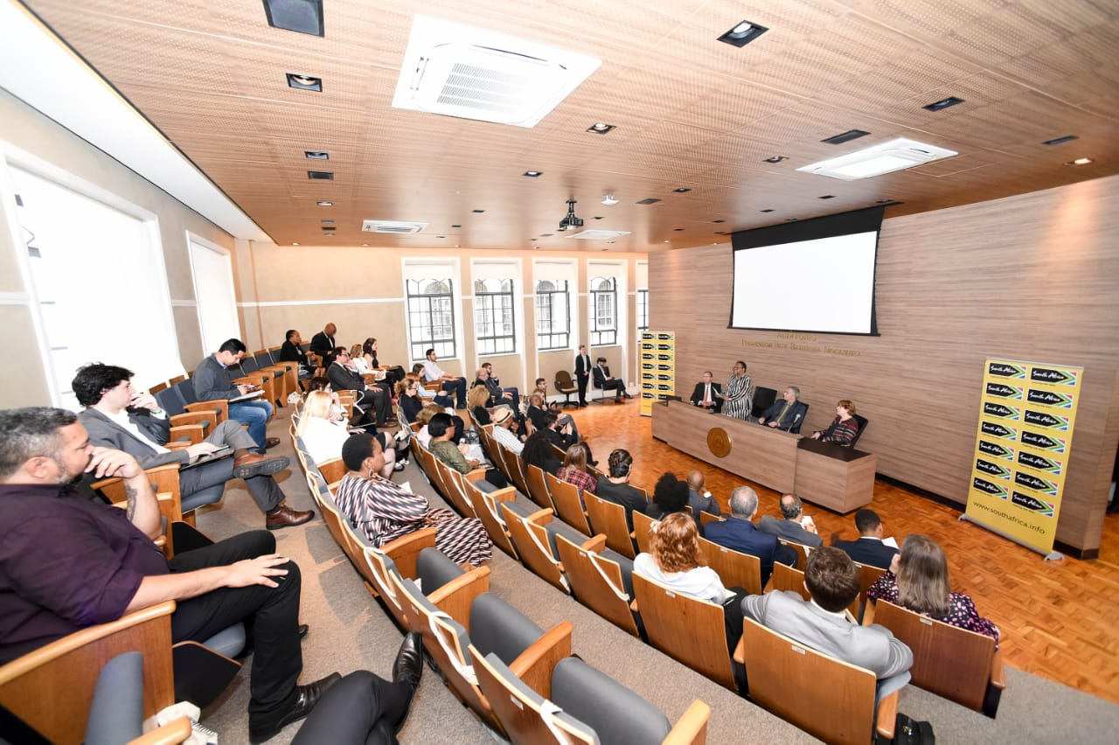
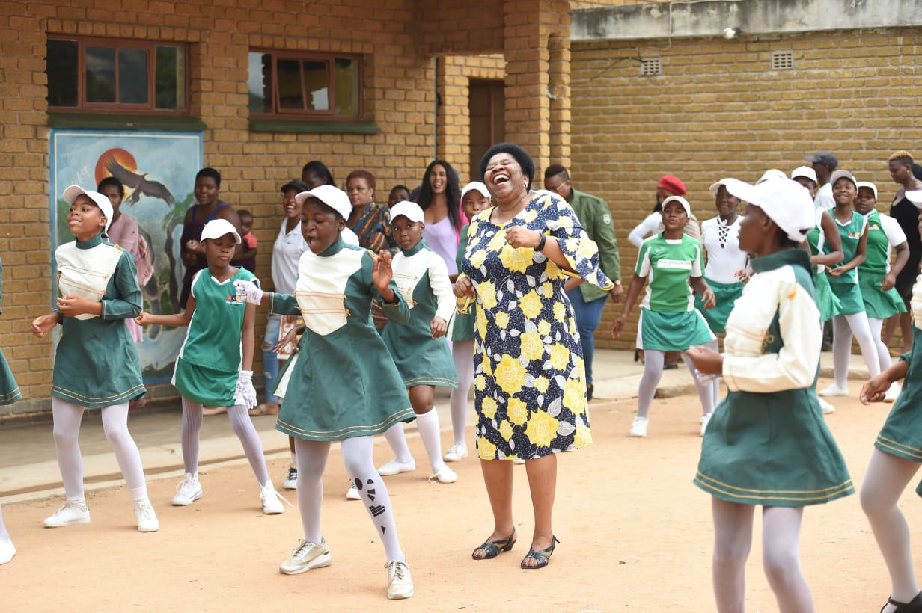
4.1 PUBLIC DIPLOMACY
South Africa’s public diplomacy is grounded in the New Development Plan, which calls for the development and implementation of a robust and sophisticated Public Diplomacy (PD) Strategy, which guided the public diplomacy activities undertaken during the period under review.
The department, through PD, continued to enhance the understanding of South Africa’s foreign policy through engagements with both the local and international audiences. Political principals utilised various platforms, such as media briefings and public participation programmes (PPPs)(15 held in 2019/20) to reach out to the public and set the agenda in public discourse of South Africa’s foreign policy.
São Paulo, Brazil Public Lecture
Hazyview, Mpumalanga PPP
Back-to-School Campaign

Slide 51
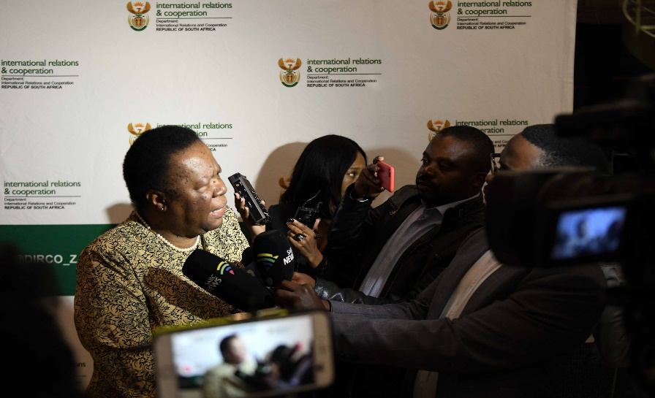
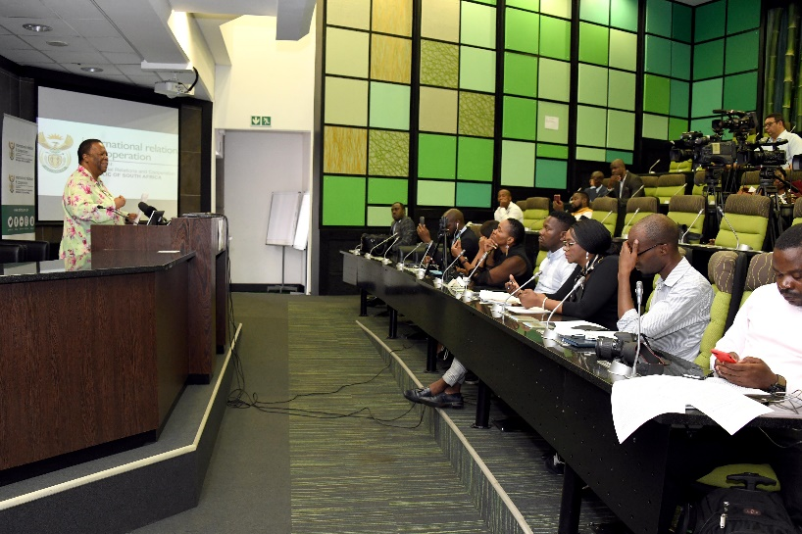
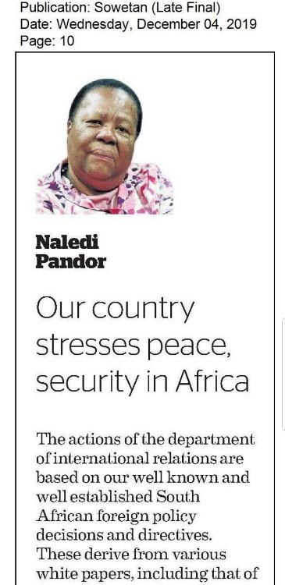
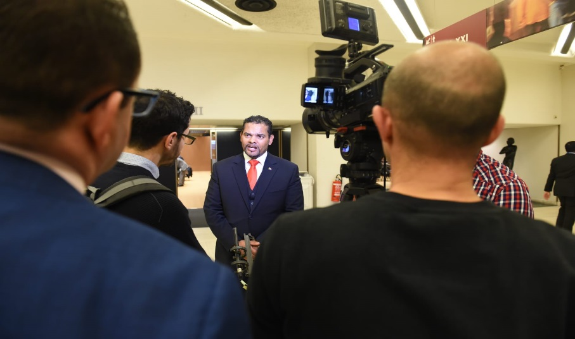
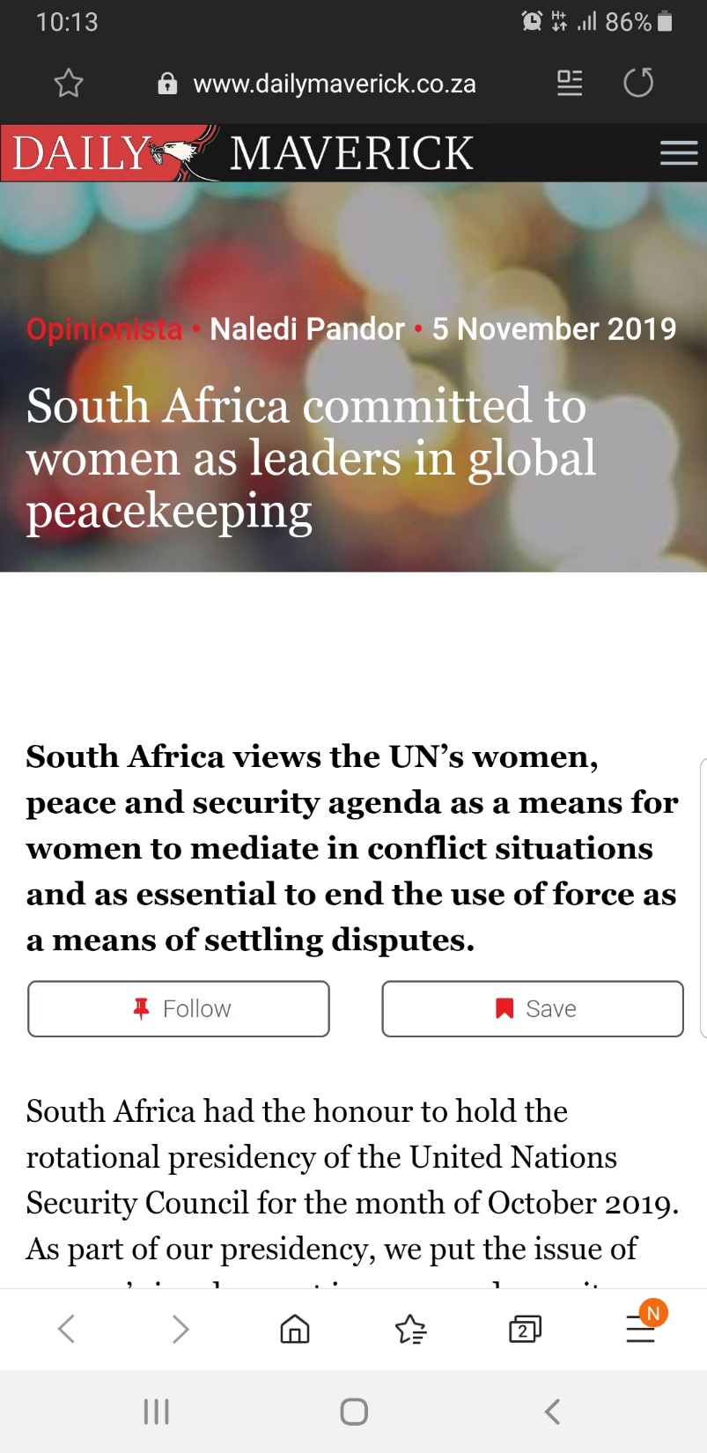
4.1 PUBLIC DIPLOMACY
Furthermore, the principals articulated South Africa’s positions on international developments through well-researched opinion pieces, which were publicised to ensure broader reach of the public. Similarly, the department and, in particular, the principals, remained accessible to the public through media engagements during which topical issues were discussed for the benefit of the respective audience. In the financial year under review, Public Diplomacy issued 122 media statements and 14 opinion pieces

Slide 52


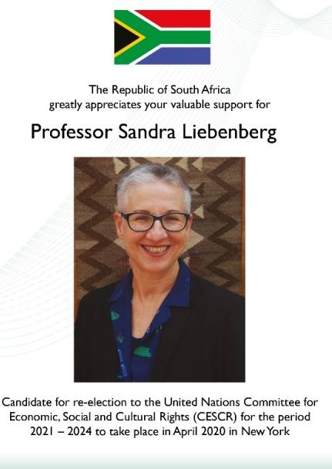
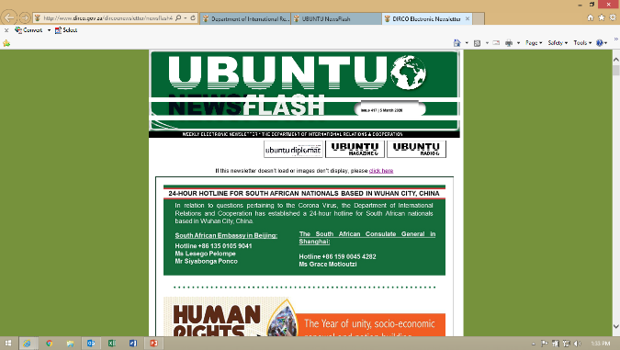
PUBLICATIONS
Public Diplomacy continued to document various engagements and activities undertaken by South Africa’s missions abroad in various Ubuntu publications. These publications were used to communicate with and educate various stakeholders on South Africa’s foreign policy positions, achievements, objectives and goals. Foreign policy researchers, analysts, aspiring diplomats and the public in general continue to rely on and use these documents as reference points/research tools.
During the year under review, PD continued to strengthen its working relationships with like-minded institutions such as Brand SA and South African Tourism, to collaborate on joint campaigns that promote our country and attract much-needed investments and tourism.

Slide 53
PROGRAMME 4.2
STATE PROTOCOL AND CONSULAR SERVICES

Slide 54
4.2 STATE PROTOCOL AND
CONSULAR SERVICES
ANNUAL TARGET | ACHIEVEMENTS
100% of protocol services rendered during state visits and international conferences | 100% (53) of state visits services rendered: 22 incoming visits 31 outgoing visits 100% (one) of protocol services rendered for international visits
Two strategic engagements held with Diplomatic Corps in support of facilitating diplomatic immunities and privileges | Not achieved One strategic engagement held with Diplomatic Corps
100% of documents accepted for legalisation processed in accordance with the guidelines set in the Service Delivery Charter | 100% (82 644) of documents legalised within the time frames stipulated in the Service Delivery Charter

Slide 55
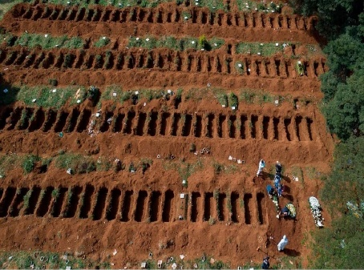







100% (929) CONSULAR SERVICES RENDERED
Mortal remains (197)
Detainees (113)
Citizens in distress (189)
Abductions (16)
Service of civil process (359)
Whereabouts (18)
Extraditions (37)

Slide 56
PART C:
GOVERNANCE

Slide 57
GOVERNANCE STRUCTURES (AUDIT & RISK MANAGEMENT)
The department has, on an annual basis, reviewed and updated its Risk Management Policy, and developed the Risk Management Strategy for the implementation of the policy.
The Risk Management Committee and Audit Committee consisted of independent external persons.
The department implemented and maintained a Fraud and Corruption Prevention Policy and Strategy, which is reviewed on an annual basis in line with its risk-management framework.

Slide 58
HEALTH AND SAFETY
With the advent of the COVID-19 pandemic, extra safety measures have been implemented to prevent the spread of COVID-19 in the workplace.
The COVID-19 Steering Committee, comprising of Management and Organised Labour, was established to deal with COVID-19 health and safety protocols, and advise the Director-General on safety measures to be implemented.
The On-Site Clinic continued to render first aid services to officials injured on duty and make the necessary referrals for further medical attention.

Slide 59
PART D:
HUMAN RESOURCE MANAGEMENT

Slide 60
EMPLOYMENT AND VACANCIES BY SALARY BAND AS ON 31 MARCH 2020
Salary band | Number of posts on approved establishment on 31 March 2020 | Number of posts filled on 31 March 2020 (included employees additional) | Vacancy Rate % | Number of employees additional to the establishment
Lower skilled (Levels 1-2) | 3 | 1 | 66.7 | 0
Skilled (Levels 3-5) | 175 | 136 | 22.3 | 1
Highly skilled production (Levels 6-8) | 798 | 715 | 10.4 | 9
Highly skilled supervision (Levels 9-12) | 1 153 | 1 004 | 12.9 | 18
Senior management (Levels 13-16) | 299 | 273 | 8.7 | 11
POBs | 3 | 3 | 0 | 0
Total | 2 431 | 2 132 | 12.3 (299) | 39
NOTE: The SMS managers reflected as additional to the establishment include employees seconded to international organisations in terms of the National Policy on the Secondment of South African Public Service Employees

Slide 61
ANNUAL TURNOVER RATES BY SALARY BAND FOR THE PERIOD
1 APRIL 2019 TO 31 MARCH 2020
Salary band | Number of employees on 1 April 2019 (included employees additional) | Appointments and transfers into the department | Terminations and transfers out of the department | Turnover rate %
Lower skilled (Levels 1-2) | 0 | 0 | 0 | 0
Skilled (Levels 3-5) | 134 | 1 | 6 | 4.5
Highly skilled production (Levels 6-8) | 737 | 2 | 26 | 3.5
Highly skilled supervision (Levels 9-12) | 1 039 | 3 | 55 | 5.3
SMS Bands A | 181 | 3 | 19 | 10.5
SMS Bands B | 75 | 1 | 8 | 10.7
SMS Bands C | 20 | 0 | 3 | 15
SMS Bands D | 2 | 0 | 0 | 0
Special Adviser | 2 | 2 | 2 | 100
POBs | 3 | 3 | 3 | 100
Total | 2 193 | 15 | 122 | 5.6

Slide 62
REASONS WHY STAFF LEFT THE DEPARTMENT FOR THE PERIOD
1 APRIL 2019 TO 31 MARCH 2020
Termination Type | Number | % of Total Resignations
Death | 2 | 1.64
Resignation | 24 | 19.67
Expiry of contract | 28 | 22.95
Dismissal – misconduct | 7 | 5.74
Dismissal – inefficiency | 0 | 0
Discharged due to ill-health | 1 | 0.82
Retirement – Section 16(1)(a) – 65 years | 18 | 14.75
Early Retirement – Section 16(4) – 60 to 64 years | 24 | 19.67
Early Retirement – Section 16(2A)(a) – 55 to 59 years | 0 | 0
Transfer to other Public Service Departments | 18 | 14.75
Total | 122 | 100
Total number of employees who left as a % of total employment (2 132) | 5.72

Slide 63
SIGNING OF PERFORMANCE AGREEMENTS BY SMS MEMBERS AS ON 31 MAY 2019
SMS Level | Total number of funded SMS posts | Total number of SMS members (excluded employees additional) | Total number of signed performance agreements | Signed performance agreements as % of total number of SMS members
Director-General | 1 | 1 | 1 | 100
Salary Level 15/16 | 10 | 18 | 17 | 94.4
Salary Level 14 | 55 | 66 | 65 | 98.5
Salary Level 13 | 229 | 176 | 168 | 95.5
Total | 295 | 261 | 251 | 96.2
NOTE: The three POBs and two special advisers are excluded. The higher number of SMS members compared to the total number of funded SMS posts is as a result of Heads of Mission appointed on contract

Slide 64
TYPES OF MISCONDUCT ADDRESSED AT DISCIPLINARY HEARINGS FOR THE PERIOD
1 APRIL 2019 TO 31 MARCH 2020
Type of misconduct | Number | % of total
Allegations of fraud and theft | 0 | 0
Contravention of PFMA, PPPFMA, Treasury Regulations and Code of Conduct for Bid Adjudication Committee | 2 | 16.67
Gross dishonesty: Misrepresentation of facts | 4 | 33.33
Other | 6 | 50
Total | 12 | 100

Slide 65
PART E (1): FINANCIAL INFORMATION

Slide 66
Overview Financial Performance
1.1. The department spent R6, 310 billion in 2019/20, which represents 97% of the adjusted appropriation. The expenditure is lower by less than 1% (percent) in comparison to R6, 370 billion spent in 2018/19 financial year.
1.2. The department managed maintained its spending within the reduced budget allocation in the implementation of the Annual Performance Plan. This was attained through the implantation of cost saving measures, such as revision of rental norms and
standards, reduction on the international travel and doing more with less through the introduction of efficiency in the operation of the missions.
1.3. However, the department had to navigate the impact of the budget cut experienced on the compensation of employees, which unfortunately, has resulted in the expenditure exceeding the budget ceiling by R246 million. Conversely, the department’s effort to delay the placement of officials to missions abroad for December 2020 placement cycle were not sufficient containing the spending within the main division of the vote. As a result, the high spending on compensation of employees constituted unauthorized expenditure and contributed to the low levels of liquidity and requires attention going forward.
1.4. The department’s inherent risk of foreign exchange rate fluctuation remains a challenge as the department’s obligation in respect to the South Africa's commitment are levied if foreign currencies whilst the budget estimates are projected in Rand. Thus for the period under review the department had to proposed virement of funds to the value of R47 million to meet South Africa's international obligation through the engagement with the National Treasury. Consequently, discussion with National Treasury and South African Reserve Bank are underway in finding a mitigating strategies to this inherent risk.

Slide 67
Appropriation per programme
 | 2019/20 |  |  |  | 2018/19
Programme | Final Appropriation | Actual Expenditure | Variance | Expenditure as % of final appropriation | Final Appropriation | Actual Expenditure | Variance
 | R'000 | R'000 | R'000 | % | R'000 | R'000 | R'000
Administration | 1,698,484 | 1,294,910 | 403,574 | 76.2% | 1,513,809 | 1,355,490 | 158,319
International Relations | 3,069,527 | 3,313934 | (244,407) | 108.0% | 3,383,266 | 3,377,476 | 5,790
International Cooperation | 538,543 | 541,104 | (2,561) | 100.5% | 526,498 | 525,744 | 754
Public Diplomacy and Protocol Services | 298,886 | 289,046 | 9,840 | 96.7% | 353,250 | 352,515 | 735
International Transfers | 903,075 | 871,050 | 32,025 | 96.5% | 775,945 | 759,014 | 16,931
Total | 6,508,515 | 6 310044 | 198,471 | 97.0% | 6,552,768 | 6,370,239 | 182,529
 |  |  |  |  |  |  | -
Compensation of employees | 2,874,494 | 3,137,506 | (263,012) | 109.1% | 2,964,489 | 3,088,959 | (124,470)
Goods and Services | 2,243,881 | 2,126988 | 116,893 | 94.8% | 2,452,343 | 2,323,595 | 128,748
Interest on unitary payments (PPP) | 105,098 | 105,016 | 82 | 99.9% | 95,022 | 94,947 | 75
Transfers and subsidies | 917,236 | 882,300 | 34,936 | 96.2% | 812,545 | 795,458 | 17,087
Payments for capital assets | 367,793 | 58,221 | 309,572 | 15.8% | 215,345 | 54,256 | 161,089
Payments for financial assets | 13 | 13 | - | 100.0% | 13,024 | 13,024 | -
Total | 6,508,515 | 6 310044 | 198,471 | 97.0% | 6,552,768 | 6,370,239 | 182,529

Slide 68
Programme 1 and 2 expenditure report
Programme 1: ADMINISTRATION
 |  |  |  |  | 2018/19
Economic classification | Final Appropriation | Actual Expenditure | Variance | Expenditure as % of final appropriation | Final Appropriation | Actual Expenditure | Variance
Compensation of employees | 509,501 | 496,550 | 12,951 | 97.5% | 472,928 | 469,437 | 3,491
Goods and services | 722,696 | 635,817 | 86,879 | 88.0% | 734,856 | 728,682 | 6,174
Interest and rent on land | 105,098 | 105,016 | 82 | 99.9% | 95,022 | 94,947 | 75
Transfers and subsidies | 3,904 | 2,057 | 1,847 | 52.7% | 2,009 | 2,002 | 7
Payments for capital assets | 357,285 | 55,470 | 301,815 | 15.5% | 195,970 | 47,398 | 148,572
Payment for financial assets | - | - | - | - | 13,024 | 13,024 | -
Total | 1,698,484 | 1,294,910 | 403,574 | 76% | 1,513,809 | 1,355,490 | 158,319
Programme 2: INTERNATIONAL RELATIONS
 |  |  |  |  | 2018/19
Economic classification | Final Appropriation | Actual Expenditure | Variance | Expenditure as % of final appropriation | Final Appropriation | Actual Expenditure | Variance
 | R'000 | R'000 | R'000 | % | R'000 | R'000 | R'000
Compensation of employees | 1,804,656 | 2,077,476 | (272,820) | 115.1% | 1,966,189 | 2,073,395 | (107,206)
Goods and services | 1,249,108 | 1,227,795 | 21,313 | 98.3% | 1,372,865 | 1,273,937 | 98,928
Interest and rent on land | - | - | - | - | - | - | -
Transfers and subsidies | 7,240 | 6,304 | 936 | 87.1% | 25,169 | 25,165 | 4
Payments for capital assets | 8,510 | 2,346 | 6,164 | 27.6% | 19,043 | 4,979 | 14,064
Payment for financial assets | 13 | 13 | - | 100.0% | - | - | -
Total | 3,069,527 | 3,313,934 | (244,407) | 108% | 3,383,266 | 3,377,476 | 5,790

Slide 69
Programme 3 and 4 expenditure report
Programme 3: INTERNATIONAL COOPERATION
 |  |  |  |  | 2018/19
Economic classification | Final Appropriation | Actual Expenditure | Variance | Expenditure as % of final appropriation | Final Appropriation | Actual Expenditure | Variance
 | R'000 | R'000 | R'000 | % | R'000 | R'000 | R'000
Compensation of employees | 365,875 | 378,361 | (12,486) | 103.4% | 341,835 | 363,160 | (21,325)
Goods and services | 168,590 | 160,376 | 8,214 | 95.1% | 175,819 | 153,892 | 21,927
Interest and rent on land | - | - | - | - | - | - | -
Transfers and subsidies | 2,080 | 1,962 | 118 | 94.3% | 8,542 | 8,407 | 135
Payments for capital assets | 1,998 | 405 | 1,593 | 20.3% | 302 | 285 | 17
Payment for financial assets | - | - | - | - | - | - | -
Total | 538,543 | 541,104 | (2,561) | 100% | 526,498 | 525,744 | 754
Programme 4: PUBLIC DIPLOMACY AND PROTOCOL SERVICES
 |  |  |  |  | 2018/19
Economic classification | Final Appropriation | Actual Expenditure | Variance | Expenditure as % of final appropriation | Final Appropriation | Actual Expenditure | Variance
 | R'000 | R'000 | R'000 | % | R'000 | R'000 | R'000
Compensation of employees | 194,462 | 185,119 | 9,343 | 95.2% | 183,537 | 182,967 | 570
Goods and services | 103,487 | 103,000 | 487 | 99.5% | 168,803 | 167,084 | 1,719
Interest and rent on land | - | - | - | - | - | - | -
Transfers and subsidies | 937 | 927 | 10 | 98.9% | 880 | 870 | 10
Payments for capital assets | - | - | - | - | 30 | 1,594 | (1,564)
Payment for financial assets | - | - | - | - | - | - | -
Total | 298,886 | 289,046 | 9,840 | 97% | 353,250 | 352,515 | 735

Slide 70
Programme 5 expenditure report
Programme 5: INTERNATIONAL TRANSFERS
 |  |  |  |  | 2018/19
Economic classification | Final Appropriation | Actual Expenditure | Variance | Expenditure as % of final appropriation | Final Appropriation | Actual Expenditure | Variance
 | R'000 | R'000 | R'000 | % | R'000 | R'000 | R'000
Compensation of employees | - | - | - | - | - | - | -
Goods and services | - | - | - | - | - | - | -
Interest and rent on land | - | - | - | - | - | - | -
Transfers and subsidies | 903,075 | 871,050 | 32,025 | 96.5% | 775,945 | 759,014 | 16,931
Payments for capital assets | - | - | - | - | - | - | -
Payment for financial assets | - | - | - | - | - | - | -
Total | 903,075 | 871,050 | 32,025 | 96.5% | 775,945 | 759,014 | 16,931

Slide 71
2. Expenditure analysis for 2019/20
The 2019/20 expenditure trend analyses is as follows:
Programme 1: Administration
2.1. Programme 1 expenditure is R1,294 billion in 2019/20, which represents 76.2% of the adjusted appropriation. The expenditure is lower than R1,355 billion spent in 2018/19, which represents a decrease of 4%. The decrease in expenditure is mainly as a result of delays in implementation of the Infrastructure Plan as well as delays in the acquiring of Information and Communications Technology (ICT) services as was initially planned in the 2019/20 financial year.
Programme 2: International Relations
2.2. (i) Programme 2 expenditure is R3,313 billion in 2019/20, which represents 108% of the adjusted appropriation. The overspending which resulted in unauthorised expenditure was experienced on Compensation of Employees (COE) due to COE ceiling implemented by National Treasury which does not cover the total cost for the filled positions as well as the depreciation of Rand against major foreign currencies which impacted expenditure incurred in missions abroad.
(ii) The 2019/20 expenditure is lower than R3,377 billion spent in 2018/19, which represents a decrease of 2%. The decrease is mainly due to the implementation of cost-containment measures, as well as the postponement of the transfer of officials to missions in the December cycle as a measure to contain costs in relation to the compensation of employees.

Slide 72
2. Expenditure analysis for 2019/20
Programme 3: International Cooperation
2.3. (i) Programme 3 expenditure is R541 million in 2019/20 , which represents 100.5% of the adjusted appropriation. The overspending which resulted in unauthorised expenditure of R2,6 million was experienced on Compensation of Employees (COE) due to COE ceiling implemented by National Treasury which does not cover the total cost for the filled positions as well as the depreciation of Rand against major foreign currencies which impacted expenditure incurred in missions abroad.
(ii) The 2019/20 expenditure is higher than R526 million spent in 2018/19 which represents an increase of 3%. The increase is due to expenditure relating to South Africa’s election to serve as a non-permanent member of the United Nations Security Council (UNSC) for the period 2019 to 2020.
Programme 4: Public Diplomacy and Protocol
2.4. Programme 4 expenditure is R289 million in 2019/20, which represents 96.7% of the adjusted appropriation. The expenditure is lower than R353 million spent in 2018/19, which represents a decrease of 18%. The decrease is due to the expenditure relating to the hosting of the 2018 Brazil, Russia, India, China and South Africa (BRICS) Summit.

Slide 73
2. Expenditure analysis for 2019/20
Programme 5: International Transfers
2.5. Programme 5 expenditure is R871 million in 2019/20, which represents 96.5% of the adjusted appropriation. The expenditure is higher than R759 million spent in 2018/19, which represents an increase of 15%. The increase is due to the increase in South Africa’s membership contribution to the African Union (AU), and Southern African Development Community (SADC).

Slide 74
PART E (2):
2019/20 AUDIT OUTCOME

Slide 75
3. 2019/20 AUDIT OUTCOME
3.1. Movable tangible capital assets – the department has managed to resolve the prior year qualification by migrating from excel asset register to Nettrace asset management system, performing 100% asset verification. The Internal Audit Unit performed proactive reviews in a form of computer assisted auditing techniques (CAATs) procedures during asset clean-up process.
3.2. Cash and Cash Equivalents – the department has managed to resolve the qualification by performing monthly reconciliations. Cash and cash equivalents were adjusted while misstatements were reclassified into current receivables, disallowance and damages. These exercises were embarked upon to isolate transactions for investigation purposes and to properly account for those transactions in line with the departmental financial reporting framework guide - chapter 6, paragraph (c).

Slide 76
4. AUDIT QUALIFCATION MATTER
4.1. The department received a qualified audit opinion on the 2019/20 financial statement based on limitation of scope due to insufficient appropriate audit evidence to support the amount disclosed in the disallowance account (receivables) with matters of emphasis.
4.2 Management response: The department confirmed and endorsed the internal control deficiencies as identified by the AG as follows:
4.2.1. Weakness in financial internal controls relating to foreign cash collections and transfer process by missions.
4.2.2. Ineffective record keeping/management process in place to maintain information that supports all financial information reported in the annual financial statements.
4.3 Action to be taken:
4.3.1. The 2019/20 audit action plan is being updated to incorporate the new matter and enforce measures to prevent recurrence thereof as well maintain the matters that have been successfully resolved.
4.3.2. To secure services of an independent service provider to conduct a forensic investigation and to be completed by end of February 2021
4.3.3. Financial strategy as per the Microsoft time lines.
.

Slide 77
5. EXPENDITURE MANAGEMENT
5.1. Unauthorised expenditure
5.1.1. The department incurred unauthorised expenditure of R246 968 000. This is due to compensation of employees ceiling which does not cover the cost for the filled positions in the department. Measures to reduce cost on compensation of employees are being put in place.
5.2. Irregular Expenditure
5.2.1. The department incurred irregular expenditure of R217 034 000 which 88% (R191 379 031) of the amount emanates from multi year contracts which were awarded not in compliance with supply chain management processes but whose services were still being rendered to the department. The irregular expenditure decreased from R298 016 000 in 2018/19 to R217 034 000 in 2019/20, which represents a decrease of 27%.
5.2.2. In the majority of the cases investigations have been conducted and finalized. The department is in the process of implementing the recommendations pertaining to consequence management.

Slide 78
5. 2019/20 AUDIT OUTCOME
5.3. Fruitless and Wasteful Expenditure
5.3.1. The department incurred fruitless and wasteful expenditure of R 1 625 000 in the current year. This is mainly as a result of time lapse between the outgoing Head of Mission and the incoming Head of Mission and this result from the challenges of securing suitable and cost-effective accommodations abroad
5.3.2. The fruitless and wasteful expenditure decreased from R2 712 000 in 2018/19 to R 1 625 000 in 2019/20, which represents a decrease of 40%.
5.3.3. All reported fruitless and wasteful cases have been assessed in line with the Fruitless and Wasteful Expenditure framework and no liability was determined. The next step will be to recommend that the amount reported be written-off.

Slide 79
Conclusion
It is recommended that the Portfolio Committee take note of the:
Annual report presentation of the department
2019/20 audit outcomes on performance information and annual financial statements
Measures in place to deal with the 2019/20 audit outcome

Slide 80


