Slide 1

2020 MEDIUM TERM BUDGET POLICY STATEMENT
2020 2ND ADJUSTED ESTIMATES OF PROVINCIAL
Revenue and EXPENDITURE
Presentation to Budget Committee
Provincial Treasury
26 November 2020

Slide 2
Outline
Cautionary notes
1. Adjustments estimated (20/21) vs MTBPS preliminary estimates (21/22 onwards)
2. Pass through and carry over effects of compensation reductions
  Context: 1st Adjustments Budget
  Background to 2nd Adjustments Budget – National MTBPS
  Implications for Western Cape Fiscal Framework
  How have we chosen to respond?
    In-year changes
      Provincial budgets
      Infrastructure
      Transfers to municipalities
    MTEF changes
  Conclusion

Slide 3
Context: 1st Adjustments Budget

Slide 4
Looking back: the 1st Adjusted Budget
  Revenue under-collection uncertainties
  Managing an evolving pandemic:
      infection dynamics, resumption of other critical health and education services
  Supporting provincial Recovery Plan

Slide 5
Since then: Economic & Fiscal Context for 2nd Adjusted Budget & 2020 WC MTBPS

Slide 6
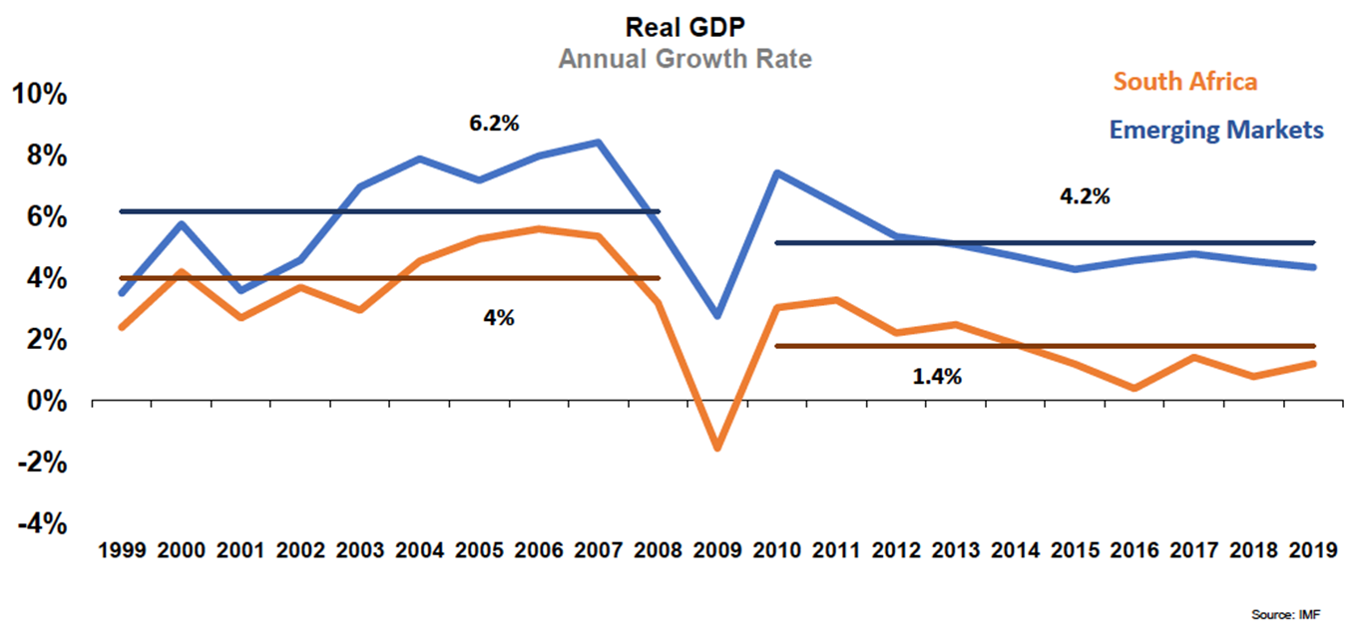
Historical deceleration and decoupling
  SA was already increasingly underperforming its EM peers before current crisis
  Illustrates long-run structural weaknesses rather than purely cyclical downturn
  While important in the short term, counter-cyclical measures will have limited impact unless structural constraint are decisively addressed (eg energy security)
Source: IMF, Stats SA, BER, 2019

Slide 7
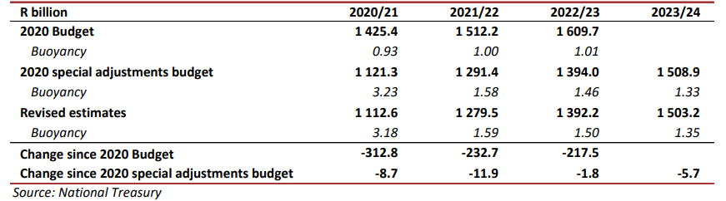
National revenue estimates continue to be revised down
Revised revenue projections
  Extraordinary shock to economic output in 2020/21 translates into large revenue shortfalls that will persist over the medium term.
  Tax‐to‐GDP ratio only likely to recover to the 2019/20 level by 2027/28.

Slide 8
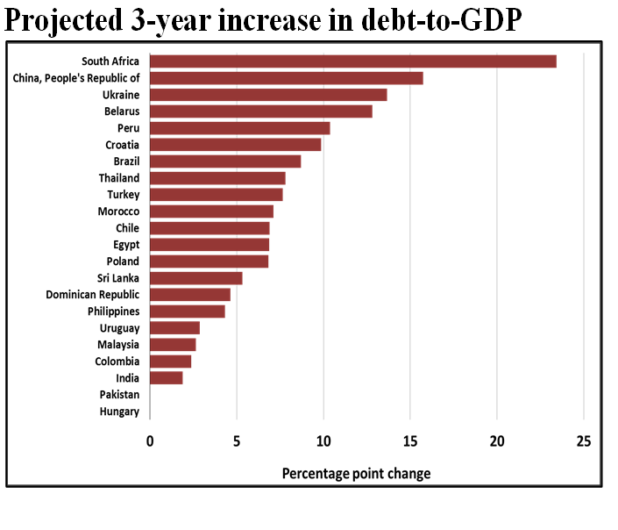
A debt crisis is looming
Debt dynamics
  Globally, South Africa has one of the largest projected increases in debt over the next three years
  The fiscal position is a risk to the outlook: higher long-term borrowing costs and risk premiums have started to affect the broader economy.
  Probability of default is at all-time highs
  Failure to arrest the debt trajectory will see debt-service costs consume around 31% of main budget revenue by 2024/25

Slide 9
Underlying driver: public sector compensation growth has crowded out other expenditures

Slide 10
National Treasury has set out a consolidation path
  A debt-stabilisation fiscal framework to stabilise government debt in 5 years instead of the previously indicated 3 years
  Approved a process to reduce public sector wage costs
  Across the board reductions to fund the current year’s SAA business rescue costs – Conditional Grant cuts
Passive
MTBPS
Active

Slide 11
Reductions will fall heavily on provinces…
Provinces will absorb a large share of the cuts
  2021/22 and 2022/23 baselines will be 5% & 10% lower than indicative baselines in the 2020 MTEF
    2021/22 baseline is 11 per cent lower than the 2020/21 baseline after reductions
  Significant impact on provincial budgets
    Does not allow provinces to account for inflationary costs of providing services, growth of the general population and school-going age population
Division of revenue – all provinces

Slide 12



In summary…
The national economy is expected to contract by 7.8 per cent in 2020, returning to real GDP growth of 3.3 per cent in 2021
Western Cape economy is expected to contract by 6.9 per cent in 2020 and rebounding by 3.8 per cent in 2021
Tax revenues for 2020/21 are forecast to be R312.8 billion lower than projected in the 2020 Budget Review
Gross national debt has risen from 63.3 per cent of GDP in 2019/20 to 81.8 per cent of GDP in the current year
Recent credit rating downgrades now put South Africa two notches below investment grade status according Moody’s, and three levels below according to Fitch. Both agencies maintained negative outlooks, while S&P kept South Africa at junk with a stable outlook
Fiscal measures will narrow the budget deficit and stabilise debt over the next 5 years to return the public finances to a sustainable position.
Large reductions in non-interest spending over the next 3 years, amounting to R300 billion relative to projections set out in the 2020 Budget Review.
  Majority of these reductions will now be applied to the wage bill: benefits and risks!

Slide 13
Implications for the WC Fiscal Framework

Slide 14

Summary of complex dynamics (lots going on, rapidly!)
Changes to Provincial Equitable Share
  Increase in the PES for demographic shifts
  Compensation reductions: the core of the new national strategy over five years
  Non-compensation adjustments related to both inflation and policy cuts
Changes to conditional grants (positive, negative and unknown)
Own revenue revisions
  Gambling taxes most uncertain
Uncertainties
  Credibility of the national fiscal path (legal action and wage negotiations)
  Prospect of a debt crisis
  Recovery and growth assumptions
  2021 MTEF carry through effects of shifts between votes from the 2020 Adjustments Budget

Slide 15
Overall, large PES revisions over MTEF
WESTERN CAPE: REVISIONS TO THE PROVINCIAL EQUITABLE SHARE (PES): 2021 MTEF - 28 October 2020
 | 2021 Medium-term expenditure framework |  |  | Total Revisions
R Thousands | 2021/22 | 2022/23 | 2023/24
Provincial equitable share (PES) (as per final 2020 MTEF allocation letter) | 59 276 313 | 63 194 019 | 66 037 750 | 188 508 082
Adjustment due to new data updates in the PES formula (phased-in from 2021/22 of 2020 MTEF) | 403 951 | 425 136 | 842 820 | 1 671 907
Total reductions | (6 242 380) | (8 962 998) | (11 721 510) | (26 926 888)
Net reduction to baseline | (5 838 429) | (8 537 862) | (10 878 690) | (25 254 981)
Total: Preliminary Provincial Equitable Share for 2021 MTEF | 53 437 884 | 54 656 157 | 55 159 059 | 163 253 100

Slide 16
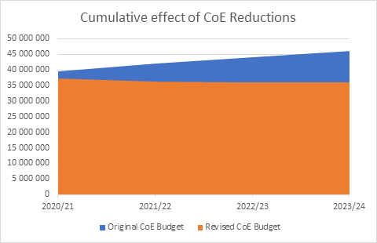
WC preliminary compensation estimates (20/21 to 23/24)
Total CoE reduction for 20/21 – 23/24 is R26.1bn:
First reduction due to unaffordable 2018 Wage bill – R15.9bn
Second reduction- fiscal consolidation to stabilise public debt – R10.2bn

Slide 17
Budgetary and service delivery risks facing the Province
Budgetary and service delivery risks, include:
    Deterioration in the fiscal environment
    Increasing population growth, high unemployment, high poverty and inequality, burden of disease, and resultant service load pressures
    High violent crime and lack of safety
    Severe public transport and mobility challenges
    Prolonged period of drought, energy security, climate change, environmental degradation; and the
    Financial sustainability of municipalities
Greatest risk to the Provincial fiscus is that of a reduced fiscal envelope, which could have serious implications on service delivery such as :
    increasing teacher-learner ratio
    non-compliance with infrastructure norms and standards at public facilities
    decreased access to- and quality of- public health services and standards and longer waiting times for emergency services
    inability to adequately provide social services and support to vulnerable groups

Slide 18
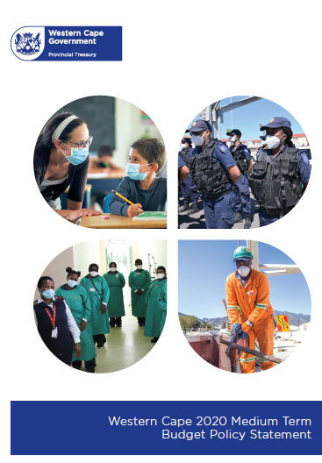
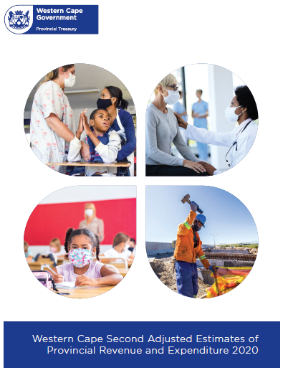
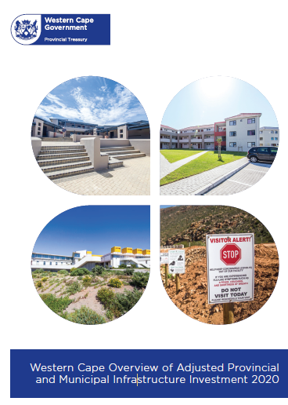
How does the WCG respond?

Slide 19
The Western Cape Fiscal Strategy maintains sustainability
Fiscal Strategy
Balanced Budget
Revenue
Expenditure
Principles supporting the WCG’s Fiscal Strategy
Allocative efficiency
Fiscal sustainability
Fiscal discipline
Fiscal consolidation

Slide 20



2021 MTEF budget spending plans and priorities
- Scale up work opportunities & skills - Boost infrastructure
- Boost investment &exports - Support PEP, SMMEs, digital & informal sector
- Strengthen economic resilience - Strengthen ease of doing business
- LEAP - Safety Ambassadors Programme Peace Officer - Data-led approach - Evidence –informed approach
- Innovative healthcare - Strong foundations
- Socio-economic &physical wellbeing - Basic needs & protecting human rights
- Improved learner outcomes & eLearning
Social cohesion & service
Our
COVID-19 preparedness
- Saving lives - Provincial hotspot strategy
- Health system preparedness - COVID-19 response capability
- Relief & support
Our enabler: New Way of Work
Streamlining and modernising government capabilities, as an enabler of effective service delivery:
- Partnerships: an area-based approach to delivery - Shifting culture & new
capabilities
- Data and evidence - Digitisation

Slide 21
Transversal response over the medium term
Infrastructure investment and development
Municipal finances as a lever for growth & development
Vulnerable municipalities
Public Participation
Public Entity Review
Supply Chain Management
Compensation of Employees Strategy
Fiscal Futures
Artificial Intelligence and Machine Learning

Slide 22
In-year changes (1):
2020 Adjusted Estimates of
Provincial Revenue and Expenditure

Slide 23
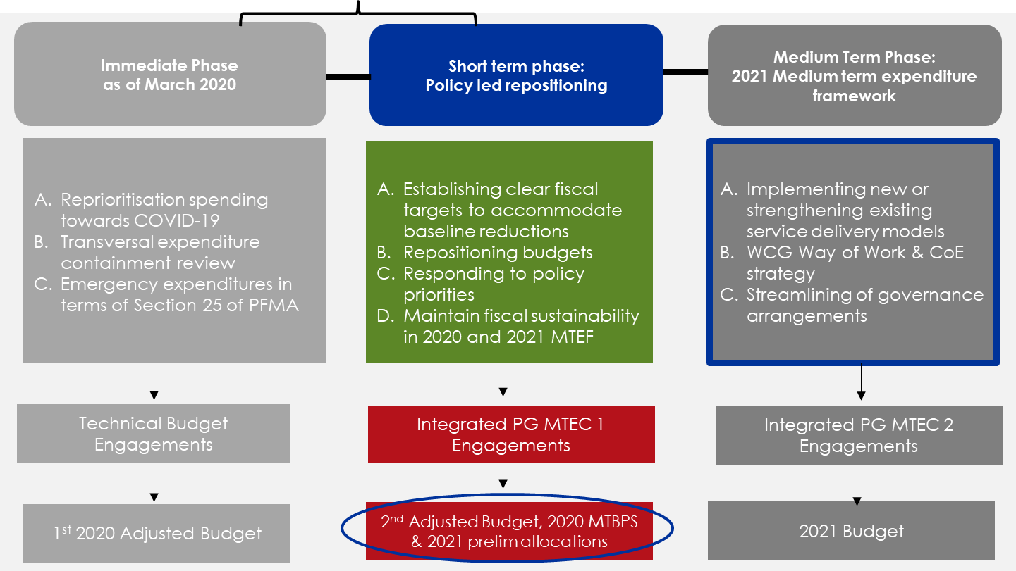
Western Cape Government 2020 Budget Approach
Positioning the WCG beyond the 2020 budget process and toward recovery within the JDMA framework

Slide 24
Provincial Expenditure as at 30 September 2020
2nd Adjustments Budget responds to the key in-year risks

Slide 25
Second Adjustments Budget
  AIM
        The 2020 2nd Adjusted Budget builds on the original 2020 Expenditure Estimates (the main budget) and the 2020 1st Adjusted Budget (immediate response to the COVID-19 pandemic)
        The objectives of the 2020 2nd Adjusted Budget are to —
          Enable reprioritisation and additional funding to support immediate financing requirements for the WC Recovery Plan (i.e. jobs, safety and wellbeing)
          Achieve fiscal sustainability in-year, while setting a base for fiscal consolidation over the 2021 MTEF, in the context of significant changes in national allocations; and
          Enable the Western Cape Government to continue to respond to
          COVID-19
Repositioning budgets towards Jobs, Safety and Dignity& well-being
Establishing clear fiscal targets
Establishing a fiscal “window” for policy-based funding

Slide 26
Principles informing Second Adjustments Budget
  Fiscal sustainability
      Management of CoE reductions
        Surrender of increase to fund 2018 wage agreement in 2020
        In order to create future efficiencies, encourage Departments to contain and reduce compensation costs (multiple mechanisms)
      Reassess and revise departmental and provincial tax receipts due to impact of COVID-19 on revenue collection
      Limit rollover and revenue retention from 2019/20 financial year
    Fiscal Consolidation
      Savings and cost containment within Votes and public entities due to further impact of COVID-19 on projects and programmes after AB1
      Reassess and revise allocations made for COVID-19 in AB1
      Revision of all earmarked allocations
    Immediate Response to the MTBPS: WC recovery plan and 3 focus areas
      Policy-Based Funding Facility – indicate alignment, performance to date, potential impact (including spatial), ability to spend & implement, prudent governance arrangements in place etc.

Slide 27
Financing the 2020 2nd Adjustments Budget
      Reserves mitigate direct and immediate impact
      R1.1 billion PEP application made to NT – allocations to Provinces funding redirected to the extension of R350 COVID-19 Grant

Slide 28
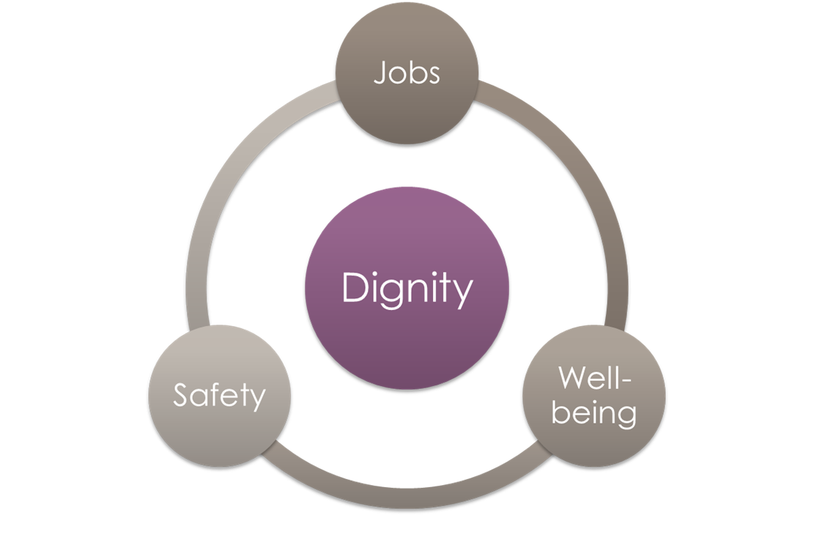
For Adjustments Budget 2, created a short-term facility
Policy-Based Funding Facility – Immediate Response
Estimated R300 million available to support the immediate delivery of the Western Cape Recovery Plan - in particular the 100 day interventions and initiating delivery on Premier’s October Special Address
Summary of process
    Lead HODs coordinate proposals
    Technical appraisal process
      readiness to implement, ability to spend, capacity to implement
      alignment with the recovery plan, a credible Theory of Change
      evidence-based and demonstrated non-financial performance, achievements or progress to date on existing or related interventions
    A joint DotP and PT review to assess proposals and make funding recommendations

Slide 29
Allocations of Policy-based Funding Facility (additional)
JOBS
SAFETY
WELL-BEING
Intervention | Vote | R’000
National
Roads Maintenance Grant | 10 | 61 316
Education assistants in schools | 5 | 814 291
Provincial
Support to Small Businesses | 12 | 12 000
Accelerated Infrastructure Maintenance (school facilities and fencing) | 5 | 145 740
Public Employment Programmes | 11, 13 | 26 200
Total PBF |  | 183 940
Total AB 2 |  | 1 059 547
Intervention | Vote | R’000
Provincial
Data Centre | 6 | 5 000
Hospital & Emergency Centre Tracking Information System (HECTIS) | 6 | 15 000
Area- Based Teams | 4 | 2 000
Peace Officers resourcing | 4 | 2 000
Accelerated fencing of schools | 5 | 36 560
Safety Ambassadors | 4 | 20 000
Total PBF |  | 80 560
Total AB 2 |  | 80 560
Intervention | Vote | R’000
National
ECD | 7 | 53 067
Nursing, Community Service posts & Training | 6 | 29 148
Food Relief | 7 | 51 281
Provincial
Staff Mental Wellness | 6 | 5 000
Youth in Service | 13 | 4 000
Total PBF |  | 9 000
Total AB 2 |  | 142 496
2020 2nd ADJUSTED POLICY- BASED FUNDING: R273.5 MILLION

Slide 30
COVID preparedness 2020/21
  DOH
    Data centre: R5 million
    Standing capacity: R227 million (excludes inventory)
  DTPW
    Q & I: R200 million
  Available reserves: R864 million (but includes COE contingency pending court case)

Slide 31
2020 2nd Adjustments Budget Allocations

Slide 32
2020 2nd Adjusted Budget in context
National: R875.6 million
Provincial: R276.7 million
National: 133.5 million
Provincial: R38.7 million
Total reduction R2.4 billion – difference from fiscus R539 million – further discussion with NT
Contribution to SAA bailout

Slide 33
In-year changes (2):
Overview of Adjusted Provincial and Municipal Infrastructure Investment

Slide 34
Summary of adjusted provincial infrastructure by category
    Upgrading & additions: Education R192.550 million to accelerate maintenance, fencing and additional ablutions (jobs, safety and dignity) at schools in support of the WCG’s Economic Recovery Plan
    Refurbishment & Rehabilitation: TPW R80 million reduction due to a projected under recovery on motor vehicle licence fees and leases. R112.664 million reallocated to 2021/22 due to slower than expected spending on infrastructure projects

Slide 35
Total provincial & municipal infrastructure estimates (20/21)

Slide 36
Municipal Infrastructure Spend: Key Observations
Sector | Preliminary Audit Outcomes | Original Budget [Adopted May/June 2020] | Adjustment Budget [August]
 | 2019/20 | 2020/21 | 2020/21
Capital Expenditure - Standard
Governance and Administration | 1 342 907 | 1 581 404 | 1 718 571
Community and Public Safety | 1 729 883 | 2 190 963 | 2 203 141
Economic and Environmental Services | 1 576 623 | 2 797 466 | 2 058 357
Trading Services | 4 036 194 | 6 278 433 | 6 454 694
Electricity | 951 682 | 1 459 420 | 1 474 706
Water | 1 441 082 | 1 943 515 | 2 084 283
Waste Water Management | 1 295 229 | 2 189 015 | 2 149 982
Waste Management | 348 201 | 686 483 | 745 723
Other | 59 034 | 95 573 | 106 511
Capital Expenditure – Standard | 8 744 642 | 12 943 839 | 12 541 274
  2019/20 preliminary audit outcomes vs 2020/21 adopted budgets: Against expectations, notable increase in capital expenditure
  Allocations towards Economic and Environmental Services and Trading Services
  Prioritised humanitarian relief efforts (strong increase towards water and sanitation), while upholding service level standards and reducing backlogs
  Downward revision towards August: Clear reprioritization amidst easing of lockdown restrictions, adjustments to National and Provincial Budgets and subsequent support to municipalities, roll-overs
  Decrease in Provincial grants and transfers reflect WCG policy position and Three-Phase Budget Approach
Sector | Audit Outcome | Original Budget | Adjustment Budget
 | 2019/20 | 2020/21 | 2020/21
Funded by:
National Government | 2 587 337 | 3 734 033 | 2 286 715
Provincial Government | 477 593 | 383 412 | 446 805
District Municipality | 904 | 724 | 920
Other transfers and grants | 71 547 | 157 872 | 161 682
Transfers recognised - capital | 3 137 381 | 4 276 042 | 2 896 121
Public contributions and donations | - | - | -
Borrowing | 1 461 974 | 3 319 075 | 3 363 815
Internally generated funds | 3 887 050 | 5 340 292 | 6 133 008
TOTAL CAPITAL FUNDING | 8 486 405 | 12 935 409 | 12 392 944
  Grants and transfers (as % of total CAPEX) decrease: Shift towards additional revenue streams. Uptake of loans commended, but emphasis on responsible borrowing cognizant of gearing ratios and ability to repay amidst dwindling revenue collection
  Diversification of own-revenue streams remain key to ensure financial sustainability
Notes:
Reference to Against Expectations: NT and PT advised municipalities to have a conservative approach towards infrastructure planning as it was unclear how long construction sector would remain shut.
Saw tremendous decrease in 2019/20 actual expenditure when compared to adjusted budgets – municipalities could not spend in last quarter of 2019/20.
Assumption was therefore that municipalities would hold back funding when they adopted their 2020/21 budgets. Data shows that it is clearly not the case. Exception being the Cape Winelands District.
Strong allocations towards Trading Services and Economic Services (which includes Transport) actually show us that the municipalities did everything in their limited power to ensure that funding is available to provide relief amidst COVID-19 but to also uphold their service standards. They should be commended for this.
Allocations were also made towards planning which relates to efforts to develop new IDPs post Local Government Election of 2021.
The decrease in allocations for WCG is interesting. It shows we took a step back to consider how we can support municipalities. Emphasise the evidence-based approach towards planning. Think this is what the Sector Departments also did. There was a substantial decrease in infrastructure allocations from WCG when compared to March 2020 Main Budget. Strangely, larger decrease for Economic Infrastructure than Social Infrastructure.
We need to do more with less: City’s approach is well articulated in their adjustments budget: Applies very strict assessment criteria when considering the implementation of capital projects i.e. projects are regularly assessed for procurement and implementation readiness, technical and financial feasibility and strategic alignment (“Brick Wall” approach).
We clearly see the decrease in grants and transfers which is good – municipalities must stand on their own feet. This decrease is however forced due to fiscal reality.
Uptake of loans bodes well considering cost of money, but we must emphasize responsible borrowing. Does not help we loan, but still don’t diversify our funding mix to ensure we can repay those loans.
Solution? Difficult to say as always. Focus on reviewing COE and operational structures i.e. shared-services model through JDMA.

Slide 37
In-year adjustments (3):
Provincial transfers to municipalities

Slide 38
Changes in provincial transfers to municipalities
  Adjustment gazette includes multiple small changes to provincial transfers to municipalities including the allocation of previously unallocated funds and some new allocations. In aaggregate, transfers to municipalities increase by R99.72 million
  Notable increases include:
    HIV/AIDS: New allocation of R4.4 million for City of Cape Town.
    Provincial contribution towards the acceleration of housing delivery: New allocations of R19 million
    Roads projects : R5.7 million for Saldanha Bay, R332 000 for Witzenberg and R1.9 million for Mossel Bay municipalities
    Public Transport: George Integrated Public Transport Network-Operations: R30.5 million and R2 million for Rail Safety for City of Cape Town.
    Community Library Services Grant: New allocation of R7.7 million to support identified municipalities that have been identified.
    Development of Sport and Recreation Facilities: New allocation of R3 million, split among identified municipalities.
    Western Cape Municipal Interventions Grant: New allocation of R3.6 million to Kannaland Municipality
  Most municipalities received small decreases as a result of a reduction of R1.521 million from Western Cape Financial Management Capacity Building Grant, as Provincial Treasury is still in the process of reviewing the grant model

Slide 39
Change in provincial transfers per municipality

Slide 40
Changes in national transfers to Western Cape municipalities

Slide 41
Medium Term:
2021 Fiscal Framework

Slide 42
Western Cape 2021 MTEF provisional fiscal framework
R'000 | Adjusted Estimate | Medium term estimate |  |  | Total
 | 2020/21 | 2021/22 | 2022/23 | 2023/24 | 2021 MTEF
Transfers from National | 66 266 507 | 67 013 844 | 68 786 036 | 69 924 783 | 205 724 663
Equitable share | 53 038 519 | 53 437 884 | 54 656 157 | 55 159 059 | 163 253 100
Conditional grants | 13 212 595 | 13 575 960 | 14 129 879 | 14 765 724 | 42 471 563
Conditional grants rollover | 15 393 | - | - | - | -
Own receipts | 2 503 207 | 2 624 526 | 2 636 541 | 2 755 185 | 8 016 252
Asset Financing Reserve | 674 730 | 594 211 | 324 439 | 329 175 | 1 247 825
PRF Financing | 1 638 492 | 1 071 910 | 797 025 | 810 | 1 869 745
Provincial Revenue Fund (Tax receipts) | 410 812 | 37 233 | 39 020 | 40 776 | 117 029
Total | 71 493 748 | 71 341 724 | 72 583 061 | 73 050 729 | 216 975 514
Percentages
Transfers from National | 92.69% | 93.93% | 94.77% | 95.72% | 94.81%
Equitable share | 74.19% | 74.90% | 75.30% | 75.51% | 75.24%
Conditional grants | 18.48% | 19.03% | 19.47% | 20.21% | 19.57%
Conditional grants rollover | 0.02% | 0.00% | 0.00% | 0.00% | 0.00%
Own receipts | 3.50% | 3.68% | 3.63% | 3.77% | 3.69%
Asset Financing Reserve | 0.94% | 0.83% | 0.45% | 0.45% | 0.58%
PRF Financing | 2.29% | 1.50% | 1.10% | 0.00% | 0.86%
Provincial Revenue Fund (Tax receipts) | 0.57% | 0.05% | 0.05% | 0.06% | 0.05%
Total | 100.00% | 100.00% | 100.00% | 100.00% | 100.00%

Slide 43
Changes to the Preliminary 2021 MTEF Fiscal Framework

Slide 44
Transitional support to strengthen service delivery
Fiscal Transition Support Facility
20 per cent of WCG reserves to provide votes with fiscal transition support - reducing potential negative impact of spending reductions and an opportunity to obtain funding to support improved service delivery outcomes and savings over the long term
Specific focus placed on providing evidence of immutable spending pressures, likely development outcomes and fiscal impacts of Votes’ strategy to restructure expenditures to achieve long-term savings
Departments to be provided an opportunity to submit proposals and to be assessed as part of PG MTEC2
  DotP initiative to provide tools for compensation reductions
Assessment criteria:
Evidence of innovative service delivery mechanisms & models to achieve long-term savings
The extent of expenditure pressures
The scale of risks to service delivery given mandates
The expected impact of delivery risks on performance outcomes over the medium term
Evidence of a strategy to restructure expenditures to drive impact within a framework of fiscal consolidation.
Determining the fiscal and service delivery trajectory
Immediate
Short
Medium

Slide 45
Conclusion

Slide 46
Going forward
  Outcome of wage agreement could impact the fiscal framework
  National engagements on compensation approach: ongoing
  Hard discussions on Compensation, Way of Work and Service Delivery Models
  Policy priorities to be prioritized
  Fiscal Transition Support Facility to be appropriated as part of 2021 Main Budget
  Zero-based budgeting process (pilots):
    cluster, classification, vote, programme and sub-programme
  Review of contractual commitments and risks
  Budget process continues: PG MTECs in January 2021 and tabling of 2021 Budget:
  4 March 2021

