Slide 1


JOINT BRIEFING TO THE PORTFOLIO COMMITTEE ON COOPEARTIVE GOVERNANCE AND TRADITIONAL AFFAIRS ON:
STATUS OF ALL MUNICIPALITIES IN THE PROVINCE;
STATUS OF MUNICIPALITIES UNDER SECTION 139;
MONITORING AND ASSISTANCE PROVIDED TO MUNICIPALITIES
MEC COGTA: T. S. Nxangisa
MEC: Finance: G. Brown
24 November 2020

Slide 2
LAYOUT OF PRESENTATION
Part A
Mangaung Metropolitan Municipality
Part B
Report on the status of Municipalities in the Province (COGTA & Provincial Treasury)
Part C
Status of Section 139 Intervention Municipalities in the Province
Part D
MFMA Compliance, Monitoring and Support by COGTA & Provincial Treasury

Slide 3
PART A:
MANGAUNG METROPOLITAN MUNICIPALITY

Slide 4
FINANCIAL VIABILITY / SUSTAINABILITY: WHAT DOES IT MEAN?
In simplistic terms a financially viable institution implies an ability to continuously achieve operational objectives, meet obligations and grow over the long term.
In narrower context Municipalities are funded by the tax payer. Accountable and transparent and effective / efficient Local Government is a Constitutional imperative.
To meet this Constitutional imperative, Municipalities should be functional, sustainable and viable.
Functionality implies;
Satisfaction amongst Constituents.
Sound and stable institutional management.
Accountable and transparent allocation and use of financial and other resources.
Consumer satisfaction with Service Delivery.
A democratic and value driven system of governance, public participation and consultation.
In all of the above Political Stability takes the centre stage.

Slide 5
FINANCIAL VIABILITY / SUSTAINABILITY: WHAT DOES IT MEAN?
Whilst the issue of financial viability remains well contested, a broader consensus exits on some key elements thereof such as;
An adequate tax base.
Sound financial management and governance with minimal audit findings.
Economic stability within the jurisdiction.
Limited dependence on grants and allocations to remain operational.
However, due to the country’s legacy and other conspiring factors such as poverty, unemployment and other socio-economic variables , the tax bases of some Municipalities are highly constrained.
In the above instance financial viability may well be permanently affected.
On the contrary financial viability may also be temporarily interdicted by factors such as poor financial management and administration.
The collapse of governance and oversight may also play a leading role.

Slide 6
Pre- and post amalgamation financial position: consolidated and audited afs 2015/16 and 2018/19
Since the 2015/16 financial year, the financial fortunes of the Municipality took a dramatic turn.
The Statement of Financial Position as at 30 June 2016 reflected the following situation as compared to the latest audited Financial Statements for the year ended 30 June 2019.
Current assets : Cash and other assets that are expected to be converted to cash within a 12-month period.
An analysis of Consolidated and Audited Financial Statements pre-amalgamation (2015/16) and 2018/19 presents the following picture;

Slide 7
CURRENT ASSETS

Slide 8
NON-CURRENT ASSETS
Non-current assets: Are assets which represent a long-term investment and cannot be converted into cash quickly e.g. land, property and investments

Slide 9
NON-CURRENT ASSETS

Slide 10
CURRENT LIABILITIES
Current liabilities: Amounts due to be paid to creditors within 12 months e.g. an overdraft facility

Slide 11
CURRENT LIABILITIES

Slide 12
NON-CURRENT LIABILITIES
Non-current liabilities: Are obligations not due for more than a year. Example include long-term loans, bonds payable and deferred revenue

Slide 13
Non-CURRENT LIABILITIES

Slide 14
TOTAL NET ASSETS
Total Net assets are the value of a Municipality's assets minus its liabilities.
As at 30 June 2016 the Council’s financial year concluded with an accumulated surplus of R 11,445,329,800

Slide 15
Total net assets

Slide 16
SURPLUS / DEFICIT

Slide 17
GOING CONCERN
Although certain accounting ratios appeared unfavourable, the AGSA felt confident in Mangaung’s ability to raise revenue, including grant allocations, that would enable Council to meet its obligations.
On 30 June 2019 Council sustained a deficit of R 268,755,783.
Most alarming as at year end, Council found itself in position where current liabilities exceeded current assets by R 135,677,202 rendering Mangaung virtually and technically bankrupt.
According to audited (2018/19) cash flow statements Council sustained a negative cash movement.
The situation was brought about by material provisions for impairment (write-off) of consumer debt for services rendered and other sources of revenue.
Furthermore, Mangaung’s operations sustained material water and electricity losses as depicted below, compared to the pre-almalgamation operational results of 2015/16.

Slide 18
Government grants and subsidies

Slide 19
Government grants and subsidies

Slide 20
Government grants and subsidies

Slide 21
Government grants and subsidies

Slide 22
Unspent conditional grants

Slide 23
Unspent conditional grants (cont.)
The upward spiral in unspent Conditional Grants is indicative of Council’s financial crisis, especially so its cash flow difficulties.
The following trend marks the increased use of Conditional Grants for un-intended purposes:
Unspent 2015/16 R 106,083,319
Unspent 2017/18 R 329,735,327
Unspent 2018/19 R 459,078,487
AGSA made it clear that events / conditions of this nature cast material and significant doubt on Mangaung’s ability to continue as a going concern.

Slide 24
MOVEMENT IN MAIN COST DRIVERS

Slide 25
Movement in Main cost drivers

Slide 26
Line and distribution losses: water and electricity
For 2015/16 Council disclosed material water losses of R 146,392,567 as compared to R 186,748,463 for 2018/19, a slight improvement to the R 266,368,991 in 2017/18.
Losses were attributed to the following;
Technical losses
Burst pipes and leaks
Leakages
Faulty meters
Unmetered consumption
Material electricity distribution losses of R 180,249,104 were reported for 2015/16 as compared to R 138,097,200 in 2018/19 which marks some improvement.
Electricity losses were attributed to theft, vandalism, faulty meters and variances in monthly consumption estimates.
A more detailed analysis is provided below.

Slide 27
Line and distribution losses: water and electricity

Slide 28
Line and distribution losses: water and electricity

Slide 29
SALARIES AND ALLOWANCES VS. EQUITABLE SHARE

Slide 30
SUPPLY CHAIN MANAGEMENT
Some goods and services with a transaction value below R 200,000 were procured without obtaining the required quotations.
Sufficient appropriate audit evidence could not be obtained in some instances that quotations were only accepted from and contracts were awarded only to bidders who had submitted a declaration on whether they were employed by the state or connected to any person employed by the state.
Sufficient appropriate audit evidence could not in all instances be obtained that quotations were only accepted from and contracts were awarded only to bidders whose tax matters had been declared by the South African Revenue Service to be in order.
Some contracts were awarded to bidders other than those recommended by the bid evaluation committee without ratification by the accounting officer.
Some contractors were awarded to bidders based on preference points that were not calculated in accordance with the requirements of the Preferential Procurement Policy Framework Act (PPPFA)

Slide 31
SUPPLY CHAIN MANAGEMENT (cont.)
Some contracts were awarded to bidders that did not score the highest points in the evaluation process, as required by the PPPFA and Preferential Procurement Regulations.
Some contracts were awarded to bidders based on prequalification criteria that differed from those stipulated in the original invitation for bidding.
Some construction contracts were awarded to a contractor that did not qualify for the contract in accordance with the Construction Industry Development Board of South Africa.
The performance of some contractors or services were not monitored on a monthly basis, as required by the MFMA. Similar non-compliance was reported in the previous year.
The contract performance and monitoring measures and methods were not sufficient to ensure effective contract management, as required by the MFMA. Similar non-compliance was reported in the previous year.

Slide 32
EXPENDITURE CLASSIFICATIONS

Slide 33
EXPENDITURE CLASSIFICATIONS (cont.)
Unauthorised expenditure in 2018/19 were mainly caused by poor financial discipline and overspending of the approved budget.
Irregular expenditure were incomplete and under-stated in 2018/19. Most irregular expenditure emanated from bids that were adjudicated by a Committee not meeting the requirements of SCM Regulation 29(2).
In Note 61 to the Audited Consolidated 2018/19 Annual Financial Statements, the AGSA reported that after financial year end Council resolved on 30 August 2019 to write off Irregular Expenditure of R 336,548,786 as irrecoverable.
Fruitless and Wasteful expenditure relates mainly to penalties and interest charged on late payment of suppliers.

Slide 34
Consequence management
Contrary to MFMA sec 32(2)(b) no investigations were conducted to determine if any person was liable for Irregular, Fruitless and Wasteful Expenditure.

Slide 35
Audit outcomes and internal control deficiencies in 2018/19
Leadership did not in all cases establish adequate mechanisms to hold individuals accountable where internal controls relating to financial reporting, performance information and compliance were not adhered to.
Management did not ensure that internal control processes were adequately designed and implemented to ensure proper planning and cost-effective procurement in certain instances and to prevent non-compliance with SCM requirements. This resulted in repeat non-compliance with procurement legislation and excessive irregular expenditure.
There was lack of adequate oversight and review by the project management unit to ensure that adequate supporting documentation was obtained from the external appointed consultants and engineers for each project.

Slide 36
Audit outcomes and internal control deficiencies in 2018/19 (cont.)
There were delays in the submission of bid documentation such as the declaration of interests, minutes of meetings, sub-contracted detail, winning bidder files and tax clearance certificates that were requested during the audit process.
Management did not prepare accurate and complete financial and performance reports that were supported and evidence by reliable reports and information due to the lack of monthly reconciliations and weak internal controls over processing transactions and safeguarding supporting documents.
Leadership’s lack of accountability for sound financial management and unwillingness to budget for non-cash items had a negative impact on the Municipality’s financial sustainability and resulted in overspending of the budget and unauthorised expenditure not being prevented in the current and previous financial years.

Slide 37
Governance and oversight

Slide 38
CONSUMER DEBTORS AND IMPAIRMENTS
In the 2015/16 financial year management made a provision for the impairment (write-off) of consumer debt and other revenue to the amount of R 2,639,474,261. However, in the 2018/19 financial year consumer debt and other revenue were impaired by R 3,552,460,833. This implies an increase of R 912,986,572 (35%).
An effective system of internal control for fines revenue was not in place, as required by the MFMA.

Slide 39
CONSUMBER DEBTORS AND IMPAIRMENTS (CONT.)

Slide 40
Consumer DEBTORS AND IMPAIRMENTS (CONT.)
In respect of the 2015/16 financial year Council wrote off consumer debt and other receivables of R 265,432,204 prior to amalgamation.
For the 2018/19 financial year R 349,974,014 million in consumer debt and other receivables were written off.
This represents R 84,541,810 more since pre-amalgamation.

Slide 41
Trade creditors
The AGSA pointed out that the average repayment terms for Creditors and Suppliers was 142 days.

Slide 42
PREDETERMINED OBJECTIVES (2018/19) (CONT.)
The AGSA reported amongst others the following material deficiencies in the Municipality’s Predetermined Objectives;
The reported achievements in the Annual Performance Report some indicators and targets were not consistent with the planned indicators approved in the Service Delivery and Budget Implementation Plan (SDBIP).
The measures taken to improve performance against targets did not include the comparison between the previous year’s actual, planned and achieved targets in the Annual Performance Report.
The AGSA was unable to obtain sufficient appropriate audit evidence that clearly defined the predetermined source information and method of collection to be used when measuring the actual achievement for some indicators. This was due to lack of formal standard operating procedures or documented system descriptions.
The AGSA was unable to obtain sufficient appropriate audit evidence for the reported achievements of some indicators. This was due to limitations placed on the scope of audit testing.
The AGSA was unable to determine whether any adjustments were required to the reported achievements in the Annual Performance Report of some indicators.
The AGSA was unable to obtain sufficient appropriate audit evidence in some instances, while in other cases the supporting evidence provided did not agree with the reported achievements.

Slide 43
Performance management (2018/19)
The AGSA was unable obtain sufficient appropriate audit evidence whether Senior Managers appointed had previously been dismissed for financial misconduct, and could therefore not confirm whether they were reappointed only after the expiry of 10 years, as required by section 57A(3) of the Municipal Systems Act of South Africa, 2000 (Act No. 32 of 2000).
Appropriate systems and procedures to monitor, measure and evaluate staff performance were not developed and adopted, as required by section 67(1)(d) of the Municipal Systems Act.

Slide 44
PART B:
REPORT ON THE STATUS OF MUNICIPALITIES IN THE PROVINCE (COGTA & PT)

Slide 45
FIRST LEVEL OF ASSURANCE PROVIDERS

Slide 46
FIRST LEVEL OF ASSURANCE PROVIDERS (CONT.)

Slide 47
Second LEVEL OF ASSURANCE PROVIDERS

Slide 48
Second LEVEL OF ASSURANCE PROVIDERS (cont.)

Slide 49
third LEVEL OF ASSURANCE PROVIDERS

Slide 50
third LEVEL OF ASSURANCE PROVIDERS (cont.)

Slide 51
AUDIT OUTCOMES

Slide 52
AUDIT OUTCOMES (CONT.)

Slide 53
AUDIT OUTCOMES (CONT.)

Slide 54
OVERVIEW OF FINANCIAL POSITION
Xhariep District
Creditors Position
The Creditors of Municipalities in the District increased with R26,694,631 from R675,081,718 reported by Municipalities as at the end of March 2020 to R701,776,349 reported by Municipalities as at 30 September 2020.
*Statistics as reported by Municipalities subject to auditing and verification.

Slide 55
OVERVIEW OF FINANCIAL POSITION
Outstanding Debtors
The Debtors position remains a major concern. The Municipalities in the District reported outstanding Debtors of R746,619,978 as at 30 September 2020.
It is anticipated that the COVID-19 pandemic and the subsequent economic decline would have significant impact on the ability of consumers to pay for services and ultimately for Municipalities to render services.
*Statistics as reported by Municipalities subject to auditing and verification.

Slide 56
OVERVIEW OF FINANCIAL POSITION
The following bar chart illustration the outstanding debtors for Municipalities in the District;

Slide 57
OVERVIEW OF FINANCIAL POSITION
Salaries VS Operating Expenditure
*Statistics as reported by Municipalities subject to auditing and verification.

Slide 58
OVERVIEW OF FINANCIAL POSITION
Cash and Bank Position
The table below reflects the overall cash and bank figures in the District:
*Statistics as reported by Municipalities subject to auditing and verification.

Slide 59
OVERVIEW OF FINANCIAL POSITION
Lejweleputswa District
Creditors’ Position
Municipalities in the District reported an increase of R1,020,378,336 on outstanding Creditors from R7,703,510,731 as at end December 2020 to R8,723,889,067 as at 30 September 2020.
*Statistics as reported by Municipalities subject to auditing and verification.

Slide 60
OVERVIEW OF FINANCIAL POSITION
Outstanding Debtors
The Debtors position remains a major concern. The Municipalities in the District reported outstanding Debtors of R6,063,115,511 as at 30 September 2020.
It is anticipated that the COVID-19 pandemic and the subsequent economic decline would have significant impact on the ability of consumers to pay for services and ultimately for Municipalities to render services.
*Statistics as reported by Municipalities subject to auditing and verification.

Slide 61
OVERVIEW OF FINANCIAL POSITION
The following bar chart illustration the outstanding debtors for Municipalities in the District;

Slide 62
OVERVIEW OF FINANCIAL POSITION
Salaries VS Operating Expenditure
*Statistics as reported by Municipalities subject to auditing and verification.

Slide 63
OVERVIEW OF FINANCIAL POSITION
Cash and Bank Position
The table below reflects the overall cash and bank figures in the District:
*Statistics as reported by Municipalities subject to auditing and verification.

Slide 64
OVERVIEW OF FINANCIAL POSITION
Thabo Mofutsanyana District
Creditors’ Position
Municipalities in the District reported an increase of R518,608,827 in outstanding Creditors from R6,817,783,274 as at 30 March 2020 to R7,336,392,101 as at 30 September 2020.
*Statistics as reported by Municipalities subject to auditing and verification.

Slide 65
OVERVIEW OF FINANCIAL POSITION
Debtors’ Position
The Debtors position remains a major concern. The Municipalities in the District reported outstanding Debtors of R4,394,232,515 as at 30 September 2020.
It is anticipated that the COVID-19 pandemic and the subsequent economic decline would have significant impact on the ability of consumers to pay for services and ultimately for Municipalities to render services.
*Statistics as reported by Municipalities subject to auditing and verification.

Slide 66
OVERVIEW OF FINANCIAL POSITION
The following bar chart illustration the outstanding debtors for Municipalities in the District;

Slide 67
OVERVIEW OF FINANCIAL POSITION
Salaries VS Operating Expenditure
*Statistics as reported by Municipalities subject to auditing and verification.

Slide 68
OVERVIEW OF FINANCIAL POSITION
Cash and Bank Position
The table below reflects the overall cash and bank figures in the District:
*Statistics as reported by Municipalities subject to auditing and verification.

Slide 69
OVERVIEW OF FINANCIAL POSITION
Fezile Dabi District
Creditors’ Position
Municipalities reported an increase of R13,968,027 on outstanding Creditors from R2,625,266,072 as at 30 March 2020 to R2,639,234,099 as at 30 September 2020.
*Statistics as reported by Municipalities subject to auditing and verification.

Slide 70
OVERVIEW OF FINANCIAL POSITION
Outstanding Debtors
The Debtors position remains a major concern. The Municipalities in the District reported outstanding Debtors of R3,992,637,935 as at 30 September 2020.
It is anticipated that the COVID-19 pandemic and the subsequent economic decline would have significant impact on the ability of consumers to pay for services and ultimately for Municipalities to render services.
*Statistics as reported by Municipalities subject to auditing and verification.

Slide 71
OVERVIEW OF FINANCIAL POSITION
The following bar chart illustration the outstanding debtors for Municipalities in the District;

Slide 72
OVERVIEW OF FINANCIAL POSITION
Salaries VS Operating Expenditure
*Statistics as reported by Municipalities subject to auditing and verification.

Slide 73
OVERVIEW OF FINANCIAL POSITION
Cash and Bank Position
The table below reflects the overall cash and bank figures in the District:
*Statistics as reported by Municipalities subject to auditing and verification.

Slide 74
Status of performance of municipal budgets as at 30 September 2020
Reporting formats
Monthly reports are prepared by using the figures from the mSCOA data strings only.
The credibility of the information contained in the mSCOA data strings is still a concern. At the core of the problem is:
The incorrect use of the mSCOA and municipal accounting practices by municipalities;
A large number of municipalities are not budgeting, transacting and reporting directly in or from their core financial systems. Instead they prepare their budgets and reports on excel spreadsheets and then import the excel spreadsheets into the system. Often this manipulation of data lead to unauthorised, irregular, fruitful and wasteful (UIFW) expenditure and fraud and corruption as the controls that are built into the core financial systems are not triggered and transactions go through that should not; and
Municipalities are not locking their adopted budgets and monthly reporting periods on their financial systems at month-end to ensure prudent financial management. To enforce municipalities to lock their budgets and close their financial system at month-end, the Local Government Portal will be locked at the end of each quarter. System vendors were also requested to build this functionality into their municipal financial systems.
The responsibility lies with the municipality BEFORE submitting the data strings to ensure that the data is an accurate reflection of the state of municipal finances.

Slide 75
Status of performance of municipal budgets as at 30 September 2020
Reporting Formats
Monthly reports are prepared by using the figures from the mSCOA data strings only.
The credibility of the information contained in the mSCOA data strings is still a concern. At the core of the problem is:
The incorrect use of the mSCOA and municipal accounting practices by municipalities;
A large number of municipalities are not budgeting, transacting and reporting directly in or from their core financial systems. Instead they prepare their budgets and reports on excel spreadsheets and then import the excel spreadsheets into the system. Often this manipulation of data lead to unauthorised, irregular, fruitful and wasteful (UIFW) expenditure and fraud and corruption as the controls that are built into the core financial systems are not triggered and transactions go through that should not; and
Municipalities are not locking their adopted budgets and monthly reporting periods on their financial systems at month-end to ensure prudent financial management. To enforce municipalities to lock their budgets and close their financial system at month-end, the Local Government Portal will be locked at the end of each quarter. System vendors were also requested to build this functionality into their municipal financial systems.
The responsibility lies with the municipality BEFORE submitting the data strings to ensure that the data is an accurate reflection of the state of municipal finances.

Slide 76
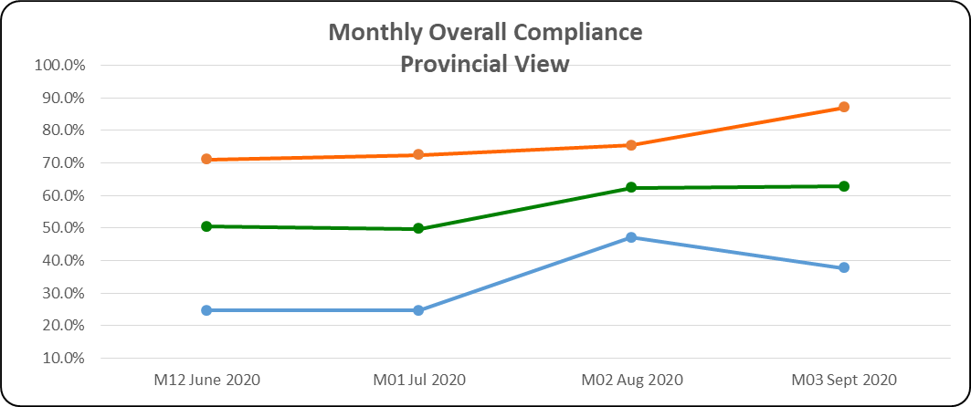
COMPLIANCE
Overall compliance = 62.8%
Although data strings are submitted (87%), submission of supporting returns remains biggest challenge (37.7%)
Non-compliance due to:
  System challenges
  Officials not able to access financial systems remotely for reporting
  Non-commitment by municipal officials to adhere to changing reporting requirements
Non-compliance communicated with defaulting municipalities
Support provided where applicable
Data strings
Overall Compliance
Supporting Returns

Slide 77
FINANCIAL PERFORMANCE

Slide 78
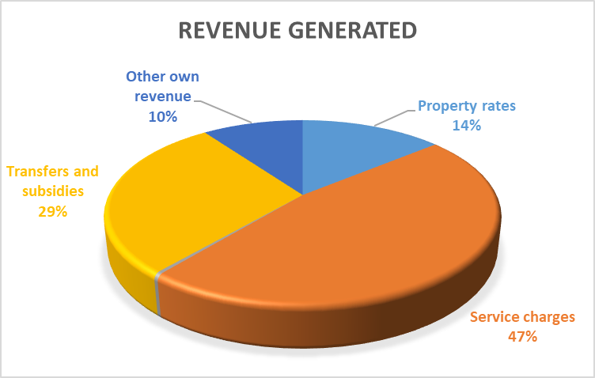
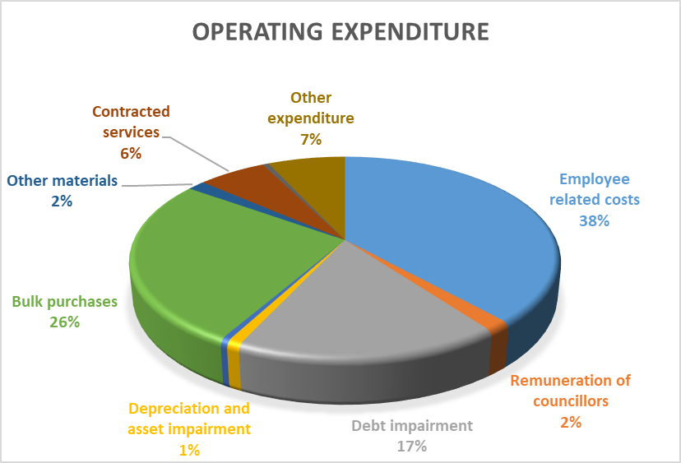
FINANCIAL PERFORMANCE – KEY FINDINGS
Operating Revenue :
Aggregate revenue generated (billed) amounted to R5.06 billion (24.5% against an adjusted budget of R20.66 billion)
Service charges contribute the highest to total revenue (47%), followed transfers & subsidies (29%) and property rates (14%)
Operating Expenditure:
Operating expenditure amounted to R3.85 billion (18.2%) against an adjusted budget of R21.13 billion.
Majority of expenditure relates to employee related cost, totaling R1.47 billion (38%), followed by bulk purchases (26%) and debt impairment (26.2%)

Slide 79
CAPITAL EXPENDITURE

Slide 80
CAPITAL EXPENDITURE - KEY FINDINGS
Capital expenditure
Total adjusted budget (R3.3 billion)
Capital expenditure as at 30 September 2020 amounts to R246.8 million (7.5% against the budget), which is a significant under performance.
5 Municipalities did not report any capital expenditure in the first quarter
Sources of finance
Sources of finance does not correspond to the capital expenditure
Capital expenditure were funded mainly through capital transfers (i.e MIG)

Slide 81
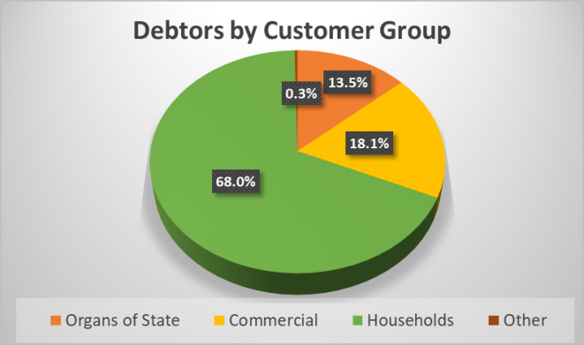
OUTSTANDING DEBTORS
Municipalities highlighted in red did not submit the debtors age analysis for the month under review (previous submitted information used for consolidation purpose)

Slide 82
OUTSTANDING DEBTORS - KEY FINDINGS
Outstanding debtors at end of September 2020 amounts to R23.3 billion (compared to R22.8 billion reported end of August 2020)
4 Municipalities failed to submit the debtor’s data string for May (Kopanong, Mohokare, Phumelela, Mantsopa), due to system challenges experienced.
Households represents the largest component of this debt at 68.0 per cent or R15.9 billion.
Collection of debt owed to municipalities remains a serious challenge and impacts on the financial sustainability of the municipalities.
Current economic shrinking compounded by Covid-19 will certainly lead to an increase in the outstanding debt which will impact further on the municipal revenues as well as the ability of municipalities to render effective services.

Slide 83
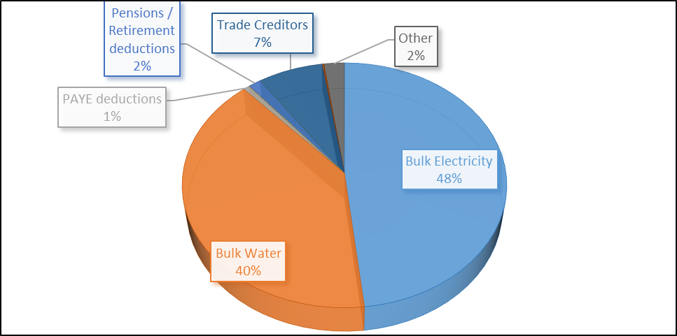
OUTSTANDING CREDITORS

Slide 84
OUTSTANDING CREDITORS (2)
Municipalities highlighted in red did not submit the debtors age analysis for the month under review (previous submitted information used for consolidation purpose)

Slide 85
OUTSTANDING CREDITORS - KEY FINDINGS
Outstanding creditors at end of September 2020 amounts to R16.9 billion (R15.8 billion reported at the end of August 2020)
2 Municipalities failed to submit the creditors data string for September 2020; namely Mohokare, & Mantsopa. Previous reported info used for consolidation purposes.
Majority of outstanding debt (88.3%) relates to bulk services, amounting to R14.9 billion. Electricity – R8.15 billion and Water – R6.78 billion.
Total outstanding for creditors may be understated, as municipalities are not utilizing the financial system (SCM module) correctly (eg. Invoices not captured on the system and not included in the outstanding creditors)
Matjhabeng contributes the highest to the total creditors, amounting to R8.7 billion, followed by Maluti a Phofung with R1.66 billion and Ngwathe (R1.70 billion).

Slide 86
BULK SERVICES DEBT - ESKOM
  Eskom: Municipalities experiencing cash flow challenges due to low revenue collection. Thus, current accounts / payment agreements cannot be serviced.
  *Source: S41 Report (Eskom) Sept 2020

Slide 87
BULK SERVICES DEBT – WATER BOARDS
  Sedibeng Water
*Source: S41 Report (Sedibeng) Sept 2020
  Bloem Water
*Source: S41 Report (Bloem Water) Sept 2020
  Rand Water
*Source: S41 Report (Rand Water) Sept 2020

Slide 88
OTHER BUDGET RELATED MATTERS
Municipalities were required to adopt Special Adjustment Budgets by 30 September 2020.
Purpose of the special adjustment budget was to:
  Include additional allocations as per the revised DoRA;
  Reprioritise budgets to address Covid-19 expenditure; and
  Correct budget in case the adopted budget was unfunded
6 Municipalities adopted funded adjusted budgets
Municipalities with unfunded budgets were required to tabled a funding plan / strategy to move towards a funded budget.
Municipalities with unfunded budgets, risk not receiving the equitable share tranche in December 2020.
PT is evaluating the funding plans / strategies and is assisting municipalities in improving on the credibility of these plans.

Slide 89
SUBMISSION OF THE 2019/20 ANNUAL FINANCIAL STATEMENTS
The following Municipalities failed to submit the 2019/20 Annual Financial Statements by the extended due date of 31 October 2020;
Kopanong Local Municipality
Mafube Local Municipality
Maluti a Phofung Local Municipality
Mantsopa Local Municipality
Masilonyana Local Municipality
Mohokare Local Municipality
Nala Local Municipality
Tokologo Local Municipality

Slide 90
MIG
The Provincial MIG Expenditure target for the end of October 2020 was set at 30%. A total amount of R185,319,675.77 (25%) out of an allocation of R746,257,000.00 was spent as at 31 October 2020.
Ten (10) Municipalities will for the 2020/2021 financial year be on a Cost Reimbursement method whereby monthly claims will be verified by MISA before service providers can be paid. These Municipalities are: Letsemeng, Kopanong, Mohokare, Masilonyana, Tokologo, Matjhabeng, Maluti-a-Phofung, Mantsopa, Metsimaholo and Mafube.
Note must be taken that Municipalities are responsible for the procurement of service providers as well as for the Implementation of projects. The Provincial MIG Management Unit (CoGTA) is responsible for the monitoring of projects and support to Municipalities.
National Treasury hosted Roll Over sessions during September 2020 to evaluate and discuss Roll Over applications received from Municipalities with unspent 2019/2020 MIG funds. Roll Over applications for the following Municipalities were provisionally approved: Tswelopele (R5m), Matjhabeng (R44.3m), Nala (R1.2m), Setsoto (R5.5m) and Ngwathe (R5.3m). The final approval of roll overs is subject to the Municipalities submitting Annual Financial Statements (AFS) by 31 October 2020. Provisional approval was given to allow Municipalities to plan for expenditure by 30 June 2021. All other applications were declined.

Slide 91
Mig expenditure as at 31 October 2020
Xhariep District
Provincial Expenditure Target: 30%

Slide 92
Mig expenditure as at 31 October 2020 (cont.)
Lejweleputswa District

Slide 93
Mig expenditure as at 31 October 2020 (cont.)
Thabo Mofutsanyana District

Slide 94
Mig expenditure as at 31 October 2020 (cont.)
Fezile Dabi District

Slide 95
MIG expenditure (cont.)
Eight (8) Municipalities reached the 30% Provincial Expenditure Target:
Letsemeng (36%)
Kopanong (34%)
Mohokare (48%)
Masilonyana (67%)
Nala (41%)
Nketoana (58%)
Phumelela (32%)
Mantsopa (52%)

Slide 96
MIG EXPENDITURE (cont.)
1 Municipality’s spending between 25% and 29% (Low Risk)
Municipality | Reasons for under expenditure forwarded by Municipalities
Ngwathe (28%) | The late submission of Payment Certificates by Service Providers resulted in the lower than expected expenditure. It is expected that the expenditure will increase during November 2020. National Treasury provisionally approved the roll over application of R5.3m. No immediate intervention is needed.

Slide 97
MIG EXPENDITURE (cont.)
4 Municipalities spending between 20% and 24% (Medium Risk)
Municipality | Reasons for under expenditure forwarded by Municipalities
Matjhabeng (23%) | Cost Reimbursement. National Treasury provisionally approved the roll over application of R44.3m and the Municipality already reported R13.3m expenditure against the roll over. This resulted in the lower than expected expenditure against the 2020/2021 MIG allocation. It is expected that the reported expenditure against the 2020/2021 allocation will increase from November 2020.
Maluti-a-Phofung (20%) | Cost Reimbursement. The Municipality could not report expenditure for the past 2 months due to a court order against their Primary bank account. The Municipality will only be able to report expenditure after the court order has been cancelled.
Moqhaka (22%) | Slow procurement processes due to the National Lockdown resulted in the lower than expected expenditure. Expenditure increased during October 2020 and it is expected that it will also increase during November 2020.
Mafube (24%) | Cost Reimbursement. The late appointment of service providers resulted in the low expenditure. Service providers have been appointed and it is expected that expenditure will further increase during November 2020.
Matjhabeng (23%) | Cost Reimbursement. National Treasury provisionally approved the roll over application of R44.3m and the Municipality already reported R13.3m expenditure against the roll over. This resulted in the lower than expected expenditure against the 2020/2021 MIG allocation. It is expected that the reported expenditure against the 2020/2021 allocation will increase from November 2020.

Slide 98
MIG EXPENDITURE (cont.)
5 Municipalities spending less than 20% ( High Risk)
Municipality | Reasons for under expenditure forwarded by Municipalities
Tokologo (0%) | Cost Reimbursement. The Municipality reported zero expenditure for the fourth consecutive month. The Department already intervened on an administrative level without any success. The Roll Over application from the Municipality were declined and the September 2020 MIG transfer was withheld due to non-compliance and under expenditure. No further transfers will be processed until the Municipality comply with reporting and expenditure requirements. Political intervention is needed in order to address the challenges with under performance on the MIG.
Tswelopele (19%) | Late appointment of service providers resulted in the lower than expected expenditure. The Municipality did not receive their September 2020 MIG transfer due to under expenditure. The Municipality is also awaiting a council resolution for a Budget Maintenance project. The Provincial MIG Management Unit facilitated a session with the Municipality during October 2020 in order to speed up the implementation of projects.
Setsoto (11%) | Late appointment of service providers resulted in the lower than expected expenditure. The Municipality did not receive their September 2020 MIG transfer due to under expenditure. National Treasury provisionally approved a reduced roll over amount of R2m. The under expenditure will be addressed during the November 2020 Provincial MIG Quarterly Review session.

Slide 99
MIG EXPENDITURE (cont.)
5 Municipalities spending less than 20% ( High Risk)
Municipality | Reasons for under expenditure forwarded by Municipalities
Dihlabeng (8%) | The low expenditure is due to non-capturing of expenditure on the MIG Management Information System and outstanding Budget Maintenance applications from the Municipality. A session was held with the Municipality during August 2020 and October 2020 in order to address PMU capacity and MIG MIS capturing challenges. The Municipality did not receive their September 2020 MIG transfer due to non-compliance on reporting. The Maluti-a-Phofung MIG PMU Data Capturer assisted the Municipality during October 2020 to sort out outstanding capturing. It is expected that expenditure will increase from November 2020 with the further capturing of outstanding expenditure.
Metsimaholo (3%) | Cost Reimbursement. The low expenditure is due to the late appointment of service providers. An intervention meeting was held with the Municipality during October 2020 in order to address the slow performance. Target dates were set for appointments to be done. The under expenditure will again be addressed during the November 2020 Provincial MIG Quarterly Review session.

Slide 100
MIG EXPENDITURE PER CATEGORY

Slide 101
MIG EXPENDITURE PER CATEGORY

Slide 102
TEMPORARY MIG JOB CREATION
1395 (47%) Jobs were created from the planned 3000 jobs. Detail as follows:
Adult Men: 451
Adult Women: 170
Young Men: 575
Young Women: 187
Disabled Men: 11
Disabled Women: 1
Women jobs created:
26% (358) Women employed of the above total
The MIG job creation per Municipality until the end of October 2020 is indicated underneath:

Slide 103
TEMPORARY MIG JOB CREATION (CONT.)

Slide 104
MUNICIPAL PROPERTY RATES ACT COMPLIANCE (cont.)
    Rate Ratio between Categories of Property
Tswelopele: State Owned properties are excessively rated compared to properties used for business/commercial purposes. State owned properties are rated at a ratio of 1:2.61 whilst businesses are rated at a ratio of 1:1:30. State owned properties exist for the sole purpose of providing public service to the citizens pursuing the profit the profit objective.
Nala: the Municipality levies different rates on residential properties; there is a rate of 0.01000 for “Residential” and 0.01499 for “Multipurpose Residential”. The rates are non- compliant with section 19(1) (a) of the Act which prohibits the levying of different rates on properties used for residential purposes. The higher rates of “Multipurpose Residential; are not permissible.
There is a rate of 0.1999 for ‘Business” and 0.1499 for “Guesthouses”. This amounts to non-compliance with section 19(1) (c) of the Act. If the Municipality considers it worthy to grant relief to the guesthouses, it is recommended that this be by granting a rebate to the business rates tariff rates rather than creating a standalone property category.
Maluti-a-Phofung: As was the case with 2018/2019 assessment outcomes, there is non-compliance with regulations on the rate ratio and non-residential properties as far as the rating service infrastructure is concerned. The ratio exceeds the prescribed maximum ratio (1:0.25); the ratio is 1:2.50. The ratio should be no more that 25% of the residential in line with the prescribed ratios in the Regulations.

Slide 105
MUNICIPAL PROPERTY RATES ACT COMPLIANCE (cont.)
    Compliance with Section 19
Maluti-a-Phofung: the Municipality is non-complaint with section 19(1) (c) of the Act. Without taking into account the automatic rebates of general application into account, state owned properties (developed) are rated at a ratio of 1:8.62 compared to business (developed) at 1:5:00.should take out those automatic rebates of general application into account, the undue differentiation is even much greater. This is because item 14.1(d) and (e) grant a rebate of 95% to “developed business, Commercial and industrial properties” whilst only a mere insignificant 23% rebate is granted to state owned properties.
There is also non-complaint with section 19(1) (c) of the Act with respect of how “shopping malls and complexes” are categorised and rated. These are rated together with industrial at a ratio of 1:6 when they are in actual effect businesses and should be categorized and rated with other businesses at a rate of ‘0.0380” (which amount to a ratio of 1:5.00).
Compliance with the provisions of section 8
Tswelopele, Mantsopa, Nala and Maluti-a-Phofung has implemented a New Valuation Roll. In preparation to comply fully with the provisions of section 8 of the Act (as amended by the Municipal Property Rates Amendment Act 2014). The Municipality is advised to align its property categories to those that must be determined in terms of section 8 and amend its Rates Policy accordingly. State Owned Properties other than those to whom the Act`s definition of ‘Public Service Purpose ‘applies must be categorised and rated according to their use. All Municipalities must be compliant with section 8 of the Act by not later than 1 July 2021.

Slide 106
PART C:
STATUS OF SECTION 139 INTERVENTION MUNICIPALITIES IN THE PROVINCE

Slide 107
MANGAUNG METROPOLITAN MUNICIPALITY

Slide 108
Operational, financial and institutional challenges
Municipality failed to meet its operational revenue target by R381,9 million.
On the expenditure side the Metro did not meet its target by R105,8 million.
Expenditure exceeded revenue by R53 million in July 2020.
A Professional company needs to support the intervention team to achieve the recovery plan objectives.
From discussion with Intervention Team and municipal staff the following institutionally areas require immediate attention:
  Strategic planning for both Council and Administration;
  Orientation for Councillors on key responsibilities;
  Organisational restructuring;
  ICT upgrading;
  Assessment and training of SCM staff and senior officials;
  Improvement of contract management;
  Enforcement of cost containment measures;
  Implementation of consequence management; and
  Training on disciplinary and grievance procedures.

Slide 109
Operational, financial and institutional challenges (cont.)
In order to address non-compliance areas, improve internal control, and expedite effective and efficient procurement of goods and services, it was advised that the Municipality centralise Supply Chain Management.
The Head of the SCM unit Mr. F. Molaba be re-instated without further delay.
The following officials removed from SCM be re-instated in their earlier positions; A. Sefako (Manager: Demand & Acquisition) and S. Lehare (Senior SCM Practitioner).
The Intervention Team recommended the following areas should be considered priority for forensic investigations:
  irregularities relating to Supply Chain Management processes;
  traffic fines;
  appointment of employees with special reference to temporary employees;
  overtime claims; appointment of officials to act in higher positions; and
  SCM and airport development node project

Slide 110
RECOMMENDATIONS
The following recommendations were made to EXCO
  EXCO requests the MEC’s of CoGTA & Finance together with the support of the Deputy Minister of Finance to engage with the Mangaung Metropolitan Council to improve the cooperation and relationship of the Executive Management Team and the Mangaung Metropolitan Municipality intervention team.
  EXCO takes note of the failures on the financial and institutional work streams. The Mangaung Metropolitan Municipality intervention team submits monthly progress to Mangaung Metropolitan Municipality war room committee, FoHOD and EXCO on a monthly basis.
  EXCO approves the appointment of a professional company as per suggested conditions to strengthen the intervention team to achieve the financial recovery plan targets. Moreover, both the Accounting Officer and Administrator must sign on all documents appertaining on Mangaung Metropolitan Municipality.
  EXCO supports the establishment of a project management at the Municipality.
  EXCO retain the support of Mr Mohlahlo and Ms Sesing with the understanding they that they are not full time on the Mangaung Metropolitan Municipality project. Their skills and knowledge base is vital for the turnaround plan.
  EXCO instructs Mangaung Metropolitan Municipal Council to re-instate the SCM head and SCM practitioners to their appointed positions.
  EXCO approves the appointment a professional company as per suggested conditions to assist the intervention team on forensic investigation following due processes.

Slide 111
MAFUBE LOCAL MUNICIPALITY

Slide 112
REVENUE ENHANCEMENT INTERVENTIONS IMPLEMENTED
Enlisted SITA for commercial printing of municipal accounts to deal with backlog of 10 months of printing and issuing accounts.
Municipality is replacing 1 458 conventional water meters with pre-paid water meters targeting industrial, business and domestic customers in the four towns. Anticipate the project to be concluded by the 30th of November 2020.
Working with DCOG with resources provided through the Municipal Systems Improvement Grant (MSIG) to conduct data cleansing exercise and review the Revenue Enhancement Strategy.

Slide 113
PROGRESS ON INVESTIGATION OF Unauthorised, irregular and fruitless and wasteful expenditure
The investigations that was conducted by the Municipal MPAC was rejected by AGSA due to methodology that was used.
Therefore, Municipal MPAC has to re-perform the investigations and the process is on going.
This Department and the Municipality have conducted a forensic investigation of Unauthorised, Irregular and Fruitless and Wasteful Expenditure and the Report will be instructive in implementing appropriate consequence management.

Slide 114
Service delivery – water services
The Municipality succeeded in spending 100% of capital grants for 2019/2020.
The Municipality provides water services to 20 744 households and has a backlog of 176 households at Frankfort.
The Municipality has installed 15 jojo tanks that are periodically filled by 5 water trucks (DWS intervention) as follows:
  Ntswanatsatsi – 5*10KL tanks
  Qalabotjha – 1* 10KL tank
  Namahadi – 8*10KL and 1* 5KL tank
The construction of Qalabotjha/Villiers 6.5 megalitres water reservoir is complete at a cost of R27.7 million from MIG.

Slide 115
Service delivery – Sanitation services
The Municipality provides basic sanitation services to 18 193 households with backlogs of 2 627 households as follows:
  In Namahadi – 2121
  In Qalabotjha – 202
  In Mafahlaneng – 304

Slide 116
METSIMAHOLO LOCAL MUNICIPALITY

Slide 117
KEY DELIVERABLES OF THE ADMINISTRATION TEAM (TERMS OF REFERENCE)
The Intervention Team was mandated to intervene and address the following matters:
Council’s failure to appoint Senior Managers (Section 56).
Suspended Municipal Manager (Mr.. Molala).
Instability in the Municipality and revived Service Delivery.
Finance Management and Supply Chain Management
2018/19 Audit Outcomes.

Slide 118
Progress report
Council’s failure to appoint Senior Managers (Section 56)
In July 2020, the Administrator recommended appointment of Acting Senior Managers:
Dr G Alberts (Social Services)
Ms K Lepesa (CFO)
Mr. T Mojela (LED & Tourism)
Mr. L Ntoyi (Technical Services)
Mr. E Sediane (Corporate Services)
The names of will be tabled in the MAYCO, to be tabled in the next Council meeting.

Slide 119
Progress report (cont.)
Council’s failure to appoint Senior Managers (Section 56) (cont.)
A report to the Mayoral Committee in August 2020 recommended that a process to fill these vacancies of Senior Managers is to commence and be finalised in the next 3 months.
Advertisements be released in August 2020.
Panel to be constituted in August 2020.
Shortlisting and Interviews be conducted during October 2020.
Notices, if any, be service in November 2020.
Assumption of duty be on 01 December 2020 (before the beginning of half yearly period (2021).

Slide 120
PART D:
MFMA COMPLIANCE, MONITORING AND SUPPORT ( COGTA & PT)

Slide 121
COGTA SUPPORT TO MUNICIPALITIES
The following Municipalities is financially assisted due to the fact that the COVID-19 pandemic adversely impacts on their already poor overall financial situation and higher demands for service delivery.

Slide 122
MFMA COMPLIANCE AS AT 30 SEPTEMBER 2020
Overall compliance = 62.8%
Although data strings are submitted (87%), submission of supporting returns remains biggest challenge (37.7%)
Non-compliance due to:
  System challenges
  Officials not able to access financial systems remotely for reporting
  Non-commitment by municipal officials to adhere to changing reporting requirements
Non-compliance communicated with defaulting municipalities
Support provided where applicable
Data strings
Overall Compliance
Supporting Returns

Slide 123
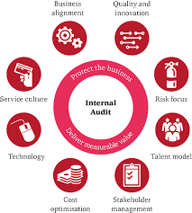
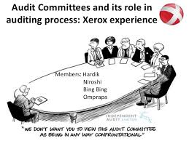
SUPPORT ON INTERNAL AUDIT & RISK MANAGEMENT
Internal Audit & RM
  Support on audit & risk charters
  Support to Audit Committee Members
  Review of performance of key performance indicators for audit internal.
  Support on FMCMM & action plans of FMCMM
  Once finalised will use the web platform to improve real time monitoring
  Conduct annual fraud awareness session
  Conduct audit committee chairperson forum on findings of AGSA
  Monitoring & reporting on performance audit committees
  Support on risk committees
123

Slide 124
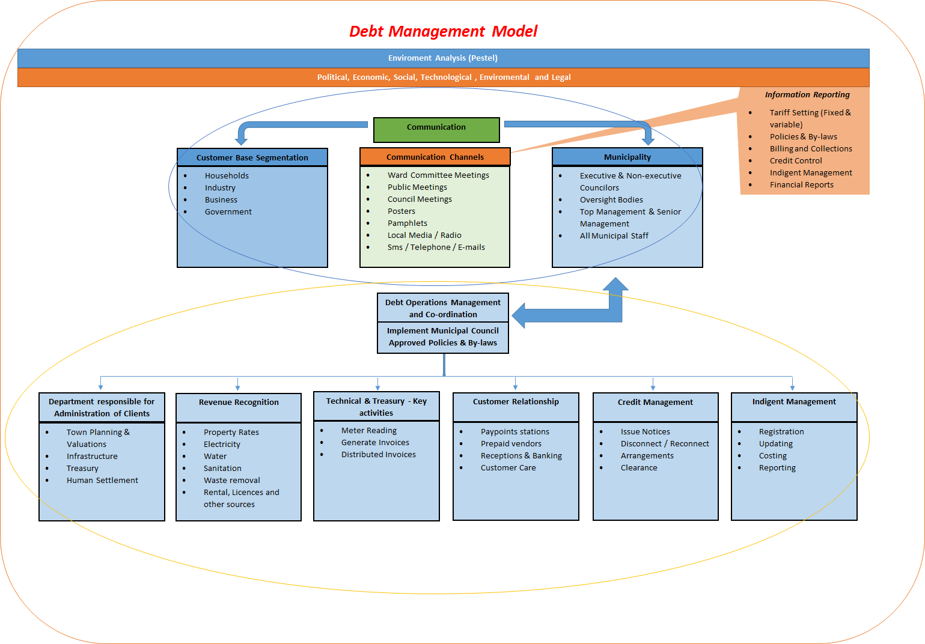
SUPPORT ON REVENUE
Revenue
  Establishment of revenue technical committees
  Focus on main value elements; billings, reporting, metering, government debt & collections – support by NT advisor.
  NT advisor supported on mapping of VR to Consbill report– variation reduce audit findings reduce “free riders”. Methodology forwarded to all municipalities
  CoGTA – support & re-evaluation of valuation roll.
  CoGTA - Legal Unit - Case law support.
  CoGTA support on Indigent registers and policy matters
  PCM support to select municipalities on meters
  PT - Technical support on cash flow reconciliation.
  Multi disciplinary team Office of the Premier – disputes, climate change, Loses – multi layered problem – SAPS “Zama Zama” – Mining towns, MIG focus on trading services & PT PCM program & Eskom credit management (Cessation of land)
124

Slide 125
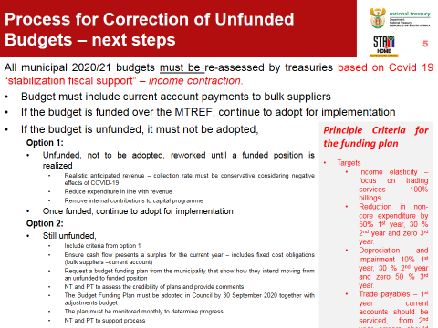
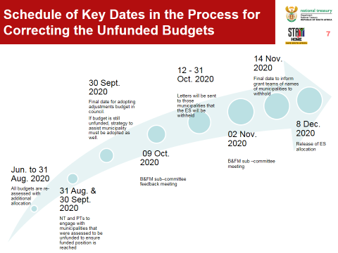
SUPPORT ON BUDGETS
Budgets
  Refocus MFMA Budget committees ( NT Circulars & budget funding options)
  PT continuous training of municipal officials responsible for budget schedules
  Focused attention on funded budgets (draft, final & adjustment budgets)
  Budgets and treasury evaluation must be considered before Councils approving budgets
  Provincial instruction, municipalities can only table unfunded with a treasury verified funding plan.
  Communicated special budgets conditions & timelines to municipalities :
    Completed budget verifications, adjustment budgets must be approved with a treasury verified funding plan if unfunded, compliance with mSCOA, proof of payment to bulk services on current accounts, valuation roll reconciles with FMS, timeline reporting on competency regulation and any other information not submitted.
    Awareness & strengthen oversight change - Reporting municipalities that approved unfunded budgets to all provincial forums
125

Slide 126

SUPPORT ON BUDGETS (CONT.)
Budgets
  Special Projects – Head Counts (similar to the provincial programme)
    Head Count circular issued to municipalities
    PROPAC monitoring of budget progress
    Multi disciplinary team on budgets (NMD & Infrastructure transfer, disputes & metering programme & conservation & climate change)
    CoGTA & DCoG programme on municipal organograms Escalate the funding mix on Capex – currently mainly from grants & engagement with financial houses
    Research on Covid Impact on FS Municipalities ( partnership with universities, banks & DESTEA)
NB: Systems in place to improve budget trajectory to funded e.g notably some may take longer Maluti, Mafube, Masilonyana & Matjhabeng Local Municipalities.
126

Slide 127


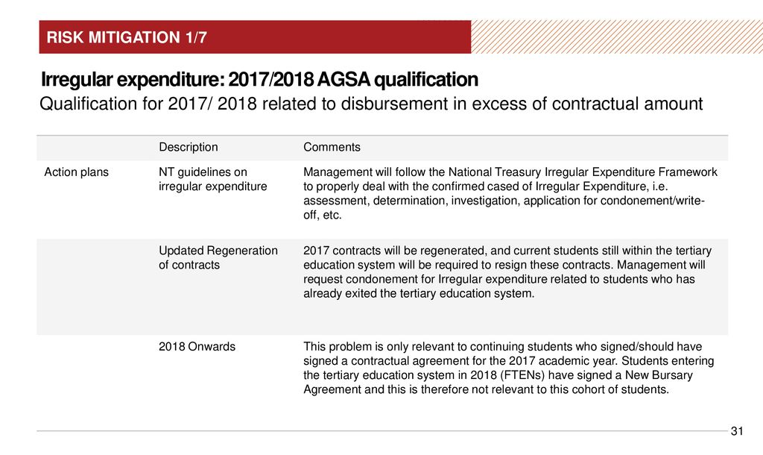
SUPPORT ON SCM
SCM unit
  PT support on SCM updates
  Assessment of all contract over R3 million before municipalities process
  PT support on MPAC training on UIF&W write off targeted 80 percent decline (Targeting top 30 percent, which contributes the larger quantum)
  PT monitor SCM deviations monthly
  Prepared guideline on reporting & templates on UIF&W regulations
  PT support on DC boards functionality
  & misconduct monitoring reports
  PT supports on policy & monitoring of web sites
  reviews of action plans to management report
127

Slide 128
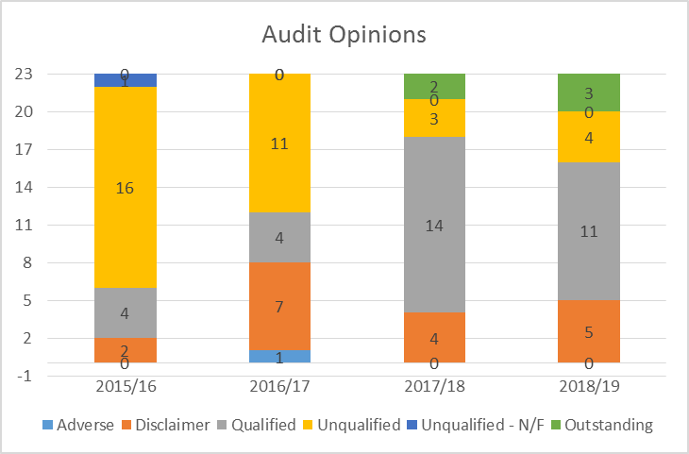
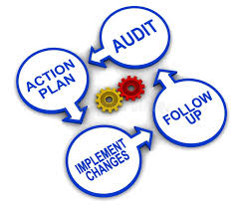
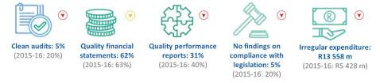
SUPPORT ON ANNUAL FINANCIAL STATEMENTS
Audit Financial Statements
  PT reviews of action plans to management report
  FMCMM will be used on the action plan monitoring
  PT, monthly monitoring progress on action plans
  PT, participates on municipal audit steering committee meetings
  NT advisor support assets register
  CoGTA support on valuation roll
  PT support municipalities on transversal matters e.g policy on billing estimates & templates
  PT monitoring & supporting the submission on RFQs & communications to AGSA.
  Escalate disputes on transversal matters to Provincial Audit Technical Steering Committee for resolution.
  PCM support to select municipalities on assets registers.
  CoGTA support on grant to select municipalities
  SALGA support findings on councillors matters
128

Slide 129
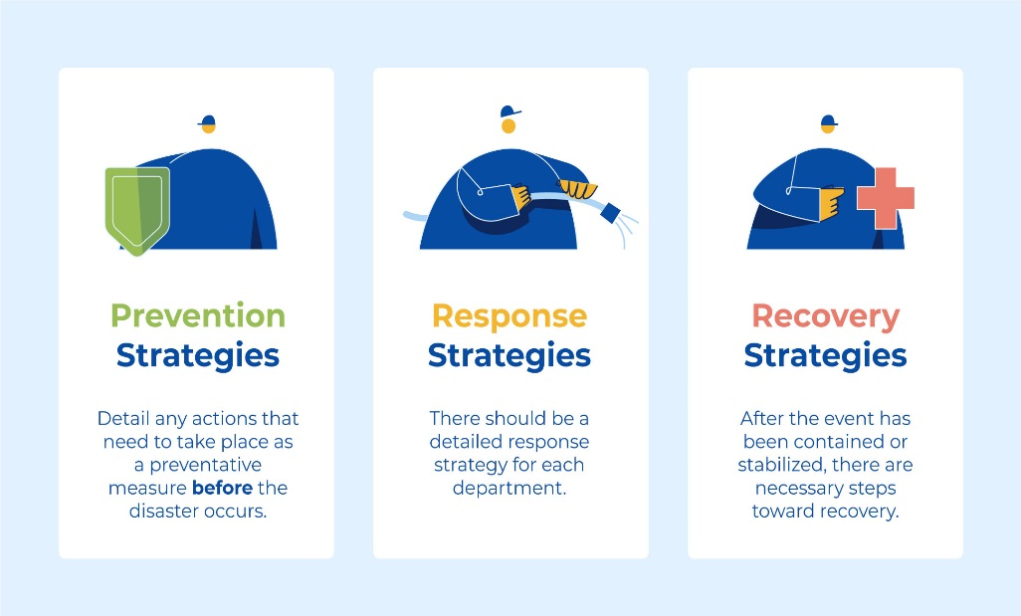

MUNICIPAL RECOVERY SERVICES
Establishment - MFRS
  CoGTA institutional support to Mafube, Maluti a Phofung, Phumelela, Dihlabeng Nala & Xhariep.
  Voluntary plans targeted at Mantsopa & Ngwathe Local Municipality
  Currently reworking Mafube & Maluti a Phofung Local Municipality FRP with NT
  DDG: Policy & Research – OTP to supporting the process on DCOG & CoGTA on Maluti a Phofung LM
  Participation and support on Mangaung Metro Municipality FRP.
129

Slide 130
MSCOA & OTHER SUPPORT
Reporting monthly on sec 71 report & regular publishing.
Format of sec 71 modernization to incorporate Internal Audit, SCM (UIF&W & Contract Management), Accounting (Audit Action Plan), Budget progress (Budget timelines) & PT support,
mSCOA support
  Vendor structures resolution problems
  Training MSCOA – Councillors
  Training Officials
  Module recaps
CFO Forms conducted.
Reports shared on CoGTA & SALGA Platforms
130

Slide 131

COGTA SUPPORT TO MUNICIPALITIES (CONT.)
Energy Master Plan for Maluti A Phofung LM (Thabo Mofutsanyana District) concluded.
Roll out Construction of Water Testing Laboratory in Thabo Mofutsanyana District – MAP; Kestell (39% complete) planned completion is December 2020.
Finalised review of Master Plans in Kopanong LM in August 2020.
Participates in weekly progress meetings where Water Boards are implementing intervention measures in various Municipalities (Bloem Water, Sedibeng Water and Rand Water).

Slide 132
COGTA SUPPORT TO MUNICIPALITIES (CONT.)
Development Bank of South Africa (DBSA) support
The DBSA support with Infrastructure Master Plans has yielded positive results and it is still continuing.
MISA through DBSA funded Maluti a Phofung and Phumelela with R1.5 million to drill boreholes in line with the COVID 19.
R8 million was approved for the refurbishment of 8 pumps stations in Maluti a Phofung.

Slide 133
COGTA SUPPORT TO MUNICIPALITIES (CONT.)
MISA Support
MISA and this Department facilitated sessions for Municipalities to re-prioritise MIG funds to accommodate Water and Sanitation Projects during COVID-19.
MISA provides Technical Assistance to all Municipalities as and when required (Infrastructure Planning, Operations and Maintenance and SCM processes).

Slide 134
COGTA SUPPORT TO MUNICIPALITIES (CONT.)
Council for Geo-Science Support
This Department, DWS and the Council for Geo-Science Support partnered with the Entity to support Maluti – A- Phofung with the drilling of 5 Boreholes.
Project is expected completion to be completed in February 2021.

Slide 135
COMPLIANCE AREA: MUNICIPAL INTERGOVERNMENTAL RELATIONS AND PUBLIC PARTICIPATION
Functional Ward Committees
In order to mitigate negative audit outcomes, Municipalities were supported with:
A template to report quarterly on the functionality of Ward Committees and public participation issues was developed and made available to all Municipalities.
Municipalities were requested to submit proof of payment of stipend (out of pocket expense) to Ward Committees on a quarterly basis.
Supported to submit a schedule of Ward Committee meetings and Councillor report back meetings and requested to provide evidence if the meetings were held, in the form of attendance registers, agenda and minutes of the meetings.
All Municipalities were supported with the development of ward operational plans in line with the SDBIP of the Municipality, except Mangaung as Ward Committees were not inducted. The Mangaung Metro insisted to appoint its own Service Provider to induct Ward Committees. However, since 2016 up to the time of the intervention the Metro failed to conclude on such an appointment.
Municipalities were further supported to develop a database of all Ward Committees indicating sector representation.

Slide 136
COMPLIANCE AREA: MUNICIPAL INTERGOVERNMENTAL RELATIONS AND PUBLIC PARTICIPATION
Functional Ward Committees (Cont.)
Challenges:
Municipalities indicated financial constraints for capacity building of Ward Committees.
High vacancy rate of Ward Committees in some Municipalities with no indication of when positions will be filled.
It is a generic constraint that the Offices of Speaker fail to submit regular, reliable and complete quarterly reports as expected which makes it difficult for province to report.
No permanent appointment of Public Participation Officers is a generic challenge in all Municipalities.
Non co-operation from Municipalities.
Lack of resources and staff in the Offices of Speaker.

Slide 137
COMPLIANCE AREA: MUNICIPAL PERFORMANCE MONITORING
Based on municipal organograms there are 129 senior managers’ posts;
There are currently 99 (77%) filled posts and 30 (23%) vacant posts;
Current positions filled by women 29 (29%);
07 MM, 03 CFO, 04 Director Technical Services, 05 Director Corporate Services,
08 Director Community Services, 01 LED &/ Planning, and 01 other posts are held by
women.

Slide 138
COMPLIANC AREA: MUNICIPAL PERFORMANCE MONITORING (CONT.)
Municipality | Position/s | Vacancy date | Progress to date
Mangaung Metro | Head: Strategic Projects & Service Delivery | 02 January 2017 | Not yet advertised. (Filling of post has been put on hold due to financial constraints)
Masilonyana LM | Chief Financial Officer | 01 November 2018 | Not yet advertised. Interviews were scheduled for 29th November 2019, rescheduled. No progress to date.
 | Director: Planning Services | Post created 30 June 2015 | Posts advertised on 11th June 2017 in the Sunday World and Sowetan 12th June 2017. No Progress to date.
 | Director: Corporate Services | 01 August 2020 | Not yet advertised.
Nala LM | Director: Public Safety and Social Services | July 2013 | Post not yet advertised. To be removed from the staff establishment. No progress to date.
 | Director: Technical Services | July 2016 | Advertised on the 06th May 2018 in the City Press closing date 04th June 2018. No progress to date.
 | Director: Corporate Services | 01 June 2018 | Advertised on the 25th March 2018 in the Sunday Times. Interviews held on the 12th July 2019 and appointment was invalidated by MEC. No progress to date

Slide 139
COMPLIANC AREA: MUNICIPAL PERFORMANCE MONITORING (CONT.)
Municipality | Position/s | Vacancy date | Progress to date
Nketoana LM | Municipal Manager |  | Interviews held, awaiting Council to pronounce on the recommended candidate
Maluti a Phofung LM | Director: Technical Services | 01 August 2015 | Post advertised in the City Press on 03rd June 2018. Municipality has placed erratum regarding term of appointment in the City Press of 10th June 2018. Council appointed selection committees on 14th August 2018. Re-advertised in the Sowetan on the 24th October 2019. No progress to date.
 | Director: Public Safety | 01 April 2017 | Advertised on 22nd June 2017 in The New Age. Awaiting finalisation of appointment of MM. Requested advice from DCOG (Director: Public Safety).
 | Director: Community Services | 01 April 2017
 | Director: LED | January 2018 | No progress to date.
Mafube LM | Municipal Manager | 01 February 2020 | Advertised in the Sunday Times on 21 June 2020 and closed on 10 July 2020.

Slide 140
COMPLIANC AREA: MUNICIPAL PERFORMANCE MONITORING (CONT.)
Municipality | Position/s | Vacancy date | Progress to date
Metsimaholo LM | Chief Financial Officer | 31 August 2018 | Advertised in the City Press of 04th November 2018 closing closed 22nd November 2018. Interviews held Friday, 08th March 2019 and rescheduled for the 18th March 2019 as only two candidates availed themselves. Council expected to sit on Friday, 06th December to approve the adverts. No progress to date.
 | Director: Organisational Development & Corporate Services | 31 December 2017 | Municipality placed under s139(b).
 | Director: Social Services | 31 December 2017
 | Director: Economic Development & Planning | 31 December 2017
 | Director: Technical & Infrastructure Services | 01 June 2018

Slide 141
COMPLIANCE AREA: MUNICIPAL PERFORMANCE MONITORING
Secondments
  Mangaung Metro: The Provincial Administration Team is comprised of the following members: Adv. Mzwakhe Mofokeng – Office of the Premier; Me Masechaba Sesing – Provincial Accountant General & CA; Me Lineo Mokheseng – Provincial COGTA; Mr Ernest Mohlahlo – Acting Head Public Works & Infrastructure & Mr Thomas Lindelo Mkaza – Vast experience in local government
  Maluti-a-Phofung LM: DCOG has seconded Mr L Zonke as Director: Technical Services and Mr. T Mawonga as Strategic Support to MAP Water;
  Metsimaholo LM: Mr T Manele from COGTA as the Exco Representative, Mr. M Mathe as the Acting Municipal Manager and Me P Qulungu as the Financial Adviser, Mr. L Ntoyi as the Director Technical Services and Ms K Lepesa as the Acting CFO.
  Dihlabeng LM: Mr J Lekgetho from COGTA as the Municipal Manager;
  Mohokare LM: Adv. MF Lepheana from COGTA as the Director: Corporate Services;
  Kopanong LM: Me SS Dhlamini from COGTA as the CFO;
  Nala LM: Me NE Radebe from COGTA as the Municipal Manager
  Mafube LM – Mr TM Moremi as Exco Representative & Mr K Masekoane as Acting Municipal Manager
  Nketoana LM – Mr Alexander was seconded as Acting Municipal Manager
24th October 2019: meeting with Tokologo LM Council on the regulated timelines regarding appointment processes;
25th June 2019: All 23 Municipalities were supported on the Implications of the Constitutional Court Judgement Declaring the Local Government: Municipal Systems Amendment Act, 2011 (Act No. 07 of 2011) invalid.

Slide 142
COMPLIANCE AREA: MUNICIPAL PERFORMANCE MONITORING
All Municipalities were provided with the Upper limits of Total Remuneration Packages (TRPs) payable to Municipal Managers and Managers directly accountable to Municipal Managers Notice No 43122 of 20th March 2020, on the 23rd March 2020;
Made a presentation to the Mayoral Committee of Matjhabeng LM on the 24th March 2020 on the TRPs;
Nala LM: invalid appointment of the Director: Corporate Services provided on the 18th March 2020;
Assisted Tokologo LM with the compilation of their appointment report with a view to submit to the Minister on the 08th June 2020
Provided technical advice on advertisements to the following Municipalities:
  Maluti-a-Phofung LM: technical advice provided on the 17th October 2019 and posts advertised on 24th October 2019 in the Sowetan.
  Tokologo LM: technical advice provided on the 24th October 2019 and posts advertised on 27th October 2019 in the City Press.
  Metsimaholo LM: technical advice provided on the 02nd December 2019 and posts not yet advertised.
  Matjhabeng LM: technical advice provided on the 04th February 2020;
  Metsimaholo LM: municipal category provided on the 26th February 2020;
  Maluti-a-Phofung LM: technical advice provided on the 04th March 2020
  Nala LM: technical advice provided on the 11th March 2020;
  Letsemeng LM: technical advice provided on the 16th March 2020;
  Metsimaholo LM: technical advice provided on the 21st May 2020;
  Matjhabeng LM: technical advice provided on the 09th June 2020;
  Mafube LM: technical advice provided on the 09th June 2020;

Slide 143
COMPLIANCE AREA: LEGAL SERVICES AND MUNICIPAL POLICY ADVICE
  Legal Services
  In an effort to mitigate and manage the current high status of litigation bills of Municipalities the Department is in the process of establishing the Provincial Free State Municipal Legal Advisor’s Forum with the following functions:
      Provide a platform to capacitate Legal Officers at municipal level;
      To share some good practice;
      Provide a co-ordinated, supportive and integrated approach on improving the functioning of the Free State Municipalities within a sound legal framework;
      To develop a uniform and integrated approach in dealing with litigation(integrated case management system);
Fraud and Anti-corruption
The Department is also engaged in activities aimed at providing support and capacitation to Municipalities on Fraud and Anti-Corruption matters through the development of policies and strategies and conduct annual workshops in partnership with DCoG National to provide capacity and training.. The Department is also responsible to monitor the extent to which anti-corruption measure are implemented in Municipalities and to identify challenges and make recommendations.
The Department is also involved with providing support and coordination services to the Municipal Demarcation regarding Municipal capacity assessments, delimitation of Municipal Wards, determination and re-determination of Municipal boundaries as well as determination of the number of Municipal Councillors.

Slide 144
COMPLIANCE AREA: SPATIAL PLANNING
Municipalities are supported in the following aspects
Drafting of the Spatial Development Frameworks (SDF)
Drafting of the Land Use Schemes (LUS)
Support with the maintenance of the Geographic Information Systems (GIS)
Support with the implementation of SPLUMA

Slide 145
COMPLIANCE AREA SPATIAL PLANNING (CONT.)
Drafting of the Spatial Development Frameworks (SDF)
Local Municipality | Support provided in the 2019/2020 financial year | Support provided in the 2020/2021 financial year
Tokologo | COGTA is assisting the Municipality with the drafting of the SDF. Final draft was adopted by Council in 20 June 2019.
Nala | COGTA is assisting the Municipality with the drafting of the SDF. Final draft is completed.
Mafube |  | COGTA will be assisting the Municipality with the drafting of the SDF

Slide 146
COMPLIANCE AREA: SPATIAL PLANNING (CONT.)
Drafting of the Land Use Schemes (LUS)
Local Municipality | Support provided in the 2019/2020 financial year | Support provided in the 2020/2021 financial year
Tokologo |  | COGTA is assisting the Municipality with the drafting of the LUS. Maps and Regulations are being finalised and public participation will take place in 2021
Nala |  | COGTA is assisting the Municipality with the drafting of the LUS. Maps and Regulations are being finalised and public participation will take place in 2021
Mafube | COGTA is assisting the Municipality with the drafting of the LUS. The drafting of the LUS is still in the initiation phase.
Maluti a Phofung |  | COGTA will be assisting the Municipality with the drafting of the LUS.

Slide 147
COMPLIANCE AREA SPATIAL PLANNING (CONT.)
Support with the maintenance of the Geographic Information Systems (GIS)
Crucial services is provided to the Municipalities in terms of processing and capturing GIS data to produce maps according to their respective needs, ensuring availability of accurate and credible spatial information and the development and maintenance of a database for GIS. Support is as follows:
Fifteen Local Municipalities and three District Municipalities do not have a functional GIS or GIS unit, therefore COGTA is providing ongoing support by keeping their Geographical Information System databases by up to date.
Three Local Municipalities (Dihlabeng, Matjhabeng and Moqhaka) and one District Municipality (Fezile Dabi) has a functional GIS and personnel, therefore COGTA provides support on an adhoc basis in terms of providing them with the latest shape files.

Slide 148
COMPLIANCE AREA: IDP
The Department of Cooperative Governance and Traditional Affairs conducted and facilitated the Provincial Draft IDP Assessment Sessions that was held from the 23rd to the 26th of April 2019.
The session brought together National and Provincial sector Departments officials; State owned entities and Agencies and other organisations to engage with Municipal IDPs with a view of providing comments that are aimed at improving the credibility and quality of IDPs.
The IDP Assessment session was necessitated by the Municipal System Act 32 of 2000, section 31 which require MEC for local government to provide comments on the respective Municipal Integrated Development Plans in the province.

Slide 149
COMPLIANCE AREA: IDP (CONT.)
Overall objectives of the IDP assessment
To support and improve the content of the MEC commenting process so as to ensure we move towards a Sustainable Development Goals.
To give platform to all sector Departments and other relevant stakeholders to monitor and evaluate Municipal IDPs in assisting and supporting Municipalities to develop legally compliant IDPs that will be implementable in their respective communities.
To assist Municipalities in developing legally compliant IDPs that are implementable in changing lives of communities.
To Influence a dialectical relationship between Municipal and sector planning with a view to making IDPs ‘A Plan for All state organs.

Slide 150
COMPLIANCE AREA: IDP (CONT.)
Municipal IDP Support provided 2019/2020 financial year
The department coordinated and facilitated two Provincial IDP Support Meeting, and the main purpose of the two sessions was to:
Encouraged maximum participation and accountability of IDP stakeholders.
Strengthened the capacity of Municipalities to develop legally compliant and credible IDPs.
Enhanced intergovernmental relations amongst all spheres of government.
The department coordinated and facilitated four Provincial IDP Manager’s Forum Meeting, and the main purpose of the four sessions was to:
To create a platform that will allow IDP managers to discuss on IDP-related developmental issues.
To focus on planning, coordination and alignment of IDPs with National & Provincial plans by facilitating the participation of stakeholders in the IDP processes.
To manage, co-ordinate and support the implementation of various IDP initiatives, IDP related activities in order to strengthen support and to avoid duplication.

Slide 151
COMPLIANCE AREA: IDP (CONT.)
Municipal IDP Support provided 2019/2020 financial year (Cont.)
Furthermore the department coordinated and facilitated two Provincial IDP Capacity Building Session, and the main purpose of the two sessions was to:
To share information on available municipal funding model avenues.
To support, assist and facilitate funding solutions to Municipalities.
To share information on IDP processes and to strengthen the capacity of Municipalities.
To assists Municipalities to develop legally compliant and credible IDPs that are implementable in changing the life of communities
Lastly the department coordinated and facilitated a three days Provincial Municipal IDP Engagement Session, and the main purpose of the two sessions was to:
To collectively respond to our own Constitutional obligation and mandate as espoused in section 154 of the Constitution of the Republic of South Africa.
To collectively lobby, solicit and consolidate support for Municipalities during the review of 2019/2020 IDPs.
To ensure effective, efficient and meaningful participation by all Sector Departments and State Owned Enterprises in the Municipal IDP processes.

Slide 152
COMPLIANCE AREA: LOCAL ECONOMIC DEVELOPMENT
Municipal LED Support provided 2019/2020 financial year
The department coordinated and facilitated three Provincial LED Meetings through the financial year. The main purpose of the three sessions was to:
To create a platform that will allow LED officials to discuss on LED related developmental issues.
To share information with LED officials on LED related matters such as: Rural Development Plans, FS Tourism Plan, DESTEA incentive schemes, SALGA role on LED etc.
To manage, co-ordinate and support the implementation of various LED initiatives in order to strengthen support and to avoid duplication.
During the one Provincial LED meeting the LED officials did receive training from STATSSA on the Super Cross Programme to capacitate them to obtain relevant information from their respective Municipalities and to plan accordingly
The Department have monthly interaction with all Municipalities in the Free State regarding the status of the LED strategies, LED Units and the Business forums.
The participation of private business is a challenge during the establishment of Business Forums. It is proposed that there should only be District Business Forums.

Slide 153
COMPLIANCE AREA: LOCAL ECONOMIC DEVELOPMENT
Municipal LED Support provided 2019/2020 financial year (cont.)
The following LED strategies are still in draft formats: Tokologo LM, Metsimaholo LM, Mafube LM, Nketoana LM,.
The situation with COVID-19 is a bid challenge to finalization the strategies
The Department did engage with other Departments on issues that are LED related. These information were shared with the Municipalities:

Slide 154
DISTRICT DEVELOPMENT MODEL
Mr. Oupa Khoabane was appointed as the Provincial Champion.
In addition the following political and administrative deployments were made;
District deployments are as follows;

Slide 155
DISTRICT DEVELOPMENT MODEL (CONT.)
Xhariep District – Mr.. Jafta appointed as District Champion

Slide 156
DISTRICT DEVELOPMENT MODEL (CONT.)
Lejweleputswa District – District Champion to be appointed

Slide 157
DISTRICT DEVELOPMENT MODEL (CONT.)
Thabo Mofutsanyana District – District Champion to be appointed

Slide 158
DISTRICT DEVELOPMENT MODEL (CONT.)
Fezile Dabi District – District Champion to be appointed

Slide 159
Thank you

