Slide 1
SYNOPSIS
STATE OF AFFAIRS
IN
MATLOSANA
AND
NGAKA MODIRI MOLEMA
MUNICIPALITITES
AND SUPPORT PROVIDED
BY SALGA
27 NOVEMBER 2020

Slide 2
PRESENTATION OUTLINE
01
CONTEXT
02
AUDIT OUTCOMES AND BUDGET
03
VACANCIES
04
INTERVENTION/S
05
SALGA’S SUPPORT
06
RECOMMENDATIONS
2

Slide 3
CONTEXT: Key interlinking challenges facing municipalities and the local government sector
Capabilities, Governance & Leadership
Fiscal Policy & Financial
Management
Weakening municipal governance and leadership characterised by poor oversight, limited consequence management, instability at senior management levels, and a lack of skills undermine service delivery and transformation at the local sphere
Increase of municipalities in financial distress due to many factors like: increase in the cost of services (tariffs), decrease in revenue collection, supply chain management inefficiencies, and irregular, fruitless and wasteful expenditure , low revenue bases, high levels of unemployment & poverty.
Spatial Transformation & Inclusion
Service Delivery & Infrastructure
Spatial transformation and inclusive communities undermined by depressed economic conditions, increasing impact of climate change, regressing social cohesion, poor coordination in planning, access to land, bulk services, limited decentralisation in housing delivery, transport challenges and safety and security
Increase in coverage of basic services but under pressure from widening funding gap for infrastructure, poor life cycle asset management, maintenance and effective project implementation, as well as lack of technical capabilities.
3

Slide 4
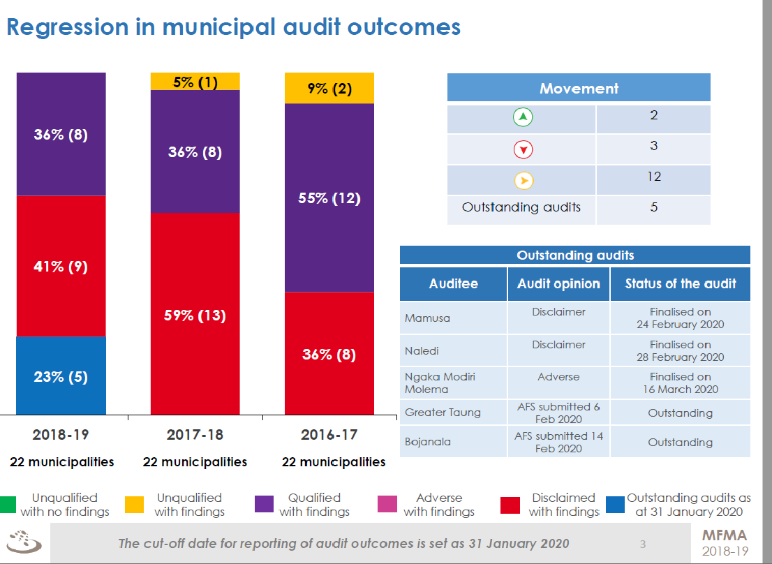
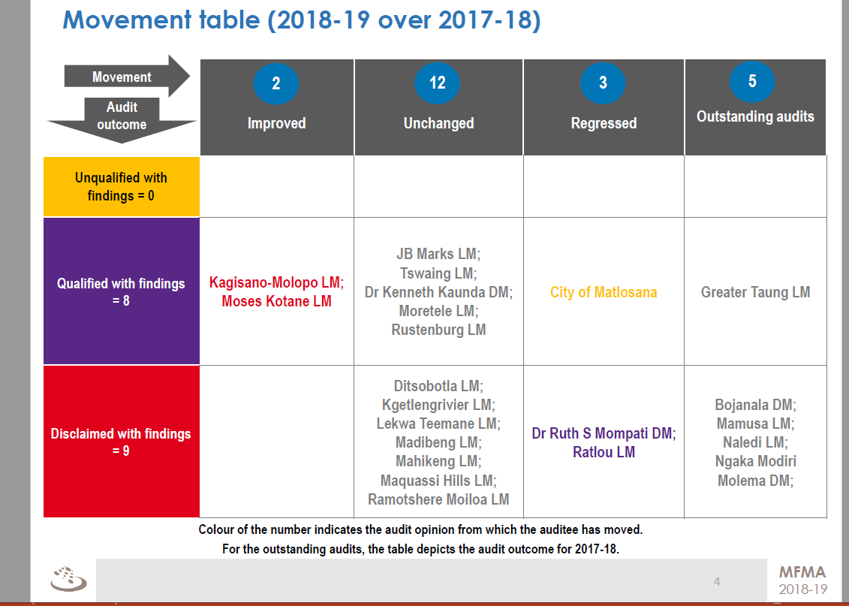
2018-19 AUDIT OUTCOMES

Slide 5
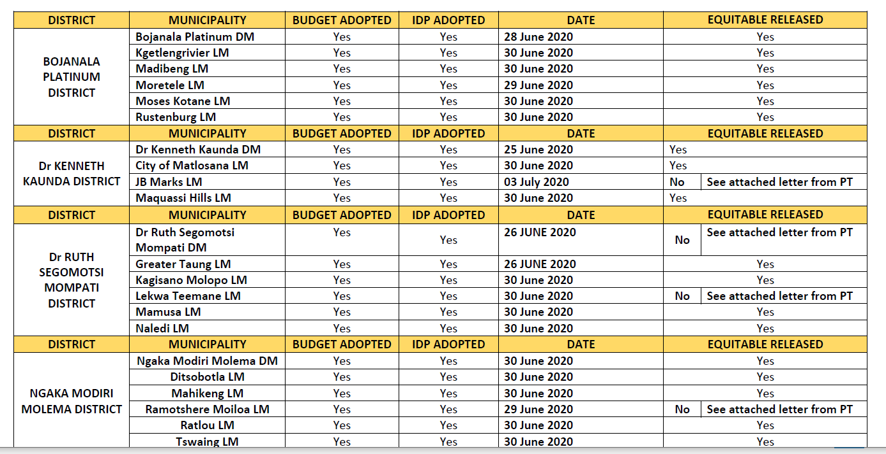
BUDGET AND IDP

Slide 6
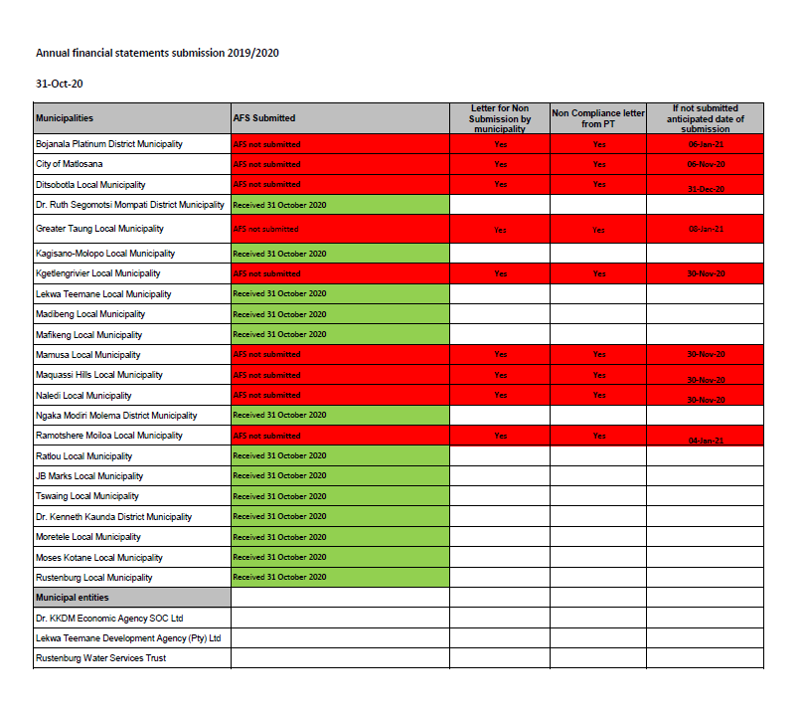
2020 SUBMISSION OF FINANCIAL STATEMENTS

Slide 7
FILLED VS VACANCIES
 | MUNICIPALITY | MUNICIPAL MANAGER | CFO
DR KENNETH KAUNDA DISTRICT | Dr Kenneth Kaunda DM | 1 | 1
 | City of Matlosana LM | 1 | 1
 | JB Marks LM | 1 | 1
 | Maquassi Hills LM | 1 | 1
 | TOTAL | 4 | 4
 | PERCENTAGE | 100% | 100%
 | MUNICIPALITY | MUNICIPAL MAMAGER | ACTING | CFO | ACTING
NGAKA MODIRI MOLEMA DISTRICT | Ngaka Modiri Molema DM | 1 |  | 1
 | Ditsobotla LM | 1 |  | 1
 | Mahikeng LM | 1 |  | 1
 | Ramotshere Moiloa LM |  | 1 |  | 1
 | Ratlou LM | 1 |  |  | 1
 | Tswaing LM | 1 |  | 1
 | TOTAL | 5 | 1 | 4 | 2
 | PERCENTAGE | 83% | 17% | 67% | 33%

Slide 8
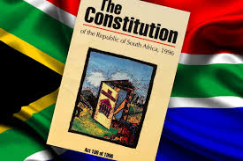
INTERVENTION/s
Interventions
Both subjected to 139 sometime ago
Ngaka Modiri Molema 137
Currently no interventions in both Municipalities

Slide 9
AREAS OF FOCUS

Slide 10
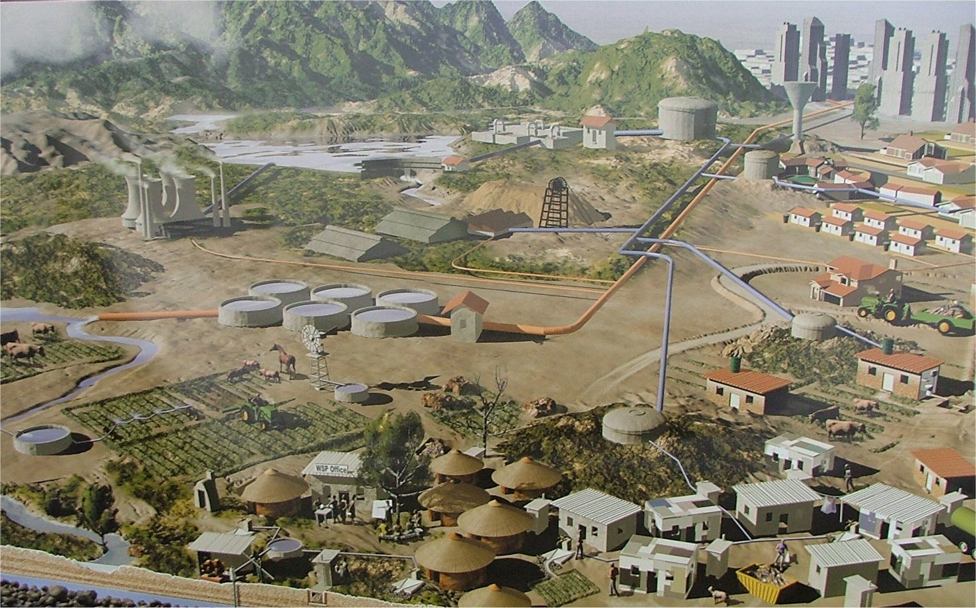
Mandate
Both Municipalities are Water Services Authorities
They receive the following grants to execute their mandate
Regional Bulk Infrastructure
Water Services Infrastructure Grant
Municipal Infrastructure Grant
Equitable Share

Slide 11
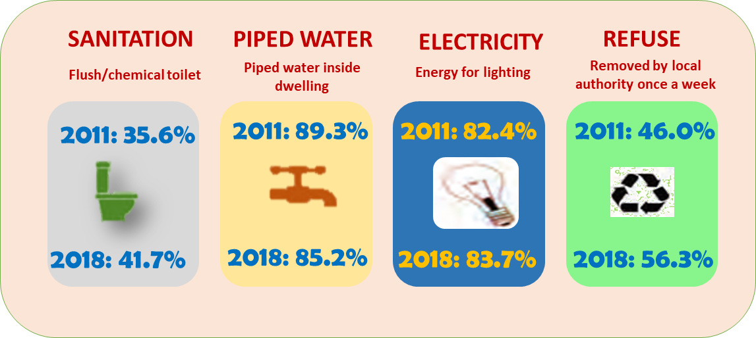
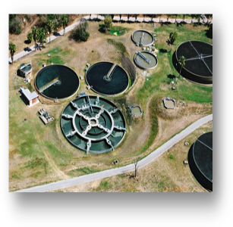
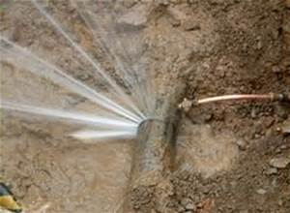
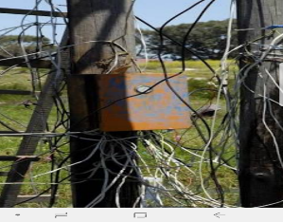
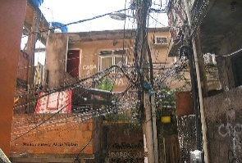
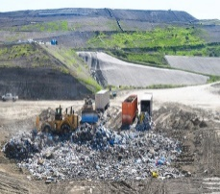
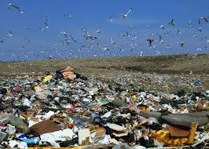
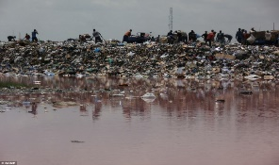
EXAMPLES OF SERVICE DELIVERY PERFORMANCE
The good
The Bad
The Ugly
Ugly
Ugly
NW
Source: Stats SA General HH Survey

Slide 12
KEY HIGHLIGHTS PER MANDATE: EMPLOYER BODY
Lobby, Advocate & Represent
Employer Body
Capacity Building
Support & Advice
Knowledge & Information Sharing
Strategic Profiling
Conducted Training to the Local Labour Forums with an objective of ensuring a smooth, less disruptive approach to labour relations matters
Conducted training to senior managers on Chairing Disciplinary hearing and prosecution

Slide 13
KEY HIGHLIGHTS PER MANDATE: CAPACITY BUILDING
SALGA and PT as part of strengthening oversight and accountability have trained MPAC Councillors on Regulation 32 (MFMA s32) as they are responsible for dealing with Unauthorised, Irregular, Fruitless and Wasteful (UIF&W) expenditures
SALGA in collaboration with Provincial Treasury conducted a training on section 71 reports for Finance Portfolio Councilors and MPAC`s
Enhancing Municipal Capacity for Development (EMCD) in collaboration with with the Commonwealth Local Government Forum
Training programmes offered for the Councillors and Officials: -
Ethics and Integrity Management
MSCOA Training
Project Management
Integrated Development Planning (IDP) for Governance in a Municipal Area
Exercise Leadership in a Councillor context, Apply Leadership Skills to Relationship Management
Chairing of Disciplinary Hearing and prosecuting
Training on councillors (Dr Ruth & Ngaka) on Municipal Leaders’ Media and Stakeholder Programme
Lobby, Advocate & Represent
Employer Body
Capacity Building
Support & Advice
Knowledge & Information Sharing
Strategic Profiling

Slide 14
KEY HIGHLIGHTS PER MANDATE: CAPACITY BUILDING
Lobby, Advocate & Represent
Employer Body
Capacity Building
Support & Advice
Knowledge & Information Sharing
Strategic Profiling
Local Labour Forum Training: SALGA continues to provide support and capacity building interventions to LLF’s to ensure functionality
Cascading Performance Management System: SALGA gave capacity building and support to Dr Kenneth Kaunda DM, City of Matlosana LM, Maquassi Hills LM and JB Marks LM on cascading PMS
Task Job Evaluation: SALGA continue capacitate Municipalities in the implementing TASK JE - Bojanala Platinum DM, Dr Ruth S. Mompati DM, Ngaka Modiri Molema DM, Lekwa Teemane LM, City of Motlosana LM, Madibeng LM, Kagisano-Molopo LM, Moses Kotane LM

Slide 15
KEY HIGHLIGHTS PER MANDATE: SUPPORT AND ADVICE
Lobby, Advocate & Represent
Employer Body
Capacity Building
Knowledge & Information Sharing
Strategic Profiling
Support & Advice
Supported Ngaka and Dr KK Districts (Matlosana) on Covid19 directives and Regulations
SALGA continues to provide support to municipalities through the Provincial Ward Committee Coordinators Forum to ensure functionality of Ward Committees.
Supported and advised municipalities by participating in recruitment panels of senior managers
Supported Ngaka Modiri Molema District and the LMs in order to rationalise and regularise the relationship between Water Service Authority (WSAs) (District Municipalities) and Water Service Providers (WSPs).
A call to apply for Energy Efficiency and Demand Side Management (EEDSM) grant was distributed to municipalities which resulted in four municipalities (Mafikeng, Mamusa, City of Matlosana & Lekwa Teemane) to continue receiving allocation amounting to R14m in 2019/20.

Slide 16
KEY HIGHLIGHTS PER MANDATE: SUPPORT AND ADVICE
Lobby, Advocate & Represent
Employer Body
Capacity Building
Knowledge & Information Sharing
Strategic Profiling
Support & Advice
SALGA conducted a work session on the SSEG (Small-Scale Embedded Generators) with Madibeng and City of Matlosana to prepare them to lodge their applications as and when the call for applications opens.
SALGA appointed a PSP to assist municipalities with feasibility study on landfill gas to energy and green waste composting in 4 secondary municipalities (Madibeng, City of Matlosana, Rustenburg and JB Marks LMs)
SALGA through MASP continues to support municipalities by participating in Audit Committee Meetings, review of PAAP’s, as well as capacitating internal audit units

Slide 17
KEY HIGHLIGHTS PER MANDATE: SUPPORT AND ADVICE
Lobby, Advocate & Represent
Employer Body
Capacity Building
Knowledge & Information Sharing
Strategic Profiling
Support & Advice
Department Small Business Development (DSBD), Department of Cooperative Governance and Traditional Affairs (CoGTA), and SALGA developed National Red Tape Reduction Guidelines (NRTRG) for reducing red tape for the benefit of small businesses at local government level
Supporting Ngaka Modiri Molema in the Development of District Economic Recovery Plan including
SALGA continues to support City of Matlosana, Madibeng and Moretele through the Small Town Regeneration Programme to resuscitate economic development.
Best practices in water O&M: Best Practices in water operations and maintenance knowledge sharing and management of water losses in partnership with WSSA and other private companies

Slide 18
KEY HIGHLIGHTS PER MANDATE: KNOWLEDGE & INFORMATION SHARING
Convened benchmarking and knowledge sharing working session on revenue management using smart technologies.
Facilitating learning session on revenue management (SALGA and Emfuleni LM in Gauteng with municipalities from NW)
SALGA in collaboration with Department of Local Government convenes a Revenue Management forum to specifically deal with revenue challenges and enhancement strategies. Platform is also used for sharing best practices.
Lobby, Advocate & Represent
Employer Body
Capacity Building
Support & Advice
Knowledge & Information Sharing
Strategic Profiling

Slide 19
KEY HIGHLIGHTS PER MANDATE: LOBBY, ADVOCATE & REPRESENT
Lobby, Advocate & Represent
Employer Body
Capacity Building
Support & Advice
Knowledge & Information Sharing
Strategic Profiling
Represent SALGA in the IGR Structures in the Province
Lobby and advocacy,
Infrastructure Grant Review
Revision of the Equitable Share
Intergovernmental Monitoring, Support and Intervention Bill

Slide 20
RECOMMENDATIONS
It is recommended that the PC: COGTA:-
NOTES the content of the presentation;
NOTES SALGA’s support to the two municipalities

Slide 21
THANK YOU

