Slide 1

Portfolio Committee on
Local Government and Traditional Affairs
City of Matlosana
25 Nov 2020
09:00-13:00

Slide 2

Table of Contents
Overview
Implementation of the Post Audit Action Plan (PAAP)
State of finances (breakdown of COVID-19 expenditure)
Revenue collection from March – June 2020
Breakdown of the unauthorized, irregular, fruitless and wasteful expenditure
Consequence management
Institutional capacity (personnel in key positions)
Internal audit committee (capacity, functionality and effectiveness)
MPAC (capacity, functionality and effectiveness)

Slide 3
1. OVERVIEW OF THE MUNICIPALITY

Slide 4
OVERVIEW – BACKGROUND
The municipality is spread over 3602 square km of land and has 39 wards with a population of 438 921.
The municipality been able; through the Government Grant allocations, to progressively address the issues of backlogs on Water and Sanitation.
Great strives have been made in the provision of accessible and adequate internal roads where over 1087 km have been tarred and/or paved, however our roads are riddled with potholes due to lack of refurbishment/resealing over the years.
More than 95% have access to electricity and the municipality has 207 high mast lights in various suburbs.

Slide 5
OVERVIEW – FRAUD AND FINANCIAL MANAGEMENT
  In an effort to address fraud the municipality developed a fraud and corruption prevention strategy aligned to the provincial strategy.
  The municipality has a fraud hotline (086 076 7076) and a register is in place to record all matters reported.
  As part of internal audit procedures, through audits that are performed, they assess if there are any indicators of fraud and recommend further investigation.
  Risk management is discussed in management meetings and at departmental levels in an effort to incorporate risk management into the language and culture of the Municipality.
  There are clear financial delegations in place, cost containment measures and cash flow management are applied.

Slide 6
OVERVIEW – COUNCIL FUNCTIONALITY
  The municipality has been without a Mayor for more than a month and this has brought serious instability within the administration as important legislated reports, i.e Adjustment budget, are not timeously processed by Council which led to serious non-compliance that may invite the invoking of section 216 (2)(Withholding of Government Grants) by National Treasury.
  The instability in our council places a limitation on the scope and extent of service delivery acceleration as administration remains helpless on matters that require council attention leading to low morale and ultimately lack of service delivery.

Slide 7
OVERVIEW – COUNCIL STRUCTURES
Audit Committee – Functional and performing oversight over Covid -19 Response Plan, Covid – 19 Risk Strategy, SDBIP, budget and Annual Financial Statements.
Risk Committee – functional and performs oversight over Risk strategy and implementation thereof.
Performance Management – Functional and perform oversight over the SDBIP
Financial Disciplinary Board – Appointments have been made, no meetings were held as yet.
MPAC – The MPAC is functional and continues to sit for critical matters.

Slide 8
2. POST AUDIT ACTION PLAN (PAAP)

Slide 9
2. POST AUDIT ACTION PLAN (PAAP)
The municipality regressed from an unqualified audit opinion in 2018/18 and received a qualified audit opinion in 2018/19 financial year
Basis for qualified opinion
Receivables from exchange transactions
The AG was unable to obtain sufficient appropriate audit evidence that all monies due to the municipality from the fresh produce market were accounted for as the municipality did not have adequate systems to reconcile and monitor all transactions related to the fresh produce market.
88 findings were also included in the management report and all 88 findings have been addressed

Slide 10
3. State of finances (breakdown of COVID-19 expenditure)

Slide 11
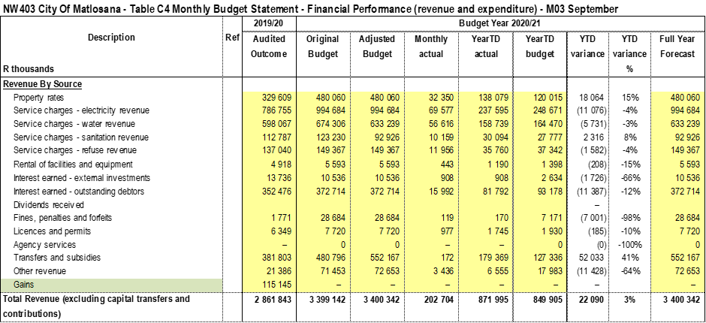
PRESENTATION ON THE TABLED 2020/21 MTREF
NW403 City Of Matlosana - Table A4 Budgeted Financial Performance (revenue and expenditure)

Slide 12
Actual operating revenue per revenue source
From table 1 above it can be seen that actual operating revenue generated of (R 883,309,266) compares unfavourably with the pro rata budgeted figures of (R 890,605,491) ­­­– a negative variance of R 7,296,225 at the end of September 2020.
The major revenue variances against the budget are:
  Interest earned on outstanding debtors: The continuous increase of the debtors book results in the increase of interest earned on outstanding debtors balances

Slide 13
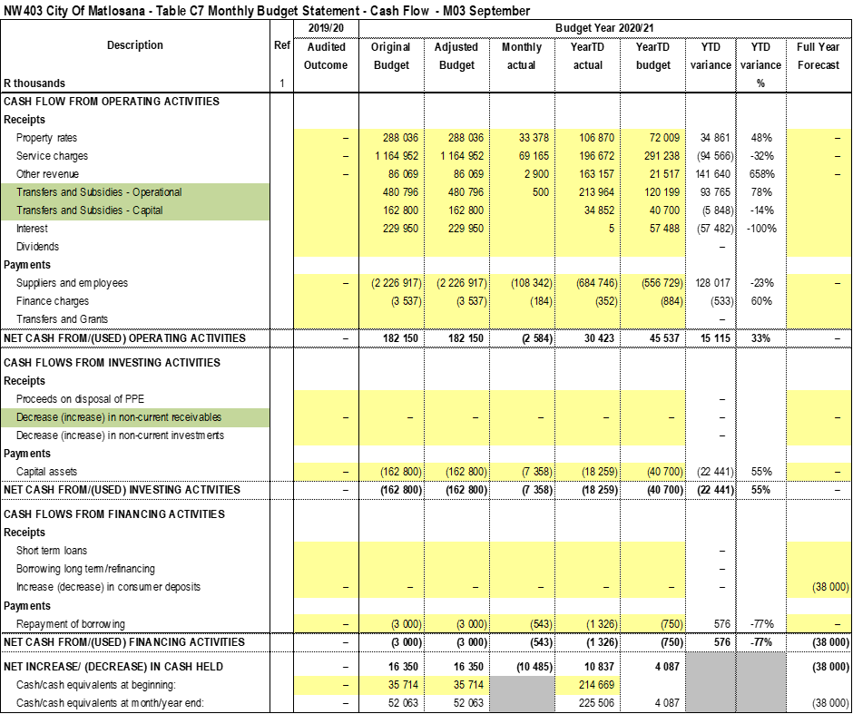
CASH FLOW STATEMENT

Slide 14
Cash Flow Statement
The opening balance for the month of September 2020 amount to R 224,916,705 and the closing balance was R 214,668,666
Total cash receipts by source reflect an amount of R 106,179,098 million as at 30 September 2020.
Total cash payments indicate an amount of R 116,427,137 million, for the month of September 2020.

Slide 15
Borrowings
The municipality started the 2020/2021 financial year with borrowing debt of R19,171,090 and after repayments of
R 989,713 were made, the total borrowings outstanding as at 30 September 2020 amounts to R 18,181,377.

Slide 16
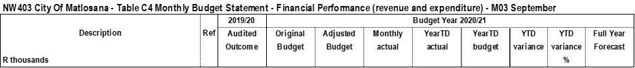
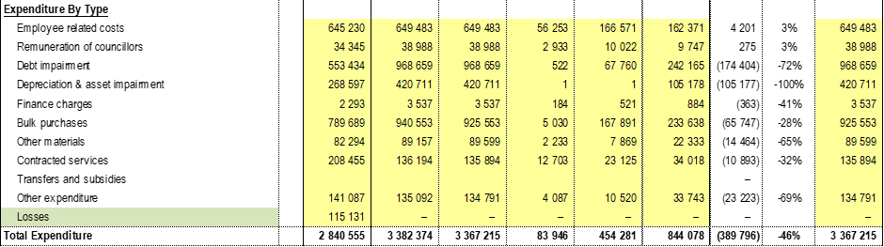
KEY OPERATIONAL EXPENDITURES DRIVERS ARE AS PER TABLE BELOW:

Slide 17
OPERATIONAL EXPENDITURE PER CATEGORY
Total actual operating expenditure of R 454,281,446 compares unfavourably with the pro rata budgeted expenditure of R 844,077,561 – a variance of
R 389,796,115

Slide 18
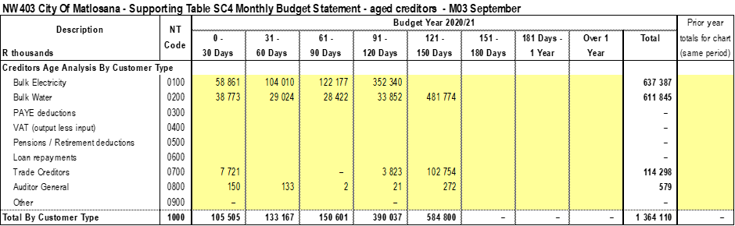
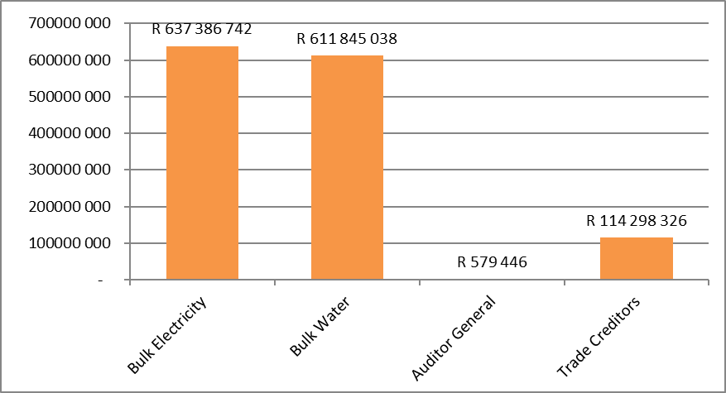
Creditors age analysis

Slide 19
Creditors age analysis
The municipality’s total outstanding creditors amounted to R 1,364,109,552 as at 30 September 2020 compared with the R 1,398,849,174 as at 31 August 2020 and decreased with R 34,739,622
The outstanding creditors is made up of R637 million (Eskom), R611 million (Midvaal) and R114 Million Trade Creditors
There are payment arrangements with both Eskom and Midvaal which are structured as follows:
  Eskom = Current account plus R8m over 48 months
  Midvaal = R5m per week until December 2020
The municipality has honoured the payment arrangements from June 2020 to Date which amounted to R104 Million, 106 million and 122 million and defaulted on the payment of 104 million in September 2020.
The municipality paid R18, 8 million towards the R104 million and we’ll continue to pay as our collection improves

Slide 20
ANNUAL FINANCIAL STATEMENTS
The municipality’s outstanding debt is R4,7 billion and continues to increase by R80 million a month
There is a growing culture of non-payment included are business and government
There was an unprotected strike by SAMWU for Compensation/Danger allowance that lasted for two weeks
The municipality was unable to submit the Annual Financial Statements as a results of the above
The AFS will be submitted on the 06 November 2020

Slide 21
4. REVENUE COLLECTION FROM MARCH – JUNE 2020

Slide 22
Debtors age analysis per service-
March to June 2020
Total debtors book R 4,429,976,570
Debtors: Government R 111,346,441 (3%)
Debtors: Business R 398,728,855 (9%)
Debtors: Household R 3,919,901,273 (88%)
The year to date collection rate for the period ended 01 March to 30 June 2020 was 65%

Slide 23
Debtors age analysis per service- July to Sept 2020
The municipality’s total outstanding debtors amounted to
R 4,718,906,908 as at 30 September 2020 compared to
R 4,623,715,479 as at 31 August 2020.
Current to 30 days debt decreased with R 13,725,358 as at 30 September 2020 compared to R 224,628,078 as at 31 August 2020.
31 to 60 days debt decreased with R 28,363,454; 61 to 90 days increased with R 57,403,852, and
91 days and older debt as at 30 September 2020 has increased with R 79,876,389 to R 4,193,036,934 compared to
R 4,113,160,545 as at 31 August 2020.
The year to date collection rate for the period ended 30 September 2020 is 56.76%

Slide 24
Debtors age analysis per debtor type
Government owe the municipality R 148,845,890 (3.2%)
Business debtors R 441,329,996 (9.4%)
Domestic debtors R 4,128,731,022 (87.5%)
The total outstanding debt of R 4,718,906,908 is a great concern in particular government and business debtors.
Council appointed debt collectors, who started on January 2019
from January 2019 to 30 September 2020 they have collected R 42 million.

Slide 25
CAPITAL PROJECTS

Slide 26
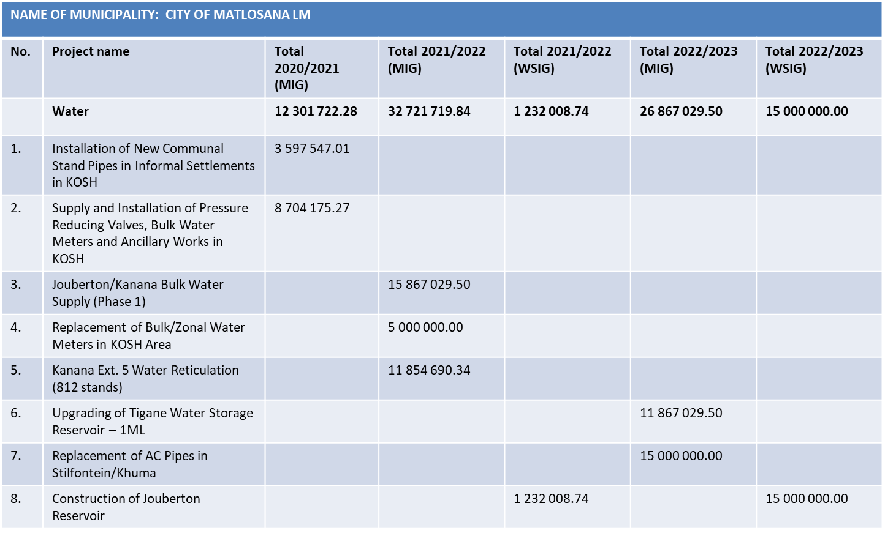
CAPITAL PROJECTS-WATER PROJECTS

Slide 27
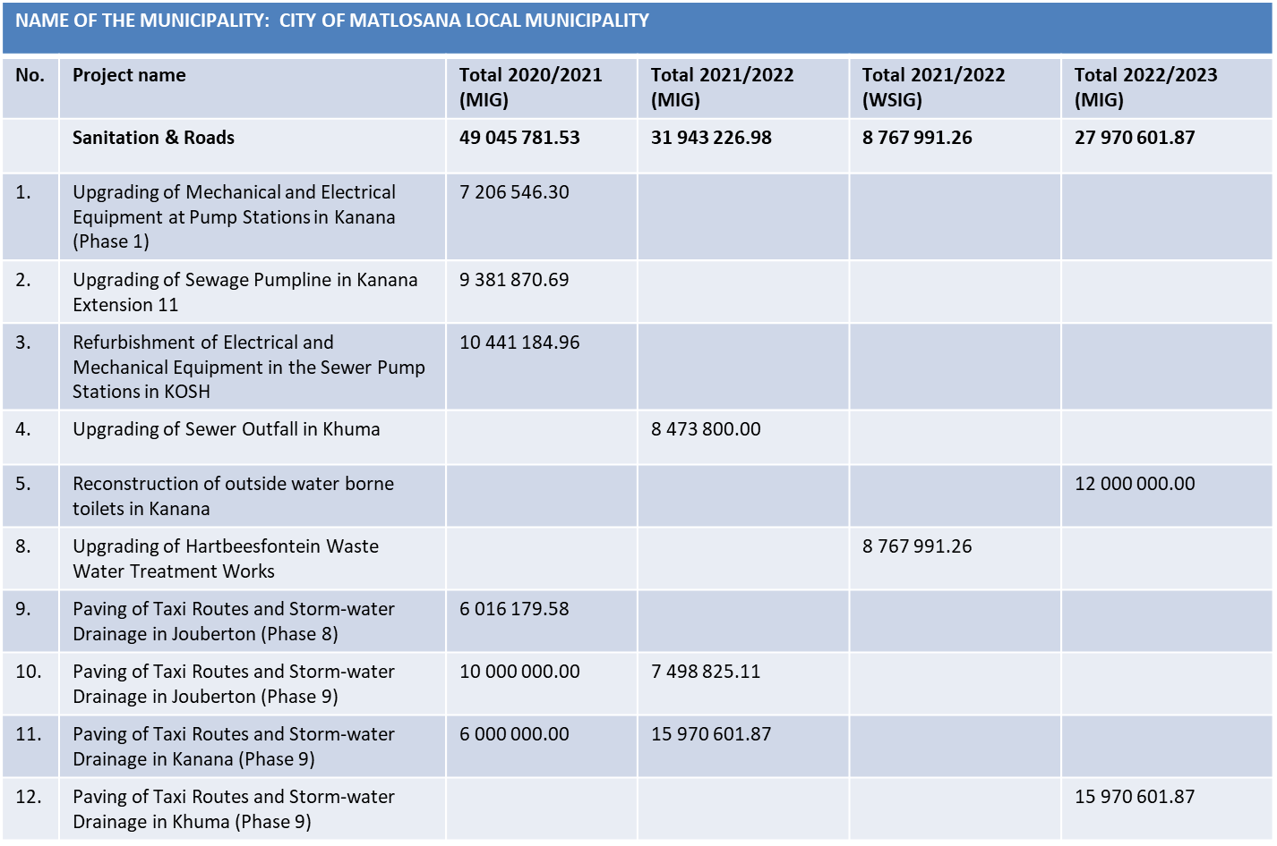
SANITATION & ROAD PROJECTS

Slide 28
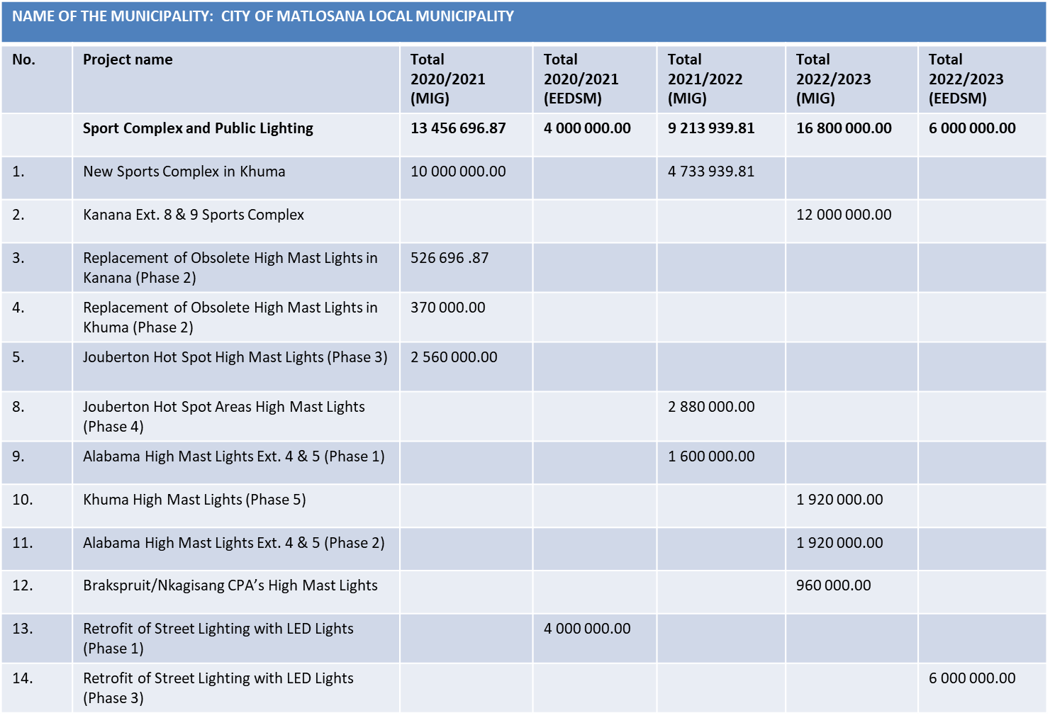
SPORTS COMPLEX AND PUBLIC LIGHTING

Slide 29
5. BREAKDOWN OF THE UNAUTHORIZED, IRREGULAR, FRUITLESS AND WASTEFUL EXPENDITURE

Slide 30


Slide 31
Opening balance R2 046 897 086
Current year - R 481 430 090
Total R2 528 327 175
Unauthorised expenditure in non-cash and is caused by the Debt Impairment (R940 037 517) and Depreciation (R411 945 633)
This is caused by the tariffs which are not cost reflective leading to an unfunded budget

Slide 32
IRREGULAR EXPENDITURE

Slide 33
5. FRUITLESS EXPENDITURE

Slide 34
UIF&W
All instances of UIF&W are timeously reported to section 32 committee
An independent legal and accounting firm were contracted to investigate the instances of UIF&W
The firm completed the first phase and recommended that the unauthorised expenditure of R2 046 billion be written off as irrecoverable
The report has however not been finalised at council

Slide 35
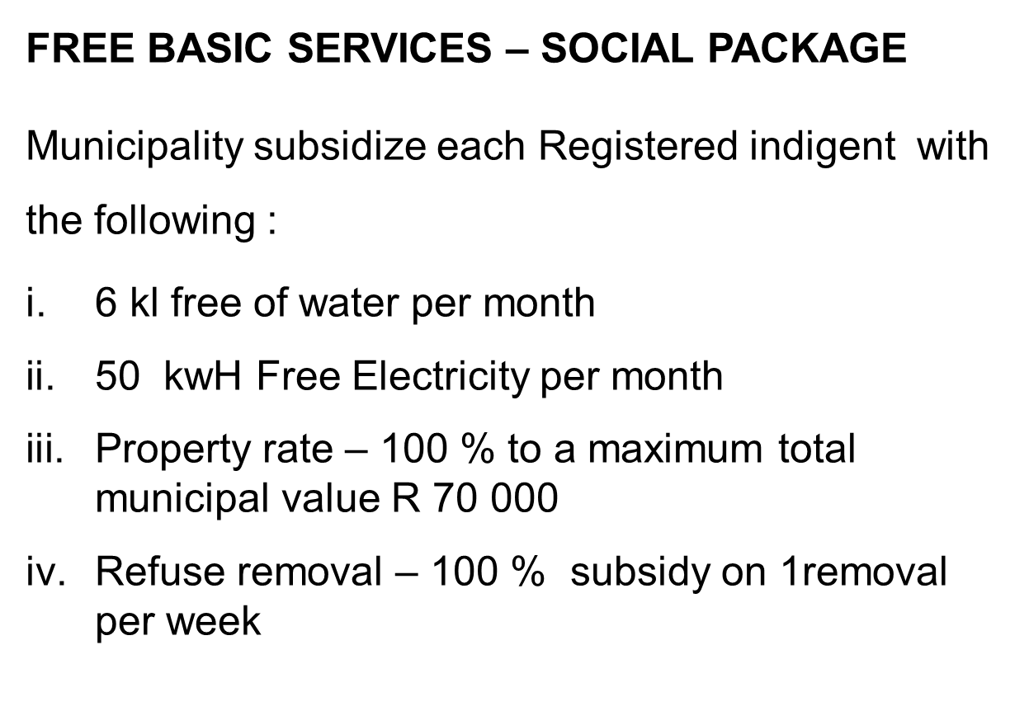
FREE BASIC SERVICES

Slide 36
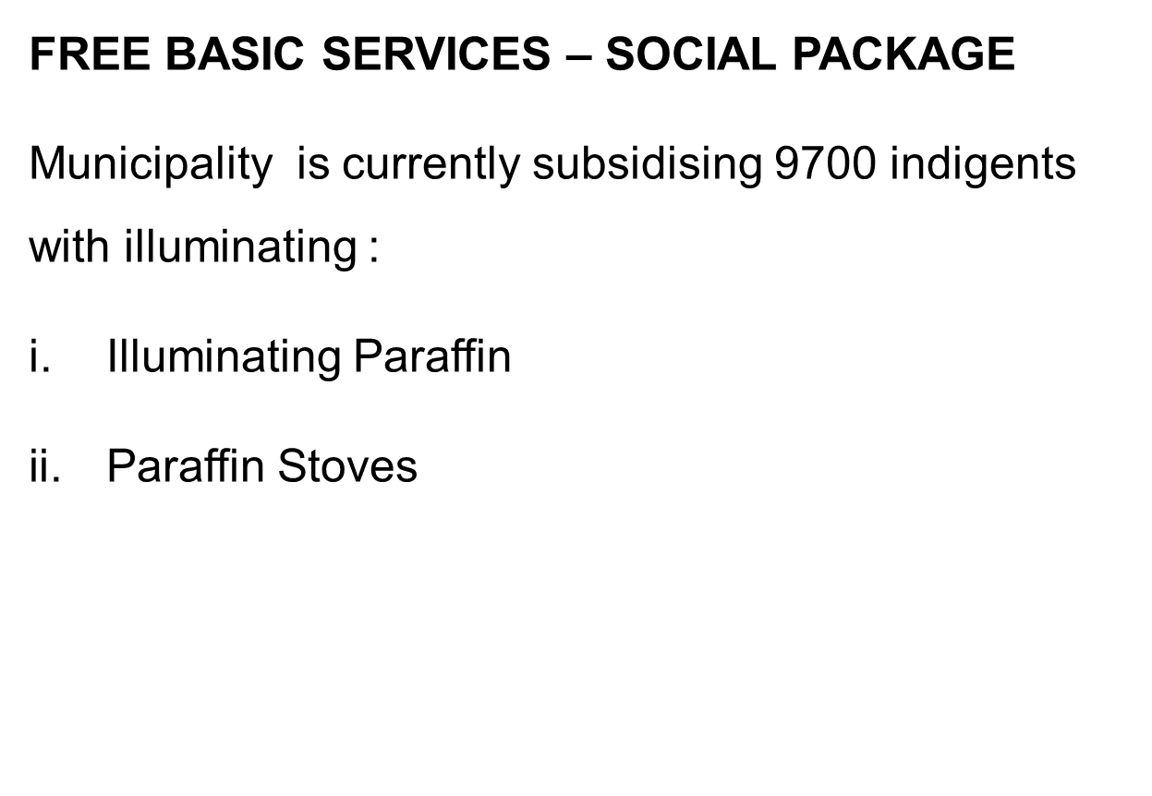
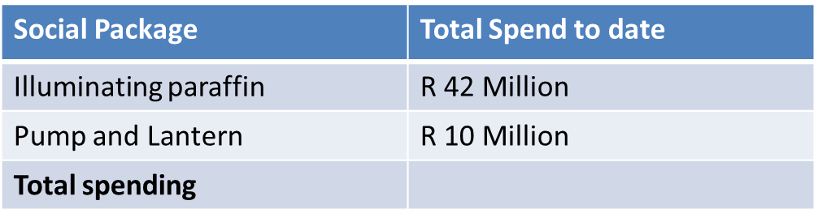
FREE BASIC SERVICES

Slide 37
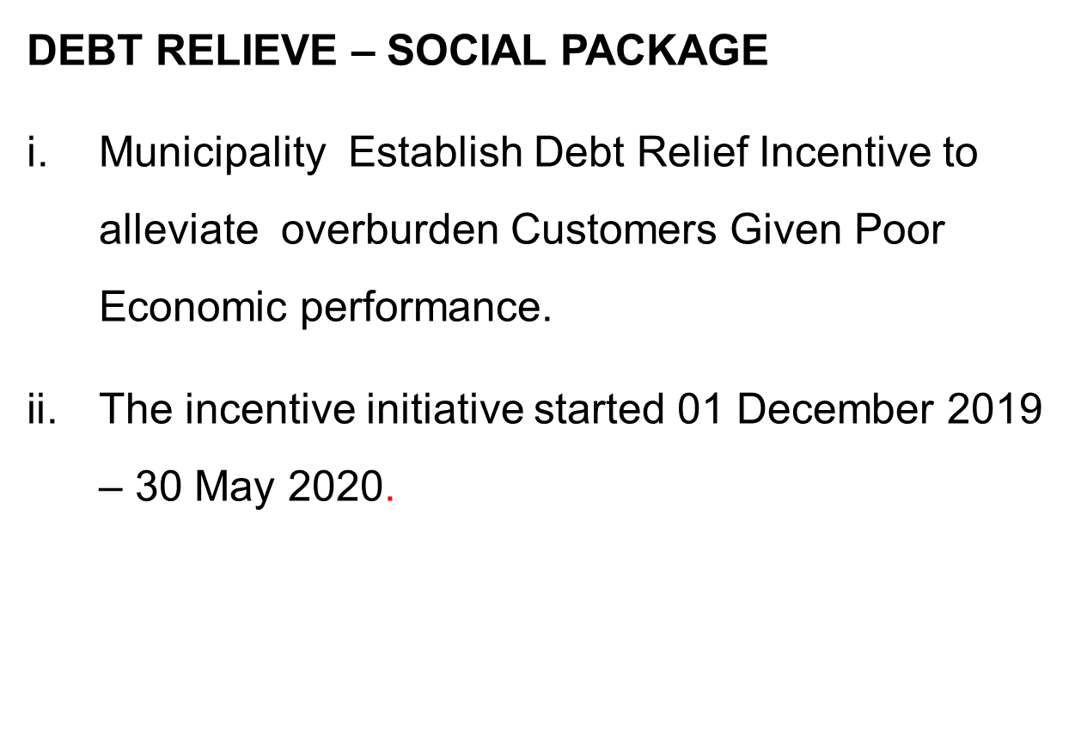
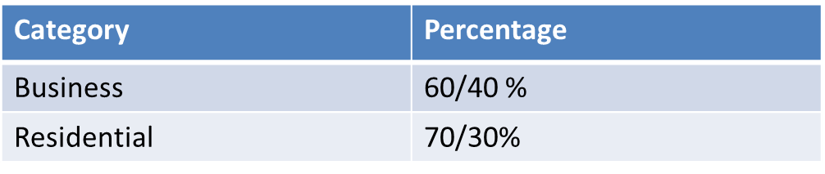
DEBT RELIEVE

Slide 38
6. CONSEQUENCE MANAGEMENT

Slide 39
Disciplinary Board has been established consisting of:
1. Chairperson of Audit committee
2. Delegate from Provincial Treasury
3. Internal Legal Services Manager
4. Acting Chief Audit Executive
At the moment there is one case relating to a loss of R21m in the books of the Fresh Produce Market.
Two officials have signed the Acknowledgement of Debt.
Two processes are unfolding namely criminal case investigation by the HAWKS and forensic investigations by an appointed Forensic Investigation company.

Slide 40
7. INSTITUTIONAL CAPACITY

Slide 41
7. INSTITUTIONAL CAPACITY
A revised organogram was discussed during a Strategic Planning session held in 2019.
Revised organogram must still be approved by Council.
Total approved posts – 2530
Total filled posts – 1988
Total vacancies – 542
Vacancy rate – 21%

Slide 42
7. INSTITUTIONAL CAPACITY
Position | Status | Contract Expiry
Municipal Manager | Filled | 30 April 2022
Chief Financial Officer | Filled | 28 February 2025
Director – LED | Filled | 29 February 2024
Director – Technical | Filled | 31 January 2023
Director - Corporate | Filled | 31 January 2023
Director – Community | Filled | 31 January 2023
Director – Public Safety | Filled | 31 January 2023
Director - Planning | Filled | 29 February 2024

Slide 43
8. INTERNAL AUDIT COMMITTEE
(CAPACITY, FUNCTIONALITY AND EFFECTIVENESS)

Slide 44
THE FUNCTIONALITY OF INTERNAL AUDIT
Completion of approved Internal Audit Plan timeously
Performing and completing Ad-Hoc Audit requested by management
Review of procurement through regulation 32 and deviations
Evaluate Controls on cashier management
Review of participation on transversal contract
Review quotations from some departments
Review adequacy of Project Specifications

Slide 45
Performed consulting work, advice on development of controls, registers, policies and procedure manuals, and further provide advices through attendance of departmental meetings.
Reviewed Audit Action Plan
Performing quarterly audits on Predetermined Objectives.
Through the efforts of Internal Audit Activity, the new dynamic, energetic and progressive Audit Committee members has been appointed and meetings are held as scheduled and legislated.
Providing value-adding recommendations.
Commenced with the process of developing combined assurance model.

Slide 46
EFFECTIVENESS: Matters that served before the Audit Committee in 2019/20
Audit Strategy – AGSA
Quarterly Internal Audit Activity Reports
Quarterly Internal Audit report on completed audits
Quarterly Financial reports
Quarterly Supply Chain Management reports
Quarterly Information Technology reports
Audit readiness plan
Post Audit Action Plan
Audit Committee Schedule of Meetings
Internal Audit and Audit Committee Charter
Internal Audit Three Year Rolling Plan and One Year Plan
Quarterly Service Delivery and Budget Implementation Plan
Quarterly Litigation Reports

Slide 47
CAPACITY OF INTERNAL AUDIT COMMITTEE
MEMBERS OF AUDIT COMMITTEE
Member Name | Capacity
Ms Mpho Mathye (IAT)(PIA) | Chairperson
Ms Sijabulile Makhathini CA (SA) | Member
Mr Jack Ramakgolo (CCSA)(CFI) | Member
Mr Thapelo Mocwaledi CA(SA)RA | Member

Slide 48
9. MPAC
(capacity, functionality and effectiveness)

Slide 52
OVERALL CHALLENGES OF THE MUNICIPALITY

Slide 53
CHALLENGES
The municipality has been without a Mayor for over a month
The municipality has not implemented cost reflective tariffs since its inception leading to under recovery for service provided
As a results the costs of the municipality exceed the revenue
Eskom charges time-of-use tariffs leading to double their summer charges in winter whereas the municipality charges a flat tariff throughout the year
The municipality has a serious shortage of staff as a results of retirements
The electricity losses amounts to 29% and water losses account for 35% as a results of illegal consumption and old infrastructure

Slide 54
CONCLUSION
We are completely indebted to all who have the interest of changing the hope and fortunes of our Municipality to become a developmental municipality that better deliver services to its citizens.

Slide 55

Thank You!

