Slide 1


Revised Strategic Plan
2020/21 - 2024/25
and
Annual Performance Plan
2020/21

Slide 2



Our Strategic Focus

Slide 3

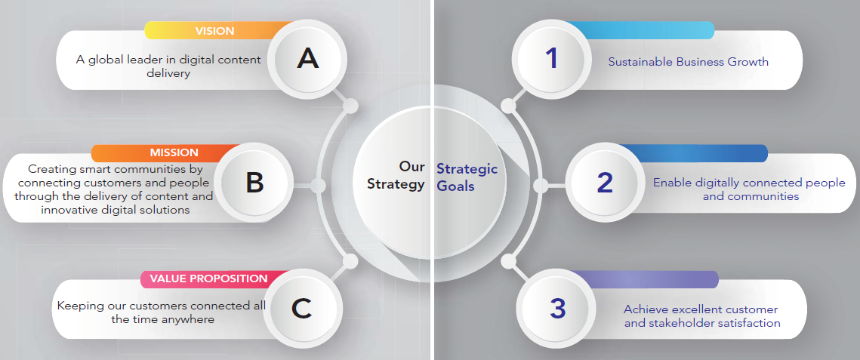
Strategic Focus, Vision, Mission and Values
Vision, Mission and Values

Slide 4
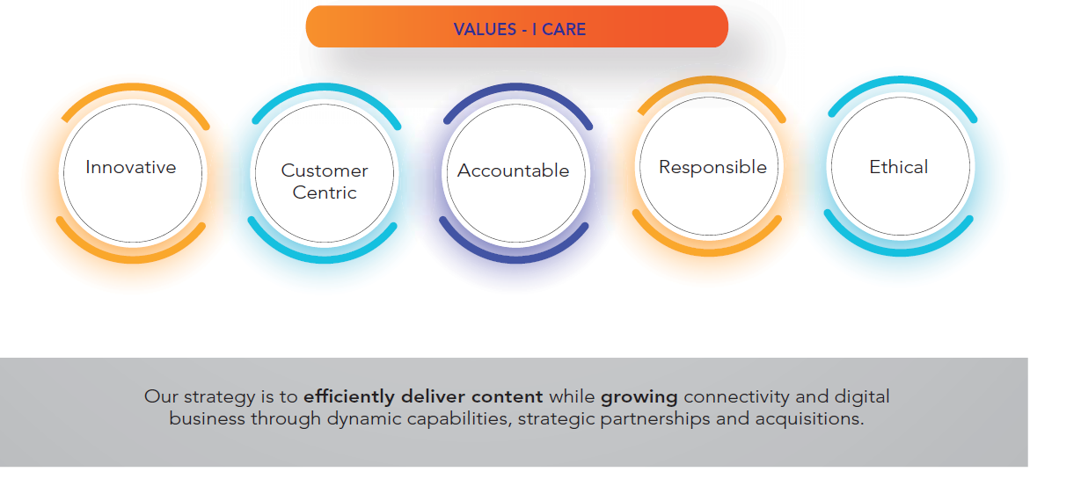
Strategic Focus, Vision, Mission and Values
Vision, Mission and Values

Slide 5
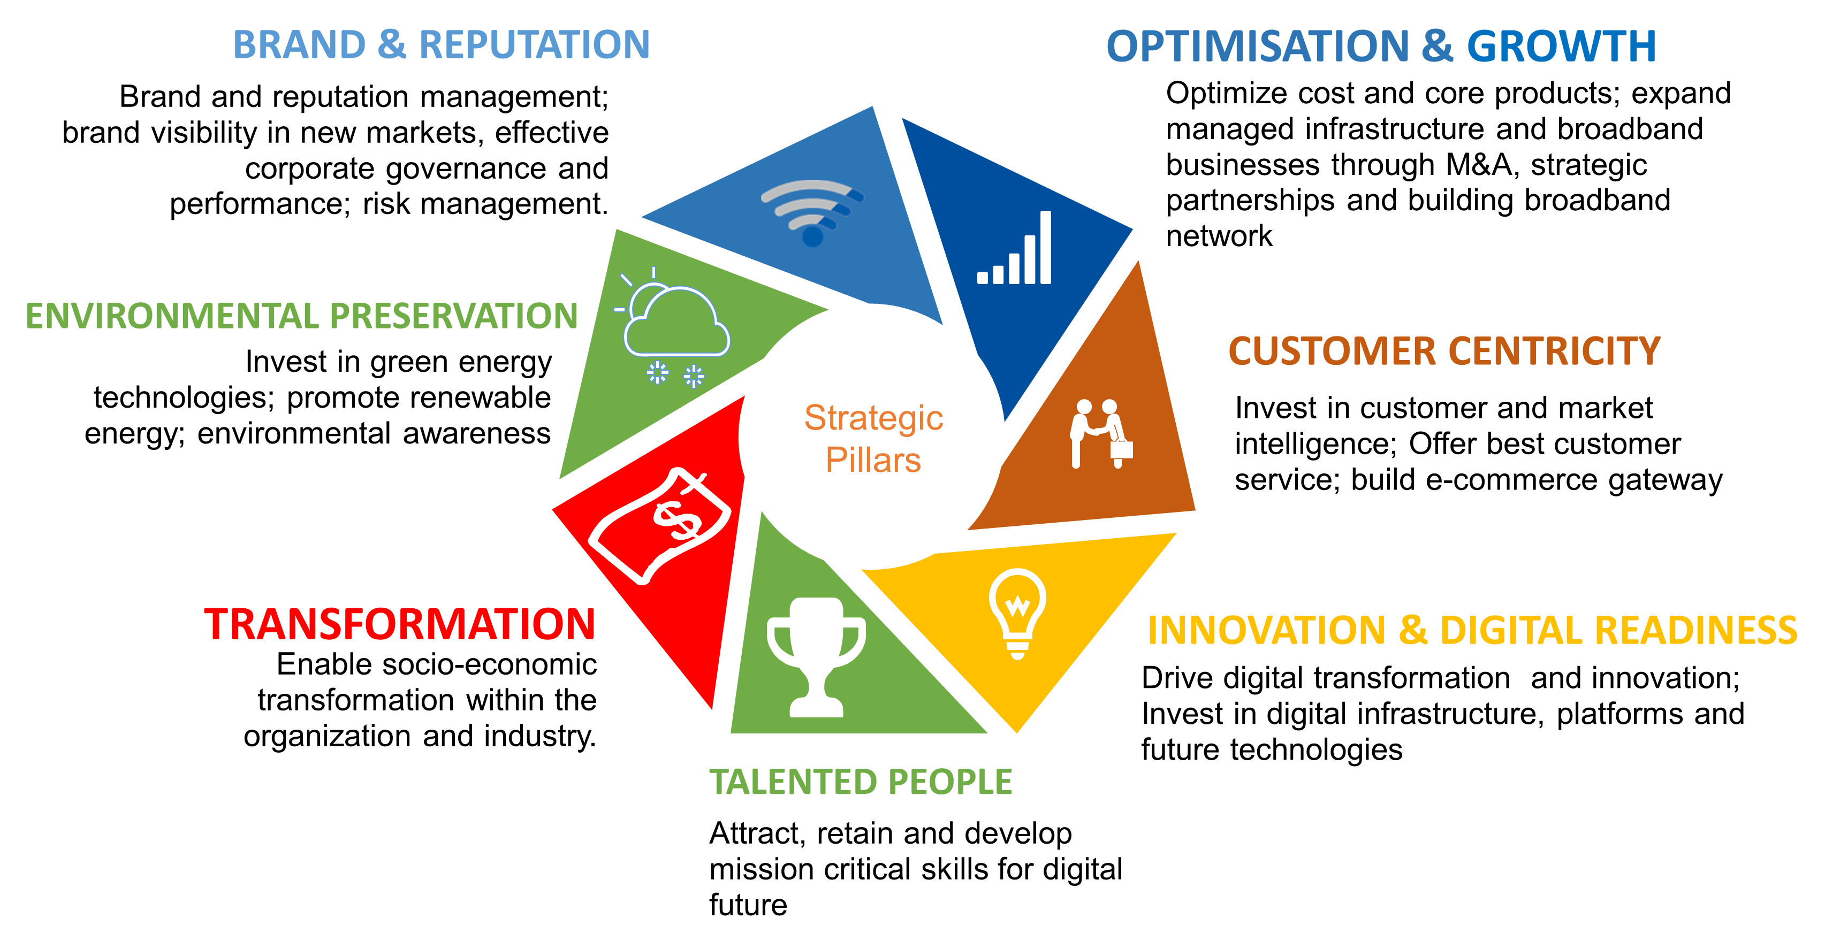
Business Strategy :
7 Strategic Pillars

Slide 6
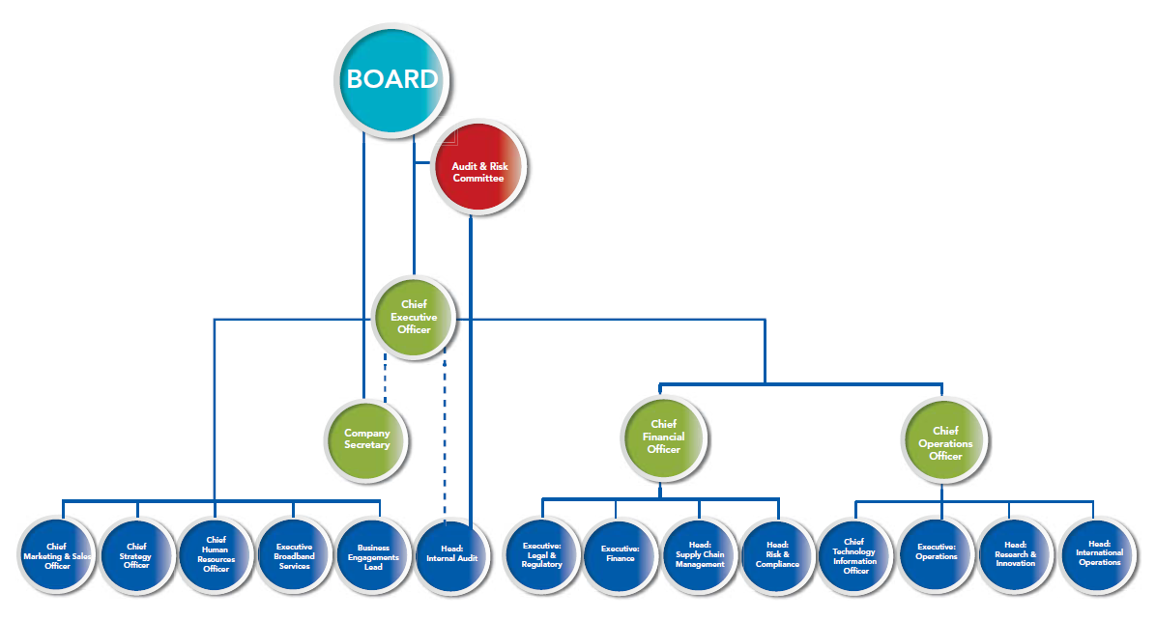
Organizational Structure
Measuring our Performance and APP
Vision, Mission and Values

Slide 7
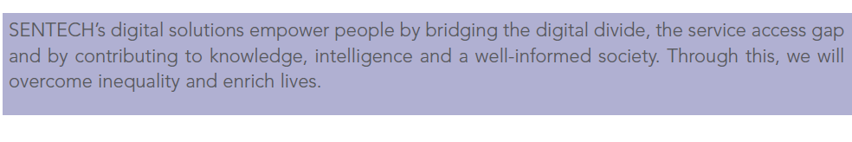
Impact Statement

Slide 8
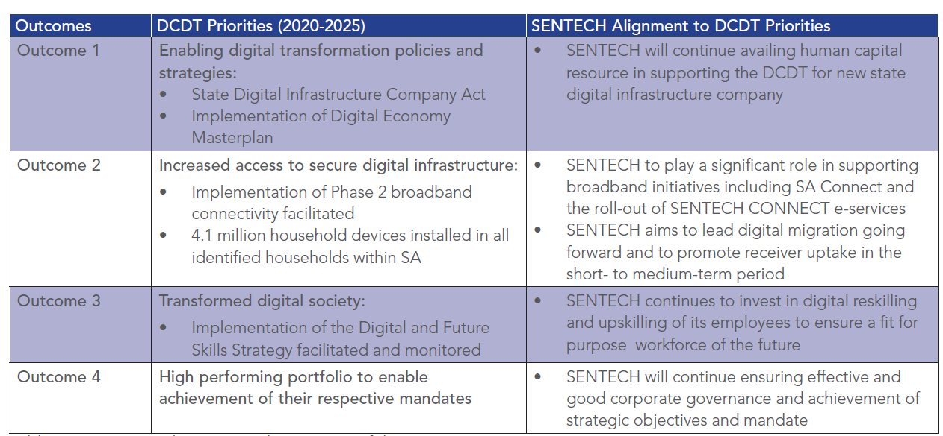
Alignment with Shareholder Priorities

Slide 9
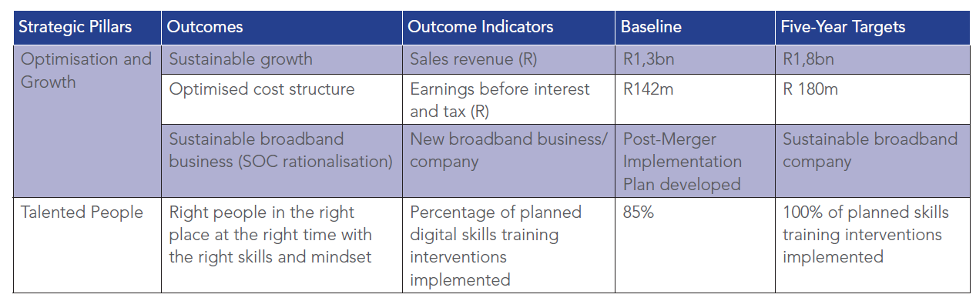
Five-Year Strategic Plan FY 2020/21–2024/25

Slide 10
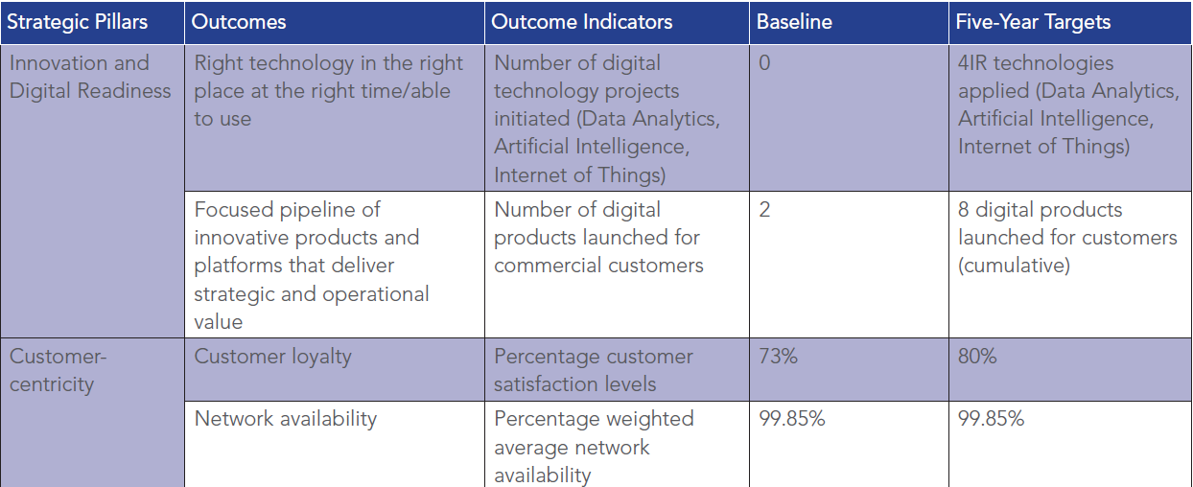
Five-Year Strategic Plan FY 2020/21–2024/25

Slide 11
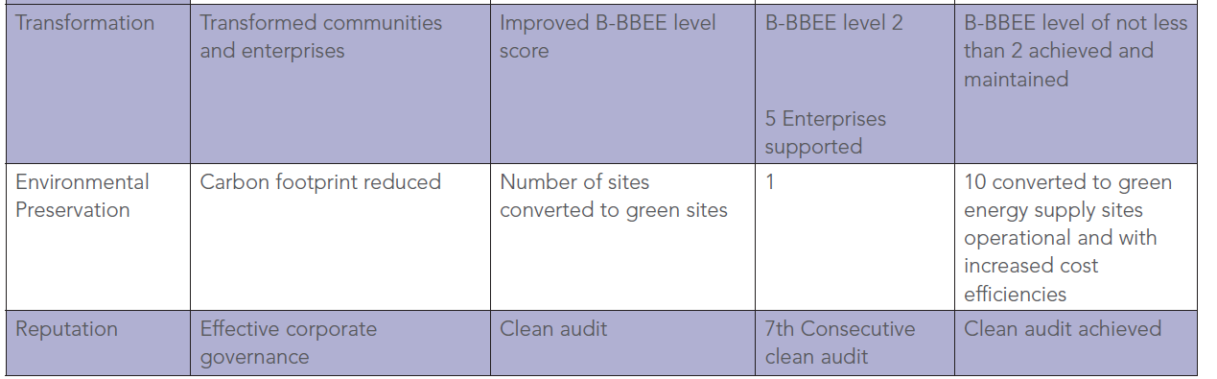
Five-Year Strategic Plan FY 2020/21–2024/25

Slide 12
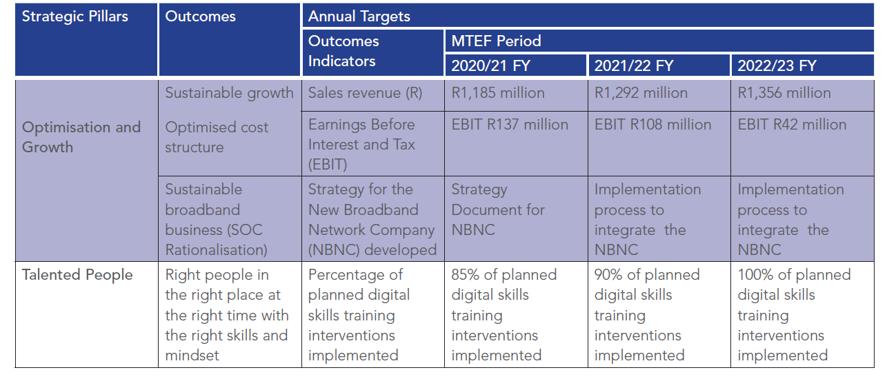
Performance Indicators for the MTEF Period 2020/23

Slide 13
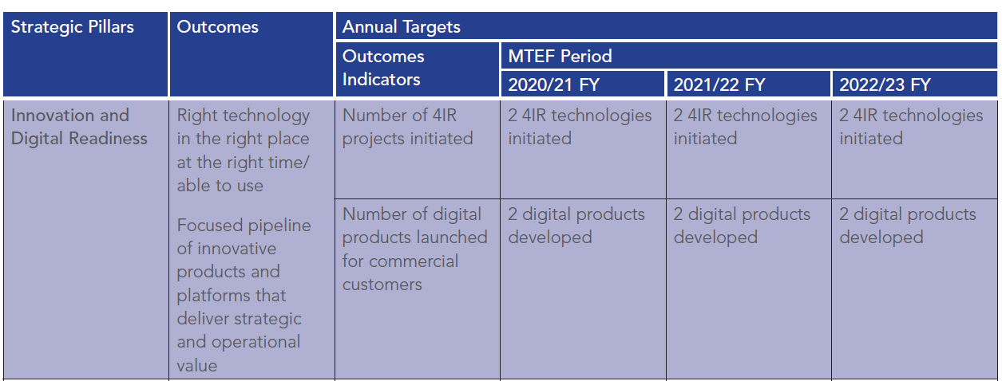
Performance Indicators for the MTEF Period 2020/23

Slide 14
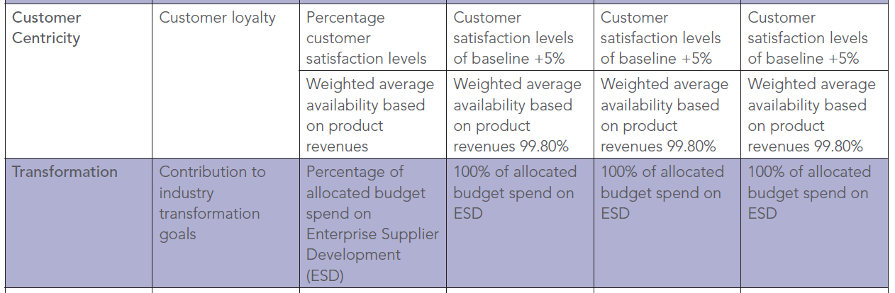
Performance Indicators for the MTEF Period 2020/23

Slide 15
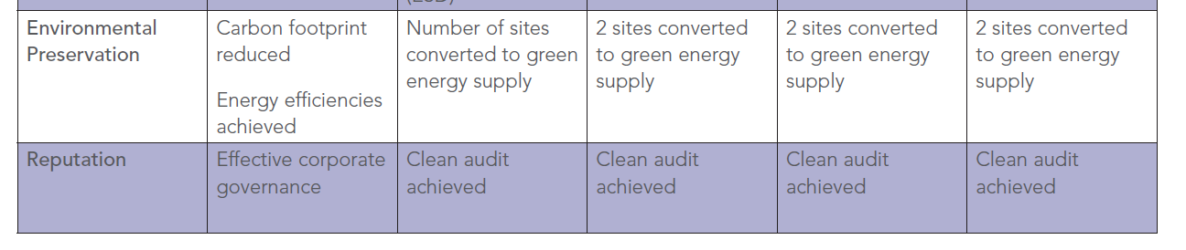
Performance Indicators for the MTEF Period 2020/23

Slide 16
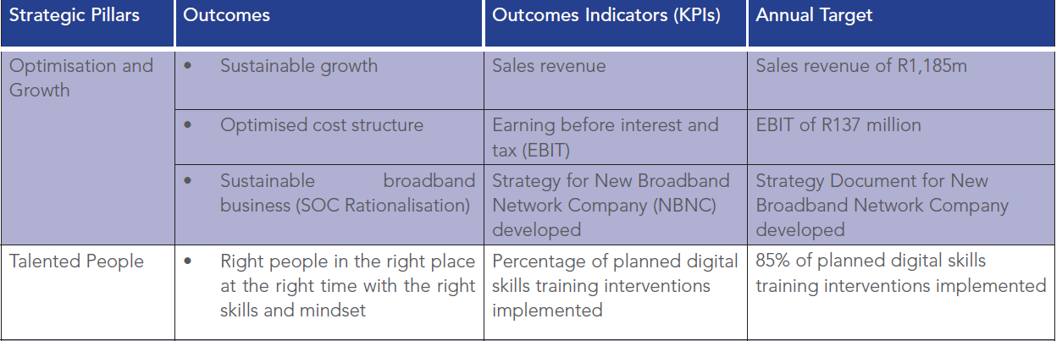
Annual Performance Plan
(FY 2020/21)

Slide 17
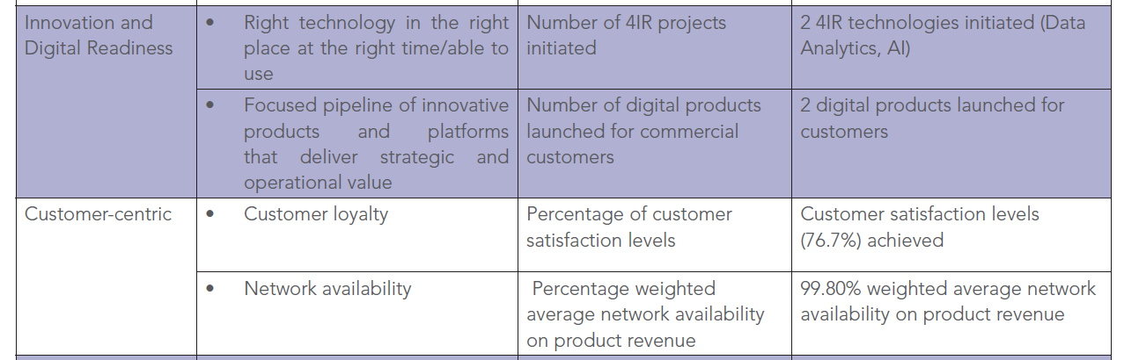
Annual Performance Plan
(FY 2020/21)

Slide 18
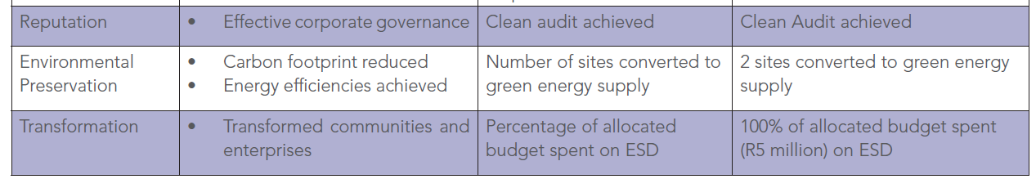
Annual Performance Plan
(FY 2020/21)

Slide 19
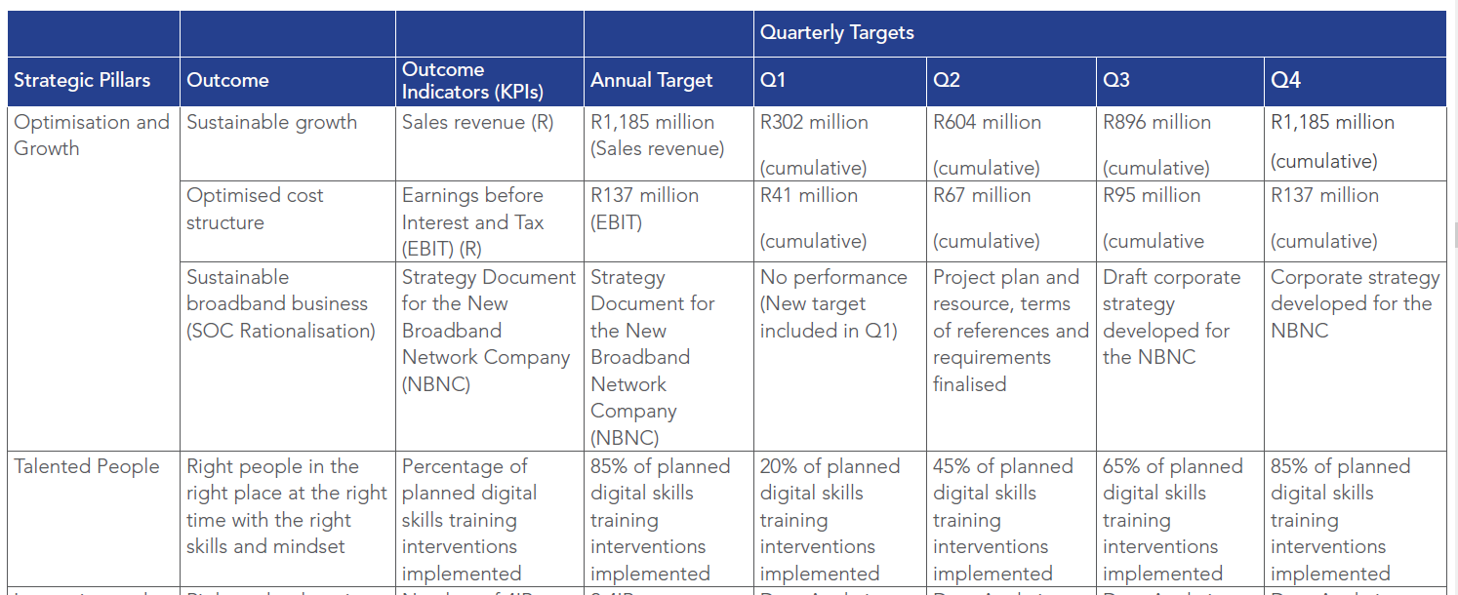
Annual Performance Plan – Quarterly Targets FY2020/21

Slide 20
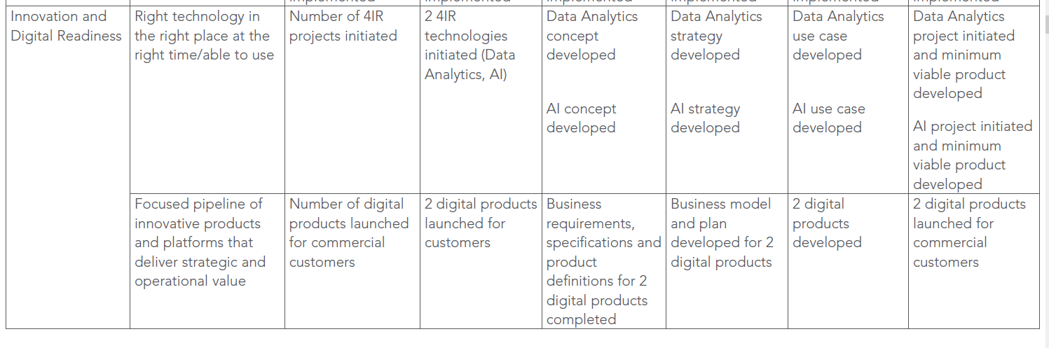
Annual Performance Plan – Quarterly Targets FY2020/21

Slide 21
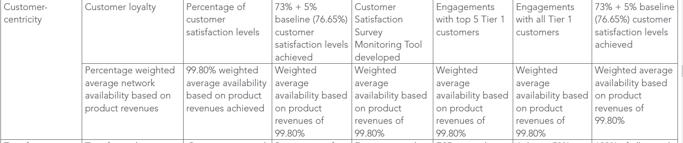
Annual Performance Plan – Quarterly Targets FY2020/21

Slide 22
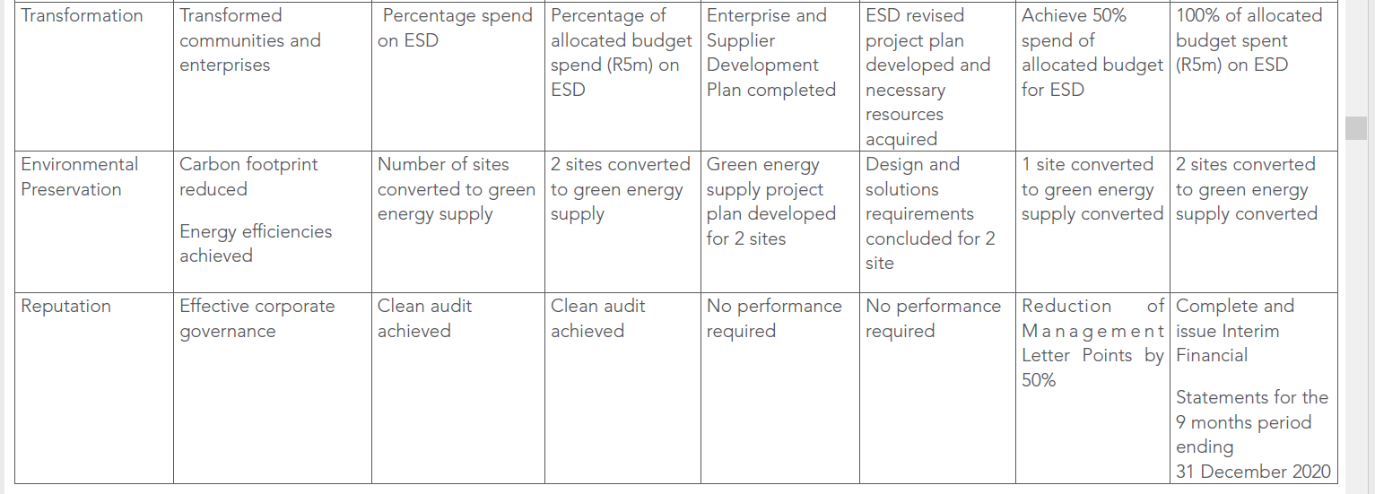
Annual Performance Plan – Quarterly Targets FY2020/21

Slide 23
Financial Plan

Slide 24
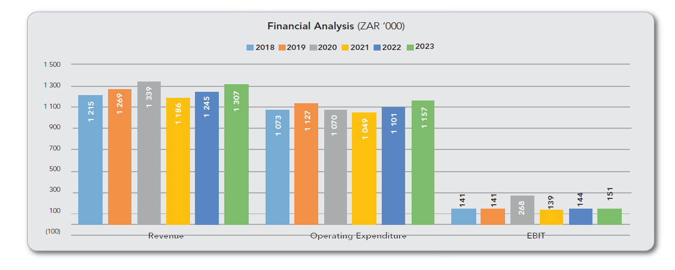
Financial Analysis
2018 - 2023
Annual Performance Plan – Quarterly Targets FY2020/21
The 2020/21 financial year operating expenditure incorporates cost containment initiatives, and focused initiatives to address revenue stagnation through enhancing the connectivity business solution and evaluation of growth opportunities to drive the acquisitive diversification
strategy.
Government has funded most of the dual illumination incremental costs since the digital signal
was switched on back in 2008, and
likewise allocated such funds for the
MTEF period.

Slide 25
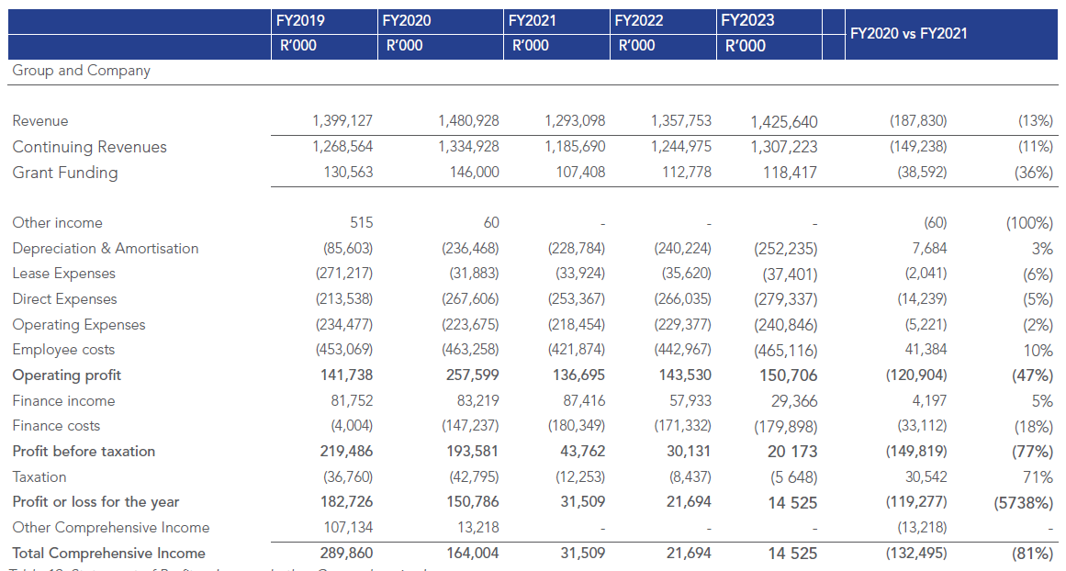
Annual Performance Plan – Quarterly Targets FY2020/21
Statement of Profit or Loss and other Comprehensive Income

Slide 26
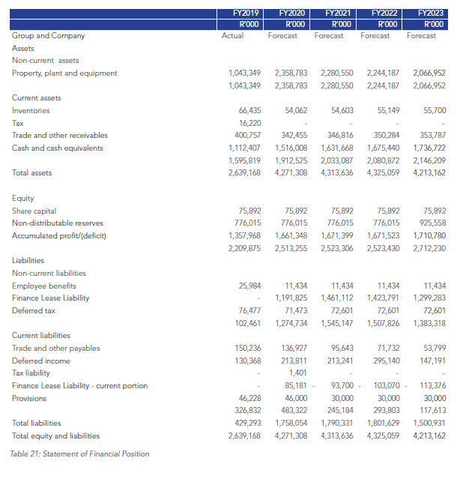
Annual Performance Plan – Quarterly Targets FY2020/21
Statement Of Financial Position
Q&A Discussion

