Slide 1
Presentation on PRASA 2019/2020 Audit Outcomes to the
Standing Committee on Public Accounts
24 November 2020

Slide 2
CONTENT
2019/2020 Financial Year at Glance
Audit Outcomes
Addressing the Findings from the AGSA
Financial Performance
Delivering on the Mandate
Repositioning PRASA to Deliver on its Mandate
Concluding Remarks

Slide 3
2019/2020 Financial Year at a Glance

Slide 4
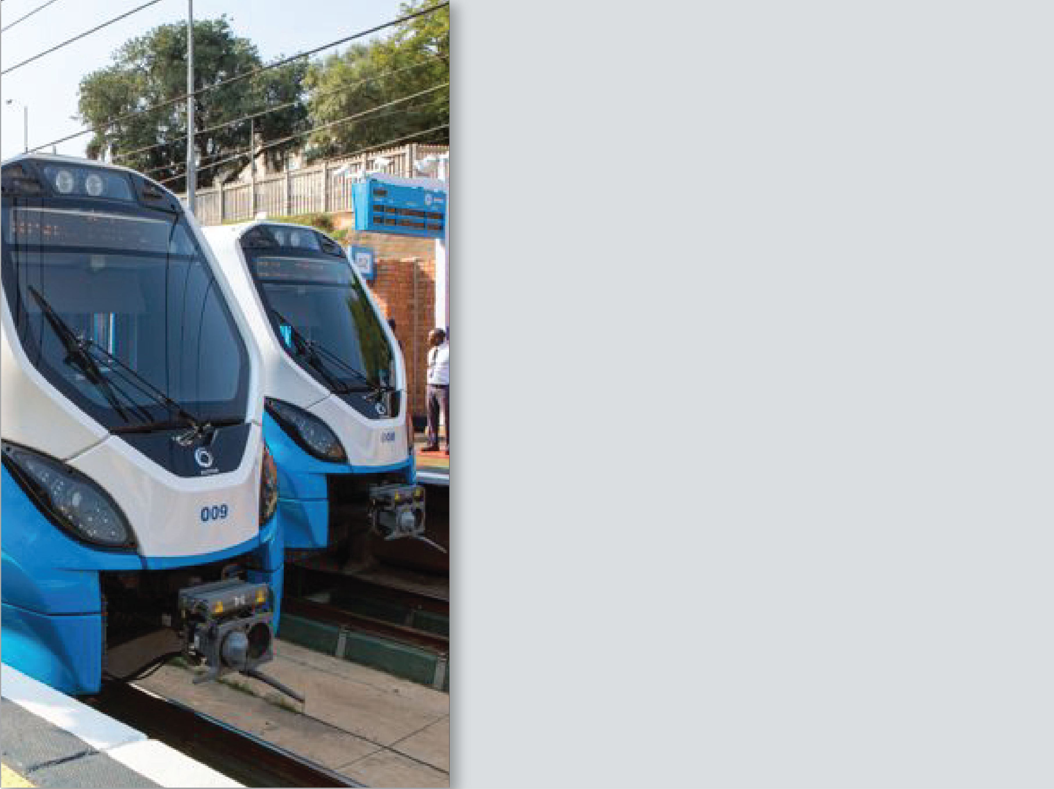
2019/2020 Financial Year at Glance
  Instability at Board of Control, leadership and key positions.
  No permanent Group Chief Executive Officer and Chief Financial Officer, with the later being in place for a limited period.
  Minister dissolved the Board of Control and appointed the Administrator.
  Protracted litigation on the appointment of the Administrator and security contracts
  Rampant theft and vandalism of the infrastructure.
  Limited capacity to implement capital programme.
  The advent of the COVID-19 pandemic.

Slide 5
2019/2020 Audit Outcomes

Slide 6
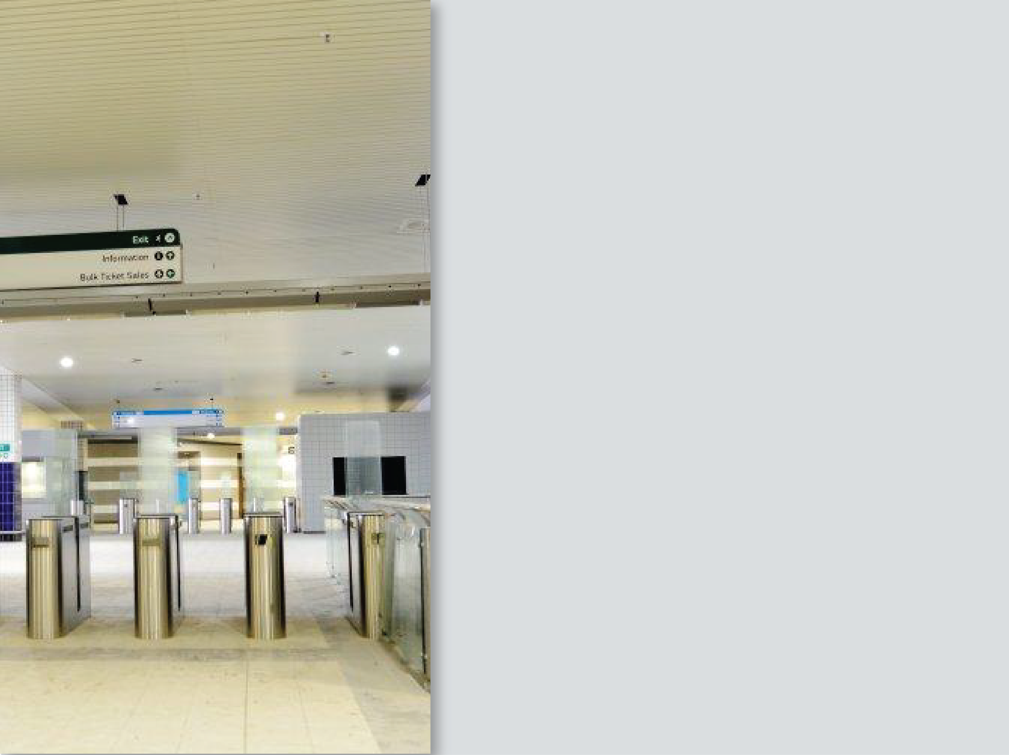
Audit Opinion
PRASA 2019/2020 audit outcome is Disclaimer with findings.
The Auditor-General South Africa highlighted the following as root causes:
    Inadequate governance records.
    Instability in key positions.
    Poor financial management and record keeping.
    Lack of compliance monitoring and enforcement
    Lack of consequence management.
    Inadequate audit findings action plan.
    Lack of effort to resolve matters related to PRASA’s financial viability and that of its subsidiaries.
    Inadequate oversight.

Slide 7
Overview of Audit Findings
2018/19 & 2019/20 Comparison
Marginal overall decrease in number of findings from 173 to 120.
An increase in Qualification matters and these will form the basis of our remedial actions.

Slide 8
Addressing the Findings from the AGSA

Slide 9
Addressing the Audit Findings
  Minister has appointed the Board of Control and the following Board Committees have been established:
    Audit and Risk;
    Human Capital and Remuneration;
    Safety, Health, Environment and Quality (SHEQ);
    Finance, Capital Investment and Procurement; and
    Governance and Performance.
  Significant progress in filling key positions including:
    PRASA RAIL CEO (June 2020)
    Chief Security Officer (August 2020)
    PRASA CRES CEO (September 2020)
    Autopax CEO (September 2020)
    Chief Information Officer (July 2020)
    Group Company Secretary (July 2020)
  The Board is urgently attending to the appointment of the Group Chief Executive Officer.

Slide 10
Addressing the Audit Findings…cont’d
Key Performance Indicators (KPIs) | Status Update
Operation Clean Audit Report Team (OPCAT) established % of remedial actions implemented All Material Irregularities (MIs) investigated and resolved % of control environment improvement recommendations Implemented | In addressing the audit findings, PRASA has established a an Operation Clean Audit Report Team (OPCAT) on Audit Findings. The OPCAT meets bi-weekly to track progress on implementation of the Audit Action Plan. Progress on addressing the 2018/2019 audit findings is reflected overleaf. Group Internal Audit is auditing the portfolio of evidence on measures implemented to address the findings. Progress reported to Group EXCO on a monthly basis and subsequently to the Audit and Risk Committee quarterly. PRASA concluded Secondment Agreement with Special Investigating Unit (SIU). SIU has seconded four resources to PRASA for a period of six months to investigate seventeen (17) Material Irregularities which were identified by AGSA. Further initiatives are underway to establish a dedicated Internal Control Function to address the weaknesses in the control environment. Statutory audit findings are systemic in nature and would require adequate resourcing to address them.

Slide 11
Addressing the Audit Findings…cont’d
Initiative | Accountable | When
PRASA has established a an Operation Clean Audit Report Team (OPCAT) on Audit Findings which meets on a bi-weekly basis to track progress on implementation of Audit Action Plan | AGCEO | Completed
An executive Forum on PFMA Financial Misconduct has been established. The Forum is focused on remediation of losses due to criminal conduct, irregular expenditure and fruitless and wasteful expenditure. The Forum meets monthly | ACHCO | Completed
Progress on addressing the 2018/2019 audit findings: Group Internal Audit is auditing the portfolio of evidence on measures implemented to address the findings. | GM: Risk | 30 November 2020
Progress on remediation of audit findings reported to Group EXCO on a monthly and Audit and Risk Committee on a quarterly basis. | GM: Risk | Monthly and Quarterly
PRASA concluded Secondment Agreement with Special Investigating Unit (SIU): SIU has seconded four resources to PRASA for a period of six months to investigate seventeen (17) Material Irregularities which were identified by AGSA. | CHCO | Monthly
Initiative are underway to establish a dedicated Internal Control Function to address the weaknesses in the control environment. | AGCEO | 31 March 2021
Statutory audit findings are systemic in nature and would require adequate resourcing to address them. Accordingly skills audit will be undertaken and appropriately qualified personnel will be appointed in key positions. | ACHCO | 31 January 2021

Slide 12
Addressing the Audit Findings (Asset Management)…cont’d
Initiative | Accountable | When
Brief CEO’s and CFO’s on revised Asset Management Approach | Group Finance Asset (GFA) | Completed
Requests Departmental Asset list as per SAP asset register from GFA (all businesses) | Group Finance Asset (GFA) | 30 November 20
Unbundling of SAP Asset Register to divisions | ICT (SAP) | 15 December 2020
Perform divisional asset tagging, verification, and conditional assessment | Divisional CEO’s and CFO’s | 01 December 2020 – 19 February 2021
Prepare progress reports on Asset Management: (submit to GFA ) – Status of assets | Divisional CEO’s and CFO’s | 15 December 2020 - monthly
Review and reconcile verification reports with SAP and vice versa. | GFA, Divisional CFO’s | 30 December 2020 - monthly
Assets not found on floor but in register - follow de-recognition process | GFA, Divisional CFO’s | 30 December 2020 - monthly
Assets found on the floor but not in register – follow recognition process | GFA, Divisional CFO’s | 30 December 2020 - monthly
Redundant/Obsolete/Surplus assets found during verification – follow disposal process | GFA, Divisional CFO’s | 30 December 2020 - monthly
Sign off Departmental Asset Register (DAR) | Divisional CEO’s and CFO’s | 30 December 2020 - monthly
SAP Asset Register updated | Divisional CEO’s and CFO’s | 30 December 2020 - monthly
Financial close process by Group Finance | GCFO and Financial Reporting | 30 December 2020 - monthly
Internal audit evaluation of asset register (completeness, validity and accuracy) | Internal Audit | 15 March 2021

Slide 13
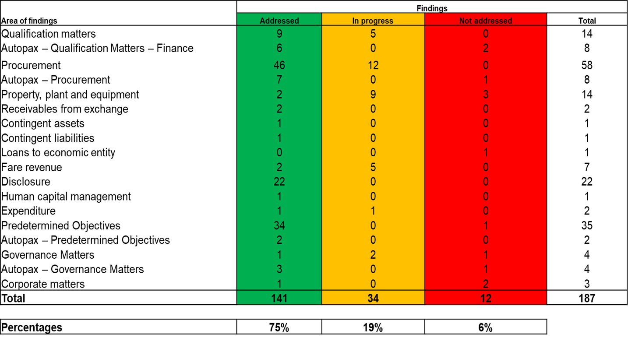
Progress in Resolving the2018/2019 Audit Findings ….cont’d

Slide 14
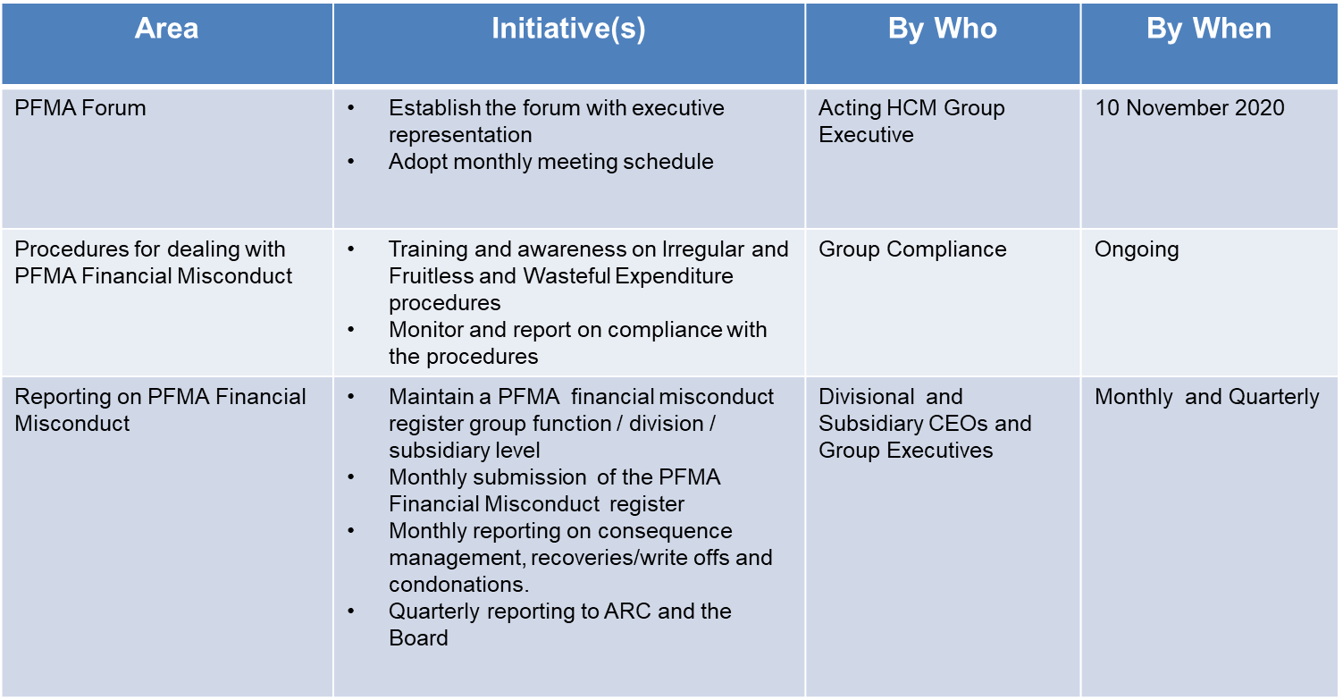
Addressing Unauthorised, Irregular, Fruitless and Wasteful expenditure

Slide 15
Irregular Expenditure Analysis
  Decline but still material requirement to limit
  Current year : R1.3bn (2019: R3bn)

Slide 16
Irregular Expenditure Analysis …..cont’d
  Major contributors:
    Competitive bidding not followed
    SCM policy not followed

Slide 17
Fruitless and Wasteful Expenditure Analysis
  Decline but requirement to limit
  Current year : R48m (2019: R51m)
  Long outstanding debt contributes to contractual interest

Slide 18
Fruitless and Wasteful Expenditure Analysis...cont’d
  Major contributors:
    Interest and penalties
    Incorrect rates for Sunday time

Slide 19
Addressing Malfeasance
Four (4) senior officials in the Protection Services Department were dismissed for procurement related irregularities in the awarding of security contracts.
Assistant Manager in the Engineering Services Department, has been dismissed on 13 counts of Gross Negligence and Gross Dishonesty, in respect of procurement related irregularities.
A Senior Manager in the Engineering Services Department was dismissed on 11 counts of Gross Negligence and Dishonesty, in respect of procurement related irregularities.
Undertaking further investigations and disciplinary processes against officials in various departments, for procurement related irregularities.
The SIU is investigating 28 matters in PRASA and secondment of resources to assist with MI.
The DPCI is investigating twenty-one (21) case dockets emanating from the Public Protector’s Derailed Report , No:3 of 2015 and Report No:7 of 2019/2020.
Eighteen (18) further case dockets have been opened for matters contravening the Public Finance Management Act by the DPCI.

Slide 20
Addressing Malfeasance
CONSEQUENCE MANAGEMENT
 | 2018/19 | 2019/20 | 2020/21
No. of employees dismissed for PFMA and other financial irregularities | N/A | 6 | 8
No. of employees dismissed for other offences, e.g. absenteeism, assault, sexual harassment, insubordination, dishonesty etc. | 222 | 148 | 96
No. of employees facing disciplinary action for PFMA and other procurement related offences | N/A | 10 (6 dismissed) | 17 (8 dismissed
No. of employees currently facing disciplinary action for other offences | N/A | N/A | 48
No. of employees currently under investigation for PFMA and other procurement related offences | N/A | N/A | 6
No. of employees who resigned | 198 | 192 | 79
No. of employees who resigned to avoid dismissal. PRASA is seeking a legal opinion on how to take the matter forward | N/A | 1 | 0
No. of Board members being investigated by SIU | N/A | N/A | 2

Slide 21
Delivering on the Mandate

Slide 22
Delivering on the Mandate
2/9
Objective 13: Building Customer and Stakeholder Confidence
0/3
0/4
Objective 5: Managing and improving the Property condition Railway Stations & Workplace Facilities
Objective 11:
Effective Management of Capital Programme
0/4
Objective 7: Protecting People, Assets and Infrastructure
0/3
Objective 14: Planning for Growth and Network Expansions
1/7
2/11
Objective 12: Built to Last Redefining the Organization
Objective 4: Ensuring Reliability and Availability of the Service & Infrastructure
0/5
2/16
Objective 6: Improving Passenger Rail Travel Experience through Modernisation
Objective 10: Procuring for the Business
7/27
Objective 3: Improving Commuter and Passenger Travel Experience Metrorail
0/5
Objective 9: Exploiting the Assets through Property Development and Commercialization
5/12
Objective 2:
Improving the Financial Position
1/5
0/3
Objective 1: Strengthening Governance and Stabilizing the Organization
Objective 8: Asset management and maintenance
Achieved
In Progress
Not Achieved

Slide 23

Performance Summary 2019/20
1
Strengthening
Governance
&
stabilizing
organisation
2
Improving
PRASA financial Position
3
Improving Commuter
&
Passenger
Experience
4
Ensuring Reliability & availability of Service &
Infrastructure
5
Managing
&
Improving
Property
Condition
PRASA Governance Framework was developed but not implemented
Risk Management Framework implemented & monitored
87% performance contracting
5-year corporate strategy not implemented
Opex savings of 3.8% were achieved
Metrorail revenue R1075.96m budget versus R563.94m
47.6% below budget.
MLPS revenue R66.94m achieved against a budget of R140.77m, 52% below budget.
Autopax revenue R419m achieved against a budget of R774.48m, 46% below budget.
Operating subsidyR6.252bn planned and R8.276 actual, virement for Eskom and NTM reinstated employees R2.1bn
MLPS had a total of 1731 trains planned versus 931 trains ran due to lack of locomotives.
MLPS passenger numbers were below target by 55%, 463000 passengers versus 205884 actual.
Bus trips at Autopax were below target by 37% due to inadequate maintenance, spares, diesel. Resulting to a 40% reduction in customer numbers.
CSI at Autopax target was 80% versus actual of 53%.
RSR permit conditions achieved 8 out of 9. conditional permit granted up to June 2021
Availability of train sets below target by 62%, most lost due to cable theft and arson
General overhaul of coaches 99% below target as no contracts were awarded
No overhaul of MLPS coaches due to contracts not in place
Electrical faults increased by 150% due to load shedding, theft and vandalism
Temporary Speed restrictions covered 137km versus target of 100km
Depot modernization 100% behind schedule
National station upgrade not implemented due to delays on tender awards
MSPI awards-5 contracts were awarded

Slide 24
Performance Summary 2019/20…cont’d
6
Improving
Passenger Rail
Travel
Experience
7
Protecting People, Assets and Infrastructure
8
Asset
Management
&
Maintenance
9
Exploiting Assets through Property Development
10
Procuring for Business
Train sets provisionally accepted 50% (train sets planned versus actual 20/10)
Station modernization programme behind schedule, Philippi station,Oakmoor station, turnout and track replacement in Gauteng
Insourcing of security not implemented
Drones and armored vehicles not implemented.
Insourcing of security not implemented
Drones and armored vehicles not implemented
Integrated control rooms not implemented.
Implementation of SAP Maintenance not achieved
Inventory Management not achieved
Engineering Standards not Developed .
Real estate operating revenue was below by 2.5%.
Property revenue of R2.9m not achieved.
Optic fiber network of 282km not achieved
Revenue growth from optic fiber of R4.8m not achieved.
13% procurement achieved on Black women Owned businesses against target of 12%
Guidelines for open tender were developed
45% of BBBEE spend
12% of procurement was achieved from small enterprises.
Level 8 BBBEE Recognition for PRASA was not achieved.
.1% Supplier Development Spend not achieved
80% Availability of components not achieved

Slide 25

Performance Summary 2019/20…cont’d
11
Effective
Management of
Capital
Programme
12
Build to Last
13
Building
Customer &
Stakeholder
Confidence
14
Planning for Growth & Network Expansion
The PRASA Long-term plan not developed
PRASA Capital Projects Investment Committee not implemented
Spend on Capital achieved was R2.41bn against a budget of R10.2bn which was adjusted with R2.3bn of 2018/19 to R12.5bn
A standard Specification Document was developed , however not socialized.
Operating Model of PRASA not developed.
Establishment of One Real Estate Entity not Completed.
Establishment of One Engineering function not completed.
A workforce Plan of PRASA not completed
Organizational culture framework not completed
An integrated Wellness Programme not implemented
PRASA customer satisfaction was below target by 7.8%, 60% target versus actual of 52.24%
Group Communications Policy & SOPs developed but not implemented
Customer Help Desk not implemented
8 Station engagement sessions were achieved
Information displays at stations not completed due to Siyangena litigation
Stakeholder Engagement Framework and Plan implemented
24- hour PRASA call center not implemented
Customer newsletter not implemented
Rail expansion project –Motherwell, Blue Downs Rail and Daveyton Etwatwa not achieved

Slide 26
Performance 2019/20: Non-Achievements
Projects and actions requiring procurement and establishment of long- term contracts are the main reason for non-achievement of 23 indicators.
These in turn result in non-achievement of Operational Performance of Metrorail (4 indicators), MLPS (5 indicators), CRES (1 indicator), Financial (3) and Empowerment (4)
Thus total impact of overall procurement process from user requirement to Contract award of 43%.
Security of assets also impacted maintenance indicators (electrical, signals and perway), signaling upgrade, train set availability & configuration and therefore operations of especially Metrorail (Passengers, Revenue, Train performance, Customer satisfaction)
Autopax financial distress impacted 8 indicators.
Funding challenges that impacted implementation of HCM plans, Marketing and communications indicators & Asset Management,
A number of projects in ICT were not allocated Capital funding or specifications not ready.
Intersite indicators (4) due to inability to allocate capital to subsidiary and divisionalisation not complete

Slide 27
Financial Performance

Slide 28
Salient Financial Position
Group Revenue : R 16.2 bn (March 2019: R14bn)
Group Expenditure : R 14.0 bn (March 2019: R16.1bn)
Group Profit/(Loss) : R 2.3 bn (March 2019: (R2.1bn))
Group Profit/(Loss) : R 0.8 bn (March 2019: (R4.3bn))
(excluding non-cash items)

Slide 29
Revenue
Revenue (reflects constrained operation conditions):
  Subsidy – Operational and Capital grants (consistent YoY excl. capital conversion of R1.8bn)
  Declining fare revenue (R0.5bn) – Network and train availability and trips, fare evasion
  Interest income dependency

Slide 30
Expenditure
Expenditure (reflects inherent fixed cost structure):
  Staff costs – consistent year on year (R100m increase)
  Reduction in general expenditure mainly due to Swifambo impairment in 2019 – R2.3bn
  General expenditure comprises: Security, Municipal costs, materials, leases (including locomotives), Insurance, Health and Risk (cleaning and SHEQ), ICT costs (including data and communication)

Slide 31
Expenditure Analysis
Staff costs: material cost driver (52% cash outflow)

Slide 32
Balance Sheet
Property, plant and equipment:
  Additions (WIP) - R 2.8bn (March 2019 : R 3.7bn)
  WIP capitalised - R 4.0bn (March 2019 : R 1.1bn)
Prepayment (Gibela) - R 8.3bn (amortisation of trains)
Cash and cash equivalents - R24.2bn (increase in deposits mainly due to unspent capex)
Capex spend - R 2.8 bn/ R8.1bn (March 2019 : R 3.5bn/R8.4bn)
Investment property - R 4.9bn (fair value adjustments)
Conditional Grants - R48.8bn (material increase correlated to unspent Capex)

Slide 33
Improvement in Internal Controls and Processes
Asset management (including impairment) – Technical PM and Finance
Work in Progress – Technical PM and Finance
Group policies and standard processes
Accounting policy matters – Capital Grants, Development Leases
SCM Compliance and Training (Institutionalisation)
Loss control process
Consequence management
Appropriately qualified and experienced personnel

Slide 34
Repositioning PRASA to Deliver on its Mandate

Slide 35
Actions to Improve Business Performance
Initiative | Accountable | When
Implement Consequence Management:
Develop and approve an Irregular, Unauthorised, Fruitless and Wasteful Expenditure Policy. | AGCEO | 31 December 2020
PFMA Violations Committee established for loss control processes. | Divisional CEOs | Completed: bi-weekly meetings
Monitoring, Tracking and Reporting - GEXCO/ARC/Board | CHCO | Monthly and quarterly
Business recovery plan: | AGCE | 31 December 2020
Develop a business recovery plan (security, corridor recovery plan, resumption of service, ticketing), including KPIs | AGCE | 31 December 2020
Implement a business recovery plan and tracking KPIs | AGCE | 31 March 2021
Business continuity plan | GM: Risk | 31 March 2021
Implement and monitor Integrated security plan
Finalise recruitment of security personnel and deployment thereof | Head: Security | 31 December 2020
Drones and e-guarding | Head: Security | 31 March 2021
Capacitate Supply Chain Management; Provide training to all management employees on the PFMA. | AGCEO | 31 December 2020
Implement document and contract management (audit trails and commitments) | CIO | 31 December 2020
Assess capabilities in Finance, Supply Chain, Performance Monitoring and adequately capacitate the functions that are critical to ensure financial and compliance discipline | CHCO | 31 December 2020

Slide 36
Actions to Improve Business Performance....cont’d
Initiative | Accountable | When
ICT stabilisation:
Hardware, software and connectivity - capacity, redundancy and scaling to operational demands | CIO | 30 November 2020
Disaster recovery and business continuity planning | CIO | 31 December 2020
ICT security management | CIO | 31 December 2020
ICT General Control environment: Access to programmes and data | CIO | 31 December 2020
Human Capital Management:
Finalise HCM related policies (specifically operational related to cost management) | CHCO | 31 January 2021
Implement an Asset Management Plan (complete, valid and accurate asset register) | AGCFO | 28 February 2021
Assessment of signaling projects and recovery plan | CEO: Tech | 31 January 2021
Capacitation of EMPO for co-ordination of Capital Programme | AGCEO | 31 December 2020
Finalisation of commercial agreement with Stadler and Swifambo Liquidators | AGCEO | 31 December 2020

Slide 37
Concluding Remarks

Slide 38
Concluding Remarks
  PRASA plays a vital role in connecting the communities to work opportunities and thus a key economic enabler.
  The Board of Control and management have no other option, but to make PRASA work as per Ministerial directive.
  Continue to focus on the 9-Point plan as mandated by the Minister.

