Slide 1
Submissions to the Select Committee on Finance on the 2020 Rates and Monetary Amounts and Amendment of Revenue Laws Bill (Rates Bill)
The National Council Against Smoking
Presentation By Sharon Nyatsanza (PhD)

Slide 2
The 2020 Rates and Monetary Amounts and Amendment of Revenue Laws Bill (Rates Bill)
The Rates Bill proposes taxation for tobacco products including
Cigarettes tax of 8.70 per pack of 10 cigarettes
An increase of only 74 cents per pack of 20 cigarettes

Slide 3
Cigarette tax increases 2018 - 2020
2018 | R1.22 per pack of 20
2019 | R1.14 per pack of 20
2020 | R0.74 per pack of 20
The proposed increase of 0.74 per pack of 20 translates to R122.00 per year / 33 cents a day for 9 cigarettes a day – negligible impact on switching to healthier behaviour and low income to fiscus

Slide 4
Tobacco taxes do not cover the cost of harm
Tobacco Taxes are too low to pay for the harm tobacco causes
R12.5 Billion Tobacco exercise tax collected in 2019/2020 tax year
vs
R42 Billion Tobacco related harm each year

Slide 5
Estimated economic cost of ill health - 6.7% of GDP in 2015 Will be 7% of GDP by 2030
Tobacco consumption linked to HIV, TB, non-communicable diseases (NCDS) like cancers, strokes and heart disease.
Reduces the efficacy of medication that is provided for HIV, TB, and NCDS like diabetes.
The estimated economic cost as a result of loss in productivity from absenteeism, and early retirement due to ill health was 6.7% of GDP in 2015
In 2018, public sector costs of diagnosed diabetes patients was R2·7 billion and would be R21·8 billion if both diagnosed and undiagnosed patients are considered.
Prevention will reduce costs – taxation and improving public health policy through the Tobacco Bill are low cost interventions with big improvements in health and saving in public funds

Slide 6
Tobacco and Covid-19
Tobacco use is associated with worse Covid-19 outcomes. Reiterating the urgent need to turn the tide on the tobacco epidemic
Tobacco use also has negative impacts on all the major NCDs
In South Africa 61% of the Covid-19 patients in hospitals had hypertension and 52% had diabetes (WHO)

Slide 7
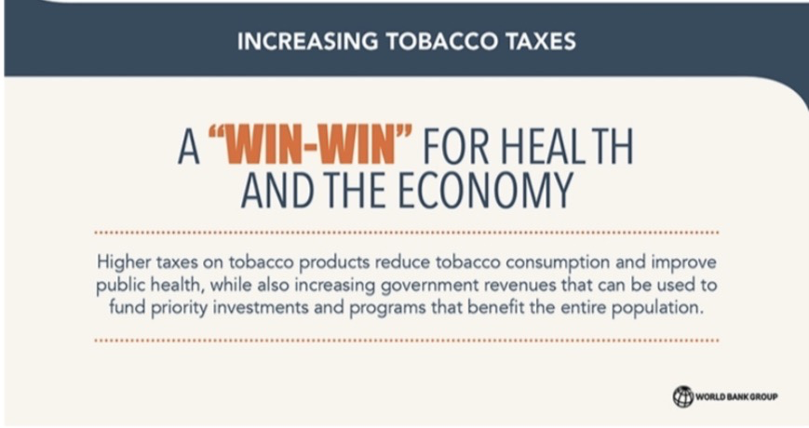
World Bank position on tobacco taxation
Increases in tobacco taxes can help expand tax base
mobilizes additional public revenue to fund public services like health and education
The Philippines raised US$3 billion - close to 1 percent of its GDP from 2013-2015
Tobacco tax increases in Colombia, Moldova, Montenegro, the Philippines, and Ukraine - resulting in an increase in total tobacco tax revenue of about 1-2 percent of GDP.

Slide 8
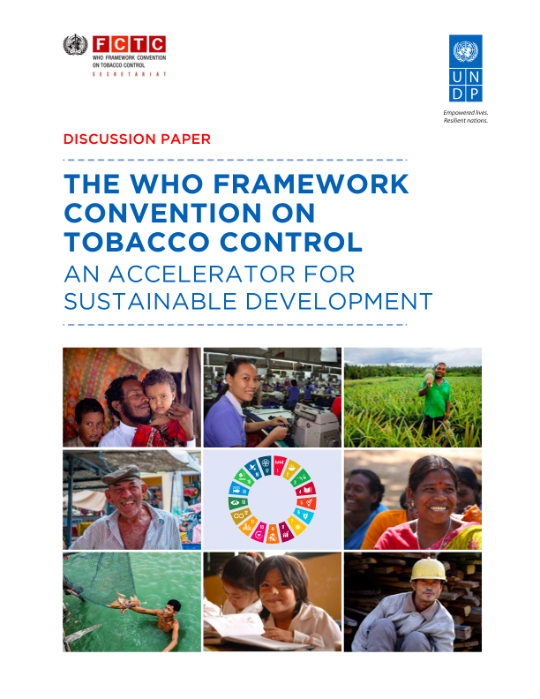
Country experiences show that tripling the excise tax worldwide offers a way to achieve the Sustainable Development Goal of reducing non-communicable disease deaths by 30 percent
According to a September 2020 Lancet report, progress on Sustainable Development Goal (SDGS)target 3·4 will have a central role in determining the success of at least nine other SDGs

Slide 9
WHO business case for prevention of NCDs
LMIC put in place the most cost-effective interventions for NCDs (including for both prevention and management),
by 2030 they will see a return of $7 per person for $1 invested
Investing in prevention and control of NCDs is essential for growth and development and, when carefully planned and implemented, is highly cost effective (WHO).

Slide 10
Increases in taxes do not lead to increases in the illicit trade
Evidence shows that the illicit cigarette market is larger in countries with low taxes and prices while smaller in countries with higher cigarette taxes and prices.
None-price factors are more important determinants of the size of the illicit tobacco market.
They relate to enforcement, quality of tax administration, strength of the regulatory framework, government commitment or willingness to control illicit activities, as well as social acceptance of the illicit trade.

Slide 11
Illicit trade and official consumption
Source: Vellios, Ross & van Walbeek (2019), van der Zee, van Walbeek & Magadla (2019), van der Zee, Vellios, van Walbeek & Ross (forthcoming), calculations derived from various issues of the National Treasury Budget Review (2001-2020)

Slide 12
Illicit trade and the impact on revenue
Illicit trade increased drastically from 2010.
A 2019 illicit trade estimate in 6 townships (non-representative) suggests that illicit trade is declining.
The significant increase in official consumption in 2019/2020 is likely the outcome of a reduction in illicit trade.
To continue the gains in capturing more of the illicit market, SARS should implement a track and trace system to monitor the cigarette supply chain.

Slide 13
References
Chelwa G, van Walbeek C. Assessing the Causal Impact of Tobacco Expenditure on Household Spending Patterns in Zambia. ERSA working paper 453 2014.
van Walbeek C. The Economics of Tobacco Control in South Africa. Department of Economics: University of Cape Town 2005.
NCD Countdown 2030: pathways to achieving Sustainable Development Goal target 3.4 Published: September 03, 2020 DOI:https://doi.org/10.1016/S0140-6736(20)31761-X
Rasmussen B, Sweeney K, Sheehan P. Economic Costs of Absenteeism, Presenteeism and Early Retirement Due to Ill Health: A Focus on South Africa Report to the US Chamber of Commerce
WHO Noncommunicable diseases increase risk of dying from COVID-19 in Africa available at https://www.afro.who.int/news/noncommunicable-diseases-increase-risk-dying-covid-19-africa
National Development Plan 2030
van der Zee K, van Walbeek C & Magadla S. Illicit/cheap cigarettes in South Africa. Trends Organ Crim (2019).
Vellios N, van Walbeek C, Ross H. Illicit cigarette trade in South Africa: 2002–2017. Tobacco Control (2019)
van der Zee K, Vellios N, van Walbeek C & Ross H. The illicit cigarette market in six South African townships. Tobacco Control (forthcoming)
Corné van Walbeek Samantha Filby Kirsten van der Zee Smoking and quitting behaviour in lockdown south africa: results from a second survey http://www.reep.uct.ac.za/sites/default/files/image_tool/images/405/News/REEP2ndreport.pdf
www.tobaccoatlas.org
https://www.who.int/tobacco/economics/taxation/en/
https://www.worldbank.org/en/topic/tobacco/brief/taxing-tobacco-a-win-win-for-public-health-outcomes-mobilizing-domestic-resources

