Slide 1
REPORT BY THE DAFF AUDIT COMMITTEE ON THE 2019/20 DAFF ANNUAL REPORT
PORTFOLIO COMMITTEE ON THE DEPARTMENT OF AGRICULTURE, LAND REFORM & RURAL DEVELOPMENT
20 November 2020

Slide 2
Table of Contents
Purpose
Audit Committee Responsibility
Effectiveness of Internal Control
Internal Audit
Key Areas of Concern
Risk Management
Performance Information
Auditor General’s Report
Conclusion

Slide 3
PURPOSE
The purpose of the presentation is to report the Annual Report of the Audit Committee to the Portfolio Committee.

Slide 4
Audit committee responsibility
The Audit Committee reports that it has complied with its responsibilities arising from Section 38 (1) (a) (ii) of the Public Finance Management Act and Treasury Regulation 3.1.13. The Audit Committee also reports that it has adopted appropriate formal terms of reference as its Audit Committee Charter, has regulated its affairs in compliance with this charter and has discharged all its responsibilities as contained therein.

Slide 5
effectiveness of internal control
The internal control reviews undertaken by the internal audit function reveal gaps in many operational environments.
The root causes for most of the identified control weaknesses relate to ineffective procedures, lack of detailed planning, competency gaps and resource shortages.
In many instances where the controls were found to be ineffective, non-adherence by officials was the reason.
Capacity constraints and inadequate consequence management were major contributors to the ineffective control environment.

Slide 6
internal audit
The following were the key activities and objectives of the Chief Directorate: Internal Audit during the 2019/20 financial year:
Assisting the Director-General in maintaining an efficient and effective system of internal control by assessing and evaluating the adequacy and effectiveness of control processes as well as assessing risk management and governance processes within the department;
Determining whether the department’s objectives will be achieved economically, efficiently and effectively by evaluating and assessing operations, processes, procedures and activities;
Making appropriate recommendations for improving governance and risk management
Review management processes in achieving the department’s objectives;
Audit follow ups on internal audit reports and the AGSA management report;
Assessing and evaluating the departmental performance information.

Slide 7
internal audit continue
A three-year rolling Strategic Plan, inclusive of a one-year Operational Audit Plan was developed in consultation with management, which was approved by the Audit Committee.
On a quarterly basis progress reports on the execution of the approved Annual Plan were reported to the Audit Committee.
The Internal Audit Annual Plan is not a static document and amendments were made to the plan in response to the emerging risks and circumstantial changes.
The Annual Plan made provision for thirty-four (34) audits comprising financial, compliance, operational, information technology and performance information audits.

Slide 8
Key areas of concern
The system of planning, approval, disbursement, execution, and monitoring of conditional grants are fraught with planning and control weaknesses.
The department has and continues to allocate conditional grants to provinces while some department’s capacity to “follow the money” has not been adequately developed.
Effective consequence management requires stability but the environment has not been conducive for consequence management. Instability challenges experienced in the prior year had an adverse impact on the reporting period.
Management’s response to a number of audit findings points to under-funding which impacted on service delivery as the department has on a number of occasions been unable to speedily and sometimes effectively implement risk mitigation/prevention measures when faced with an outbreak of animal, plant or food related disease as experienced in recent times.

Slide 9
Key areas of concern continue
Shortcomings in resource utilisation prioritisation, gaps in planning and resource wastage also impact on the department’s ability to adequately pursue development opportunities within its area of mandate.
Achievement of objectives: Challenges relating to the lack of long range planning; priorities not always being scientifically backed; organisational design not aligned with priorities; operational planning not detailed enough; risk management not operationalised; monitoring and evaluation not systematically resourced; internal controls not adequate or effective; information and communication systems not adequately geared to support core business; and ineffective co-ordination, particularly planning and reporting arrangements with provinces were observed and had an adverse impact on the achievement of the department’s objectives.

Slide 10
Key areas of concern continue
The implementation of the Land Care and Drought Relief Programme - Concern relating to fraud risk indicators have been highlighted by the reviews undertaken by both the internal and external audit functions.
The progress made by management in the investigation, processing and closure of irregular, fruitless and wasteful expenditure is a matter of concerns as the implementation of the necessary actions to address the reported irregular, fruitless and wasteful expenditure are very slow.

Slide 11
Risk management
There is a concern with the level of maturity in risk management.
There were persistent delays in the conclusion of the annual review of both the strategic and operational risk assessments resulting in the development, execution and monitoring of the risk mitigation action plans not effectively taking place.
The resourcing of the risk and investigations unit is a concern as the current capacity is not aligned to the mandate and functions of this unit.

Slide 12
Performance information
The reliability of reported performance information for the transversal targets included in the Annual Performance Plan (APP) remains a concern.
Significant gaps were observed in many PDAs relating to the relevance and completeness of reported information with regard to project business plans and portfolio of evidence.
Poor controls in the filing and reconciliation of supporting documents necessary to validate the completeness, accuracy and validity of reported performance were evident in many provinces.

Slide 13
Auditor general’s report
The Department’s progress in addressing the AGSA findings has been slow. A review of the progress on the execution of the corrective measures by Internal Audit revealed that a significant number of action plans had not been finalised.
The Audit Committee concurs and accepts the conclusions of the Auditor-General on the Annual Financial Statements and is of the opinion that the audited Annual Financial Statements be accepted and read together with the report of the Auditor-General.

Slide 14
conclusion
The Department has an independent Audit Committee structure which provides independent oversight over the financial management and reporting, governance, risk management, internal control, compliance, performance information management, internal and external audits, and information communications and technology functions of DAFF.
The Committee is supported by the Internal Audit Unit which undertakes risk based audit assignments to evaluate the adequacy and effectiveness of the internal controls and the control environment
The Audit Committee meets on a quarterly basis to receive and review reports from management, make recommendations and review progress on actions addressing findings of both the AGSA and Internal Audit.

Slide 15
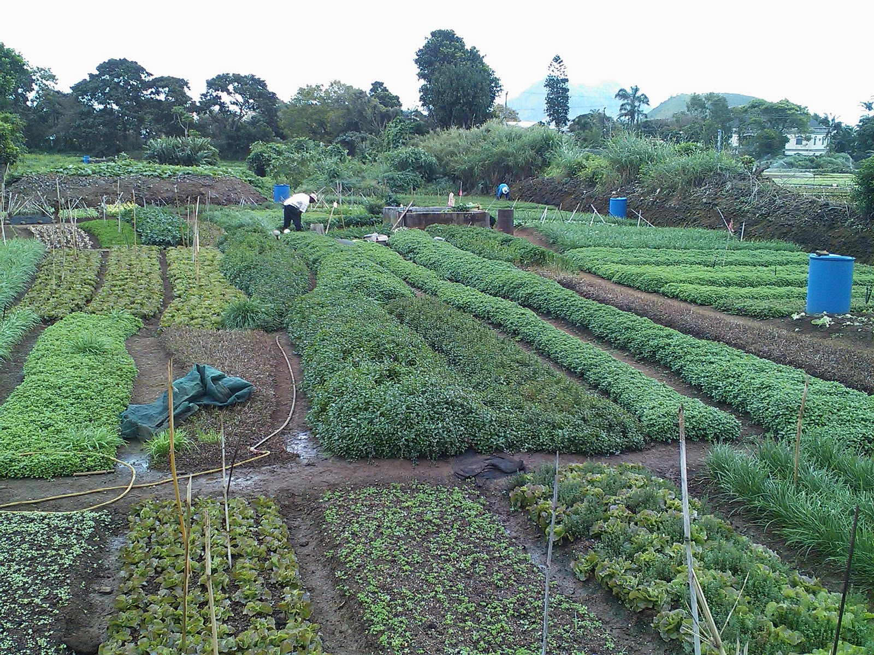
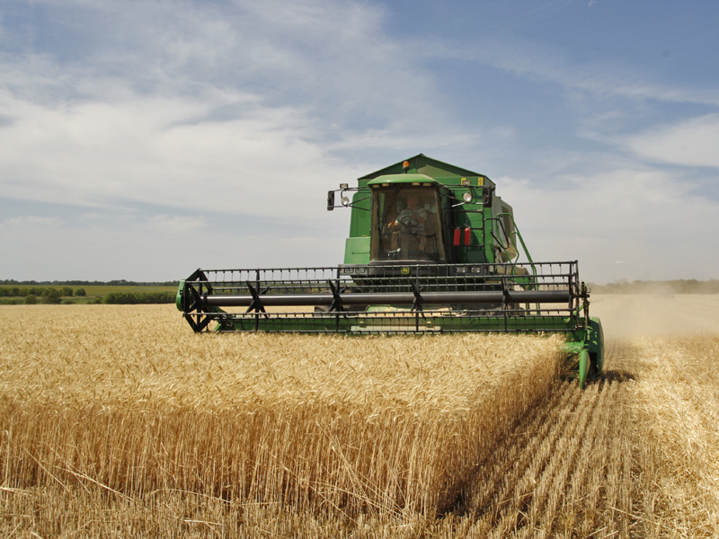
Thank you!

