Slide 1
SAQA’s work in terms of Implementing the Articulation Policy Presentation to the Parliamentary Portfolio Committee on Higher Education & Training 18 November 2020

Slide 2
Presentation overview
Purpose
Background information
Progress made by SAQA
Responsibilities of SAQA
1
2
3
4

Slide 3
1.Purpose
To report on the progress made by SAQA in implementing the 2017 Articulation Policy for the Post-School Education and Training System of South Africa

Slide 4
2.Background information
Minister: HEST published the Articulation Policy in 2017
“a well -articulated system is one in which there are linkages between its different parts; there should be no silos, no dead ends. “
“Learners must be supported in their individual learning and work pathways”
The Articulation Policy “establishes the overarching conceptual structure, principles and policy statements to support the implementation of credible approaches to articulation within the South African post-school education and training system”

Slide 5
3. Responsibilities of SAQA
Determine criteria for Articulation
Provide leadership to QCs in terms of Articulation processes and practices
Provide annual reports to the Minister
Ensure that all qualifications have Articulation statements
Resolve systemic challenges and incongruities
Advise the Minister about amendments to legislation/policy
Co-ordinate the work of QCs to eliminate Articulation conflicts

Slide 6
4. SAQA’s Progress in terms of its Responsibilities
a. Determine criteria for articulation
By 31 March 2021, the QCs must ensure that institutional policies include national entry and progression requirements, and post-qualification pathways, in line with SAQA and DHET policies
SAQA has encouraged the QCs to align their policies to the revised national policies. In this regard, SAQA made extensive inputs into the Quality Council for Trades and Occupations’ CAT revised policy in June 2020. The QCTO’s CAT Policy, when published, should be aligned to SAQA’s revised CAT policy and the DHET’s Articulation Policy.
Inputs into Umalusi’s (a) revised Recognition of Prior Learning (RPL) and CAT policies in February 2020, (b) articulation for the new General Education Certificate (GEC) in the General and Further Education and Training Qualifications Sub-Framework of the National Qualifications Framework (GFETQSF), and (c) as part of the Technical Working Group for the Department of Basic Education’s Ministerial Task Team, towards articulation in the new Three Stream Model for Basic Education.
Inputs into the Council on Higher Education’s ‘Norms and Standards for Certification for the Higher Education Sector in the Context of the Higher Education Qualifications Sub-Framework (HEQSF)’, published in 2020, in which RPL and CAT feature in a way that is broadly aligned to SAQA and DHET Recognition of Prior Learning (RPL), CAT and Articulation Policies.
Reviewed the SAQA 2014 Credit Accumulation and Transfer (CAT) Policy in 2020 to align it to the Articulation Policy. The CAT Policy will be published on 23 November 2020 for public comment. The reviewed policy will be gazetted in March 2021.
Participating in the CHE’s Task Team to enhance articulation between TVET and Higher Education. The alignment of the CHE policies for RPL and CAT is under discussion

Slide 7
b. Ensure that that all new qualifications, and those submitted for re-registration, have statements about articulation
SAQA revised its Policy and Criteria for Registering Qualifications and Part-Qualifications on the NQF, to provide for these aspects. The revised policy was published via Government Gazette in March 2020.
During the 2020/2021 financial year, all qualifications registered on the NQF comply with the registration requirements. SAQA returns qualifications with no articulation pathways to the QCs for amendments.
SAQA has identified 74 Higher Education qualifications already registered on the NQF after 1 January 2014 that do not have an articulation option, and requested the missing information from the Council on Higher Education (CHE). So far, the CHE has submitted eight (8) qualifications and SAQA has processed them.
SAQA made inputs into the Umalusi Policy and Criteria for the Development, Registration and Publication of Qualifications on the General and Further Education and Training Qualifications Sub-Framework of the National Qualifications Framework. The aim was to ensure that, when the policy is published, it is aligned with the SAQA Policy and Criteria for Registering Qualifications and Part- Qualifications on the NQF in terms of Articulation.
100% of qualifications registered by SAQA have at least one horizontal and vertical articulation option.
SAQA designed the 2021 NQF Impact Study to focus on the implementation and impact of the national policies for RPL, CAT and system flexibility. SAQA will complete this study and publish its findings by March 2023.
Surveyed 500 stakeholders; Extended deadline until December 2020 to increase responses. A preliminary analysis was conducted in August 2020, of the responses relating to CAT – the results were circulated within SAQA in September 2020, and informed SAQA’s CAT policy review process and inputs.

Slide 8
d. Provide annual reports to the Minister, after consultation with the QCs, about the implementation of articulation across the education and training system
The Articulation Policy requires SAQA to report to the Minister: Higher Education, Science and Technology (HEST) on the National Qualifications Framework (NQF) family's progress with implementing it. The CEO Committee set up a task team comprising SAQA, the DHET and the QCs, to develop a reporting template for this purpose. The Task Team developed a draft Theory of Change for the Articulation Policy, which provided the framework for the report. In the report, each specifies how it will contribute to the outputs and outcomes, and provide its delivery deadlines. Each entities reports its progress against clear deliverables.
SAQA consolidated the first annual report to the Minister (HEST) and submitted it in April 2020. The second report will be submitted in April 2021.

Slide 9
e. Resolving systemic challenges and incongruities as they occur; address deficiencies so as to produce a well-articulated system that brings
The Policy and Criteria for the Registration of Qualifications and Part-qualifications on the NQF (As amended – 2020) requires that Quality Councils (QCs) must indicate horizontal, vertical and diagonal articulation options when recommending qualifications for registration on the NQF. The Quality Council for Trades and Occupations (QCTO) develops Occupational qualifications and part-qualifications from levels 1 to 8 and recommend it for registration on the NQF.
The problems with articulation within occupational qualifications and part-qualifications are the following:
i) Part-qualifications with credits less than 120 articulate to qualifications registered within the OQSF and HEQSF with 120 credits or more.
ii) Qualifications) with less than 120 credits articulate to qualifications registered within the OQSF and HEQSF with 120 credits or more.
iii) Articulation options are considered within and across sub-frameworks without considering the entry requirements of the qualifications to which it articulates.
iv) Occupational qualifications articulate to historical qualifications that expired or are about to expire.
v) HEIs do not accept occupational qualifications for entry to their qualifications.
Meetings with QCTO, the Development Quality Partners (DQPs), Assessment Quality Partners (AQPs) and Qualification Development Facilitators (QDFs) to discuss issues relating to articulation of occupational qualifications with qualifications registered on the HEQSF.
One of the biggest challenges for articulation of qualifications across the two sub-frameworks is the development of Exit Level Outcomes (ELOs). ELOs within occupational qualifications reflect occupational tasks which are not framed against the level descriptors. DRR is in the process to develop a guideline document to assist the developers of qualifications in the development of ELOs to ensure better articulation between qualifications within and across sub-frameworks.

Slide 10
f. Advice given to the Minister by SAQA
DETERMINATION OF THE SUB-FRAMEWORKS THAT COMPRISE THE NATIONAL QUALIFICATIONS FRAMEWORK
Advised on Levels and Qualification Types
Exceptions
Transitional Arrangements

Slide 11
g. Co-ordinate the work of QCs and eliminate conflicts
(1) Simplifying the NQF
CEO Committee engagement towards addressing articulation jointly across SAQA and the Quality Councils (NQF Sub-Frameworks)
Process to align all higher education qualifications – including legacy qualifications – with the HEQSF
Process to align legacy occupational qualifications with the OQSF
Registering qualifications at NQF Level 5 (e.g. Higher Certificates) – that help to bridge across the NQF Sub-Frameworks
Collaboration between NQF partners and with NQF stakeholders
Providing NQF advice, advocacy, communication

Slide 12
Research and developments that have deepened articulation
(2) SAQA research and development
Understanding TVET College lecturers
Learning-and-work pathways for sustainable development
Developing an inclusive RPL model
Flexible Learning and Teaching Practices (FLTP)
Articulation between TVET, higher education and the workplace
Strengthening learning pathways in Community Development, ECD, Engineering
Case Study on Flexible Learning Pathways (FLPs) in South Africa
NQF Impact Studies

Slide 13
Project: Understanding TVET College lecturers
SAQA partnership research 2009 – 2012
TVET College lecturers are ‘agents of articulation’
The research looked at: who TVET College lecturers are, what education and training they have, what languages they speak, how they teach
Main outputs: (1) SAQA Bulletin 2015 and (2) policy inputs
Main impact: Research fed into the DHET’s Policy on Professional Qualifications for Lecturers in TVET

Slide 14
Project: Learning-and-work pathways for sustainable development
SAQA partnership research 2009-2011 + 2012-2015
Focus: (1) Understanding learning-and-work pathways and (2) developing learning-and-work pathways in emerging fields
The research looked at: how learning-and work pathways are taking place in emerging sustainable development areas, and how to strengthen such pathways
Main outputs: (1) Summary report, (2) SAQA Bulletin 2017, (3) actual development of learning pathways
Main impact: Led to the development of actual pathways _ informed all further articulation research and development by SAQA

Slide 15
Project: Developing an inclusive RPL model
SAQA partnership research 2009 – 2015
The research looked at: Understanding inclusive RPL processes and developing an RPL model applicable across a wide range of contexts – RPL for (a) access to undergraduate studies, (b) access to postgraduate studies, (c) workplace contexts, (d) in Worker Education
Main outputs: One of three peer reviewed RPL books in the world, and deepened RPL practices in the sectors involved
Main impact: (1) informed national RPL policy development in 2013, 2016, 2019, (2) informed Quality Council RPL policies, (3) informed the implementation of RPL across the country

Slide 16
Project: Flexible Learning and Teaching Practices (FLTP)
SAQA partnership research 2012-2015
Main outputs:
Actual FLTP that have persisted since the project
a booklet on the project
The project involved: using action research to develop FLTP at a public HEI that serves poor and working class students
a poster on the project
Main impact
deep and lasting transformation in one public HEI
deep sharing of the research with all public HEIs, USAf, CHE/ across-HEI learning
informed all SAQA’s further articulation research and development

Slide 17
Project: Articulation between TVET, higher education and the workplace
SAQA partnership research 2016-2020
the National Articulation Baseline Study
identifying existing articulation initiatives
developing a set of articulation enablers towards taking successful initiatives to scale
developing actual articulation via action research in seven case studies
National Articulation Baseline Study Report
The project involved
Main outputs
Set of Articulation Enablers
Booklet on the whole project
Actual articulation in the context of the seven case studies
Main impact
knowledge and understanding of articulation that exists in the country and how it works
formed the basis of, and provided support for, SAQA’s initiative to strengthen learning pathways in Community Development, Early Childhood Development, Engineering and other sectors

Slide 18
Project: Strengthening learning pathways in Community Development, ECD, Engineering
September 2018
SAQA convened sector leaders, identified specific sectoral articulation challenges, sketch plans to address
May 2019
SAQA convened sectoral meetings to add detail to and fine-tune the plans
SAQA hosted the 3rd NQF Conference ‘Strengthening learning pathways in , CD, ECD, Engineering – articulation plans were shared, improved, adopted with around 200 stakeholders
SAQA, the Quality Councils, the professional bodies concerned, and sector leaders and stakeholders implement the plans
4th NQF Conference to report back on the plans implemented
September 2019
2020 -2022
2022/23

Slide 19
Project: Case Study on Flexible Learning Pathways (FLPs) in South Africa
May 2019-June 2022
UNESCO identified eight countries with strong articulation initiatives/ FLPs
Chile, Finland, India, Jamaica, Malaysia, Morrocco, South Africa, UK
UNESCO’s international survey
(2) eight country case studies that (a) documented national FLP policies, tools and practices, and (b) captured national and institutional views on what is being done re FLP/ articulation
the enablers and barriers (South African study: 51 interviews with 80 people)
Country report
The research included
Main outputs
short paper
policy brief
webinar and information-sharing

Slide 20
Project: NQF Impact Studies
2014 NQF Impact Study
Focused on the system’s progress regarding access, redress, progression (articulation), quality, transparency (SAQA, 2017)
2017 NQF Impact Study
Focused on the implementation and impact of (1) SAQA’s policies for RPL, CAT and assessment, (2) the NQF Level Descriptors, (3) NLRD tools, (4) the integration of public + private HE, (5) the QCTO model – all of which link directly to articulation (SAQA, 2019)
2021 NQF Impact Study
Focuses on the impact of RPL, CAT and FLP policies across all NQF stakeholders (SAQA, 2021/22 – forthcoming

Slide 21
Some short-term research linked to articulation…..
The possibilities of Convener System under the NQF (2011)
RPL in SETAs (2012)
Criteria and processes for registering qualifications (2012)
Learning pathways in the EW sector (2015)
Learning pathways in Community Development (2015)
Continuing Professional Development (CPD) (2015)
Worker Education (2015)
RPL cases (2010-2015)
SAQA as Articulation Ombud (2016)
Understanding learning pathways (2017)
Elaborating on successful articulation initiatives (2018)
Sustainable professional bodies (2019)
Overlaps in legislation for NQF, SAQA, QCs, PBs (2020)

Slide 22
Getting articulation research/ development into policy and practice (GRIP)
Advice to the Minister
Events
Publications

Slide 23
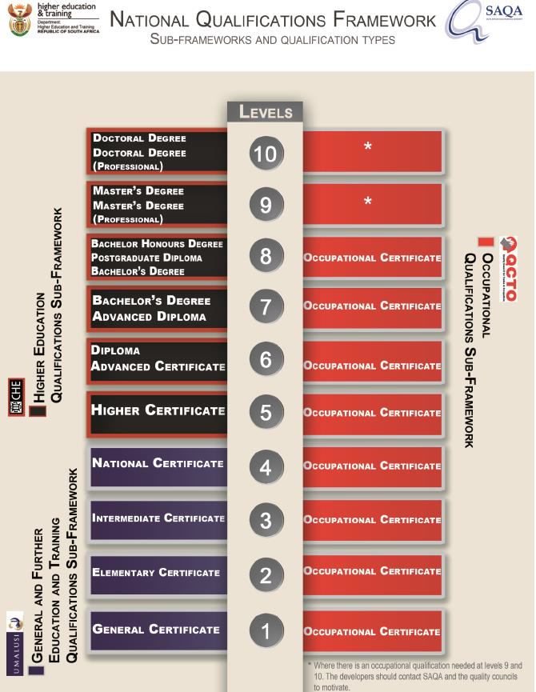

Slide 24
Revised NQF: SAQA’s Advice to Minister: HEST
NQF Sub- Framework/ Quality Council | NQF Level | NQF Sub-Framework and Qualification Type |  | NQF Sub- Framework/ Quality Council
Higher Education Qualifications Sub- Framework (HEQSF)/ Council on Higher Education (CHE) | 10 | Doctoral Degree Doctoral Degree (Professional)
 | 9 | Master’s Degree Master’s Degree (Professional)
 | 8 | Bachelor Honours Degree Post Graduate Diploma Bachelor’s Degree | Specialised Occupational Diploma | Occupational Qualifications Sub-Framework (OQSF) Quality Council for Trades and Occupations (QCTO)
 | 7 | Bachelor’s Degree Advanced Diploma | Advanced Occupational Diploma
 | 6 | Diploma Advanced Certificate | Occupational Diploma
 | 5 | Higher Certificate | Higher Occupational Certificate
General and Further Education and Training Qualifications Sub- Framework (GFETQSF)/ Umalusi | 4 | National Certificate | National Occupational Certificate
 | 3 | Intermediate Certificate | Intermediate Occupational Certificate
 | 2 | Elementary Certificate | Elementary Occupational Certificate
 | 1 | General Certificate | General Occupational Certificate

Slide 26
National Articulation Baseline Study
Articulation initiatives found in the National Articulation Baseline Study (SAQA, 2018)

Slide 27
Reported articulation
Institution type | Developed articulation scenarios | Emerging articulation scenarios | Latent articulation scenarios | Not sure | Total no. of articulation scenarios
HEIs | 8 | 9 | 7 | 1 | 25
TVET Colleges | 8 | 29 | 13 | 0 | 50
Total no. of articulation scenarios | 16 | 38 | 20 | 1 | 75

Slide 28
Articulation enablers
Collaborative relationships
Advocacy + use of NQF regulatory system
Creation + commitment to MoU/MoA
Inclusive admission criteria
Quality teaching & learning
Career advice
Focusing on particular pathways (highways) at a time
Critical resources
Articulation research

Slide 30
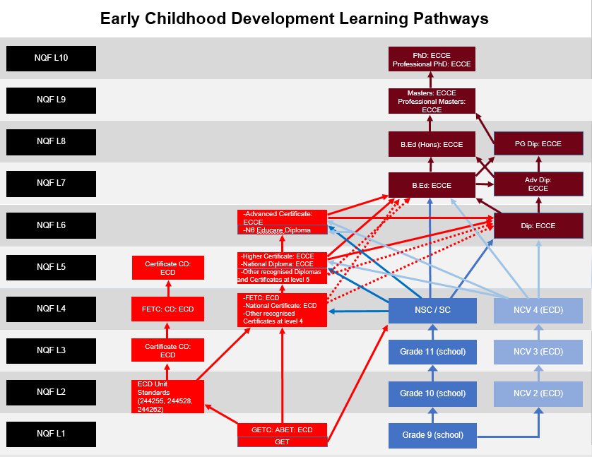

Slide 31
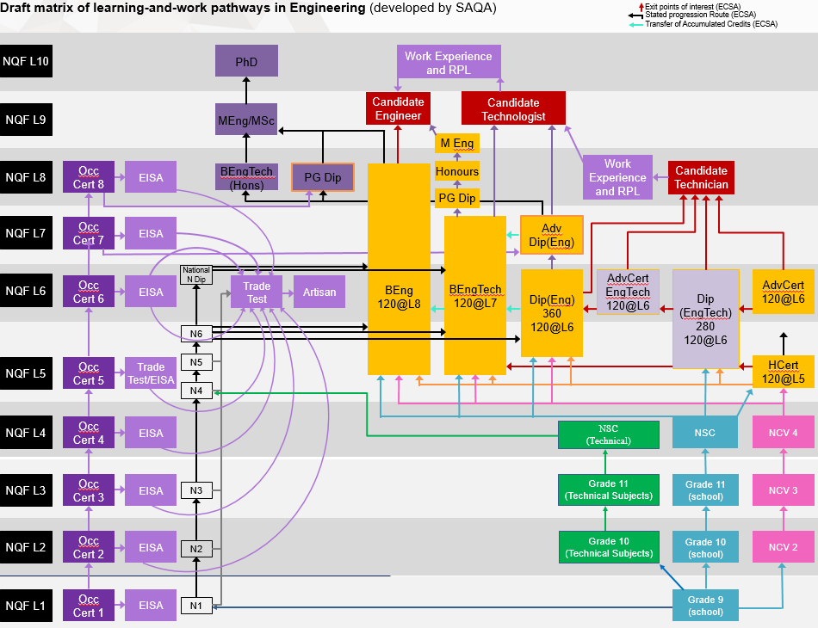

Slide 32
Recently
Analysis of overlaps in legislation for the NQF, SAQA, the Quality Councils and statutory professional bodies
Technical Working Group for the DBE’s Ministerial Task Team on Articulation in the Three Stream Model for Schools
CHE Task Team to enhance articulation between TVET and higher education

