Slide 1
UPDATE ON THE SCRAPPING OF ILLEGALLY CONVERTED TOYOTA QUANTUM PANEL VANS
November 2020

Slide 2
CONTENTS
Purpose
Background
Progress and Update
Update and Breakdown per Province
Draft Proclamation
Update on Other Issues in the Report
Update of System Redesign
Recommendations

Slide 3
PURPOSE
The purpose of this presentation is to provide an update and progress on the scrapping of illegally converted Toyota Quantum Panel Vans in compliance with the Public Protector’s Remedial Action

Slide 4
BACKGROUND
In 2009 the Department became aware of the unsafe practices of illegally converting panel vans into passengers carrying vehicles (taxis).
The Taxi Industry approached the then Minister seeking intervention to assist the industry.
On 11 February 2010 the Minister approved a process of rectification through a retro fitment.
A data filtration was conducted and 2353 vehicles were identified as illegally converted panel van vehicles
Only 436 were retrofitted
Balance of the identified panel vans continued to operating illegally

Slide 5
PROGRESS AND UPDATE
The Public Protector issued a report and remedial action on 27 March 2019.
The remedial action for the Department was that these panel vans must be scrapped through the Taxi Recapitalisation Programme
Data extrapolated by the RTMC and the Taxi Recapitalisation South Africa (service provider appointed for scrapping) identified 1916 panel vans that could possibly qualify for scrapping
Only 1226 of these vehicles had operating licences and were eligible for scrapping since an operating licence is a pre-requisite to qualify for scrapping
Of the 1226 only 503 submitted applications for scrapping since April 2019 implying that 723 are still outstanding

Slide 6
UPDATE & BREAKDOWN PER PROVINCE
 | Panel Vans |  | Applications
Province | In Province | With OL | Received To Date | Paid/Scrapped 2019/20 | Paid/Scrapped 2020/21 | In Process
Eastern Cape | 169 | 131 | 45 | 36 | 5 | 4
Free State | 88 | 84 | 26 | 22 | 2 | 2
Gauteng | 711 | 261 | 137 | 88 | 12 | 37
KZN | 220 | 138 | 34 | 31 | 0 | 3
Limpopo | 166 | 120 | 54 | 44 | 7 | 3
Mpumalanga | 133 | 109 | 40 | 30 | 4 | 6
North West | 185 | 165 | 58 | 53 | 4 | 1
Northern Cape | 5 | 4 | 3 | 2 | 1 | 0
Western Cape | 239 | 214 | 106 | 66 | 17 | 23
 | 1916 | 1226 | 503 | 372 | 52 | 79

Slide 7
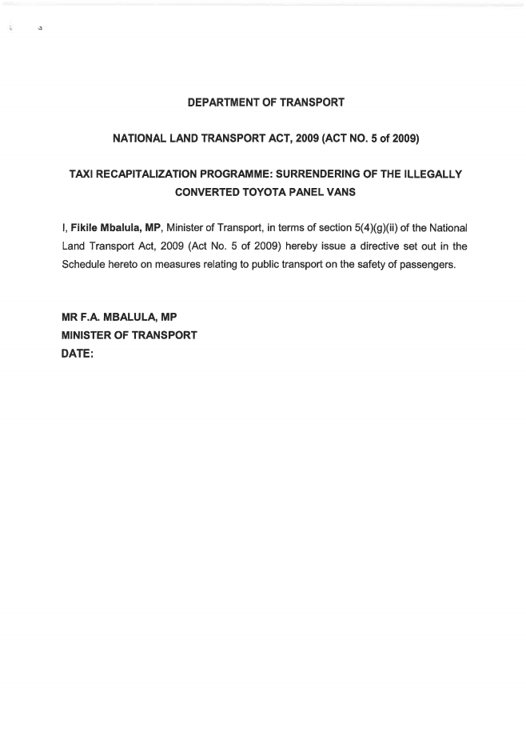
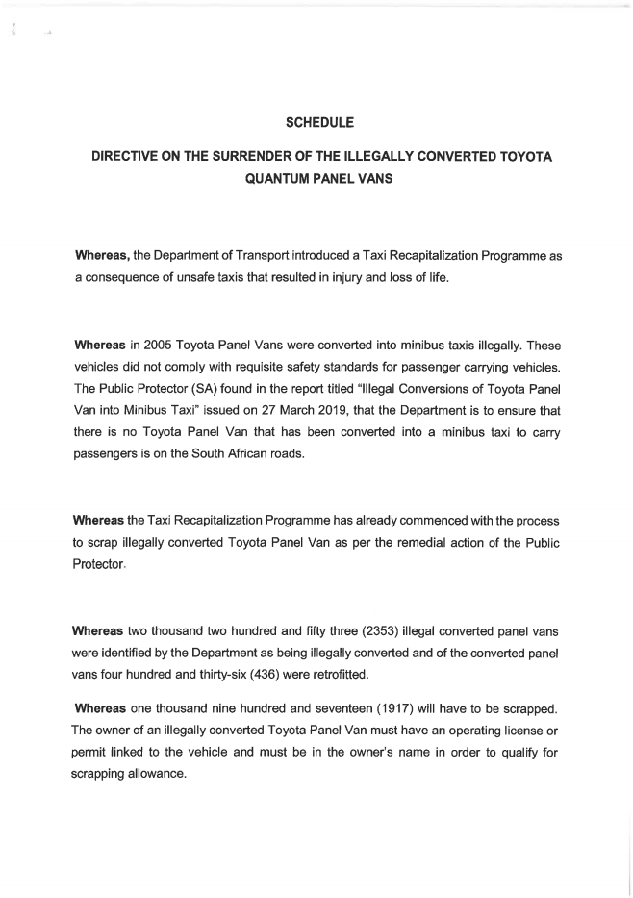
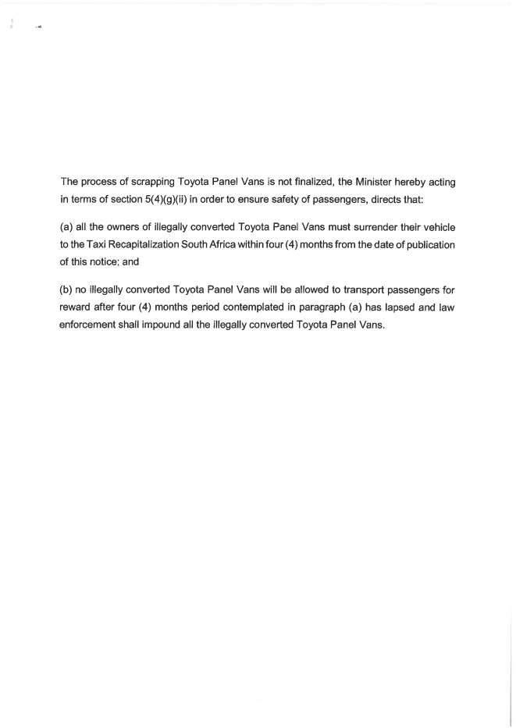
DRAFT PROCLAMATION

Slide 8
UPDATE ON OTHER ISSUES IN THE REPORT
Update on matters referred to SIU regarding the illegal vehicle conversions
No report received from the SIU with regard to compliance with matters related to the Proclamation
Update on progress made in addressing issues referred to DG in Public Protector report
On ensuring that measures taken and agreed to with the Minister are implemented: The Department has commenced with the redesign of the NLTIS to close gaps that may have been exploited. Engaged with the SIU to investigate the irregularities and manipulation of the system. In the process of issuing a Proclamation announcing the cut-off date for the grace period to qualify for scrapping process
On ensuring that there is no Toyota Panel Van that has been converted into minibus that is on the South African roads: All identified panel vans have been admin marked on the eNatis system and their licences cannot be renewed

Slide 9
UPDATE ON SYSTEM REDESIGN
The following scope of work was undertaken:
To integrate the system with the Geographical information System (GIS).
Ensure interoperability with e-NaTIS.
Liaise with the relevant national, provincial and municipal stakeholders to gather functional requirements
Interface as far as possible with provincial systems kept at provinces.
Migrate data from historical systems like the Land Transport Permit System (LTPS) into the new Operating License Administration System (OLAS).

Slide 10
PROGRESS TO DATE ON THE REDESIGN
Inclusion of the new modules for National Public Transport Regulator (NPTR), Transport Appeals Tribunal, etc.
System design alignment to User Requirements Specifications
NPTR Testing and User Acceptance Testing
Legitimate data migration and system testing

Slide 11
OUTSTANDING ACTIVITIES ON THE REDESIGN
Migrating data from historical systems like the Land Transport Permit System (LTPS) into the new Operating License Administration System (OLAS).
Ensuring interoperability with other systems i.e. e-NaTIS (NLTA Requirement)
Interface with other systems such as
SARS – tax compliance vetting
Home Affairs – validation of Identity Number and status
SAPS – Criminal Activity checks
Full System testing and Implementation

Slide 12
WAY FORWARD
The Minister has committed to the following:
Engage with the Technical Committee.
Meet with Toyota to lobby for their contribution on resolving the challenge
Meet with the Special Investigations Unit (SIU) to expand their mandate on the current R37 Proclamation investing eNatis irregularities.
Issue a proclamation setting a deadline for the discontinuation of use of the illegally converted panel vans

Slide 13
RECOMMENDATION
It is recommended that the update and progress on the scrapping of illegally converted panel vans be noted

Slide 14
THANK YOU

