Slide 1
National School of Government Annual Report 2019/20: A presentation to the Portfolio Committee on Public Service and Administration
Mr Busani Ngcaweni
Principal: NSG
November 2020

Slide 2
Outline of Presentation
Reflections of the five-year strategy and performance (2015-2020)
Backdrop to the annual performance
Executive Summary
Highlights of Performance
2019/20 Non-Financial Performance
2019/20 Financial Performance
Human Resource Oversight
Conclusion

Slide 3
NSG Five Year Strategy (2015-2020)
The 2019/20 Annual Report is the final report of the five-year strategic plan (2015-2020). For this period, the NSG set out four strategic outcome oriented goals for achievement
Goal 1: A well-resourced high performing learning centre of excellence
Goal 2: Improved learning and development opportunities influenced by impactful research, strategic diagnosis and monitoring and evaluation
Goal 3: Learning and development tools, quality-driven curriculum, programmes and services responding to public service needs and training and development
Goal 4: Integrated and collaborative network of training and development institutions and practitioners providing the public service with affordable access to quality training and development opportunities

Slide 4
Five Year Performance (2015/16 to 2019/20)
During this five year period, the NSG has trained a total of 255 225 public servants in all forms of learning and development. This measured against the five year projected target of 259 017 (which was later increased to 263 517 to include mandatory programmes) represents a 98% achievement of the projected target
Training was undertaken in the three spheres of government, SOEs, legislative sector) and with youth (interns and unemployed youth graduates), through a curriculum framework of accredited and non-accredited courses and programmes
This is a significant achievement to provide the opportunities for workplace learning – however, the entire workplace ecosystem needs to be in place in order to ensure application of workplace learning.
During this period, the curriculum design processes were improved on curriculum design ideas and innovations of how courses, programmes and other forms of learning interventions can be delivered. A new curriculum philosophy and approach was adopted during this period, which is underpinned by a decolonizing and social justice theory. Participatory and indigenous methodologies such as story-telling, African leadership, Ubuntu philosophy and peer sharing are used
The NSG also offers eLearning courses (facilitated, open learning and communities of practice). The open courses are not facilitated and allows learners to study at their own time and own pace. Some of the self-paced courses designed and delivered during this period include: Ethics in the Public Service; Writing for Government; and Know and Live Our Constitution. Facilitated eLearning courses include: Contract Management; Qualitative Research Methods for M&E; Supply Chain Management; and Basic Project Management for the Public Service

Slide 5
Five Year Performance (2015/16 to 2019/20)
Being a knowledge intensive institution, the Research and M&E functions contribute towards knowledge generation – including publications. Between the 2015/16 and the 2019/20 financial years, the NSG generated 87 reports on training needs analysis as well as the results of skills audits in all spheres of government.
In addition to the Training Needs Analyses, a number of reports focussed on capacity constraints and service delivery issues experienced at specific times and places. These reports are of much relevance as they indicate the possible involvement of the NSG through targeted interventions and the rollout of applicable training programmes
The Case Study Project was initially aimed at delivering 10 case studies, but in the end it resulted in 15 completed case studies as well as a case study repository to be accessed as an open source. The case studies addresses key issues in the public administration such as the political-administrative interface; implementation of public policy within complex, multi-layered contexts; participatory and co-operative governance; leadership and management; strategic planning; transformation; financial governance; monitoring and evaluation; social justice and transformation themes (including ethics, gender, disability and diversity); and impact assessments
Annually M&E reports are also generated which provide the NSG with information on the quality of the ETD interventions

Slide 6
Five Year Performance (2015/16 to 2019/20)
The NSG integrated and collaborated with network of training and development institutions and practitioners, including independent individual contractors, on-board trainers, higher education institutions, and private entities
The NSG strengthened its international relations and partnerships, including the EU partnership, and National Chinese Academy of Governance (NCAG). An important accomplishment for the NSG and the Africa Management Development Institutes’ Network (AMDIN) was the publication of a unique new journal under the editorship of the NSG
The Africa Journal of Public Sector Development and Governance (AJPSDG) is a peer-reviewed scholarly journal which investigates a broad spectrum of matters and issues related to policy research and implementation in public sector leadership, management and development in Africa

Slide 7
Backdrop to the Annual Performance
The NSG draws its mandate from section 195 of the Constitution, and with particular reference to 195(1) (h), which stipulates that: “good human resource management and career-development practices, to maximise human potential, must be cultivated”
Legislative provisions in the Public Service Act and Public Administration Management Act mandate the NSG to provide education, training and development to the three spheres of government)
The 2019/20 performance plan is also guided by the February 2019 State of the Nation Address (SONA), wherein the President announced that “In improving the capabilities of public servants, the National School of Government is introducing a suite of compulsory courses, covering areas like ethics and anti-corruption, senior management and supply chain management, and deployment of managers to the coal face to strengthen service delivery”.
NSG
Mandate
1. Provide education & training (individual)
3. Foster collaboration
4. Offer qualifications
5. Three spheres of government, SOEs, organs of state
6. Conduct training, examinations or tests (pre-requisites)
2. Support development (institutional)

Slide 8
Backdrop to the Annual Performance
The annual performance of the NSG is being presented at a time of severe constraints, which has affected the past performance and will impact on the current and future performance
Training performance was severely affected due to the slow uptake of training perpetuated by the outbreak of the COVID-19 pandemic that necessitated the restriction of persons to attend face-to-face training. The NSG offers the majority of its ETD interventions through face-to-face learning and revenue generation is calculated on a scenario of a maximum of 20 learners per class
Training delivery was affected in the last quarter compared to the same period in the previous financial years. Past performance trends show the last quarter to be the best performing period. We already indicated to the Portfolio Committee (and subsequently the National Treasury) of monthly revenue losses due to class cancelations
We can indicate that leading to the period of the national lockdown, particularly in March 2020, the NSG management worked on a response plan going forward, which was approved by the Minister. Key interventions for the NSG are: shifts to greater online learning; partnerships that will assist in revenue generation; improvements in ICT infrastructure

Slide 9
Backdrop to the Annual Performance
The 2019/20 financial year was also affected by the transition period – from 5th to 6th Administration. Often, during transitions, training numbers drop due to changes in top management and, at this time, the National Macro Organization of Government (NMOG)
This transition period impacted on the training performance of the NSG in the following ways:
The merging of affected national government departments meant that training within these departments for different employee levels were minimised or did not take place
Delays were experienced in scheduling training for those employees, particularly in Induction training
Programmes designed for executives, such as the EIP, could not be undertaken due to non-filling of posts at DG and DDG levels prior and immediately post the new administration. It is difficult to achieve EIP targets during a transition year
Many HODs’ contracts were either expiring and posts were being advertised, or up for renewal. It is difficult to get people for training, whose contracts are expiring

Slide 10
Executive Summary
The presentation provides non-financial performance highlights of the NSG for 2019/20 financial year, measured against the approved Annual Performance Plan (APP)
The APP for the 2019/20 financial year has a total of 27 performance targets (for both programmes). In terms of the APP targets, 23 are achieved against the target of 27. Four targets were not achieved as planned. This translates to an 85 % achievement of performance targets
With regard to the training targets, the NSG trained a total of 46 378 against an annual target of 53 783, representing 86% achievement. The annual revenue generation by the end of the financial year was R150.3million
The TTA closed the year with a surplus of R14.0 million in 2018/19 and the closing status in 2019/20 is a surplus of R35.2 million
The information presented herein was finalised through the external audit process done by the Auditor- General of South Africa

Slide 11
Highlights of Annual Performance
The online programme – Nyukela - went live on 15 July 2019, as a compulsory offering in response to the Directive on minimum entry requirements for the SMS. Since going live and by the end of the financial year, 161 learners enrolled and 136 completed the programme (84% completion rate)
The DPME partnered with the NSG to develop training material for a training course: Theory of Change for Planning in the public sector. The training was delivered to a total of 1706 learners, which included planners, M&E practitioners, internal auditors, financial officials and programme managers
The NSG developed experiential learning programme to prepare South African public sector managers for site visits at the coalface of service delivery, named Khaedu. Most African countries requested the NSG to train their officials on the same programme which was then termed “Khaedu Africa”. In this financial year, a total of 100 senior managers (25 from four countries) were trained
In relation to provision of training for mandatory programmes, the NSG collaborated with the North West Ikatisong School of Governance (ISOG) resulting in the uptake of 1 019 officials to be trained in various programmes before the end of the financial year
The Executive Induction Programme (EIP) for DDGs and DGs took place on 17-19 March 2020, with a total of six delegates (National, Limpopo, Eastern Cape, KZN, North West). The guest speakers were Adv. Thabo Mokoena, DG from DMR&E, and Ms Mpumi Mpofu, CEO from ACSA.

Slide 12
Constitutional values and principles governing public administration
The NSG was subjected to a quantitative evaluation by the Public Service Commission (PSC) against the nine CVPs and the results were made available to the NSG on 11 December 2019. The nine CVPs have been divided into the following four categories: Good System; Professional Culture; Professional Behaviour; Good Institutional Processes. The table below provided the overall evaluation scores against the evaluation tool.
Category | Score %
PART A: Good system Public Administration must be development oriented Efficient, economic and effective use of resources must be promoted Public Administration must be accountable | 5/5 13/13 5/10 | 23/28 (82%)
PART B: Professional Culture Transparency must be fostered by providing the public with timely, accessible and accurate information Services must be provided impartially, fairly, equitably and without bias | 11/18 3/3 | 14/21 80.5%
PART C: Professional Behaviour A high standard of professional ethics must be promoted and maintained People’s needs must be responded to and the public must be encouraged to participate in policy-making | 13/15 2/6 | 15/21 (71%)
PART D: Good Institutional Processes Good human resource management and career development practices, to maximize human potential, must be cultivated Public administration must be broadly representative of the South African People | 11/15 3/4 | 14/19 (73.6%)

Slide 13
2019/20 Non-Financial Performance

Slide 14
Programme 1: Targets Achieved
Performance Indicator | Planned Target 2019/2020 | Actual Achievement 2019/2020 | Comment on deviations | Mitigation
Achieve an unqualified or clean audit by Auditor-General | Unqualified or clean audit report issued by the AGSA | Clean audit for Vote and unqualified audit for TTA issued by Auditor- General. | None | None
Number of days for payment of suppliers from the date of receipt of a valid invoice | All suppliers paid within 30 days of receipt of a valid invoice | All suppliers were paid within the prescribed 30 days | None | None
Projected revenue of R119m generated by the TTA | Cumulative projected revenue of R119m generated by end of March 2020 | An amount of R151.3 million in revenue was generated by end of March 2020 | Training targets exceeded in the training streams Administration, Leadership and Management resulting in additional income. | None
Coordinate international exchange supporting capacity development interventions in the public service | International exchanges facilitated | 2 international exchanges facilitated; China and France | None | None
 | Host AMDIN to steer capacity development | AU Agenda 2063 and UN Agenda 2030 seminar discussing Sustainable Development Goals (SDGs) was held in March 2020 | None | None

Slide 15
Programme 1: Targets Achieved
Performance Indicator | Planned Target 2019/2020 | Actual Achievement 2019/2020 | Comment on deviations | Mitigation
Percentage of posts vacant by the end of FY | Vacancy rate at 10% or less by end of the quarter | Vacancy rate at 8.2% by 31 March 2020 | None | None
Average number of days taken to resolve disciplinary cases | All disciplinary cases resolved within 60 days from the date of receiving the case | 1 case was reported and the department undertook all the processes to resolve the case within 60 days | Case was closed as the employee that lodged the case resigned from the department | None
Develop Service Delivery Model of the NSG | Develop the Service Delivery Model of the NSG | NSG Service Delivery Model developed and approved by the MPSA | None | None
Effective ICT Disaster Recovery solution | Monitor and test ICT Disaster Recovery solution through the Disaster Recovery Plan | Continuous DRP tests conducted and reports developed | None | None

Slide 16
Programme 1: Target Not Achieved
Performance target | Quarterly Performance Status | Challenges | Remedial actions
Average number of days for current debt collection at 45 days or less from date of debt | 56 average days for collection of current debt | Increase in number of invoices issued towards the end of the financial year. Furthermore, the national lockdown and COVID-19 pandemic has negatively impacted on the NSG ability to increase the debt collection | The NSG will review its internal policies relating to the pre-payment by client departments as well as bookings and cancellations

Slide 17
Programme 2: Targets Achieved
Performance Indicator0 | Planned Target 2019/2020 | Actual Achievement 2019/2020 | Comment on deviations | Mitigation
Number of research projects to inform training and development needs and opportunities completed | Complete 6 research projects (cumulative) | Completed 8 research projects to inform training needs and opportunities | Additional request for research projects resulting in more projects. | None
Number of training needs analyses completed to inform training and development needs and opportunities | Complete 10 training needs analysis (cumulative) | Completed 13 training needs analysis with public sector institutions | Request from client departments to increase the scope of TNAs | None
Number of research colloquia or workshops hosted by the NSG as a knowledge sharing platform | Host 6 research colloquia or workshops (cumulative) | Hosted 6 research colloquia or workshops | None | None
Number of articles/ papers submitted for publication to promote thought leadership, knowledge creation and dissemination | Submit 4 articles/ papers to promote thought leadership | Submitted 6 research articles/papers to promote thought leadership | More effort was given by researchers to publish completed research
Development of diagnostic tool for a public service skills database | Develop an implementation plan | Develop an implementation plan | None | None

Slide 18
Programme 2: Targets Achieved
Performance Indicator | Planned Target 2019/2020 | Actual Achievement 2019/2020 | Comment on deviations | Mitigation
Develop an implementation plan for an assessment center in the public service | Develop and pilot the diagnostic tool for a public service skills database | Developed and piloted the diagnostic tool for a public service skills database | None | None
Number of evaluations to be carried out by end of financial year | 66 evaluations quarterly | 72 evaluations were conducted during the quarter | Additional requests to evaluate specific programmes and facilitators | None
Number of application of learning studies progress reports produced by the end of financial year | Complete 7 application of learning studies progress reports produced for 7 identified training programmes | Completed 7 application of learning studies progress reports produced for 7 identified training programmes | None | None
Number of programmes/courses developed or reviewed annually | Develop 6 new programmes/courses in line with a curriculum framework | Developed 6 new programmes/courses in line with a curriculum framework | None | None

Slide 19
Programme 2: Targets Achieved
Performance Indicator | Planned Target 2019/2020 | Actual Achievement 2019/2020 | Comment on deviations | Mitigation
Number of programmes/courses quality assured annually | Quality Assure 6 Programme/ course by end of the quarter | Quality assured 13 programmes/ courses by the NSG Quality Assurance Committee | Increased demand for programme/ courses to be quality assured in order to make revised course material available. | None.
Number of online courses offered by the NSG by the end of the financial year | Offer 26 existing NSG courses for anytime, anywhere online learning | Offered 27 existing NSG courses for anytime, anywhere online learning | None. | None.

Slide 20
Programme 2: Targets Achieved
Performance Indicator | Planned Target 2019/2020 | Actual Achievement 2019/2020 | Comment on deviations | Mitigation
NSG status as an accredited training provider maintained | Facilitation of various accreditation processes as required by the accrediting bodies | Facilitated the accreditation process through the application process, coordinated PSETA annual site monitoring visit for the purpose of determining the NSG compliance to their required standards in relation to accreditation | None. | None.
 | Manage various accreditation processes as required by the accrediting bodies | Managed and facilitated the review of General Manager and Public Service Administrator occupational qualifications with PSETA | None. | None.
Professionalised training facilitators recruited as part as part of Rutanang Ma Afrika initiatives (including IICs) as well as serving and retired public servants) | 4 Training Of Trainers (ToTs) or Trainer Learners Networks (TLNs) held by the end of the financial year | 16 Training of Trainers (ToTs) or Trainer Learners Networks (TLNs) held by the end of the financial year | More capacity development necessitated especially for the Induction Programme roll out the CIP 4-5 and Accelerated CIP | None.

Slide 21
Programme 2: Targets Achieved
Performance Indicator | Planned Target 2019/2020 | Actual Achievement 2019/2020 | Comment on deviations | Mitigation
Number of memorandum of agreement (MOAs) signed with the public sector departments and other organs of the state | Sign 10 MOAs with the public sector departments and other organs of the state (cumulative) | Signed 14 MOAs with the public sector departments and other organs of the state | NSG signs MOAs with public sector stakeholders with the intention to influence course uptake and revenue. | None

Slide 22
Programme 2: Targets Not Achieved
Performance target | Quarterly Performance Status | Challenges | Remedial actions
Train 46 783 new and current public servants through face to face and online learning Including Compulsory Induction and demand led trainings (cumulative) | 41 802 (90% achievement) new and current public servants through face to face and online learning (Including Compulsory Induction and demand led trainings) | The effects of the COVID-19 pandemic has significantly impacted on the performance in the last quarter of the FY | The NSG would have achieved this performance target, had the aforementioned challenges not negatively impacted
Orientate 3 000 unemployed youth graduates and interns through the BB2E Programme | 2189 (73% achievement) unemployed youth graduates and interns were orientated through the BB2E Programme | Decision to appoint interns for a 24 month period limited the intake on BB2E programme | Expand training to include all youth training, not only BB2E
Train a cumulative of 4 000 public servants trained on mandatory courses (cumulative) | 2387 (60 % achievement) learners trained on mandatory courses (cumulative) | Delays in implementing the mandatory courses. | The NSG has partnered with North West OTP to support rapid capacity development. A review of the process to rollout mandatory courses

Slide 23
Training Performance per Stream
Training Stream | Annual Training Targets | Actual Performance | % Achieved
Administration | 4 343 | 5 857 | 135%
Management | 9 600 | 12 039 | 125%
Leadership | 6 520 | 10 993 | 169%
Induction | 26 320 | 12 913 | 49%
Unemployed youth graduates | 3 000 | 2 189 | 73%
Mandatory Training | 4 000 | 2 387 | 60%
Total | 53 783 | 46 378 | 86%

Slide 24
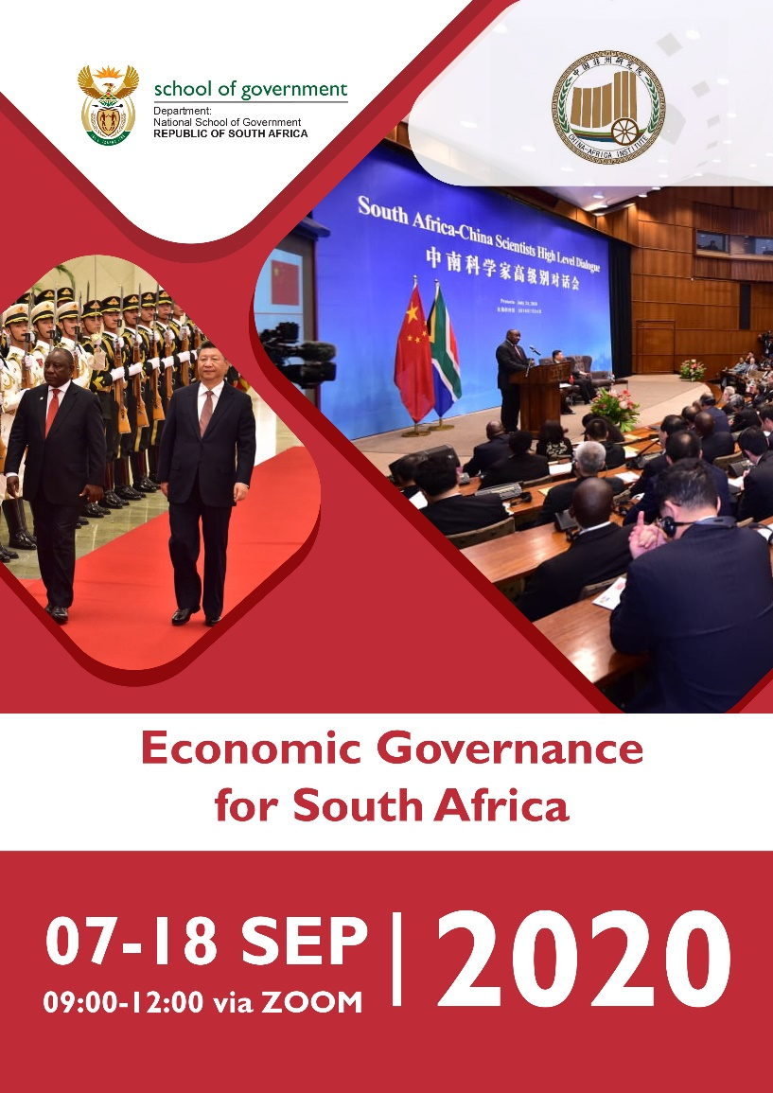
2019/20 Financial Performance

Slide 25
2019/20 Financial Performance for NSG: Vote Account
 | Annual Budget 2019/20 | April to March Actual Expenditure 2019/20 | April to March Variance budget compared to actual (over)/under | April to March Expenditure as % of pro-rata budget
 | R'000 | R'000 | R'000 | %
Administration | 100,441 | 95,522 | 4,919 | 95%
Public Sector Organisational and Staff Development | 87,464 | 87,464 | - | 100%
Total Vote Expenditure | 187,905 | 182,986 | 4,919 | 97%
Economic classification | Annual Budget 2019/20 | April to March Actual Expenditure 2019/20 | April to March Variance budget compared to actual (over)/under | April to March Expenditure as % of pro-rata budget
 | R'000 | R'000 | R'000 | %
Compensation of Employees | 58,416 | 55,309 | 3,107 | 95%
Goods and services | 38,772 | 37,896 | 876 | 98%
Payments for capital assets | 3,253 | 2,317 | 936 | 71%
Transfer to Trading Entity | 87,464 | 87,464 | - | 100%
Total Vote Expenditure | 187,905 | 182,986 | 4,919 | 97%
Donor Funding (EU Project) | 11,391 | 8,734 | 2,657 | 76%
The underspending was mainly due to vacant posts which have now been filled

Slide 26
2019/20 Financial Performance for NSG: Trade Account
 | Annual Budget 2019/20 | April to March Actual Expenditure 2019/20 | April to March Variance budget compared to actual (over)/under | April to March Expenditure as % of budget
 | R'000 | R'000 | R'000 | %
Training related revenue (course Fees) | 143,351 | 145,347 | 1,996 | 101%
Transfer from the Vote | 87,464 | 87,464 | - | 100%
Other Revenue (Interest) | 3,200 | 3,922 | 722 | 122%
Donations of Intangible asset at fair value |  | 2,243 | 2,243 | 0%
Total Revenue | 234,015 | 240,760 | 6,745 | 102 %
Compensation of Employees | (105,356) | (90,439) | 14,917 | 86%
Goods and services | (121,042) | (115,081) | 5,961 | 95%
Total Trade Expenditure | (226,398) | (205,520) | 20,878 | 90%
Surplus/(Deficit) | 7,617 | 35,240 | 27,623
The training revenue has positive outcome of R1.9 million more than the budgeted amount. Non-cash donations of courses at fair value was R2.2 million.
The underspending of compensations of employees was due to vacancies.
The accounting surplus for the year was R35.2 million

Slide 27
Human Resource Oversight

Slide 28
Human Resource Oversight
The NSG has a total of 231 posts on the organisational structure
212 posts filled and 19 vacant, vacancy rate is therefore 8.2%
Of the 19 vacant posts, 6 posts are SMS whilst 13 are non SMS posts
The vacant posts are due to the repositioning of the NSG and budget ceiling on compensation of employees
Demographic Profile
African | 81%
White | 9%
Coloured | 5.3%
Indian | 4.7%
Employment Equity
NSG has fair representation of gender; females (57.5%), females SMS (55.8%). Youth (24.1%) and PWD (2,8%)

Slide 29
Human Resource Oversight
The NSG trained 146 officials not in line with the 153 as planned in the Workplace Skills Plan (WSP). The target could not be met due to training which was scheduled in the last month of the financial year which was cancelled due to COVID 19. The focus on training the officials was on critical skills required to deliver on the mandate of the School namely Business Processing Modelling, Finance for Non-financial managers and Contract Management.
The NSG is committed to investing in developing its own capacity. The uniqueness of the NSG mandate requires us to place emphasis on our own intellectual capital. Many of the NSG employees have been graduating after completing their studies. The NSG awarded 49 bursaries to employees to further their studies for the 2019/2020 academic years. The NSG provided opportunities for internship, benefiting 11 Graduate Interns and 1 Structured Youth Development Programme (Side Internship) in the financial year, and maintains a database of all interns from prior years
From 2009/10 to date, 26 interns have been offered permanent employment in the NSG. In this financial year one of the Graduate Interns and Structured Youth Development Programme (Side Internship) were offered employment in the NSG
To ensure employees’ well-being, the NSG implemented an Employee Health and Wellness Programme and monitors its environment to ensure compliance to environmental wellness and safety standards. The NSG performed excellently in implementing programmes aimed at enhancing active uptake of EHW Interventions. A total of 180 employees’ were able to access Health and Wellness programmes during this financial year.
There has also been an improvement in the morale and culture, particularly over the five year period, through undertaken through an internal study – which augurs well for the future positioning of the NSG

Slide 30
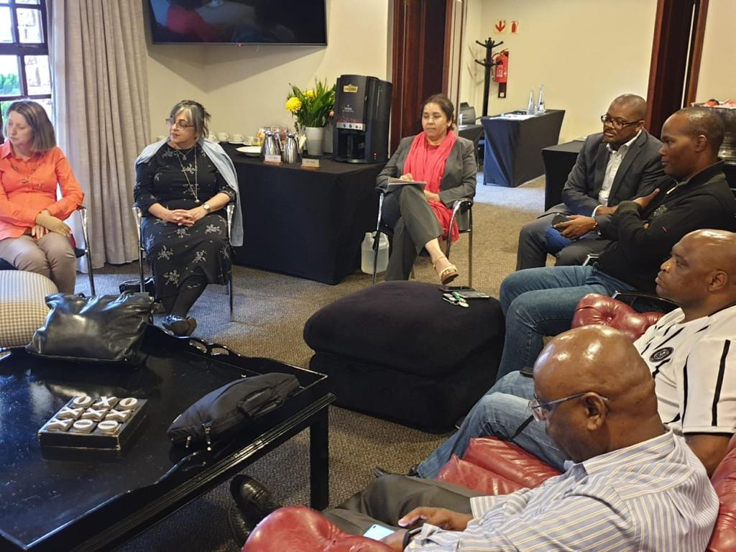
Conclusion

Slide 31
Conclusion
The NSG has performed against delivered on its annual performance plan with an 84% achievement. The online programme – Nyukela – continues to gain momentum, as a compulsory offering in response to the Directive on minimum entry requirements for the SMS
The impact of the COVID pandemic has definitely impacted on the performance on the NSG, as well as in the current financial year. In this regard, the NSG is continuing with work on its response plan
Going forward, the NSG has defined a new strategy and service delivery model which are being aligned to the reconfigured organisational structure. In repositioning for the future, we will …
Implement the prescripts of an expanded MANDATE (education, training and development in three spheres of government, state owned entities and organs of state) and support the outcomes of priority 1 of MTSF (professionalising public administration)
DIRECT (provide directly or facilitate ETD) – INFLUENCE (content creation of public administration, quality of ETD, broader society & citizens) – REFER (where the NSG can not offer ETD intervention, it can be referred to other recognised training providers)
Measure the IMPACT of ETD interventions
Emphasise the QUALITY of the ETD interventions, and those who deliver for us
Embrace PARTNERSHIPS and collaborations with public and private institutions to support ETD interventions

Slide 32
The NSG:
Learn: expanding learning opportunities for public servants to master state craft
Serve: building the capacity (and culture) of public servants to serve society effectively
Grow: helping public servants to combine learning and service (experience) to grow professionally

