Slide 1
2019/20 ANNUAL REPORT
PRESENTATION TO THE P0RTFOLIO COMMITEE
Date: November 2020

Slide 2
Presentation Outline
TOPIC
1. Strategic Overview
1.1 The Constitutional & Legislative Mandate
1.2 The GCIS Mandate
1.3 Vision, Mission, Values
2. GCIS 2019/20 Performance Highlights
3. Summary of Organizational Performance
4. 2019/20 Performance Per Programme
5. 2019/20 Budget and Expenditure

Slide 3
1. Strategic Overview

Slide 4
1. Strategic Overview
1.1 Constitutional Mandate
& Legislative Mandate
Section 195 (g) of the Constitution (1996) - Public should be provided with timely, accurate and accessible information.
Deepen democracy and sustain nation-building and patriotism by ensuring that the citizenry is informed about government programmes and that they are able to influence and participate in such programmes.
In 1998, the South African Communication Service was dissolved and the GCIS established by Cabinet, largely on the basis of recommendations contained in the report of the Task Group on Government Communications (Comtask: 1996: 58).
The Public Finance Management Act, 1999 (Act 1 of 1999), as amended.
Section 41: Cooperative governance values.
Section 195: Basic values and principles governing public administration.
Sections 231: International agreements.
Relevant Policies
The Medium Term Strategic Framework 2014-2019.
Framework for Strategic & Annual Performance Plans.

Slide 5
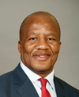
1.2 The GCIS Mandate
Drive coherent messaging across the three spheres on the key priorities of government
Secure value for money in advertising
Take the Executive to the people
Set, influence adherence to professional communication standards
Provide professional communication services and build communications capacity
Proactively communicate with the public about government policies, plans programmes and achievement
Mr Jackson Mthembu, MP
Minister in The Presidency
Ms Thembi Siweya, MP
Deputy Minister in The Presidency
Notes:
MAKING HEADLINES
GCIS continues to interact with the media and monitors the environment to enable accurate responses to topical issues. The GCIS provides media monitoring services to all government departments both electronic and print on a daily basis.
GCIS invests significant resources in tracking media coverage daily and continuously to assess the impact of government’s own messaging and the tone and content of journalistic reporting, editorial comment, analysis by commentators and others. GCIS issues short message service (SMS) alerts to communicators, DGs and political principals at 06:00 am. Messages are also sent out in the event of breaking news. This is preceded by a media monitoring service that starts at 03:00. GCIS also produces media clippings of the print coverage to all government communicators at 07:00, followed by electronic media coverage in the morning and in the afternoon.
Among GCIS’ proactive and reactive interventions in the media environment were the following:
The Acting CEO has weekly columns in the Pretoria News and the The New Age newspapers to communicate government messages on a variety of topical issues linked to the five priorities. In 2013, more than 74 opinion pieces have appeared in the Pretoria News, The New Age, the government blog on www.gov.za and the Acting CEO’s Home Brewed feature on SANews.gov.za, government’s official news agency. Opinion pieces also featured on SABC Online.
The GCIS Radio Unit has started broadcasting two news bulletins on weekdays to community radio stations on topical issues. The news is part of the Rapid Response Strategy and is broadcast live to 35 radio stations at 12:00 and at 16:00. So far, 190 news bulletins have been produced and also posted on the government and GCIS websites, www.gcis.gov.za and www.gov.za
The GCIS through its Radio Unit has also produced a total of 88 radio spots with eight adverts in 11 languages each, apart from live reads. This work was produced on behalf of The Presidency, the Department of Agriculture, Forestry and Fisheries, the Department of Health and the South African National Roads Agency Limited.
Furthermore, the GCIS Radio Unit has produced at least 32 one-hour long phone-in programmes for community radio stations. These shows were in English, as well as in the Nguni and Sotho languages. However, callers are allowed to speak the languages of their choice. These programmes were produced on behalf of various government departments and Parliament.
GCIS coordinates government’s cluster media briefings against Cabinet’s quarterly reporting cycles. These cluster briefings are aimed at updating the country on the implementation of government’s five priorities.
Following every Cabinet meeting, the Acting CEO briefs the media on Cabinet’s decisions. Some departments elaborate on certain key issues from the Cabinet statement in separate media briefings. This needs to be enhanced.
GCIS also in this year issued 199 statements and hosted 62 media briefings on behalf of departments. These statements did attract coverage in a broad range of print and broadcast media.
The media monitoring products produced are as follows:
364 media coverage reports covering broadcast and online media between 1 January and 31 May
143 sets of print headline news, and 7 799 sets of general press clippings.

Slide 6
1.3 Vision, Mission, Values
The pulse of communication excellence in Government
Vision
Mission
To provide professional services, to set and influence adherence to standards for an effective government communication system, to drive coherent government messaging and to proactively communicate with the public about government policies, plans, programmes and achievements.
Values
Professionalism
Diversity
Openness & transparency
Innovation
Honesty & integrity

Slide 7
2. GCIS 2019/20 Performance Highlights
GCIS GBVF INITIATIVES
GCIS Media Buying Advertising Campaigns in support of Department of Justice and Constitutional Development against GBVF
GBVF Opinion pieces and Key Messages to guide communication and setting the agenda around GBVF
Public Opinion Research that assessed awareness and impact of GBVF communication campaigns.
SaNews articles on GBVF stories that fed into the wider media space
Paid for social media campaign and pushing content on all GCIS digital/social platforms

Slide 8
2. GCIS 2019/20 Performance Highlights
GCIS GBVF INITIATIVES
Quarterly Media Content Analysis Reports on GBVF and daily media monitoring on GBVF related stories to inform Rapid Response
Vuk’uzenzele articles on GBVF
The following articles on GBVF were translated into isiZulu and isiXhosa respectively in 2019/20 Financial Year
Radio Script on GBVF Summit 12 April 2019
GBV Video Content 12 September 2019
GBVF article for placement on Isolezwe: 27 January 2020

Slide 9
2. GCIS 2019/20 Performance Highlights
Media engagement:
Inaugural Africa Media Tour – building our continental media footprint
GCIS Studio at the 2nd SA Investment Conference – high profile interviews
Communication Strategy and Plan for each of the three Pilot Launches of the District Development Model by the President
Rollout of the comprehensive CARA Funded anti-corruption campaign
Outreach campaign to support the 2019 Rugby World Cup which saw SA win and event graced by the President galvanizing the nation
Led the communications workstream for the Presidential Inauguration
Communications Support for the June 2019, 1st of the 6th Democratic Administration
Communications Workstream to support the public awareness, information and education about the 6th democratic general election
Supported programme of Landhandovers – Mkhwanazi Handover in KZN

Slide 10
2. GCIS 2019/20 Performance Highlights
Profiling of economic interventions – Presidential launch of the new Nissan Bakkie and localisation facility in Rosslyn
Economic opportunities booklet by GCIS:
Youth Environmental Services (YES) programme by the Department of Environmental Affairs and the Wildlife and Environment Society of South Africa (WESSA). Learning opportunities on environmental skills training and community service. Job Placement Programme by NYDA links skilled and unskilled young people.
Corporative Incentive Scheme by the Departments of Small Business and Department of Agriculture and Land reform. Bela-Bela CPA benefited R12 million to start a chicken farm specializing in egg layers.

Slide 11
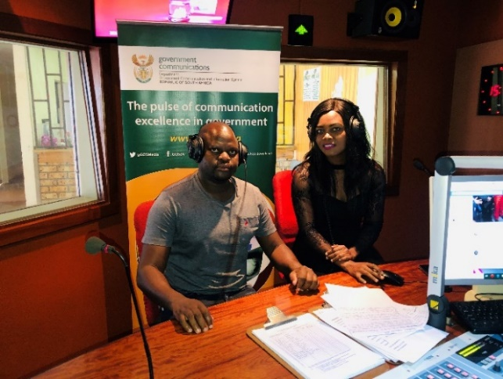
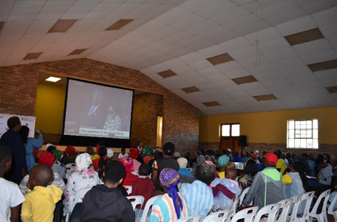
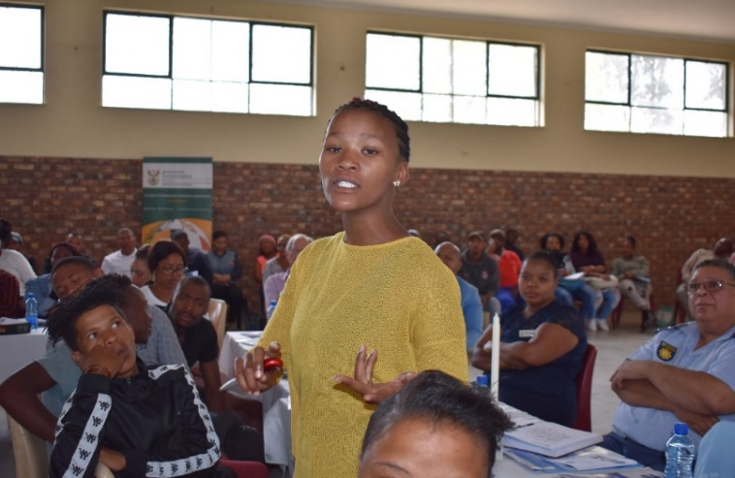
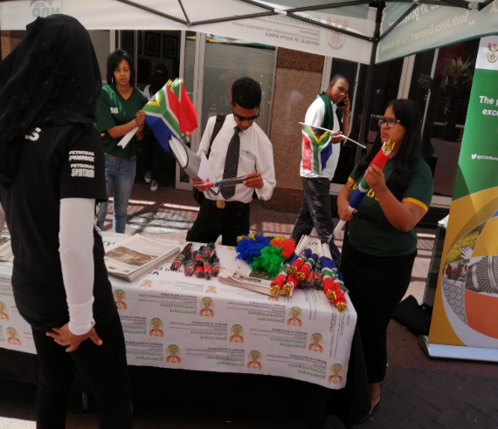
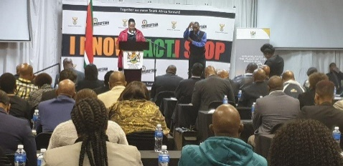
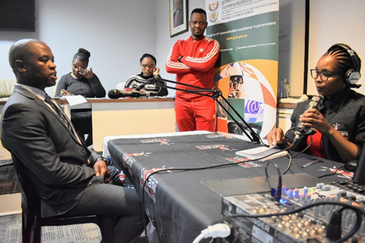
GCIS 2019/20 Performance Highlights
GCIS official Todani and Sipho Mahlangu form Cogta conducting radio interview at Moutse Community Radio, encouraging the public to watch the 2019 Presidential Inauguration.
Community members from Kareedouw watching the Presidential Inauguration live viewing coordinated by GCIS at Kagiso Community Hall.
IEC in partnership with GCIS hosted a community dialogue to focus on poor youth participation in the 2019 General Elections.
GCIS assisted with the coordination of the Mpumalanga Provincial Anti-Corruption Communication Strategy Consultation at White River Country Estate, Ingwenyama Conference and Lodge.
Chris Hani Mayor Wongama Gela participating in a mock and practical exercise on how to conduct interviews during the Communication, Media, Protocol and International Relations training supported by GCIS.
GCIS team handing out South-African Flags and information pamphlets in Cape Town to mobilise the public to watch the quarterfinals of the Rugby World Cup.

Slide 12
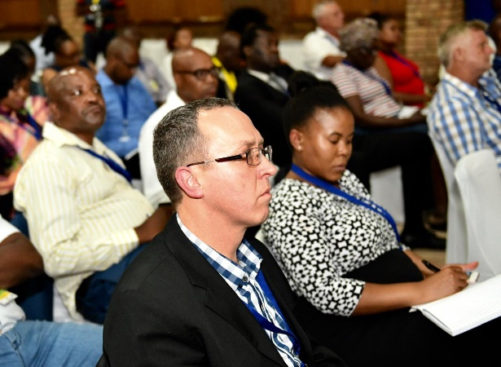
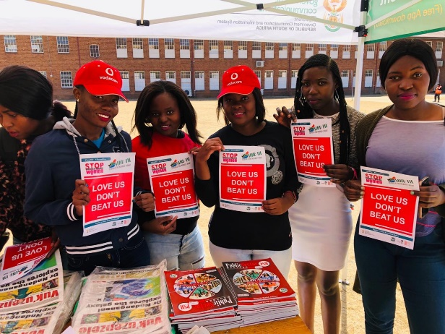
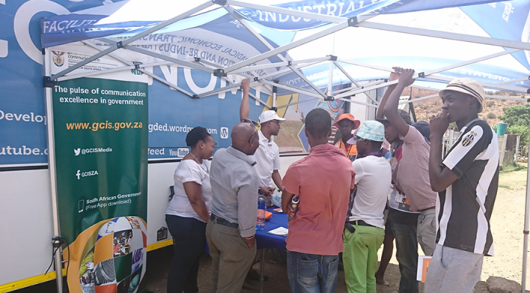
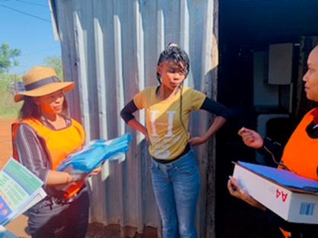
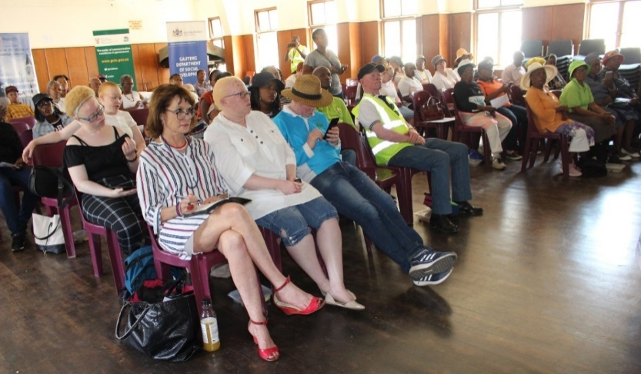
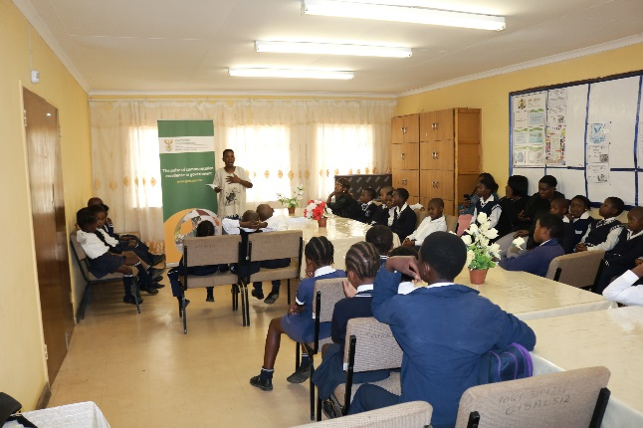
GCIS 2019/20 Performance Highlights
GCIS together with Gauteng Department of Economic Development hosted an activation with an effort of raising awareness about available economic opportunities in the Province.
Business people who attended the Business Forum during the President’s activities of the launch of the Waterberg District Development model in Waterberg.
Nkangala TVET College, Waterval Boven Campus students holding the GBVF posters at the GCIS activation during the College Open Day
GCIS and Northern Cape Drug Rehabilitation Centre official embarked on a door to door activation in Ivory Park.
GCIS visited Phamong Primary School to conduct reading session with learners after receiving request from PanSALB.
Social Development in Mogale City and GCIS conducted an information sharing session to create awareness about challenges that People with Albinism, in Krugersdorp.

Slide 13
2. GCIS 2019/20 Performance Highlights
95% of 2019/20 performance targets achieved. (41 out of 43 targets)
Distributed more than 19 million copies of Vuk’uzenzele newspaper.
Conducted 1900 out of 1710 community and stakeholder liaison visits
1737 out of 1140 development communication projects conducted on government priorities
271 out of 240 radio products and services provided. including radio broadcasts, radio news bulletins, live link-ups, community radio phone-in programmes and recordings of government’s events
Supported political principals in 84 izimbizo events.

Slide 14
3. SUMMARY OF ORGANISATIONAL PERFORMANCE
The department had 43 targets for the 2019/20 financial year. 41 (95%) targets were achieved and 2 (5%) targets were not achieved
Communication & Content Management
Programme | Targets | Achieved | Not Achieved
Administration | 10 | 10 | 0
Content Processing and Dissemination | 19 | 19 | 0
Intergovernmental Coordination and Stakeholder Management | 14 | 12 | 2
Total | 43 | 41 | 2

Slide 15
3. TARGETS THAT WERE NOT ACHIEVED
PERFORMANCE INDICATOR | PLANNED TARGET 2019/20 | ACTUAL PERFORMANCE 2019/20 |  | DEVIATION FROM PLANNED TARGET |  | COMMENT ON DEVIATION
Programme 3: Intergovernmental Coordination and Stakeholder Engagement
Number of Internal Communicators’ Forums (ICF) held | 10 ICFs held | 9 ICFs were held | Target underachieved by one |  | One forum which was planned to take place at the end of March 2020 was cancelled due to the circumstances overtaken by COVID-19
Number on post-Cabinet media briefings and/or statements issued after ordinary Cabinet meeting | 17 post-Cabinet media briefings and/or statements issued after ordinary Cabinet meetings | 14 post-Cabinet media briefings were held | Target underachieved by three |  | The new Cabinet held fewer meetings than planned in the first quarter of the financial year. In April the general elections were held thus government activities were scaled down and Cabinet was reconstituted after the elections and Presidential Inauguration on 25 May 2019. As result of the above, the target was not met and there was no Cabinet constituted in April and May

Slide 16
4.2019/20 PERFORMANCE PER PROGRAMME
Programme 1 : Administration
Communication & Content Management
Purpose: Provide overall management and support for the organisation
Overview of Achievements
EE Targets :
Target for Woman at SMS level was exceeded at 53% vs 50%
People with disability target was over achieved at 3,35% vs 2%
100% of disclosure of financial interest was achieved at SMS level and designated groups
The GCIS received a Clean-audit outcome for the 2019/20 financial year.

Slide 17
Programme 1: Administration
Sub-programme: Strategic Planning and Programme Management
PERFORMANCE INDICATOR | PLANNED TARGET 2019/20 | ACTUAL PERFORMANCE 2019/20 | DEVIATION FROM PLANNED TARGET | COMMENT ON DEVIATION
APP tabled in Parliament within prescribed regulations | 2020-2023 APP tabled in Parliament within prescribed regulations | The 2020-2023 APP was tabled in Parliament on 18 March 2020, within prescribed regulations | None | None
Number of approved quarterly performance reports submitted to National Treasury, Department of Planning, Monitoring and Evaluation (DPME), and Executive Authority, according to prescribed legislation | Four approved quarterly performance reports submitted to National Treasury, DPME and Executive Authority according to prescribed legislation | Four approved quarterly performance reports were submitted to the National Treasury, DPME and Executive Authority according to prescribed legislation. | None | None

Slide 18
Programme 1: Administration
Sub-programme: Strategic Planning and Programme Management
PERFORMANCE INDICATOR | PLANNED TARGET 2019/20 | ACTUAL PERFORMANCE 2019/20 | DEVIATION FROM PLANNED TARGET | COMMENT ON DEVIATION
Annual Report tabled in Parliament within National Treasury guidelines and legislative time frames | Departmental Annual Report tabled in Parliament within National Treasury guidelines and legislative time frames | The 2018/19 Annual Report was tabled in Parliament on 27 September 2019 within National Treasury guidelines and legislative time frames | None | None
Number of progress reports on the implementation of the risk-mitigation plans produced | Four progress reports on the implementation of the ERM framework produced | Four progress reports on the implementation of the ERM framework were produced | None | None

Slide 19
Programme 1: Administration
Sub-programme: Human Resources
PERFORMANCE INDICATOR | PLANNED TARGET 2019/20 | ACTUAL PERFORMANCE 2019/20 | DEVIATION FROM PLANNED TARGET | COMMENT ON DEVIATION
MTEF Human Resource Plan (HRP) implemented | Annual adjusted HRP and HRP Implementation Report submitted to the DPSA | Human Resource Management did not adjust the HR Plan. Priorities as outlined in the 2017-2020 HRP were still applicable. DPSA was informed accordingly. The HRP Implementation Report was submitted to the DPSA on 31 May 2019 | None | None

Slide 20
Programme 1: Administration
Sub-programme: Information Management and Technology
PERFORMANCE INDICATOR | PLANNED TARGET 2019/20 | ACTUAL PERFORMANCE 2020/20 | DEVIATION FROM PLANNED TARGET | COMMENT ON DEVIATION
Number of reports on IM&T governance implemented | Four reports on the availability of IT Infrastructure presented to the IM&T SC | Four reports on the availability of IT Infrastructure were presented to the IM&T SC | None | None
 | Four reports on IM systems development presented to the IM&T SC | Four reports on IM systems development were presented to the IM&T SC | None | None

Slide 21
Programme 1: Administration
Sub-programme: Finance, Supply Chain Management and Auxiliary Services
PERFORMANCE INDICATOR | PLANNED TARGET 2019/20 | ACTUAL PERFORMANCE 2019/20 | DEVIATION FROM PLANNED TARGET | COMMENT ON DEVIATION
AFS prepared and issued within legislated prescripts | Annual financial statements prepared and issued within legislated prescripts. | The 2018/19 AFS were prepared and issued within legislated prescripts. Three 2019/20 interim financial statements were compiled and submitted to National Treasury within the legislated prescripts. | None | None

Slide 22
Programme 1: Administration
Sub-programme: Internal Audit
PERFORMANCE INDICATOR | PLANNED TARGET 2019/20 | ACTUAL PERFORMANCE 2019/20 | DEVIATION FROM PLANNED TARGET | COMMENT ON DEVIATION
Risk-based Internal Audit Plan and operational plan updated and implemented | Risk-based Internal Audit Plan updated and 2019/20 Operational Plan implemented | Number of progress reports on assurance audits produced019/20 Operational Plan were approved by the ARC and implemented. | None | None
Number of progress reports on assurance audits produced | Four progress reports on performance, compliance, financial audit conducted | Four progress reports on performance, compliance, financial audit conducted were produced | None | None

Slide 23
2019/20 PERFORMANCE PER PROGRAMME
Programme 2: Content Processing and Dissemination
Communication & Content Management
Purpose: Provide strategic leadership in government communication to ensure the coherence, coordination, consistency, quality, impact and responsiveness of government communication
Overview of Achievements
19.35 million copies Vuk’zenzele newspapers were produced and
The South African Government News Agency (SAnews.gov.za) published over 2668 stories for the year 2019/20
A total of 2380 media products from the target 1713 were developed
88% (257 out of 293 media buying campaigns were implemented) against the target 0f 40%
Ten cluster reports on perception of government were produced during the 2019/20 financial year.

Slide 24
Programme 2: Content Processing and Dissemination
Sub-programme : Products and Platforms
PERFORMANCE INDICATOR | PLANNED TARGET 2019/20 | ACTUAL PERFORMANCE 2019/20 | DEVIATION FROM PLANNED TARGET | COMMENT ON DEVIATION
Number of copies of Vuk’uzenzele newspaper produced | 18.7 million copies of Vuk’uzenzele newspaper produced | 19.35 million copies of Vuk’uzenzele newspaper were produced | Target overachieved by 650 000 | The print run for the July edition was increased by 650 000 to commemorate the State of the Nation Address
Number of editions of PSM magazine published annually | 11 editions of PSM magazine published | 11 editions of PSM magazine published | None | None
An online edition of SAYB and published Official Guide to South Africa (formerly Pocket Guide to South Africa) printed annually | An online edition of 2018/19 SAYB published and 40 000 copies of the Official Guide to South Africa printed annually | 2018/19 SAYB and Official Guide to South Africa were published online, and 40 000 copies of Official Guide to South Africa were also printed. | None | None
Communication & Content Management

Slide 25
Programme 2: Content Processing and Dissemination
Sub-programme: Products and Platforms (continued)
PERFORMANCE INDICATOR | PLANNED TARGET 2019/20 | ACTUAL PERFORMANCE 2019/20 | DEVIATION FROM PLANNED TARGET | COMMENT ON DEVIATION
Percentage of language services requests completed | Daily news updates on key government programmes and activities (excluding public holidays, weekends and holiday periods) | 100% (1 724 of 1 724) language services requests were completed | None | None
News updates on key government programmes and activities (excluding public holidays, weekends and holiday periods) | Daily news updates on key government programmes and activities (excluding public holidays, weekends and holiday periods) | Daily news were updated on key government programmes and activities (excluding some public holidays, weekends and holiday periods) : • Stories published over quarter: 2 668 | News articles had to be updated on Saturdays and Sundays to cover key government programmes that took place | Government programmes had increased significantly over the reporting period. To the extent that news articles had to be published on Saturdays and Sundays. Being the Government’s news agency – the only one – SAnews could not lag behind the other private news agencies in publishing government news

Slide 26
Programme 2: Content Processing and Dissemination
Sub-programme: Products and Platforms (continued)
PERFORMANCE INDICATOR | PLANNED TARGET 2019/20 | ACTUAL PERFORMANCE 2019/20 | DEVIATION FROM PLANNED TARGET | COMMENT ON DEVIATION
Update social media accounts as per content received (excluding public holidays, weekends and holiday periods) | Daily updates on GCIS social media accounts implemented (excluding public holidays, weekends and holiday periods) | Daily updates on GCIS social media accounts were implemented (including public holidays, weekends and excluding holiday periods) | The GCIS social media accounts were updated on public holidays and weekends | Government programmes had increased significantly over the reporting period, which required updates on the GCIS social media accounts

Slide 27
Programme 2: Content Processing and Dissemination
Sub-programme: Policy and Research
PERFORMANCE INDICATOR | PLANNED TARGET 2019/20 | ACTUAL PERFORMANCE 2019/20 | DEVIATION FROM PLANNED TARGET | COMMENT ON DEVIATION
Number of cluster reports on perceptions of government priorities produced | 10 cluster reports on perceptions of government priorities produced | Produced 10 cluster reports on perceptions of government priorities | None | None
Number of reports on government communication monitoring and evaluation (GCME) produced | Two reports on government communication monitoring and evaluation produced | Produced two reports on government communication monitoring and evaluation | None | None
Percentage of key messages produced. (excluding weekends, public holidays and holiday periods) | Produce 100% of key messages requested. (excluding weekends, public holidays and holiday periods) | Produced 168 (100%) sets of key messages as per requests. (excluding weekends, public holidays and holiday periods). | None | None
Percentage of opinion pieces produced (excluding weekends, public holidays and holiday periods) | Produce 100% of opinion pieces (excluding weekends, public holidays and holiday periods) | Produced 79 (100%) of opinion pieces requested (excluding weekends, public holidays and holiday periods) | None | None

Slide 28
Programme 2: Content Processing and Dissemination
Sub-programme: Communication Service Agency
PERFORMANCE INDICATOR | PLANNED TARGET 2019/20 | ACTUAL PERFORMANCE 2019/20 | DEVIATION FROM PLANNED TARGET | COMMENT ON DEVIATION
Number of video services provided per year | 600 video services provided | 750 video services were provided | Target overachieved by 150 | More request for video coverage were received than planned
Percentage of approved media buying campaigns implemented | 40% of approved media buying campaigns implemented | 88% of approved media buying campaigns were implemented | Target overachieved by 48% | More requests were received than planned
Number of photographic services provided per year | 450 photographic services provided | 525 photographic services were provided | Target overachieved by 75 | More requests for photographic coverage were received than planned
Number of radio products and services provided per year | 240 radio products and services provided | 271 radio products and services were provided | Target overachieved by 31 | More requests for radio recordings were received than planned

Slide 29
Programme 2: Content Processing and Dissemination
Sub-programme: Communication Service Agency (Continued)
PERFORMANCE INDICATOR | PLANNED TARGET 2019/20 | ACTUAL PERFORMANCE 2019/20 | DEVIATION FROM PLANNED TARGET | COMMENT ON DEVIATION
Number of graphic designs completed per year | 400 graphic designs completed | 671 graphic designs were completed | Target overachieved by 271 | More requests for graphic designs were received than planned
Percentage of approved marketing services requests implemented | 100% of approved marketing services requests implemented | Received and implemented 84 approved requests for marketing services (100%) | None | None
Number of GCIS print products distributed | 23 print products produced by the GCIS distributed (22 editions of Vuk’uzenzele and GCIS Annual Report) | 24 print products produced by the GCIS were distributed (22 editions of Vuk’uzenzele, GCIS Annual Report and Official Guide to South Africa) | None | The GCIS Distribution Unit did not initially plan to distribute The Official Guide to South Africa since no briefing from downstream was received. However, this was included in the plans of the Products and Platforms Unit hence the achievement on the Annual Report.

Slide 30
2019/20 PERFORMANCE PER PROGRAMME
Communication & Content Management
Programme 3 : Intergovernmental Coordination and Stakholder Management
Purpose: Implementation of development communication through mediated and unmediated communication and sound stakeholder relations and partnerships.
Overview of Achievements
GCIS Communication flagship projects included providing support to :
The fight against GBV and Femicide (GBVF), 2019 Democratic Elections, 25 Year Review, Presidential Inauguration and the two February 2020 and June 2019 SoNAs
Successfully leading the communication of the implementation of the NHI
Provided strategic communication advice to Inter-Ministerial Task Team (IMTT) on the North West Intervention
COVID-19 Communication Strategy and Implementation: headed the task team to coordinate the communication for the COVID-19 communication efforts.

Slide 31
Programme 3: Intergovernmental Coordination and Stakeholder Management
Sub-programme: Clusters
PERFORMANCE INDICATOR | PLANNED TARGET 2019/20 | ACTUAL PERFORMANCE 2019/20 | DEVIATION FROM PLANNED TARGET | COMMENT ON DEVIATION
Number of engagements with heads of communication (HoCs) held | Four engagements with HoCs were held | Four engagements with HoCs were held | None | None
Number of Internal Communicators’ Forums (ICF) held | 10 ICFs held | 9 ICFs were held | Target underachieved by one | One forum which was planned to take place at the end of March 2020 was cancelled due to the circumstances overtaken by COVID-19
Number of Cluster Communication Plans (CCPs) developed | Five CCP developed | Five CCPs were developed | None | None
Number of reports on the implementation of CCPs | 50 reports developed on the implementation of the 2019/20 CCPs | 50 reports were developed on the implementation of 2019/20 CCPs | None | None

Slide 32
Programme 3: Intergovernmental Coordination and Stakeholder Management
Sub-programme: Clusters (Continued..)
PERFORMANCE INDICATOR | PLANNED TARGET 2019/20 | ACTUAL PERFORMANCE 2019/20 | DEVIATION FROM PLANNED TARGET | COMMENT ON DEVIATION
Number of government communicators trained per year | 100 government communicators were trained | 270 government communicators were trained | Target overachieved by 170 | More requests for training from different government institutions were received. The department attended to all requests hence the large number that was trained.

Slide 33
Programme 3: Intergovernmental Coordination and Stakeholder Management
Sub-programme: Provincial and Local Liaison
PERFORMANCE INDICATOR | PLANNED TARGET 2019/20 | ACTUAL PERFORMANCE 2019/20 | DEVIATION FROM PLANNED TARGET | COMMENT ON DEVIATION
Number of reports on support to the functioning of government communication system produced (provincial and local level) | Four reports on support to the functioning of government communication system produced (provincial and local level) | Four reports on support to the functioning of government communication system produced (provincial and local level) | None | None
Number of development communication activations aligned to the GCP | 1 140 development communication activations aligned to the GCP | 1737 development communication activations aligned to the GCP were conducted | Target overachieved by 597 | Overachievement was as a result of awareness on 2019 National Elections, Presidential Inauguration, two SONAs, GBV, Youth and Job Opportunities and launch of the DDM
Number of marketing events for Thusong programme held | 252 marketing events for Thusong programme held | 334 marketing events for Thusong programme were held | Target overachieved by 82 | Overachievement was due to heightened activities during elections and the Thusong Annual Week

Slide 34
Programme 3: Intergovernmental Coordination and Stakeholder Management
Sub-programme: Provincial and Local Liaison
PERFORMANCE INDICATOR | PLANNED TARGET 2019/20 | ACTUAL PERFORMANCE 2019/20 | DEVIATION FROM PLANNED TARGET | COMMENT ON DEVIATION
Number of community and stakeholder liaison visits undertaken | 1 710 community and stakeholder liaison visits undertaken | 1 900 community and stakeholder liaison visits undertaken | Target overachieved by 190 | Overachievement was due to heightened activities during Thusong Annual Week, launch of the District Development Model, support provided for two SoNAs. GBV, Youth and Economic opportunities.
Number of reports on Izimbizo events held | Four quarterly reports on Izimbizo events held | Compiled four reports on 84 Izimbizo events held | None | None
Number of electronic My District Today newsletters published | 45 electronic My District Today newsletters published | Published 45 electronic My District Today newsletters | None | None

Slide 35
Programme 3: Intergovernmental Coordination and Stakeholder Management
Sub-programme: Media Engagement
PERFORMANCE INDICATOR | PLANNED TARGET 2019/20 | ACTUAL PERFORMANCE 2019/20 | DEVIATION FROM PLANNED TARGET | COMMENT ON DEVIATION
Number on post-Cabinet media briefings and/or statements issued after ordinary Cabinet meeting | 17 post-Cabinet media briefings and/or statements issued after ordinary Cabinet meetings | 14 post-Cabinet media briefings were held | Target underachieved by three | The new Cabinet held fewer meetings than planned in the first quarter of the financial year. In April the general elections were held thus government activities were scaled down and Cabinet was reconstituted after the elections and Presidential Inauguration on 25 May 2019. As result of the above, the target was not met and there was no Cabinet constituted in April and May

Slide 36
Programme 3: Intergovernmental Coordination and Stakeholder Management
Sub-programme: Media Engagement
PERFORMANCE INDICATOR | PLANNED TARGET 2019/20 | ACTUAL PERFORMANCE 2019/20 | DEVIATION FROM PLANNED TARGET | COMMENT ON DEVIATION
Number of requests for media briefings received from government departments conducted per year | 100 media briefings conducted | 90 media briefings were conducted | Target underachieved by 10 | Government departments scaled down on media briefings due to the conclusion of the Fifth Administration in Q1 and due to departments having had to defer briefings and only have COVID-19 briefings in Q4
Number of biweekly Rapid Response reports produced (excluding December and January) | Produced 24 biweekly Rapid Response reports for the Minister (excluding December and January) | 24 biweekly Rapid Response reports produced (excluding December and January | None | None

Slide 37
5. 2019/20 Budget and Expenditure

Slide 38
Expenditure per Programme – 2019/20
Programme | Final Budget | Final Expenditure | % Spent | Variance (under spending)
 | R'000 | R'000 |  | R'000
Programme 1: Administration | 170,681 | 167,655 | 98.2% | 3,026
Programme 2: Content Processing and Dissemination | 145,382 | 139,804 | 96.2% | 5,578
Programme 3: Intergovernmental Coordination and Stakeholder Management | 122,620 | 118,109 | 96.3% | 4,511
TOTAL | 438,683 | 425,567 | 97.0% | 13,116

Slide 39
Expenditure per Economic Classification – 2019/20
Economic Classification | Final Budget | Final Expenditure | % Spent | Variance (under spending)
 | R'000 | R'000 |  | VR'000
Compensation of Employees | 267,502 | 255,862 | 95.6% | 11,640
Goods and Services | 162,477 | 161,094 | 99.1% | 1,383
Transfers and Subsidies | 864 | 689 | 79.7% | 175
Capital Assets | 7,840 | 7,838 | 100% | 2
Payment for financial assets | - | 84 | - | -84
TOTAL | 438,683 | 425,567 | 97.0% | 13,116

Slide 40
Thank you

