Slide 1
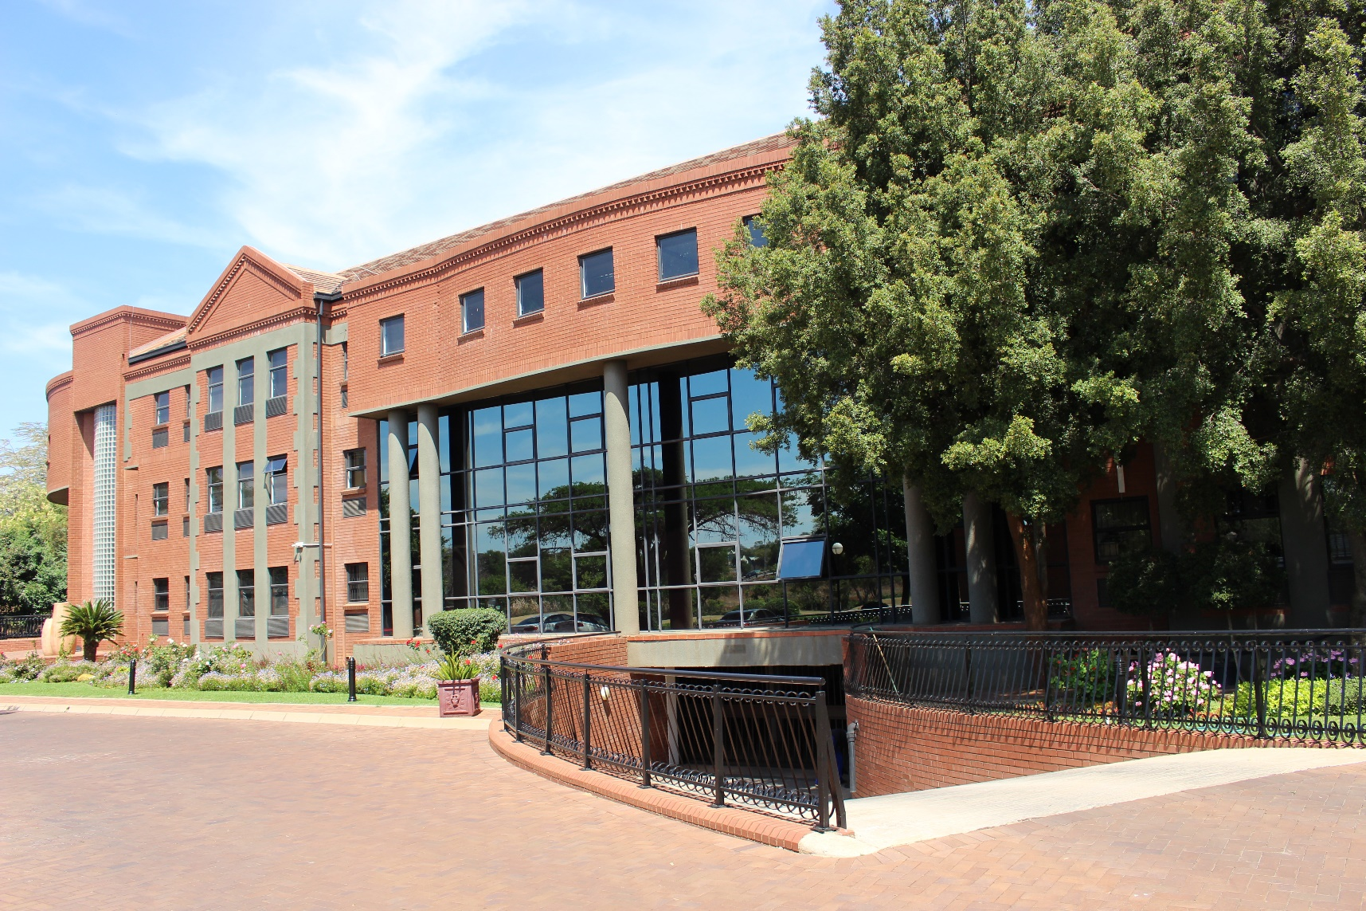
Articulation from Technical & Vocational Education & Training (TVET) Colleges to Higher Education
Presentation to the Parliamentary Portfolio Committee on Higher Education, Science & Technology
18 November 2020

Slide 2
The Position of the CHE Regarding Articulation
Articulation is a key mechanism for advancing objectives of the NQF
Does not just happen on its own
Needs to be promoted, facilitated & supported
Needs interventions at multiple levels: ‘articulation by design’ at the levels of:
- Learning programme
- Institution
- Group of institutions (inter-institution)
- System
Notes:
Bullet point two: vertical, lateral and horizontal movement of learners within the NQF.

Slide 3
HE Enrolment of Students through the TVET Sector Route
Enrolment into HE from the school sector is governed by national regulatory frameworks
a) Min requirements for admission (NSC): 2008, revised 2018
b) Min requirements for admission (NCV): 2009, revised 2018
There are no national regulatory frameworks governing enrolment into HE from the TVET sector
Admissions into HE through the TVET Sector route is at the mercy of HEIs
HEIs have different criteria
Criteria may also differ between Faculties & Departments within same HEIs

Slide 4
University Enrolment Figures through the TVET Route
 | 2014 |  | 2015 |  | 2016 |  | 2017 |  | 2018
 | Count | % | Count | % | Count | % | Count | % | Count | %
UG Dip/Cert | 873 | 1.3% | 1,065 | 1.5% | 1,128 | 1.9% | 2,009 | 2.3% | 2,290 | 2.4%
3yr Deg | 64 | 0.1% | 91 | 0.2% | 93 | 0.2% | 202 | 0.4% | 290 | 0.5%
Prof 1st (3yr) | 2 | 0.1% | 0 | 0.0% | 16 | 0.5% | 32 | 1.0% | 33 | 1.1%
BTech | 48 | 2.0% | 29 | 1.3% | 44 | 1.8% | 66 | 2.2% | 27 | 1.7%
4yr Deg | 69 | 0.2% | 96 | 0.2% | 76 | 0.2% | 186 | 0.4% | 244 | 0.5%
Total | 1,056 | 0.6% | 1,281 | 0.7% | 1,357 | 0.8% | 2,495 | 1.3% | 2,884 | 1.4%
Data source: HEMIS

Slide 5
What do the Figures Tell Us?
Admissions to HE through the TVET route still very small: less than 3000 students for all 26 universities in 2018
If the figures were to be disaggregated by individual universities, the picture will be worse
Proportion of admission through TVET to total admission rose from 0.6% in 2014 to 1.4% in 2018
Steadily increasing, but the annual rate of increase still less than 1%
Much of the enrolment is in UG Dip/Cert & BTech: TVET certificates &/subject credits not widely accepted for most HE qualification programmes
Needs to be promoted, facilitated & supported

Slide 6
Possible Intervention 1: Regulations & Guidelines
Regulations like the ones governing admission to HE from the school system:
: NCV &NSC
Guidelines to be developed by the Quality Councils (QCs)
: CHE, QCTO, Umalusi
Consultation with Universities South Africa is essential

Slide 7
Possible Intervention 2: Articulation Incentive Programme
Articulation Policy acknowledges that ‘specific articulation’ is ‘articulation in practice
Based on agreements between institutions: HEIs & TVET Colleges, for example
There are no incentives for HEIs to enter into these agreements, nor sanctions for choosing not to
Incentives could go a long way to promote ‘specific articulation’
Possibility of developing & implementing an ‘Articulation Incentive Programme’ should be explored

Slide 8
Possible Intervention 3: The CAS Bill
The Central Applications Service (CAS) Bill was released last year
Seeks to establish & operationalise the CAS for HEIs & TVET Colleges
CAS could help promote & facilitate articulation
Provide all prospective entrants with access to the necessary information
Provide advice service for prospective & unsuccessful applicants
Provide career counselling service
Provide clearing house service

Slide 9
Possible Intervention 4: Review of the HEQSF
The Higher Education Qualifications Sub-Framework (HEQSF) regulates qualification & learning programme offerings in HE
All HE offerings need to be aligned to the HEQSF
First published in 2013: now going through a review
Some aims of the review:
Need to provide greater clarity on the articulation possibilities between qualifications on the HEQSF & those on the OQSF
Emphasise parity of esteem of qualifications on the same NQF levels on the HEQSF & OQSF
Will consult widely, including TVET sector before finalisation of review

Slide 10
Possible Intervention 5: Professional BEd/MEd/DEd Programmes for TVET Educators
HE sector should assist to build capacity in the TVET sector by training curriculum development specialists for the sector, training education management specialists for the sector
Universities should increase the production of teacher graduates/educators in technical subject areas
Develop professional programmes for TVET educators at BEd, Med & DEd levels
Universities to apply for UCDP grants emphasising the imperative of developing capacity for the TVET sector

Slide 11
Possible Intervention 7: Structural Reform
Aim of WP on PSET: single, expanded, effective & integrated PSET system
What we have: perceived hierarchy of PSET institutions:
- from traditional universities at the apex of the pyramid to TVET &/or community colleges at the base
Serious structural obstacle to articulation
Exacerbated by reality of having ‘advantaged’ & ‘disadvantaged’ dichotomies within each institutional type
Dialogues should take place between & among different institutional types
DHET could facilitate such dialogues: CHE willing to play a role in such dialogues

Slide 12
Possible Intervention 8: Research
The Articulation Policy acknowledges that articulation is complex
Adoption of workable articulation practices has to be guided by research
But not much research is being conducted in this area by universities &/or QCs
Research to identify barriers & international best practices would be essential
Research towards establishing parity of esteem between qualifications on the same NQF levels but on different sub-frameworks
Research on monitoring trends also essential
The CHE plans to conduct a snap survey of institutions in its domain to elicit their responses to the articulation initiatives with the TVET sector

Slide 13
Thank you

