Slide 1
ANNUAL REPORT FOR 2019/20
FINANCIAL YEAR
BRIEFING TO THE PORTFOLIO COMMITTEE ON PUBLIC SERVICE AND ADMINISTRATION, PLANNING/MONITORING & EVALUATION
18 NOVEMBER 2020

Slide 2
PRESENTATION OUTLINE
Briefing on the progress report with regard to the implementation of the recommendations contained in the budget report (Vote 10) 2019/20 financial year
Briefing by the Public Service Commission on the annual report for 2019/20 financial year (BRRR)
Background
Summary of Performance Information
Financial Performance
Audit outcome
Overview of draft Performance Information per Programme

Slide 3
Briefing on the progress report with regard to the implementation of the recommendations contained in the budget report (Vote 10) 2019/20 financial year

Slide 4
RECOMMENDATION IN BUDGET REPORT
11.17: That the PSC should continue monitoring and evaluating government on the Constitutional Values and Principles (CVPs) in the public sector. The PSC should after having tabled the report to Parliament, publish the results on the State of the Public Service with regard to the adherence to the CVPs to the members of the public by utilising platforms such as media conferences and social media as a way of popularising its work.
The monitoring and evaluation of the CVPs is an annual programme of the PSC. In the 2020/21 financial year the PSC will conduct quantitative evaluations of 25 departments.
Overall, the work of the PSC across all streams hinges on the CVPs.
The evaluations, including other initiatives culminate in a State of the Public Service Report. The 2019 report was approved in March 2020.
The PSC popularises the findings of its report in presentations to various stakeholders and also publicises it through the media (5 articles in 2020), as well as through its quarterly publication, the “Pulse of the Public Service”.
On 1 October 2020 the PSC hosted a Webinar on the State of the Public Service, which was well attended by various stakeholders, including heads of department, academia, international representatives and the press.

Slide 5
Briefing by the Public Service Commission on the Annual Report for 2019/20 financial year

Slide 6
BACKGROUND
The draft Annual Report was submitted to the Auditor-General (AG-SA) on 31 July 2020 as per revised compliance deadlines by National Treasury.
The audit by the AG-SA commenced on 1 August 2020 until 30 September 2020.
Audit processes including sign-off on the finalization of the Annual Report was concluded on 30 October 2020 and the Annual Report will be tabled in Parliament on 16 November 2020

Slide 7
SUMMARY OF PERFORMANCE FOR 2019/20 (1)
The PSC attained all its Annual Performance Plan (APP) targets in the 2019/20 financial year.
PROGRAMME | TOTAL NO OF APP TARGETS | TOTAL ACHIEVED
Administration | 7 | 7
Leadership and Management Practices (LMP) | 5 | 5
Monitoring and Evaluation (M&E) | 2 | 2
Integrity and Anti-Corruption (IAC) | 7 | 7
Total | 21 | 21
The PSC also delivered on an additional 78 outputs outside the APP which were achieved. Noteworthy outputs will be reflected under the relevant programmes.

Slide 8
2019/20 FINANCIAL PERFORMANCE
 | Actual Expenditure
 | R’000
2019/20 Final Budget | 278,229
2019/20 Actual Expenditure | 274,529
% of Budget Spent | 98.67%
% of Budget Under Spent | 1.33%
Budget Under Spent | 3,700

Slide 9
2019/20 BREAKDOWN OF BUDGET UNDER SPENT
 | R’000
Compensation of Employees | 130
Goods and Services | 3,828
Transfers and Subsidies | 2
Payment for Capital Assets | 11
Payment for financial assets (theft & loss) | (271)
Budget Under Spent | 3,700
Reason for variances:
Suppliers delayed with invoices due to Covid-19 related complications.
Some orders could not be paid by suppliers due to Covid-19 related challenges.
SITA related delays in procuring new video conference facility. Roll-over request of R2.3 million was submitted to National Treasury for consideration.

Slide 10
2019/20 EXPENDITURE PERFORMANCE
PER PROGRAMME
Programme | Final Budget (R’000) | Actual Expenditure (R’000) | % of Budget Spent (%) | Budget Under Spent (R’000) | % of Budget Under Spent (%)
Administration | 128,603 | 125,719 | 97.76% | 2,884 | 2.24%
Leadership & Management Practices | 49,693 | 48,991 | 98.59% | 702 | 1.41%
Monitoring & Evaluation | 42,363 | 42,313 | 99.88% | 50 | 0.12%
Integrity & Anti-Corruption | 57,570 | 57,506 | 99.89% | 64 | 0.11%
TOTAL | 278,229 | 274,529 | 98.67% | 3,700 | 1.33%

Slide 11
2019/20 EXPENDITURE PERFORMANCE
PER ECONOMIC CLASSIFICATION
Economic Items | Final Budget (R’000) | Actual Expenditure (R’000) | % of Budget Spent (%) | Budget Under Spent (R’000) | % of Budget Under Spent (%)
Compensation of Employees | 212,866 | 212,736 | 99.94% | 130 | 0.06%
Goods and Services | 55,836 | 52,008 | 93.14% | 3,828 | 6.86%
Transfer and Subsidies | 2,692 | 2,690 | 99.93% | 2 | 0.07%
Payments of Capital Assets | 6,835 | 6,824 | 99.84% | 11 | 0.16%
Payments for Financial Assets | 0 | 271 | 0.00% | (271) | 0.00%
TOTAL | 278,229 | 274,529 | 98.67% | 3,700 | 1.33%

Slide 12
PSC 2019/20 AUDIT OUTCOME
During 2019/20 audit cycle, the PSC received a clean audit.
Types of Audit Outcomes
Clean audit
Unqualified audit with findings
Qualified with findings
Adverse with findings
Disclaimer with findings
Outstanding audits

Slide 13
2019/20 AUDIT OUTCOME
Trend analysis of findings affecting the audit report:

Slide 14
2019/20 AUDIT OUTCOME
Creditors payment days
No fruitless and wasteful expenditure, as well as unauthorised expenditure incurred. The following irregular expenditure incurred:

Slide 15
Overview of
Performance Information

Slide 16
PROGRAMME 1: ADMINISTRATION

Slide 17
PROGRAMME 1: ADMINISTRATION (1)
Indicator | APP Target | Consolidated Achievement
Approved Annual Performance Plan tabled in Parliament by 31 March 2020 | APP tabled in Parliament in March 2020 | Target achieved APP (2020/21) was tabled in March 2020 | Achieved
Unqualified audit opinion | Unqualified audit opinion | Target achieved Obtained an unqualified audit opinion in July 2019 Implemented Audit Improvement Plan. Positive outcome of interim audit on performance information. Clean audit for the 2019/20 fy
100% of valid invoices paid within 30 days of receipt | 100% | 100% Target achieved 3 641 of 3 641 of valid invoices paid within 30 days of receipt
17

Slide 18
PROGRAMME 1: ADMINISTRATION (2)
Indicator | APP Target | Consolidated Achievement
Number of interim financial statements submitted to NT quarterly | 4 | Target achieved 4 | Achieved
PAIA Section 15 Notice submitted to DoJCD | Submit Section 15 Notice to DoJCD | Target achieved Section 15 Notice submitted to DoJCD in March 2020
Percentage of BBBEEE suppliers appointed by March 2020 | 10% | Target exceeded A total of 58% (45 out of 78) BBBEEE suppliers were appointed by March 2020
Number of risk management reports produced | 4 | Target achieved 4
18

Slide 19
ADDITIONAL OUTPUTS OUTSIDE THE APP (3)
In providing institutional support to the PSC, the OPSC maintained a vacancy rate of 7% (19 vacancies out of 274 approved posts) and out of the 9 vacant critical posts at SMS level, 6 were filled, 4 of these posts were filled by women in an effort to attain the 50% representation of women at SMS level.
During the 2019/2020 financial year the OPSC reviewed 13 Human Resource Management and Development policies.
Amendments were made to the organisational structure relating to the Branch: Corporate Services wherein two Chief Directorates were created and the post of Deputy Director-General was abolished.
The OPSC achieved a 100% submission rate in respect of the Performance Agreements for all employees by the due date of 31 May 2019. The moderation of the Performance Appraisals for the 2018/2019 performance cycle in respect of 219 eligible employees was finalised in September 2019.
During the reporting period, the PSC’s visibility improved and this was done through various mediums of communication. The outputs such media articles and the Pulse of the Public Service, which was released on a quarterly basis, continued to raise the profile of the PSC.

Slide 20
PROGRAMME 2: leadership and management practice (LMP)

Slide 21
PROGRAMME 2: LMP (1)
Indicator | APP Target | Consolidated Achievement
% of grievances of employees on salary levels 1 – 12 finalised within 30 working days from date of receipt of all relevant information | 80% | 84% Target exceeded by 4% As at 31 March 2020, 806 grievances were registered of which 725 (90%) were for level 2-12. Of the 725 cases, 549 (76%) were concluded of which 460 (84%) were concluded within 30 working days of receipt of all relevant information) | Exceeded
% of grievances of SMS members finalised within 45 working days from date of receipt of all relevant information | 80% | 92% Target exceeded by 12% The 806 cases mentioned above include 81 cases for members of the SMS, of which 61 (75%) were concluded and 56 (92%) within 45 days
Targets exceeded due to improved business processes and engagements with departments
21

Slide 22
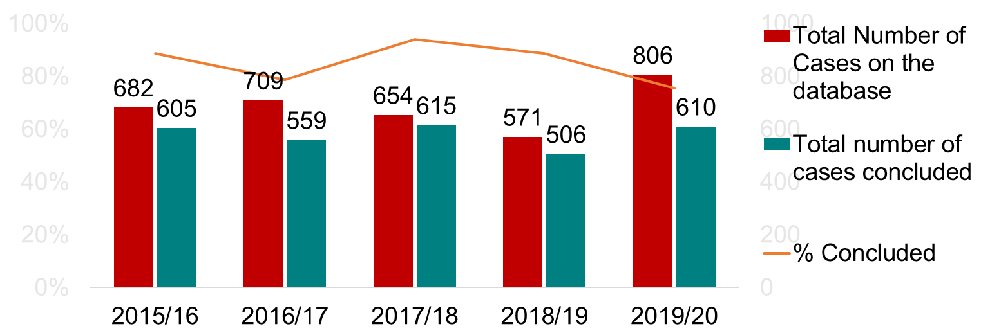
PROGRAMME 2: LMP (2)
Trends analysis of the management of grievances over the past five years
The trends analysis above shows that the number of grievances referred to the PSC during 2019/2020 increased significantly when compared to the previous four years, especially the 2018/19 financial year. The increase in the number of grievances referred to the PSC is consistent with an increase in the number of grievance lodged in departments.

Slide 23
PROGRAMME 2: LMP (3)
Indicator | APP Target | Consolidated Achievement
Number of reports on management of grievances in the public service produced | 3 | Target achieved 2 bi-annul reports and 1 Factsheet produced | Achieved
Number of communiques on grievance management approved by Mar 2020 | 2 | Target achieved 2 communique produced in September 2019 & March 2020, respectively
Number of research reports on strategic human resources and leadership produced | 2 | 3 Target exceeded by 1 Report/Guide for EAs, HoDs, Senior Management and other staff on prescripts and legislative requirements for the new administration. Report on Contract Appointments in the Public Service was signed off in March 2020. Report on performance of selected departments in the Public Service | Exceeded
23

Slide 24
ADDITIONAL OUTPUTS OUTSIDE THE APP (4)
The PSC participated in the induction and orientation of Executive Authorities (EAs) at national and provincial levels at the beginning of the 6th Administration in 2019. The engagements were considered important in contributing towards building a capable, career-oriented and professional Public Service through preventing challenges related to non-compliance with legislative obligations placed upon EAs regarding public administration.
The EA-HOD Guide covers various topical issues that cut across the mandate of the PSC, including among others, the application of the CVPs, role clarification at the political-administrative interface, managing recruitment and selection practices, managing ethics in the Public Service, the role of EAs in labour relations as well as mechanism to ensure continuity when there are leadership changes.
The PSC conducted a study on the performance of the Commission on the Restitution of Land Rights, which is attached to the Department of Rural Development and Land Reform through assessing, among others, the organisational structure, skills, capacity and performance management of human resource as well as the leadership put in place to ensure implementation of the land restitution mandate.
The PSC engaged with various stakeholders on employment equity implementation challenges and solutions in the Public Service at the Commission for Employment Equity's (CEE) strategic partner’s symposium.
24

Slide 25
ADDITIONAL OUTPUTS OUTSIDE THE APP (5)
The PSC, in response to requests from stakeholders and on its own accord due to situational analysis during the course of the financial year, completed the following additional activities:
A paper on Reflection on the challenges in the Public Service and Public Administration and the Implications for the NDP, which was presented at the National Planning Commission’s NDP Review Colloquium.
A paper which was presented at the National Planning Commission’s NDP Review Colloquium on Achieving a transformed, effective and development-oriented Public Service.
Convened Roundtable sessions for national and provincial departments on the Extent and Nature of Contract Appointments in the Public Service and produced a report based on the roundtable sessions.
Conducted advocacy sessions on grievance rules and engagement sessions and workshops on topical labour relations issues for several departments on its own and in collaboration with other stakeholders.
Provided assistance to pension beneficiaries who were experiencing challenges in access their pension benefits due to numerous challenges, including misplacement of submitted documents and inadequate communication channels.
25

Slide 26
IMPACT/ OUTCOME OF LMP OUTPUTS (6)
Strengthened stakeholder relations and influence on government policy: The PSC’s investigation of grievances that are referred to it as well as the monitoring of the management of grievances by all departments has enabled the PSC to address policy gaps and inconsistent practices with specific departments and the DPSA in a holistic manner, thus contributing towards the enhancement of sound labour relations in the Public Service. Systemic challenges identified through grievance management were addressed through well researched articles that are published via the grievance management communique, which is circulated to Labour Relations Officers and departments. The PSC’s collaboration with bargaining councils enabled the PSC to advocate for the implementation of recommendations made in various grievance cases and labour relations reports through making presentations to departments at the national level and in all provinces.
26

Slide 27
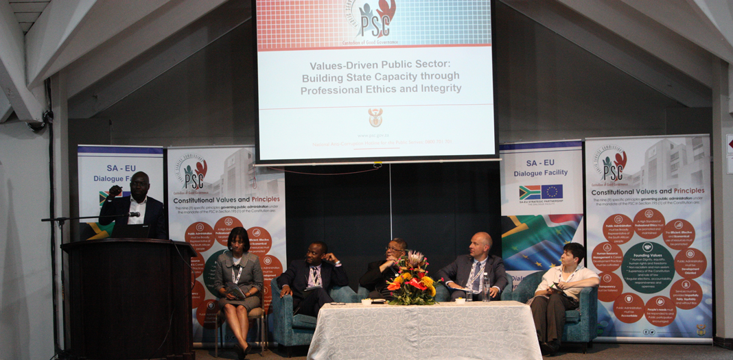
IMPACT/ OUTCOME OF LMP OUTPUTS (7)
Alignment/ Integrated approach to investigation of Grievances and addressing of HRM in the public service by the PSC: There is a logical flow between the PSC’s investigations on labour relations and HRM issues with the various strategic engagements, presentations, research and publications. The investigations by the PSC deal with specific incidents/cases while research and engagements address key issues at the broader policy level and popularise findings and recommendations to the broader Public Service in order to ensure consistency, capacitate departments or groups of employees across all departments and prevent the recurrence of similar challenges.
27

Slide 28
PROGRAMME 3: monitoring and evaluation

Slide 29
PROGRAMME 3 : M&E (1)
Indicator | APP Target | Consolidated Achievement
Number of CVP Promotion Engagements held by 31 March 2020 | Annual: 10 | Target exceeded A total of 58 engagements were held Target exceeded due to invitations, seizing of opportunities and requests from stakeholders | Exceeded
Number of reports on Evaluation of departments against the CVPs produced | Annual: 12 | Target achieved 12 Reports on evaluation of departments produced | Achieved
This comprehensive set of evaluations enabled the PSC to make a clear diagnosis on the performance of the public service both at the level of each provincial government and the above-mentioned sectors at national level.
Furthermore, the evaluations propose how the form and character of the public service should change from institutional fundamentalism (a rules-driven and compliance orientation) towards a more responsive and values-driven public service.
29

Slide 30
ADDITIONAL OUTPUTS OUTSIDE THE APP (2)
The PSC produced the State of the Public Service Report, which raises critical issues such as that public service mmanagers that fail to display agency, or they do not act on the agency they have.
Held two engagements with the Standing Committee of Appropriations. The engagements focused on, amongst others, strategies available to significantly improve management practices in the Public Service, issues of governance across the Public Service, expenditure against budgets versus performance for national departments as well as opportunities for efficiency, effectiveness and value for money in the Public Service.
The PSC in partnership with the SA-EU Dialogue Facility (funded by the EU Delegation) and UNISA hosted an international dialogue on a values-driven public sector: building state capacity through professional ethics and integrity.
A CVPs Booklet was developed, which aims to develop a shared understanding of the CVPs and provide a norm of what can be expected from the public administration and most importantly, to encourage the application of the values and principles in the delivery of services.
30

Slide 31
ADDITIONAL OUTPUTS OUTSIDE THE APP (3)
Service delivery inspections were conducted at the Cecilia Makiwane Hospital (Mental Unit) and the Frere Hospital Nerina House Nurses Home in the Eastern Cape. Key findings highlighted weaknesses in the safety and security measures at the Cecilia Makiwane Hospital whilst the conditions in which the medical personnel living at the Nerina House Nurses Home were highly unhygienic and posed a serious health risk to nurses’ lives.
The PSC has taken to various media platforms to promote the CVPs, with particular focus on good governance, the professionalization of the public service and strongly condemning delinquent departments in support of President Cyril Ramaphosa's call to pay SMMEs within 30 days through thought-provoking published media articles to stimulate a national dialogue on the CVPs.
In ushering the 6th administration, the PSC in April 2019, provided the President with comprehensive inputs on enhancing the capacity of the Public Service and the reconfiguration of government to best deliver services to the citizens of the country.
Various papers and opinion pieces on key topics were produced and presented at events hosted by stakeholders and published in the media.
31

Slide 32
IMPACT/ OUTCOME OF M&E OUTPUTS (5)
Telephonic access to departments was enhanced following PSC’s appeal to ensure that alternative numbers were made available to the public during lockdown The PSC intervened to fact-track payment of suppliers where the requirement of 30 days payment was not honored. A number of COVID-19 grant payment (R350) were fast tracked and paid due to PSC’s intervention. Water tanks were delivered in KZN to facilitate access to water following the PSC’s intervention. The PSC worked with SAPS to assist families that required papers for the inter-provincial travelling and due to such intervention, necessary papers were granted. The Mamelodi Hospital indicated notable improvements from the availability of beds through the renovation of old wards to the installation of a generator. There was also a follow-up engagement with 1 Military Hospital on the implementation of recommendations, which showed a significant improvement in the availability of medicines and medical equipment, with notable improvements in the availability of human resource capacity and related processes.
32

Slide 33
PROGRAMME 4: integrity and anti-corruption

Slide 34
PROGRAMME 4: IAC (1)
Indicator | APP Target | Consolidated Achievement
% of public administration investigations finalised within 3 months upon receipt of all relevant information | 70% | 96% Target exceeded by 26%: As at 31 March 2020, there were 315 complaints on the database, of which 225 were finalized and 90 were in progress. Of the 225 finalised, 216 (96%) were finalised within 3 months of receipt of all relevant documents The overachievement is ascribed to the close monitoring of investigations. | Exceeded
Number of factsheets on financial misconduct produced | 1 | Target achieved 1 Factsheet produced in November 2019 | Achieved
34

Slide 35
PROGRAMME 4: IAC (2)
Trends analysis of the management of complaints over the past four years
There has been a slight increase in the closure rate of cases of 68% in 2018/19 to 71% in the 2019/20 financial year.
The impact of cost containment measures such as a lack of funding for travelling and a number of posts that have been abolished on the closure of cases was mitigated as is evident in the increase in the closure rate.
However, the complexity of cases required more time and resources spent on investigations.

Slide 36
PROGRAMME 4: IAC (3)
Indicator | APP Target | Consolidated Achievement
Percentage of NACH cases referred within 7 working days of receipt of case report | 90% | 100% Target exceeded by 10% 1 591 of 1 591 of NACH cases were referred within 7 days of receipt of case reports The target was exceeded due to the close monitoring of compliance with timeframes. | Exceeded
Number of reports produced on the closure of NACH cases by departments | 1 | 1 Target achieved A report was produced in March 2020 | Achieved
Number of overview reports on Financial Disclosure Framework produced | 1 | 1 Target achieved An overview report was produced in March 2020
36

Slide 37
PROGRAMME 4: IAC (4)
Indicator | APP Target | Consolidated Achievement
Number of research reports in professional ethics produced | 1 | 1 Target achieved: A report on “Assessment of professional ethics in the Public Service” produced in March 2020 | Achieved
Percentage of investigations on early resolution cases finalized within 45 working days upon receipt of all relevant information | 90% | 100% Target exceeded by 10% A total of 42 of 42 ER cases finalised within 45 days from date of receipt of all relevant information The target was exceeded due to close monitoring and follow ups with relevant departments | Exceeded
37

Slide 38
ADDITIONAL OUTPUTS OUTSIDE THE APP (5)
During the period under review, 69 complaints of alleged corruption relating to national and provincial departments were closed.
In addition, 99 complaints of alleged corruption which were cases reported during the previous financial years were closed.
The PSC also closed 999 cases relating to public entities. Public entities are only required by the PSC to report on the conclusion of these cases on a regular basis.
The reasons for not investigating complaints beyond the initial assessment are a combination of the following:
The complaints did not reasonably raise a suspicion of misconduct.
The complainants were informed that another law enforcement agency or court was more appropriate to deal with the matter.
The matter fell outside of the mandate of the Public Service.
Callers did not provide adequate information for investigation.
The PSC hosted International Anti-Corruption Day on 09 December 2019, under the theme: “United Against Corruption: Building a Culture of Accountability for Sustainable Development”.
38

Slide 39
ADDITIONAL OUTPUTS OUTSIDE THE APP (6)
Various ethics initiatives were implemented to encourage ethical behaviour and integrate ethics into the Public Service.
Briefing sessions and workshops on the Code of Conduct to address issues related to professional ethics at departments.
Targeted visits to national and provincial departments to conduct workshops on professional ethics as well as roundtables on professional ethics.
Hosting an Ethical Leadership Seminar during Nelson Mandela Month, to engage with public servants on “Leading like Mandela: Dawn of the new era of ethical, value based leadership”.
The PSC monitored the implementation of the Financial Disclosure Framework by members of the SMS members throughout the Public Service.
To this end, 9834 SMS members submitted financial disclosure forms to the PSC by the due date of 31 May 2019. Accounting for 97% of the total number of SMS members
The PSC engaged with EAs to consult with the SMS members to determine the reasons for not disclosing their directorships, and where necessary disciplinary action should be instituted against these SMS members.
39

Slide 40
IMPACT/ OUTCOME OF IAC OUTPUTS (7)
The implementation of recommendations emanating from the PSC investigations enables the EAs to enforce accountability and consequence management where disciplinary proceedings were undertaken. Advice provided brings about improved systems and personnel practices that are compliant to the applicable prescripts. The management of Conflict of Interest through Financial Disclosure Framework ensures openness and transparency and mitigates against officials conducting business with the state. The survey on Leadership commitment to the promotion of ethics in the public service assessed progress made in implementing the Ethics Management Framework in the Public Service and advise on required improvements where gaps are identified. The speedy referral of all cases reported through the NACH to the respective departments for attention will raise the profile of the whistleblowing mechanism and encourage more people to report, especially when they see appropriate action against wrongdoers.
40

