Slide 1
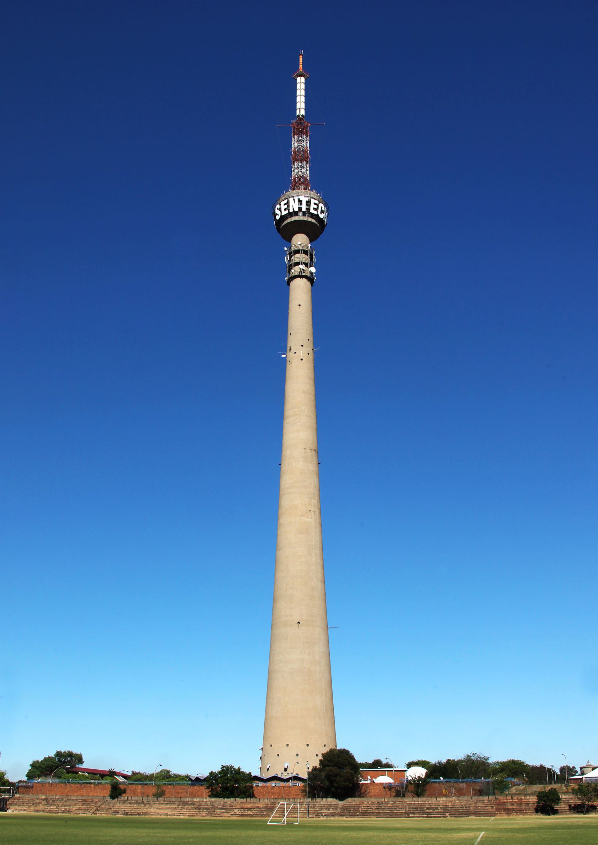
SENTECH SOC LTD
Signal Distribution Costs Presentation
9 November 2020

Slide 2
SENTECH BUSINESS OVERVIEW
Largest Satellite Teleport based in Honeydew
Over 300 transmitter sites
Data Centre in Nasrec
National Call Center
24/7 365 NOC and 15 Operation Centres

Slide 3
Presentation Outline
Background and Challenges
The legislative provisions
Community broadcasters’ debt to SENTECH and breakdown as per province
The cost drivers specific to community broadcasters
Conclusions

Slide 4
Background
SENTECH provides broadcast transmission services to more than 146 community broadcasters country-wide.
Between 1998 and 2011 the ”Department of Communications” had a support program to assist community broadcasters with signal broadcasting costs.
The support scheme was in line with Government’s commitment to building a strong community broadcasting sector in the country to ensure maximum impact and benefits to selected communities.
The support scheme stopped in 2012 and since then community broadcasters have been facing sustainability challenges of not being able to pay for the signal distribution services consumed.
Community Broadcasters’ sustainability issues, more specifically continued lack of financial resources to meet obligations, have far reaching effects on SENTECH’s ability to fulfill its functions.

Slide 5
Challenges
Community Broadcasters have been simultaneously receiving services as per contracts, and SENTECH has an enforceable right to payment for services delivered.
Over the past few years, unfortunately payment terms have been at the customers’ discretion, and the timing is based on factors outside of SENTECH’s control and requires more active management.
Revenues billed for services offered has not been collectable for a couple of years.
Community broadcasters’’ tariffs are discounted, and most pay less than service agreements while SENTECH is still responsible for the maintenance and repair of the assets built for them, up to and including future equipment break downs or those needing replacement.
Community broadcasters’ debt to Sentech stands at R70 million as of October 2020.

Slide 6
Legislative Framework
SENTECH’s service provisioning is guided by section 62 of the EC Act (as amended), supported by regulations gazetted by the Authority.
The EC Act prescribes the following:
Services only provided based on an appropriate and valid broadcasting licence;
SENTECH to provide services on an equitable, reasonable, non-preferential and non-discriminatory basis.
SENTECH’s tariff's schedule must take into consideration the different categories of broadcasting, including being appropriate to and commensurate with the broadcasting services to which they relate

Slide 7
Community broadcasters’ debt to Sentech
Debt per province in ZAR million |  |  |  |  |  | # of customers per province
Province | FM | TV | MW | Total |  | FM | TV | MW | Total
KwaZulu-Natal | 11 | 1 | - | 12 |  | 29 | 1 |  | 30
Gauteng | 5 | 1 | 4 | 10 |  | 17 | 1 | 4 | 22
Mpumalanga | 8 | - | - | 8 |  | 14 |  |  | 14
Eastern Cape | 8 | - | - | 8 |  | 20 |  |  | 20
Limpopo | 7 | - | - | 7 |  | 14 |  |  | 14
Western Cape | 7 | 1 | - | 8 |  | 17 | 1 | 1 | 19
North West | 6 | - | - | 6 |  | 8 |  |  | 8
Free State | 4 | - | - | 4 |  | 13 |  |  | 13
Polokwane | 2 | - | - | 2 |  | 3 |  |  | 3
Northern Cape | 2 | - | - | 2 |  | 3 |  |  | 3
Total | 60 | 3 | 4 | 67 |  | 138 | 3 | 5 | 146

Slide 8
Community Broadcasters’ Debt To SENTECH
 | Total Due | >120 Days | 91-120 Days | 61-90 Days | 30-61 Days | Current
Debt for service delivery | 70 | 61 | 2 | 2 | 2 | 2
Assets Terminal Value | 11 | 11 | - | - | - | -
Amounts in ZAR million | 81 | 72 | 2 | 2 | 2 | 2
Community Broadcasters owe SENTECH R70 million for services delivered as indicated in table above.
MDDA has requested the cost to buy out the invested community broadcasters assets and the terminal value of these assets is R11 million.
The total payable for the debt and assets terminal value if elected is R81 million.

Slide 9
Historic Funding Support
Community Broadcaster receive a discounted tariff for signal distribution service
This FY MDDA has made payments of R11 Million towards CRB

Slide 10
Relationship Management
Engagements are done with all customers at regular intervals
SENTECH presented the new tariff model to MDDA and their grantees to assist in community radio sustainability.
SENTECH is also participating in the MDDA funding outreach programme to present the community radio model which reduces the debt burden on SENTECH.
Regional Operation Centres continue to support and ensure service availability for all customers.

Slide 11
SENTECH BUSINESS MODEL
Content & Multimedia Services
Radio and TV – Digital and Analogue
Content Platform Applications
OTT /Video on Demand
Value Added Services
Consultancy Services
ICT Services
Wireless Broadband Connectivity
Datacenter Solutions
Broadband Value-Added Services
Infrastructure Management Services
3rd Party Facility Management
Facility Leasing
Consultancy Services

Slide 12
Current Operating Model (COM)
SETUP COSTS
EQUIPMENT COSTS
Transmitters
Audio Processors
RDS
Combiners
Linking Equipment
INSTALLATION COSTS
Combiner installation
Linking Installation
transmitter Installation
SUPPORT & MAINTENANCE COSTS
NOC & Call Center
Technical Support
Reactive Maintenance
Proactive Maintenance
Equipment repairs
Equipment Replacement Costs
SPARES
Replacement Spares
Equipment Refresh
3RD PARTY COSTS
Site Sharing
3rd Party Links
SENTECH Facilitation
Recovery amortized over a period

Slide 13
Future Operating Model (FOM)
SETUP COSTS
ONCE-OFF FUNDED
EQUIPMENT COSTS
Transmitters
Audio Processors
RDS
Combiners
Linking Equipment
POSSIBLE FUNDERS
MDDA
DCDT
Community Funding/ donors
SUPPORT & MAINTENANCE COSTS
TIME & MATERIAL BASED
OPTION 1
Monthly tariff calculated for on Equipment Support & Maintenance
Spares to be include as part of the above tariff
OPTION 2
Creation of Technical Expertise within Communities (Training)
2nd Level support: Call Centre support
3rd Level : On-Site Support (Time & Material based)
OPTION 3
Analyses Monthly support stats per CRB (Capacity requirements)
2nd Level : On-Site Support (Time & Material based)
3RD PARTY COSTS
DIRECT CONTRACTING
Direct Contracting btw CRB & 3rd Party
3rd Party Contract Transfer
SENTECH to Facilitate Negotiations
SPARES HOLDING
OPTION 1
Procurement of Spares as Part of Setup Costs
SENTECH hold Spares
OPTION 2
SENTECH procure and rent out spares in case of failures
OPTION 3
CRBs takes full responsibility of spares
) RECOVERY AMORTASED OVER A PERIOD

Slide 14
Global Trends of CRBS Funding
CRBs in most countries are funded through :
Government grants;
Members and public donations;
Advertising and content sharing revenues;
Collection of household licence fees (mostly on TV);
Strong dependence on volunteers

Slide 15
Conclusions
Community Broadcasters owe SENTECH R70 million for services delivered
MDDA has requested the cost to buy out the invested community broadcasters assets and the terminal value of these assets is R11 million.
The total payable for the debt and assets terminal value if elected is R81 million
Engagements are done with all customers at regular intervals
SENTECH presented the new tariff model to MDDA and their grantees to assist in community radio sustainability.
SENTECH is also participating in the MDDA funding outreach programme to present the community radio model which reduces the debt burden on SENTECH.

Slide 16
Sentech Business Model
SENTECH is a Schedule 3B public entity listed under the Schedules of the PFMA.
The requisite foundation of a Schedule 3B is that the company must be self sustaining. Therefore SENTECH cannot expect any bailout from the fiscus.
The customer base consists of public broadcaster, commercial broadcasters, community broadcasters, facilities leasing and Connectivity customers
SENTECH’s effective governance processes ensures effective and efficient management of its finances
SENTECH has achieved 8 consecutives clean audit opinion
We honour our service level agreements (SLA) to customers with 99.80% network availability by managing and maintaining the infrastructure. This preventative maintenance costs a lot of money.
SENTECH is consistently looking at innovative ways to offer the best quality services in a cost effective manner to its customers.
The tariff determination takes into consideration all of the above factors.
The mandate to deliver universal access to broadcasting requires SENTECH to invest in a national network that provides coverage for all customers according to their licence conditions as issued by ICASA.

Slide 17
Thank you

