Slide 1
Access to diversified media for alla
MDDA Community Media Support Programmes
Portfolio Committee on
Communications
November 2020

Slide 2
LEGISLATIVE MANDATES
CONSTITUTIONAL MANDATE
Section 16:
Everyone has a right Freedom of Expression
Section 32:
Everyone as
a Right to Access
to Information
Section 15 (1)
“Everyone has the right to freedom of conscience, religion, thought, belief and opinion

Slide 3
ESTABLISHMENT OF THE AGENCY
SECTION 2 OF THE MDDA ACT (2002)
Agency Acts only through the Board
Juristic Person
01
02
03
Act in terms of PFMA, 1999
05
Must not interfere in the editorial content of the media
04
Independent, impartial & exercise its powers and duties without fear or prejudice, political or commercial interference

Slide 4
THE MDDA MANDATE
SECTION 3 OF THE MDDA ACT, 2002
Encourage ownership of, and access to media by Historically Diminished Groups as well as by historically diminished indigenous language and cultural groups
Encourage the development of human resources and training, and capacity building, within the media industry, especially amongst historically disadvantaged groups
A
B
Raise public awareness with regard to media development and diversity issues and support initiatives which promote literacy and a culture of reading.
C
Encourage channeling of resources to the community and small commercial media sectors.
D

Slide 5
OTHER RELATED LEGISLATION
REGULATORY FRAMEWORK
Broadcasting Act, 1999 as amended
Community media broadcasting
Independent Communications Authority of SA Act, 2000,
Powers to grant, renew, amend, transfer and revoke licences.
The Eco System
Electronics Communications Act, 2005
Chapter 9(50): Community broadcasting services licenses (non-profit)
Universal Service and Access Fund (USAF) Levy
Promotion of Administrative Justice Act, 2000
Administration of Justice
Public Finance Management Act, 2009
Good and accountable governance.
BBBEE Act No.59 of 2003

Slide 6
NATIONAL DEVELOPMENT PLAN
ALIGNMENT TO VISION 2030
Priority 6
Priority 1
Priority 5
Building a Capable, Ethical and Developmental
State
Economic Transformation and Job Creation
Social Cohesion and Safe communities
MDDA Goal:
Media diversity promoted through the growth and sustainability of community-based media in SA.
MDDA Goal:
Capable, effective and efficient organisation in support of the delivery of the mandate
MDDA Goal:
Capacitated, digital responsive community- based media in SA.

Slide 7
VISION, MISSION & VALUES
Vision
An accessible, transformed
and diversified media.
Mission
To support the development of a vibrant, innovative, sustainable and people-centred community media sector through resourcing, knowledge-based research and capacity building, in order to give a voice to historically disadvantaged communities.
Vision
Values
Mission
Values
Accountability, Inclusivity, Integrity, Ubuntu, Professionalism.

Slide 8
STRATEGIC OBJECTIVES
2020/2025 MEDIUM TERM STRATEGIC FRAMEWORK
Objective 1
Objective 2
Objective 3
Facilitate ownership, control and access to information and content production of community broadcasting by historically advantaged communities.
To facilitate ownership, control and access to information and content production of community and small commercial publications by historically Advantaged communities.
To monitor and evaluate input, output and compliance to MDDA grant-in-aid contracts to measure the effectiveness and efficiency of the MDDA support
Objective 4
To ensure compliance with applicable legislative requirements and sustainability of the Agency
Objectives 5
Objective 6
To position the MDDA as an authoritative leader and voice on community and commercial media by proactive advocacy and lobbying interventions and established stakeholder relationships
To expand our footprint as the MDDA by creating a positive image in pursuance of the MDDA’s mandate to grow the community and small commercial media.

Slide 9
WHO DO WE SUPPORT?
Under the MDDA Act
1. Community media
Geographically founded community/ any group of persons or sector of the public having a specific ascertainable common interest.
2. Small Commercial Media
Independent media enterprises or initiatives
Run for personal gain as micro, very small or small business as classified in the National Small Business Act, 1996.
NPO, NGO, CBO, Section 21 non- profit
3. Research and Capacity Building
4. Digital, New and Online Media
Through procurement processes
Informed by Skills Audit
Non-profit organisations
Online publications

Slide 10
WHY DO WE SUPPORT COMMUNITY MEDIA
Defining Characteristics of the Community Media
Social Dialogue
Public Participation &
Active Citizens
,.
Social
Cohesion
Transformation of the media
Voice for
the voiceless
Dissemination of information
Nation Building

Slide 11
CRITERIA FOR FUNDING AND SUPPORT
Qualifying Application Criteria (Regulations (2003)
Extent to which project promotes media development and diversity
Extent to which project develops human resources, training and capacity building within media industry, especially amongst historically disadvantaged groups.
1
2
Compliance with media laws and codes of conduct.
Extent to which project encourages ownership, control, participation and access to media
Good governance practices of the project.

Slide 12
ITEMS FUNDED FOR THE BROADCAST SECTOR
The Basket
Content Production
Training and Capacity Building
Stipends
Salaries
Telecommunications
Local travel
Sales & Marketing
Finance
Grantee Orientation
Management
Administration
Capital Expenditure
Bank charges
Audit Fees
Rentals
Maintenance
Insurance
Stationery
Broadcast Studios
Computers
Laptops
OBE Devices
Generators
Printers
Transmission or Signal Distribution
Set-up costs
Relief for Sentech Fees

Slide 13
ITEMS FUNDED FOR PUBLISHERS
The Basket
Capital Expenditure
1
2
Printing and Distribution
Computers
Laptops
Printers
Cameras
Furniture
Website Design
Cash Grants and negotiated discounts with commercial print companies.
Operational Costs
4
3
Content Production
Salaries, stipends, transportation
Stationery
Bank Charges
Audit Fees

Slide 14
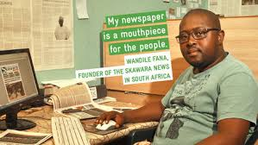
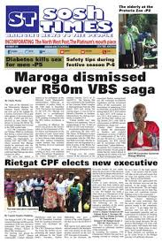
MDDA PROJECTS

Slide 15
THE MEDIA LANDSCAPE
Third Tier of the Media Sector in SA
MDDA Act promulgated
2004 January – MDDA funds 1st project
1994
2003
2020
2002
2004
Limited to Vyre Weekblad & Bush Radio funded by International Donors
Media industry highly monopolised,
- Limited or no diversity of news or opinion
- Voice of black people in media suppressed.
2003 - MDDA starts operating
MDDA Regulations Published
271 licensed community radio stations.
8 million reach
5 Community Television.
Over 200 publishers.

Slide 16
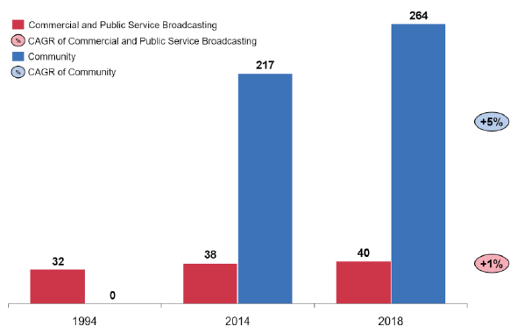
GROWTH IN COMMUNITY MEDIA BROADCASTING: 1994 - 2018
Source: National Association of Broadcasters, 2019.

Slide 17
PUBLISHING TODAY
No. of Publications
Circulation
Readership
Publishing Languages
Total Funded
- 180
- 87 weekly
38 fortnightly
55 monthly
7 million per month
+20 million per month
97 publish in indigenous languages or combination of indigenous and English/Afrikaans
33 community print
45 small commercial print
+ 60% Black ownership.

Slide 18
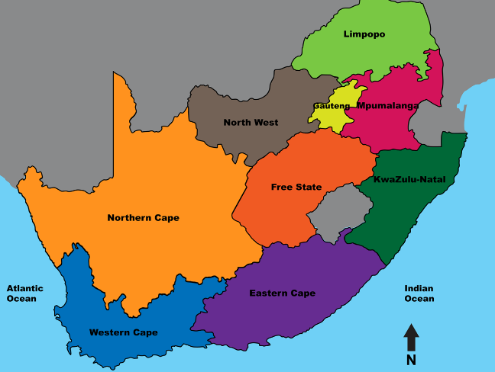
17 YEARS OF SUPPORTING THE SECTOR
145 Radio Stations , Four (4) Televisions, 78 Publishers
28
9
14
25
16
12
2
9
6
12
3
7
22
5
16
13
14
10

Slide 19
2019/20 FINANCIAL YEAR SUPPORT
22 community radio stations approved on 28 March 2020 across provinces & 10 community and small commercial print media on 28 March 2020 per province.
Total Budget Spent:
Broadcast Projects: R41 852 000.00
Publishers: R3 922 000.00
Signal Distribution: R11 165 291.50

Slide 20
SIGNAL DISTRIBUTION FUNDING 2019/20
CALLS FOR APPLICATIONS IN MARCH 2020
Funding for 22 approved projects
R6,6 million for 22 approved projects.
Debt settlement & 12 months transmission fees
Connection Fees
About R2m for 4 projects funded previously but were still off air.
Call for Applications
R11,1 approved and paid for 17 qualifying projects for debt settlement
Total Sentech Debt: R67,5m (30 Sept 2020)
Total Approved (March 2020) R18m

Slide 21
TRAINING AND RESEARCH 2019/20
CAPACITY BUILDING
NAME | DATE | PARTNERS | PARTNERS | AMOUNT FUNDED | NUMBER OF ATTENDEES | NUMBER OF ATTENDEES
Community Media Climate Change Reporting Workshop | 11 September 2019 | Food and Trees for Africa (FTFA) | Food and Trees for Africa (FTFA) | Did not pay/partnership | 35 | 35
Grantee Orientation Workshop | 29 July – 1 August 2019 | SARS, ICASA | SARS, ICASA | R700 000 | 40 | 40
Community Media Research, Fact Checking and Verification training | 14 to 17 October 2019 | Africa Check | Africa Check | R752 092 | 19 | 19
Web Rangers Digital Media Literacy Training | Launched 6 February 2019 (Safer Internet Day) | Media Monitoring Africa | Media Monitoring Africa | R 355 240 | 200 learners across various schools in WC, GP, NW | 200 learners across various schools in WC, GP, NW
TOTAL SPENT: R1 807 332.00 TOTAL TRAINED: 294
RESEARCH
RESEARCH PROJECT |  | PARTNER |  |  | AMOUNT
1. Skills and Capacity Assessment |  | Sizwe Media |  |  | R500,000
2. Community Media Digital Strategy |  | DMC Precision |  |  | R473,040
TOTAL SPENT: |  |  |  |  | R973 040.00

Slide 22
MDDA OFFICIALLY OPENED A CALL FOR FUNDING APPLICATIONS:
15 OCTOBER – 30 NOVEMBER 2020
Call Announced through 95 radio stations interview, country-wide roadshows, 2 x media statements. Application method interpreted in videos in 11 official languages

Slide 23
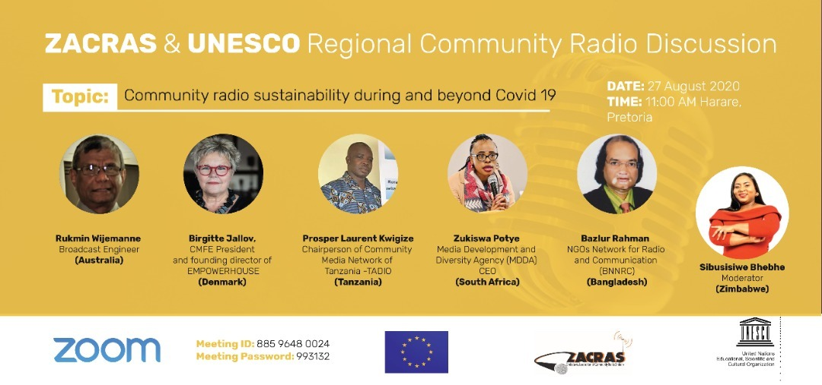
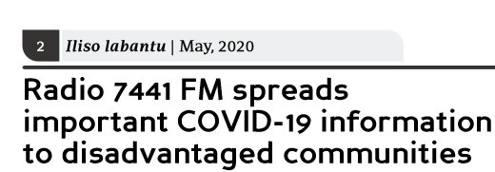
MDDA COVID-19 EMERGENCY RELIEF FUND

Slide 24
MDDA’S RESPONSE TO COVID-19
LAUNCHED R20 MILLION EMERGENCY RELIEF FUND ON 30 MARCH 2020
Phase I: R10m
Phase II: R10m
TOTAL PACKAGE PER PROJECT
TOTAL PACKAGE PER PROJECT: R45 000.00
For content generation
Telecommunications,
Fuel & PPEs
Printing & Distribution.
R50 000 for Broadcasters
R20 000 for Publishing
R290 000 for Television
FULLY DISBURSED R10m:
114 Radio Stations
1 Television
116 Publishers
UNDER DISBURSEMENT
Disbursed R6 232 485.00.
98 print projects
93 Radio stations
2 Television stations
Total Disbursed
R16 232 485.00

Slide 25
LOBBYING & PARTNERSHIPS
PUTTING THE PUZZLE TOGETHER
DRAFT FUNDRAISING STRATEGY
Broadcast Funders
Major Print Sector
3-year contract with Multichoice R40 million p.a.
Lobbying other commercial broadcasters who are not directing USAF levy to MDDA.
1
Draft SLAs with major print on:
Printing Discounts
Access to Paper
Training interventions
Distribution
Preferential Printing
Monthly Acc Reconciliations
Digitalisation
4
2
Telecommunications
Met with MTN, Vodacom & Volt Africa (Media24) Receptive to partner MDDA on digital media pilot study.
Finalise partnerships
Others
3
National Lotteries
Africa Media Fund
Google
Facebook
Open Foundation Society
SLA with Seda on training & development
SLA with the MICT Seta and
Draft with NEMISA

Slide 26
WAY FORWARD
FUTURE PLANS
Sustainability Model for the Sector
Consultative Conference August 2020
Draft ToRs for sustainability research
Research on sustainability 2021
Launch Sustainability Model for the Sector January 2023
20 Years MDDA Review:
Impact of Mandate from January 2022
Policy & Enabling Legislation
Participate in the amendment of both the Act and Media Transformation Charter
Review MDDA Regulations 3003
High Cost for Signal Distribution
Sectoral Digital Presence
Funding set-up up costs for Start Ups
Exploring Self Provisioning
Explore off-setting capital costs
Develop Technical Skills & Capacity/Partner with
Sentech
Finalising Digital strategy
Audited projects current digital presence (very low presence: 24 broadcast & 12 Publishers)
Conduct Audit on Sector Audit Needs
Negotiated with MultiChoice to include Community Radio Stations on the DSTV Audio bouquet
Expand community television footprint
Percentage Increase in community television across SA by 2024

