Slide 1
Presentation to the Parliamentary Portfolio Committee on Communications Regulatory Framework for Community Broadcasting Dr Keabetswe Modimoeng Chairperson 10 November 2020

Slide 2
Presentation Outline
Organisational Mandate, Vision, Mission & Values
Guiding Principles
Regulatory Framework- Licensing and Compliance
Distribution of Community Radio Stations
Licensing Framework
New Licensing Framework-Process
Sustainability of Community sector- Licensing Perspective
Sustainability of Community sector- Compliance Perspective
2

Slide 3
Organisational Mandate
ICASA is established pursuant to section 192 of the Constitution and in terms of the ICASA Act of 2000, as amended
ICASA is mandated to –
Regulate electronic communications, broadcasting and postal sectors in the public interest
Ensure affordable services of high quality for all South Africans
ICASA’s mandate is derived from:
The Constitution, 1996
ICASA Act, 2000
EC Act, 2005
Broadcasting Act, 1999
Postal Services Act, 1998
ECT Act, 2002
3

Slide 4
Guiding Principles
The Authority is guided by the national objectives with regard to preservation and protection of cultural heritage, promotion and redress of identities, languages and cultures that were previously discriminated against
Regulations seeking to strike a balance between the viability of broadcasters, public interest and the promotion of the independent producers and artists
Regulations crafted around issues of development of cultural industries, expansion of diversity of points of views, freedom of expression, and access to information and linguistic rights
4

Slide 5
Regulatory Framework (Licensing and Compliance)
Regulations on Standard Terms and Conditions for Class licences 2010, as amended;
Licensing Processes and Procedures Regulations for Class licences 2010, as amended;
Radio Frequency Spectrum Regulations 2015, as amended
ICASA South African Music Content Regulations 2016;
ICASA South African Television Content Regulations 2016;
Compliance Procedure Manual Regulations 2011;
Community Broadcasting Services Regulations 2019; and
General Licence Fees Regulations 2012, as amended
5

Slide 6
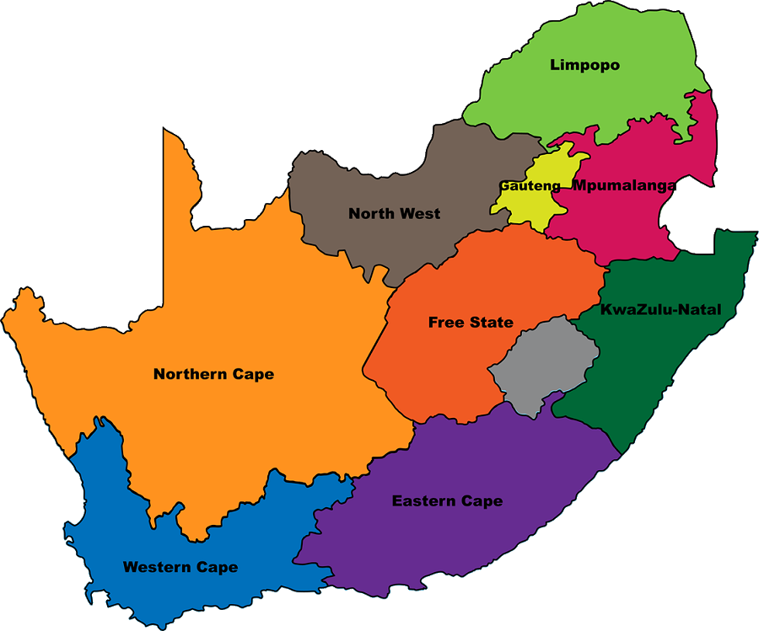
Distribution of Community Radio Stations ( Geographically founded and community of interest)
LP: 33
Distribution of community radio stations
All communities have a voice
Scope for growth of the sector
Source of local content
NW: 22
MP: 24
GP: 65
NC: 8
FS: 15
ICASA, MDDA and Sentech work together to support growth in this sector
KZN: 35
EC: 24
WC: 36
6

Slide 7
Licensing Framework
Licences are valid for a period of 5 years and are renewable. Special event licences are valid for 45 days and are non - renewable
The Authority will issue an Invitation to Apply twice a year
Applications for the amendment & transfer of community broadcasting licences are done on an ad hoc basis
Applications for renewal are done on an ad hoc basis 6 months prior to expiry of the licence
The Registration of community broadcasters is done in terms of section 17 of the ECA
Community Broadcasting
Requirements to provide Broadcasting Services:
Radio Frequency Spectrum Licence
Broadcasting Service Licence
Electronic Communication Network Service Licence (in case of self-provisioning)
7

Slide 8
New Licensing Framework- Process
Applicants must have been registered as a non-profit entity for 2 years prior to the lodgment of the application
Decide on the pre-registration notice within 90 days of closing date for submission of the pre-registration notice
Authority may conduct public hearings
The Authority issued an invitation for applicants to submit pre-registration notice and a list of available frequencies in each district and local municipality closing date 30 June 2020
If Applicants meet the requirements for the granting of a licence, such decision will be communicated in writing
Community Broadcasting
Requirements to provide Broadcasting Services:
Radio Frequency Spectrum Licence
Broadcasting Service Licence
Electronic Communication Network Service Licence (in case of self-provisioning)
The Authority received in excess of 130 applications for Community sound pre registrations
8

Slide 9
Sustainability of Community Broadcasting sector- Licensing Perspective
In reviewing applications for community broadcasting, the Authority considers the following so as to promote sustainability in the community broadcasting sector:
Ownership by community members, with Board of Directors as custodian of the licence
Provision of proper funding details for the proposed service, incl:
Realistic projected capital, and operating expenditures
Viable business plan
Description of proposed community and its needs, and how registrant will serve community interests and fulfil identified needs
Provision of estimated listenership and proof of support for the proposed service (e.g. letters or signatures)
Provision of detailed proposed programming schedule, with indicated of how community members will be encouraged to participate in selection and provision of programmes
9

Slide 10
Sustainability of Community Broadcasting sector- Compliance Perspective
Monitoring Process followed in ensuring sustainability of the Community Sector:
A pro-active approach:
Ensure compliance with regulatory requirements (e.g. regular workshops and board)
Attend Annual General Meetings to ensure community participation
Ensure implementation of good corporate governance principles to safeguard sustainability
Refer non-compliance to ICASA’s Compliance and Complaints Committee (CCC)
Collaborate with Media Diversity Development Agency (MDDA) and Dept of Communications & Digital Technologies (DoCDT), for sustainability of sector
Assist with corporate governance in line with the constitutions
Ensure no political office bearers are part of the stations
Collaboration with relevant stakeholders
Referrals to CCC
Visits and Workshops
10

Slide 11
Thank You

