Slide 1
GCIS COMMUNITY MEDIA SUPPORT: 2019 - 2020 November 2020
Ms Phumla Williams
Director – General GCIS

Slide 2
CONTENTS
CONTEXTUAL FRAMEWORK
Why community media?
INFORMING THE NATION. TOGETHER.
In summary
PLL
Who are we reaching?
HOW HAVE WE SUPPORTED COMMUNITY MEDIA IN 2019/2020?
Media Engagement
Advertising spend
WHAT OPPORTUNITIES LIE AHEAD?

Slide 3
CONTEXTUAL FRAMEWORK | WHY COMMUNITY MEDIA?
STRATEGIC OVERVIEW
MANDATE | CONSTITUTIONAL Section 195 (g) of the Constitution (1996) - Public should be provided with timely, accurate and accessible information. 2. Deepen democracy and sustain nation-building and patriotism by ensuring that the citizenry is informed about government programmes and that they are able to influence and participate in such programmes. |  | LEGISLATIVE & POLICY ENVIRONMENT The Public Finance Management Act, 1999 (Act 1 of 1999), as amended. The Medium Term Strategic Framework 2019-2024. Framework for Developing Strategic & Annual Performance Plans. 7 Priorities of the 6th Administration
VISION & MISSION | The pulse of communication excellence in government. To deliver effective strategic government communication; set and influence adherence to standards and coherence of message and proactively communicate with the public about government policies, plans, programmes and achievements.
STRATEGIC GOALS | GOAL 1 Maintain a responsive, cost-effective, compliant and business-focused organisation. | GOAL 2 Professionalise the communication system by building a reliable knowledge base through communication products. |  | GOAL 3 Maintain and strengthen a well-functioning communication system that proactively informs and engages the public.

Slide 4
CONTEXTUAL FRAMEWORK | WHY COMMUNITY MEDIA?
Anchor the democratic order and Constitutional right to information
to reach SA’s information deprived communities.
to ensure the growth of diversity of voice and plurality of opinion in the media.
Community media emulate national and international commercial practice and engage audiences in print, online, on radio, TV and on social media with varying degrees of capacity or success – and in languages of users’ choice and by people that they know.
Provide information to citizens in places where most of people’s lives unfold and allow citizens to express themselves on developments in the spaces that matter most to them – metropolitan, local or down to suburb/township level (see Government Segmentation Model).
THEREFORE - Community Media are top of mind in every communication campaign across all 3 Spheres of government.
Community media are influencers and agenda setters in local communities in both urban and rural settings with government information forming a part of a rich content mix of community media

Slide 5
CONTEXTUAL FRAMEWORK | WHO ARE WE REACHING?
S1 | S2 | S3 | S4 | S5
Rooted Realists | City Seekers | Safely Suburban | Metro Mobiles | Cosmopolitan Capital
27.8 Million People (48% of SA adult population) | 14.4 Million People (25% of SA adult population) | 5.9 Million People (10% of SA adult population) | 6.1 Million People (11% of SA adult population) | 3.6 Million People (6% of SA adult population)
They are mostly unemployed, with low education levels. Some try to remain positive and acknowledge that they have come a long way. However, their optimism is challenged by difficult financial circumstances and most rely on government grants. They long for financial independence, permanent employment and improved living conditions.
People in this segment are city dwellers who are familiar with the demands of a competitive urban life. They are generally hopeful, ambitious, career-oriented and constantly looking for opportunities to improve their lives and that of their families. Despite the day-to-day challenges they continue looking for job opportunities because they see this as the answer to a better future.
Safely Suburbans are of the view that their quality of life has declined. They identify their lack of appropriate education as an obstacle to accessing employment or getting better jobs. For this segment, the high cost of living, labour cost and investment are critical areas of concern. They are safety conscious and highly protective of their physical, social and economic environment.
Metro Mobiles are interested in keeping a particular lifestyle. They are the lookout for ways to improve their lives, be it financial aid to start a business or upskilling themselves. These people see themselves as inspirational, role models and influencers. They are concerned about drugs, unemployment, corruption, crime, the economy and basic service delivery.
These people are mostly affluent, professional and independent. They have the highest amount of disposable income, highest proportions of tertiary education, employment. They are influential, business-focused and concerned about anything that would negatively impact the economy and consequently their independence and their net worth.
Live: | Non-metro traditional settlements (63%), 30% non-metro urban informal settlements. Eastern Cape 24%, Limpopo 20%, KZN 18%, Mpumalanga 11%.
Age: | 30% are 18-34 yrs, 15% are 35-49 yrs and 14% are older than 50.
Gender: | Females 52%, males 48%.
Race: | 94% Black, 5% Coloured.
Home Language: | 93% speak an African language – Isizulu 28%, Isixhosa 17%, Sepedi 15%.
Education: | One-in-ten have not completed high school, 4 in 10 have some high school education, 29% completed matric.
Employment: | High unemployment – about one-in-ten have fulltime employment.
Annual household income: | Low income - 45% (R0 – R39 504), 31% (R39 505 – R65 320), and 25% (R65 321 – R138 821).
Metro (91%) and mainly in informal (52%) and formal (43%) settlements. Gauteng (47%), KZN (17%), Western Cape (15%) and Eastern Cape (15%).
34% are 18 – 34 yrs, one-fifth are 35 – 49 yrs old and 13% are 50+ years.
Females 49%, males 51%.
Predominantly Black 90%, Coloured 9%
Majority speak African languages (87%) - Isizulu 34%, Isixhosa 19%, Sesotho 11%.
40% High school completed and 37% did not complete high school.
High unemployment – 42% are unemployed.
Low income - 20% (R0 – R39 504), 38% (R39 505 – R65 320), and 42% (R65 321 – R138 821).
The majority (81%) live in non-metro urban and mainly in formal dwellings. Western Cape 18%, KZN 15%, Mpumalanga 12%, North West 11%.
18 – 34 year olds make up 30%, one-fifth are 35 – 49 yrs and a fifth are 50 yrs+.
Equal male and female split.
Black 52%, White 29%, Coloured 15%.
Largest proportion speak Afrikaans (30%) followed by English 20%.
High Education levels: 36% completed high school, 21% completed higher education.
29% full time employment, 12% self-employed, 23% unemployed.
Majority (85%) in middle income bracket – R138 822 – R472 501.
They live in metro areas and mainly in formal dwellings. Gauteng (44%), Western Cape (22%) and KZN (19%).
18 – 34 year olds 31%, 22% are between 35 – 49 yrs old and 21% are 50 yrs+.
Females 51%, males 49%.
Black 54%, 21% Coloured, White 13%.
English 34%, Afrikaans 22%, Isizulu 20%.
43% completed high school, 22% did not complete high school and 14% completed higher education.
27% employed full time, 13% self-employed and 26% unemployed.
Middle income - 35% (R138 821 – R237 593), 65% (R237 594 – R472 501)
100% Metro. Gauteng 62%, Western Cape 22%, KZN 9%.
26% are 18 – 34 yrs old, 25% 35 – 49 yrs old and 26% are 50 yrs+.
Female (52%), male (48%)
White 51%, Black 34%, and Indian 9%.
Mainly English (47%), Afrikaans (17%) and Isizulu (11%).
High education levels: 33% have matric and 38% have higher education.
43% employed full time, 18% self-employed and 10% unemployed.
Upper income - 41% (R472 502 – R616 852), 32% (R616 853 – R798 172), 19% (R798 173-R1 053 843) and 8% above
Notes:
Government's segmentation model that gives us insights into psychographic make-up of our audiences and tells us what people’s media consumption preferences are and community media services all these segments.

Slide 6
INFORMING THE NATION. TOGETHER.
Government engagement with community media presumes and respects editorial independence of media
Government engagement is also sensitive to the financial and talent constraints faced by many community media who do not have the same information gathering infrastructure and capacity as large-scale commercial enterprises & GCIS has structured its support offering with this in mind
Government engagement is also sensitive to the fact that the advertising revenue stream in many localities is too weak to support local media whose business models depend on sustainable advertising
This impetus builds on a longstanding relationship between government communications across all three spheres and community media

Slide 7
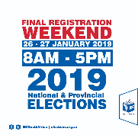
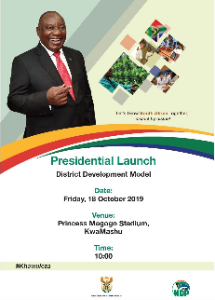
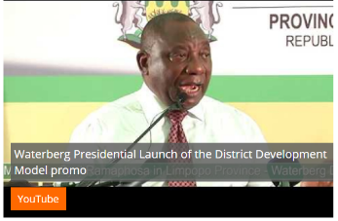
HOW HAVE WE SUPPORTED COMMUNITY MEDIA IN 2019/2020?
In the 2019/20 financial year community media are a vital point of engagement for government communicators before, during and after the sixth general election.
From voter registration to the provision of identity documents and educating the nation about the electoral process, the Independent Electoral Commission, the Department of Home Affairs, the South African Police Services and other actors engaged intensively with community media to empower and encourage citizens to exercise their ballot.
During the year under review the launch of the District Development Model – One District, One Plan – gave fresh impetus to the engagement between national, provincial and local government, on one hand, and community media.

Slide 8
HOW HAVE WE SUPPORTED COMMUNITY MEDIA IN 2019/2020?
SUMMARY OF GCIS SUPPORT
Development programmes for the sector led by MDDA aimed at ensuring sustainability, stability and professionalism in the community media through Round table discussions and Media Networking sessions (key coordination role of GCIS provincial and district offices with MDDA & GCIS Radio Unit).
Practical training and capacity building initiatives in collaboration with for example SARS and ICASA.
Participation in Strategic Communication Forums especially the DDM Model which elevate District based community media platforms to reach out to targeted communities
Community Stakeholder Engagements through IDP Public consultations and Provincial Executive outreaches
Advocacy for the use of Community Media by other spheres of Government for advertising
Content provided for free from SANews, Key Messages, Media Advisories, Media statements, Cabinet Statements, including images and videos on online and digital platforms and 2 X daily news bulletins
Campaign implementation guided by the Priorities of Government – both a platform and a partner

Slide 9
HOW HAVE WE SUPPORTED COMMUNITY MEDIA IN 2019/2020?
Community media are part of departments’ and entities’ media databases for the distribution of media statements;
Community media are our primary interface during provincial and local visits by national or provincial leadership;
Community media are accredited to cover provincial legislatures and municipal councils
GCIS provides radio content and hosts call-in programmes and interviews with government leadership with up to 105 community radio stations; 2 x daily News Bulletins
Content support includes voice recordings by spokespersons of selected statements to ensure that community media have audio editions of key statements
GCIS photography and video products are shared with community media and posted on YouTube to provide access to content to community broadcasters and online publishers
The GCIS-operated government news agency – SAnews.gov.za – generates new content daily on developments in government that are of relevance to citizens. These stories are freely available for reproduction or reposting by community media

Slide 10
GOVERNMENT ONLINE PRESENCE
Website Existence
Base Size
Count
243
233
29
28
65
62
149
143
According to the 2019 study by GCIS together with Africa Response – 96% of government Departments across all three spheres have active websites.
Social Media
The study also showed that government has multiple and active social media platforms. Of these, Facebook and Twitter are the most utilised.
Notes:
Whilst almost everybody has an active website – No Government Department or Municipality should be without a website. Government online presence is a crucial tool of access to community media.

Slide 11
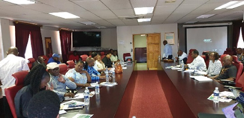
PROVINCIAL & LOCAL LIAISON SUPPORT
The GCIS provincial offices play a strategic liaison role across the system of communication intergovernmentally, with various tactical and support interventions in place to ensure alignment and strengthening of strategic government communication in provincial and local government.
Part of this support entails partnerships with the MDDA, Sentech, ICASA, SARS and the SABC in provinces to develop a more coherent and well managed series of radio programmes to afford local political leadership to communicate service delivery programmes, as well the placing of adverts.
Additionally the GCIS provincial offices undertake capacity building interventions to the sector which include governance issues as well as content packaging using modern technology (e.g. CSD Compliance with SARS and Treasuries).
A total of fifty-seven (57) capacity building interventions were facilitated between April 2019 and 31 March 2020 and included government communicators and members from the community media sector, as well as MDDA, Sentech, SARS, ICASA and the SABC.
A media workshop was organized by GCIS in partnership with Department of Women on 19 Nov 2019 in Limpopo, to capacitate media houses on sensitive reporting focusing on gender-based violence.

Slide 12
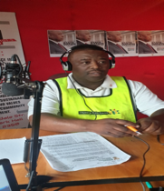
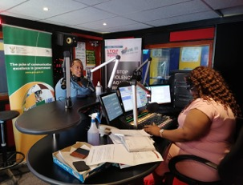
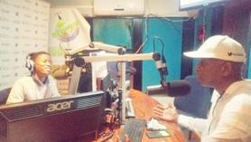
PROVINCIAL & LOCAL LIAISON SUPPORT. LOCAL CAMPAIGN IMPLEMENTATION 2019/2020
Total Community Media Projects: 259 out of 1737 overall PLL Development Communication activations guided by the 7 Priorities Total Estimated People Reached: 19 318 946 Total Expenditure: R937, 518. 21
GCIS Gert Sibande District official at Ligwa Community Radio Station on 11 Feb 2020, to communicate and popularise the SONA 2020.
GCIS official Cholo Mothibi during a Transport Month talk show at Mosupatsela FM.
GCIS official Kagisho Meremetsi creating awareness on coronavirus, at Modiri FM on 17 March 2020.
Notes:
12

Slide 13
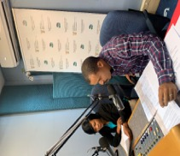
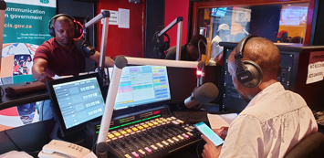
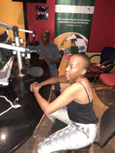
PROVINCIAL & LOCAL LIAISON SUPPORT. LOCAL CAMPAIGN IMPLEMENTATION 2019/2020
On 14 Nov 2019, GCIS in collaboration with Office on the Status of Disabled Persons and Disabled Children’s Action Group conducted a radio interview in commemoration of Disability Rights Awareness Month in Platfontein X-K FM.
GCIS Official, Lehlohonolo Manoto communicating Back to School messages focusing on Bogus Colleges at Mosupatsela FM on 22 January 2020.
GCIS official Ntombi Mhlambi and SAPS official Captain Malebo Khosana from Matjhabeng Men’s Forum talking GBVF at The Rock FM on 05 March 2020
Notes:
13

Slide 14
PROVINCIAL & LOCAL LIAISON SUPPORT. SYSTEM SUPPORT 2019/2020
Interventions
ICASA is a standing member of provincial communication core teams to assist to look at interventions and support to community radio sector.
The Provincial Government Communication Plans include weekly media plans which include all community media houses. The weekly interview schedule is used by all provincial departments on a rotational basis.
Offices of the Premier working with the communication core teams continue to coordinate training and capacity building for the sector. The Premiers continue to host live sessions from time to time to deliberate on governments program through Community Media.
GCIS continues with one-on-one engagements to deal with the challenges and refer where needed. These range from Tax non-compliance which hinders efforts to effectively use the service of community radios.
The community media sector continues to avail unpaid slots where possible to support government programmes however, there are concerns from community media practitioners that Provincial government is not doing enough in the sector.
Notes:
14

Slide 15
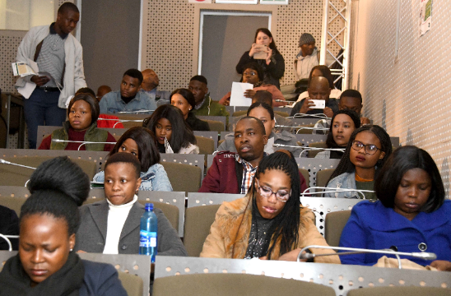
MEDIA ENGAGEMENT SUPPORT
Media Briefings
Approx. 96 media briefings held in 2019/2020 for both Cape Town (via link up) and Gauteng address by Ministers and DMs
Engagement with community media for content sharing: 213 community media on the GCIS database – many other data bases
Some community media from Gauteng attend the briefings physically, e.g:
Some CT community media also attend via the link up, eg:
GCIS Radio Unit links community radios up via live satellite feeds.
Youth Month masterclass with community media on the transition of traditional media to digital platforms on 27 June 2019
Pina News
Pina News

Slide 16
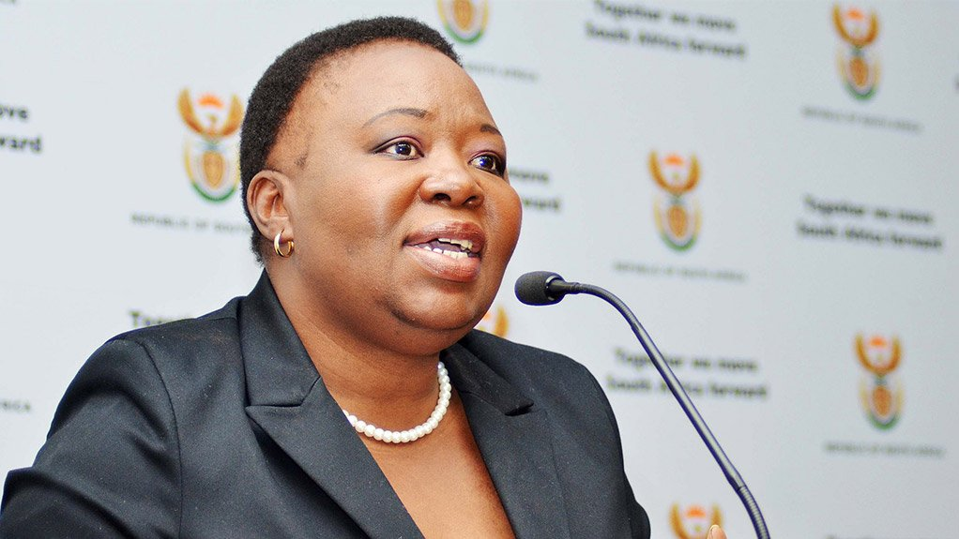
MEDIA ENGAGEMENT | POST-CABINET SUPPORT
Post-Cabinet - a detailed briefing schedule is planned for the DG and interviews are conducted on available community media on the decisions of Cabinet.
Any issued government statement, we provide community media with the audio clip from the DG and from some departments.
Statements are also shared with Community newspapers
In March 2019, community media were linked through the GCIS radio platform to access all major briefings including the start of the COVID-19 pandemic.
Distribution of Public Service Announcement audio clips to community media for Post-Cabinet media briefings and key government projects
Community media are engaged daily for media events.

Slide 17
MEDIA BUYING AD SPEND | COMMUNITY MEDIA IN 2019/2020
Of the 36 National Departments, only 19 and 9 Public Entities implemented campaigns through GCIS Media Buying in the 2019/20.
17 National Departments’, and Entities procured community media directly or through agencies.
All Provincial Departments’ and all Municipalities do not procure Media through GCIS; they also procure directly with media owners.
PERIOD | RADIO | TV | PRINT
2019/2020 | R19 148 978.21 | R4 303 671.78 | R4 142 204.99
Total to date | R19 148 978.21 | R4 303 671.78 | R4 142 204.99
Of the R19 148 878,21 spent on community radio, R937 518,21 was spent by the nine GCIS Provincial and fifty-three district offices who implemented 259 projects.

Slide 18
MEDIA BUYING AD SPEND | COMMUNITY PRINT & COMMUNITY TV CAMPAIGNS 2019/2020
COMMUNITY PRINT 2019/2020
CLIENT | CAMPAIGN | ORDER AMOUNT
Compensation Fund | Last Call on Claims | R1 933 943.37
Compensation Fund | Vocational Rehabilitation Bursaries campaign Addendum 3 | R991 815.90
Department of Labour | National Minimum wage phase 2 campaign | R1 216 445.72
Total |  | R4 142 204.99
COMMUNITY TV 2019/2020
CLIENT | CAMPAIGN | ORDER AMOUNT
Compensation Fund | Last Call on Claims 2019 | R600 000.00
Department of Arts & Culture | Mass Campaigns 2019 | R275 000.00
National Home Builders Registration Council (NHBRC) | Profiling Campaign | R553 671.78
South African Social Security Agency (SASSA) | Beneficiaries awareness campaign 2019 | R2 875 000.00
Total |  | R4 303 671.78
Of the 28 clients using GCIS,18 clients implemented 52 campaigns on community radio; 2 clients implemented 3 campaigns on print, and 4 clients implemented 4 campaigns on community television.

Slide 19
MEDIA BUYING AD SPEND | COMMUNITY RADIO CAMPAIGNS 2019/2020
COMMUNITY RADIO MAIN CAMPAIGNS 2019/2020
CLIENT | CAMPAIGN | ORDER AMOUNT
Compensation Fund | Vocational Rehabilitation Bursaries campaign | R966 900.00
Department of Home Affairs | Budget_Vote_2019 | R564 840.00
Department of Justice and Constitutional Development | Let's Talk Justice 2019 | R7 762 080.00
Department of Social Development | Know_Your_NPO_Status | R552 000.00
Department of Women | Disability rights awareness month 2019 | R400 000.00
GCIS | Presidential_Inauguration_2019 | R342 000.00
GCIS | SONA 2020 Live | R294 000.00
Health Professions Council of South Africa (HPCSA) | Roles and responsibilities radio awareness | R606 900.00
Media Development and Diversity Agency (MDDA) | New MDDA Funding Model | R342 840.00
The Small Enterprise Development Agency (SEDA) | Phone in Program and Adverts | R390 000.00
Total |  | R12 221 560.00
The above are the main campaigns that the GCIS Radio Unit implemented on behalf of clients.

Slide 20
CONTENT SUPPORT| RADIO PROGRAMMES
Examples of paid-for programming during the 2019/20 cycle:
Live broadcasts of the two 2019/2020 State of the Nation Addresses.
Live broadcast of the Presidential Inauguration.
Live broadcast of the RAF On the Road roadshows.
Live Broadcast of the Compensation Fund: Mall activations campaign.
About 7 Ministers were hosted on the GCIS radio station; Minister of Tourism, the Minister of Home Affairs, the Minister of Transport, the Minister of Social Development, the Minister of Agriculture, Rural Development and Land Reform, the Minister of Justice as well as the Deputy Minister of Justice and Constitutional Development.
Departmental Budget Votes were broadcast live (4 - Home Affairs,
Transport, Agriculture, Rural Development and Land Reform, and NW Department of Finance
NOTE: All content from paid-for live broadcasts of national events is still shared with the community radio database regardless of compliance, for their news and current affairs purposes
Notes:
Whilst almost everybody has an active website – No Government Department or Municipality should be without a website.

Slide 21
CONTENT SUPPORT| RADIO PROGRAMMES
Phone in programmes
Let’s talk Justice Season 4: 20x episodes, 1 broadcast as free added value.
Rural Development: Handover of title deeds 2x episodes
Social Development: Know your NPO Status 2 episodes
ETDP: Provincial workshop radio programmes 1x episode each province.
Department of Transport: Easter Safety Campaign 2x episodes
National broadcasts with an
average of 51 community radio stations connecting to the feed per broadcast
26
55
Of
those
Community radio link-up & phone-in programmes
29
Provincial and district – based community radio stations ranging from 1 -15 per broadcast depending on client request.
Of
those
Notes:
Whilst almost everybody has an active website – No Government Department or Municipality should be without a website.

Slide 22
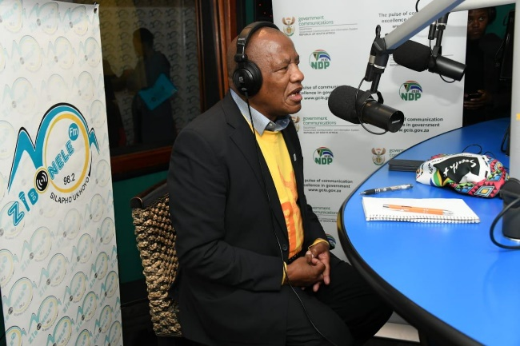
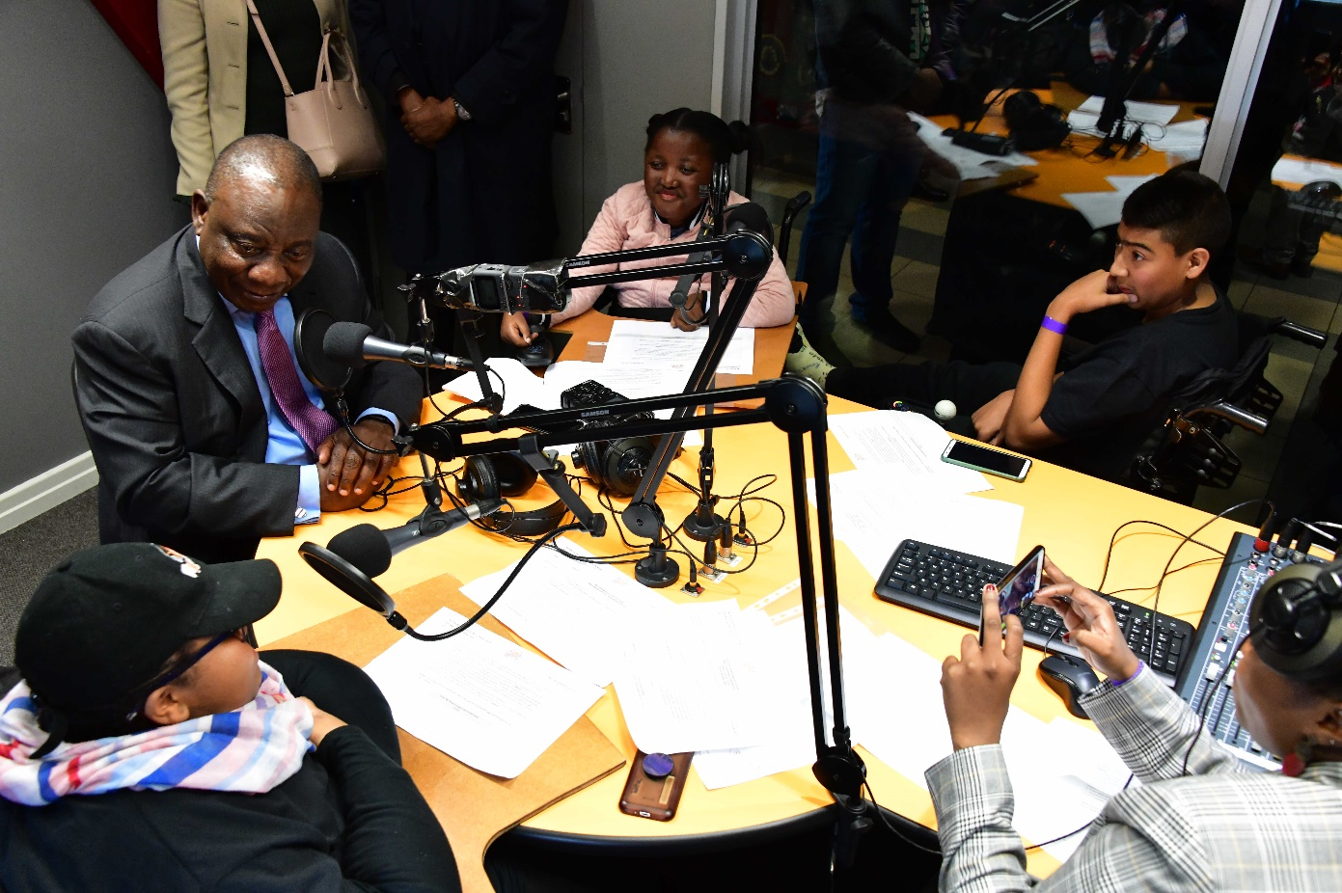
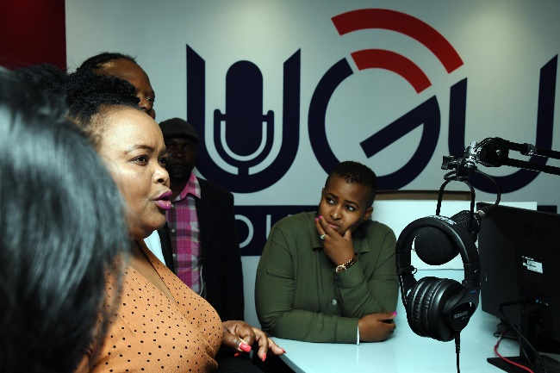
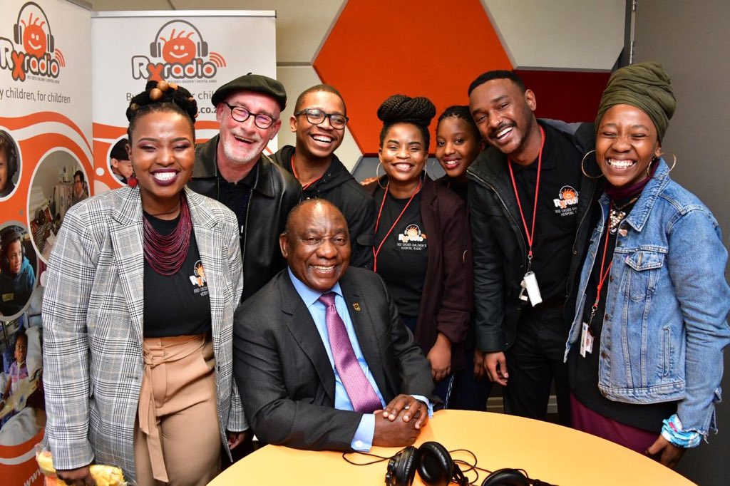
COMMUNITY RADIO STATIONS VISITED
COMMUNITY RADIO STATIONS VISITED
Minister Mthembu on Radio Zibonele in 2019
Deputy Minister Siweya visits Ugu Youth Radio with MDDA
President Cyril Ramaphosa visits RX Radio Station near the Red Cross Children's Hospital
Minister Zulu in studio at Tshedimosetso House

Slide 23
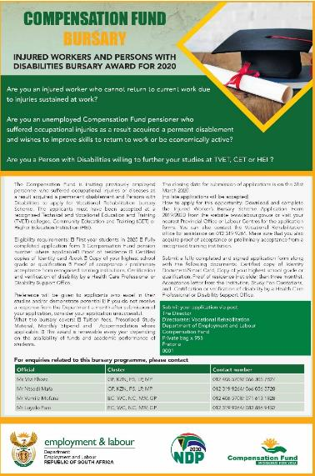
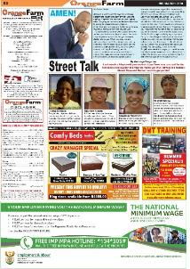
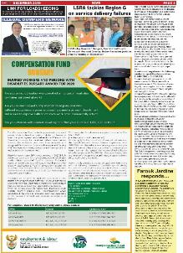
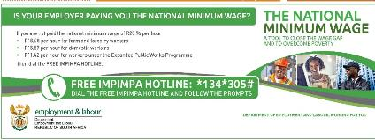
MEDIA BUYING | CAMPAIGNS
CAMPAIGNS
COMPENSATION FUND BURSARY CAMPAIGNS
NATIONAL MINIMUM WAGE
Orange Farm News
Globe Post

Slide 24
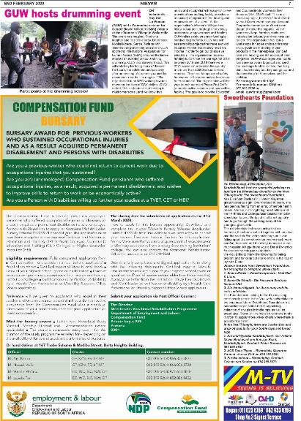
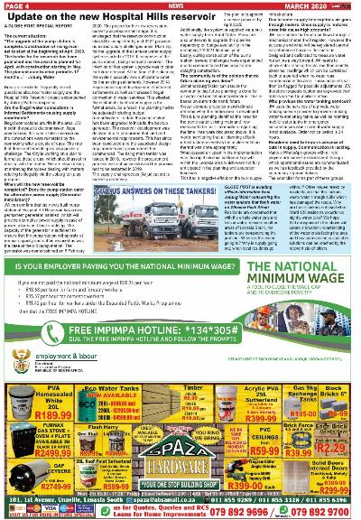
MEDIA BUYING | CAMPAIGNS
CAMPAIGNS
COMPENSATION FUND BURSARY CAMPAIGNS
NATIONAL MINIMUM WAGE

Slide 25
MEDIA BUYING SPEND| COMMUNITY MEDIA IN 2019/2020
PERIOD | RADIO | TV | PRINT
2019/2020 Commercial | R31 568 066.86 | R30 994 556.16 | R57 538 032.44
2019/2020 Community | R19 148 978.21 | R4 303 671.78 | R4 142 204.26
Total to date | R50 716 945.07 | R35 298 227.94 | R61 680 236.72
Average % | 38% | 12% | 7%
19%
The total average spend
on community media
during this period.

Slide 26
WHAT OPPORTUNITIES LIE AHEAD?
The advent of COVID-19 has wreaked significant damage on the traditional business model of commercial and community media, and has inflicted the loss of employment and sources of information for journalists and their audiences.
At the same time the health crisis induced and enabled new forms of communication which expanded ad enriched engagement between government communicators and community media
The appointment of District Champions to lead the multi-sectoral response to COVID-19 in districts and to oversee economic development at this level demands more consistent, detailed and creative engagement with community media – this is mutually beneficial
The positioning of districts as the centres of implementation of the South African Economic Reconstruction and Recovery Plan presents new opportunities for democratic participation and for citizen access to information that can transform individual lives and conditions in communities

Slide 27
THANK YOU

