Slide 1
2020 Annual
Report Presentation
Chairperson of the Board: Mandla Ngcobo
06 Nov 2020

Slide 2
OUR JOURNEY - p4
Zero irregular expenditure
NOSA accreditation
OHSAS 18001 certification retention
33 PoPs optimised
Number of customers increased to 23
B-BBEE level 3
Positive EBITDA
87.50% achievement of the Shareholder Compact
Unqualified audit opinion
Zero irregular expenditure
OHSAS 18001 certification retention
ISO 9001-2015 certification process started
18 PoPs optimised
Number of customers increased to 30
B-BBEE level 2
Positive EBITDA
72% achievement of the Shareholder Compact
Unqualified audit opinion
313 SA Connect sites connected and 258 sites tested successfully end-to-end
72% increase in sales volume
ISO 9001-2015 certification- two external audits completed successfully
B-BBEE level 7
The number of customers increased to 61
Positive EBITDA
Positive cash flow generated from operations
95% achievement of the Shareholder Compact
Unqualified audit opinion
OHSAS 18001 certification retention
ISO 9001-2015 certification - two external audits completed successfully
Number of customers increased to 46
B-BBEE level 7
Positive EBITDA
Positive cash flow generated from operations
64% achievement of the Shareholder Compact
Unqualified audit opinion
Milestones for the previous five financial years and part of the current financial year below:
ISO 9001-2015 certification retained
ISO 1800 certification retained
Number of customers increased to 79
Strategic partnerships for value enhancement forged
B-BBEE level 7*
Undersea Cable Monitoring launched in 2020
Lusikisiki Clinic Connected
Positive EBITDA
Positive cash flow generated from operations
68% achievement of Shareholder Compact
Unqualified audit opinion
*subsequently, we have achieved B-BBEE Level 4

Slide 3
Financial Capital - p54
Sales
Revenue
Cash Balance
R227 million new sales contracts against a target of R350 million
14% year-on-year increase against a target of 34%
Gearing Ratio*
Debtors
days
Improve
Operating Profit
R109 million cash balance
SMME payment days
53% Debt to Equity
*Shareholders loans treated as equity
Decreased by R84 million against a target of R10 million
SMMEs paid within 19 days
28 days debtors days

Slide 4
Manufactured Capital - p55
SA Connect Sites
333 SA Connect Sites connected to BBI network against a target of 400
Mean Time To Repair
5.63 hours to repair network faults
Network rebates
0.13% of gross profit provisioned to pay network rebates

Slide 5
Social and Relationship Capital - p55
SMMEs
4 SMMEs were allocated installation work
Black Owned Entities
46% of total B-BBEE spend, spend on BOE
Black Women Owned
B-BBEE Spend
B-BBEE Level
CSI
44% spend of 40% spend on BWO
122% of total discretionary budget to be spend on B-BBEE
B-BBEE Level 6, downgraded to a Level 7 against a target of Level 6
Byletts Combined School in Eastern Cape.

Slide 6
Human Capital
Governance - p55
Training Spent
External Audit Findings
Interns
1,83% of payroll on training
Five new Interns were employed
4 Repeat external audit findings
6
Not Achieved
19 KPIs
68%
13 Achieved

Slide 7
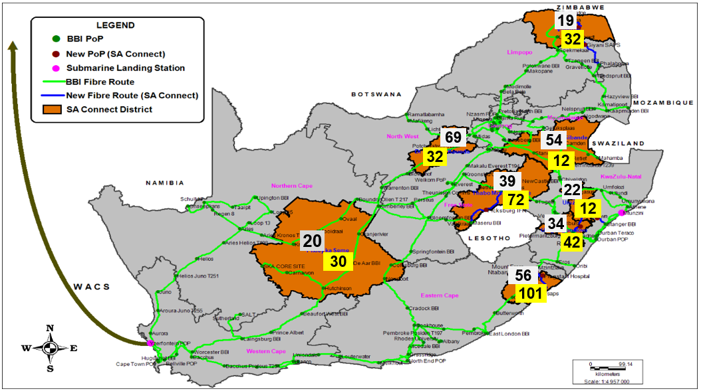
SA Connect Progress – p65
646 sites have tested successfully under Phase 1A x313 sites and Phase 1B x333 sites as highlighted in Grey and Yellow, respectively

Slide 8
Governance: Board Meetings - p88
Number of Meetings | 2017/18 |  | 2018/19 |  | 2019/20
 | No | % | No | % | No | %
Members
M Ngcobo* | 7/8 | 88 | 7/8 | 88 | 7/7 | 100
Z Kabini | N/A | - | N/A | - | 6/7 | 86
S Mabalayo | 5/8 | 63 | 5/8 | 63 | 5/7 | 71
L Mabece | N/A | - | N/A | - | 7/7 | 100
G Mphefu | N/A | - | N/A | - | 7/7 | 100
N Selamolela | 7/8 | 88 | 7/8 | 88 | 6/7 | 86
J Schreiner | N/A | - | N/A | - | 6/7 | 86
Mr A Matseke | 2/2 | 100 | 2/2 | 100 | 7/7 | 100
Mr I van Niekerk | 8/8 | 100 | 8/8 | 100 | 7/7 | 100
Chairperson
N/A Not a Member

Slide 9
Statement of Profit or Loss and other Comprehensive
Income – p107
R’m | Audited March 2016 | Restated Audited March 2017 | Audited March 2018 | Audited March 2019 | Audited March 2020
Revenue | 452 | 397 | 379 | 411 | 469
Cost of sales | (260) | (222) | (187) | (181) | (217)
Gross profit | 192 | 175 | 192 | 230 | 252
Other Income | 0 | 83 | 90 | 178 | 103
Operating expenses | (292) | (303) | (304) | (320) | (351)
Results from operations | (100) | (46) | (23) | 87 | 4
Finance income | 9 | 6 | 3 | 4 | 7
Finance costs | - | (85) | (94) | (106) | (122)
Profit/ (Loss) before taxation | (91) | (124) | (113) | (14) | (111)
Income tax expense | - | (3) | (0) | (0) | (0)
Profit/ (Loss) for the year | (91) | (127) | (113) | (14) | (111)
EBITDA | 30 | 35 | 36 | 102 | 71
Revenue
^{Increased by 14% year on year}
Cost of Sales
^{Increased by 20% year on year}
Operational Expenses
^{Increased by 10% year on year}
Operational Loss
^{Increased by R97m to R111m}
(normalised loss in 2019 – R114m)

Slide 12
Financial Position - p109
Assets
^{Increased by R66m}
^{ROU assets R52m}
Cash
^{Increased to R110 million.}
Equity
^{Discounting Shareholders Loans}
^{DCDT authorised conversion}
Non-current Liabilities
^{Lease Labilities – R57m}

Slide 13
Internal Control: Irregular Expenditure - p139
R’000 | Audited March 2018 | Audited March 2019 | Audited March 2020
Opening balance | 0 | 1 603 | 53 935
Incurred and identified in the current year
Non-compliance to cost containment instructions issued by National Treasury | 202
Non-compliance to a provision of legislation (Co Act) | 1 401
Continued to utilise services after contract negotiations failed |  | 6 398 | 0
Tender not advertised for 21 working days |  | 5 974 | 15 095
Continued to utilise services after contract expired |  | 904 | 858
Continued to utilise services not approved by National Treasury |  |  | 5 467
Carried forward | 1 603 | 14 879 | 75 355

Slide 14
Internal Control: Irregular Expenditure (Cont…)
R’000 | Audited March 2018 | Audited March 2019 | Audited March 2020
Brought forward | 1 603 | 14 879 | 75 355
Incurred in prior year, identified in the current year
Continued to utilise services after contract negotiations failed |  | 26 324
Tender not advertised for 21 working days |  | 3 885 | 7 392
Continued to utilise services after contract expired |  | 9 049
Removal from register |  | (202)
Amount not condoned carried over* | 1 603 | 53 935 | 82 747
*Internal processes in progress

Slide 15
Five Years External Audit Findings - p100 - p103
Department | Finding Category | Total number of findings 2015/16 | Total number of findings 2016/17 | Total number of findings 2017/18 | Total number of findings 2018/19 | Total number of findings 2019/20
Finance | Going Concern (Repeat 1) | 1 | 1 | 1 | 1 | 1
 | Commitments; Provisions and Revenue, Financial Classifications (Repeat 1) | 3 | 4 | 5 | 1 | 4
 | Property Plant and Equipment (Repeat 2) | 6 |  | 3 | 4 | 5
 | Trade and other payables (Repeat 1) | 1 | 1 |  | 2 | 3
 | Irregular, fruitless and wasteful expenditure | 3 |  | 1
SCM | Compliance | 4 |  | 2 | 2 | 1
HRM | Compliance |  |  | 1
CEO Office | Compliance :Performance Information | 1 | 5 | 2 |  | 1
Shareholder | Compliance (Repeat) (MOI) |  | 1 |  | 1
IT | User Access; General and Application controls |  |  | 7 | 1
Company secretariat | Compliance |  |  | 2 | 1
Total |  | 19 | 12 | 24 | 13 | 15

Slide 16
Status of addressing audit findings
The Audit Report received was Unqualified with findings
The findings on the report related to:
Going concern
Assets, contract management and financial information
Total of 15 external audit findings for 2019/20

Slide 17
Summary of progress on audit action plan – 2019/20
 |  |  | Continuous Improvement Plan
Programme | No. of findings raised by the AGSA | No. of Internal Controls developed for implementation | 0% - Not Addressed | 25% In- Progress | 50% Implementation Achieved | 75% Adequately Effective | 100% Fully Effective | Not due for implementation
Finance | 9 | 9 | 0 | 0 | 0 | 0 | 4 | 5
Going Concern | 1 | 1 |  |  |  |  |  | 1
Assets | 5 | 5 |  |  |  |  | 3 | 2
Trade Payables | 2 | 2 |  |  |  |  | 1 | 1
Annual Financial Statements | 1 | 1 |  |  |  |  |  | 1
Supply Chain Management
Irregular Expenditure | 1 | 1 |  |  |  |  |  | 1
Performance Information Management
Key Performance Indicators | 1 | 1 |  |  |  |  | 1
Discounting of Debtors, Creditors, COS and Revenue
Finance | 4 | 4 |  |  |  |  | 4
Totals | 15 | 15 |  |  |  |  | 9 | 6

Slide 18
Status on addressing audit findings
Area of Audit Findings | Details of Findings | Action Plan to Address Audit Findings | Progress on implementation of Action Plan
Finance | Material uncertainty related to going concern | The Company is in discussion with funders for specific ring-fenced projects that would generate sufficient revenue to service the loans and add to the overall profitability of the Company. The conversion of the shareholders’ loans into equity have been approved and are progressing. Once done, the net asset value of BBI will improve. | This is ongoing Management continues to actively manage and drive the new sales strategy that was implemented. Management is also finalising and formalising an improvement action plan.
SCM | National Treasury approval for deviations from normal procurement process not obtained | This matter will be added to the Irregular Expenditure register and investigated by the Lost Control Steering Committee. | Not yet due
CEO Office | Predetermined Objective not clearly defined | The target is defined in this way in the KPI technical indicator description and method of calculation. Including the shareholders’ loans as equity is a better reflection of the true gearing of the Company. | This was resolved at year end.
Finance | Leases taken against opening retained earning instead of against the assets | Management understood and applied IFRS16.C5(b) and IFRS16.C6 to implement IFRS 16 on a modified retrospective approach being the adjustment of the cumulative effect of initial application to opening balance of retained earnings. | Not yet due
 | Discounting of Revenue not classified correctly | Management took note of this finding and will review possible financing elements in future, if material. The discounting according to IAS 18 will however distort results. | This was resolved at year end. The correction required was not material. It was raised for completeness purposes.

Slide 19
Status on addressing audit findings
Area of Audit Findings | Details of Findings | Action Plan to Address Audit Findings | Progress on implementation of Action Plan
Finance | Assets carried at net book value of R1 or less (PPE) | The fully depreciated assets will continue being in operation until the asset replacement plan is fully implemented. | Resolved at year end and controls implemented to reassess useful life of assets annually.
 | Asset not verified nor tagged | A physical verification exercise of all assets was performed during the financial year to ensure that, among others, all assets that have been purchased and capitalised by the 31st of March have been recorded on the fixed assets register. | These assets are still being investigated and will be resolved by 31 December 2020.
 | Asset attributable costs not capitalised to the main asset | These individual asset items will remain on the FAR as they form part of activities and expenses that brought the related assets into location and working condition. | For the last number of years, all individual capital expenses relating to specific asset have been capitalised as part of that specific PPE item. This was resolved at year end.
 | Purchases of assets capitalised at incorrect amount. | Other costs incurred to bring assets into operation was incurred. Management believe this finding should have been removed as supporting information were supplied. | This was resolved at year end.
 | Discounting of cost of sales not classified correctly | Management took note of this finding and will review possible financing elements in future, if material. The discounting according to IFRS 9 will however distort results. | This was resolved at year end. The correction required was not material. It was raised for completeness purposes.

Slide 20
Status on addressing audit findings
Area of Audit Findings | Details of Findings | Action Plan to Address Audit Findings | Progress on implementation of Action Plan
Finance | Creditors not paid within 30 days | Management must ensure that the ageing is calculated from the date that the invoice has been received from the supplier. | Creditors are mostly paid within 30 days. This is expected to be completed by 31 March 2020.
 | Discounting of Trade and Other Payables not classified correctly | Management took note of this finding and will review possible financing elements in future, if material. The discounting according to IFRS 9 will however distort results. | This was resolved at year end. The correction required was not material. It was raised for completeness purposes.
 | Payables invoices have been recorded in the incorrect ageing period. | Invoices are only raised in the accounting system once approved for payment by the cost centre manager, as this indicate that the end used is satisfied that goods and services was received as contracted. | BBI can not raise liabilities and track payment dates on invoices where goods and services has not been delivered yet. As a result, this was resolved at year end.
 | Significant financing component on Receivables not classified correctly. | Management took note of this finding and will review possible financing elements in future, if material. The discounting according to IFRS 15 will however distort results. | This was resolved at year end. The correction required was not material. It was raised for completeness purposes.
 | Lack of descriptive information on fixed asset register. | Management should ensure that the fixed asset register is descriptive enough, to allow for the tracing back of the items listed on the fixed asset register back to the computer software licenses. | Not yet due

Slide 21
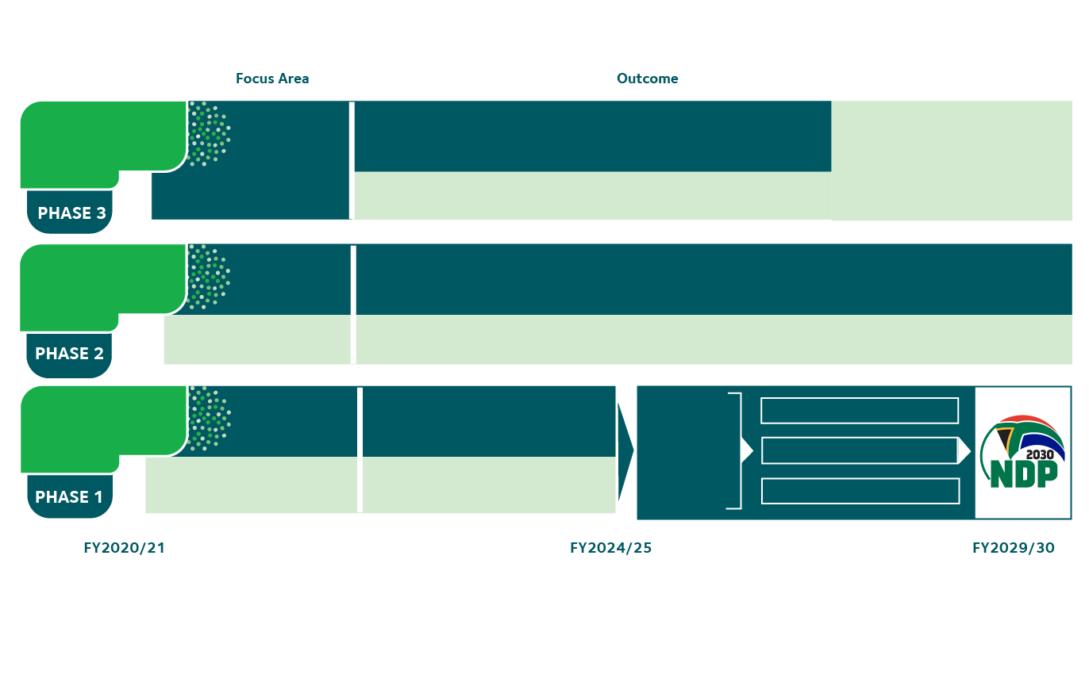
Future Outlook: Strategy - p43
Grow Services to
Enable Digital
Transformation
5. The preferred partner of Government in enabling the digital transformation
Phase 3 considers growth beyond the infrastructure core mandate that will enable the digital transformation of the State
Enabled
Last Mile
Connectivity
6. Facillitate Socio-Economic Transformation
Build Infrastructure
& Grow Customer
Base
Digital
Transformation
& Infrastructure
3. An increased base achieved through customer fulfillment and state-of-the-art infrastructure and services
Enable Last Mile
Connectivity
4. The preferred partner of Government in enabling the digital transformation
Stabilise & Mobilise
Financial &
Operational
Sustainability
1. To strengthen BBI’s financial position for growth and sustainability
Supports the attainment of key DCDT
Focus Areas
as well as
NDP targets
DIGITAL TRANSFORMATION
ENABLING DIGITAL ENVIRONMENT
Organisational
Enablement
2. To enable the organisation to deliver upon the mandate
DIGITAL INFRASTRUCTURE

Slide 22
Future Outlook: Shareholder Funding
BBI Act & established
BBI Licensed
Neotel ROU End
 | 2006 /2007 | 2007/2008 | 2008/2009 | 2009/2010 | 2010/2011 | 2011/2012 | Total
DPE * | - | R 627 000 000 | R 377 000 000 | R 208 530 000 | R 138 599 926 | - | R 1 351 129 926
IDC | - | - | R 352 756 756 | R 73 267 298 | R 48 697 297 | - | R 474 721 351
Total | - | R 627 000 000 | R 729 756 856 | R 281 797 298 | R 187 297 223 | - | R 1 825 851 277
The above is an indication of the capitalisation received by BBI to date from Shareholders.
The Company requires further capitalisation to remain financially sustainable.
BBI is a Schedule 2 entity in terms of the PFMA, and can raise capital from the markets using its Balance Sheet.
In FY 2016/17 there was a change in accounting standards which classified the above Shareholders’ Loans as long-term liabilities and not Equity.
BBI started the process of having these Shareholders’ Loans converted to Equity, in order to strengthen the Balance Sheet and make it possible to raise funding.
The Minister of Communications and Digital Technologies approved the conversion of the DCDT Shareholder Loan to Equity on 7 June 2019.
In November 2019, the Board of the IDC supported the conversion of the IDC Shareholder Loan into Equity. Some of the terms of that decision require endorsement by the Minister of Trade, Industry and Competition. That approval is still outstanding. This delay is harmful to the sustainability of BBI.

Slide 23
Future Outlook: SOC Rationalisation
Activities | Date
PwC appointed as a Transaction Adviser | December 2019
BBI & Sentech workshops kickstarted | 10 February 2020
Post-Merger Integration Plan completed by PwC | 31 March 2020
BBI valuation completed by PwC | 23 April 2020
TOR for Strategy Development drafted | 18 September 2020
Strategy Development | 30 November 2020
DCDT has shared the draft Business Case for the merger with both entities for their inputs. Both entities will make inputs into the Business Case by Oct 2020.
Slide 23

Slide 24
Thank You

