Slide 1
SC ON TRADE AND INDUSTRY, ECONOMIC DEVELOPMENT, SMALL BUSINESS DEVELOPMENT, TOURISM, EMPLOYMENT AND LABOUR
sefa’s Support to Entrepreneurs with Disabilities
03 NOV 2020

Slide 2
Introduction
Building financial inclusivity and ensuring access to finance to SMMEs and Co-operatives, particularly those who faced historical discrimination is the core mandate of sefa.
In this context, sefa’s core target market in the SMME sector primarily focuses on small businesses that are owned and operated by black-, women-, youth- and entrepreneurs with disabilities.
To support SMMEs and Co-operatives owned by entrepreneurs with disabilities, sefa:
has a Corporate Performance Indicator that measures funding support to entrepreneurs with disabilities.
In December 2016, sefa introduced a dedicated funding scheme to support entrepreneurs with disabilities, called Amavulandlela Disability Scheme.

Slide 3
Amavulandlela Funding Scheme
Eligibility Criteria
The scheme is targeted at small and medium-sized enterprises and Co-operatives with at least 50+1% ownership by entrepreneurs with disabilities.
The entrepreneur must be operationally involved in the daily running of the business;
Financing applications must have economic merit (financially sustainable & technically feasible);
Application of funds can be applied for business expansion, start-ups or contract financing;

Slide 4
Amavulandlela Funding Scheme (Cont.)
2. Support Provided under the Scheme
The scheme offers entrepreneurs with credit facilities ranging from R50 000 to R5 million at a preferential interest rate.
Repayment terms for facilities are up to 60 months. The actual loan duration is subject to the projected cash flows of the business.
Customised business support:
Business Plan support up to R75k
Post Investment Support of up to R350k comprising of mentoring and coaching as well as other business support.
Payment moratorium dependent on the cashflow of the business.
3. Support to Entrepreneurs with disabilities over the past three financial years, sefa financed:
32 SMMEs with entrepreneurs with disabilities
Disbursed R17.5 million via its Wholesale Lending (21) and Direct Lending (11) channels

Slide 5
Action Plan to Increase Support Entrepreneurs with Disabilities
sefa will appoint champion Investment Officers per region to promote financing to entrepreneurs with disabilities;
sefa to partner with institutions that represent the interests of people with disabilities (business development);
In collaboration with Seda, sefa will identify business opportunities in different industry value chains for participation by people with disabilities and market such opportunities to entrepreneurs with disabilities;

Slide 6
Profile of Funded Clients

Slide 7
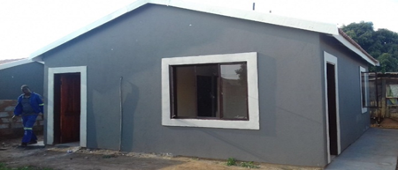
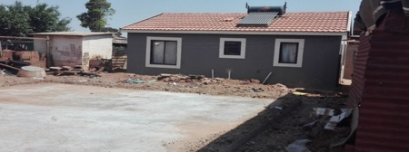
Linked Thoughts Consulting cc
Linked Thoughts Consulting is a construction and project management company that was incorporated in 2008
The business is owned and managed by a black entrepreneur living with a disability
Majority of the revenue in the business is derived from the construction of schools and low-cost housing on behalf of the Government
The entrepreneur is an existing sefa client
sefa has approved funding to the amount of R3 670 000 for the construction of 200 low cost housing in the Winnie Madikizela Township in Tembisa, Gauteng on a contract with the Department of Human Settlements
Seven Jobs were maintained, and 130 Contractors will be hired to complete the project
Key Information
Location: Tembisa
Job maintained: 7
Funding amount: R3.6m
Sector: Construction

Slide 8
Mahlaku a Mosebo Contractors cc
Mahlaku a Mosebo Contractors cc is a black woman wholly owned business by an entrepreneur with disabilities. The business was formally registered in 2002.
Mrs. Mokgadi Regina Chaba is a person with disability due to multiple joints rheumatoid arthritis ailment.
She was referred to sefa by a consulting company called Esuvo Consulting after the business was awarded a contract for the construction of 110 RDP houses in the Mogalakwena Municipality by CoGHSTA.
A loan of R4,055,135 was approved to acquire material and pay for labourers.
Through this loan the business will create 110 jobs.
Key information
Location: Polokwane, Ivypark
Job created: 110
Funding amount: R 4 055 135.00
Sector: Building and Civil Construction

Slide 9
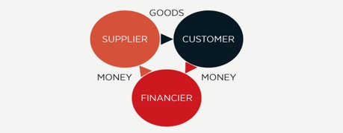
Mvudi Valley Trading 5 CC
Mvudi Valley Trading 5 CC is a company formed and registered with CIPC in July 2004 by Ms Avhahumi Masindi
The member is an entrepreneur with disabilities
The business operates from Shayandima
Mvudi Valley Trading 5 CC is 100% black and woman owned
The core business is general trading in all aspects including supply and delivery
The Company was awarded an order by Department of Public Works to supply 100 x 200L drums of diluted emulsion SS60 to be delivered at Thohoyandou Cost Centre
The client was referred by one of sefa’s existing clients.
A loan amounting to R163k was approved to purchase the drums
Key Information
Location: Shayandima
Jobs Maintained: 1
Jobs created: 0
Loan amount: R163k.
Sector: Services

Slide 10
EZY MOK General Trading (Pty) Ltd
EZY MOK General Trading (PTY) LTD (2015/179554/07) was registered on the 06th of June 2015.
. The Company is 100% black owned by 3 Directors with shareholder ship as follows : Mr. Olebogeng Ezekiel Mokhai 49%, Ms. Josephine Ntwayagae 26% and a person with disability , Ms. Boishwarelo Mohlanke 25%.
The business trades as a general trader, but mainly currently acquiring supply and delivery opportunities.
The business was awarded a purchase order by the South African Police Services in Kuruman, to supply and deliver office furniture for the Police station.
The funds approved were used to acquire the furniture and deliver to South African Police Services as per contract. The client heard about sefa by word of mouth.
Key information
Location : Kuruman
Job Maintained : 1
Funding amount: R 102 861
Sector: procurement of goods and services

Slide 11
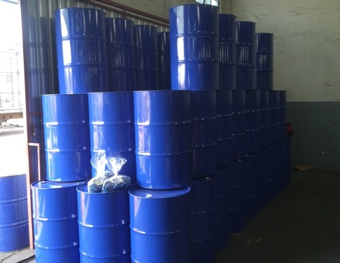
Butterfly Industrial Packaging And Contracting CC
Butterfly Industrial Packaging & Contracting CC is a close corporation that was registered in 2005.The business sole member is Gonaseelan Shunmugam. The member is classified as disabled due to a speech impairment which limits his communication and impacts on his quality of life.
The member had approached sefa for the setup of a new plastic washing and waste removal operation. He has negotiated long term contracts with customers in need of this service. The entrepreneur has 17 years experience within the industry and is well networked to suppliers and customers.
sefa approved a Term Loan of R279 278.17 and ISA of R173 009.99 . The funds to be utilized towards vehicle, stock, small equipment, Protective gear and overhead costs .
Through sefa funding 5 new jobs will be created and sefa will be funding a disabled black male.
The project is good for sefa as this type of project is in the waste recycling industry. sefa will be funding a disabled individual which falls within the priority target group of sefa.
Key information
Location: KZN – Durban
Job creation: 5 new jobs
Funding amount: R452 288.16
Sector: Recycling

Slide 12
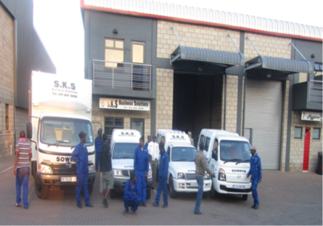
SKS Business Solutions cc
SKS Business Solutions cc is a 100% black owned construction business that was established in 2005 by Petrus Zwane, a person with disability.
The business has its focus on Construction, Civil, Electrical and General Building Maintenance both in the Private and Public Sector.
He heard about sefa from friends.
The business was awarded a contract by the Department of Local Government and Human Settlements in the North West Province to construct 190 Low Cost housing units in the Rustenburg rural area of Dini Estate, Rustenburg Local Municipality. The contract value amounts to R23 535 680.
sefa approved a Term Loan facility of R4, 7 million to assist in purchasing building material and labour costs.
In the past, the business had provided services to City of Johannesburg, Gold Fields, Pikitup, Department of Infrastructure, Eskom and Department of Education.
The loan assisted in creating and maintaining 77 jobs.
Key information
Location: Rustenburg, North West
Jobs: 77
Funding: R4 700 000
Sector: Construction (Low cost housing)

Slide 13
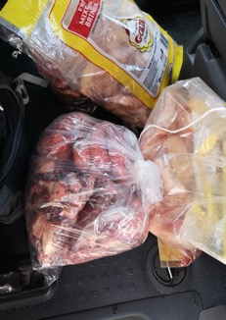
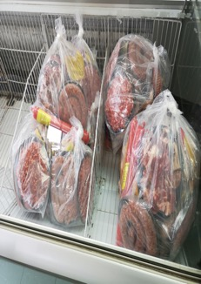
Great Meat Hampers (Pty) Ltd
Great Meat Hampers (Pty) Ltd was founded by two shareholders, Tshutlhedi Mpho Abel (39), and Pearl Ayanda Mthembu (25). Both shareholders are the only directors of the business who are also involved in the day to day running of the business
The business sells meat hampers to the members of the South African Municipal Workers Union (SAMWU) within various municipalities in Gauteng Province. Four different meat types are included in the meat hamper, namely beef, pork, poultry and mutton and the customers also have an option to choose own variety. Through a Union led initiative, Great Meat Hampers has been allocated a payroll code from the employer (Municipalities) which allows Great Meat Hampers to receive payments for services provided from the municipality’s payroll.
Great Meat Hampers approached sefa to raise finance of R3 882 520 to use for working capital purposes to cover stock payments of meat hampers to at the respective butcheries from which the union members collect their stock of meat hampers.
Sefa approved a Facility of R3 882 520 which is made up of a grant of R1 106 518.20 and a term loan of R2 776 001.80.
Key information
Location : 17 Nienaber Road, Elandspark, JHB
Job Created: 17
Funding amount: R3 882 520 (inclusive of 29% grant)
Sector: Retail

Slide 14
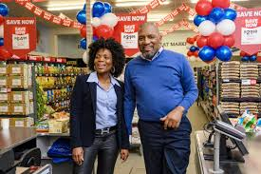
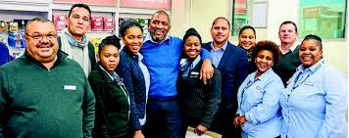
Ambelisi (Pty) Ltd
Ambelisi (Pty) Ltd is 100% owned by Mr. Zongezile Liwani. He is a person with disability.
Mr. Liwani has entrepreneurial and retail experience. In 2005, he started his 1st business (a liquor store) in Nyanga that was an immediate success. In 2008, due to the success of the liquor store he was approached by the Spar Group and was requested to convert and manage an underperforming Score Store into a Spar Family Store.
In 2017, Mr. Liwani and his wife opened a Pick ‘n Pay Ndwamba Market Store in Nyanga. This was financed by Masisizane Fund.
The success of the Ndwamba Market Store led to the entrepreneurs having identified an opportunity to open a 2nd store that is based in the Mbekweni Township in Paarl, Western Cape.
Mbekweni Market Store was financed by sefa. The amount of the loan is R4 448 350. The DSBD Grant of R800 000 will be paid directly to sefa in month 13 to reduce exposure of the funding to R3 648 350.
Key information
Location: Western Cape, Paarl
Job creation: 14
Funding amount: R3 648 350
Sector: Retail

