Slide 1
S79 REFERRAL OF LIQOUR PRODUCT AMENDMENT BILL
B 10 B- 2016

Slide 2
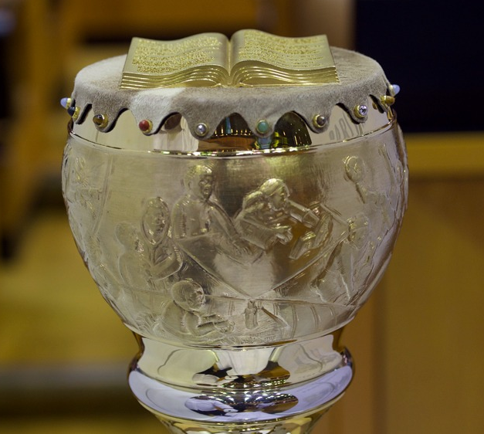
PARLIAMENT HOUSES & REFERRALS

Slide 3
BACKGROUND & ATC
On 2 June President wrote a referral letter in terms of section 79 of the Constitution.
The President in terms of s79(1) has referred the Liquor Product Amendment Bill back to the NA for reconsideration.
The President has reservations related to lack of compliance or referral in terms of s 18 of the Traditional Leadership and Governance Framework Act 41 of 2003 which stipulates as follows:
Referral of Bills to the National House of Traditional Leaders. 18(1)(a) Any parliamentary Bill pertaining to customary law or customs of traditional communities must, be referred to the NHTL for its comments before being passed by the house of Parliament.

Slide 4
President’s reservations
The President has drawn the attention of Parliament to the definition of “beer” citing word “traditional” within the definition of “liquor product”.
The reservation makes further reference to the inserted section 6A(requirements regarding beer), 6B and 6C(requirements for any other fermented drinks) of B10 B-2016,the Bill passed by Parliament to which President did not assent to but instead returned to Parliament for reconsideration. 6B presents requirements for traditional beer for commercial purposes or selling it but not pertaining to customs.

Slide 5
S18 TLGFA
Referral of Bills to National House of Traditional Leaders
Any parliamentary Bill pertaining to customary law or customs of traditional communities must:
Before it is passed by the house of Parliament (NCOP or NA) where it was introduced must be referred by the Secretary to Parliament to the NHTL
It is referred to the NHTL for its comments.
Once comments are received such are considered by Parliament.

Slide 6
PARLIAMENT’S PROCESS ON THIS BILL
As per the tagging opinion and certification opinion of the State Law Adviser, this Bill was not referred formally to the NHTL in terms of s18 of the TLGFA. Reading and interpreting this provision it was not necessary to comply with this provision since the traditional or African beer made for trading purposes does not pertain nor affect people’s traditions.
The Bill does not regulate nor address anything that has to do with customs, customary practises or customary law. S18 requires a referral of any parliamentary Bill to the NHTL if the content of the Bill pertains to custom or customary law.
The Bill does not dictate nor regulate the making of home made beer or traditional beer where the context is for traditional customary purposes but only seek to regulate where home made or traditional beer is made for commercial purposes and for the protection of the general public that buys the made traditional beer.

Slide 7
Long title of Liquor Product Act = Principal Act
The purpose of the Liquor Product Act is to provide for control over the sale of certain alcoholic products, the composition and properties of such products and the use of certain particulars in connection with the sale of such products. Another mentioned purpose of the Principal Act is for control over the import and export of certain alcoholic products (commercial or economic purposes inside and outside the country).
The purposes of the Principal Act should not and cannot be sidestepped for all legislative processing of this Bill including the referral.

Slide 8
RECONSIDERATION ON THE BASIS OF S18
The position is still as was explained during the processing of the Bill in Parliament and canvassed by the State Law Advisers’ opinion.
The use of the term “traditional beer” does not immediately result in everything about it relating to custom or customary law. An example is the “ijuba” a very old known fermented drink sold at supermarkets. Such an alcoholic drink does not pertain to custom but is produced, distributed and consumed like any alcoholic drink and that is why the Bill comprehensively seeks to cover all liquor products within the domain of commercial purposes.
There is no legal justification for the reconsideration by Parliament as per the confined reservations of the President.

Slide 9
WAY FORWARD
Both committees of Parliament the Portfolio Committee on Agriculture and Select Committee on Land Reform, Minerals and Energy canvassed this constitutional and legal issue thoroughly in the appropriate application of s18 to the Bill.
After full explanation both committees accepted the legal advise and took a resolution of the lack of justification to invoke s18 of the TLGFA. However, the NHTL could still have brought their input as an interested stakeholder.
Other: The above said on previous work done by both committees of Parliament, the support staff already engaged the House and requested their views on the matter giving effect to s 18.

Slide 10
Deliberations taking matter forward
Committee consider the letter from the NHTL and adopt a report for submission to the NA House and its approval that after considering the views of the NHTL as per the President’s reservations, the NA still holds the view that the regulatory space in terms of the Liqour Product Amendment Bill is not as such that it pertains and impact on cultural practices.
Thank you.

