Slide 1
PRESENTATION TO THE PORTFOLIO COMMITTEE ON COOPERATIVE GOVERNANCE & TRADITIONAL AFFAIRS
MOGALAKWENA LOCAL MUNICIPALITY
PRESENTER:
03 NOVEMBER 2020

Slide 2
TABLE OF CONTENT
Background and Overview
Implementation of Post Audit Action Plan
State of Finances (breakdown of COVID-19 expenditure)
Revenue Collection (March-June 2020)
Breakdown of unauthorized, irregular, fruitless and wasteful expenditure, consequence management
Institutional Capacity (Top management)
Internal Audit Committee (Capacity, functionality and effectiveness)
MPAC (Capacity, functionality and effectiveness)

Slide 3
BACKGROUND AND OVERVIEW
Mogalakwena Municipality is situated in the western quadrant of the Limpopo Province, within the Waterberg District Municipality, and is bordered by Lepelle Nkumpi Local Municipality to the east, Mookgophong Local Municipality to the south, Lephalale Local Municipality to the west and Blouberg Local Municipality to the north
The total geographical area of the Mogalakwena is approximately 6166.0740 square kilometres
Mogalakwena Local Municipality constitute over 45 % of the Waterberg District Municipality’s total population with 307 682 and 79 396 households
The municipality consists of 3 proclaimed townships and 178 villages and also covers a range of other smaller settlements in the area between Mokopane and Rebone.
Development in Mogalakwena is based on three economic pillars:
  tourism, agriculture and mining

Slide 4
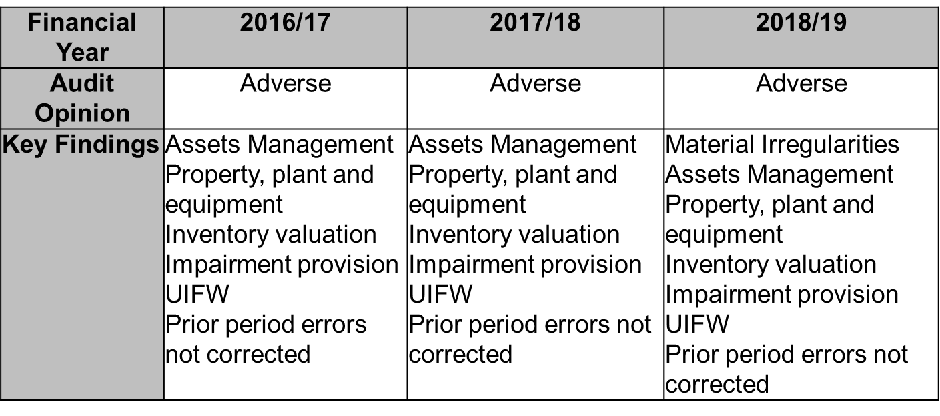
IMPLEMENTATION OF THE POST AUDIT ACTION PLAN (PAAP)
AUDIT OUTCOMES

Slide 5
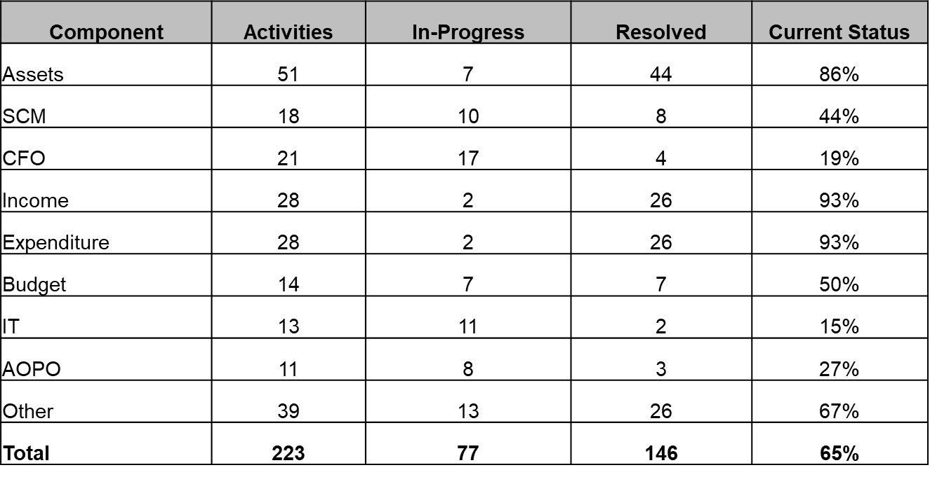
IMPLEMENTATION OF THE POST AUDIT ACTION PLAN (PAAP)
AUDIT ACTION PLAN

Slide 6
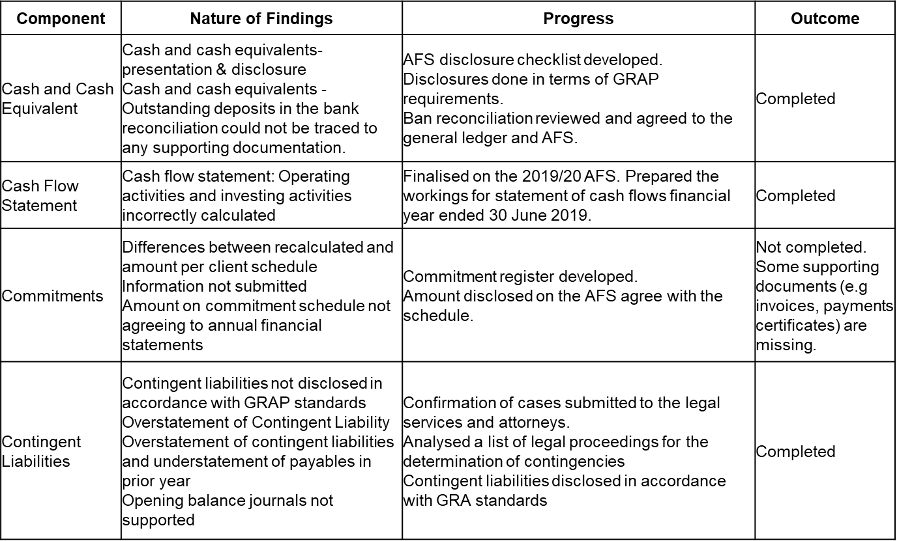
IMPLEMENTATION OF THE POST AUDIT ACTION PLAN (PAAP)
DETAILED ACTION PLAN 2018/19

Slide 7
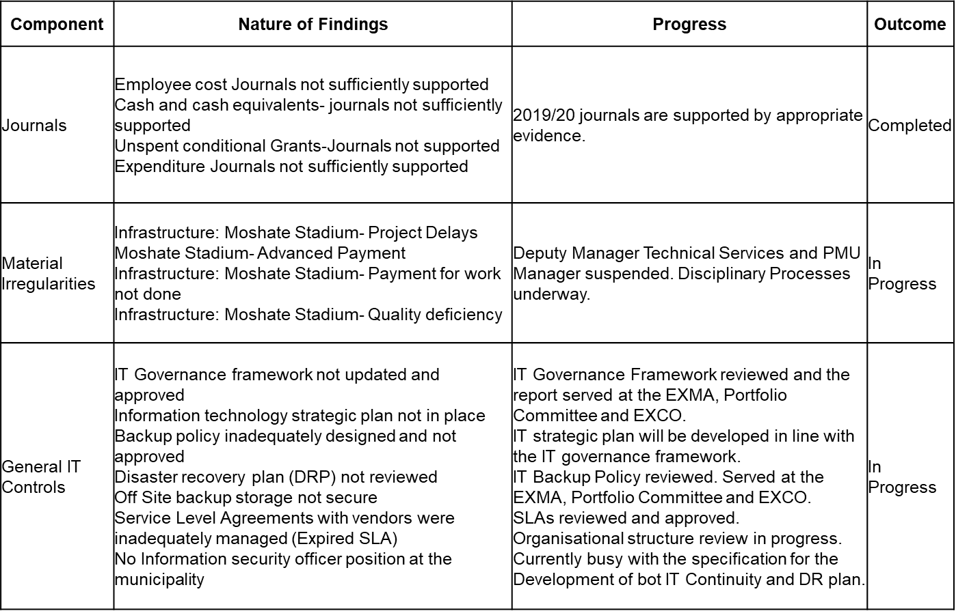
IMPLEMENTATION OF THE POST AUDIT ACTION PLAN (PAAP)
DETAILED ACTION PLAN 2018/19..cont.

Slide 8
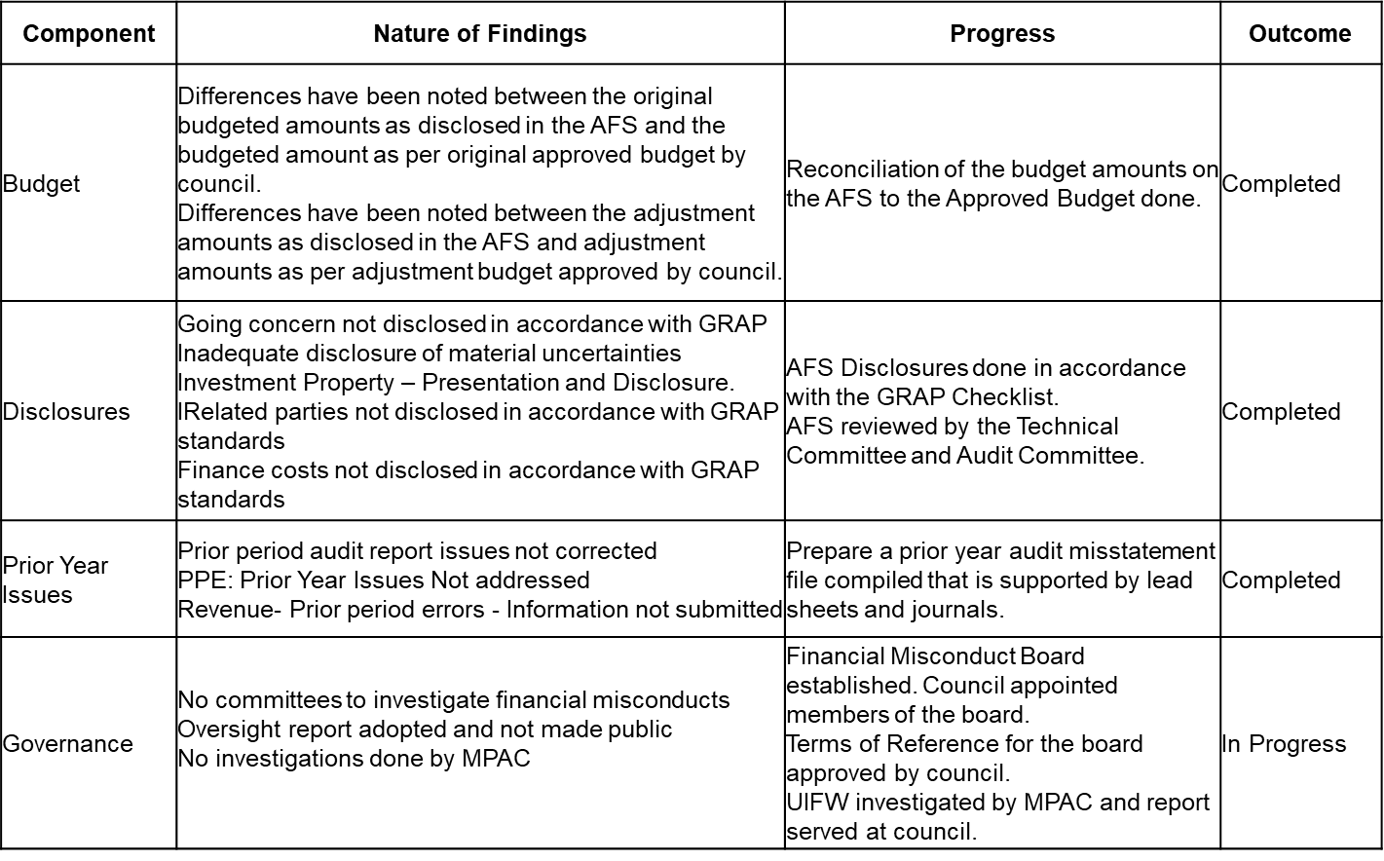
IMPLEMENTATION OF THE POST AUDIT ACTION PLAN (PAAP)
DETAILED ACTION PLAN 2018/19..cont.

Slide 9
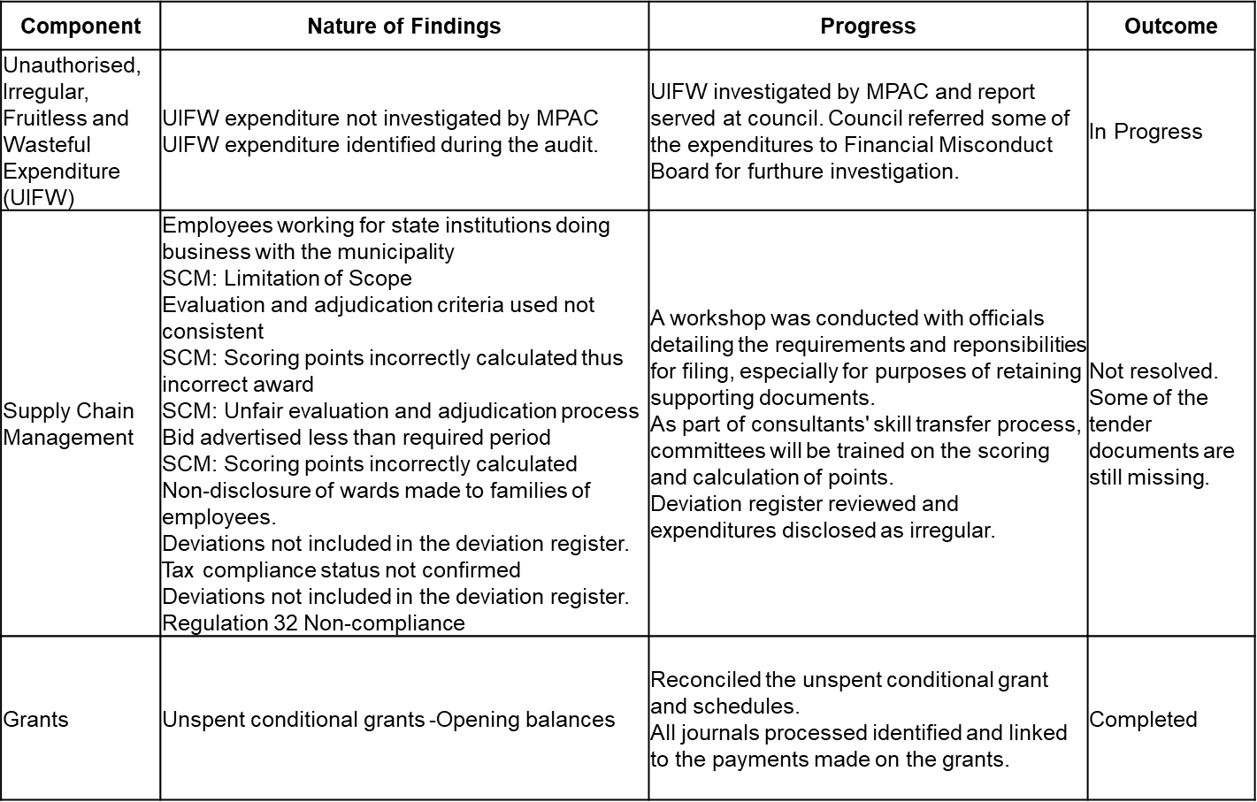
IMPLEMENTATION OF THE POST AUDIT ACTION PLAN (PAAP)
DETAILED ACTION PLAN 2018/19..cont.

Slide 10
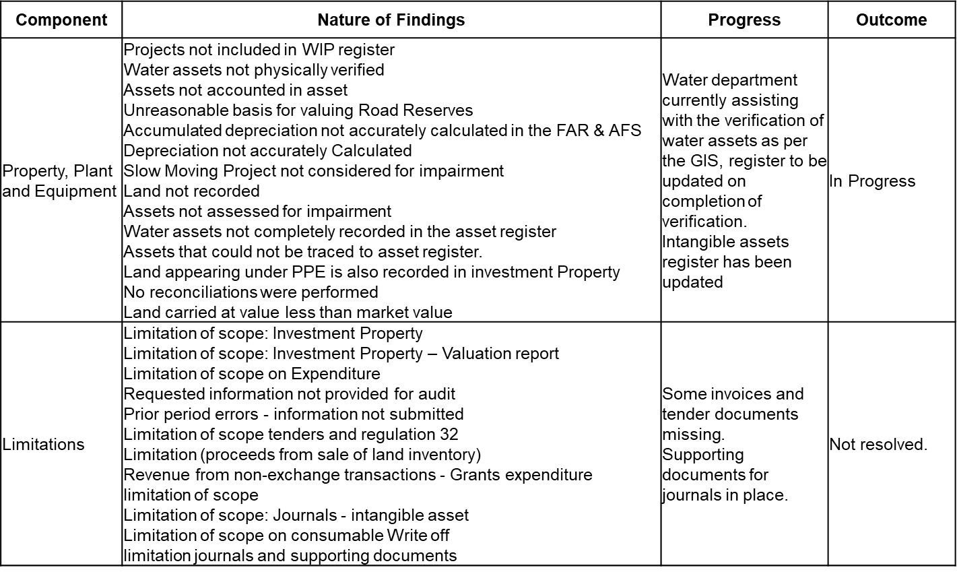
IMPLEMENTATION OF THE POST AUDIT ACTION PLAN (PAAP)
DETAILED ACTION PLAN 2018/19..cont.

Slide 11
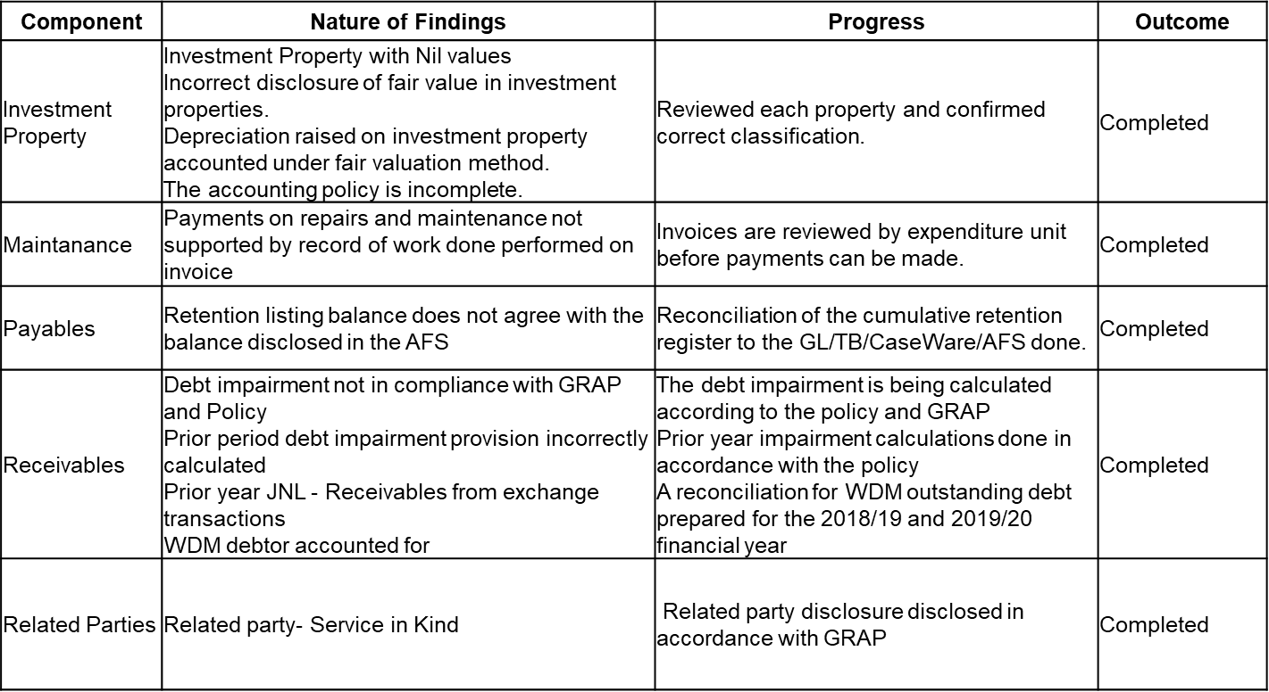
IMPLEMENTATION OF THE POST AUDIT ACTION PLAN (PAAP)
DETAILED ACTION PLAN 2018/19..cont.

Slide 12
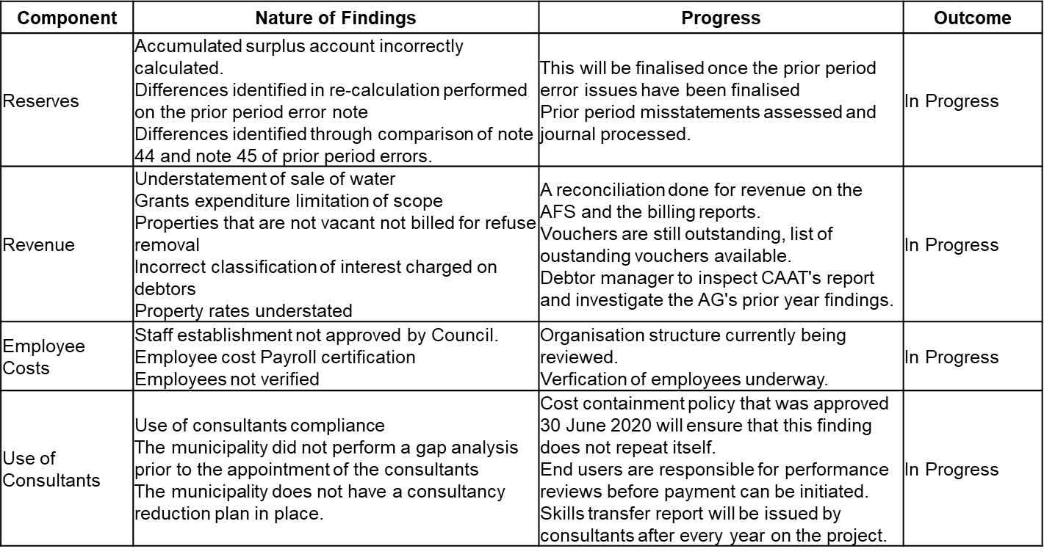
IMPLEMENTATION OF THE POST AUDIT ACTION PLAN (PAAP)
DETAILED ACTION PLAN 2018/19..cont.

Slide 13
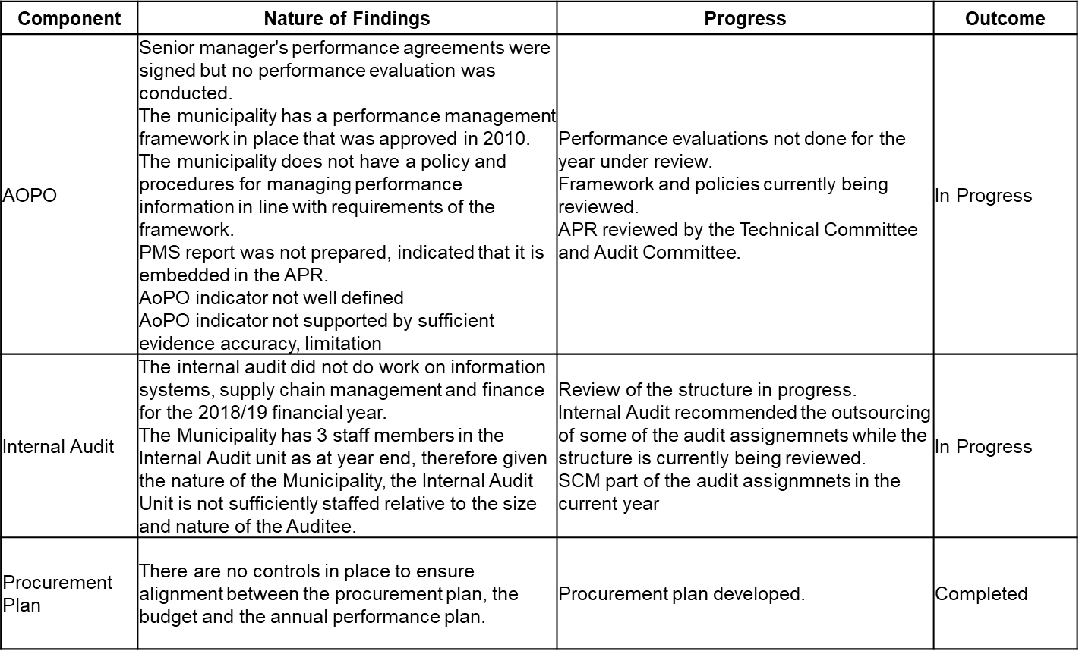
IMPLEMENTATION OF THE POST AUDIT ACTION PLAN (PAAP)
DETAILED ACTION PLAN 2018/19..cont.

Slide 14
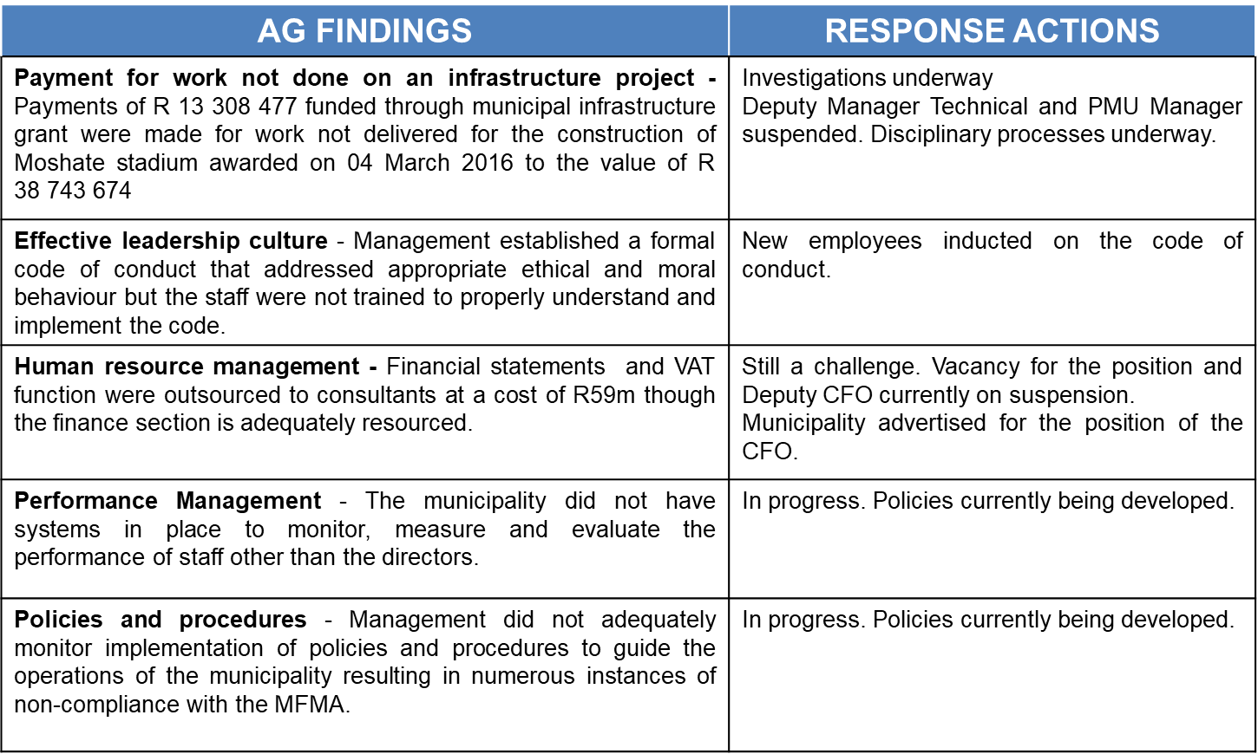
IMPLEMENTATION OF THE POST AUDIT ACTION PLAN (PAAP)
ACTIONS TO ADDRESS INTERNAL CONTROL DEFICIENCIES

Slide 15
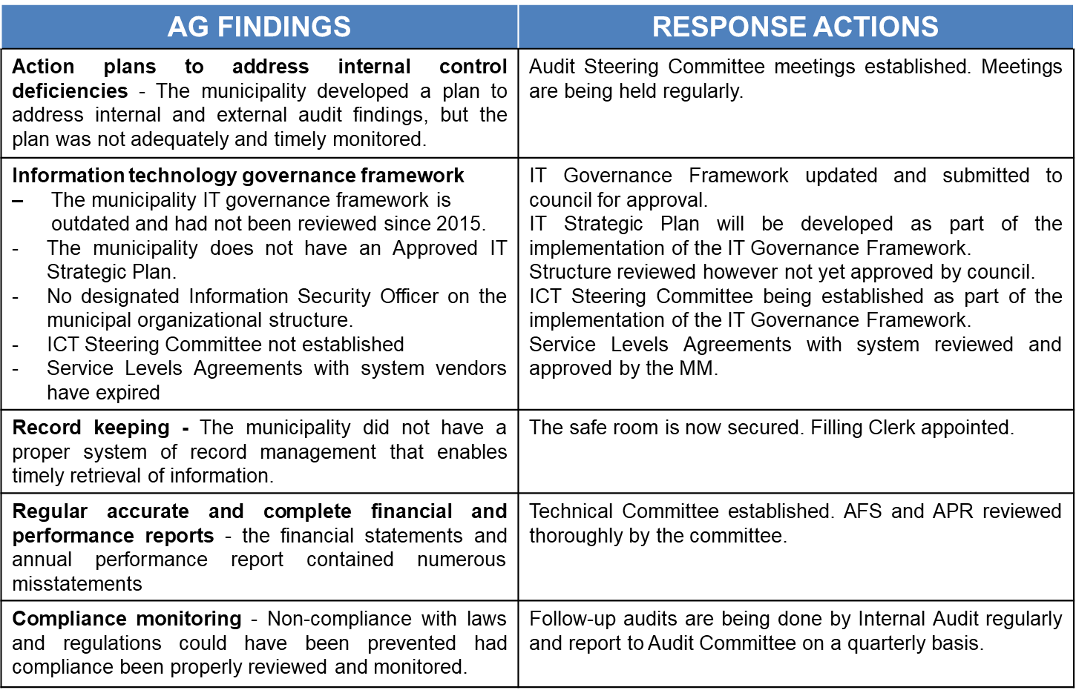
IMPLEMENTATION OF THE POST AUDIT ACTION PLAN (PAAP)
ACTIONS TO ADDRESS INTERNAL CONTROL DEFICIENCIES…cont…

Slide 16
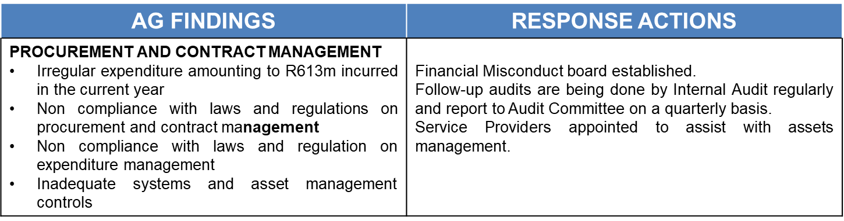
IMPLEMENTATION OF THE POST AUDIT ACTION PLAN (PAAP)
ACTIONS TO ADDRESS INTERNAL CONTROL DEFICIENCIES…cont…

Slide 17
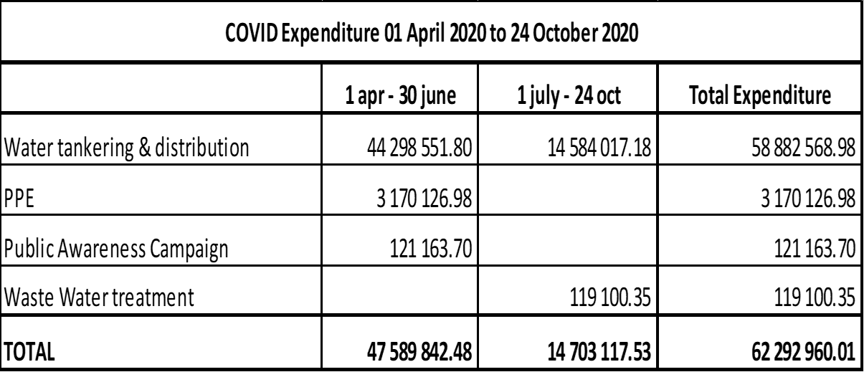
STATE OF FINANCES
BREAKDOWN OF COVID-19 EXPENDITURE
NB: Procurement of PPE items were guided by the Instruction 5 on price lists (as amended) issued by National Treasury as from 28th May 2020. .

Slide 18
STATE OF FINANCES
BREAKDOWN OF COVID-19 EXPENDITURE…cont..
The Municipality had to procure PPE for employees working during National lockdown The SLA with the Protective Clothing supplier expired in December 2019 National Treasury issues a directive to all government departments and municipalities to procure personal protective equipment from the RT57 contract. The Municipality liaised with service providers and issue them with specification of the items required. However, no response was forthcoming due to huge demand, pre-payment requirements prior to delivery of goods. Some Service providers whom the National Treasury directed municipalities to procure materials from them were unable to deliver to scarcity of the materials at the time due to huge demand in the country. Other service providers on the transversal contract for protective clothing were demanding 50% payment prior to supply and delivery of the materials which would be against the prescripts of the MFMA, and Municipality’s SCM policy. The municipality resorted to emergency procurement through SCM Regulation 36 of MFMA i.e. deviation (3 quotations) Procurement of goods and services was guided by directives issued National Treasury

Slide 19
COVID 19 WATER INTERVENTIONS
ALLOCATION OF MAINTENANCE WORK COVID-19 RESPONSE
The municipality re-allocated funds for Covid-19. Further allocated works to deal with immediate interventions on water supply issues to all service providers already appointed under the Municipality’s Water & Sanitation maintenance contracts.
The service providers were appointed following Municipal SCM process on an as and when it required basis for a period of 3 years from the 01st April 2018 to 01st April 2021.
The municipality appointed four (4) service providers who are responsible for the repairs and maintenance of water and sewer electromechanical works and 2 service providers who are responsible for the repairs and maintenance of water and sewer works infrastructure.
The electromechanical service providers were allocated work on pump stations or pump houses, boreholes within the municipality.
The water and sewer infrastructure service providers were allocated work in various areas with the municipality for repairs and maintenance of water and sewer networks.
The areas affected were the Mokopane town and peri urban areas, Bakenberg, Salem, Nkidikitlana and Mapela satellite areas.
The works were allocated on rotational basis between the appointed service providers.

Slide 20
COVID 19 WATER INTERVENTIONS
ALLOCATION OF MAINTENANCE WORK COVID-19 RESPONSE…cont..
At the start of Alert Level 5 of the Covid-19 outbreak, there were interventions from National Department of Human Settlements, Water & Sanitation in the form of provision of water tankers and JoJo tanks allocated to Mogalakwena Local Municipality.
The initiatives where Headed by Lepelle Northern Water on behalf of the Department.
Imisebeni Trading Enterprise was appointed as an agent of Lepelle Northern Water to implement the installation of sixty four (64) JoJo tanks that where allocated to Mogalakwena Local Municipality by the department in various villages.
The municipality also appointed seven (7) service providers to assist the municipality with providing water to 114 villages using water tankers. A total of thirty four (34) water tankers were used amongst the total service providers.
The service providers were allocated working areas per cluster.
The DWS/Rand Water assisted by allocating three (3) water tankers to assist the municipality in addition to six (6) municipal owned water tankers from April 2020 to July 2020. The water tankers were allocated working areas.

Slide 21
COVID 19 WATER INTERVENTIONS
DWS INSTALLED STORAGE TANKS RAND WATER/LNW
Village Name | No. installed | Contractor | Status
Steiloop Plaza | 2 | Imisebeni Trading Enteprise | Completed
Monte Christo | 1 | Imisebeni Trading Enteprise | Completed
Tenerif | 1 | Imisebeni Trading Enteprise | Completed
Serapis | 1 | Imisebeni Trading Enteprise | Completed
Waterfall | 2 | Imisebeni Trading Enteprise | Completed
Uitzight | 2 | Imisebeni Trading Enteprise | Completed
Thabaleshoba | 1 | Imisebeni Trading Enteprise | Completed
Mapela | 4 | Imisebeni Trading Enteprise | Completed
Bakenberg | 4 | Imisebeni Trading Enteprise | Completed
Mzombana | 2 | Imisebeni Trading Enteprise | Completed
Phola Park | 1 | Imisebeni Trading Enteprise | Completed
Maroteng/Masehlaneng | 3 | Imisebeni Trading Enteprise | Completed
Moshate / Sekgakgapeng | 3 | Imisebeni Trading Enteprise | Completed
Sekgakgapeng | 3 | Imisebeni Trading Enteprise | Completed
Machikiri | 1 | Imisebeni Trading Enteprise | Completed
Sekuruwe | 2 | Imisebeni Trading Enteprise | Completed
Ga-Mokaba | 2 | Imisebeni Trading Enteprise | Completed
Tshamahansi | 2 | Imisebeni Trading Enteprise | Completed

Slide 22
COVID 19 WATER INTERVENTIONS
DWS INSTALLED STORAGE TANKS RAND WATER/LNW…cont..
Village Name | No. installed | Contractor | Status
Madiba | 4 | Imisebeni Trading Enteprise | Completed
Masodi | 1 | Imisebeni Trading Enteprise | Completed
Bakenberg Matlaba | 2 | Imisebeni Trading Enteprise | Completed
Pudiyakgopa | 1 | Imisebeni Trading Enteprise | Completed
Galakwenastroom | 1 | Imisebeni Trading Enteprise | Completed
Bohwidi | 1 | Imisebeni Trading Enteprise | Completed
Mamatlakala | 1 | Imisebeni Trading Enteprise | Completed
Marulaneng | 1 | Imisebeni Trading Enteprise | Completed
Kgopeng ext | 1 | Imisebeni Trading Enteprise | Completed
Ham 1 ext | 1 | Imisebeni Trading Enteprise | Completed
Lekhureng ext | 2 | Imisebeni Trading Enteprise | Completed
Tipeng ext | 2 | Imisebeni Trading Enteprise | Completed
Taueatswala | 2 | Imisebeni Trading Enteprise | Completed
Senita | 1 | Imisebeni Trading Enteprise | Completed
Mathekga | 1 | Imisebeni Trading Enteprise | Completed
Nkidikitlana | 2 | Imisebeni Trading Enteprise | Completed
Nelly | 1 | Imisebeni Trading Enteprise | Completed
Paulos | 2 | Imisebeni Trading Enteprise | Completed
TOTAL | 64

Slide 23
COVID 19 WATER INTERVENTIONS
WORK ALLOCATION TO SERVICE PROVIDERS
Service Provider | Village names
Koketso Kamogelo Trading Enterprise | Fothane, Ga-Tshaba’ Maala Parekisi, Magope, Matopa, Kwakwalata, Mabuela, Mabusela, Masoge, Mesopotania, Mmahlogo, Phafola, Ramorulane, Mahwelereng, Madiba East, Madiba
Ramatlaohle Pty Ltd | Ga-Tlhako, Taueatswala, Dipere, Ga-Nong, Senita, Rapadi, Ga-Mushi, Ga-Monare, Grasvlei, Mphelelo, Nkidikitlana, Diphichi, Ramosesane, Raadslid, Segole 1, Segole 2, Rebone, Sterkwater
Mohauqhawe Capital | Mzumbana South, Maribashoop / Oorlogsfontein Plots, Maruteng, Masehlaneng, Masodi, Moshate, Mountain View, Sekgakgapeng
Munesumusa Pty Ltd | Kgopeng, Galelia, Bavaria, Blinkwater, Ham 1, Seirappes, Hlogoyanku, Makobe, Matjitjileng, Mattanau, Tennerif, Breda, Duren, Khala, Polen, Lennes, Setuphulane, Sodoma, Thabaleshoba, Tipeng, Vergenoeg
Minahlanhlagane Pty Ltd | Ga-Molekana, Machikiri, Mohlotlo Ga-Puka, Mohlotlo Ga, Sekhaolelo, Sekuruwe, Mohlotlo ya Kgale, Ga-Magongoa, Ga-Mokaba, Kgobudi, Mmalepeteke, Mzumbana North, Tshamahansi, Sekgoboko, Millenium Park, Witrivier
Pasima Technologies | Danisane, Ga-Chokoe, Ga-Pila Sterkwater, Hans, Lelaka, Leleso, Mabusela Sandsloot, Mashahleng, Masenya, Matlou, Seema, Skimming, Sterkwater Mountain View, Lekiting
Mokete Lepipo Trading Enterprise | Biesjeskraal / Rooisloot, Bakenberg Basogadi, Bakenberg Kwanaite, Bakenberg Matlaba, Bakenberg Mautjana, Bakenberg Mmotong, Malokongskop, Pudiyakgopa, Rooiwal, Sepharane (Mankopane),Taolome, Galakwenastroom, Kromkloof, Basterspad, Dikgokgopeng, Harmansdal, Kaditshwene, Lesodi, Makekeng, Mamatlakala, Jakkalskuil, Marulaneng

Slide 24
REVENUE COLLECTION
The municipality experienced a sharp decline on the collection rate during the national lockdown. Collection dropped from average of 77% to 55% in June 2020 as Municipality could not institute credit control process.

Slide 25
UNAUTHORISED, IRREGULAR AND FRUITLESS EXPENDITURE
BREAKDOWN OF THE UNAUTHORIZED, IRREGULAR, FRUITLESS AND WASTEFUL EXPENDITURE
Mogalakwena Local Municipality has reported an escalating trend in unauthorised, irregular, fruitless and wasteful expenditure over the past six (6) years, evident in audit opinions and in the annual reports; The audited annual financial statement for the period ending 2018/19 reported is outlined as follows: The municipality has, with the support initiative by National Treasury and Provincial Treasury, developed a Reduction strategy on Unauthorised, Irregular and Fruitless & Wasteful (UIFW) Expenditure;
 | Irregular | Fruitless and Wasteful
R2.8 billion | R2.3 billion | R11.3 million

Slide 26
UNAUTHORISED, IRREGULAR AND FRUITLESS EXPENDITURE
BREAKDOWN OF THE UNAUTHORIZED, IRREGULAR, FRUITLESS AND WASTEFUL EXPENDITURE

Slide 27
UNAUTHORISED, IRREGULAR AND FRUITLESS EXPENDITURE
BREAKDOWN OF THE UNAUTHORIZED, IRREGULAR, FRUITLESS AND WASTEFUL EXPENDITURE IDENTIFIED CAUSES OF AN INCREASE IN MOGALAKWENA UIF&W
No preventative mechanisms to eliminate reoccurrence No effective internal controls measures No detailed reasons for incurring of UIFW expenditures as captured in the registers according to National Treasury Circular 68 Annexure A Lack of investigation on identified UIFW by the relevant council committees None implementation of processes to be followed when dealing with UIFW Lack of consequence management (Financial Misconduct) Inadequate budget controls Failure to pay suppliers on time due to cash constraints resulting in interest payments

Slide 28
UNAUTHORISED, IRREGULAR AND FRUITLESS EXPENDITURE
BREAKDOWN OF THE UNAUTHORIZED, IRREGULAR, FRUITLESS AND WASTEFUL EXPENDITURE PROCESS FLOW STRATEGIES ON THE IMPLEMENT REDUCTION PLAN
Capacitating the SCM Division Review of the SCM policy to ensure alignment with SCM regulations and guidelines Compliance to SCM policy and regulations and procurement plan Utilisation of SCM Regulation 32 on contracts that have expired to reduce the increase in UIF Develop and adhere to the approved procurement plan Consequence management be applied to officials who causes the transgression and non-compliance with legislations, policies, procedures and guidelines Introduction of vigorous Contracts management Payments of completed projects be inspected (despite the payment certificate issued by the Consulting Engineers to avoid Consulting Engineers to collude with Contractors and Municipal employees) Initiate legal proceedings on Contractors that did not complete the projects (with the view of recovering the lost money on these projects) Adhere to Circular 68 issued by NT

Slide 29
UNAUTHORISED, IRREGULAR AND FRUITLESS EXPENDITURE
BREAKDOWN OF THE UNAUTHORIZED, IRREGULAR, FRUITLESS AND WASTEFUL EXPENDITURE IN LINE WITH THE GOVERNMENT 4 YEAR MEDIUM TERM STRATEGIC FRAMEWORK, THE REDUCTION PLAN IS AS FOLLOW:

Slide 30
STATE OF FINANCES
CONSEQUENCE MANAGEMENT
Name of Employee | Department | Type of Misconduct | Date of suspension | Return Date | Progress to date
TF Mojapelo | Technical Services | Theft of Diesel | 1 Oct 2018 | Still Suspended | Still waiting for sanction
B Mathibe | Finance Department | Failure to perform duties /Financial misconduct and Tender irregularity | 9 Jun 2020 | Still Suspended | Still under disciplinary hearing.
H Mosethla | Traffic Department | Failure to perform duties /Financial misconduct and Tender irregularity | 9 Jun 2020 | 7 Sept 2020 | Suspension has been revoked and the employee is back at work
MD Molewa | Finance Department | Failure to perform duties /Financial misconduct and Tender irregularity | 9 Jun 2020 | Still Suspended | Still under disciplinary hearing.
A Sibanda | Traffic Department | Failure to perform duties /Financial misconduct and Tender irregularity | 9 Jun 2020 | 7 Sept 2020 | Suspension has been revoked the employee is back at work
M Choshane | Technical Services | Financial misconduct | 19 May 2020 | Still Suspended | Still under disciplinary hearing.
KD Malepa | Technical Services | Financial misconduct | 19 May 2020 | Still Suspended | Still under disciplinary hearing.

Slide 31
STATE OF FINANCES
CONSEQUENCE MANAGEMENT
Name of Employee | Department | Type of Misconduct | Date of suspension | Return Date | Progress to date
MM Matlala | Corporate Support Services | Recruitment of officials in contravention with the recruitment policy as approved by council allegedly committed Violation of the labour law prescripts including collective agreements concluded between parties to the South African Local Government Bargaining Council Disposal of municipal land in contravention with the Municipal Council Resolution | 7 Jul 2020 | Still Suspended | Still under disciplinary hearing.

Slide 32
STATE OF FINANCES
CONSEQUENCE MANAGEMENT
Name of Employee | Department | Type of Misconduct | Date of suspension | Return Date | Progress to date
K Maluleka | Manager Planning & Development Services | Recruitment of officials in contravention with the recruitment policy as approved by council allegedly committed Violation of the labour law prescripts including collective agreements concluded between parties to the South African Local Government Bargaining Council Disposal of municipal land in contravention with the Municipal Council Resolution | 7 Jul 2020 | Letter of Intention to suspend the employee was issued. However, he opted to resign before he could make any representation | The employee resigned on the 06th July 2020 with immediate effect.

Slide 33
STATE OF FINANCES
CONSEQUENCE MANAGEMENT
Name of Employee | Department | Type of Misconduct | Date of suspension | Return Date | Progress to date
JP Mashamaite | Corporate Support Services | Contravention of section 78(1) and section 171(3)of the municipal Finance management Act 56of 2003 Failure to act in the utmost good faith Dereliction of duties and dishonesty | 6 Sept 2019 | 20/09/2019 | The matter is finalized and the employee is back at work. (Sanction: Not guilty.)
BS Gunqisa | MM’s officers | Irregular appointment of service provider Permit wasteful & fruitless expenditure Undue influence or interference on the work of SCM Criminal Record Gross Negligence | 7 Jul 2020 | 06th October 2020 | The matter is finalized and the employee is back at work.

Slide 34
INSTITUTIONAL CAPACITY
PERSONNEL IN KEY POSITIONS
Employee/Manager | Filled/Vacant | Qualifications and Experience
Municipal Manager Ms BS Gunqisa | Filled | Bachelor of Business Administration (Hons) MFMP 18 years experience in LG Sector
Manager Traffic & Emergency (Contract lapsed on the 31st October 2020) | Vacant | Position advertised
 | Acting Manager M Mampa | Master of Public Admiration MFMP 10 years experience in LG Sector
Manager Community Services Ms M Mampa | Filled | Master of Public Admiration MFMP 10 years experience in LG Sector
Manager Corporate Support Services Ms M Matlala (currently on suspension) | Filled | Master of Public Administration MFMP 20 years experience in LG Sector
Manager Technical Services | Vacant | Re-advertised .
Chief Financial Officer (Incumbent resigned) | Vacant | Shortlisting held on the 13th October 2020

Slide 35
INSTITUTIONAL CAPACITY
PERSONNEL IN KEY POSITIONS
Employee/Manager | Filled/Vacant | Qualifications and Experience
Manager Planning & Development Services (Incumbent resigned) | Vacant | Shortlisting held on the 20th October 2020
 | Acting Manager Mr ML Mashishi | Bachelor of Public Administration (Honours) MFMP 18 years experience in LG Sector
Manager Electrical Services (Incumbent resigned) | Vacant | Advertised.
 | Acting Manager Mr E Manamela | National N Diploma: Engineering field of Study 11 Years Experience
Chief Financial Officer (Incumbent resigned) | Vacant | Shortlisting held on the 13th October 2020

Slide 36
INSTITUTIONAL CAPACITY
PERSONNEL IN KEY POSITIONS SUPPORT FROM WDM THROUGH SEC 88 OF STRUCTURES ACT
Employee/Manager | Highest Qualifications, Competency and Experience
Acting Manager Corporate Support Services Ms GM Seleka | B Tech Public Administration MFMP 10 years experience in LG sector
Acting Manager Technical Services Ms B Mthombeni | B Tech: Civil Engineering: Transportation Engineering Engineering Council of South Africa (ECSA): Candidate Technologist, Reg no: 200880342 South Africa Institution of Civil Engineers (SAICE): Associate Member, Member no: 203291 18 years experience in LG sector
Acting Chief Financial Officer Ms T Muelelwa | Master of Business Administration MFMP 17 years experience in LG sector

Slide 37
INTERNAL AUDIT COMMITTEE
CAPACITY, FUNCTIONALITY AND EFFECTIVENESS
COMPOSITION
SAB Ngobeni (Chairperson) PR Mnisi TC Modipane TG Nevhutalu
FUNCTIONALITY
The Audit Committee is functional. In the 2019/20 financial year 6 Audit Committee meetings were held.
EFFECTIVENESS
The Audit Committee submitted 4 reports to municipal council.
SUPPORT STAFF
Divisional Head Internal Audit Internal Auditor Internal Audit Assistant

Slide 38
MPAC
CAPACITY, FUNCTIONALITY AND EFFECTIVENESS
COMPOSITION
Cllr Satege L.K :Chairperson Cllr Mooka T.A Cllr Majadibodu K.S Cllr Ratema M.A Cllr Selemela R.G Cllr Mogale M.T Cllr Moloto M.E Cllr Laka L.E Cllr Sebajane R.P Cllr Magongoa N.B Cllr Monama T.E Cllr Leshiba M.C
FUNCTIONALITY
6 meetings held during 2019/20 FY to consider UIFW referred to the committee by Council
EFFECTIVENESS
MPAC established. Requested intervention of SALGA for capacity building in a form of training. The committee has already submitted report to council on 2017/18 UIFW MPAC Researcher position advertised. Currently utilising PMS Officer to support the committee administratively

Slide 39
CONCLUSION
POST AUDIT ACTION PLAN, DRAFT FRP & REDUCTION OF UIFW STRATEGY
In conclusion, the Committee should note the progress on the circulated detailed Post Audit Action Plan, Financial Recovery Plan (to be institutionalised and implemented) & Reduction of UIFW Strategy for the municipality which details the progress and the level at which the corrective actions have been implemented.
THANK YOU

