Slide 1
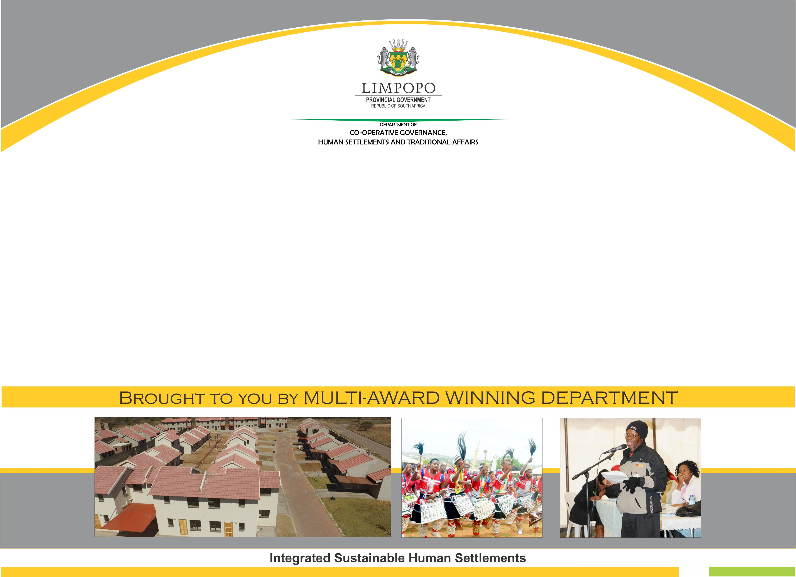
REPORT ON SUPPORT PROVIDED TO GREATER TZANEEN AND MOGALAKWENA LOCAL MUNICIPALITIES
PORTFOLIO COMMITTEE

Slide 2
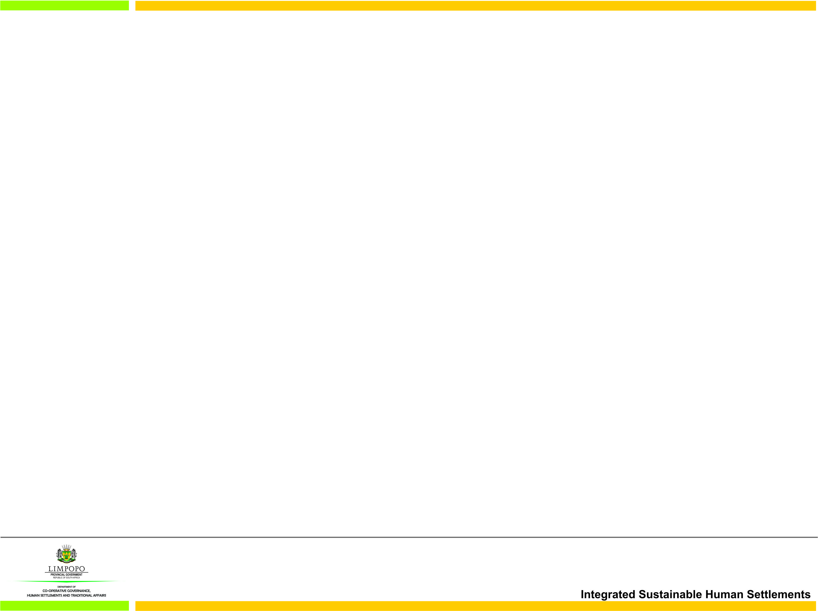
PRESENTATION OUTLINE
PURPOSE
INTRODUCTION
SUPPORT PER KEY PERFORMANCE AREA
3.1. BASIC SERVICES
3.2. MUNICIPAL INSTITUTIONAL DEVELOPMENT AND TRANSFORMATION
3.3. LOCAL ECONOMIC DEVELOPMENT
3.4. MUNICIPAL FINANCIAL VIABILITY AND MANAGEMENT
3.5. GOOD GOVERNANCE AND PUBLIC PARTICIPATION
4. CONCLUSION
5. RECOMMENDATIONS

Slide 3
PURPOSE
To provide a report on support provided to Greater Tzaneen and Mogalakwena Local Municipalities in terms of the five key performance areas for them to improve their performance as per Portfolio Committee’s request.

Slide 4
GREATER TZANEEN LOCAL MUNICIPALITY

Slide 5
BASIC SERVICE DELIVERY
2016/2017 – 2020/2021 GREATER TZANEEN LM MIG IMPLEMENTATION
Municipality allocated R 536,736,999.00 million over five financial years which include the additional fund and the roll-over.
R 451,425,734.54 million was spent within the 5 financial years and only R 27,967,890.76 million remain unspent.
2016/2017: The Municipality has additional funding of R65million on top of their allocation, only R19,448,541.00 remain unspent.
2017/2018: The Municipality spent 100% on both the allocation and additional funding of R5,8million.
2018/2019 and 2019/2020: The municipality spent 90.49% and 99% respectively.
The municipality is part of the GTAC and MISA support programme and spending on the MIG has been affected by Covid 19 pandemic in 2019/2020 and 2020/2021 financial years.
F/Y | Allocation + Additional Fund |  | Expenditure | % | unspent amount
2016/2017 | 89,797,999.00 | 65,000,000.00 | 135,348,459.00 | 87.44% | 19,448,541.00
2017/2018 | 95,942,000.00 | 5,800,000.00 | 101,742,000.00 | 100%
2018/2019 | 92,315,000.00 |  | 83 537 913,02 | 90.49% | 7,750,288,94
2019/2020 | 94, 263,000.00 |  | 93, 494,927.18 | 99% | 768,072.82
2020/2021 | 93,619,000.00 |  | 36,275,626.30 | 38.75 | Still implementing projects
TOTAL | 536,736,999.00 |  | 451,425,734.54 | 80% | 27,967,890.76

Slide 7
2016/2017 – 2019/2020 MIG IMPLEMENTATION
Over the past 4 financial years the municipality have in the main prioritized Roads and Sport facilities in their allocation of resources.
73.9% of the allocation has been spent on Roads and Storm water
15.0% on Sport facilities
4.8% on PMU fees
6.0% on Community facilities
0.3% on Community Lighting
A critical sector such as Solid Waste (refuse removal) has received no allocation.

Slide 8
CHALLENGES
Challenges established in the municipality
External factors
Poor contractor performance
Demands by communities – community unrest
Internal factors
SCM processes
Delay in the appointment of contractors
Intervention to be done by the municpality
Implementation processes need to be undertaken in time to avoid a situation in which activities need to be hurried up without adhering to the set policies.
Proper planning to be done to avoid poor administration and unsatisfactory standard of physical works in progress
To involve technical expertise during the evaluation of bids in order to avoid court interdicts.

Slide 9
INTERVENTION / CURRENT SUPPORT
As per DoRA straight line projection, the municipalities should be at or above 25% expenditure, to date the municipality have spent 38,75%
The municipality is supported and engaged through the following structures.(Municipalities, CoGHSTA, CoGTA, MISA,GTAC and Sector Departments):
Monthly Provincial and District MIG meetings, that’s where expenditures, progress, challenges, policies and guidelines are vigorously discussed.
Provincial Project appraisal meetings, assist the municipalities to be committed for MTEF period
Monthly Consultants meeting, this is the platform where progress report on project is presentenced by both the Engineers and the contractors
Provincial Treasury mid-year assessment, that's where the performance of the entire municipality as look at and where there is some discrepancy, recommendation are made.

Slide 10
MUNICIPAL INSTITUTIONAL DEVELOPMENT AND TRANSFORMATION
The municipality is supported on the following;
Review and implementation of staff establishment which was adopted on the 26 June 2020.
The department is supporting Greater Tzaneen municipality on job evaluation process. The municipality has 420 jobs on the approved organisational structure. All 420 jobs have been evaluated and awaiting to be submitted to the Provincial Audit Committee for auditing and moderation.
The department in collaboration with GTAC conducted capacity interventions on Standard for Infrastructure Procurement and Delivery Management(SPDIM) and Infrastructure Delivery Management System(IDMS).
Appointment of senior managers and management of their contracts thereof. All Senior Managers posts are currently filled.

Slide 11
INTEGRATED DEVELOPMENT PLAN
Provide support to the Greater Tzaneen Local Municipality in the development and annual review of the IDPs by:
Coordinating and supporting the municipality during IDP engagement sessions. ( Analysis, Strategies and Project Phases).
Analyzing the local municipality’ Draft IDP/Budget documents and Final IDP documents and issuing the report with recommendations (IDP Analysis Report as well as the MEC’s IDP Assessment Report).
Coordinating and supporting municipality during the IDP Steering Committee meetings, Rep Fora and Strategic Planning sessions.
The municipality has adopted its Integrated Development Plan (IDP) by the end of June 2020 as required amidst the COVID – 19 pandemic and the subsequent lockdown.
The IDP of the municipality is credible and has been rated high as per the 2020/21 MEC IDP Assessment Report.
The IDP and SDBIP of the municipality are not aligned for two consecutive years (2019/20 and 2020/21)

Slide 12
Municipality is supported on implementation of SPLUMA
SPLUMA BY-LAWS
The municipality was supported to develop and approve the SPLUMA By-laws and is currently being implemented.
Municipal Planning Tribunal
The municipality has opted for independent Municipal Planning Tribunal and currently operating. Officials from the department participate in the tribunal as observers.
Spatial Development Framework
  The greater Tzaneen Municipal Council has approved and adopted the Spatial Development Framework in 2017. The adopted SDF is in line with the provisions of the Spatial Planning and Land Use Management Act, 2013 (Act 16 of 2013). The Department continues to provide an oversight role through support and monitoring the implementation of the adopted SDF, this include providing guidance/advices during the Municipal Planning Tribunal meetings to ensure that decisions taken on land use applications aligns with the SDF, as well as ensuring that plans highlighted by the municipality on the SDF such as Precinct Plans are actually developed.
Land Use Scheme
The municipality is being supported to develop the Land Use Scheme in terms SPLUMA guidelines. The department participates in the Steering Committee.

Slide 13
MUNICIPAL FINANCIAL VIABILITY AND MANAGEMENT
Monitored compliance with the provision of Municipal Property Rates Act
Assessed the 2018/2019 audit action plans and provided feedback to the municipality, as well as to monitor progress on the implementation thereof.
Conducted 2019/2020 AFS readiness assessment
Attended audit steering committee meetings
Conducted government debt reconciliation/working session

Slide 14
MOGALAKWENA LOCAL MUNICIPALITY

Slide 15
2016/2017 – 2019/2020 MIG implementation
Municipality allocated R 608,283 million over four financial years.
R 455,454 million was spent within the financial year with R 132,944 million unspent.
Further more, an total amount of R 20,256 million was stopped and re-allocated to other municipalities due to poor spending in the by the municipality during the 2018/2019 financial year.
The municipality is part of the MISA support programme.
Financial Year | Allocation R’000 | Stopping/ Reallocation | Expenditure R’000 | % expenditure | unspent amount R’000
2016/2017 | 139 486 | 0 | 136 666 | 98 | 2 820
2017/2018 | 159 266 | 0 | 111 049 | 69 | 48 217
2018/2019 | 153 114 | (20 256) | 127 710 | 83 | 5 148
2019/2020 | 156 417 | 0 | 79 658 | 51 | 76 759
TOTAL | 608 283 | (20 256) | 455 454 | 75 | 132 944

Slide 17
MOGALAKWENA 2016/2017 – 2019/2020 MIG implementation
Over the past 4 financial years the municipality have in the main prioritized Roads and Sport facilities in their allocation of resources.
17.2 % of the allocation has been spent on Roads and Storm water
12.9 % on Sport facilities
61.1 % on Water projects
2.8 % on Sanitation
4.1 % on PMU fees
1.8 % on Community lighting
A critical sector such as Solid Waste (refuse removal) has received no allocation.

Slide 18
Challenges / Intervention / current support
Challenges
Communities disruption of projects
Contracts have lapsed but projects are not completed.
Inability to finish complete projects timeously leading to escalation in costs.
Conflicting reporting on MIGMIS and hard copies
Intervention required / done
Intervention meetings held
Support being provided (be MISA, GTAC, COGHSTA)
MISA and CoGHSTA support
Mogalakwena LM support on MIG.
· Monthly district and provincial MIG PMU managers meetings to discuss projects progress.
· Acting Technical Manager seconded from Waterberg DM.
· MISA Engineer deployed to assist on technical issues.
· Quarterly intervention meetings with management of the municipality.
· Projects site visits and site meetings attendance for progress and expenditure verification.
· Projects registrations and monthly expenditure reporting.

Slide 19
MUNICIPAL INSTITUTIONAL DEVELOPMENT AND TRANSFORMATION
The municipality is supported on the following:
  Review of the organizational structure.
  Development of job descriptions for job evaluation purpose.
  Compliance and implementation of performance management system as per legislation.
  Appointment of senior managers and management of their contracts thereof.
  Support the municipality on compilation of statutory reports and submission thereof. E.g. Quarterly, Annual and Oversight reports.

Slide 20
Local Municipality: Implementation of SPLUMA:Mogalakwena
Municipality supported on implementation of SPLUMA
SPLUMA BY-LAWS:
  The municipality was supported to develop and approve the SPLUMA By-laws and currently being implemented.
Municipal Planning Tribunal:
  The municipality has opted to join the District Municipal Planning Tribunal and is in the process taking council resolution to formalize participation in the District Municipal Planning Tribunal. The department designated officials to support the DMPT to ensure its functionality.

Slide 21
Implementation of SPLUMA:Mogalakwena Local Municipality
Spatial Development Framework and Land Use Scheme
The Municipal Council adopted the Review of the Spatial Development Framework, however this process is still uncompleted. The municipality is engaging with the Service Provider on alternative approach to conclude this process as soon as possible. The Department is part of the Steering Committee for the Review of the SDF, with the Departmental mandates being to ensure that the review process take into cognisance of both the Provincial and National Plans such as Limpopo Spatial Development Framework, LDP, NSDF and etc. the continuous monitoring and support will ensure that the Draft SDF under review is credible and aligns with other sector plans.
The municipality is currently in the process of developing/reviewing its Land Use Scheme in terms SPLUMA guidelines. The department support the municipality LUS through provincial SPLUMA forums.

Slide 22
INTEGRATED DEVELOPMENT PLAN
Provide support to the Mogalakwena Local Municipality in the development and annual review of the IDPs by:
Coordinating and supporting the municipality during IDP engagement sessions. ( Analysis, Strategies and Project Phases).
Analyzing the local municipality Draft IDP/Budget documents.
Assessment of municipal Draft and Final IDP documents and issuing the IDP Analysis Report as well as the MEC’s IDP Assessment Report.
Coordinating and supporting municipalities during the IDP Steering Committee meetings, Rep Fora and Strategic Planning sessions.
The Municipal IDP was adopted prior to end of June 2020.

Slide 23
MUNICIPAL FINANCIAL VIABILITY AND MANAGEMENT
Monitored compliance with the provision of Municipal Property Rates Act.
2018/2019 assessment of audit action plans and provided feedback to the municipality
Held 2018/2019 audit action plan engagements session to check progress on implementation
Conducted 2019/2020 AFS readiness assessment and attended audit steering committee meetings.
Conducted government debt reconciliation/working session.

Slide 24
CONCLUSION
Although differentiated support is provided to these municipalities, there are still challenges in relation to service delivery performance.
The department is embarking on a process to compile a diagnostic study in all municipalities in order to identify recommendations for support and /or capacity development.

Slide 25
RECOMMENDATIONS
It is recommended that the Portfolio Committee notes the report

Slide 26
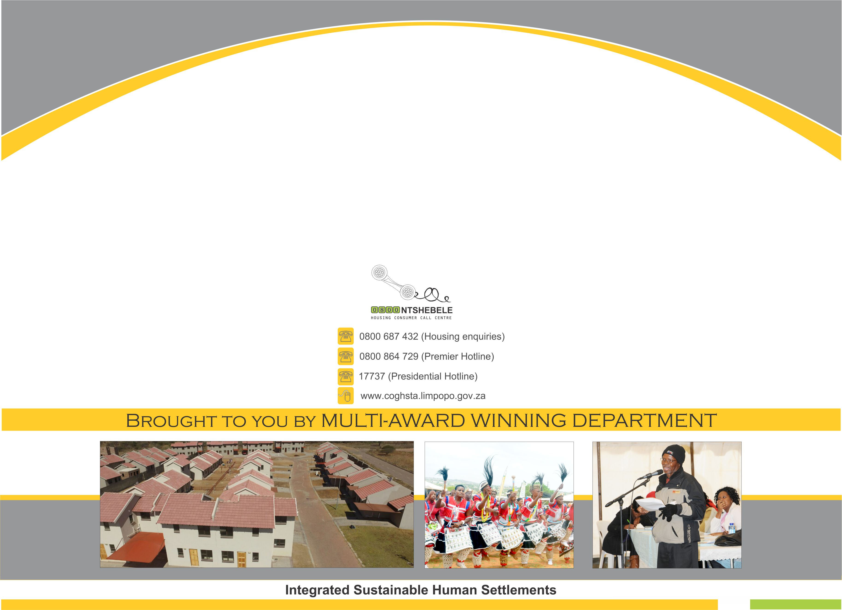
THANK YOU

