Slide 1
NATIONAL CONVENTIONAL ARMS CONTROL COMMITTEE (NCACC)
PRESENTATION TO THE JOINT STANDING COMMITTEE ON DEFENCE (JSCD).
BY MINISTER J.M. MTHEMBU – CHAIRPERSON OF THE NCACC
NCACC REPORTS

Slide 2
INTRODUCTION
The NCACC would like to thank the Joint Standing Committee on Defence (JSCD) for this Invitation to present the 2nd Quarterly 2020 Report.
The NCACC has approached the task as follows:
Present the Q2 2020 as requested by JSCD Report, including statistics. The Q1 was presented on 25 June 2020.
This Report (Q2) has already been tabled in Parliament.
We trust that the JSCD will accept this approach.

Slide 3
PROCEDURAL MATTERS REGARDING BRIEFING THE JSCD THE NCACC
Reporting to Parliament is prescribed in the law. (The NCAC Act)
Appearing to brief the JSCD is by invitation in terms of the Committees oversight role.
The NCACC seeks always respond to the invitation by the JSCD to provide such briefing
The NCACC can only brief the JSCD on Reports already tabled in Parliament.

Slide 4
HIGH(low)LIGHTS OF Q2/2020
The NCACC has approved and amended the End User Certificate provision as regards inspections post shipment.
The Amendment has been gazetted, on 11 May 2020. The amended provisions of the UEC, have force amend effect in law as per the Regulations of the Act.
The country entered alert level 5 of the State of Disaster due to the COVID-19 pandemic

Slide 5
THE CONTEXT – INTERNATIONAL: THE LEGAL FRAMEWORK
Treaties – based on International Public Law, which is Legally Binding.
Conventions – based on International Common Law, through accepted practice which is morally and persuasively Binding.
International Interest Group Arrangement(s) attempt to close gaps that may not be covered by either (Treaty and Convention).
Notes:
Parties to a Treaty are bound by its terms and conditions. Thus obligations that arise therefrom must be fulfilled by the Party concerned. Thus South Africa is no exception and has therefore domesticated law in order to give effect to these treaties. The NCAC Act is one such example.

Slide 6
South Africa’s membership to Treaties and Conventions
ATT – Arms Trade Treaty
MBT – Anti-Personnel Mine Ban Treaty
CCW - Certain Conventional Weapons
CCM - Convention on Cluster Munitions
WA- Wassenaar Arrangement
CONVENTIONAL ARMS CONTROL

Slide 7
THE CONTEXT- DOMESTIC: THE LEGISLATIVE IMPERATIVE
The National Conventional Arms Control Act
Act 41 of 2002 (as amended) (primary Act).
Act 73 of 2008 (amendment Act).
The National Conventional Arms Control Act also frames the:
Regulation of Foreign Military Assistance Act (RFMA), Act 15 of 1998.
Prohibition of Mercenary Activities and Regulation of Certain Activities in an area of Armed Conflict Act – Act 27 of 2006.
Notes:
The current Conventional Arms Control framework under the auspices of the National Conventional Arms Control (NCACC) is regulated through the NCAC Act, as amended. The amendment was made in 2012 in order to contend with new realities of the Defence Industry Complex. In order to regulate and curb mercenary activities and tendencies owing to persons who do not subscribe to South Africa’s Democratic values, the RFMA was promulgated. This Act has been amended as well in 2006, it has been assented to by the President currently under certification in order to be published in the Government Gazette in order to operationalise the Act.

Slide 8
POLICY IMPERATIVES
The Act captures the Object as being:
To ensure compliance with Govt. policy in respect of arms control.
To implement a legitimate, effective and transparent control process.
To provide for an inspectorate to ensure compliance with the provisions of the Act.
Protection of Economic and Security Interests.
Foster National and International confidence for control over trade in conventional arms
Notes:
This reflects the Strategic Thrust of Policy to achieve key aspects of Sustainable Growth for South Africa as a country

Slide 9
COMPOSITION OF THE COMMITTEE
The Committee is appointed by the President in terms of s5 of the NCAC Act.
The Cabinet Committee is Sui Generis
The Committee may not be chaired by (a) Minister(s) with a line responsibility interest in trade in conventional arms s5(3).
A member must vacate office if: s4(a-c)
Member resigns
Member is removed from office by the President
Notes:
This is the founding provision of the NCAC Act that establishes the Cabinet Committee

Slide 10
CURRRENT NCACC MEMBERS
MINISTERS
DEPUTY-MINISTERS
Min. J.M. Mthembu - Chairperson
Min. R. Lamola - Deputy Chairperson
Min G.N. Pandor
Min. N. Mapisa-Nqakula
Min. A. Dlodlo
Min. P.J. Gordhan
Min. E. Patel
Min. B. Cele
Min. B. Nzimande
DM T.S.P. Makwetla
DM C. Mashego-Dlamini
DM D. Masondo
Notes:
Here is the current Cabinet Committee. The Chair and Deputy Chair and Minister of Defence are some of the long serving members in this Committee.

Slide 11
PILLARS OF SA ARMS CONTROL
RSA GOVERNMENT
NCACC ACT
NON PROLIFERATION ACT
FIRE ARMS CONTROL ACT &
EXPLOSIVES
ACT
DOD
DTI
SAPS
Notes:
This represents the full gamut of the Arms Control Framework Nationally. The 3 Pillars cover all aspects of the national desire to contribute to Peace and Security in the world, through regularised transfers. Where there are prohibitions this is also the framework that ensures that adjustments are made domestically in compliance with International dictates under which South Africa is obliged to act.

Slide 12
TIERS OF DECISION MAKING
NCACC
Cabinet Committee - Sui Generis
Chaired by the Minister in the Presidency: Min J.M. Mthembu
SCRUTINY COMMITTEE
Review Departments
Chaired by the Secretary for Defence: Ms G Kudjoe*
(Dr S.M. Gulube was SecDef during this period, Q2).
DOD; DIRCO; DTI; SAPS; SSA; DEFENCE INTELLIGENCE
Notes:
Graphic of the levels of decision making by the NCACC and its constituents. The last tier represents the Review aspect of processes, who peruse each application within the remit of their disparate tasking. This means each Department and Agency must apply its own prism to evaluate such application(s).

Slide 13
THE NCACC STRUCTURE
CABINET COMMITTEE
SCRUTINY COMMITTEE
SECRETARIAT
INSPECTORATE
COMPLIANCE
DEFENCE INDUSTRY

Slide 14
SCRUTINY COMMITTEE (SC)
Established in terms of s7(1-9).
The SC is chaired by the Secretary for Defence as Director-General of the Department of Defence.
Members are Senior Government Officials
Scrutinize and Recommend decisions to the NCACC.
Notes:
This is what establishes the Scrutiny Committee of the NCACC, legally

Slide 15
ARMS CONTROL PROCESS
Application
Consideration
Submissions
Decision
Review
Risk Assessment
Risk Mitigation
Execution
Approve
Hold
Denial
Delivery

Slide 16
SAFEGUARDS ON TRANSFERS
The Guiding Principles and Criteria of s15:
UN Security Council Resolutions (Arms Embargo)
Governance – Politics, Human Rights
Regional Dynamics – Stability
Risk of Diversion – Proliferation (Non State Actors)
National Interest – Security, Political & Economic
Notes:
The NCACC applies the above criteria of the section in the Act, for all its decisions that authorise the transfer of Controlled items. Each application must enjoy this consideration in order to arrive at an approval or denial of each transaction. Given the global temperature in the world as regards conflict, for example Syria and the forays of ISIS, careful consideration has to be had when authorising these transfers for export.

Slide 17
SAFEGUARDS ON TRANSFERS
The receiving country must provide the NCACC with various undertakings (letters) s16.
End-User Certificate (EUC) s17.
Routine Inspections must be conducted s18.
Entry and Search of Premises with warrant s19.
Disclosure and Non disclosure of information s23.
Notes:
These are further requirements for compliance, before an export could be authorised for controlled goods and services out of South Africa.

Slide 18
SOURCES OF INFORMATION - RISK ASSESSMENT FOR SOUTH AFRICA
Publicly available information
Government processed information from line function departments
Diplomatic missions
Information from bilateral and regional cooperation arrangements
Information from multilateral institutions

Slide 19
PROCESS FLOW AND RISK MANAGEMENT
RISK GATES AND MANAGEMENT
REGISTRATION
MARKETING
CONTRACTING
EXPORT
IMPORT
TRANSIT
TRANSHIPMENT
BROKERING

Slide 20
EXCHANGE ASSURANCE
RSA
OTHER COUNTRY
A
A
B
B
TRANSFER OF GOODS/SERVICES
PROVISION OF EUC

Slide 21
END USER CERTIFICATE
A legal document recognised under International Law (article 1 Hague Convention)
Required in terms of s17 of the Act, under pinned by s16
Supports criteria 3 and 4 of s15 – Risk of Diversion (primarily) but lends greater support in promoting non-proliferation of arms (controlled items) and Regional Stability
Permit Holders are under obligation to provide a VALID End User Certificate
Annexure B of the Government Gazette R35283 (9741 Vol. 562)
Permit Holder must inform the potential client (importer) of the requirement that ensures that there is compliance with the NCAC Act.
Without a valid EUC, an Export cannot be effected under Law
TOOL

Slide 22
Content of Report (s23)
Report(s) must be presented to Parliament.
Quarterly and Annually (Cabinet and Parliament)
Content of Report is prescribed by law s23(2)
The Report must reflect the following:
Controlled Items regulation statistics; Exports authorised; Imports authorised; Conveyances authorised
The Report has to comply with the UN Conventional Arms Register (UNCAR)
UNCAR has 7 + 1 + 1 Categories.
Notes:
Reporting to Parliament is in accordance with these provisions in the Act (NCAC Act). The categories are as follows:

Slide 23
REPORTING CYCLES
Statistics done on a Calendar not Financial Year basis
The Annual Report of past calendar year is compiled, during the Q1 of the year following.
The 1st Quarterly Report of current year is compiled during the 2nd Quarter.
The Report to the United Nations is also compiled in Q2, this report needs approval by Parliament before submission to UN.
DIRCO reports to the UN on behalf of RSA.
Notes:
The NCACC follows this reporting cycle.

Slide 24
2020 QUARTER 2 STATISTICS
APPENDIX A
CONTROLLED ITEMS STATISTICS
EXPORT AUTHORISED
IMPORTS AUTHORISED
CONVEYANCE AUTHORISED

Slide 25
2020 QUARTER 2 STATISTICS
 | AMOUNT/ VALUE
REGISTRATIONS | 1
MARKETING | 6
CONTRACTING
Number Permits Authorised Number of Applications Denied Total Value of Contracts Authorised No. of Countries Contracted | 15 None R663,074,409.00 10
EXPORT
Number Permits Authorised Value Permits Authorised Total Countries Contracted with | 50 R229,304,770.00 25
DESCRIPTION

Slide 26
2020 QUARTER 2 STATISTICS.
IMPORT
Number of Import Permits Authorised Total Value of Imports Authorised Total No. of Countries Imported from | 53 R55,840,485.00 17
CONVEYANCE
Number of Conveyance Permit(s) Authorised | 0
Number of Countries Conveyanced to | 0
EXPORT (DUAL USE GOODS TECHNOLOGIES
Number of Permits Authorised | 21
Total Value of Exports | R87,722,360.47
Total No. of Countries Exported to | 6
Notes:
Conveyance Permit: ?????

Slide 27
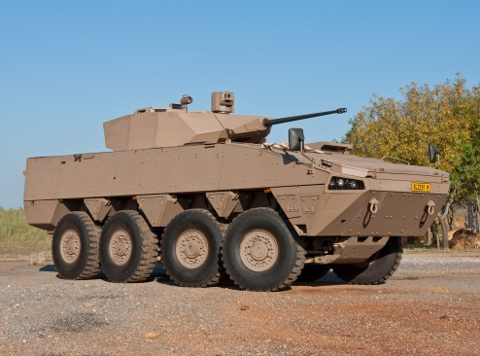
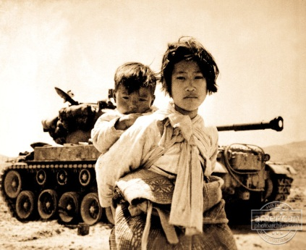
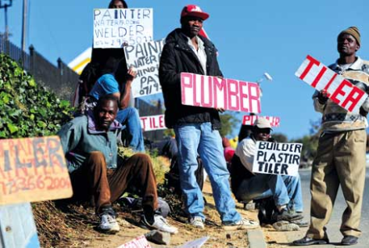
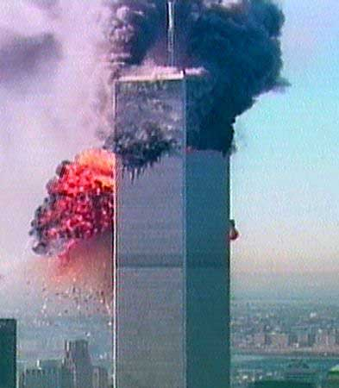
Arms Control: The Balancing Act
Defence Industry/Economy
International
Obligations
Defence Needs
Governance & Legislation
NGOs
Jobs
Proliferation Concerns

Slide 28
WHERE TO FIND US
4th Floor Defence Headquarters, Armscor Building
Corner Nossob and Rigel Streets, Erasmuskloof
Tel: +27 12 355 6109; Fax: +27 12 355 6274; email: makhosonke.jele@dod.mil.za

Slide 29
SUMMARY
The NCACC Framework is grounded in domestic law, which is in harmony with Treaties and Conventions.
The Cabinet Committee applies itself effectively within the confines of prescribed Laws.
The Cabinet Committee supports compliance with our International Commitments on Arms Control and the Secretariat is supported to attend Arms Control Meetings wherever these meetings take place.
Defence Industry members registered under the NCAC Act. are subject thereto and must operate, grow within those parameters (Arms Control Framework).

Slide 30
Conclusion
Thank You
Question and Answer Session

