Slide 1

Presentation to the Portfolio Committee on Public Service & Administration
Department of Planning, Monitoring and Evaluation
28 October 2020

Slide 2
Presentation Overview
DPME Mandate
The Integrated Planning System
Priorities of the Medium Term Strategic Framework (MTSF)
Budget Prioritisation Framework
Revision of the MTSF
Integrated Planning Framework Bill
Comments on the National Spatial Development Framework (NSDF)

Slide 3
The Mandate of DPME
The overall mandate of DPME is to support national planning, monitoring & evaluation of government programmes in support of the implementation of the National Development Plan (NDP) and Medium Term Strategic Framework (MTSF);
The NDP is the long term plan and vision of the country which is supported by the National Planning Commission. The NPC is supported by the NPC Secretariat which resides in DPME;
The MTSF is the five-year plan through which the NDP and the electoral mandate are implemented;
DPME monitors the implementation of the NDP through the MTSF;
Programmatic evaluations are conducted on the performance of government programmes;

Slide 4
The Integrated Planning System
INTERNATIONAL AND REGIONAL DEVELOPMENT PRIORITIES
CONSTITUTIONAL AND LEGISLATIVE MANDATES
Ruling Party Election Manifesto
NATIONAL DEVELOPMENT PLAN
Medium Term Strategic Framework
Budget Prioritisation Framework
National Sphere
Sector Policies and Priorities
Strategic Plan
Annual Performance Plan
3A Public Entity Plans
Annual Operational Plan
Provincial Sphere
Implementation Programme Plan
Provincial Policies and Priorities
Strategic Plan
Annual Performance Plan
Annual Operational Plan
Local Sphere
3C Public Entity Plans
Implementation Programme Plan
Local Government Integrated Development Plans
Service Delivery and Budget Implementation Plans (SDBIPs)
4

Slide 5

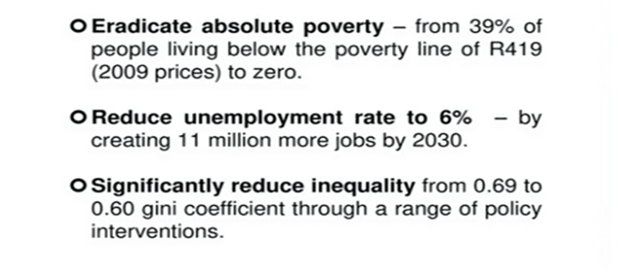

The 7 Apex Priorities continue to drive the MTSF 2019-20
The Seven Priorities are derived from the NDP, Electoral Mandate and SONA:
Priority 1: A Capable, Ethical and Developmental State
Priority 2: Economic Transformation and Job Creation
Priority 3: Education, Skills and Health
Priority 4: Consolidating the Social Wage through Reliable and Quality Basic Services
Priority 5: Spatial Integration, Human Settlements and Local Government
Priority 6: Social Cohesion and Safe Communities
Priority 7: A better Africa and World
Cross Cutting Focus
Women, Youth & People with Disabilities
The overarching goals of the NDP:

Slide 6
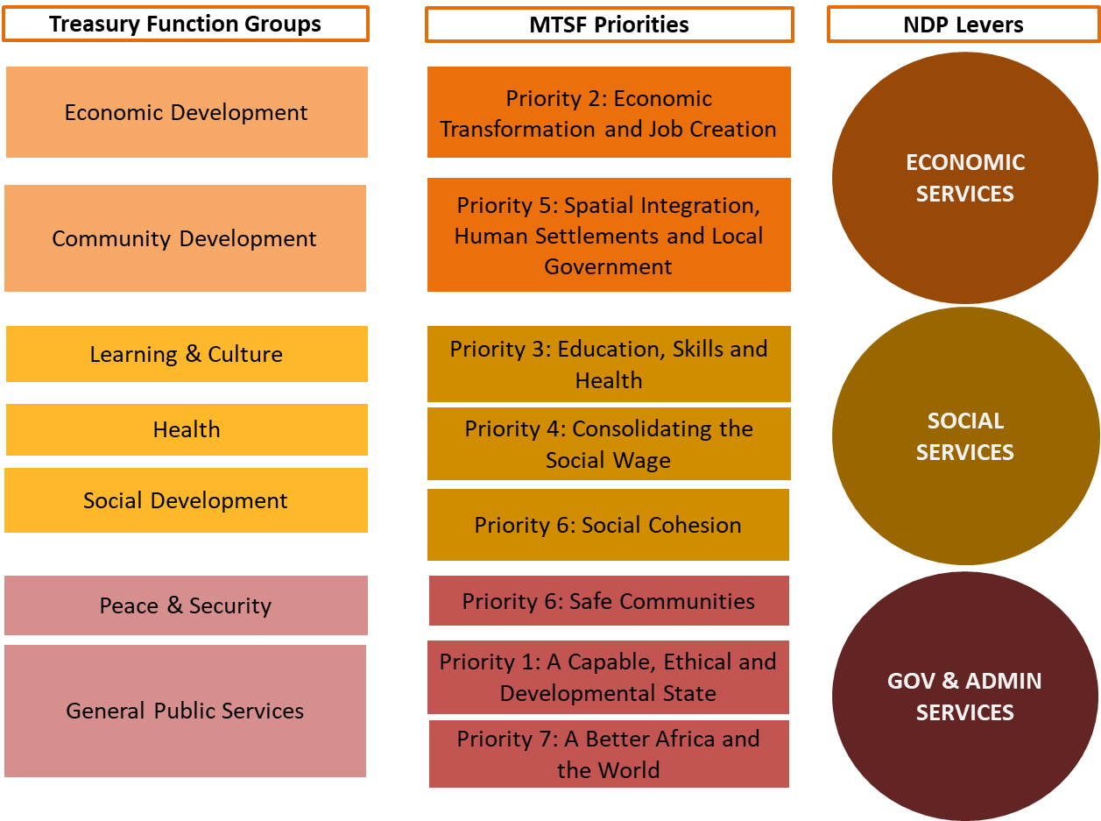
Aligning budgets and plans

Slide 7
Budget Prioritisation Framework (1)
General Public Services
Economic Development
Community Development
Modernisation of the public service including state-owned entities
Support reindustrialisation through the development of sector masterplans
Accelerate land reform, spatial transformation and well-located housing
Strengthening the governance systems of SOEs
Support for Small Medium-Sized and Micro Enterprises
Rehabilitation of ecological infrastructure and a just transition
Implementation of the Integrated Financial Management System in the public sector
Infrastructure investment, especially renewable energy and embedded generation
Ensure agrarian transformation and food security
Implementation of the District Development Model (DDM)
Reduce the cost of doing business and improve competitiveness
Improved basic service delivery through the implementation of DDM
Implementation of the integrated Monitoring and Evaluation System

Slide 8
Budget Prioritisation Framework (2)
Learning
Health and Social Dev
Peace & Security
Stabilise and improve quality of and undertake conceptual planning for Pre-Grade 1 (ECD)
Expedite the process of finalising the NHI Bill leading to its promulgation.
Ensure safer communities through visible policing and effective training.
Develop education curriculum that responds to a digitised world
The progressive implementation of the National Quality Health Improvement Plan
Focus on interventions that reduce domestic violence, GBV and crimes against children.
Enhance capacity in the investigative directorate, crime intelligence and prosecution.
Invest in education infrastructure and reduce basic services backlogs
Development of a comprehensive health human resource strategy
The mitigation of risks associated with medical litigation
Strengthen coordination at the country’s borders and ports of entry.
Expand access and quality at TVETs
Developing a standardised social welfare package.
Operationalise the integrated cybersecurity centre and enhance public private partnership.

Slide 9

The need for updating the MTSF 2019-2024
COVID-19 impacted on the implementation of the MTSF and most of Government’s programmes;
Our assessment of APPs suggested that national departments have been able to achieve about 60% of its planned targets and provincial departments have been able to achieve 40% of planned targets;
The impact of COVID-19 coincided with an economy already in recession, which has worsened in-year;
Our biggest risk to delivery is the deterioration of our fiscal position which will require further reprioritisation over the MTEF;
The key is to learn lessons from the pandemic and to improve the delivery capability of the state to support recovery.

Slide 10
Key Inputs to the Revision of the MTSF
NDP
2030
MTSF 2019-2024
MTSF Review
Cluster and Sector Plans
NDP Review
4IR Implementation Plan
Lesson from COVID-19
Revised Fiscal Framework
NDP Review Report
Economic Recovery Plan
District Development Model
Capture lessons learnt and realign medium- and long-term planning.
Capture lessons learnt and realign medium-term planning across sectors.
The intention integrate all key plans into a results-based framework through the MTSF. This will assist with coordination and ensure that important interventions and milestones are monitored to support delivery and accountability.

Slide 11
The Integrated Planning Framework Bill: An update
Work on updating the draft Bill had initially stalled due to the impact of COVID-19 and the budget cuts that resulted from the Budget reprioritisation;
DPME gained legal assistance from the Department of Trade, Industry and Competition towards the legal review and updating;
DPME is establishing an interdepartmental technical committee to ensure alignment with key stakeholders, which include:
  Department of Cooperative Governance, Department of Agriculture, Land Reform & Rural Development, National Treasury, Human Settlements and the South African Local Government Association.
The technical committee with seek to align key functions and will run in parallel to the legal review process and will produce an analysis report for incorporation into the Bill;
The updated Bill will follow the stipulated process which includes the conducting of a Socio Economic Impact Assessment and submission to the Office of the State Law Advisor;
The updated Bill will be available for public comment in the next financial year.

Slide 12
The National Spatial Development Framework: Comments
The responsibility for the National Spatial Development Framework (NSDF) resides with the Department of Agriculture, Land Reform and Rural Development (DALRRD) who is the custodian of the Spatial Planning and Land Use Management Act;
DPME continues to engage with DALRRD on the functions around the NSDF and invited DALRRD to share its insights at our Departmental Strategic Planning Session (20th October);
Based on insights gained, DG:DPME has requested a trilateral meeting with DG: DALRRD and the DG: Cooperative Governance to resolve issues around re-assignment of functions → this is scheduled for the first week of November;
DPME continues to collaborate with DALRRD to facilitate the implementation of the NSDF.

Slide 13
NSDF collaboration
DPME supported DALRRD on the NSDF Indaba
NSDF still to be approved by Cabinet
Engagements between DPME and DALRRD on NSDF Implementation
Agreed to have two broad spectrum stakeholder engagement sessions for Implementation of the NSDF by March 2021
An NSDF Colloquium will be held with stakeholders and leading spatial experts to guide and define NSDF Implementation by 31 March 2021
DPME and DALRRD agreed to combine processes to include Priority 5 of the MTSF in the colloquium
DPME and DALRRD have been engaging on the matter of the NSDF Implementation;
It was noted that the NSDF is still to be approved by Cabinet;
Challenges regarding procurement and COVID-19 have delayed procurement of the service provider for the implementation charters;
It was agreed to conduct two stakeholder engagements (public and external) on the NSDF implementation and a NSDF Implementation Colloquium by 31st March 2021;
DPME is supporting the DALRRD in developing the NSDF Implementation Charters.

Slide 14


