Slide 1
PRESENTATION TO MEMBERS OF THE PORTFOLIO COMMITTEE ON DEFENCE AND MILITARY VETERANS
Independent and Impartial
Presenter: Ms Annelize Welgemoed
Date: 28 October 2020

Slide 2
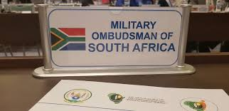
AIM
Independent
&
Impartial
The aim of the presentation is to present the Military Ombud Annual Activity Report for the FY2019/20 as per the Portfolio Committee on Defence and Military Veterans 2020 Fourth Term Programme

Slide 3
SCOPE
The following will be discussed as part of the presentation:
Strategic Overview
Mandate
Vision
Mission
Values
Organisational Structure
Performance Overview
Governance
Strategic Risks
Governance Structures
Operations (Core Business)
Statistical Overview
Stakeholder Management
International Relations
Outreach Programme
Legal Services
Corporate Support
Human Resource Management
Financial Management
Independent
&
Impartial

Slide 4
STRATEGIC OVERVIEW
Vision:
A World
Leading
Independent and
Impartial
Military Ombud Institution
Mission: To provide an Independent,
Impartial and Expeditious Complaints
Resolution Process for Serving and Former
Members of the SANDF and the Public to Promote Good Governance.
Mandate. The mandate of the Office as captured in the Military Ombud Act No 4 of 2012 is to investigate complaints lodged in writing by –
A member regarding his or her conditions of service;
A former member regarding his or her conditions of service;
A member of the public regarding the official conduct of a member of the Defence Force; or
A person acting on behalf of a member.
Core Values. The values reflect the work ethics and culture in support of the mission of the Office of the Military Ombud:
Accountability; Confidentiality; Commitment ; Impartiality; Professionalism and Integrity
Independent
&
Impartial

Slide 5
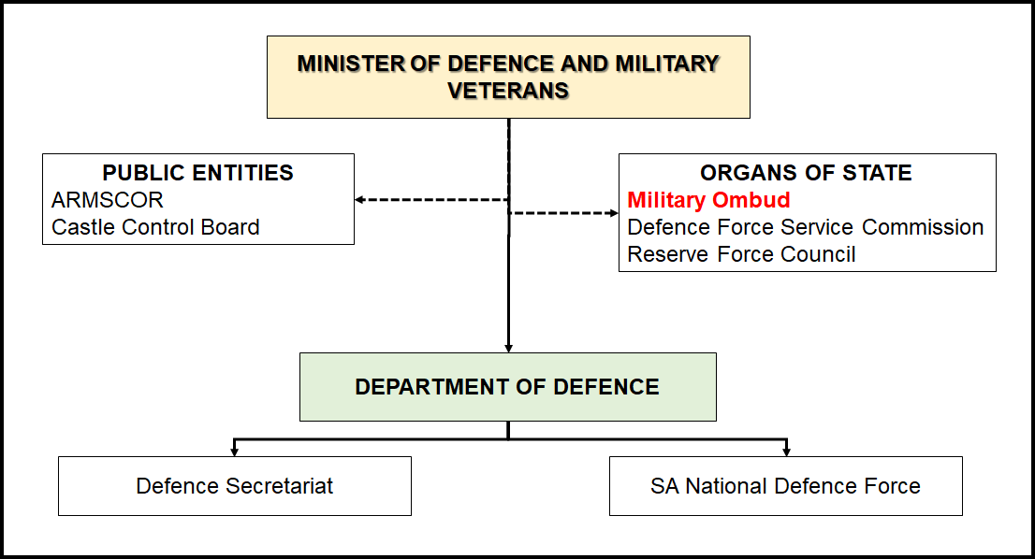
ORGANISATIONAL PLACEMENT
Independent
&
Impartial

Slide 6
STRUCTURE OF THE OFFICE
Office of the Military Ombud
Total number of approved posts within the Executive Office is 9
Total number of posts as approved by the Minister of Defence and Military Veterans during June 2012 is 89
Office of the Deputy Military Ombud
Total number of approved posts within Corporate Support is 21
Independent
&
Impartial
Total number of approved posts within Corporate Operations is 59
Corporate Operations
Corporate Support
Operations
Legal Support
Communication
Policy, Strategy & Planning
Human Resources
Logistics
Finance
Intake & Analysis
Information, Communication & Technology
Facility, Security & Reception Management
Investigations
Research & Development
NB: The Chief Directorate: Operations is the core business of the Office responsible for the effective, efficient resolution of complaints in a fair, economical and expeditious manner as prescribed.

Slide 7
PERFORMANCE OVERVIEW
Ser No | Performance Indicator | Annual Target as per APP | Performance |  |  |  |  |  |  |  |  | Achievement / Reason for Deviation / Corrective Action / Planned Management Intervention
 |  |  | Quarter 1 |  | Quarter 2 |  | Quarter 3 |  | Quarter 4 |  | Annual Performance Pre-Audited
 |  |  | APP | Validated | APP | Validated | APP | Validated | APP | Validated
 | a. | b. | c. | d. | e. | f. | g. | h. | i. | j. | k. | l.
Strategic Objective 1: To ensure direction to the Office of the Military Ombud in-line with Government’s intent and expectations
1. | Percentage compliance to the Policy on Policy. | 80% | 80% | 60% | 80% | 60% | 80% | 100% | 80% | 100% | 80% | Achieved
2. | Percentage compliance with submission dates of Military Ombud accountability documents. | 100% | 100% | 100% | 100% | 100% | 100% | 100% | 100% | 80% | 80% | Due to Covid-19 and the lockdown period. The Office did not table the AAR as per the set date in the Military Ombud Act.
3. | Percentage compliance to organisational requirements. | 80% | 80% | 80% | 80% | 80% | 80% | 100% | 80% | 100% | 80% | Achieved
Strategic Objective 2: To enhance and maintain corporate operations within the Office of the Military Ombud
4. | Percentage of written complaints finalised within the Office of the Military Ombud. | 75% | 18.75% | 22.19% | 37.5% | 43.5% | 56.25% | 54.4% | 75% | 74.78% | 75% | Achieved
5. | Percentage of timely, effective and efficient legal services provided. | 70% | 70% | 61% | 70% | 54% | 70% | 80% | 70% | 90% | 71.3% | Achieved
6. | Percentage compliance to the R&D plan. | 80% | 20% | 20% | 20% | 20% | 20% | 20% | 20% | 20% | 80% | Achieved
Strategic Objective 3: To administrate Military Ombud resources, as prescribed in the regulatory framework
7. | Status of stakeholder opinion of the Office of the Military Ombud. | 90% | 90% | 100% | 90% | 84% | 90% | 100% | 90% | 87% | 92.8% | Achieved
8. | Percentage compliance with HR Plan. | 95% | 95% | 89% | 95% | 86% | 95% | 68% | 95% | 78% | 80,3% | The deviation on both strength and expenditure is due to attrition. The Military Ombud will address the shortage on the COE with the Secretary for Defence.
9. | Percentage compliance with allocated budget. | 95% | 95% | 97% | 95% | 102% | 95% | 84% | 95% | 97% | 95% | Achieved
10. | Percentage compliance with allocated logistic budget. | 95% | 95% | 81% | 95% | 79% | 95% | 66% | 95% | 67% | 73.3% | The Office will commence the procurement process earlier than anticipated to ensure that the timely delivery of goods/services takes place.
11. | Percentage compliance to the ICT plan. | 95% | 95% | 70% | 95% | 75% | 95% | 71% | 95% | 75% | 72.8% | New internal procurement process will be initiated in the next financial year.
12. | Percentage compliance to the security policy. | 75% | 75% | 70% | 75% | 72% | 75% | 65% | 75% | 50% | 64.3% | Will initiate a new approach with Defence Intelligence (DI) to speed-up the security clearances of members. Will ensure more awareness programmes wrt security and security awareness within the Office.

Slide 8
GOVERNANCE
Governance Structures within the Office of the Military Ombud. The Office of the Military Ombud established a corporate governance structures to:
enhance accountability,
ensure timely and accurate disclosures,
deal fairly with stakeholder interests, and
maintain high standards of business ethics and integrity.
The following governance structures have been institutionalised within the Office of the Military Ombud.
Independent
&
Impartial
Governance Structure | Function/Aim | Frequency | Chairperson | Number of Meetings Planned versus Achieved
 |  |  |  | Planned | Achieved
a. | b. | c. | d. | e. | f.
Executive Meeting (EXCO) | To provide strategic direction to the Office of the Military Ombud | Quarterly | Military Ombud | 4 | 4
Management Committee (MANCO) | To ensure oversight over the administrative function within the Office of the Military Ombud. | Monthly | Deputy Military Ombud | 12 | 11
Military Ombud Dashboard | To act as an oversight body ensuring standardisation compliance to service delivery standards. | Quarterly | Military Ombud | 4 | 6
Operations Complaints Assessment Meetings | To assess newly received complaints | Weekly | Chief Director Operations | 52 | 22
Operations Quality Assurance Dashboard | To provide guidance wrt the standardisation of complaints handling and investigation approach. | Monthly | Chief Director Operations (CD Ops) | 12 | 14
Corporate Support Management Meeting | The management and co-ordination of the Corporate Support environments daily activities. | Twice a Month | Chief Corporate Support (CCS) | 20 | 14

Slide 9
GOVERNANCE
Strategic Risks. During the year under review the Office continued to dedicate and commit its efforts towards an improved and effective enterprise risk management approach. The transversal enterprise risks impact on the Office from the strategic output and outcome perspective, continued to be subjected to regular monitoring and scrutiny by the Management Forums and oversight governance structures such as the EXCO and MANCO.
Independent
&
Impartial
Strategic Objective | Military Ombud Delivery (Aligned with Military Ombud Strategy Map) | Risk Description | Risk Response
 | a. | b. | c.
To ensure strategic direction to the Office of the Military Ombud in-line with governments intent and expectations. | D4 – Ensure Military Ombud Services in compliance with Regulatory Framework | The Military Ombud Act does not address the governance and accountability framework hampering the Office in obtaining institutional and financial independence. | Updating of the Military Ombud Act and Regulations.
To ensure strategic direction to the Office of the Military Ombud in-line with governments intent and expectations. | D1 – Govern Military Ombud commitments in accordance with government policy and strategy | Independence is at risk. | Updating of the Military Ombud Act and Regulations. Conducting of a public perception survey and the intensifying of stakeholder engagements, education, awareness and outreach programmes on the mandate of the Office
To administrate Military Ombud’s resources as prescribed in the regulatory framework. | D4 – Ensure Military Ombud Services in compliance with Regulatory Framework | The credibility, integrity and provision of management reports of complaints lodged and captured/registered are unreliable due to the limited availability of information. | Development of a Case and Matter Management System. Complaints Handling Manual was reviewed and updated.

Slide 10
OPERATIONS
Statistical Overview.
Financial Year | Total Carried Over Cases | Total Cases Received in the FY | Total Caseload | Total Finalised | Active Cases at FY End
a. | b. | c. | d. | e. | f.
FY2012/13 | 0 | 307 | 307 | 117 | 190
FY2013/14 | 190 | 301 | 491 | 219 | 272
FY2014/15 | 272 | 279 | 551 | 318 | 233
FY2015/16 | 233 | 250 | 483 | 365 | 118
FY2016/17 | 118 | 310 | 428 | 236 | 192
FY2017/18 | 192 | 607 | 799 | 664 | 135
FY2018/19 | 135 | 390 | 525 | 246 | 279
FY2019/20 | 279 | 308 | 587 | 439 | 148
Independent
&
Impartial
Since the establishment of the Office of the Military Ombud in
May 2012 a total number of 2752 complaints have been
registered with the Office of these 2606 have been finalised
leaving 148 active cases at the end of March 2020.
To maintain the operational edge and encourage innovation one of the key priorities within the Office is to ensure that all energy and focus is directed towards the expeditious resolution of
complaints.
Complaints Finalised in 2019. The finalisation rate was at 75% with a total caseload of 587 of which 439 were finalised. The average turn-around time for finalisation of complaints is 247 days which is approximately 8 months.

Slide 11
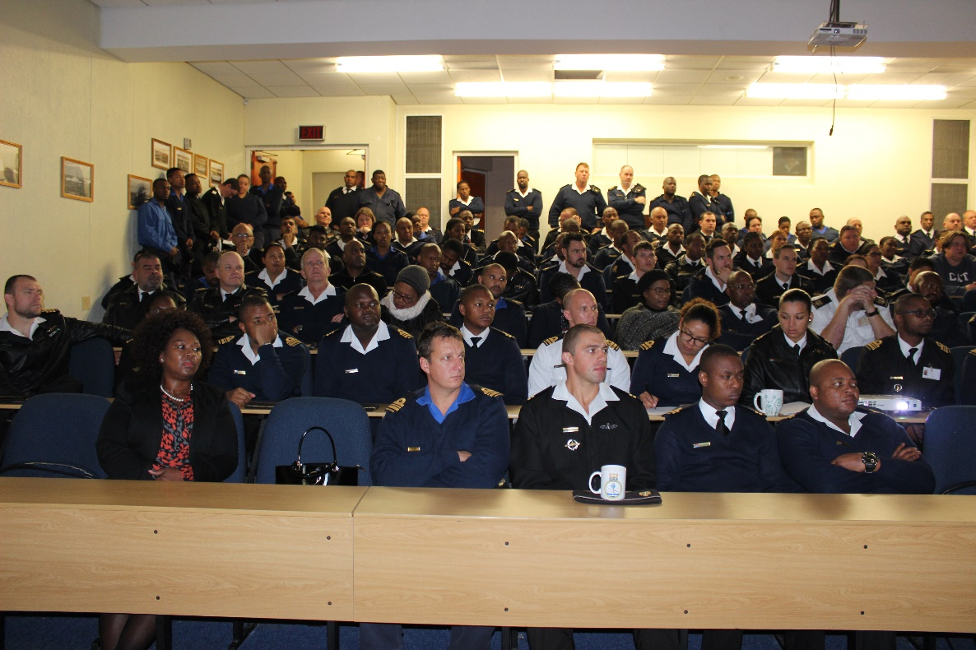
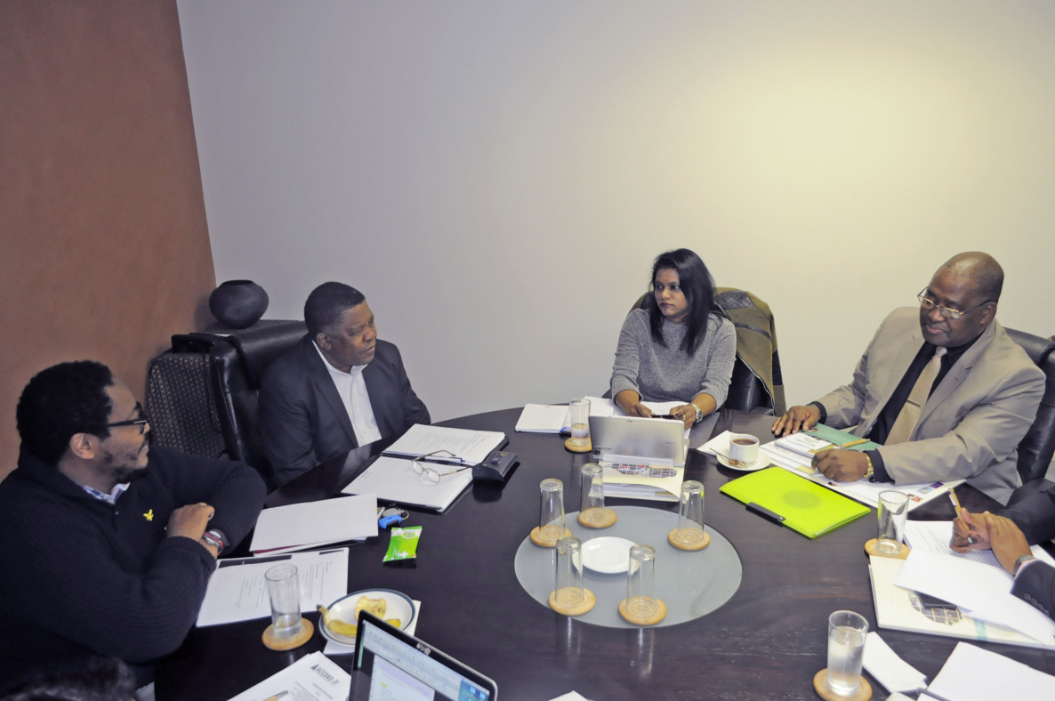
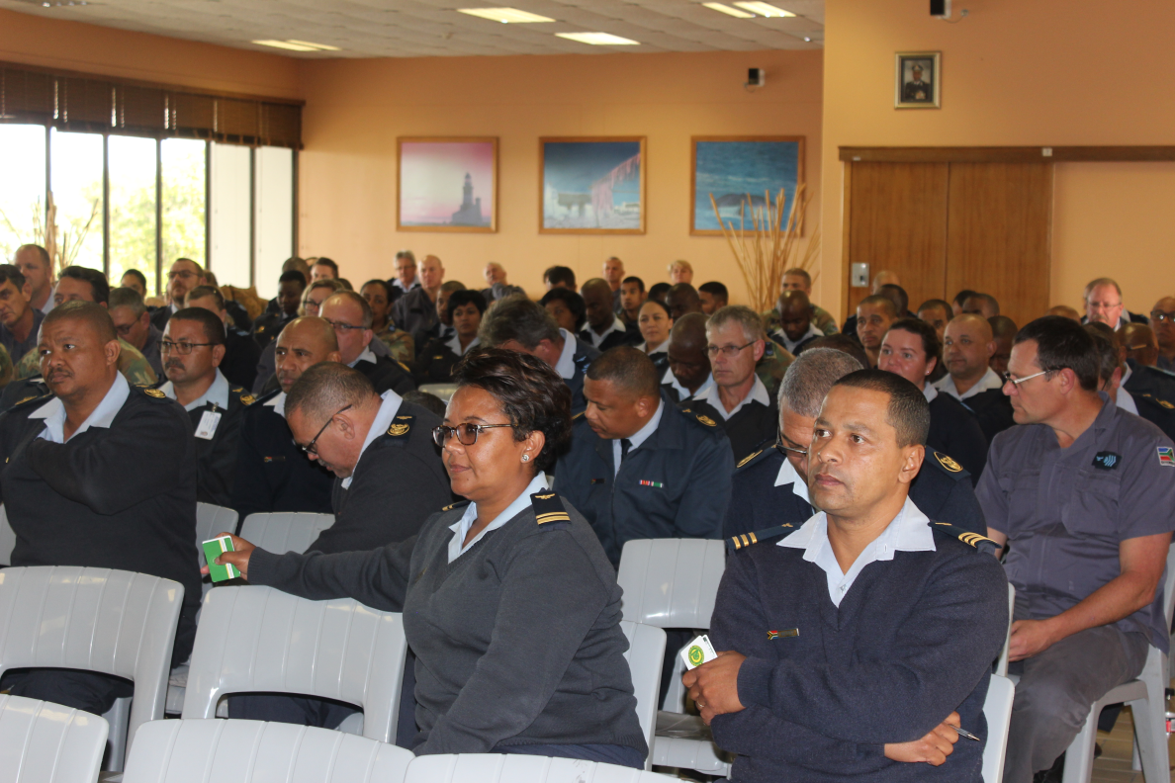
OPERATIONS
Number of Complaints Finalised within FY2019/20.
Reason for Finalisation | Number of Complaints Finalised
Complaint dismissed | 107
Complaint upheld | 67
Complaint withdrawn by Complainant | 2
Condonation declined | 6
Complaint will undermine channel of command | 5
Did not follow grievance procedure | 58
Mediation, Conciliation, Negotiation | 24
Matter referred to appropriate public institution | 71
Matter pending before civilian court | 6
Not a condition of service | 5
Similar Complaints/Collective Investigation | 87
Duplicate complaint | 1
Grand Total | 439
Independent
&
Impartial
Age Analysis of Active Complaints.
FY 19/20 | FY18/19 | FY17/18 | FY16/17 | Total
71 | 64 | 12 | 1 | 148

Slide 12
OPERATIONS
Number of Complaints Submitted as per the Mandate of the Office.
Independent
&
Impartial
During the year under review, the Office of the Military Ombud received a total of 308 new complaints. A total of 306 complaints relate to service conditions of members of the SANDF which amounts to 99% of the new complaints received. Only 2 complaints were received with regards to the official conduct of a member.

Slide 13
OPERATIONS
Complaints Category Information.
Category | Received in FY2019/20
a. | b.
Promotion, Demotion and Career Intervention | 61
Service Benefits and Working Environment | 58
Remuneration | 52
Service Termination | 45
Utilisation and Placement | 19
Grievance / Discipline Procedures | 18
Education, Training and Development | 7
Official Conduct of Member of SANDF | 2
Other | 46
Total | 308
Independent
&
Impartial
The Complaints recorded under other range from complaints relating to military veteran benefits of which the Military Ombud does not have a mandate as well as those from members relating to incorrect capturing of reason for exiting the SANDF

Slide 14
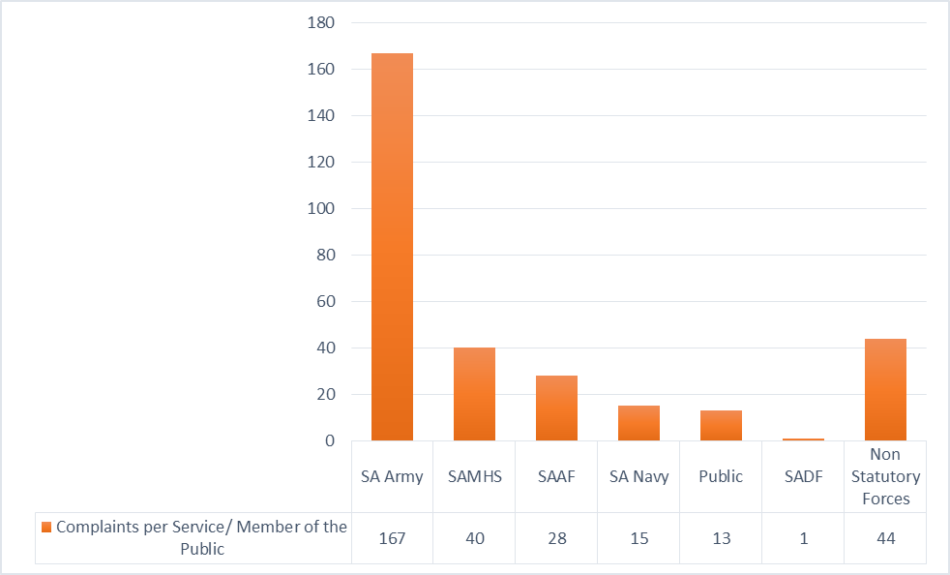
OPERATIONS
Number of Complaints per Service / Members of the Public.
The majority of complaints received during this Financial Year were against the SA Army at 167 which is 54% of the total new complaints received during the year. Complaints from members of the public were only 13 of which only 2 related to the official conduct of a member. Majority of complaints from members of the public
were those who complained on behalf of members. This year the office also saw an influx of complaints from members of former Non Statutory Forces who required assistance with accessing military veterans’ benefits.
These complaints were referred to the Department of Military Veterans for assistance.
Independent
&
Impartial

Slide 15
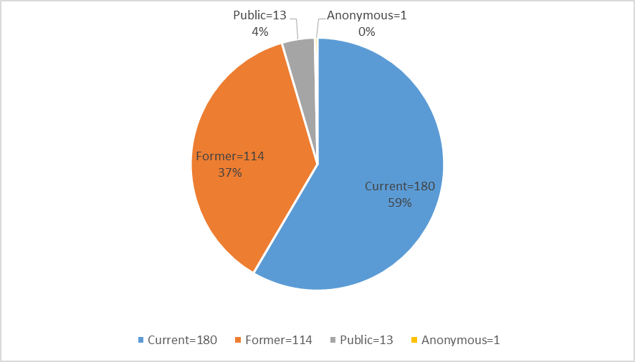
OPERATIONS
Complaints from Current, Former and Members of the Public.
Complaints from current serving members of the SANDF totalled 180 of the new complaints received. This constitutes 59%. This is followed by 114 complaints received from former members. Complaints from members of the public were 13 which amounted to 4% of the total number of complaints received. 1 complainant did not state their category
Independent
&
Impartial
Complaints from Current Members.
Complaints from Former Members.
Rank Levels | Number
a. | b.
Generals/ Flag Officers | 2
Senior Officers | 24
Officers | 18
Candidate Officers | 4
Warrant Officers | 10
NCO’s | 81
Other Ranks | 41
Total | 180
Rank Levels | Number
a. | b.
Generals/ Flag Officers | 1
Senior Officers | 8
Officers | 4
Candidate Officers | 2
Warrant Officers | 4
NCO’s | 15
Other Ranks | 80
Total | 114

Slide 16
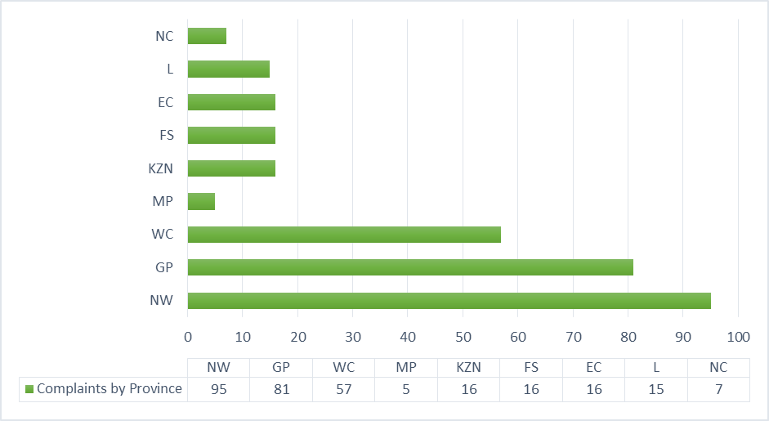
OPERATIONS
Complaints per Province. During the year under review the Office of the Military Ombud saw an increase in the number of complaints that were lodged from North West. This was as a result of a targeted outreach that was held in that province. Complaints from Gauteng were the second highest whereas Mpumalanga registered the lowest.
Independent
&
Impartial

Slide 17
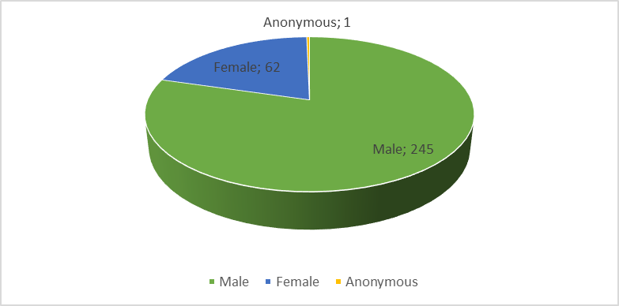
OPERATIONS
Complaints per Gender.
Independent
&
Impartial
The large percentage of complaints that were lodged with the Office of the Military Ombud this Financial Year were from males at 245 which constitutes 80% of the total complaints received. Complaints from females were 62 which amounted to 20%. 1 complainant preferred to remain anonymous.

Slide 18
OPERATIONS
Implementation and Non-Implementation of Recommendations. The number of recommendations that are awaiting implementation comprise those that have been accepted by the Minister of the Defence and Military Veterans and has issued a directive for the CSANDF to implement. It also consists of those that the Minister has not accepted and has directed that the reports be reviewed. There were also complaints that were resolved with the SANDF of which the Defence Force will be implementing the recommendations that were issued as a result of the amicable resolution.
Independent
&
Impartial
Total Number of Complaints Upheld | Number of Recommendations Implemented | Number of Recommendations Awaiting Implementation | Number of Recommendations not Accepted by MOD&MV | Number of Complaints Resolved with the SANDF
a. | b. | c. | d. | e.
67 | 10 | 14 | 4 | 14
Liaison Forum Meetings. A total of 10 Monthly Liaison Forum Meetings with the CSANDF and Services
were held. The purpose of this Forum is to track and follow up on non-responses to investigations and preliminary reports as well as monitor progress on the recommendations that are awaiting implementation. The meetings are held in accordance with the Memorandum of Understanding between the Military Ombud and the CSANDF.

Slide 19
OPERATIONS
Internal Stakeholder Interactions.
Stakeholder | Date | Event
a. | b. | c.
Woman’s Day Celebration | 31 August 2019 | A motivational speaker Ndivhuho Maphwanya was invited to speak about issues on gender equality and women empowerment.
Heritage Day Celebration | 20 September 2019 | Staff members cooked and shared various dishes depicting South African cultures. Speakers who specialise in indigenous plants were also invited to exhibit and speak to staff about indigenous knowledge
Annual Military Ombud Employee Recognition Awards with all the staff members | 05 December 2019 | The Military Ombud, Lt Gen (Ret) Masondo joined the Deputy Military Ombud and staff members on his first event in Office, after his Inaugural Swearing-in ceremony held on 8 November 2019. Employee Recognition Awards was held in December 2019. The event celebrated employees who went beyond the call of duty and achieved exceptional performance in the following key aspects: • High standards of work performance • Excellent client relations • Living by the values of Military Ombud. Noteworthy operation or support efforts Walking an extra mile
Military Ombud Welcome to 2020 Breakfast. | 17 January 2020 | This is an event led by the Social Committee to welcome members in the Office of the Military Ombud and to enable the Military Ombud to set the tone for the new year.
Human Rights Day. | 20 March 2020 | An event aimed at commemorating human rights of South Africans in our democratic state.
Independent
&
Impartial

Slide 20
OPERATIONS
External Stakeholder Interactions.
Stakeholder | Date | Event
a. | b. | c.
King Sabata Dalinyebo Local Municipality Mayor’s Office | 04 April 2019 | To discuss community outreach collaboration.
Annual Military Ombud Symposium | 26 April 2019 | The objective of this critical dialogue is to engage in discussions with private sector, military and security industry, captains of industry as well as other stakeholders.
Seven Year Review Book Launch and Gala Dinner | 10 May 2019 | This event celebrated seven years of the existence of the Office and bib farewell to Lt Gen (Ret) T.T. Matanzima as his seven year term as the first Military Ombud came to an end.
Government Pensions Administration Agency (GPAA). | 27 May 2019 | Bilateral meeting to discuss working relationship or collaboration in terms of the outreach programme.
Health Ombud | 28 May 2019 | Bilateral meeting to discuss working relationship or collaboration in terms of the outreach programme.
Public Service Commission (PSC) | 28 May 2019 | Bilateral meeting to discuss working relationship or collaboration in terms of the outreach programme.
Old Mutual | 05 June 2020 | Briefing on logistics and planning pertaining to the Annual Military Golf Day.
Health Ombud | 06 June 2019 | Follow -up outreach planning meeting
Western Cape Police Ombud | 28 June 2019 | To discuss community outreach programme collaboration.
Phoenix Aviation Mamelodi | 30 July 2019 | Nelson Mandela Day was commemorated with the handing over of non-perishable goods to Phoenix Aviation from Mamelodi, Pretoria East.
Annual Military Ombud Golf Day | 23 August 2019 | The objective of this event was to interact with stakeholders from the military and civil society in a relaxed environment. This event was also used as a platform to present the mandate of the Office of the Military Ombud to participants.
South African Military Veterans Association (SAMVA) | 12 September 2019 | A meeting was held with members of SAMVA to discuss some of their frustrations regarding Military Veterans benefits.
Independent
&
Impartial

Slide 21
OPERATIONS
External Stakeholder Interactions.
Stakeholder | Date | Event
a. | b. | c.
Joint Operations. | 04 October 2019 | A meeting was held to discuss the outreach programme to border posts.
Military Ombud Inauguration | 12 November 2019 | The South African Military Ombud Office welcomed its newly appointed Military Ombud Lt Gen (Ret) Vusumuzi Masondo at a swearing-in ceremony that took place on Friday 8 November 2019, at SAMHS Training Formation in Thaba Tshwane. General Masondo has replaced Lt Gen (Ret) Temba Matanzima who served in the position for a period of 7 years. Lt Gen (Ret Masondo ascended into the position after his appointment by the President of the Republic of South Africa, Mr Cyril Matamela Ramaphosa, and will serve in the position for a period of 7 years. The swearing in ceremony was officiated by the High Court Judge Lettie Molopa-Sethosa and the Minister of Defence and Military Veterans, Ms Nosiviwe Mapisa-Nqakula gave the key note address. Speaking at the swearing in ceremony Minister Nosiviwe Mapisa-Nqakula told those in attendance that the new Military Ombud has got a task in ensuring that the Office enforces its mandate. “Most important thing is the protection of the fundamental rights and freedom of members of the Armed Forces, and ensuring that there is minimisation of the violation of human rights,” said the Minister. She said to Lt Gen (Ret) Masondo as he takes over the role of the Military Ombud, he must remain ever cognisant of the institutions independence and impartiality, and ensuring that justice is delivered to serving or retired members, as well as the South Africa’s public.
Independent
&
Impartial

Slide 22
OPERATIONS
External Stakeholder Interactions.
Stakeholder | Date | Event
a. | b. | c.
Log Support Formation. | 04 December 2019 | A meeting to discuss logistics pertaining to the Annual Military Ombud Employee Recognition Awards and Gala Dinner.
SALGA Western Cape Provincial Office | 11 December 2019 | A meeting to discuss a working relationship to access local government structures.
Caroline Peters founder of 1000 Women One Voice. | 11 December 2019 | A meeting was held to discuss the Outreach Programme in communities around the Cape Flats.
Ministerial Task Team (MTT). | 16 January 2020 | A presentation was conducted to the Military Ombud by the MTT on the findings of prevalent sexual harassment in the Defence Force from the time of appointment by the Minister of Defence and Military Veterans. The MTT was also looking at ways of collaborating with the Office of the Military Ombud to publicise the Call Centre.
Joint Operations. | 17 January 2020 | A meeting was held to discuss logistics pertaining to the planned Eco Origin internal Outreach Programme targeting military units within the Business Park and those on Witch Hazel Avenue as well as organisations operating within who form part of the mandate of the Military Ombud.
Defence Force Service Commission (DFSC) | 3 February 2020 | Meeting to strengthen bilateral relations and the existing MOU.
SALGA Western Cape Speakers Forum. | 06 February 2020 | A delegation led by the Military Ombud presented the mandate of the Of the Office to Members of the Speakers Forum.
SALGA National Office, Pretoria. | 02 March 2020 | A delegation led by the Military Ombud presented the mandate of the Office to SALGA officials and also discussed possible areas of collaboration country wide.
Independent
&
Impartial

Slide 23
OPERATIONS
International Relations. International relations remains a pillar whilst the Office continues to promote the strategic objectives and improve external partnerships. In the 2019/20 financial year, the Office attended various bilateral and multilateral international engagements. A summary of these visits per membership and/or association are outlined below:
Military Ombud African Footprint Project
11ICOAF Preparatory Meeting over the period 11 – 12 June 2019
AOMA Southern African Regional Meeting over the period 5 – 8 August 2019
11ICOAF in Bosnia and Herzegovina over the period 27 – 29 October 2019
International Ombudsman Expo over the period 28 – 31 October 2019
DCAF Foundation Council in Zurich, Switzerland over the period 26 – 29 November 2019
12ICOAF Preparatory Meeting in Vienna, Austria over the period 27 – 27 February 2020
International Training Event Hosted (GMSI) in Pretoria, South Africa over the period 16 -20 September 2019
Independent
&
Impartial

Slide 24
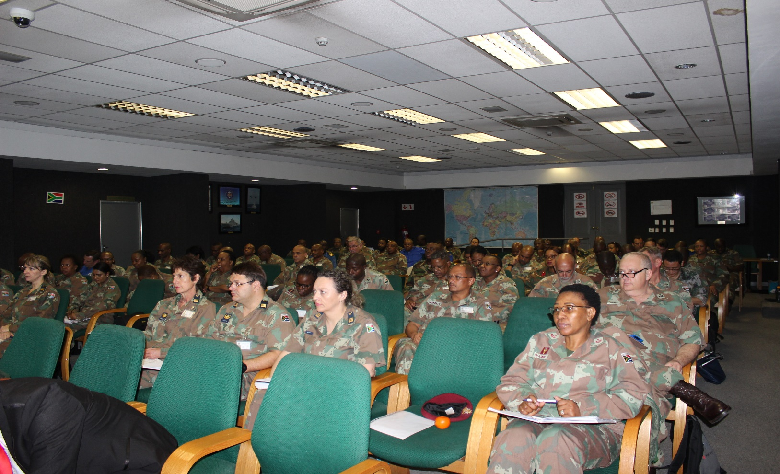
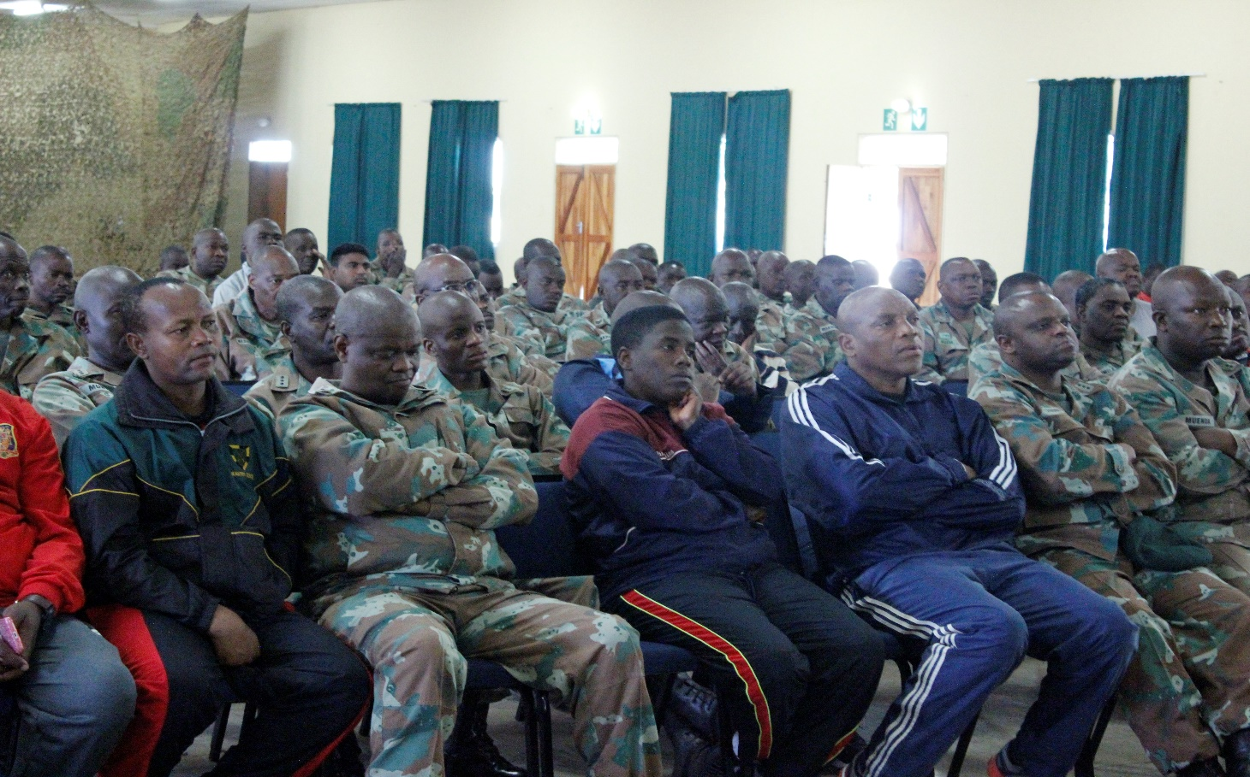
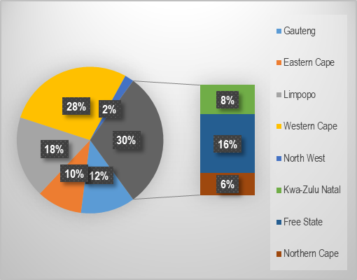
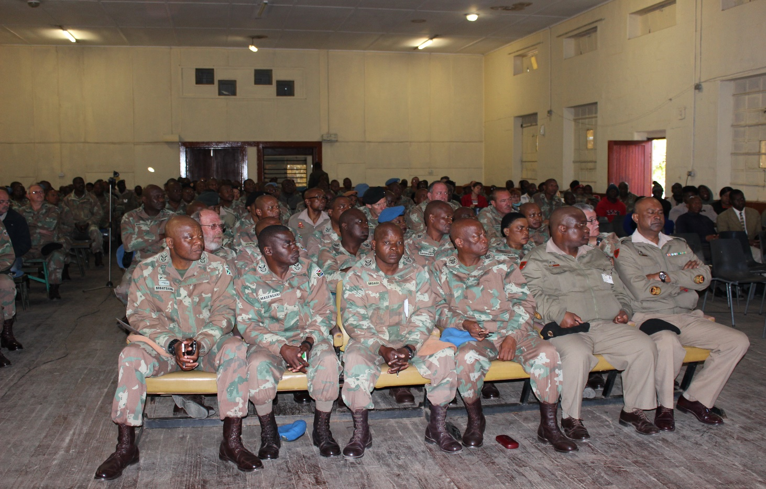
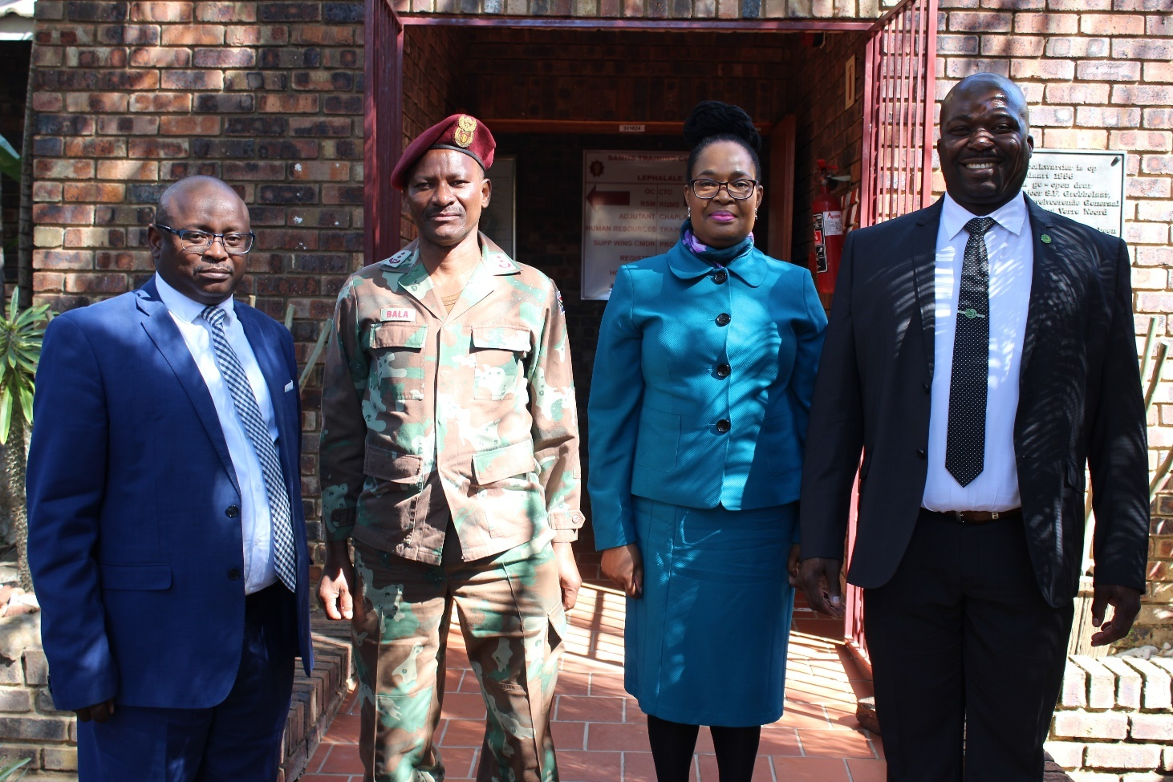
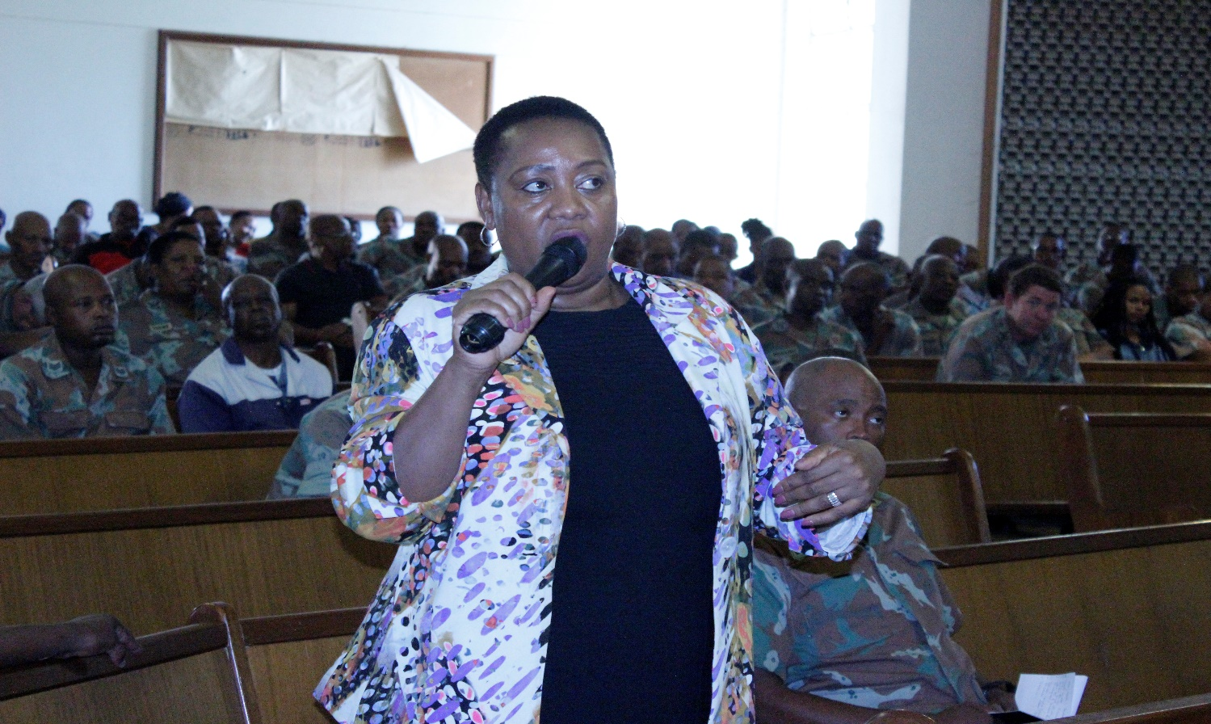
OPERATIONS
Number of Outreach Programmes done per Province.
Province | Number of Outreaches
a. | b.
Gauteng | 6
Eastern Cape | 5
Limpopo | 9
Western Cape | 15
North West | 1
Kwa-Zulu Natal | 4
Free State | 9
Northern Cape | 3
Total | 52
Independent
&
Impartial

Slide 25
OPERATIONS
Legal Services
Ministerial Directive on the Authority of the Military Ombud. The Ministerial Directive on the authority of the Military Ombud for the purposes of enhancing the independence of the Office was approved and signed by the Minister on 25 October 2018 and during the FY19/20 rigorous steps were taken with the office of the Secretary for Defence to ensure the implementation thereof.
Litigation. Litigation matters managed in this FY ranged from applications instituted by complainants in the High Court either seeking orders against the MOD&MV for the implementation of the Military Ombud’s findings and recommendations or applications to review and set aside the Military Ombud’s findings and recommendations.
Legal Advisory Services. In this financial year legal advisory services was continually provided, to ensure the Office rigorously complied with the regulatory and good governance framework.
Memoranda of Understanding and Service Level Agreements. This environment has continuously contributed to the enhancement of complaints handling through the management of stakeholder relations by ensuring effective implementation of Memoranda of Understanding (MOU) and Service Level Agreements (SLA) that were signed in the previous and current financial year. While these MOU’s and SLA’s are being continuously reviewed for effectiveness and efficiency, new agreements were developed and signed to ensure significant stakeholder relationships are formalised and sustained.
Independent
&
Impartial
MOU’s with Other Ombud Institutions and Public Entities:
Chief of the South African National Defence Force (CSANDF) and the Secretary for Defence (SecDef);
Military Academy / University of Stellenbosch;
Department of Military Veterans;
Public Service Commission;
The Health Ombud;
The Public Protector of South Africa (PPSA);
South African Human Rights Commission (SAHRC);
Defence Force Service Commission (DFSC); and the
Western Cape Police Ombud.

Slide 26
Corporate support
Human Resource Management.
Planned versus Actual as at 31 March 2020
Environment | Planned Strength | Actual Strength
a. | b. | c.
Executive Office | 7 | 7
Corporate Operations | 36 | 36
Corporate Support | 20 | 18
Independent
&
Impartial
Employment and Vacancies per Environment as at 31 March 2020
Environment | Approved Posts | Staffed Posts | Vacant Posts
a. | b. | c. | d.
Executive Office | 9 | 7 | 2
Corporate Operations | 59 | 36 | 23
Corporate Support | 21 | 20 | 1
Personnel Cost
Expenditure | Number of Approved Posts | Number of Staffed Posts | R-Value
a. | b. | c. | d.
Total Expenditure | 89 | 61 | Rm 41,513,828
Number of Skills Development Opportunities as at 31 March 2020
Short Courses | Symposia/Seminar
a. | b.
50 | 11
Employment Equity Figures as at 31 March 2020
Environment | Male |  |  |  | Female
 | African | Asian | Coloured | White | African | Asian | Coloured | White
a. | b. | c. | d. | e. | f. | g. | h. | i.
Office of Military Ombud | 24 | 00 | 00 | 02 | 31 | 01 | 01 | 02

Slide 27
Corporate support
Financial Management. The current economy and the strain that there is on the fiscus with reduced allocations means that the Office has to be efficient and effective with resources allocated to it to ensure that the Office is able to meet its mandate and the expectations of its clients to resolve complaints lodged with it. In its endeavour to perform optimally the Office continuously evaluates its performance and the use of the resources allocated to it. The Office is, however, still affected by the Compensation of Employees ceiling that is placed on the DOD. This matter will be addressed with the SecDef.
Expenditure Analysis. The vote for the Office for the 2019/20FY was Rm54,505. The Office had a total expenditure of Rm53,080 of which Rm41,514 was spent on Compensation of Employees and Rm11,566 was spent on Operating costs. The allocation for Compensation of Employees was 74% of the vote while 26% of the vote was available for operating costs.
Plans to Address Future Financial Challenges. The Office is engaging the SecDef to have the allocation of the Office adjusted to cater for Compensation of Employees that is not fully funded.
Independent
&
Impartial

Slide 28
How to Contact us
South African Military Ombud
South African Military Ombud
@Mil_OmbudSA
Physical Address: Block C4, Eco Origin, 349 Witch-Hazel Ave, Highveld, Centurion
Postal Address: SA Military Ombud, Private Bag X163, 0046
Tel: +27 12 676 3800; Fax: +27 12 661 2091
Toll Free: 080 726 6283 (080 SA OMBUD)
E-mail: intake@milombud.org

Slide 29
THANK YOU
for your attention

