Slide 1
SALGA Presentation to PC CoGTA
West Rand District Municipality
27 October 2020

Slide 2
OVERVIEW OF PRESENTATION
SALGA Mandate and Overview
Governance, Inter-Governmental Relations, Support & Interventions
Finance and Fiscal Management
Some matters for Consideration regarding financial sustainability of district municipalities

Slide 3
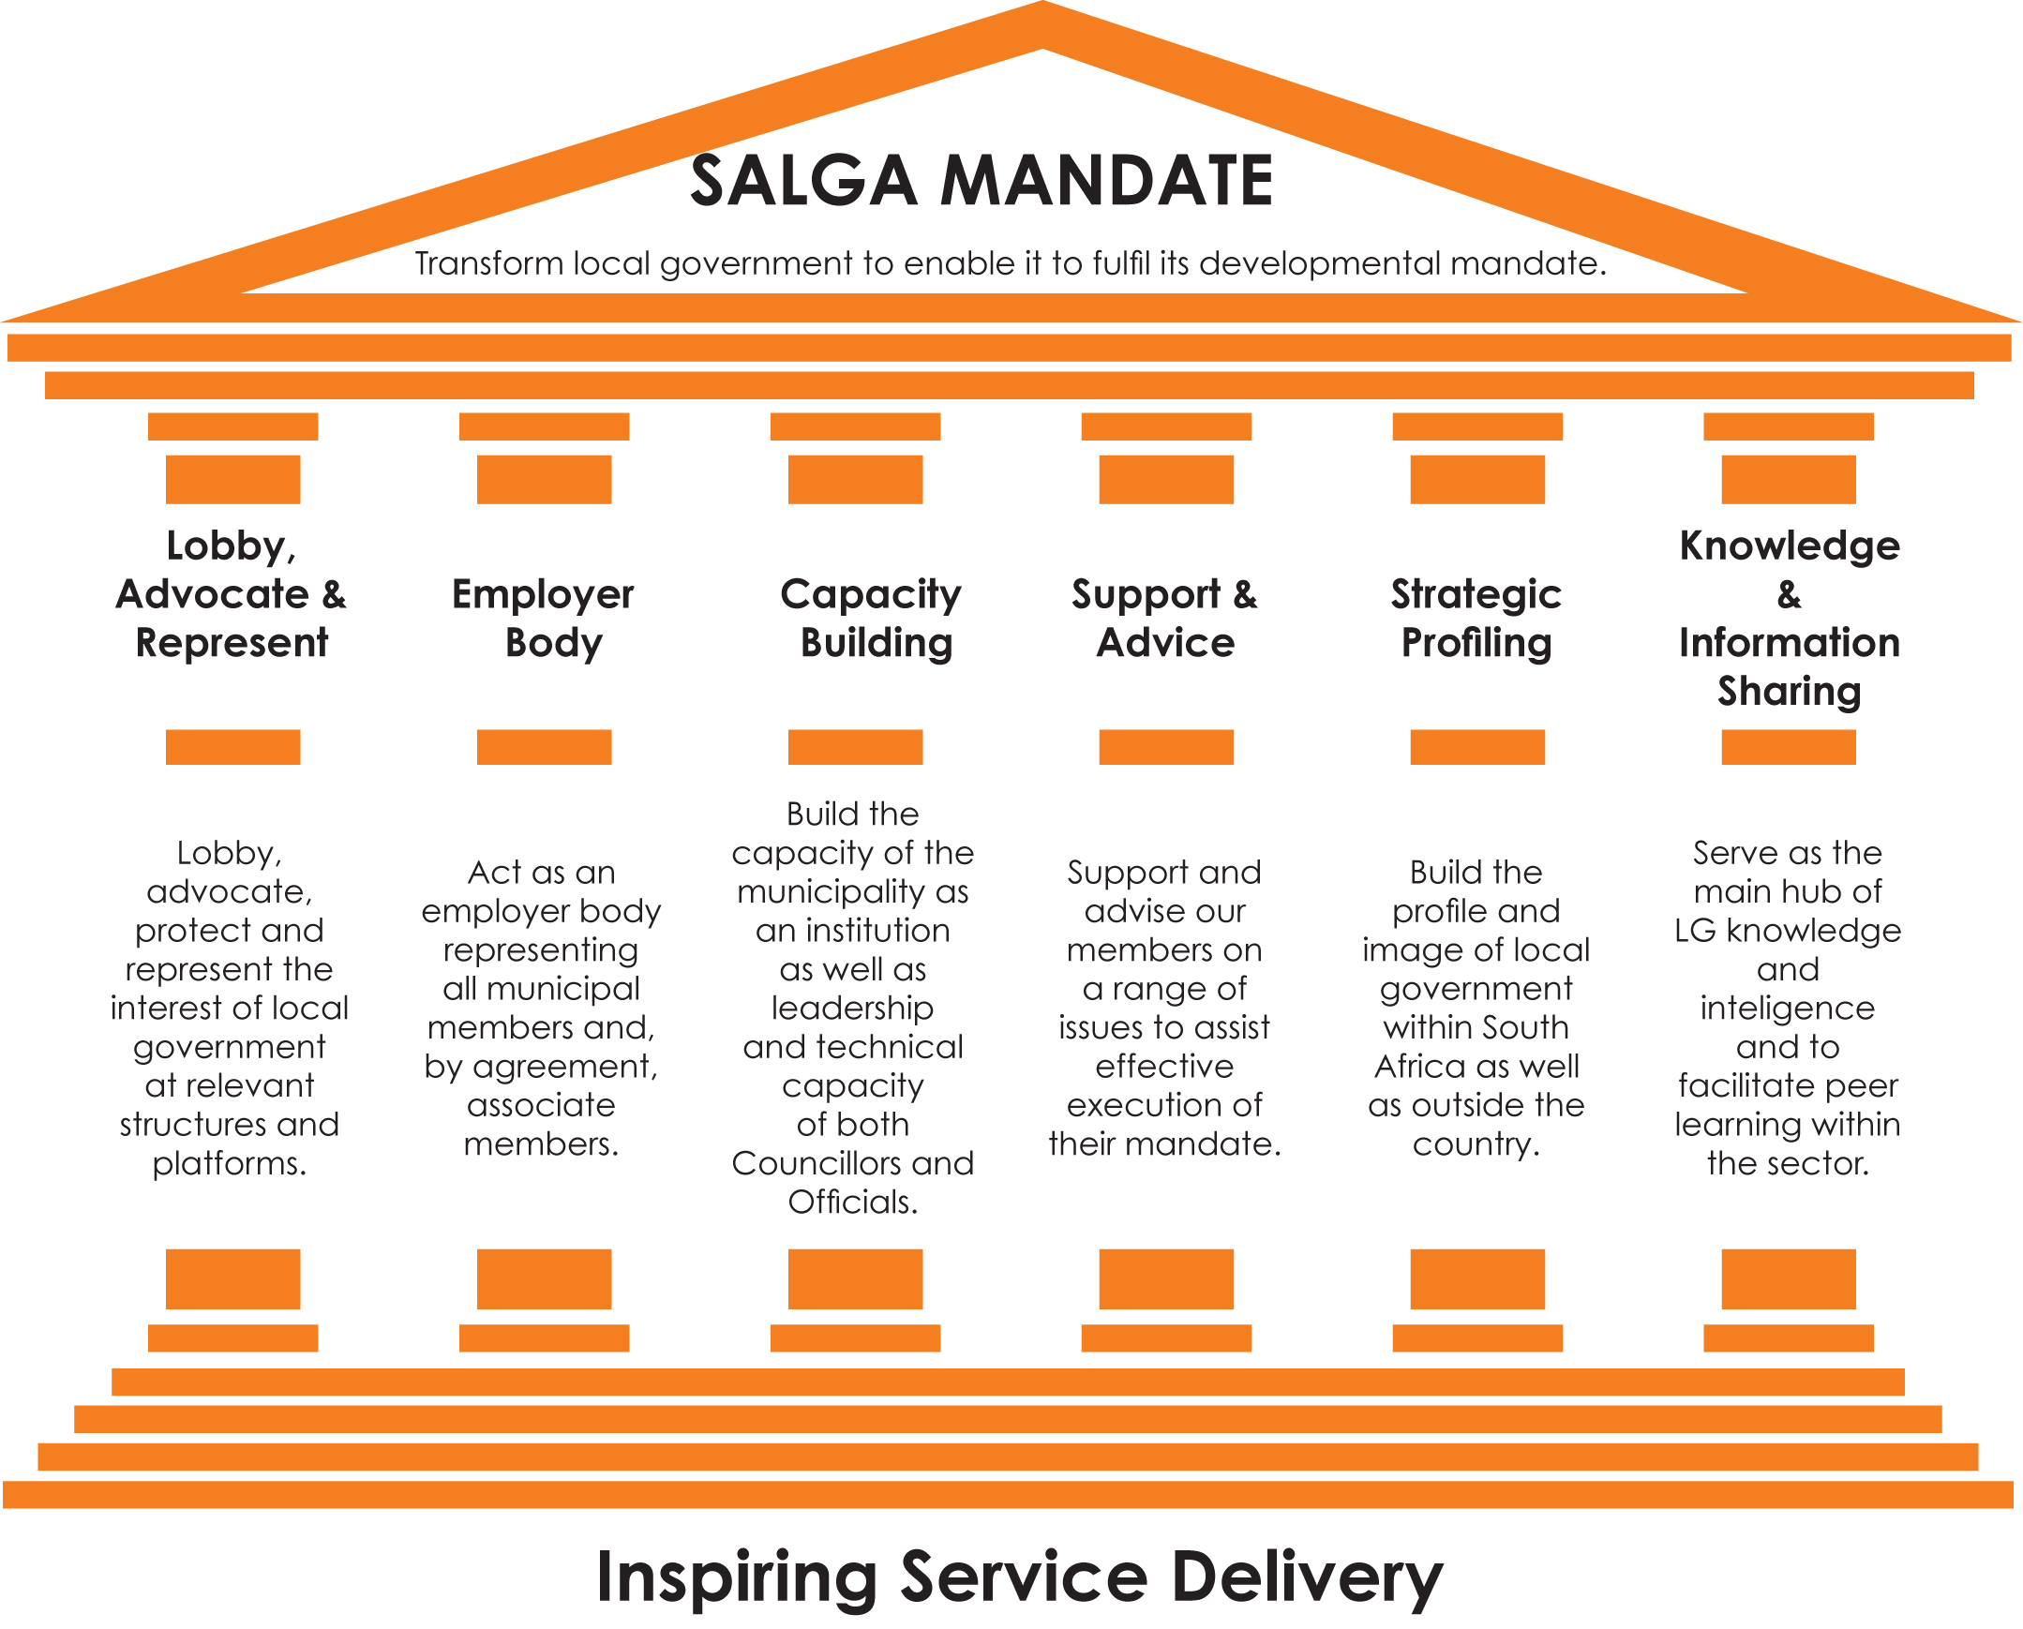
…
7

Slide 4
SALGA
STRATEGIC GOALS
13
1
3
2
Goal 01
Goal 03
Goal 02
Sustainable, Inclusive Economic Growth underpinned by Spatial Transformation
Financial Sustainability of Local Government and Fiscal Equity
Good Governance & Resilient Municipal Institutions

Slide 5
GOVERNANCE,
INTERGOVERNMENTAL RELATIONS, SUPPORT & INTERVENTIONS

Slide 6
MUNICPALITIES UNDER SECTION 139 IN GAUTENG
Since 2016, three (3) municipalities have been subjected to various stages of section 139 intervention of the Constitution of RSA.
In June 2018, Emfuleni Local Municipality was placed under section 139 (1) (b) read together MFMA section 139 (a)-
2019 West Rand District Municipality was also placed under the same section 139 (1) (b);
In March 2020 the Council of the City of Tshwane was dissolved after the Provincial EXCO resolved to apply section 139(1)(c)

Slide 7
CONCERNING NUMBER OF MUNICIPALITIES UNDER SECTION 139 INTERVENTION
Lobby for fast tracking of the revised IMSI Bill;
Establish Interventions Support Unit to Coordinate Implementation of Sec 3 of MSA
Lack of Cooperative Governance;
Steady annual increase in number of INTERVENTIONS
SALGA to execute its legislative obligations to enhance cooperative governance
Challenges
Proposed Solutions
SALGA’s Role

Slide 8
INTERVENTIONS SUPPORT UNIT (ISU)
A strong focus of the ISU will be to meet the following objectives:-
  Achieve internal coherence on SALGA’s role with respect to support and interventions;
  Serve as a coordinating structure on how support and interventions should be directed towards municipalities;
  Foster a partnership approach and manage relationships with both internal and external stakeholders in terms of roles and responsibilities with respect to monitoring, support and intervention directed towards municipalities; and
  Develop common approaches to support municipalities to perform their obligations.

Slide 9
ISU: KEY SUPPORT INTERVENTIONS (PARTNERSHIP APPROACH)
Introduce Municipal Self-Assessment tools (Early Warning Monitoring & Reporting System)
Promote Self – Correction : Municipality taking remedial steps to avert non-fulfillment of an obligation
01
Use IGR Role to influence national and provincial govt. to play monitoring role
Early identification of possible / impending / actual non-fulfillment of an obligation
02
Mobilise targeted national and/or provincial and/or local government and/or SALGA support for munics
Avert defaulting on obligations through horizontal and/or vertical IGR
03
8
P A G E

Slide 10
SECTION 139 (1)(b) and 139 (5)(a) INTERVENTION IN
WEST RAND DISTRICT MUNICIPALITY

Slide 11
LEGISLATIVE FRAMEWORK FOR INTERVENTIONS
Section 139 of Constitution provides for the following three instances where a province may intervene in the affairs of local government:-
(a) Section 139 (1) provides for general intervention in instances where a municipality fails to fulfil an executive obligation;
(b) Section 139(4) provides for instances where a municipality fails to
approve a budget or any revenue raising mechanism as required by legislation; and
(c) Section 139(5) provides for intervention in instances where a municipality due to its financial affairs is unable to deliver services or meet its obligation.

Slide 12
LEGISLATIVE ROLE OF SALGA IN INTERVENTIONS
No specific role allocated by Constitution of the Republic to SALGA in Section 139 Interventions;
Municipal Finance Management Act (MFMA) provides that in Mandatory Provincial Interventions arising from Financial Crisis in municipalities, SALGA:-
  Must be consulted prior to finalisation of Financial Recovery Plan;
  Receive quarterly progress reports on the Intervention; and
  Make representations to the NCOP when considering the Intervention.

Slide 13
LEGISLATIVE PROVISIONS FOR THE INTERVENTION
Section 139 (1)(b):-
“(b) assuming responsibility for the relevant obligation in that municipality to the extent necessary to-
Maintain essential national standards or meet established minimum standards for the rendering of a service;
Prevent that Municipal Council from taking unreasonable action that is prejudicial to the interest of another municipality or to the provinces as a whole; or
Maintain economic unity”.
Section 139 (5)(a)
“(a) impose a recovery plan aimed at securing the municipality’s ability to meet its obligations to provide basic services or its financial commitments”.

Slide 14
INTERVENTION PROCESS IN WRDM
SALGA PEC has engaged with WRDM to identify key challenges experienced by the municipality:
The municipality reported that they are unable to continue providing fire services, primary healthcare & disaster management as these services are inadequately funded or underfunded.
There was a decision taken by the Provincial EXCO to assign powers and functions for the delivery of bulk services from the district municipalities to local municipalities.
The removal of RSC levies created a serious challenge for district municipalities as a source of revenue for these municipalities.
In actual fact, the districts rely solely on equitable shares and a very small RSC replacement grant as a source of income.

Slide 15
INTERVENTION PROCESS IN WRDM
On 31 January 2018, WRDM wrote to SALGA reporting that they have written to both MECs of Finance and CoGTA intending to invoke Section 135 of the MFMA.
On 22 November 2018, the Gauteng Provincial Executive resolved to intervene in the WRDM in terms of Section 139(5)(a) of the Constitution read in conjunction with Section 139 of the MFMA.
On 10 April 2019, the Municipal Finance Recovery Service (MFRS) briefed the then Executive Mayor and Mayoral Committee that the Minister of Finance had approved the MFRS team of National Treasury to prepare and finalise the FRP for WRDM within a period of 90 days.
The Municipal Finance Recovery Plan (FRP) was sent to SALGA for comments/input
Subsequently, SALGA made comments on the FRP which was then sent to the MEC of Finance for approval.
On the 28 August 2019, WRDM Council adopted the Financial Recovery Plan.
Thereafter, various works-teams were established to overlook the implementation of FRP

Slide 16
FINANCIAL MANAGEMENT & MUNICIPAL AUDIT SUPPORT PROGRAMME (MASP)

Slide 17
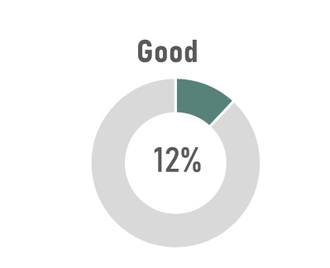
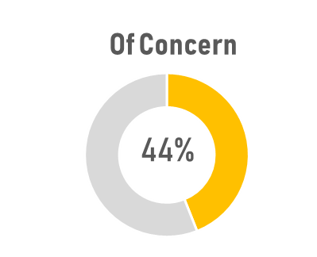
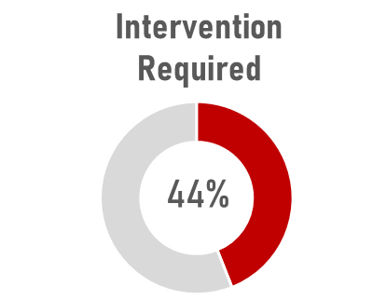
FOUR OF GAUTENG’s MUNICIPALITIES ARE IN A VULNERABLE FINANCIAL POSITION
According to 2018/19 AG’s report; 72 (31%) municipalities are in a vulnerable position and might not be able to continue operating and /or received disclaimed or adverse opinion, which means that the financial statements were not reliable enough for analysis (35 (15%) municipalities)
Gauteng
FINANCIAL HEALTH OF GAUTENG’S MUNICIPALITIES
GOOD
Only one municipality in Gauteng is in a good financial condition.
OF CONCERN
Four municipalities (44%) in the province are of concern
INTERVENTION REQUIRED
Four municipalities (44%) in the province require intervention.
Debt not recoverable
There is a slight decline in the number of municipalities with debt recoverable.
2018-2019
Overall assessment includes municipalities with disclaimed/adverse opinions

Slide 18
2018/19 Audit Outcomes and Progress on Audit Action Plans

Slide 19
SUMMARY OF KEY CHALLENGES EMANATING FROM AG REPORT
Non-compliance with SCM policies and SCM regulations giving rise to Unauthorised, Irregular, Fruitless & Wasteful Expenditure. Inadequate records management. Inadequate Consequence Management and Accountability. Municipal Standard Chart of Accounts (mSCOA). Financial Health indicators.

Slide 20
CAPACITY BUILDING FOR IMPROVED FINANCIAL MANAGEMENT AND OVERSIGHT
Challenges | Lack of proper oversight role by respective municipal structures Lack of controls or inadequate controls over daily and monthly processing and reconciling of transactions against supporting evidence
Interventions | SALGA organised experiencial learning for Municipal Finance and Fiscal Policy working group members to learn on social and economic development through infrastructure investment and help to alleviate poverty by producing free basic services to the poor households. SALGA in partnership with PWC coordinated a Supply Chain Management (SCM) training which was used as a platform to analyse and critique the cost containment measures and the concept of customer driven SCM. Coordinated MPAC training on UIFW in partnership with COGTA and Provincial Treasury with the objective of equipping the municipalities with the understanding of roles and responsibilities of audit committee and Municipal Public Audit Committee (MPACs). SALGA co-ordinated a Financial Misconduct and Cost Containment Regulations training for members of MPAC, Municipal Finance Portfolio Committee, Internal Audit Committee and Audit Committee. The purpose for the training was to strengthen governance in municipalities through enhancing oversight on Financial Misconduct, Cost Containment and consequence management.

Slide 21
SOME MATTERS FOR CONSIDERATION

Slide 22
MATTERS FOR CONSIDERATION
In 2010, the then MEC for Local Government resolved to assign powers and functions from districts to local municipalities to enhance effectiveness and efficiency service delivery to communities
Effectively, this meant allocations for bulk services was now transferred to local municipalities instead to the district municipality.
Therefore, district municipalities solely relied on equitable share and RSC levy replacement grants.
Furthermore, the GP province resolved to provincialise Municipal Health Services which were previously provided by the District municipalities .
Inadequate or insufficient funding for disaster management
No funding for fire services
Therefore the financial health of district municipalities in Gauteng is severely compromised and needs to be addressed with urgency

Slide 23
Thank You

