Slide 1
nyda
Presentation to PORTFOLIO COMMITTEE
QUARTER TWO REPORT
2020 / 2021

Slide 2

Agenda
Situational analysis
Impact of Covid-19 on NYDA Operations
Audit Outcomes
Key program reporting
Performance Information
Financial Information
Human Resources
Questions

Slide 3
Situational analysis
The NYDA continues to function operationally – we have safely reopened all our offices and thus far have only had seven confirmed cases of Covid-19 amongst employees with no deaths.
We have continued to focus on the Youth Micro Enterprise Relief Fund and the restoration of all products and services.
Our branches and centers have opened for NSFAS applications from 15 September 2020
We support government on relief programs and economic recovery through NATJOINTS. We have made detailed inputs to the Economic Recovery Plan.
Management submits monthly reports to the Ministry and Department on the status of the organisation.
Our in year budget has been cut again by R14 million in the MTBPS – this is due to Covid-19 and the decision to cut budgets to provide funding to SAA. This is in addition to the R97 million cut announced in the supplementary budget taking the cumulative annual cut to R111 million.

Slide 4
IMPACT OF COVID-19 ON BUSINESS OPERATIONS

Slide 5
Impact of Covid-19 on Business Operations
The NYDA has adjusted to Level 1 of the Risk Adjusted Strategy and the Agency has returned to full capacity except at eight centres which do not have sufficient space for social distancing and continue to operate at 50% capacity:
Johannesburg
Cape Town
Durban
Thulamela
Polokwane
Mbombela
Rustenburg
Mafikeng
All offices have been successfully reopened to the public.

Slide 6
AUDIT OUTCOME

Slide 7
Audit outcomes
We have received a sixth consecutive clean audit report (unqualified with no material findings) from the Auditor General of South Africa for the 2019 / 2020 financial year.
The Agency also achieved 23 out of 24 planned targets for the financial year. This translates to a 96% performance achievement.
The NYDA also incurred irregular expenditure of R171 000 (0.03% of the total expenditure). An investigation indicated that an employee who was involved in the procurement process failed to declare a conflict of interest. The employee has been subjected to a disciplinary process and pleaded guilty to the charges. The employee has been suspended for three months without pay, docked salary of R150 000 and has been placed on a final written warning. No fruitless and wasteful expenditure was incurred during the 2019 / 2020 financial year.
We are preparing the annual report for tabling in November.

Slide 8
KEY PROGRAMS

Slide 9
Youth Micro Enterprise Relief Fund
The NYDA developed the Youth Micro Enterprise Relief Fund as a response mechanism to Covid-19 for particularly young entrepreneurs affected by Covid-19.
Fund targeted at niche community of youth micro enterprises which may be missed by other relief funds.
R10 million capital provided by NYDA. R2 million was provided by the Mpumalanga Provincial Government.
Criteria: Youth owned, in existence for the last six months, three-month bank statements, proof of existence, CIPC certificate if formal enterprise.
Grant capped at maximum of R10 000, to subsidize losses during the lockdown.
NYDA continues to refer those who may not qualify to other funds: SMME Fund, Skuma Fund, Tourism Fund, Spaza Relief, Agriculture Fund. All funds have set asides for youth.
Applications received: 8558, Approved applications: 1 027, Approved Funding: R8.4 million
The NYDA will publish the list of all beneficiaries to maintain fairness and transparency

Slide 10

Presidential Youth Employment Intervention
Currently the Youth Employment Intervention is focussed on the development of the SAYouth.Mobi. This is a platform being developed by Harambee, NYDA, SALDRU, Tshepo 1 Million, Department of Employment. It was part of the announcements made at SONA 2020 and will be launched in the third quarter. It will create a platform for young people to build a profile for themselves and be connected to economic opportunities closest to where they live.

Slide 11
1000 Businesses in 100 Days Campaign
The 1000 Businesses in 100 Days campaign was announced in the State of the Nation 2020 by the President as one of the first initiatives of the Presidential Youth Employment Intervention. The original vision was to have 1000 businesses funded through an existing pipeline between February 14th (SONA) and June 16th (Youth Day). The hard lockdown meant almost 70 days were lost and the adjusted date agreed between the PMO and the NYDA was August 12th, International Youth Day.
The project was completed on the 12 August 2020 and the final report submitted.
• Total approved applications: 1000
• Total expenditure: R46.9 million

Slide 12
NYDA / NSFAS PARTNERSHIP
The NYDA / NSFAS partnership has been run successfully for the last three years. Young people register through NYDA centres where they are assisted step by step by NSFAS staff in completing their application. Last year close to 120 000 young people applied for NSFAS through NYDA centres.
NSFAS has already opened applications for the 2021 academic year. We have been opened for NSFAS applications since 15 September 2020.

Slide 13
QUARTER TWO PERFORMANCE REPORT 2020/21

Slide 14
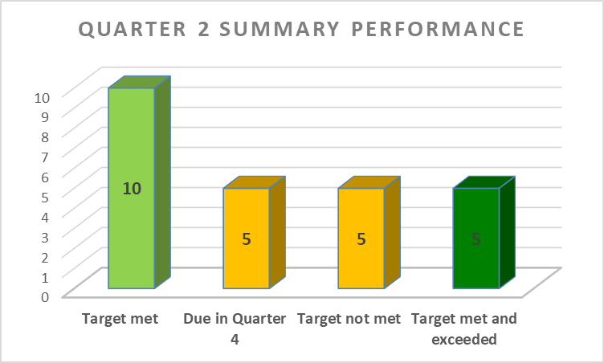
2020/21 Q2 SUMMARY OF PERFORMANCE
In this period under review (April – September 2020) the NYDA has 25 KPIs, of which 10 are met, 5 are due in quarter 4 and 5 are met and exceeded. The overall achievement is 75%. Implementation of most programmes started in Quarter 2 due to lockdown challenges hence the improved performance as compared to Quarter 1. More stringent verification and data collection measures are applied across all programmes. Catch up plan has been developed, targets not met will be monitored closely and be achieved by end of quarter 3.

Slide 15
PROGRAMME AREA 1: ADMINISTRATION
OUTCOME | OUTCOME INDICATOR | YEAR TO DATE TARGET(Cumulative) | QUARTER 2 ACHIEVEMENT | QUARTER 2 ACHIEVEMENT (Cumulative) | REASON FOR VARIANCE | CORRECTIVE MEASURES
An effective Agency characterised by good corporate governance and ethical leadership | NYDA Quarterly Management Reports produced | 1 | 1 | 1 | None | Target met
 | Implemented Annual Workplace Skills Plan | No Target | Target Applicable in quarter 4 | Target Applicable in quarter 4 | Target Applicable in quarter 4 | Target Applicable in quarter 4
 | Developed and implemented Annual Procurement plan and produce quarterly reports | Develop Annual Procurement Plan and approved Quarterly | Annual Procurement Plan and Quarterly Report produced | Annual Procurement Plan and Quarterly Report produced | None | Target met
 | Value of funds sourced from public and private sectors to support the youth development programmes | R20 million | R12 626 250 | R12 626 250 | Target not met due to outstanding partnership agreements sign off | Constantly making follow up with our partners and a catch up plan has been developed to meet this target by end of quarter 3
 | Number of SETA partnerships established | 1 | 1 | 1 | None | Target met

Slide 16
PROGRAMME AREA 1: ADMINISTRATION
OUTCOME | OUTCOME INDICATOR | YEAR TO DATE TARGET(Cumulative) | QUARTER 2 ACHIEVEMENT | QUARTER 2 ACHIEVEMENT (Cumulative) | REASON FOR VARIANCE | CORRECTIVE MEASURES
An effective Agency characterised by good corporate governance and ethical leadership | Number of Partnerships signed with technology companies | No Target | Target Applicable in quarter 3, however 1partnership signed with a technology company | Target Applicable in quarter 3, however 1 partnership signed with a technology company | Target Applicable in quarter 3, however 1partnership signed with a technology company | None
 | Review and implement ICT Strategic Plan | Review ICT Strategic Plan and approved by Ops Exco | Reviewed ICT Strategic Plan and approved by OPS EXCO | Reviewed ICT Strategic Plan and approved by OPS EXCO | None | Target met
 | Review and implement Integrated Communication and Marketing Strategy | Review and implement Integrated Communication and Marketing Strategy | Reviewed and implemented Integrated Communication and Marketing Strategy | Reviewed and implemented Integrated Communication and Marketing Strategy | None | Target met
 | Produce NYDA Strategic Risk register | No Target | Target Applicable in quarter 4 | Target Applicable in quarter 4 | None | None

Slide 17
PROGRAMME AREA 2: DESIGN, DEVELOPMENT AND DELIVERY
OUTCOME | OUTCOME INDICATOR | YEAR TO DATE TARGET(Cumulative) | QUARTER 2 ACHIEVEMENT | QUARTER 2 ACHIEVEMENT (Cumulative) | REASON FOR VARIANCE | CORRECTIVE MEASURES
Increased access to socio-economic opportunities, viable business opportunities and support for young people to participate in the economy | Number of youth owned enterprises supported with financial interventions | 715 | 467 Grant= 376 Relief Fund= 91 | 1424 Grant = 397 Relief fund =1027 | None | Target met and exceeded
 | Number of youth supported with Business Consultancy Services | 145 | 0 | 0 | There were technical challenges with the Voucher Management System that impacted the programme delivery through the on line platform | We have since designed an alternative manual system to be able to deliver on the programme while we resolve the ICT challenges
 | Number of youth supported with non-financial business development interventions | 145 | 88 | 88 | Target not met due to COVID19 (lockdown) challenges | Catch up plan developed to meet this target by end of quarter 3
 | Number of jobs created and sustained through supporting entrepreneurs and enterprises | 1113 | 871 | 1740 | None | Target met and exceeded
 | Number of jobs facilitated through placements in job opportunities | 235 | 787 | 823 | None | Target met and exceeded

Slide 18
PROGRAMME AREA 2: DESIGN, DEVELOPMENT AND DELIVERY
OUTCOME | OUTCOME INDICATOR | YEAR TO DATE TARGET(Cumulative) | QUARTER 2 ACHIEVEMENT | QUARTER 2 ACHIEVEMENT (Cumulative) | REASON FOR VARIANCE | CORRECTIVE MEASURES
Increased number of young people entering the job market trained | Number of young people capacitated with skills to enter the job market | No Target | Target Applicable in quarter 3, however 42 young people were capacitated with skills to enter the job market during this quarter | Target Applicable in quarter 3, however 42 young people were capacitated with skills to enter the job market during this quarter | Target Applicable in quarter 3, however 42 young people were capacitated with skills to enter the job market during this quarter | None
 | Number of young people capacitated with skills to participate in the economy | No Target | Target Applicable in quarter 3, however 302 young people capacitated with skills to participate in the economy during this quarter | Target Applicable in quarter 3, however 302 young people capacitated with skills to participate in the economy during this quarter | Target Applicable in quarter 3, however 302 young people capacitated with skills to participate in the economy during this quarter | None

Slide 19
PROGRAMME AREA 3: NATIONAL YOUTH SERVICE
OUTCOME | OUTCOME INDICATOR | YEAR TO DATE TARGET(Cumulative) | QUARTER 2 ACHIEVEMENT | QUARTER 2 ACHIEVEMENT (Cumulative) | REASON FOR VARIANCE | CORRECTIVE MEASURES
Increased co-ordination and implementation of NYS programmes across all sectors of society | Implemented NYS Communication and Marketing Strategy | No Target | Target Applicable in quarter 4 | Target Applicable in quarter 4 | None | None
 | Number of National Youth Service projects registered | 5 | 25 | 25 | None | Target met and exceeded
 | Number of partnerships coordinated to deliver on NYS programmes | 5 | 20 | 20 | None | Target met and exceeded
 | Presidential Youth Service Programme designed | Presidential Youth Service Programme designed | Presidential Youth Service Programme designed | Presidential Youth Service Programme designed | Target met | Target met
 | Higher Education Youth Service programme designed | Draft documents produced and shared with stakeholders | Daft document produced but not yet shared with all stakeholders | Daft document produced but not yet shared with all stakeholders | Target was not met due to delayed Higher Education sector return. | Catch-up plan has been developed to try and meet the target by end of quarter 3

Slide 20
PROGRAMME AREA 4: RESEARCH AND POLICY
OUTCOME | OUTCOME INDICATOR | YEAR TO DATE TARGET(Cumulative) | QUARTER 2 ACHIEVEMENT | QUARTER 2 ACHIEVEMENT (Cumulative) | REASON FOR VARIANCE | CORRECTIVE MEASURES
To produce research and policy which influences change on youth sector and build sustainable relationships | Number of customer surveys conducted | 1 | 1 | 1 | None | Target met
 | Number of impact programme evaluations conducted | No Target | Target Applicable in quarter 4 | Target Applicable in quarter 4 | None | None
 | An Annual report on Government wide priorities produced | No Target | Target Applicable in quarter 4 | Target Applicable in quarter 4 | None | None
 | Number of youth status outlook reports produced | No Target | Target Applicable in quarter 3, however 2 youth status outlook reports produced during this quarter | Target Applicable in quarter 3, however 2 youth status outlook reports produced during this quarter | Target Applicable in quarter 3, however 2 youth status outlook reports produced during this quarter | None

Slide 21
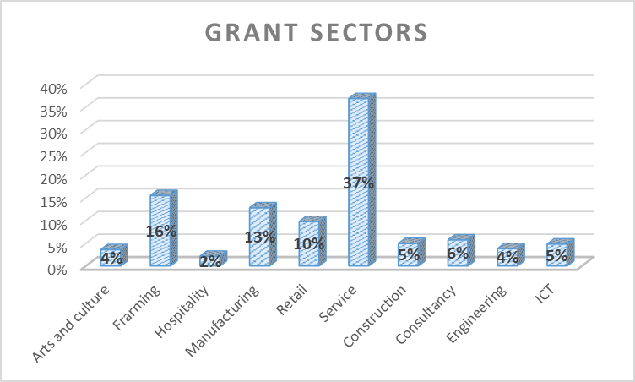
GRANTS BREAKDOWN PER SECTOR
The NYDA Grant programme has been contributing to various sectors such as agriculture, construction, arts and culture, engineering, services, hospitality, ICT, retail, and manufacturing. The sectors where most recipients of grants were coming from are service, agriculture and manufacturing whilst least recipients are from the hospitality, engineering and arts and culture sectors.

Slide 22
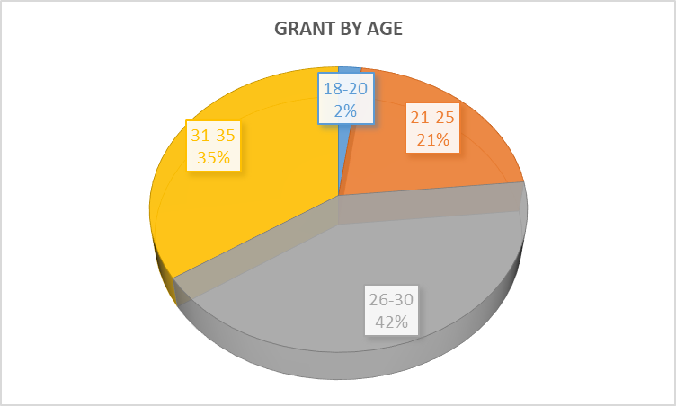
GRANTS BREAKDOWN BY AGE AND GENDER
By end of Quarter 2 grants were highly consumed by young people between the ages of 26-30 who constituted 42% of the grants issued, followed by those aged 31-35 at 35%. There was a lower consumption for young people between the ages of 18-20.

Slide 23
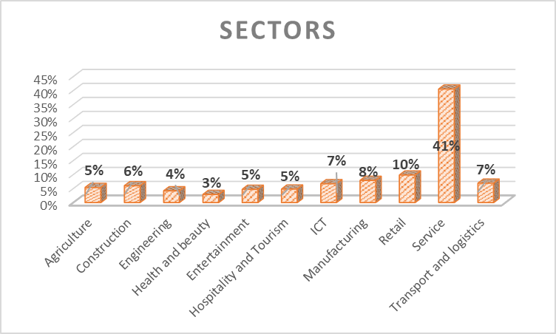
RELIEF FUND BY SECTOR
The sectors where young people came from were: Agriculture, Construction, Engineering, Entertainment, Hospitality and Tourism, ICT, Manufacturing, Retail, Service and transport and Logistics.
Health and beauty and Engineering had the least recipients whilst services sector had the highest. The services sector was highly affected by lockdown as most businesses could not function. Examples of businesses that operate in the services sector are hair salons, car wash, eateries, photography, musical equipment hire, pest control, clothing (seamstress), DJ and photo booth hire etc. Most companies in the services sector could not function without people interacting. They had to come for relief fund to get assistance to pay rent, salaries, electricity, airtime, data (to come up with innovative ways of being functional on digital platforms) and pay for insurance etc.

Slide 24
RELIEF FUND BY GENDER

Slide 27
FINANCIAL INFORMATION quarter two 2020 / 2021

Slide 28
Q2 Revenue analysis
Line item | 2019 / 2020 budget | 2019 / 2020 actual | Percentage deviation
Transfer payment | R240 000 000 | R240 000 000 | 0%
Interest income | R1 000 000 | R929 000 | 7%
Donor income | R12 260 000 | R10 081 000 | 18%
Other income | R5 500 000 | R5 411 000 | 2%
Total | R258 760 000 | R256 421 000 | 1%

Slide 29
Q2 Expenditure by program
Program | Annual Budget | Q2 Budget | Actual | % spend | Link to the MTSF
Economic participation | R91 465 947 | R42 586 379 | R29 149 913 | 68% | Economic transformation and job creation
JOBS | R31 637 718 | R12 655 087 | R9 537 806 | 75% | Education, skills and health
National Youth Service | R24 467 851 | R9 787 140 | R2 077 000 | 21% | Social cohesion and safe communities
Universal access | R26 798 710 | R10 719 268 | R10 655 000 | 99% | Consolidating the social wage through reliable and quality basic services
Research and policy | R7 602 305 | R3 040 922 | R383 000 | 13% | A capable, ethical and developmental state
Administration | R44 244 575 | R17 697 830 | R17 619 000 | 100% | A capable, ethical and developmental state
Employee costs | R184 635 434 | R92 317 717 | R91 360 966 | 99% | A capable, ethical and developmental state
CAPEX | R10 600 000 | R5 300 000 | R5 644 359 | 107% | Consolidating the social wage through reliable and quality basic services
Total | R421 452 000 | R194 104 343 | R166 427 224 | 86%

Slide 30
Q2 Expenditure by Nature
Nature | Annual Budget | Q2 Budget | Q2 Actual | %
Administration and overheads | R47 767 058 | R19 106 823 | R20 942 352 | 110%
Communications and ICT | R43 619 002 | R17 447 601 | R15 932 743 | 91%
Audits | R6 030 000 | R2 412 000 | R1 338 229 | 55%
Risk and legal | R4 706 000 | R1 882 400 | R1 024 161 | 54%
Human Resources | R3 608 415 | R1 443 366 | R827 748 | 57%
Youth training programs | R5 069 129 | R2 027 651 | R196 500 | 10%
Travel and accommodation | R9 021 201 | R3 608 480 | R761 950 | 21%
Project disbursements | R37 793 831 | R15 117 532 | R2 023 865 | 13%
Donor funded expenditure | R30 650 000 | R12 260 000 | R10 081 000 | 82%
Grant and voucher disbursements | R27 951 930 | R11 180 772 | R7 517 437 | 67%
Youth Micro Enterprise Relief Fund | R10 000 000 | R10 000 000 | R8 775 734 | 88%
Goods and services | R226 216 566 | R96 486 626 | R69 421 719 | 72%
Employee costs | R184 635 434 | R92 317 717 | R91 360 966 | 99%
Capital expenditure | R10 600 000 | R5 300 000 | R5 644 539 | 107%
Total | R421 452 000 | R194 104 343 | R166 427 224 | 86%

Slide 31
Q2 Donor funding
Partner | Funds raised | Funds spent | Project description
Services SETA | R10 000 000 | R5 900 256 | Artisan training
Department of Small Business Development | R3 900 000 | R3 000 000 | 1000 Businesses in 100 Days
Department of Small Business Development | R1 400 000 | R169 176 | Braai Café
Department of Sports, Arts and Culture | R10 000 000 | R1 012 500 | The Young Patriots Program
Flemish government | R3 500 000 | - | National Youth Service
Department of Sports, Arts and Culture | R600 000 | - | Youth Day
Industrial Development Corporation | R1 000 000 | - | Voucher program
Princes Trust | R250 000 | - | E learning
Total | R30 650 000 | R10 081 932

Slide 32
Covid -19 Expenditure
On the 18th of March 2020 the president declared a state of disaster due to the Covid-19 outbreak in the country. The NYDA had to then procure hand sanitizers and masks for the staff members, these were delivered on the 25th March 2020. On the 28th March 2020, the president announced the lock down and the offices were then shut down from the 28th March 2020.
The entity closed operations during level 5 and level 4.
The entity’s operations resumed on level 3 lockdown regulations on 1 June 2020, this was only for head office staff members and was on a rotational basis. The building had to be cleaned and additional PPE had to be procured to comply fully with the lockdown regulations.
On 15 June the operations from branches also resumed but only for staff members, procurement of PPE had to be done before hand to ensure compliance with lock down regulations.
The entity opened all the branches to the public from the 26th August 2020 after the lock down regulations were relaxed to level 2.
The details of all the procurements of PPE have been included as an attachment to this presentation.
The Auditor General audited the entity’s COVID-19 related transactions as requested by treasury and no findings were raised.
All Covid-19 expenditure has been reported to National Treasury.

Slide 33
Covid-19 expenditure
Item | Quantity | Price paid | National Treasury price | Total
Sanitizers, 500ml - Sanitizer, with not less than 70% alcohol must comply to WHO-recommended hand rub formulations. Hospital Grade 70% Alcohol Hand Sanitiser & Disinfectant with Emollient | 4 704 | R65.27 | R91.80 | R307 075
Sanitiser 1L refill for dispenser | 2 600 | R70.65 | R183.60 | R183 690
Sanitisers 25L refill 70% Alcohol Base Hand Sanitizer Antibacterial Moisturizing | 80 | R3 393.00 | R3 450.00 | R271 440
Sanitisers floor stand dispensers | 80 | R1 550.75 | None | R124 060
Digital Body Thermometers Infrared Non-Contact – Each | 180 | R892.50 | R2 527.20 | R160 650
Cloth Face Masks - Mask - 3 layers of fabric (As per the DTIC guidelines & Specifications). Branded with organisational logo. | 1 204 | R35.08 | R25 | R42 242
Disposable Masks - 3 ply surgical face masks, 3 layers made up of a soft fibre layer, a filter layer made of polypropylene (making them hypoallergenic) and the top non-woven layer. (Pack of three) | 1 500 | R35.00 | R45 | R52 500
Disposable aprons - Straight apron with bib, 100%pvc, water proof, sewn strip for neck and back fastening. Minimum weight: 300g/m2, covering size 70cm to 90cm (width) x 120 - 150cm: Reusable - Box of 100 pieces | 100 | R290 | R297 | R29 000
Disinfector wipes (bucket) - 70% alcohol, Hand and general wipes, 2000's | 80 | R800 | None | R64 000
Disposable gloves - gloves examination/surgical, sterile, Gloves - surgical or examination - nitrile, powder-free, sterile, single-use. Gloves should have long cuffs, reaching well above the wrist, ideally to mid-forearm. Sizes: small, medium, large pack of 100 pieces | 304 | R323.68 | R700 | R98 400
Face shields - Made of clear plastic and providing good visibility to both the wearer and the patient. Adjustable band to attach firmly around the head and fit snuggly against the forehead, fog resistant (preferable). Completely cover the sides and length of the face. May be re-usable (made of robust material which can be cleaned and disinfected) or disposable. | 100 | R105.00 | R108.00 | R10 500
Provision of 4 cleaners and disinfecting of Head Office | 4 000 sq. m | R15/sq. m | None | R60 128
Sanitation and Disinfecting of Branch | 400 sq. m | R15/sq. m | None | R5 980
Sanitation and Disinfecting of Branch | 300 sq. m | R12/sq. m | None | R3 542
Sanitation and Disinfecting of Branch | 400 sq. m | R14/sq. m | None | R5 650
Total |  |  |  | R1313 334

Slide 34
Covid-19 expenditure

Slide 35
HUMAN RESOURCES

Slide 36
Expiry of management contracts
Management contracts in NYDA are signed for fixed term periods of five years. In 2020, approximately 21 of these contracts will be expiring at following levels:
Management has studied its contracts and per legal advice will follow this process:
A macro structure for the organisation will be developed.
The macro structure for posts which have become vacant because of expiry of contracts will be advertised.
Posts will be filled through a competitive process before year end shutdown.
Thus far, two Executives, one Senior Manager and two managers have left the organisation with the remainder scheduled to exit in October and November.
We are concerned by two key items as it relates to the end of management contracts:
Given the implications of the budget cuts as alluded to above, we may not be able to advertise all posts. We are of the view that seven posts in total can be filled and that would mean 14 employees have effectively been let go.
The CEO, in our view cannot fill Executive posts, given that these posts must be appointed in consultation with the Board of Directors.
Level | Number
Management | 17
Senior Management | 2
Executive | 2

Slide 37
OUTSTANDING MATTERS

Slide 38
Outstanding matters
We are working closely with the DWYPD on the NYP2030 and the NYDA Amendment Act.
We are working with the Department of Agriculture, Rural Development and Land Reform, AGRISeta and Land bank on the release of state land, training of youth in agriculture and funding of youth enterprises in agriculture. Support to small scale farmers identified as one of the priorities in the Economic Recovery Plan.
We are part of the NEDLAC discussions on the deregulation of hemp.

Slide 39
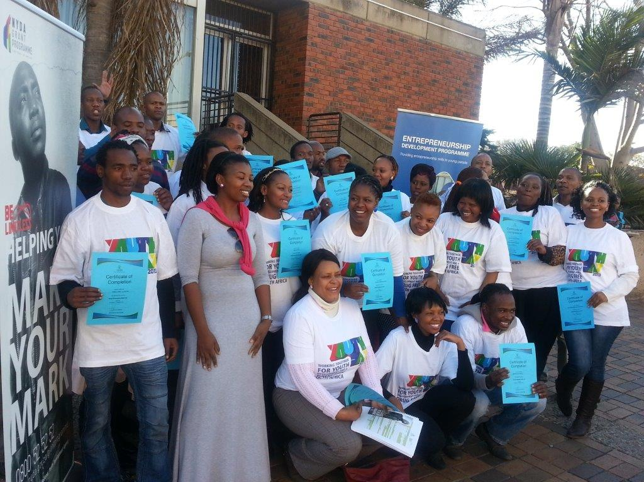
questions

