Slide 1
West Rand District Municipality
State of the Municipality report 27 October 2020
Presenter
Samuel Ramaele
CFO

Slide 2
Content
Demographics of the West Rand
Implementation of the Post Audit Action Plan (PAAP)
State of finances
Breakdown of the UIFW and consequence management
Institutional Capacity
Personnel in key positions (MM, CFO, technical department)
Internal audit committee (capacity, functionality and effectiveness)
MPACs (capacity, functionality and effectiveness)

Slide 3
DEMOGRAPHICS OF THE WEST RAND

Slide 4
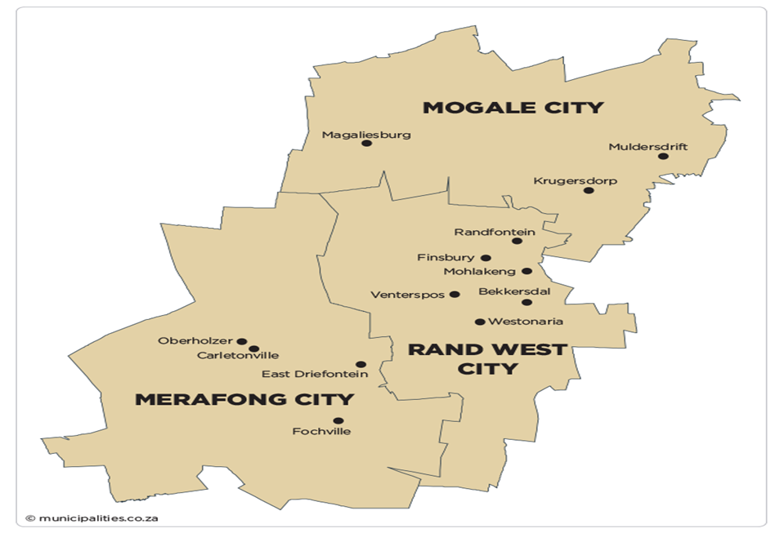
The West Rand District Region is home to the Cradle of the Humankind World Heritage Site and it has a population size of 838,594 within its regions which cover 4,095 km2 size of the land. It comprises of the following three local municipalities: Merafong, Mogale and RandWest Cities.

Slide 5
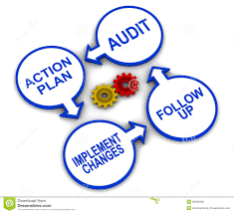
Implementation of the Post Audit Action Plan (PAAP)

Slide 6
Implementation of the Post Audit Action Plan
.
West Rand District Municipality received unqualified audit opinion for 2019/20 financial year.
There were 27 findings raised by the office of Auditor General South Africa.
Department | Function | Number | Category | Progress
Finance | Expenditure management | 2 | Compliance | 50%
 | Financial statements | 9 | Compliance Internal controls AFS Disclosures | 100%
 | Supply chain management | 2 | Compliance | 100%
Performance management | Annual performance report | 2 | Compliance | 100%
 | Business processes | 1 | Internal control | 100%
Information and communication technology | ICT security | 6 | Internal control | 100%
 | ICT Governance | 5 | Compliance | 100%

Slide 7
Implementation of the Post Audit Action Plan
.
All findings were resolved prior to 30 June 2020 with exception of two findings under expenditure management. This is due to financial challenges still being faced by the municipality.
Expenditure management findings are presently in progress.
Finding | Action Plan | Key Tasks to be performed | Complete/ In Progress | Progress to date
EXPENDITURE MANAGEMENT
Payments to suppliers not made within 30 days | Service providers are prioritized for payments on monthly basis due to the financial challenges the municipality is faced with. The municipality is currently implementing the approved MFRP. | Implementation of MFRP- Expenditure management | 50% | The municipality negotiated with it’s top ten creditors to implement the extended payment plan linked with the dates of receipt of equitable share. Top ten creditors paid 40% of total debt Small creditors paid 100% of total debt As part of MFRP process, a financial turnaround strategy was tabled to Council on 29 June 2020. Implementation of the strategy includes: - 14 Contracts reviewed and 5 contracts terminated and 8 contracts scaled down. (resulting in a saving of R29 million a year) - Application for review of unfunded mandates in terms of section 87 of Municipal Structures Act. - Reapplication for introduction of fire service levy to NT.

Slide 8
Implementation of the Post Audit Action Plan
.
Finding | Action Plan | Key Tasks to be performed | Complete/ In Progress | Progress to date
EXPENDITURE MANAGEMENT
Late payments to benefit funds | A financial recovery plan in place will assist the Municipality in improving financial sustainability so that current obligations are met. | Implementation of the MFRP- Expenditure management | 50% | The municipality is still facing challenges in making payments to benefit funds within the prescribed timelines; however the municipality is up to date with payments made to benefit funds and only owes interest in arrears. The following months were not paid with 7 days after month-end: - September 2019 - October 2019 - January 2020 - February 2020 - June 2020 From July to October 2020 the municipality has been up to date with payments within prescribed timelines.

Slide 9
Municipal Finances
.

Slide 10
Municipal Finances: Financial Performance
.
West Rand District Municipality - Financial performance Summary
Description | 2018/19 | 2019/20 | 2020/21 | Budget information
R thousands | Audited Outcome | Unaudited Outcome | First Quarter | Final Budget 2020/21 | Special Adj Budget 2020/21
Financial Performance
Total Revenue | 302 981 | 297 512 | 109 817 | 261 957 | 261 957
Total expenditure | (267 817) | (276 166) | (59 554) | (260 795) | (260 795)
Surplus/ (Deficit) | 35 164 | 21 346 | 50 263 | 1 162 | 1 162
Financial analysis
Grant funding | 273 438 | 270 663 | 105 876 | 241 910 | 241 910
Percentage of grants | 90% | 91% | 96% | 92% | 92%
Salaries | (189 763) | (193 361) | (52 281) | (203 587) | (203 587)
Contracted services | (45 648) | (44 898) | (3 292) | (17 230) | (17 230)
Percentage of salaries | 71% | 70% | 88% | 78% | 78%
Percentage of Contracted services | 17% | 16% | 6% | 7% | 7%
Underfunded mandates | 15% | 20% | 20% | 20% | 20%
Unfunded mandates | 60% | 55% | 55% | 50% | 50%

Slide 11
Municipal Finances: Debtors and Creditors
.
West Rand District Municipality – Debtors: First Quarter
Description |  | Current Year 2020/21
R thousands | NT Code | 0-30 Days | 31-60 Days | 61-90 Days | 91-120 Days | 121-150 Dys | 151-180 Dys | 181 Dys-1 Yr | Over 1Yr | Total | Total over 90 days | Impairment - Bad Debts
Debtors Age Analysis By Income Source
Other | 1900 | 258 | 186 | 166 | 1 581 | 147 | 145 | 131 | 20 202 | 22 816 | 22 206 | (3 293)
Total By Income Source | 2000 | 258 | 186 | 166 | 1 581 | 147 | 145 | 131 | 20 202 | 22 816 | 22 206 | (3 293)
2020/21 - totals only |  |  |  |  |  |  |  |  |  | – | –
Debtors Age Analysis By Customer Group
Local municipalities | 2200 |  |  |  |  |  |  |  | 14 200 | 14 200 | 14 200
Commercial | 2300 | 258 | 186 | 166 | 1 581 | 147 | 145 | 131 | 2 709 | 5 323 | 4 713
Other | 2500 |  |  |  |  |  |  |  | 3 293 | 3 293 | 3 293 | (3 293)
Total By Customer Group | 2600 | 258 | 186 | 166 | 1 581 | 147 | 145 | 131 | 20 202 | 22 816 | 22 206 | (3 293)

Slide 12
Municipal Finances: Debtors and Payables
.
West Rand District Municipality - Payables: First Quarter
Description | NT Code | Current Year 2020/21
 |  | 0 - 30 Days | 31 - 60 Days | 61 - 90 Days | 91 - 120 Days | 121 - 150 Days | Over 1 Year | Total
R thousands
Payables list
PAYE deductions | 0300 | 2 959 |  |  |  |  |  | 2 959
Pensions deductions | 0500 | 3 140 |  |  |  |  |  | 3 140
Trade Creditors | 0700 | 1 063 | 629 | 629 | 13 050 | 19 746 |  | 35 117
Auditor General (Creditors) | 0800 |  |  |  | 828 | 622 |  | 1 450
Leave payable (other) | 0600 | 23 475 |  |  |  |  |  | 23 475
Deferred income (other) | 0900 | 9 086 | 2 518 |  | 1 318 |  | 30 444 | 43 366
Total By Payables Type | 1000 | 39 723 | 3 147 | 629 | 15 196 | 20 368 | 30 444 | 109 507

Slide 13
Municipal Finance: Debtors and payables

Slide 14
Municipal Finances: Covid-19 Expenditure
.
Category | Nature | Amount
Overtime | Indirect cost | 920 799.56
COVID-19 PPE's | Direct cost | 271 966.94
Fuel and oil | Indirect cost | 136 753.04
 |  | 1 329 519.54
ALLOWANCE | APR | MAY | JUN | TOTAL
Overtime | 20 280.51 | 21 820.78 | 25 868.73 | 67 970.02
Night shift allow | 95 914.05 | 96 416.13 | 93 335.76 | 285 665.95
Public holidays | 44 925.81 | 136 551.98 | 43 057.87 | 224 535.67
Sunday allow | 104 819.52 | 90 779.18 | 106 411.62 | 302 010.32
Standby | 10 748.00 | 14 329.20 | 15 540.40 | 40 617.60
 |  |  |  | 920 799.56

Slide 15
Municipal Finances: Covid-19 Expenditure
.
Fuel and oil
PERIOD | EXPENSE | TOTAL | COVID-RELATED
202004 | Fuel April 2020 | 7 883.78 | 3 153.51
202004 | Fuel April 2020 | 105 503.54 | 42 201.42
202005 | Fuel 30 May 2020 | 6 328.36 | 2 531.34
202005 | Fuel 30 May 2020 | 118 527.30 | 47 410.92
202006 | Fuel 30 June 2020 | 97 478.12 | 38 991.25
202006 | Fuel 30 June 2020 | 6 161.49 | 2 464.60
 |  |  | 136 753.04
During level 5 - 4, employees were not reporting for duty save for essential workers. Essential service workers utilised official vehicles during the period as per lockdown regulations. Therefore the expenditure incurred for fuel was COVID-19 related.

Slide 16
Municipal Finances: Covid-19 Expenditure
PPE's and Disinfectant
Item Number | Supplier Name | Date | System Vendor Number | CSD Vendor Number | Item Description | Method of Procurement | Total
1 | Biologica Pharmaceutical (Pty)Ltd | Mar-20 | 99762 | MAAA0014602 | Surgical Masks | Deviation (Circular 100) | R 13 324.99
2 | ShutterLock | Mar-20 | 2757 | MAAA0518138 | Safety Goggle | Deviation (internal process) | R 43 912.70
3 | Supra Health Care | Mar-20 | 6712 | MAAA0035243 | Overshoes Non Woven, Surgeon Gown and KN95 Masks | Deviation (Circular 101) | R 50 010.75
4 | Allenco Medical & Dental | Apr-20 | 6723 | MAAA0003731 | Masks, Gloves, Masks, Masks, Shields / Visors, Gowns and Coveralls | Deviation (Circular 101) | R 56 407.50
5 | Minatlou Trading | May-20 | 98706 | MAAA0091821 | Face Masks | Written Quotation Over R 2000 up to R 30 000 [VAT included] | R 20 000.00
6 | Moruledi Projects | May-20 | 6731 | MAAA0515366 | Air Conditioner assessement | Request for quotation | R1 920.00
7 | Shenka Distributors CC | May-20 | 98666 | MAAA0582485 | Hand Sanitizer and Empty 500ml Bottles | Request for quotation | R 9 710.60
8 | Blu Transfuxion Logistics Solutions | Jun-20 | 418 | MAAA0462564 | Hand Sanitizer and Empty 500ml Bottles | Request for quotation | R 15 226.00
9 | Mukhuva Consulting and Project | Jun-20 | 6726 | MAAA0559460 | Infrared Thermometers | Request for quotation | R17 250.00
10 | Mootlwana Business Enterprise | Jun-20 | 6735 | MAAA0673604 | Empty 500ml Bottles | Request for quotation | R3 104.40
11 | Molale Properties | Jun-20 | 612 | MAAA0765518 | Vacuum Cleaner | Request for quotation | R7 000.00
 |  |  |  |  |  | Total | R 237 866.94
.

Slide 17
Breakdown of the UIFW and consequence management
.

Slide 18
Breakdown of the UIFW
Unauthorized Expenditure
Year | Description | Amount | Reasons | MPAC recommendations | Remedial actions
2018/19 | Over spending on actual expenditure vs budgeted expenditure | 51 137 625 | Investments held with VBS Bank amounting to R76 million were impaired. Impairment loss was not budgeted for. | That the Council should align itself with the Deloitte and Touché report including COGTA forensic report as the matter is sub judice. That a similar approach that Merafong City Local Municipality has taken in terms of VBS saga should also be implemented in West Rand District Municipality, i.e. ‘report the matter to the South African Police Service. | Following the implementation of this resolution, the municipality became aware that a case was already opened with SAPS. CAS. 1/06/2019. The municipality was informed that the matter has been taken over by National Office. They first approached the Municipality for the affidavit on 16 May 2019. They took the affidavit on the 20 June 2019. The case number then became CAS. 414/02/2020. Subsequent to the MPAC meeting a follow up was made with the Officer (Col Josiah) who confirmed that the Case number starting with 1/06/2019 has been replaced with a fresh case number 414/02/2020.
2019/20 | Conditional grants not supported by cash available at the reporting date | 28 871 695 | Municipality did not have sufficient cash ring-fenced in its bank accounts to support unspent grants | Unauthorized Expenditure of R28 871 695 as at 30 June 2019 be written off. | The municipality opened a call account available on demand with FNB bank to ring-fence conditional grants
2020/21 | Operational expenses for Fire brigade services for October and November 2019 | 28 176 572 | Implementation of MFRP to remove unfunded mandates from the budget | Current structure be reviewed in line with the Human capital available and this must be done during adjustment budget process and unauthorized expenditure be written off. | Adjustment budget process to include unfunded mandates. Application for review of unfunded mandates in terms of section 87 of Municipal Structures Act
 |  | 108 185 892

Slide 19
Breakdown of the UIFW
Fruitless and wasteful expenditure
Year | Description | Amount | Reasons | MPAC recommendations | Remedial actions
2017/18 | SARS | 267 783 | Interest and penalties charges on late payments on PAYE, UIF and SDL | All service providers must be prioritised and rotated on monthly basis in an effort to meet all financial obligations. | Service providers are being prioritised and payments arrangements are linked to the receipt of Equitable share transfer, however the issue is not perpetuated by negligence of officials but it is due to the financial situation of the Municipality.
2018/19 | SARS | 1 590 198 | Interest and penalties charges on late payments on PAYE, UIF and SDL | All service providers must be prioritised and rotated on monthly basis in an effort to meet all financial obligations. | Service providers are being prioritised and payments arrangements are linked to the receipt of Equitable share transfer
2018/19 | Pension funds | 206 625 | Interest on late payments to benefit funds | All service providers must be prioritised and rotated on monthly basis in an effort to meet all financial obligations. | Service providers are being prioritised and payments arrangements are linked to the receipt of Equitable share transfer
2019/20 | Marce (Pty) Ltd | 909 744 | Interest and penalties charged on late payments | Management must engage with Marce Projects to negotiate the use of accurate and reasonable interest rate in relation to R909 744. | Management met with Simunye Management Fleet and Marce projects on 18 June 2020 concerning the reasonability of the interest and penalties charged however both parties are not reaching consensus. Both parties have now involved their legal departments and they decided to proceed with the matter through the court of law.

Slide 20
Breakdown of the UIFW
Fruitless and wasteful expenditure (continue…)
Year | Description | Amount | Reasons | MPAC recommendations | Remedial actions
2019/20 | SARS | 449 591 | Interest and penalties charges on late payments on PAYE, UIF and SDL | MPAC report pending | Awaiting for MPAC recommendations
2019/20 | Van Wyk Oosthuizen Attonerys | 172 399 | Contract dispute with landlord | MPAC report pending | Awaiting for MPAC recommendations
2019/20 | Departmet of Labour | 188 758 | Interest on late payments for Workmen's compensation | MPAC report pending | Awaiting for MPAC recommendations
2019/20 | Ndakisa Siyasanga | 4 347 | Subsistence allowance to candidate for CFO position as reimbursement for interviews. The process has to be restarted. | MPAC report pending | Awaiting for MPAC recommendations
2019/20 | Human Communications | 65 259 | Advert for CFO position and the process had to be started again. | MPAC report pending | Awaiting for MPAC recommendations
2019/20 | Arbitration awards | 1 843 824 | Labour disputes | MPAC report pending | Awaiting for MPAC recommendations
2019/20 | Pension funds | 171 589 | Interest on late payments to benefit funds | MPAC report pending | Awaiting for MPAC recommendations
 |  | 5 870 116

Slide 21
Breakdown of the UIFW
Irregular expenditure
Year | Description | Amount | Reasons | MPAC recommendations | Remedial actions
2018/19 | Simunye Fleet | 13 200 000 | Non-compliance with PPPF Act. Functionality criteria for evaluating the following bid was based on the supplier experience in leasing projects of a similar nature at other entities. The bid document of the winning bidder did not include proof of similar projects in leasing of vehicles that they completed previously at other entities. | That this matter must be referred to Disciplinary Board for further investigations and possible rescinding of the Council resolution taken on 31 July 2018. | The Disciplinary Board not yet established.
2018/19 | Afrirent | 8 922 853 | Non-compliance with PPPF Act. The bid was evaluated and awarded based on an incorrect price. Subsequent changes to the bid price were noted after the bid was submitted. | That this matter must be referred to Disciplinary Board for further investigations and possible rescinding of the Council resolution taken on 31 July 2018. | The Disciplinary Board not yet established.
2019/20 | Simunye Fleet | 13 216 569 | Non-compliance with PPPF Act. Functionality criteria for evaluating the following bid was based on the supplier experience in leasing projects of a similar nature at other entities. The bid document of the winning bidder did not include proof of similar projects in leasing of vehicles that they completed previously at other entities. | That this matter must be referred to Disciplinary Board for further investigations and possible rescinding of the Council resolution taken on 31 July 2018. | The Disciplinary Board not yet established.

Slide 22
Breakdown of the UIFW
Irregular expenditure
Year | Description | Amount | Reasons | MPAC recommendations | Remedial actions
2019/20 | Afrirent | 4 650 280 | Non-compliance with PPPF Act. The bid was evaluated and awarded based on an incorrect price. Subsequent changes to the bid price were noted after the bid was submitted. | That this matter must be referred to Disciplinary Board for further investigations and possible rescinding of the Council resolution taken on 31 July 2018. | The Disciplinary Board not yet established.
2019/20 | PK Financials | 544 498 | There was no addendum to SLA after the contract was extended with further twelve months. | MPAC report pending | Awaitinng for MPAC recommendations
2019/20 | Munsoft | 2 392 000 | Municipality procured the services of AFS review due to capacity constraints in the finance department. No formal process followed and variation of scope is more than 15% of the original contract. | MPAC report pending | Awaitinng for MPAC recommendations
 |  | 42 926 200

Slide 23
Institutional Capacity
.

Slide 24
Personnel in key positions (MM, CFO, technical department)
Senior management
Name | Position | Position on Organogram | Appointment Date | Qualification | All Relevant Work Related Experience
Elias Koloi | Accounting Officer (Acting) | Vacant | 01-Nov-19 | NQF level 8 | 7 years and more
Samuel Ramaele | CFO Municipality | Filled | 01-Mar-20 | NQF level 8 | 7 years and more
Mashudu Nevhungoni | Acting EM: Regional Planning | Vacant | 01-Nov-19 | NQF level 8 | 7 years and more
Rethabiseng Mokebe | EM: Corporate Services | Filled | 02-May-17 | NQF level 8 | 7 years and more
Morongwe Mazibuko | EM: Health and Social | Filled | 02-May-17 | NQF level 9 | 7 years and more
Nico Kahts | Acting EM: Public Safety | Filled | 01-Nov-19 | NQF level 7 | 7 years and more

Slide 25
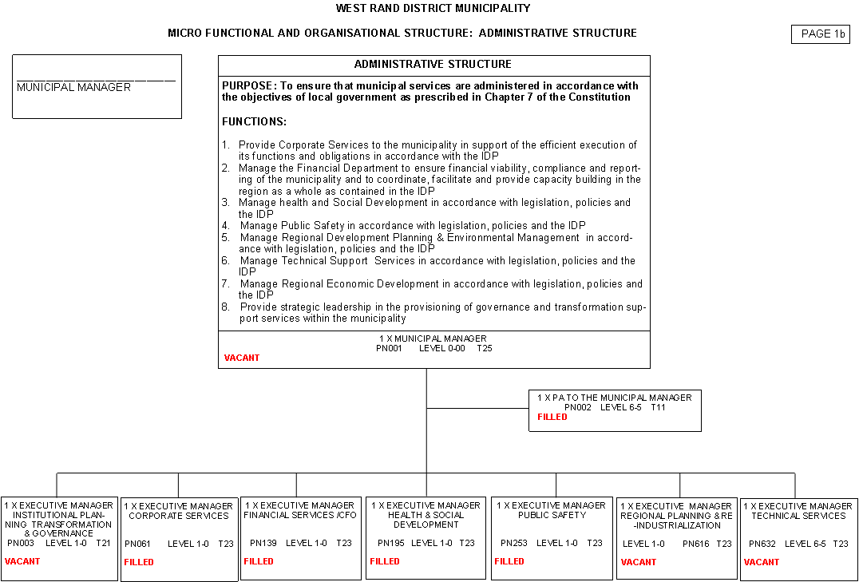

Slide 26
Organisational Structure Summary
Department | Total Posts | Total Employees Placed | Total Vacancies | Vacancy rate %
Administrative Structure | 2 | 1 | 1 | 50
Institutional Planning, Transformation & Governance | 60 | 34 | 26 | 43
Corporate Services | 79 | 37 | 42 | 53
Regional Planning & Re-industrialization | 16 | 10 | 6 | 37.5
Technical Services | 17 | 2 | 15 | 88.2
Financial Services | 56 | 21 | 35 | 62
Health & Social Development | 68 | 50 | 18 | 26
Public Safety | 383 | 188 | 195 | 50.9
Secondment to WRDA |  | 1
STRUCTURE | 683 | 344 | 338 | 53.6
Contractual to Holder – number of employees | 14

Slide 27
KEY VACANCIES
POSITION | FILLED | VACANT | D.O A.
MUNICIPAL MANAGER |  | X
CHIEF FINANCIAL OFFICER | X |  | 1 MARCH 2020
CORPORATE SERVICES | X |  | 1 MAY 2017
HEALTH & SOCIAL DEVELOPMENT | X |  | 1 MAY 2017
PUBLIC SAFETY | X |  | 1 MAY 2017
REGIONAL PLANNING & REINDUTRIALISATION |  | X
TECHNICAL SERVICES |  | X

Slide 28
Internal audit committee (capacity, functionality and effectiveness)
WRDM Council appointed audit committee to advice on internal controls and performance audit committee to advice on service delivery objectives.
The two committees are appointed on 3 years term
These committees meet at least four times a year in terms of the audit committee charter.
These committee also reviews financial statements and performance reports.
Members of these committees are independent.

Slide 29
Internal audit committee (capacity, functionality and effectiveness)
AUDIT COMMITTEE MEMBER | QUALIFICATIONS AND EXPERIENCE
Mr Bashir Ahmed CA(SA)- Chairperson | CA(SA) B Com Information Systems Chartered Management Accountant SAICA member 30 years’ experience in public sector, 15 years in Governance committees.
Mr Luyanda Mangquku CA(SA) | CA(SA) Masters in Business Leadership 20 years’ experience in public and private sector.
Mr Luvuyo Malinga | B Com Accounting & Auditing 13 years as Chief Director- SCM at National Treasury- Now retired Consulting services in private & public sector
Mr Todani Nemadzhilili | B Sc Mathematical Statistics 15 years experience in debt collections and credit risk analysis.
Mr Percry Mongalo | B Com Hons Accounting MBA 35 years experience in public & private sector. 15 years as member of governance committees

Slide 30
Internal audit committee (capacity, functionality and effectiveness)
PERFORMANCE AUDIT COMMITTEE MEMBER | QUALIFICATIONS AND EXPERIENCE
Mr Percy Mongalo- Chairperson | B Com Hons Accounting MBA 35 years’ experience in public & private sector. 15 years as member of governance committees
Dr Roger Govender | PhD in HRD 40 years’ experience in private & public sector Extensive experience in performance management
Mr Andries Mangokwana | M Sc Social Planning & Administration 30 years’ experience in private & public sector Extensive experience in Monitoring & Evaluation
Mr Bashir Ahmed CA(SA) | CA(SA) B Com Information Systems Chartered Management Accountant SAICA member 30 years’ experience in public sector, 15 years in Governance committees.
Mr Piet Fourie CA(SA) | CA(SA) 27 years as Partner at PWC Over 15 years in Governance committees SAICA and IRBA member.

Slide 31
MPACs (capacity, functionality and effectiveness)
MPCA committee is established n in terms of section 79 of Municipal Structures Act.
MPAC committee is appointed by Council
The committee meet four times a year to deal with matters referred to the, for investigation by the WRDM Council.
The committee composed of a representative from all political parties.
The functionally of the committee is supported by administrative staff.
Members of MPAC committee attended annual oversight training course provided by Provincial CoGTA. They were also trained on UIFW oversight by SALGA, Gauteng Treasury and CoGTA.

Slide 32
MPACs (capacity, functionality and effectiveness)
MPAC Committee
Councillor | Position | Political Party
Cllr Velile Khumalo | Chairperson | ANC
Cllr Ben van der Berg | Member | FPL
Ald Blackie Zwart | Member | DA
Cllr Rowles Zwart | Member | DA
Cllr Kholeka Mandyu | Member | EFF
Cllr Mathapelo Agondo | Member | ANC
Cllr Mlungisi Ndamase | Member | ANC
Cllr Njani | Member | ANC
Cllr Bukiwe | Member | ANC
MPAC Support staff
Employee | Position
Mr E Ngcanca | Coordinator
Ms A Kutoane | Administrator
Ms P Tsele | Intern

Slide 33
Thank You

