Slide 1
Presentation to Parliament Date: 20 October 2020

Slide 2
Presentation Outline
Chairperson Overview
Chief Executive Officer Overview
Revised APP for 2020/21 Due to Budget Cut and Covid-19
Budget Appropriation and Revision of DSAC
PanSALB Budget Allocation
PanSALB Anticipated Budget Cuts
Unfunded Projects
Efficiencies implemented to fund core operations
Impact of Covid 19 on the outlook
Vision, Mission and Values
Constitutional, Legislative and other mandate
PanSALB Structures
PanSALB Programmes
Impact Statement
Strategic Outcomes

Slide 3
Presentation Outline
SWOT Analysis
Organisational Environment
Strategic Plan
Annual Performance Plan
Governance
Human Resource Management
Programme Recourse Consideration

Slide 4
Chairperson Overview
The 2015/2020 Strategic Plan heralds the Pan South African Language Board’s (PanSALB) earnest and frank reflection on its impact in an attempt to solemnly execute its language mandate and ultimately improve human lives.
Language is every citizen’s enterprise, thus performance of PanSALB, or lack thereof, affects the entire nation. To the lower societal strata, language is more than a means of communication, it is also a survival apparatus.
As vividly revealed now during the Covid-19 national state of disaster, language can be a determinant between life and death. More so, a demarcation between quality and mediocre education, or prosperity and penury.
Although previously misused to rift, in metropolitans language is rapidly building bridges of communal cohesion among people, yet rural hinterlands remain largely isolated and denigrated.

Slide 5
Chairperson Overview
The multilingual principle enshrined in the Constitution of the Republic of South African justly reaffirms that no single language is capable of expressing all forms and degrees of human comprehension. Every language matters, more so, enriches, and is enriched by, other languages.
The denigrating language disparity in South Africa stems from imperial social constructs. With enabling legislative muscles of the post-1994, the linguistic landscape was supposed to be leveled by now, 26 years after.
Alas, language circulation - driven mainly by politics of place, power, and race – still mirrors historic segregationist supremacy.
The neoliberal linguistic dynamics of South Africa are not unique to other former colonies, however, we are well-equipped to follow, say, Tanzania in the attainment of a practical language emancipation.

Slide 6
Chairperson Overview
Some have, rightfully or wrongly, used such deficits to validate the claims that PanSALB has done everything but promotion and development of languages. As the current board of directors, we availed ourselves to serve with hope of saving this crucial body.
Since our appointment on 6 March 2019, we embarked on an inside-to-outside clean-up process, confronting long-lasting institutional impediments, among others, paucity of accountability and lack of consequent management.
Despite the vastly challenging conditions and various fightback campaigns we faced, this phase is almost concluded. The subsequent phase will be emphatic on the strengthening of institutional culture and systems, especially internal controls.
PanSALB has achieved a lot, yet in order to catch up with the demand, it ought to accelerate its momentum through creative and innovative interventions ardent on quality rather than a virtuous circle of quantity-driven activities of least impact, if at all.

Slide 7
Chairperson Overview
We will prioritise pragmatic projects of tangible outcomes, advance monitoring tools, and aim at achieving more with less. Language development, however, is a non-ending task. On-going human progresses will always necessitate a corresponding linguist complement.
Unlike other Institutions Supporting Democracy, PanSALB is excitingly unique since its powers are for both a player and a referee: a watchdog that also contributes towards conducive condition for language development as well as national language planning.
In the next five years, the institution will give a closer attention to standardisation, review of autonomous status of the so-called dialects, indigenous languages-medium education, further development and possible officialisation of South African Sign Language (SASL) and languages of the KhoiSan nations, especially N/uu. The efficiency and effectiveness of all the PanSALB structures is imperative.

Slide 8
Chairperson Overview
The Disaster Management Act of 2020 does not suspend the Constitution, obliging all organs of state to continue complying with the Use of Official Languages Act of 2012 (UOLA Act) during the on-going national state of disaster.
Inseparable is language preference from the larger arena of economics and politics. For PanSALB’s efforts to be realised, it will challenge the ideological battle that perceives European languages as, if not associating them with, intellectualism.
Identity resides in action. We are what we do, Eduardo Galeano says, especially what we do to change what we are. PanSALB is currently reposition itself into a leading language custodian not only in the SADC region, but rather the African continent and beyond.

Slide 9
Chairperson Overview
We are deeply indebted to the PanSALB staff, PanSALB structures, our executive authority and various oversight structures of the parliament, for your much-appreciated inputs in the overhauling of this significant constitutional institution.
Together we will!

Slide 10
Chief Executive Officer Overview
This Strategic Plan is target oriented and articulates the priorities of the institution in discharging its constitutional mandate for the next five years, which entail the following:
Monitor the Use of Official Languages Act, 2012;
The establishment of a Khoe and San Languages epicenter in the Northern Cape, to serve as a central point for the preservation and development of these endangered languages;
The development of a South African Adaptation of Nama Orthography Rules from the Namibian Nama Orthography Rules;
The officialisation of the South African Sign Language, and a nationwide awareness campaign on the South African Sign Language Charter.

Slide 11
Chief Executive Officer Overview
Our preliminary assessment of the core business programme revealed that, more than 95% of the targets will be adversely affected by the Covid-19. In trying to mitigate this challenge, all activities set to realise the quarterly targets were reconfigured. While most of the activities were initially contact-based, we shall be exploring some other creative digital ways of delivering on the mandate.
This will involve among others the following:
Holding meetings virtually where physical interaction is not required
The electronic round robin sharing of documents
Exploring social platforms and community radio stations as an alternative mode of delivery and linguistic communities outreach
Articles for publishing online and through both electronic and print media
Online workshops
Resourcing the members of PanSALB structures and staff members to enable delivering remotely
Provide technical support to address the Covid-19 related challenges through provision of multilingual services (e.g. providing translation and SASL interpreting)

Slide 12
Chief Executive Officer Overview
Through various structures of the institution such as the National Language Bodies and the National Lexicography Units, continue to ensure adequate research and development of all the official languages, including Khoi, Nama and San languages, and the South African Sign Language.
Provincial Language Committees to continue providing advice on language policy, legislation, and monitor implementation and the observance of linguistic human rights.
As part of a continued discourse on multilingualism in Africa, PanSALB will continue to commemorate significant language days such as Mother Language Day (Language Activism Month), Africa Month, Heritage Month, and other related activities to raise critical language awareness issues affecting education, culture and heritage, economic development and scholarships.

Slide 13
Chief Executive Officer Overview
In conclusion, with its various structures and expertise, PanSALB is well positioned to champion the development and promotion of the equitable use of all our official languages and other languages such as Khoi, San, Nama and South African Sign Language.
It is our conviction that the languages of a nation are on the same level as all other natural resource s, and as such, should be harnessed and developed for the overall benefit of the nation and the continent as a whole.
PanSALB commends the leadership and support from the Hon. Minister Nathi Mthethwa, Hon. Deputy Minister, Nocawe Mafu, Speaker of the National Assembly Hon. T R Modise and Deputy Speaker Hon. S L Tsenoli.

Slide 14
Chief Executive Officer Overview
Programme 1: Administration and institutional Support’s indicators and targets will be achieved as planned in the Annual Performance Plan (APP) for 2020/21. The Covid-19 pandemic will not affect directly the achievement of the APP targets, however they may affect the operations of the institution.
The interventions put in place will be to explore technology and digitisation. The meetings and workshops planned will be conducted virtually. Recording of presentation and reading material will be used online. Some of the indicators and targets will be delayed and achieved in the quarter 2,quarter 3 and quarter 4. Activities such as advertisements of post and interviews will be done online.

Slide 15
Chief Executive Officer Overview
Board Members, Executive, Staff and Chairpersons of structures and members of the structures such as NLUs, NLBs and PLCs will be provided with data and tools of trade. The legislative submissions of Annual Financial Statement and Annual Report will depend on the extension of submission date by the Department of Sports, Arts and Culture and National Treasury. There will be delays with the AGSA auditing for financial year 2019/20.
Payments of invoices will be made within 30 days as required by the National Treasury Regulations.

Slide 16
Revised APP for 2020/21 Due to Budget Cut and Covid-19
Since the beginning of the COVID-19 pandemic, South African debt has increased, 21 cents of every rand in tax goes to previous debts that the country already had.
South Africa's government revised its budget deficit forecast to 14.6 percent of GDP in 2020/21 fiscal year from an earlier estimate of 6.8% in February and compared to 6.3% in 2019.
That would be the largest budget shortfall since the end of apartheid, as the Covid-19 pandemic and related lockdown measures hit severely the country's fragile economy.
Meantime, government debt should jump to 81.8 percent of GDP from 63.5 percent last year, before hitting 87.4 percent in 2023/24.

Slide 17
Budget Cut and Covid-19 cont,
In the previous two (2) years departmental budgets have been reduced by R85.7-billion over the medium term by the National Treasury.
This translated to a R27.4-billion cut in 2018, R24.7-billion in 2019/20 and R33.0-billion in 2020/21. The cuts would fall on large programmes and transfers to government entities.
In the past 3 years the budget of DSAC was also reduced. Since PanSALB is a subsidiary of DSAC and receives its funding from them to promote the Use of Official Languages Act (2012), as one of the Departmental Mandate it was expected that the institution would be affected by the budget adjustment.
The budget reduction received by DSAC was below the inflation rate which has been sitting at 4,58% to 2,43% since five (5) years ago. The budget reduction was less than 2% throughout the previous three (3) years.

Slide 18
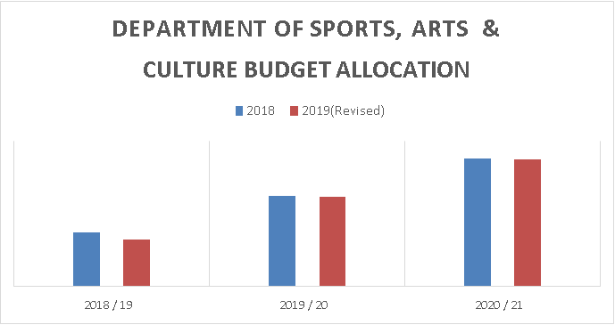
Budget Appropriation and Revision of DSAC

Slide 19
Budget Appropriation and Revision of DSAC cont,
In the past three (3) years PanSALB has not received any budget reductions despite the economic conditions the country has been facing.
In the current financial year PanSALB was allocated a budget of R125,540 million for the financial year 2020/21.
Owing to the COVID-19 pandemic, the budget of the institution has been reduced to R112,540 million which is a reduction of R13 million by the DSAC.

Slide 20
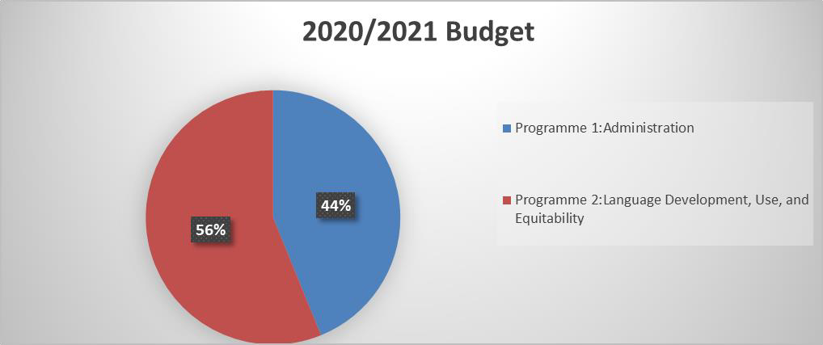
PanSALB Budget Allocation

Slide 21
Budget Allocations cont,
The strategic objectives as appearing in the APP was reconfigured and reprioritised and thus affecting the normal operations.
Strategic reprioritizations over the 2020 MTEF period will include the creation of conditions for the development and use of the South African official languages, ensuring the equitable use of South African Official Languages through the promotion of multilingualism, ensuring protection of linguistic human rights and the implementation of all language constitutional imperatives inclusive of the Use of official languages Act of 2012.
This will also entail the creation of the organisation’s sustainable institutional ability to deliver on the core business and comply with legislation, regulations and prescripts.
Based on the current year budget cut of 10.3% it is anticipated the previously approved MTEF allocations will also be reduced by roughly 10 % due the effects of Covid-19. Due to these certain projects will be prioritised, whilst others will be completed in a longer term than planned

Slide 22
PanSALB Anticipated Budget Cuts

Slide 23
Unfunded Projects
Resources available could cater for some and not all services provided for on the Constitutional mandate and the five-year strategy.
Part of the mandate like dictionary production, language promotion, language awareness and linguistic human rights were funded and carried out on available resources.
Several other key projects and strategic goals such as the following were adversely affected as they could not be funded. The establishment of the Khoi Nama and San epi-centre.
The Nu/u language audio visual dictionary project which commenced in 2019 (As instructed by the Presidency to save the Nu/u language, which currently has only four remaining speakers).
Inhouse publishing to meet the internal publishing demands of the National Lexicographic Units and the general publishing demands for language and literary materials by communities and individuals.
Screening and Evaluation of literary materials produced for school consumption. Verification and authentication of terminologies and other language products Language research.

Slide 24
Efficiencies implemented to fund core operations
Over the years, PanSALB implemented the following measures and efficiencies to reduce its expenses and improve service delivery on core mandate owing to the minimal increase of its budget and some budget cuts.
The following key cost-cutting measures adopted over the past few years:
Suspending recruitments and appointments to some key positions and share among or redistribute key performance tasks to available human resources
Reduced outsourcing of services to service providers
Reconfiguration and reprioritisation of core business programmes
Implementation of cost containment measures as provided by National Treasury
Due to the diminishing resources caused by COVID-19, PanSALB will have to apply measures to fulfil its mandate with limited resources.

Slide 25
Impact of Covid 19 on the future Outlook
With the economy shrinking already this year, the fiscus is already facing constraints which may threaten the optimal performance of Institutions Supporting Democracy (ISDs) like PanSALB.
COVID-19 has become an epidemic disruption, impacting service and support delivery and affecting the speech communities countrywide. PanSALB should use this assessment to establish near- and long-term strategies for responding to potential impacts.
Continuity of PanSALB monitoring role and other significant operations are threatened by increased absenteeism from members of the structures, stakeholders, role players, management and staff due to quarantines and working remotely. Unpredictable work conditions create pressure and demand on employees and structure members, fueling anxiety and morale issues.

Slide 26
Impact of Covid 19 on the future Outlook
While the demand for service from ISDs like PanSALB is on the rise due to public awareness, these institutions are firmly dumped into great depression with negative growth for the foreseeable future. The harsh impact on what little achievements we have will be immense.
Due to COVID-19 PanSALB will reduce costs through:
Travel and accommodation will be ceased as meetings, trainings and workshops will be held virtually.
Dictionaries will be published online rather than printing
PanSALB will incur higher costs in the current year due acquiring tools of trade for employees. Costs are expected to be lesser in the future.

Slide 27
STRATEGIC OVERVIEW

Slide 28
Vision
The custodian of multilingualism to promote social cohesion in South Africa.
Mission
promote multilingualism
create conditions for the development and use of all official South African languages, including the Khoi, Nama and San languages and South African Sign Language
promote respect and recognition for all languages, including previously marginalised languages and all other languages commonly used by South African communities
promote the development of previously marginalised languages
advocate for rights relating to language and the status of language
initiate, enable and conduct research in accordance with the PanSALB mandate

Slide 29
Values

Slide 30
Constitutional, Legislative and other Mandate
Sections 6(5) (a) and (b) of the Constitution of the Republic of South Africa (Act 108 of 1996) provide for the establishment of a Pan South African Language Board. Other mandate and legislative prescripts which include amongst others the following: The PanSALB Act (No. 59 of 1995 as amended in 1999) The Use of Official Languages Act (No. 12 of 2012) In response to Priority 5 of the NDP on Social Cohesion and Safe Community, the organisation has multiple approaches to achieve such inline with its mandate. These include among others promotion of multilingualism, linguistic human rights and equitable use of languages.

Slide 31
PanSALB Structures
PanSALB
NLUs
NLBs
PLCs

Slide 32
PanSALB Structures cont.
National Lexicography Units (NLUs)
These are dictionary units operating as companies limited by guarantee under section 21 of the Companies Act, 1973 (as amended), to which PanSALB shall allocate funds for the fulfilment of their function. They are accountable to the Board for monies allocated to them and are also expected to abide by the policies of the Board.
National Language Bodies (NLBs)
Also established in terms of the PanSALB Act, these units give advice to the Board on matters relating to any particular language in terms of standardisation, terminology development, literature promotion, translation and any other matter affecting the quality of language.

Slide 33
PanSALB Structures cont.
Provincial Language Committees (PLC)
Provincial language committees in each province provide advice to the Board on any language policy related matters affecting any province. They are further responsible for ensuring the implementation of provincial language acts, linguistic human rights awareness and other language related promotions activities.

Slide 34
PanSALB Programmes
The institution is divided into two programme, name; PROGRAMME 1: Administration and Institutional Support Provides administrative support for optimal functioning of the our core business. It consists of the following: Financial Management, Supply Chain Management, Information and Communication Technology, Marketing and Communication and Institutional Performance and Governance.

Slide 35
PanSALB Programmes cont.
PROGRAMME 2: Business Development (Language Development, Use and Equitability): It consists of the following sub-programmes: Language Development and Use; Equitability of Language Use and; Linguistic Human Rights.

Slide 36
Impact Statements
Priority 5 of the Social Cohesion | Fast track the promotion and implementation of indigenous languages
Impact statement: 1 | Conducive environment for the development and use of South African official languages; Khoi, Nama and San languages, and the South African Sign Language.
Impact statement: 2 | Equitable use of South African official languages, Khoi, Nama and San languages, and the South African Sign language.
Impact statement: 3 | Linguistic human rights compliant society.
Impact statement: 4 | Effective and efficient administration support provided to deliver on core business, and comply with legislation, regulation, and prescripts of government.

Slide 37
Strategic Outcomes
Administration and institutional Support | Finance management processes and procedures improved to support PanSALB mandate
 | 2. Supply Chain Management (SCM) processes and procedures improved to support PanSALB mandate
 | 3. Information and Communication Technology (ICT) processes and procedures improved to support PanSALB mandate
 | 4. Human Resource Management processes and procedures improved to support PanSALB mandate
 | 5. Marketing and Communication processes and procedures improved to support PanSALB mandate
 | 6. Strategic Management processes and procedures in support to PanSALB mandate

Slide 38
Strategic Outcomes cont.
Language Use, Development and Equitability | Languages developed
 | 2. Equitable use of languages
 | 3. Violations of linguistic human rights addressed

Slide 39
SWOT Analysis
STRENGTHS | WEAKNESSES
Language expertise Linguistic diversity Enabling the legislative environment Appointment of the PanSALB Board (06 March 2019) Existence of PanSALB structures Stakeholder engagement Working relationship with ISDs and OISD Existence of provincial offices The relevance of PanSALB existence | Negative Media coverage Lack of synergy between PanSALB structures High vacancy rate. Leadership Instability Lack of visibility Lack of public awareness of PanSALB language programmes Non-compliance with governance prescripts (AGSA Report) Lack of staff capacitation and training Unhealthy organisational culture lack of income-generating mechanisms (fundraising) Low staff morale Inadequate expertise in risk management Lack of automation (e.g. Digitalisation)

Slide 40
SWOT Analysis cont.
STRENGTHS | WEAKNESSES
 | Non-functional organisational structure (due to high vacancy rate) Limited IT infrastructure Lack of succession planning and career pathing (policy gaps) The non-existence of a Marketing and Communication Strategy Nonmarket related sitting fees and travel allowances which have an impact Improper budget allocation Non-cooperation of NLUs or PanSALB with other organisations Lack of synergy between lexicography and terminology development Underspending of budget Lack of preservation and maintenance strategies of indigenous language, Tshivenda and isiNdebele and Xitsonga) Lack of coordinated support services

Slide 41
SWOT Analysis cont.
OPPORTUNITIES | THREATHS
Strengthen relationships with institutions of higher learning Strengthen relationships with organs of state (Strategic Partnership) Knowledge management to enhance institutional memory Cross-border relations (languages spoken and used) and linguistic cooperation without borders South African Sign Language to be the twelfth official language Research on all South African previously marginalised official languages Availability of new technology digitisation e.g. lexical databases (4th Industrial Revolution) Increased activism by speech communities and rights groups Review of organisational policies | The dominance of English Unfavorable economic condition e.g. budget cuts Social media counteracting standardisation

Slide 42
Strategic Plan

Slide 43
Strategic Plan for 2020/25 Administration
No. | Outcome | Outcome Indicator | Baseline | Five-Year Target 2025
1. | Finance processes and procedures improved to support PanSALB mandate | Number of finance policies reviewed and approved by the Board | 4 | 20
 |  | Clean audit opinion by AGSA | Qualified audit opinion by AGSA | Clean audit opinion by AGSA
 |  | Action Plan approved by the Board | Draft Audit Action Plan | Audit Action Plan approved by the Board
 |  | Number of quarterly reports on the implementation of the audit action plan submitted to Audit and Risk Committee for approval | New indicator | 20

Slide 44
Administration cont.
No. | Outcome | Outcome Indicator | Baseline | Five-Year Target 2025
 | Finance processes and procedures improved to support PanSALB mandate | Number of approved quarterly financial reports submitted to NT and DSAC | 4 | 20
 |  | Number of approved AFS submitted to DSAC, NT and AGSA | 2 | 10
 |  | Number of approved ENE submitted to DSAC, NT and AGSA | 2 | 10
 |  | Percentage of payments of invoices within 30 days as prescribed by treasury regulations | New indicator | 100%
 |  | Number of finance workshops conducted on related matters | New indicator | 20

Slide 45
Administration cont.
No. | Outcome | Outcome Indicator | Baseline | Five-Year Target 2025
2. | SCM processes and procedures improved to support PanSALB mandate | SCM policy reviewed and approved by the Board | New indicator | SCM policy reviewed and approved by the Board
 |  | Contract register approved by the CFO | New indicator | Approved and updated Contract Register
 |  | Procurement Plan approved by CEO and submitted to NT and DSAC | Procurement Plan | Approved Procurement Plan submitted to NT and DSAC
 |  | Number of approved quarterly procurement reports submitted to NT and DSAC | 4 | 20
 |  | Demand Management Plan approved by the CEO and submitted DSAC | Demand Management Plan | Approved Demand Management Plan

Slide 46
Administration cont.
No. | Outcome | Outcome Indicator | Baseline | Five-Year Target 2025
 |  | Number of quarterly reports on the implementation of the demand management plan submitted to the CEO for approval | New indicator | 20
 |  | Number of workshops on SCM processes and procedures | 2 | 10
3. | ICT processes and procedures improved to support PanSALB mandate | ICT Master System Plan developed and in line with SITA Act and DPSA guidelines approved by the Board | Draft Requirements of the Master Plan | ICT Master System Plan reviewed in line with SITA Act and DPSA guidelines.
 |  | Information Security Policy and Cyber Security Policy developed and approved by the Board | Information Security Policy and Cyber Security Policy | Reviewed Information Security Policy and Cyber Security Policy

Slide 47
Administration cont.
No. | Outcome | Outcome Indicator | Baseline | Five-Year Target 2025
 |  | Corporate website developed | New indicator | Functional corporate website
 |  | Organisational Intranet developed | New indicator | Functional intranet
 |  | Number of ICT workshops conducted | New indicator | 20
4. | Human Resource Management processes and procedures improved to support PanSALB mandate | Number of HRM policies reviewed and approved by the Board | 19 | 40
 |  | Human Resource Management Plan approved by the Board | Draft HRM Plan | HRM Plan reviewed and approved
 |  | Percentage of vacancy rate against the approved staff compliment | 20% | 20%

Slide 48
Administration cont.
No. | Outcome | Outcome Indicator | Baseline | Five-Year Target 2025
 |  | Percentage of performance agreements finalised with senior management in line with DPSA prescripts | New indicator | 100%
 |  | Percentage of performance assessments finalised with senior management in line with DPSA prescripts | 90% | 100%
 |  | Number of employees trained in line with the training plan | New indicator | 300
 |  | Number of approved quarterly reports on Employee Wellness Services submitted to CEO for approval | 4 | 20
 |  | Number of meetings held for the PanSALB Bargaining Chamber | 4 | 20

Slide 49
Administration cont.
No. | Outcome | Outcome Indicator | Baseline | Five-Year Target 2025
5. | Marketing and Communication processes and procedures improved to support PanSALB mandate | Marketing and Communication Policy approved by the Board | New indicator | Approved Marketing and Communication Policy
 |  | Stakeholder Engagement Policy approved by the Board | New indicator | Approved Stakeholder Engagement Policy
 |  | Stakeholder Engagement Strategy approved by the Board | New indicator | Approved Stakeholder Engagement
 |  | Marketing and Communication Strategy reviewed and approved by the Board | Draft Marketing and Communication Strategy | Approved Marketing and Communication Strategy
 |  | Number of PanSALB office branded in phases | 0 | 10

Slide 50
Administration cont.
No. | Outcome | Outcome Indicator | Baseline | Five-Year Target 2025
 |  | Number of news articles published | 12 | 60
 |  | Number of internal newsletters produced | 9 | 55
 |  | Number of staff engagements on operation matters | 2 | 20
6. | Strategic Management processes and procedures improved to support to PanSALB mandate | Strategic Management Policy approved by the Board | New indicator | Reviewed Strategic Management Policy
 |  | Strategic Risk Plan approved by the Audit and Risk Committee | New indicator | Reviewed Strategic Risk Plan
 |  | Number of approved Risk Reports on the implementation of the Strategic Risk Plan approved by the Risk and Audit Committee submitted to NT and DSAC | 4 | 20

Slide 51
Administration cont.
No. | Outcome | Outcome Indicator | Baseline | Five-Year Target 2025
 | Strategic Management processes and procedures improved to support to PanSALB mandate | Approved Annual Performance Plan as required by the prescripts submitted to NT, DSAC and DPME | 2 | Approved Annual Performance Plan
 |  | Number of approved quarterly performance reports on the implementation of the APP submitted to NT, DSAC and DPME | 4 | 20
 |  | Approved Annual Report submitted to NT, DSAC and AGSA | 1 | Approved Annual Report
 |  | Number of workshops on strategic management processes and procedures | 0 | 10

Slide 52
Business Development (Language Development, Use and Equitability)
No. | Outcome | Outcome Indicator | Baseline | Five-Year Target 2025
7. | Languages developed | Number of dictionaries published | 11 | 44
 |  | Number of status reports on compilation of dictionaries | 11 | 55
 |  | Publishing of N/uu audio visual dictionary | New indicator | Revision of N/uu audio visual dictionary
 |  | Number of NLUs Board of directors meetings held in line with the Memorandum of Incorporation | 22 | 220
 |  | Percentage of terminology lists authenticated | 100% (11) | 100%
 |  | Number of workshops on revised spelling and orthography rules for previously marginalised official languages | 4 | 45
 |  | Status report on spelling and orthography rules for the Nama language | 0 | Workshop on the Nama spelling and orthography rules

Slide 53
Business Development (Language Development, Use and Equitability)
No. | Outcome | Outcome Indicator | Baseline | Five-Year Target 2025
 | Languages developed | Number of consultative workshops on development of spelling and orthography rules for Nama language | New indicator | 2
 |  | Establishment of Khoe and San language centre | 0 | Khoe and San language centre established
 |  | Number of NLB meetings held in line with the Norms and Rules | 15 | 260
8 | Equitable use of languages | Number of significant language days celebrated | 3 | 15
 |  | Number of workshops promoting SASL use | 1 | 20
 |  | Number of language awareness campaigns | 4 | 20
 |  | Number of PLCs meetings held in line with norms and rules | 14 | 180
 |  | Number of engagements with stakeholders on language related matters | 0 | 90

Slide 54
Business Development (Language Development, Use and Equitability)
No. | Outcome | Outcome Indicator | Baseline | Five-Year Target 2025
 | Equitable use of languages | Number of Government departments and public entities monitored to implement the Use of Official Languages Act | 36 | 180
 |  | Report on language research conducted | One reports on language research conducted | Five reports on language research conducted
 |  | Number of indigenous languages literature development projects | 5 | 25
 |  | Publishing unit established | 0 | 1
 |  | Number of engagements promoting mother language education | New indicator | 45
9. | Violations of linguistic human rights addressed | Percentage of linguistic human rights complaints resolved | 4 | 100%
 |  | Publications of linguistic human rights matters | New indicator | Published linguistic human rights matters

Slide 55
Key Risks
Outcome | Key Risk | Risk Mitigation
Administration processes and procedures improved to support PanSALB mandate | Non-compliance with administration policies. | Enforce adherence to administration policies through regular communication with staff.
Reduction of audit findings. | Negative audit findings from AGSA. | Implementation of the audit action plan.
Languages developed. | Departments and institutions not prioritizing the language mandate. | Constant monitoring to put pressure on institutions and departments to comply with their language mandates.
Equitable use of languages. | Departments and institutions not having sufficient resources for equitable use of languages. | Affordable strategies such as rotating languages will be advised.
Violations of linguistic human rights addressed. | Incapacity to pursue linguistic human rights violations that require legal interventions | Strategically aim for amicable solutions to linguistic human rights violation complaints.

Slide 56
Annual Performance Plan

Slide 57
Programme 1: Administration and Institutional support
The purpose of this programme is mainly to provide administration and support services for the optimal functioning of PanSALB’s core business. These services include the full array of corporate management services:
Finance and supply chain management services
Information Technology services
Human Resource management
Marketing and Communication
Institutional Performance and Governance services

Slide 58
Sub-Programme 1.1: Finance Management
Impact Statement 4: Effective and efficient administration support provided to deliver on core business and comply with legislation, regulation and prescripts of government.
Outcomes: Finance processes and procedure improved to support PanSALB mandate
Output | Output Indicators | Estimated Performance 2020/21 | Target 2021/22 | Target 2022/23 | Target 2023/2024
Finance policies reviewed and approved | Number of finance polices reviewed and approved by the Board. | 4 | 4 | 4 | 4
Audit opinion of the AGSA | Clean audit opinion of the AGSA | Clean audit opinion | Clean audit opinion | Clean audit opinion | Clean audit opinion
Quarterly reports on the implementation of the audit action plan | Number of quarterly reports on the implementation of the audit action plan submitted to Audit and Risk Committee for approval | 4 | 4 | 4 | 4

Slide 59
Sub-Programme 1.1: Finance Management cont.
Impact Statement 4: Effective and efficient administration support provided to deliver on core business and comply with legislation, regulation and prescripts of government.
Outcomes: Finance processes and procedure improved to support PanSALB mandate
Output | Output Indicators | Estimated Performance 2020/21 | Target 2021/22 | Target 2022/23 | Target 2023/2024
Quarterly financial report submitted to NT and DSAC | Number of approved quarterly financial reports submitted to NT and DSAC | 4 | 4 | 4 | 4
AFS submitted to DSAC, NT and AGSA | Number approved AFS submitted to DSAC,NT and AGSA | 2 | 2 | 2 | 2
ENE submitted to DSAC and NT | Number of approved ENE submitted to DSAC and NT | 2 | 2 | 2 | 2
Turnaround times for payments of invoices | Percentage of payments of invoices within 30 days as prescribed by treasury regulations | 100% | 100% | 100% | 100%

Slide 60
Sub-Programme 1.2: Supply Chain Services Management
Impact Statement 4: Effective and efficient administration support provided to deliver on core business and comply with legislation, regulation and prescripts of government.
Outcome: SCM processes and procedures improved to support PanSALB mandate
Output | Output Indicators | Estimated Performance 2020/21 | Target 2021/22 | Target 2022/23 | Target 2023/2024
SCM policies reviewed and approved | SCM policy reviewed and approved by the board | Reviewed and approved SCM policy | - | - | -
Maintenance of contract register | Contract Register approved by the CFO | Contract register updated and approved by CFO | Contract register updated and approved by CFO | Contract register updated and approved by CFO | Contract register updated and approved by CFO
Procurement Plan developed and approved | Procurement Plan approved by CEO and submitted to NT and DSAC | Approved Procurement Plan submitted to NT and DSAC | Approved Procurement Plan submitted to NT and DSAC | Approved Procurement Plan submitted to NT and DSAC | Approved Procurement Plan submitted to NT and DSAC
Procurement reports submitted to NT and DSAC | Number of approved quarterly procurement reports submitted to NT and DSAC | 4 | 4 | 4 | 4

Slide 61
Sub-Programme 1.2: Supply Chain Services Management cont.
Impact Statement 4: Effective and efficient administration support provided to deliver on core business and comply with legislation, regulation and prescripts of government.
Outcome: SCM processes and procedures improved to support PanSALB mandate
Output | Output Indicators | Estimated Performance 2020/21 | Target 2021/22 | Target 2022/23 | Target 2023/2024
Demand management plan developed and approved | Demand management plan approved by CEO and submitted to NT and DSAC | Approved Demand management plan submitted to NT and DSAC | Approved Demand management plan submitted to NT and DSAC | Approved Demand management plan submitted to NT and DSAC | Approved Demand management plan submitted to NT and DSAC
Quarterly reports on the implementation of the demand management plan | Number of quarterly reports on the implementation of the demand management plan submitted to the CEO for approval | 4 | 4 | 4 | 4
Workshops on SCM processes and procedures | Number of workshops on SCM processes and procedures | 4 | 4 | 4 | 4

Slide 62
Sub-Programme 1.3: Information Technology Services
Impact Statement 4: Effective and efficient administration support provided to deliver on core business and comply with legislation, regulation and prescripts of government.
Outcome: ICT processes and procedures improved to support PanSALB mandate
Output | Output Indicator | Estimated Performance 2020/21 | Target 2021/22 | Target 2022/23 | Target 2023/2024
ICT Master System Plan developed in line with SITA Act, DPSA guidelines approved the Board | ICT Master System Plan developed in line with SIT Act and DPSA guideline approved by the Board | Approved ICT MSP | Report on MSP implementation | Report on MSP implementation | Report on MSP implementation
Information Security Policy and Cyber security policy | Number of Information Security and Cyber Security Policy developed and approved by the board | Approved Information Security Policy and Cyber Security Policy | - | - | -

Slide 63
Sub-Programme 1.3: Information Technology Services cont.
Impact Statement 4: Effective and efficient administration support provided to deliver on core business and comply with legislation, regulation and prescripts of government.
Outcome: ICT processes and procedures improved to support PanSALB mandate
Output | Output Indicator | Estimated Performance 2020/21 | Target 2021/22 | Target 2022/23 | Target 2023/2024
Corporate website | Corporate website developed | Developed website | Status reports on the websites | Status reports on the websites | Status reports on the websites
Organisational intranet | Organisational intranet developed | Developed organisational intranet | Status report on organisational intranet | Status report on organisational intranet | Status report on organisational intranet
Conducting workshop on ICT policy: Info Security and Cybersecurity | Number of ICT workshops conducted | 4 | 4 | 4 | 4

Slide 64
Sub-Programme 1.4: Human Resources
Impact Statement 4: Effective and efficient administration support provided to deliver on core business and comply with legislation, regulation and prescripts of government.
Outcome: HRM processes and procedures improved to support PanSALB mandate
Output | Output Indicators | Estimated Performance 2020/21 | Target 2021/22 | Target 2022/23 | Target 2023/2024
HRM policies reviewed | Number of HRM policies reviewed and approved by the board | 19 | 8 | 8 | 8
HRM Plan approved aligned to PanSALB strategy | HRM Plan approved by the board | HRM Plan approved by the CEO | - | HRM Plan review and approved by CEO | -
Vacancy rate against the approved staff compliment | Percentage of vacancy rate against the approved staff compliment | 20% | 20% | 20% | 20%
Performance agreements developed | Percentage of performance agreements finalised with senior management in line with DPSA prescripts | 90% | 100% | 100% | 100%

Slide 65
Sub-Programme 1.4: Human Resources cont.
Impact Statement 4: Effective and efficient administration support provided to deliver on core business and comply with legislation, regulation and prescripts of government.
Outcome: HRM processes and procedures improved to support PanSALB mandate
Output | Output Indicators | Estimated Performance 2020/21 | Target 2021/22 | Target 2022/23 | Target 2023/2024
Performance assessments finalised | Percentage of performance assessment finalised with senior management in line with DPSA prescripts | 90% | 100% | 100% | 100%
Employees trained | Number of employees trained in line with the training plan | 60 | 60 | 60 | 60
Conducive working environment maintained | Number of approved quarterly reports on Employee Wellness Services | 4 | 4 | 4 | 4
Labour peace in the organisation maintained | Number of meetings held for PanSALB Bargaining Chamber | 4 | 4 | 4 | 4

Slide 66
Sub-Programme 1.5: Marketing and Communications
Impact Statement 4: Effective and efficient administration support provided to deliver on core business and comply with legislation, regulation and prescripts of government.
Outcome: Marketing and Communication processes and procedures improved to support PanSALB mandate
Output | Output Indicators | Estimated Performance 2020/21 | Target 2021/22 | Target 2022/23 | Target 2023/2024
Develop Marketing and Communication Policy | Marketing and Communication Policy approved by the Board | Approved Marketing and Communication policy | - | Reviewed and approved Marketing and Communication on Policy | -
Develop Stakeholder Engagement Policy | Stakeholder Engagement policy approved by the Board | Approved Stakeholder Engagement policy | - | Reviewed and approved Stakeholder Engagement policy | -
Develop Stakeholder engagement strategy | Stakeholder Engagement Strategy approved by the Board | Approved Stakeholder Engagement strategy | - | Approved Stakeholder Engagement strategy | -

Slide 67
Sub-Programme 1.5: Marketing and Communications cont.
Impact Statement 4: Effective and efficient administration support provided to deliver on core business and comply with legislation, regulation and prescripts of government.
Outcome: Marketing and Communication processes and procedures improved to support PanSALB mandate
Output | Output Indicators | Estimated Performance 2020/21 | Target 2021/22 | Target 2022/23 | Target 2023/2024
Develop the marketing and communication strategy aligned to PanSALB strategy | Marketing and Communication Strategy reviewed and approved by the Board | Reviewed and approved Marketing and Communication Strategy | - | Reviewed and approved Marketing and communication strategy | -
PanSALB offices branded | Number of PanSALB office branded in phases | 2 | 2 | 2 | 2
Media Relations | Number of news articles published | 2 | 2 | 2 | 2
Staff engagements | Number of staff engagements on operation matters | 4 | 4 | 4 | 4

Slide 68
Sub-programme 1.6: Institutional Performance and Governance
Impact Statement 4: Effective and efficient administration support provided to deliver on core business and comply with legislation, regulation and prescripts of government.
Outcome: Strategic management processes and procedures improved to support PanSALB mandate
Output | Output Indicators | Estimated Performance 2020/21 | Target 2021/22 | Target 2022/23 | Target 2023/2024
Development of the Strategic Management Policy in line with the NT and DPME prescripts | Strategic Management Policy approved by the Board | Approved Strategic Management Policy | - | - | -
Strategic Risk Plan in line with King IV requirements | Strategic Risk Plan approved by the Audit and Risk Committee | Approved Strategic Risk Plan | Approved Strategic Risk Plan | Approved Strategic Risk Plan | Approved Strategic Risk Plan

Slide 69
Sub-programme 1.6: Institutional Performance and Governance
Impact Statement 4: Effective and efficient administration support provided to deliver on core business and comply with legislation, regulation and prescripts of government.
Outcome: Strategic management processes and procedures improved to support PanSALB mandate
Output | Output Indicators | Estimated Performance 2020/21 | Target 2021/22 | Target 2022/23 | Target 2023/2024
Risk Management Reports in line with King IV requirements | Number of Risk Reports on the implementation of the Strategic Risk Plan approved by Risk and Audit Committee submitted to NT and DSAC | 4 | 4 | 4 | 4
Annual Performance Plan submitted to relevant authority as required by the prescripts | Approved Annual Performance Plan as required by the prescripts submitted to NT, DSAC and DPME | Approved Annual Performance Plan for 2021/22 | Approved Annual Performance Plan for 2022/23 | Approved Annual Performance Plan for 2023/24 | Approved Annual Performance Plan for 2024/25

Slide 70
Sub-programme 1.6: Institutional Performance and Governance cont.
Risk Management Reports in line with King IV requirements | Number of Risk Reports on the implementation of the Strategic Risk Plan approved by Risk and Audit Committee submitted to NT and DSAC | 4 | 4 | 4 | 4
Annual Performance Plan submitted to relevant authority as required by the prescripts | Approved Annual Performance Plan as required by the prescripts submitted to NT, DSAC and DPME | Approved Annual Performance Plan for 2021/22 | Approved Annual Performance Plan for 2022/23 | Approved Annual Performance Plan for 2023/24 | Approved Annual Performance Plan for 2024/25

Slide 71
Sub-programme 1.6: Institutional Performance and Governance cont.
Quarterly Performance Information Reports to relevant authorities | Number of approved quarterly performance reports on the implementation of the APP submitted to NT, DSAC and DPME | 4 | 4 | 4 | 4
Annual Report to Relevant authorities | Approved Annual Report submitted to NT, DSAC and AGSA | Approved Annual Report for 2019/20 | Approved Annual Report for 2020/21 | Approved Annual Report for 2021/22 | Approved Annual Report for 2022/23
Workshops on strategic management processes and procedures | Number of workshops on strategic management processes and procedures | 4 | 4 | 4 | 4

Slide 72
Programme 2: Language Use, Development and Equitability
Sub-programme 2.1: Language Development and Use
First Section: Dictionary Development
Impact Statement: Conducive environment for the development and use of South African official languages; Khoi, Nama and San languages, and the South African Sign Language.
Outcome: Languages developed
Output | Output Indicators | Estimated Performance 2020/21 | Target 2021/22 | Target 2022/23 | Target 2023/2024
Dictionary published | Number of dictionaries published | 8 | 8 | 13 | 6
Status reports on compilation of dictionaries compiled | Number of status reports on compilation of dictionaries | 11 | 11 | 11 | 11
Audio visual dictionary in N/uu | Published N/uu audio visual dictionary | Published N/uu audio visual dictionary | - | - | -
NULs board of directors meetings | Number of NLUs board of directors meetings held in line with the Memorandum of Incorporation | 22 | 44 | 44 | 44

Slide 73
Second Section: National Language Bodies
Terminology lists authenticated | Percentage of terminology lists authenticated | 100% | 100% | 100% | 100%
Revised spelling and orthography rules for previously marginalised Official languages | Number of workshops on revised spelling and Orthography rules for Previously marginalised Official languages | 9 | 9 | 9 | 9
Development of spelling and orthography rules for Nama language | Status report on spelling and orthography rules for the Nama language | Status Report Spelling and orthography rules for the Nama language | Development of draft Spelling and orthography rules for the Nama language | Printing and promotion of spelling and orthography rules for the Nama language | Workshop on the Nama language spelling and orthography rules

Slide 74
Second Section: National Language Bodies cont.
Consultative workshops on development of spelling and orthography rules for the Nama languages | Number of consultative workshops on development of spelling and orthography rules for Nama language | 2 | - | - | -
Khoe and San languages centre | Establishment of the Khoe and San languages centre | 1 consultative workshops on the establishment of the Khoe and San languages centre | 2 consultative workshops on the establishment of the Khoe and San languages centre | Procurement Processes for the establishment of Khoe and San languages centre | Launching of the Khoe and San languages centre
NLBs meetings line with the Norms and Rules | Number of NLBs meetings held in line with the Norms and Rules | 26 | 52 | 52 | 52

Slide 75
Sub-programme 2.2: Equitability of Language Use
Impact Statement 2: Equitable use of South African official languages, Khoi, Nama and San languages and the South African Sign language.
Outcome: Equitable use of languages
Output | Output Indicators | Estimated Performance 2020/21 | Target 2021/22 | Target 2022/23 | Target 2023/2024
Campaigns promoting language use | Number of significant language days celebrated | 3 | 3 | 3 | 3
Workshops promoting SASL use | Number of workshops promoting SASL use | 3 | 4 | 4 | 4
Language awareness campaigns | Number of language awareness campaigns | 4 | 4 | 4 | 4
PLCs meetings held in line with norms and rules | Number of PLCs meetings held in line with norms and rules | 18 | 36 | 36 | 36

Slide 76
Sub-programme 2.2: Equitability of Language Use cont.
Impact Statement 2: Equitable use of South African official languages, Khoi, Nama and San languages and the South African Sign language.
Outcome: Equitable use of languages
Output | Output Indicators | Estimated Performance 2020/21 | Target 2021/22 | Target 2022/23 | Target 2023/2024
Engagements with stakeholders on language related matters | Number of engagements with stakeholders on language related matters | 9 | 18 | 18 | 18
Monitoring of the implementation of the Use of Official Languages Act | Number of Government departments and public entities monitored to implement the Use of Official Languages Act | 36 | 36 | 36 | 36

Slide 77
Sub-programme 2.2: Equitability of Language Use cont.
Impact Statement 2: Equitable use of South African official languages, Khoi, Nama and San languages and the South African Sign language.
Outcome: Equitable use of languages
Output | Output Indicators | Estimated Performance 2020/21 | Target 2021/22 | Target 2022/23 | Target 2023/2024
Language research programmes | Report on language research conducted | Report on language research conducted | Report on language research conducted | Report on language research conducted | Report on language research conducted
Indigenous languages literature activities | Number of indigenous languages literature development workshops | 5 | 7 | 7 | 7
Establishment of a publishing unit | Publishing unit established | Established publishing unit | - | - | -
Language in education activities | Number of engagements promoting mother language education | 9 | 9 | 9 | 9

Slide 78
Sub-programme 2.3: Linguistic Human Rights
Impact Statement 3: Linguistic human rights compliant society.
Outcome: Violations of linguistic human rights addressed
Output | Output Indicators | Estimated Performance 2020/21 | Target 2021/22 | Target 2022/23 | Target 2023/2024
Linguistics human rights violations resolved | Percentage of linguistics human rights violations resolved | 100% | 100% | 100% | 100%
Publications on linguistics human rights matters | Publications on linguistic human rights matters | Publications on linguistic human rights matters | - | - | -

Slide 79
Governance

Slide 80
GOVERNANCE
NAME OF COUNCIL MEMBER | EXPERTISE | GENDER | RACE
Dr TD Maahlamela | Language | Male | Black
Ms P Dabideen | Legal | Female | Indian
Dr FDG Dlavane | Language | Female | Black
Ms PP Chilwane | Legal | Female | Black
Dr TJ Mbuli | Language | Male | Black
Mr NE Mudau | Language | Male | Black
Dr NH Rasana | Language | Female | Black
Mr C Gqabu | Language | Male | Black
Ms SB Dichabe | Language | Female | Black
Ms B Muthien | Language | Female | Black
Dr LM Badenhorst | Language | Female | Black
Ms KG Bilankulu | Language | Female | Black

Slide 81
Governance: Sub-Committees of the Board
Governance and Human Resource Committee: The mandate of the Governance and Human Resources Committee is to assist the board with oversight related to governance and human resources affecting PanSALB.
Finance Committee: The Finance Committee is charged with the responsibility of keeping all the necessary accounting and related records in compliance with Section 10 B. of the PANSALB Act.
Core Mandate Committee: The purpose of PanSALB is to promote and continue to preserve and protect multilingualism in South Africa.
Audit and Risk Committee: The committee should assist the board in carrying out its functions relating to the safeguarding of assets, the operation of adequate risk management and control processes and the preparation of financial statements in compliance with all applicable legislation and regulations, and the oversight of the external and internal audit appointments and function.

Slide 82
GOVERNANCE cont.
The Internal Audit (Rakoma & Associates Inc) continued to provide auditing services to the institution.
The National Lexicography Units (NLUs), National Language Bodies (NLBs) and Provincial Language Committees (PLCs) members were reconstituted in 2019. Induction to the above mentioned structures was conducted.

Slide 83
Human resources

Slide 84
Composition of Management
NAME | DESIGNATION | GENDER/RACE | CONTRACT/ PERMANENT | CONTRACT EXPIRY DATE
Dr. B.E Mpungose | Chief Executive Officer | Male | Contract | 01 March 2025
Mr. LR Ndlovu | Acting Executive Head: Languages | Male | Contract | Until the post is filled
Ms V Dwamena | Acting Chief Financial Officer | Female | Contract | Until post is filled

Slide 85
Composition of Management
NAME | DESIGNATION | GENDER/RACE | CONTRACT/ PERMANENT | CONTRACT EXPIRY DATE
Ms. S Tau | Senior Manager: Institutional Performance and Governance | Female | Permanent | N/A
Ms. SA Netshiheni | Senior Manager: NLBs | Female | Permanent | Retiring employee until April 2020
Dr. N Mali | Senior Manager: Western Cape | Female | Permanent | N/A
Ms. J Madiba | Senior Manager: Limpopo | Female | Permanent | N/A
Ms. SM Maepa | Senior Manager: Gauteng | Female | Permanent | N/A
Ms. N Mathebula | Senior Manager: Free State | Female | Permanent | N/A
Ms N. Huluhulu | Senior Manager: Communications and Marketing | Female | Permanent | N/A
Mr. WP Manana | Senior Manager: North West | Male | Permanent | N/A

Slide 86
Composition of Management
NAME | DESIGNATION | GENDER/RACE | CONTRACT/ PERMANENT | CONTRACT EXPIRY DATE
Mr. BP Moremi | Senior Manager: Northern Cape | Male | Permanent | N/A
Mr. X Tshongolo | Senior Manager: Eastern Cape | Male | Permanent | N/A
Mr. JD Simelane | Senior Manager: KZN | Male | Permanent | N/A

Slide 87
Composition of Staff
TOTAL STAFF COMPLEMENT | GENDER |  | RACE
 | Male | Female | B | C | I | W
66 | 21 | 45 | 65 | 0 | 0 | 1

Slide 88
PROGRAMME RECOURSE CONSIDERATIONS

Slide 89
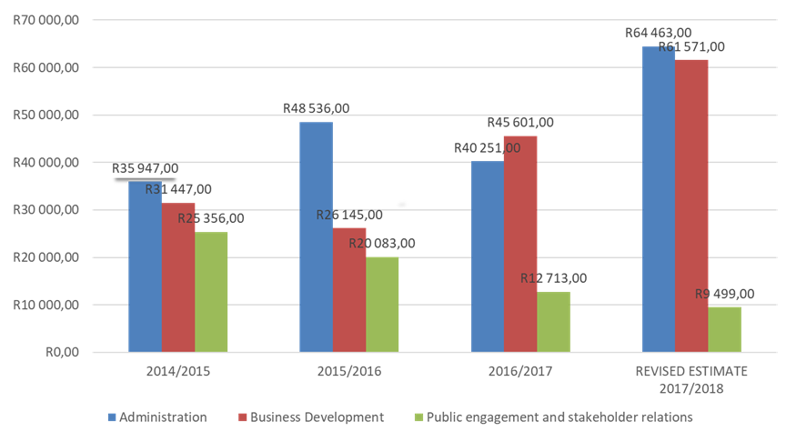
Audited Outcome & Revised Estimates

Slide 90
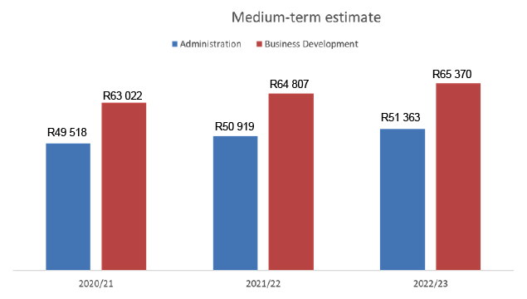
Medium-Term Estimate

Slide 91
Relating Expenditure Trends to the Strategic Outcomes

Slide 92
Relating Expenditure Trends to the Strategic Outcomes cont.

Slide 93
Reconciling Performance Targets with the Budget and the MTEF for Programme 1: Administration

Slide 94
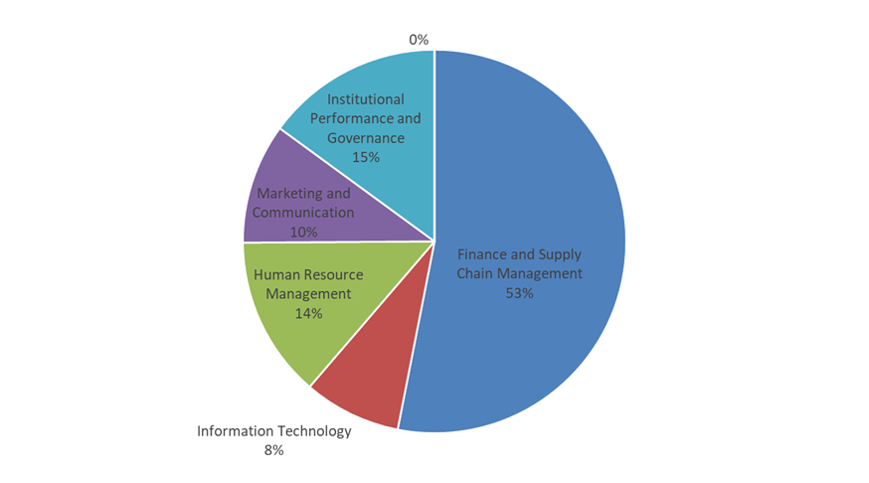
Programme 1: Administration 2020/21 Allocation R49,518,00

Slide 95
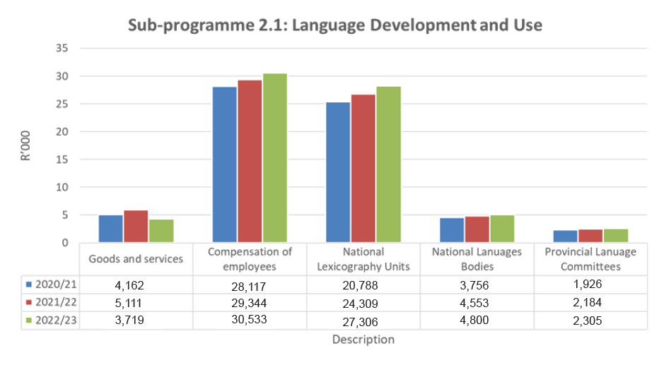
Reconciling performance targets with the budget and MTEF for Programme 2: Business Development

Slide 96
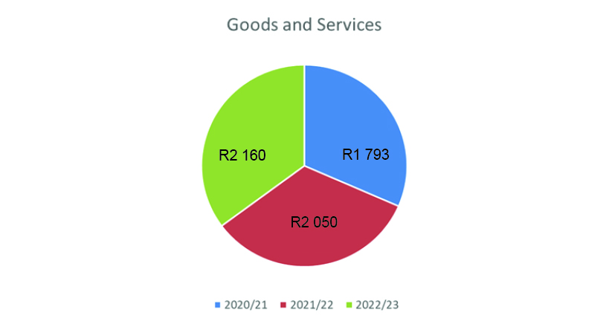
Sub-programme 2.2 Equitability of Language Use

Slide 97
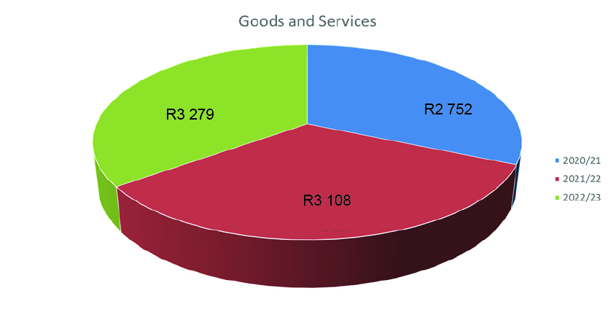
Sub-Programme 2.3 Linguistic Human Rights

Slide 98
THANK YOU

