Slide 1
Comment on the Economic Regulation of Transport Bill [B1 – 2020]
Matt Johnston

Slide 2
About US
The Organisation Undoing Tax Abuse, also known as OUTA, is a Non-Profit Company incorporated in terms of the Companies Act, 2008, and has been approved as a public benefit organisation in terms of the Income Tax Act, 1972.
OUTA is funded by ordinary South Africans as well as small and medium-sized local businesses who believe in and support our organized civil activism. Our supporters are aligned with OUTA’s vision of an engaged and empowered civil society that ensures the responsible use of tax revenues throughout all levels of government.

Slide 3
Our Vision
What we aim for
To ensure that tax revenue is spent in a frugal and lawful manner to advance the prosperity of our nation. OUTA’s objective is to promote public accountability, transparency, and good public governance.
Our Vision

Slide 4
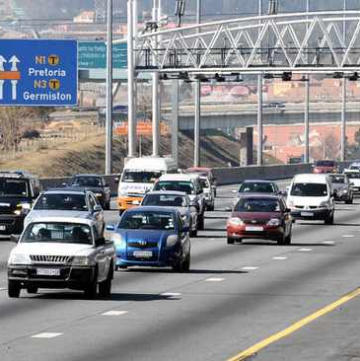
Our Story
History & Locations
History
OUTA became known for its e-toll challenge. Prior to 2016, we were the Opposition to Urban Tolling Alliance. In 2016, we became the Organisation Undoing Tax Abuse. Since then, our mandate has broadened to reactively and proactively challenging maladministration and corruption whilst advocating for fiscally sound government policy.
Locations
Gauteng
Western Cape
Kwazulu-Natal
Economic Regulation of Transport Bill

Slide 5
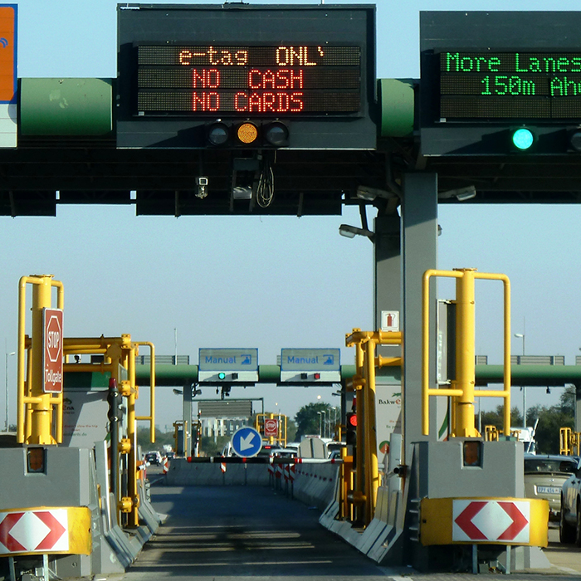
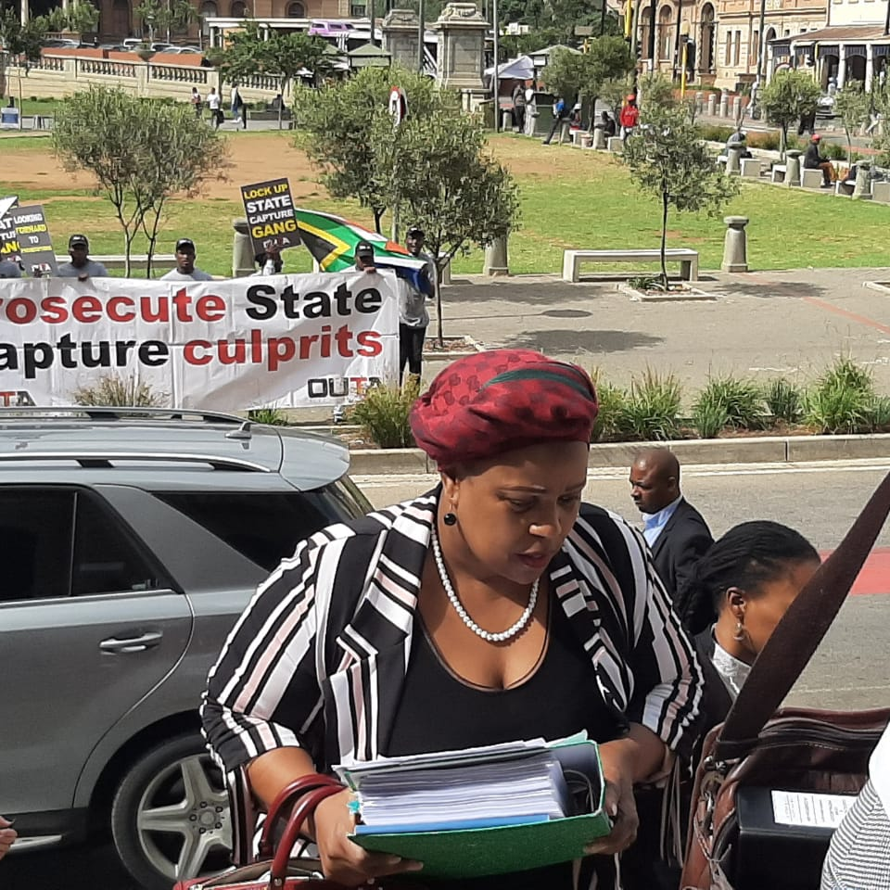
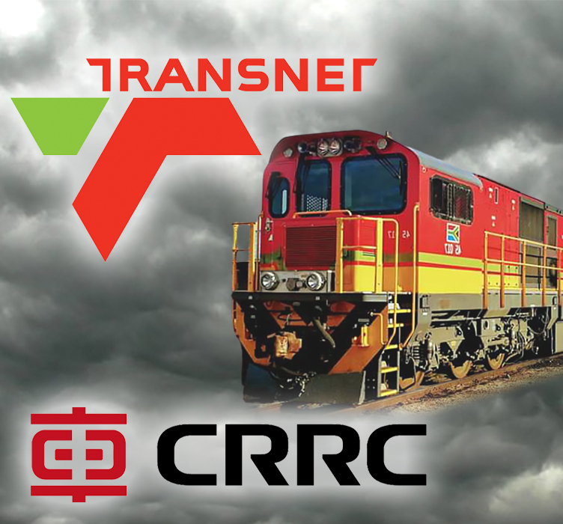
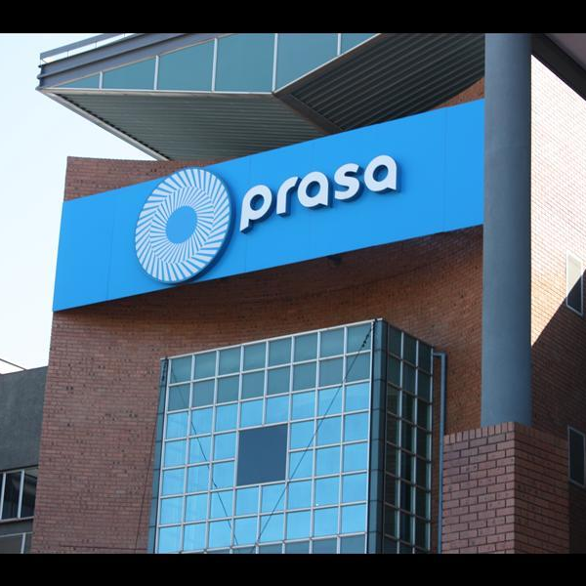
Relevant Projects
Why we care about this Bill
SANRAL: Toll Concessionaires
SAA: Delinquent Director
Transnet: Procurement
PRASA: Corruption
Ascertain whether Freeway concession profitability is inline the contract, reasonableness. Is SANRAL receiving the due revenue from the concessionaire? Lack of transparency.
Investigations and case compilation to have Duduzile Myeni declared a delinquent director because of her abuse of power as Chairperson of the SAA board. Political interference.
Investigations and criminal charges stemming from findings of strategic tender irregularities. Monopolization of the freight rail industry by the state. Mega procurement meant mega corruption.
Engaging Hawks & NPA to investigate and prosecute culprits of corrupt activities. This challenge is a result of passenger rail market monopoly in South Africa.

Slide 6
Comments and Recommendations
Proactive measures to prevent the abuse of power and taxes in the Transport sector

Slide 7
Comments & Recommendations 1
Clarity & Definitions
Relevant Section | Description | Comments & Recommendations
Memorandum of Objects | Policy Review + Purpose of the Bill | Aims to achieve “technically competent, independent and adequately resourced regulator, which is well placed to improve economic outcomes in the transport sector”. Suitable benchmarks of regulated prices to be published in the annual reports of the regulator as well as any circumstances that influence regulated prices in relation to such benchmarks.
Section 4(2) | Application of the Act | The Ministerial discretion, in consultation with the Regulator, to apply the Bill to any market, entity or facility in the public or private sectors. Consultation only with the regulator, to the exclusion of those that would be affected in the industry (both suppliers and users), runs contrary to the batho pele principles and the scope of the values and principles contained in Section 195 of the Constitution. ‘Preconditions for efficiency and cost-effectiveness’ (in section 4(2)b) are independent of the 70% market share requirement set in (in section 4(2)a). The meaning of these ‘preconditions’ should be articulated, qualified and made less ambiguous in the definitions or publicly (transparently) be interpreted by the regulator to ensure that this provision cannot be abused.

Slide 8
Comments & Recommendations 2
Price Regulation Methods & Accountability
Relevant Section | Description | Comments & Recommendations
Section 11(1) & (2) | Determination of price controls | Every regulated entity is subject to price regulation in accordance with a price control determined by the Regulator. The ‘method for setting the price’, as included in the definition of price control should be included in the items (a) to (d) of section 11(2).
Sections 11(5), 14(4) and 15 | Regulatory accounting and disclosure requirements + Complaints against regulated entities | We support formalization and subsidization of the taxi industry, financial transparency of all regulated entities, and empowerment of people who depend on monopolized transport industries to lodge complaints.

Slide 9
Comments & Recommendations 3
Compliance & Limitations of Price Reduction
Relevant Section | Description | Comments & Recommendations
Section 20 | Issuance of compliance notices | OUTA fully supports the compliance section of the Bill as this will enforce accountability and responsibility which will be followed by prosecution if not abided. The Regulator should ensure that compliance is a key component of the ‘business’. The Regulator’s role will be to enforce compliance within the transport industry where non-compliance will result in the matter being referred to the National Prosecuting Authority.
Section 21 | Directed price control reduction | OUTA agrees with the section as the Regulator will oversee price controls, this will force the service providers to take care of their consumers. (4) The Bill imposes limits on the powers of the Regulator in terms of price reduction “not to exceed more than 10% of the entity’s annual turnover”. It is not clear why the reduction should be limited to 10% especially in cases where cost decreases or efficiency gains exceed 10% or in cases where medium term industry agreements for higher (fixed or capital) cost recoveries are followed by periods of lower regulated prices when cost recovery has been achieved (for example, the agreement between the airlines association (AASA) on passenger service charge for ACSA to fund ACSA’s CAPEX for the 2010 World Cup event)

Slide 10
Comments & Recommendations 5
Institutions, Enforcement and Public Information
Relevant Section | Description | Comments & Recommendations
Chapters 4,5 and 6 – Section 44 in particular | Establishment of Institutions & Enforcement of Act + Advice and recommendations to the Minister | We recommend that the Regulator should be completely independent from the onset. The Bill now states that the DoT will assist in the implementation phase, however the implementation phase is not defined. This means that there is a risk that the DoT could open the door to corruption, as we contend, they have in the past. Bill states that the Regulator “may” advise the Minister. We are of the opinion that the Regulator “must” advise the Minister on all matters, which means that the Minister should have oversight over all decisions taken by the Regulator. In turn, the Minister “must” report to Parliament in a manner that prioritizes complete transparency and public accountability.
Section 42 (2) | Research and public information | The Regulator may request any person requesting the Regulator to conduct any research in terms of this Act, to fund the cost of the research, and may decline to conduct such research, if the required funding is not provided. It is our view that the section diminishes the values and principles contained in Section 195 of the Constitution and does not promote the objectives of public awareness and increase knowledge of the economic nature and dynamics of the transport market.

Slide 11
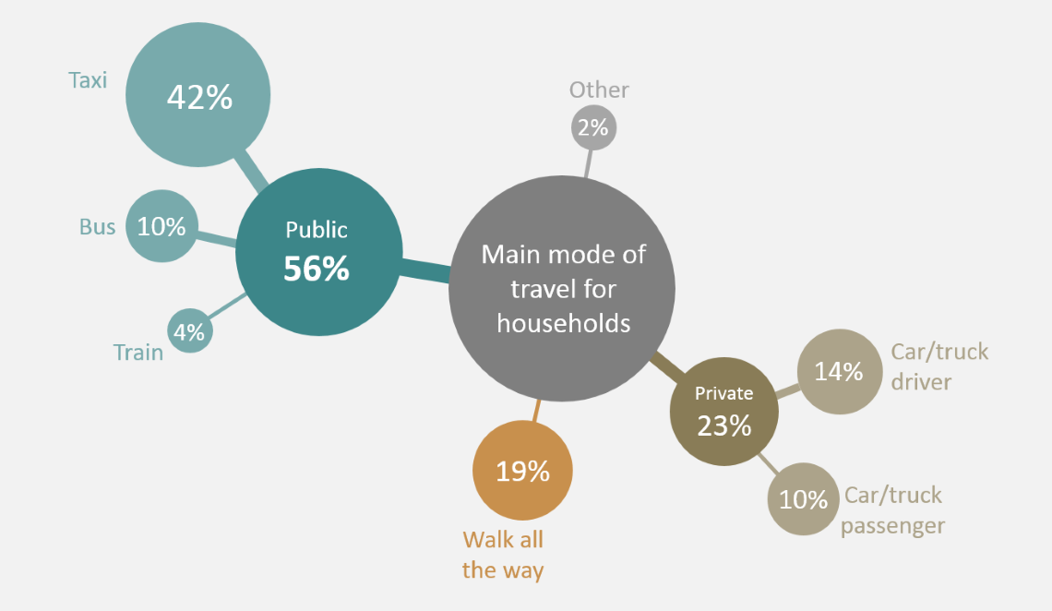
Statistics 1
Logistics
How do South Africans move?
According to StatsSA research conducted between 2003 and 2013, this is how South Africans get around.
56% of people travelled by means of public transport, of which the vast majority used taxis.
What is the Economic Regulation of Transport Bill’s overall impact going to be on the taxi industry? How will SANRAL be regulated outside to prescripts of the SANRAL Act to benefit road users?

Slide 12
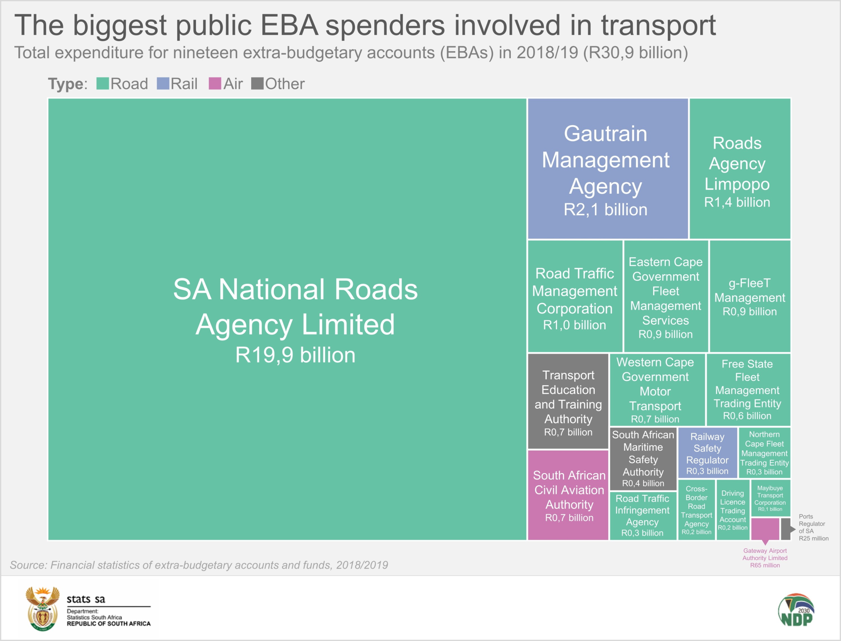
Statistics 2
Finances
Who is spending taxpayer money?
SANRAL is by far the biggest spender that will be regulated by the Economic Regulation of Transport Bill. What about concurrent jurisdiction and its unsustainable financial model?
The colour coding paints a clear picture of South Africa’s transport system, which is dominated by road use.
Will such contextual factors be considered in the application of the Bill? How will the organized road transport (such as taxi associations) respond to price controls in favour of commuters?

Slide 13
Final Remarks
Conclusion & Closing
OUTA welcomes this Bill and supports it in principle. Some provisions should be even stronger to tackle predatory transport.
The Regulator should consist of experienced experts from a variety of subsectors in the Transport sector.
Its leadership should not be politically appointed. This will assist the Regulator to make independent decisions that will lift the economy and prevent biased decision-making.
The transport sector has been wrought with large scale corruption and the abuse of capital-intensive public procurement. Locomotive procurement in both PRASA and Transnet are obvious examples of this issue.
OUTA will make a more substantive submission to the Select Committee on Transport, Public Service and Administration, Public Works and Infrastructure in the National Council of Provinces – depending on this process.

Slide 14
Thank You!
Any Questions?

