Slide 1
Presentation to Parliamentary Portfolio Committee on Small Business Development 21 October 2020 Esido Mushwana – Chairperson of the Board

Slide 2
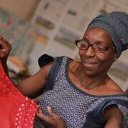
INTRODUCTION TO THE DMA
The DMA (Development Microfinance Association) is a not-for-profit association which represents Development Microfinance Institutions (DMFIs) in South Africa.
Development microfinance is about giving a chance to poor, hard working, entrepreneurial people, helping them to help themselves.
Creating jobs, alleviating poverty: October 2020

Slide 3
INTRODUCTION TO THE DMA
Registered in 2005
Most members are not-for-profit institutions
Committed to providing responsible developmental micro enterprise credit, savings and other support services to micro enterprises in poor communities.
Creating jobs, alleviating poverty: October 2020

Slide 4
VISION & MISSION
VISION
DMA members envision greater opportunity, employment and dignity for millions of poor South Africans who, with access to finance and other support, can live better lives and have greater chances to break free of poverty.
MISSION
DMA's mission is to promote effective financial inclusion in South Africa by facilitating the sustainability and growth of pro-poor development microfinance institutions (DMFIs).
Creating jobs, alleviating poverty: October 2020

Slide 5
DISTINCT FROM COMMERCIAL MFIs
Commercial Microfinance Institutions (MFIs) | Development Microfinance Institutions (DMFIs)
Primarily lend to wage earners | Primarily lend to self employed / microenterprise owners
Target HHs above poverty line | Target vulnerable HHs and those below the poverty line
Primarily urban and peri-urban | Primarily rural and peri-urban
Male and female | Primarily female (90%+)
Profit seeking Private companies (Pty) | Dual bottom line: sustainability and development impact (job creation & poverty alleviation) Most are non profit companies and PBOs

Slide 6
OUR MEMBERS
Name | Areas of Operation
Small Enterprise Foundation (SEF) | Limpopo, Mpumalanga, Eastern Cape, Gauteng, North West, KwaZulu Natal, Northern Cape
Phakamani Foundation (PKF) | Mpumalanga, Limpopo, KwaZulu Natal
Women’s Development Business (WDB) - Siyakhula | Kwa Zulu Natal, Limpopo, Gauteng
Thuthukani Finance | Gauteng, KZN, Mpumalanga
Akanani Finance | Limpopo
Creating jobs, alleviating poverty: October 2020

Slide 7
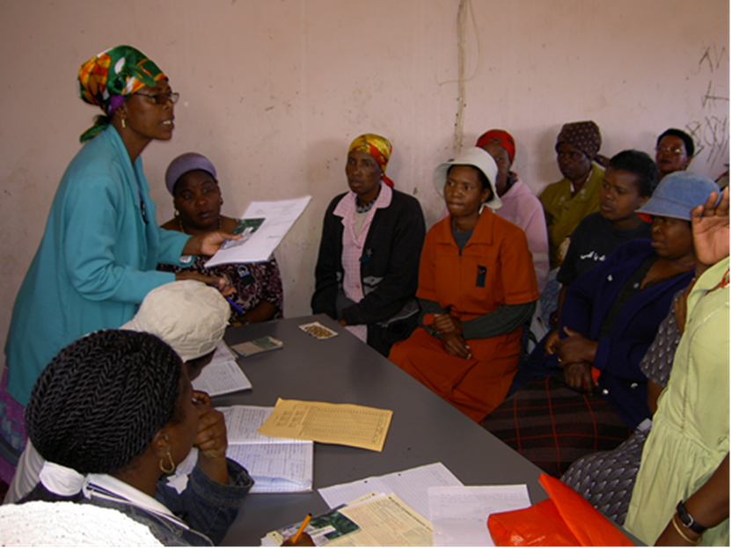
OUR OPERATING MODEL
Predominantly a group lending model
We go to the clients at their businesses;
Provide access to loans and facilitate savings to deal with financial shocks
They meet together every month or fortnight to conduct their financial transactions
Access to housing loans
Creating jobs, alleviating poverty: October 2020

Slide 8
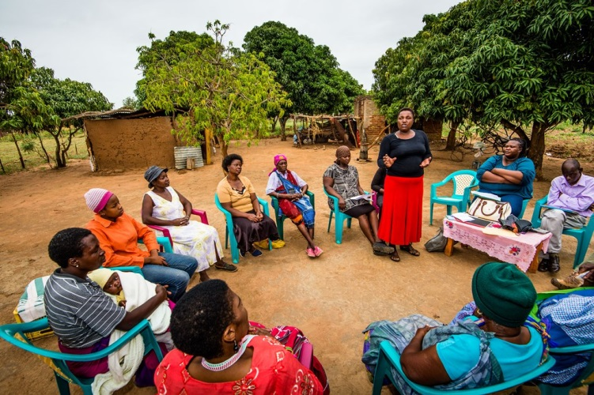
OUR OPERATING MODEL
Provide support clients to start, build, grow and stabilise their businesses;
Provide and facilitate training on financial, business, health education, etc.
We teach clients leadership skills
We introduce clients to formal banking and encourage them to save and build financial assets
Creating jobs, alleviating poverty: October 2020

Slide 9
OUR REACH
DMA members currently:
Operate in 7 out of the 9 Provinces of South Africa
Provide credit to 255,000 Rural and Township informal business clients
Have approximately 99% women clientele
About 18% youth clients
Create and sustain over 250,000 jobs annually
Disburse R183 million monthly, on average
Have an outstanding loan book of R725 million
Employ a total of 1 369 staff members
Creating jobs, alleviating poverty: October 2020

Slide 10
TARGETS
DMFI TARGETS (Contingent upon appropriate support)
600,000 clients by 2025
1,000,000 clients by 2030
DMFIs reduce the social security burden on government.
With a modest level of appropriate support, DMFIs could reach these targets.
Creating jobs, alleviating poverty: October 2020

Slide 11
SOCIAL IMPACT
Job Creation
Poverty Alleviation
Economic transformation of communities through facilitating:
Decent housing
Essential business and health education
Decent incomes and nutrition
Women empowerment
Access to quality education
Creating jobs, alleviating poverty: October 2020

Slide 12
SOCIAL IMPACT
Our members utilize Progress out of Poverty index (PPI) to identify poor households, this can also be used to measure impact
Our members are part of the global network Social Performance Task Force (SPTF)
https://sptf.info/
https://sptf.info/universal-standards-for-spm/start-here
Creating jobs, alleviating poverty: October 2020

Slide 13
EXAMPLES OF SUPPORTED BUSINESSES
Trade
Spaza and tuck shops
Fruit/veg stalls
Beauty/health,
Network marketing
Production
Small-scale agriculture (raising chickens, fruits/vegetables)
Livestock
Manufacturing
Sewing
Pots/ceramics
Service
Fast food
Catering/events
Hairdressers
Transport
Crèche
Room rentals
Creating jobs, alleviating poverty: October 2020

Slide 14
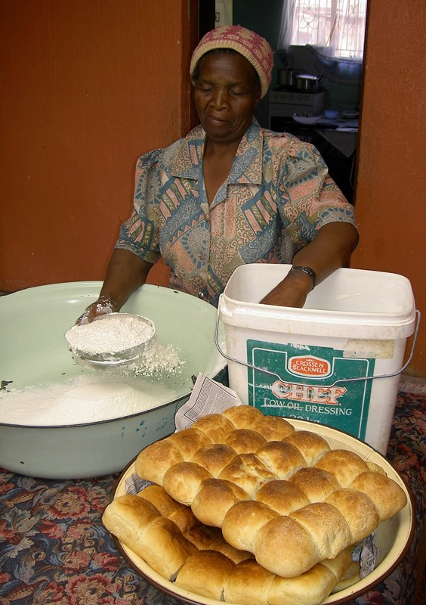
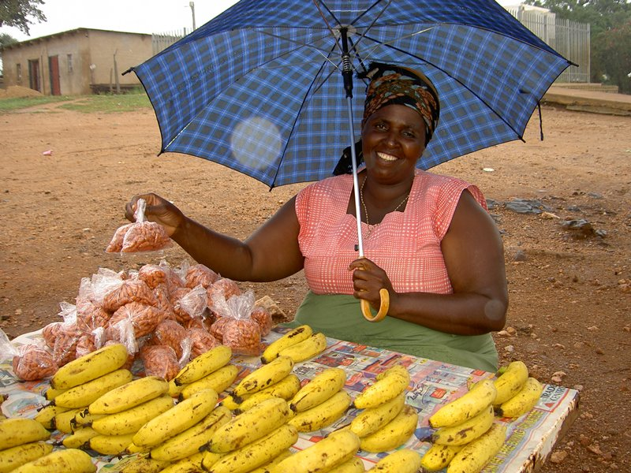
EXAMPLES OF SUPPORTED BUSINESSES

Slide 15
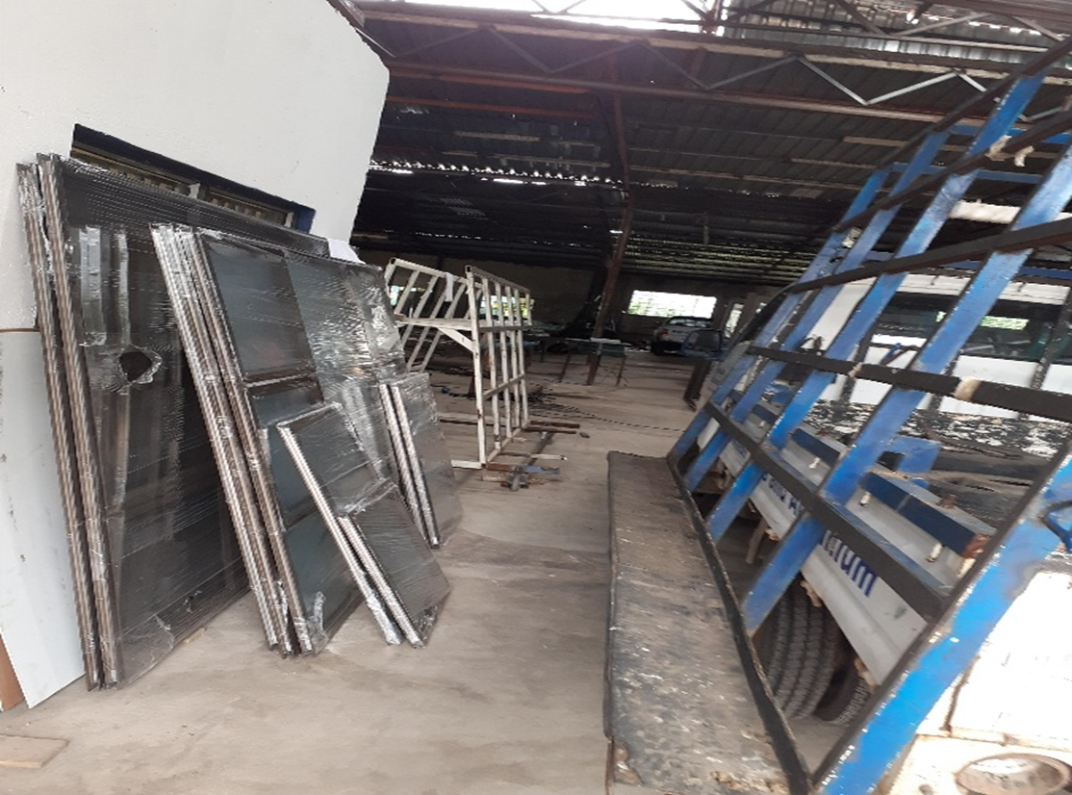
EXAMPLES OF SUPPORTED BUSINESSES

Slide 16
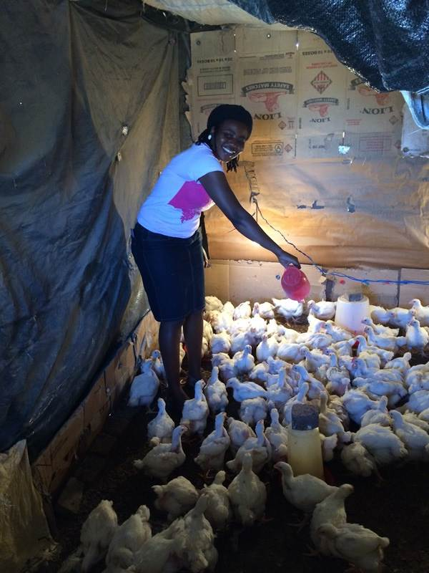
EXAMPLES OF SUPPORTED BUSINESSES

Slide 17
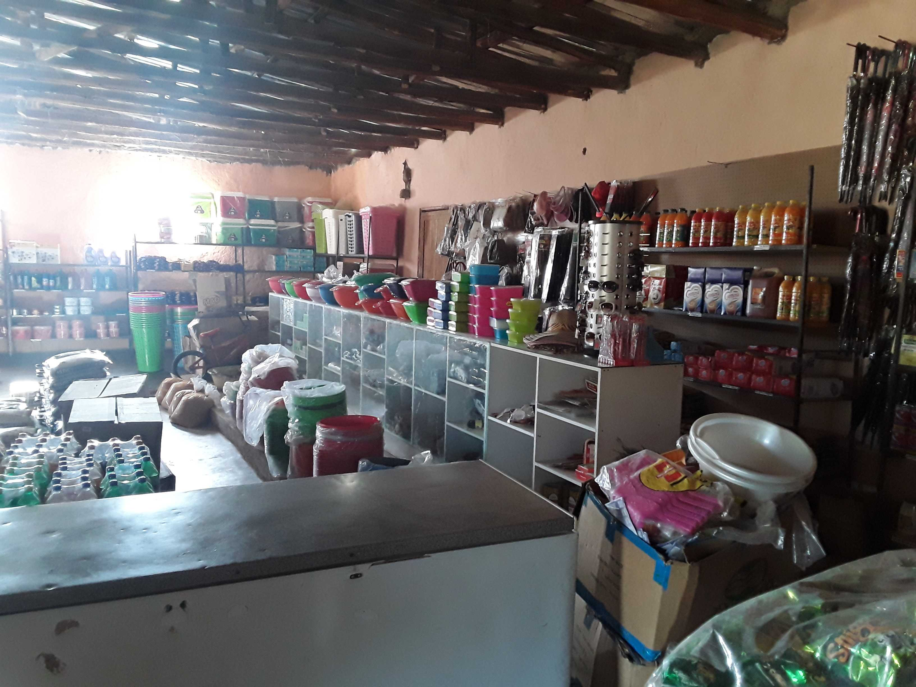
EXAMPLES OF SUPPORTED BUSINESSES

Slide 18
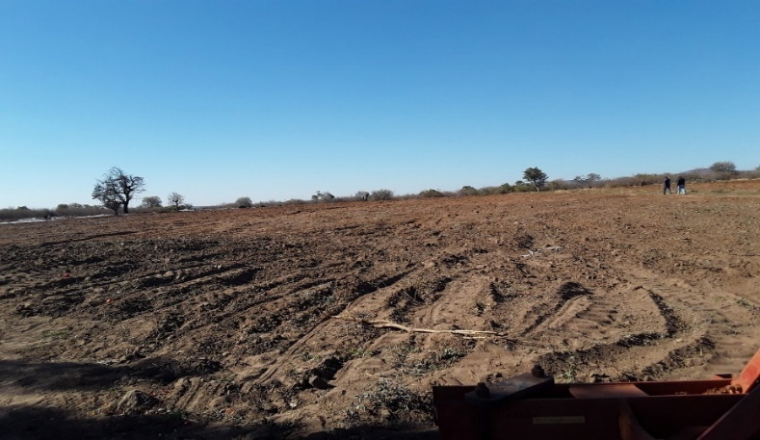
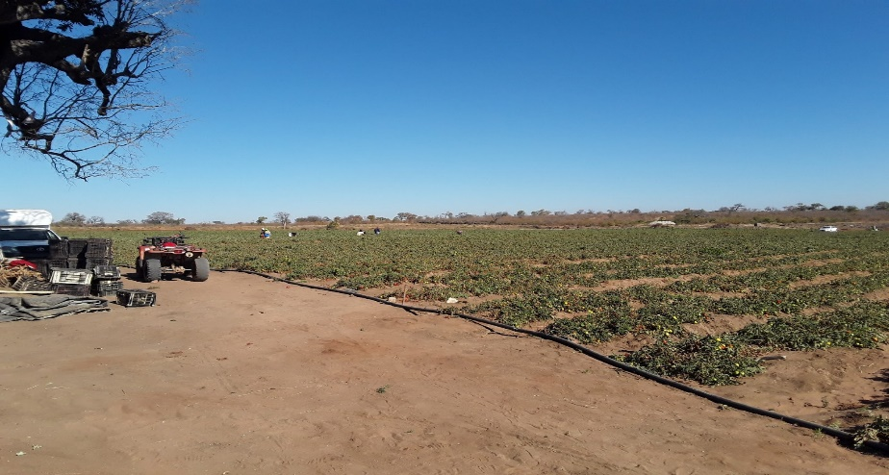
EXAMPLES OF SUPPORTED BUSINESSES

Slide 19
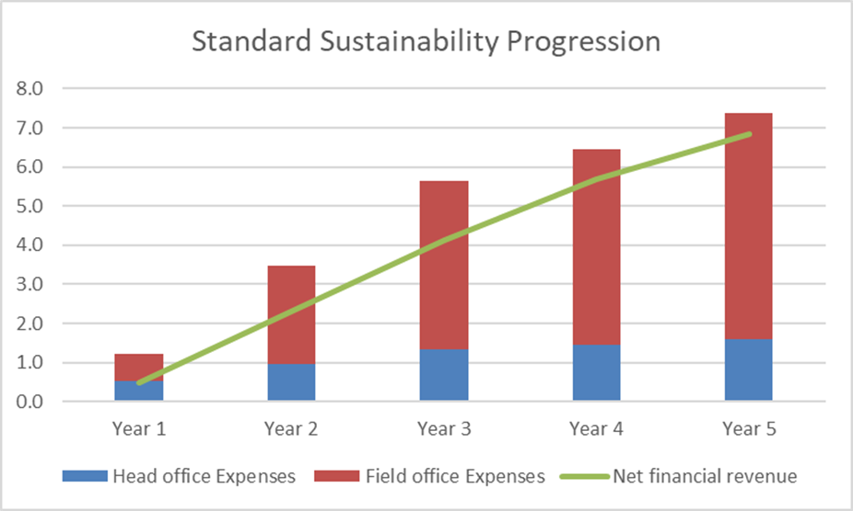
PROGRESSION TO SELF SUFFICIENCY

Slide 20
RESPONSE TO COVID-19
April – September 2020 (the hard lock-down)
Reinvented our lending methodology to support our clients
Continued operations remotely
Creating jobs, alleviating poverty: October 2020

Slide 21
RESPONSE TO COVID-19
May – offered Payment Holidays
40% of clients took this option
April to July operations
Disbursed over 200,000 loans
Worth over R1,1 billion
Some of our members collaborated with donor organizations and government agencies to distribute critical grants to some of our clients.
Support from BNP Paribas to support some of our clients with larger businesses with R6 500 grants
Government in the same period:
10,000 Businesses
Only 7% of allocated funds disbursed
Creating jobs, alleviating poverty: October 2020

Slide 22
SUPPORT REQUESTED FROM GOVERNMENT
Initiatives to Reduce Costs | Initiatives to Enhance Appropriate Support
Introduce mobile banking | SEFA to adopt a developmental and partnership model
Support innovation with time saving technologies | Changes to the B-BBEE score card
Support to non-traditional collateral based on international best practices | Persuade commercial banks to support the sector.
Creating jobs, alleviating poverty: October 2020

Slide 23
Experience in Working with SEFA
Creating jobs, alleviating poverty: October 2020

Slide 24
EXPERIENCE WITH WORKING WITH SEFA
Have received funding from Khula, SAMAF, and SEFA
Currently Members have access to revolving loan facilities totalling R140 million with SEFA
Reasonable interest rate – prime less 3%
Creating jobs, alleviating poverty: October 2020

Slide 25
CHALLENGES WORKING WITH SEFA
SEFA still has a lot to learn about the DMFI sector and how it should be supported
Inability of SEFA to support the capacity building requirements of DMFI’s
SEFA has pressure to be self-sufficient and does not have a good budget to support grants
Lack of resources to conduct a comprehensive study of the SMME sector to understand its challenges and needs, especially the funding needs
Creating jobs, alleviating poverty: October 2020

Slide 26
CHALLENGES WORKING WITH SEFA
Failure by SEFA to articulate the positive impact of the DMFI operations in reaching poor rural women with essential credit and other non-financial services
We have consistently provided more than 70% of all SEFA’s annual statistics in terms of the numbers of businesses supported.
Creating jobs, alleviating poverty: October 2020

Slide 27
SUPPORT REQUESTED FROM DSBD AND ITS AGENCIES
Acknowledge the importance of supporting the microenterprise sector, given that it makes up over 70% of the MSME sector and plays an important role in addressing the triple challenges of unemployment, poverty, and inequality
Acknowledge that past microenterprise finance initiatives by commercial banks OR government entities were not sustainable and that DMFIs are the most appropriate vehicles for delivery of microenterprise finance and support
Creating jobs, alleviating poverty: October 2020

Slide 28
GREAT IMPEDIMENT TO THE INFORMAL SECTOR
The insistence of DSBD on registration with CIPC, SARS and UIF is a huge threat to the informal sector
This could bring far greater harm to our country’s poor than COVID-19 did
Creating jobs, alleviating poverty: October 2020

Slide 29
RECOMMENDED FUTURE SEFA STRATEGY
Partnership model that fosters additional, strong, independent, and sustainable DMFI’s
Funding provided for 3 years on a quasi-equity basis to the DMFI’s (especially new ones):
Operational shortfalls funding
Capacity building funds
On-lending capital
SEFA to receive specific reports on the performance of the DMFI’s;
Creating jobs, alleviating poverty: October 2020

Slide 30
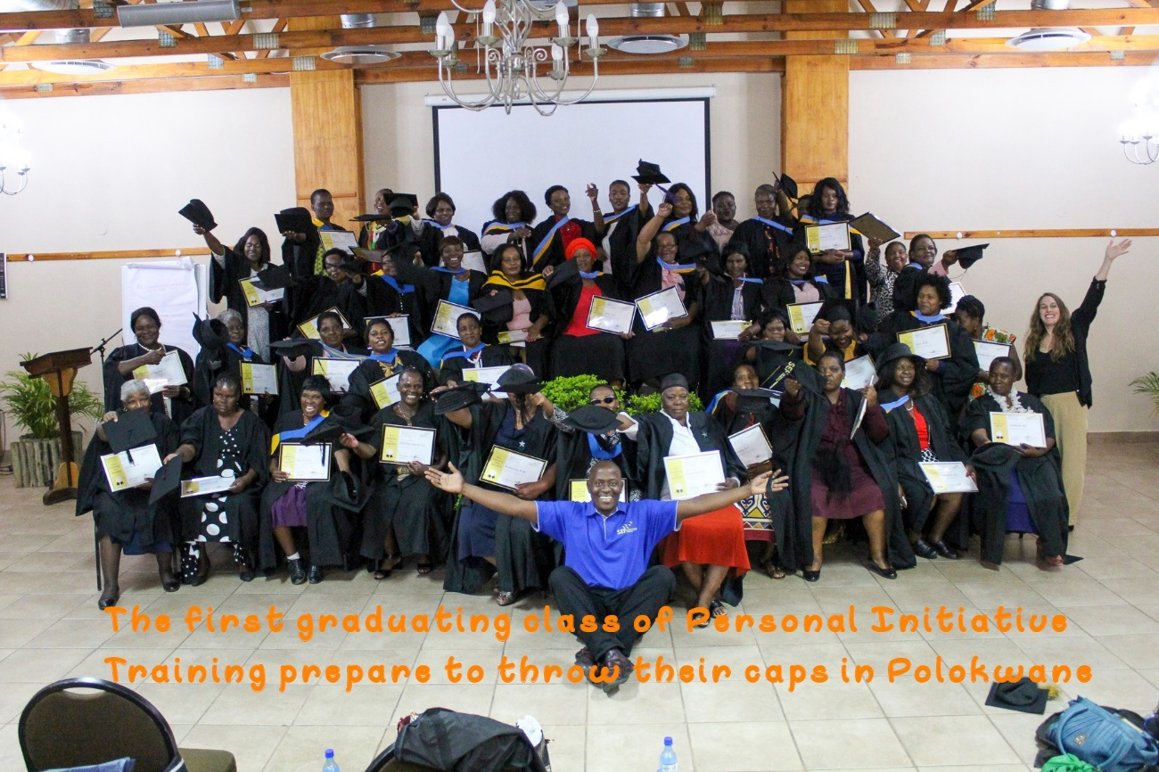
THANK YOU

